Slide 1
FANTASY LEAGUE INFO
What we built
over the offseason
Eight new things — trends, projections, a player page, and games.
Notes:
Tour of everything added since last season. Screens show mid-season sample data.

Slide 2
What's new
All of it is already live.
1
2
3
4
5
New navbar
Trends
Player Rankings
Projections
Matchup Quality
Where everything sits
Who just changed role
8-cat z-scores, your weights
A line for tonight's games
How they defend each cat
6
7
8
9
10
Player Page
Slot usage
Custom ranges
Minigames
Global search
One page per player
Games left in every slot
Any window you want
Four games, four leaderboards
Ctrl+K to jump anywhere

Slide 3
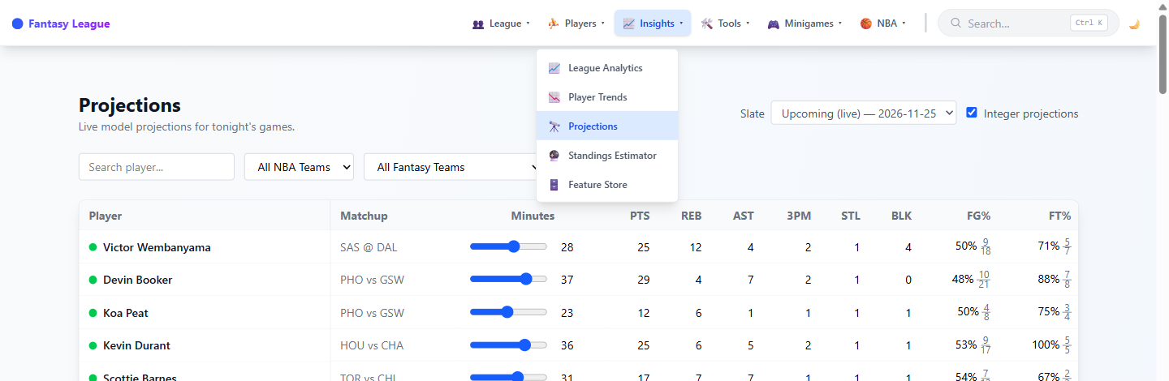
New Navbar
Where everything sits now
Six menus: League, Players, Insights, Tools, Minigames, NBA
Trends, Projections and Analytics live under Insights
Search sits on the right — or hit Ctrl + K

Slide 4
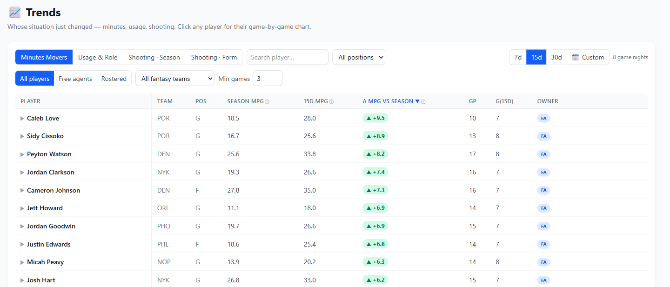
Trends
1 / 4
Who just got more minutes
Biggest minutes swings vs season average
Owner column: free agent, or whose roster
Window: 7d / 15d / 30d, or any custom range
Filter by position, team, minimum games

Slide 5
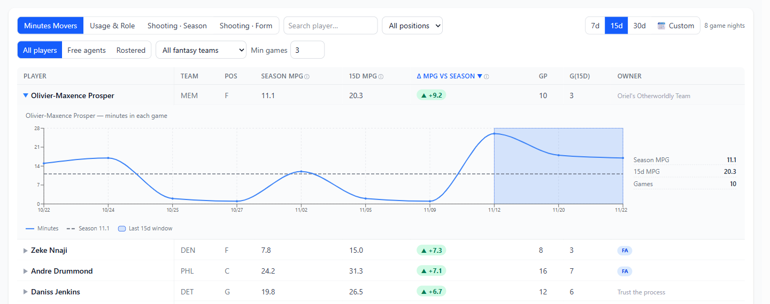
Trends
2 / 4
Click a row, get the chart
Minutes in every game this season
Shaded band = the recency window
Dashed line = season average
Same charts sit on each player's page

Slide 6
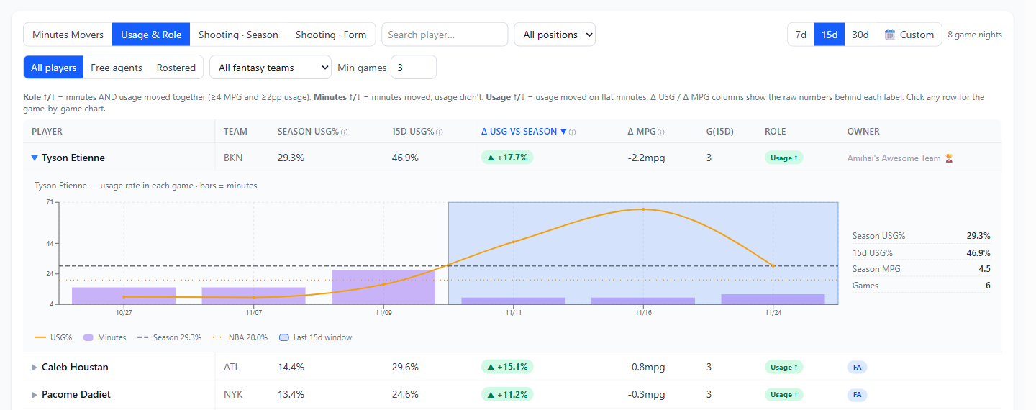
Trends
3 / 4
Usage and role changes
Usage% line with minutes as bars
Role = minutes and usage moved together
Usage = same minutes, more of the offense
Catches breakouts before the box scores

Slide 7
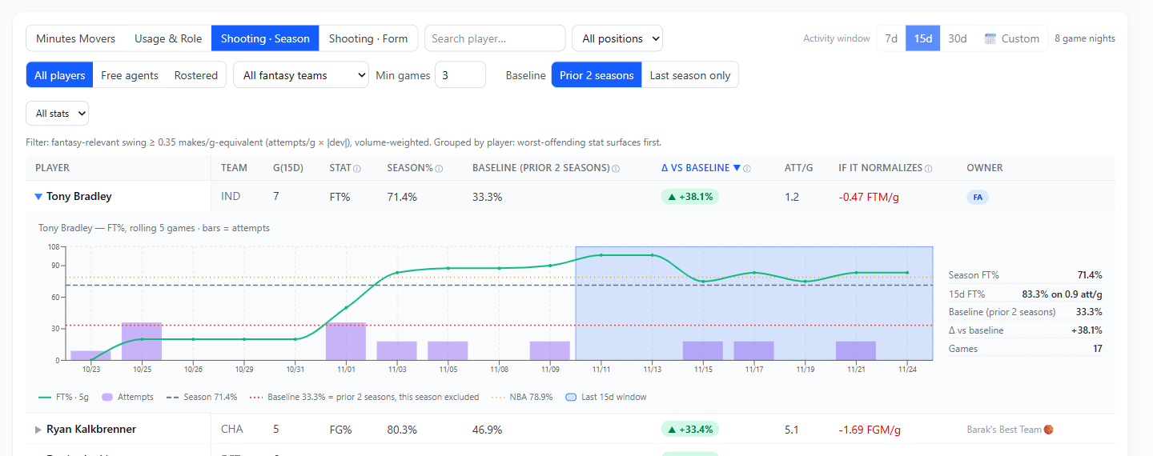
Trends
4 / 4
Shooting due to regress
Hot and cold streaks vs his own baseline
Baseline: last season, or prior two
“If it normalizes” = makes/game you'd lose
Season mode, or just the recent window

Slide 8
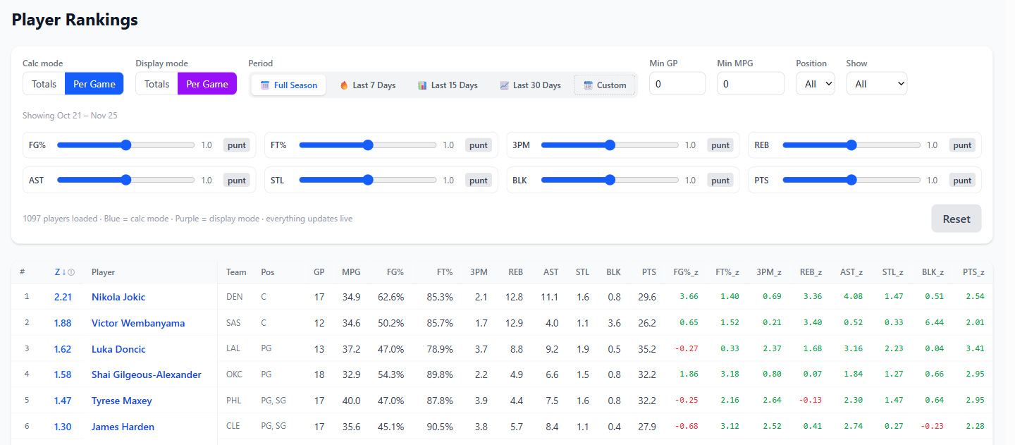
Player Rankings
The whole pool, ranked by 8-cat value
Every player ranked, best value first
8-cat z-scores over any date range
Slide the weights to match your build
Punt a category with one click

Slide 9
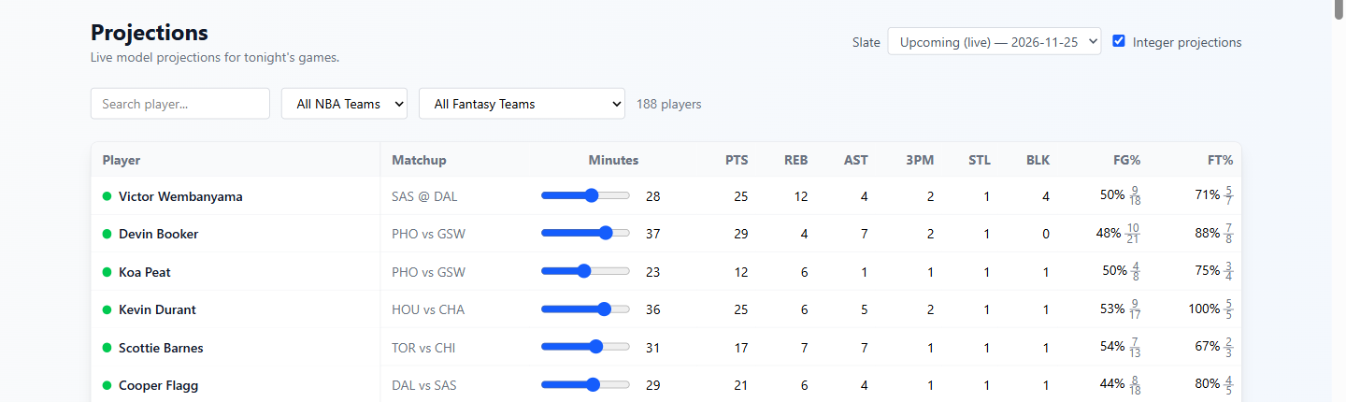
Projections
A line for every player tonight
Projected stat line for the whole slate
Drag minutes, the projection updates
Green dot = enough recent games to trust
Also on player pages, players and roster tables

Slide 10
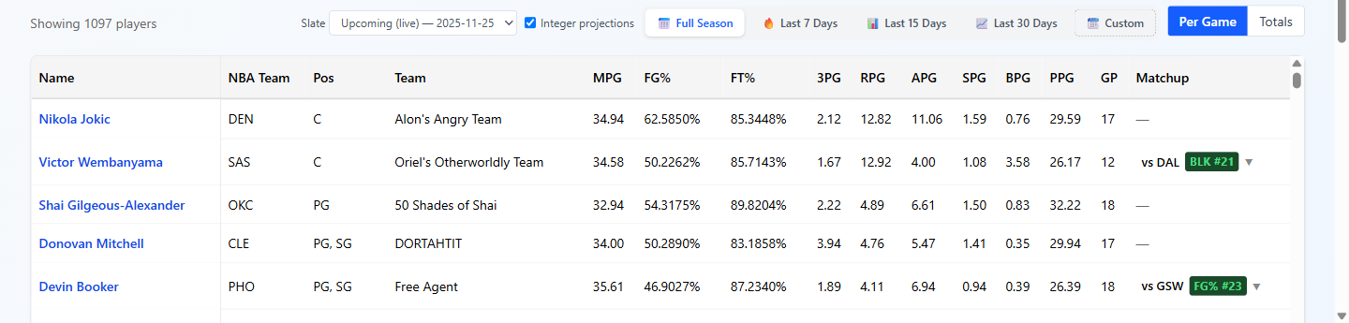
Matchup Quality
1 / 2
Who your player draws tonight
Tonight's opponent, right in the table
Badge = best category to attack, for him
Same column on the team roster page

Slide 11
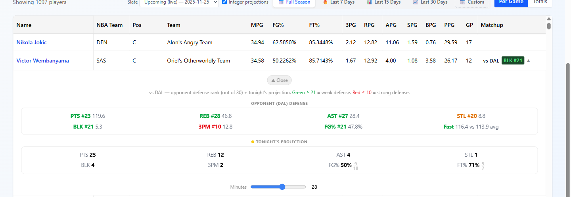
Matchup Quality
2 / 2
Open the row for the detail
Opponent's defensive rank in all 7 cats
Green = soft matchup, red = avoid
Pace shown against league average
Tonight's projection sits underneath

Slide 12
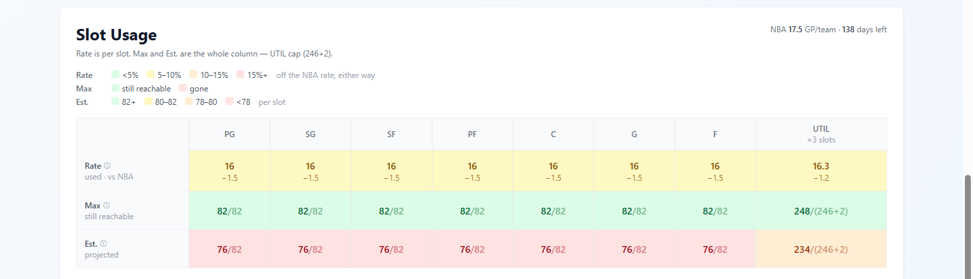
Slot Usage
Games left in every lineup slot
Rate: games used, and how far off NBA pace
Max: the most that slot can still reach
Est.: where you finish if the pace holds
Replaces the old slots view

Slide 13
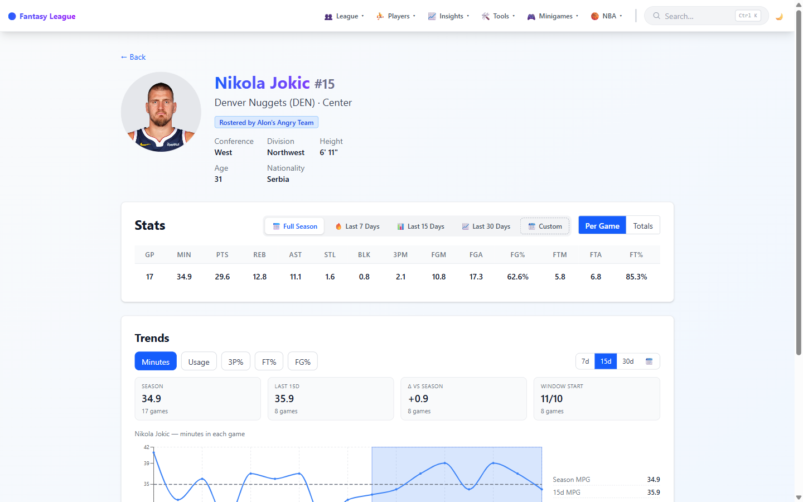
Player Page
1 / 2
One page per player
Bio, team, and who rosters him
Season · L7 · L15 · L30 · custom range
Linked from every table and from search

Slide 14
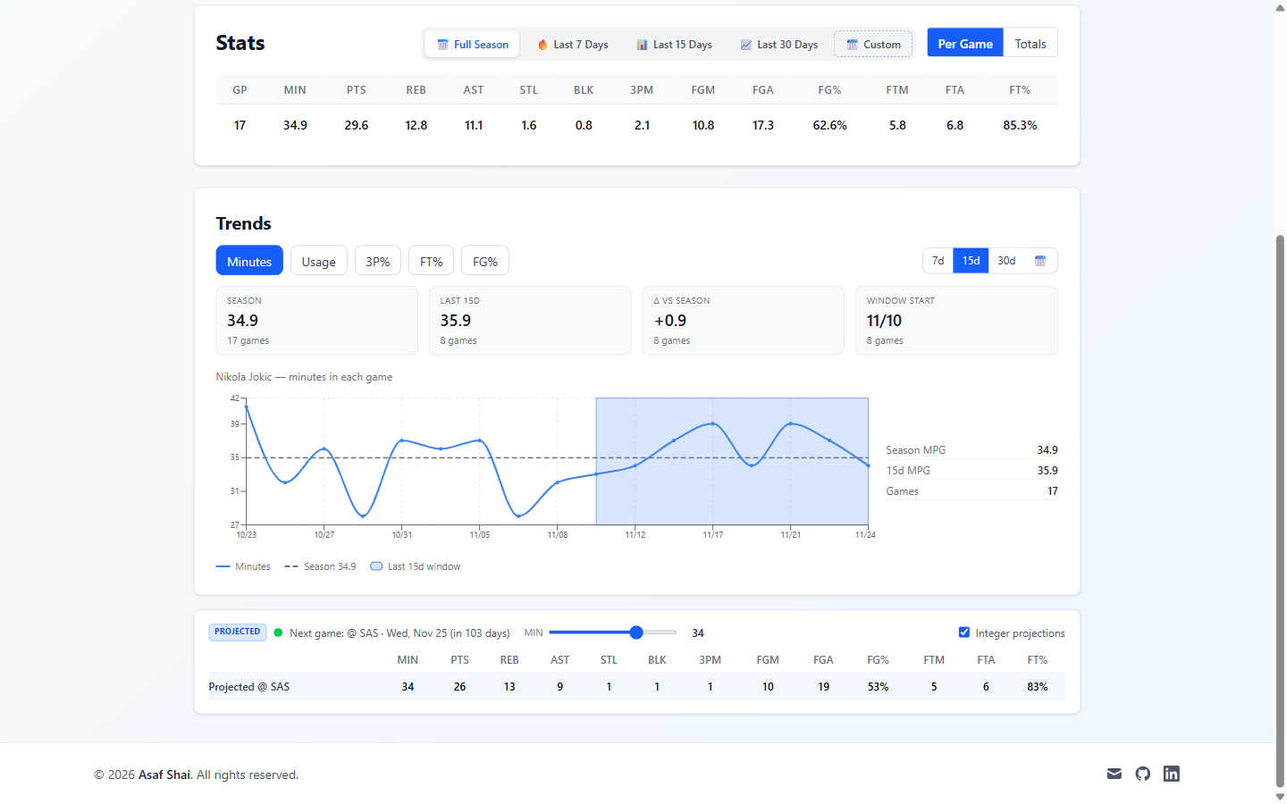
Player Page
2 / 2
Charts and tonight, together
Minutes, usage and shooting charts
Same trend data, scoped to one player
Next-game projection at the bottom

Slide 15
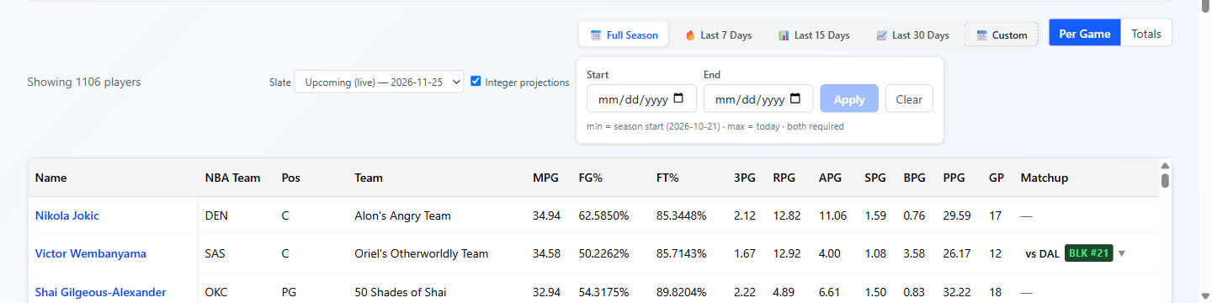
Custom Date Ranges
Any window, not just 7 / 15 / 30
Pick any start and end date
Players, teams, player pages and trends
Answers “since the trade” questions

Slide 16
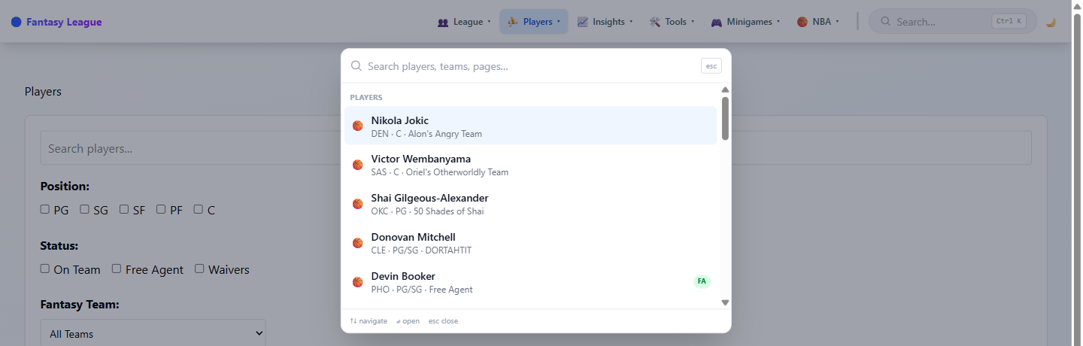
Global Search
Ctrl + K from anywhere
Players, fantasy teams, NBA teams, pages
Arrows to move, Enter to open
Free agents and injured flagged inline

Slide 17
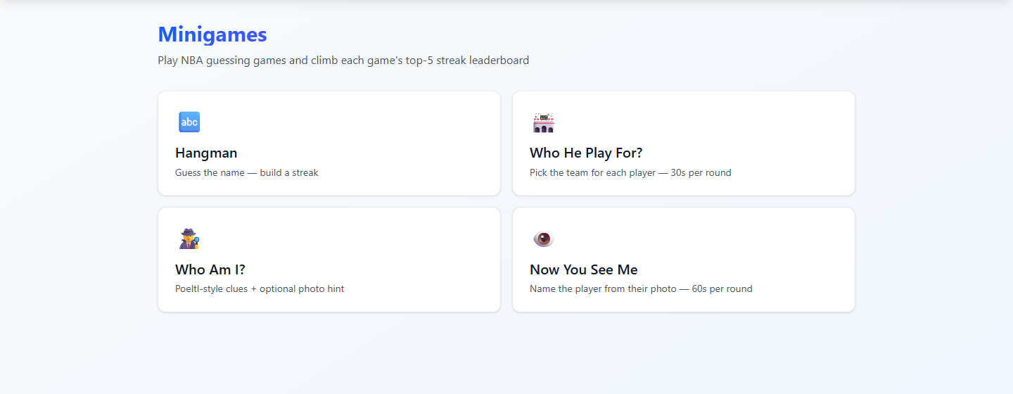
Minigames
1 / 3
Four NBA guessing games
Hangman, Who He Play For, Who Am I, Now You See Me
Each game keeps its own top-10 streak board
Timed rounds on two of them — 30s and 60s

Slide 18
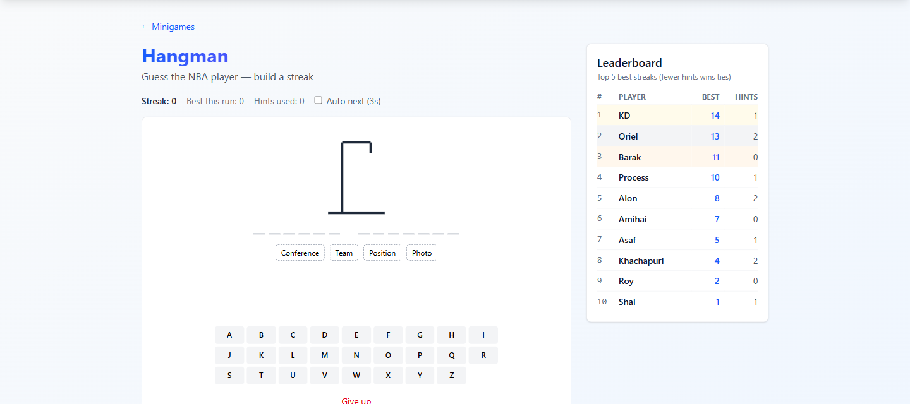
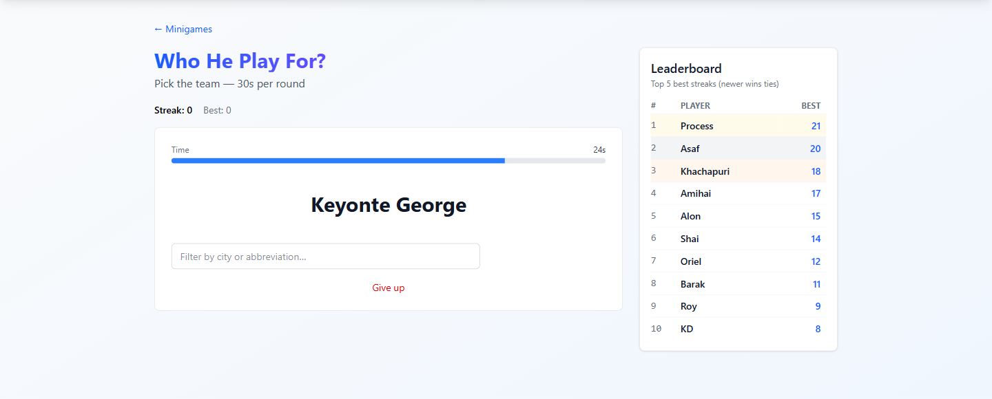
Minigames
2 / 3
Hangman and Who He Play For
Hangman — guess the name, build a streak.
Who He Play For — pick his team, 30s a round.
Leaderboards are shared across the league.

Slide 19
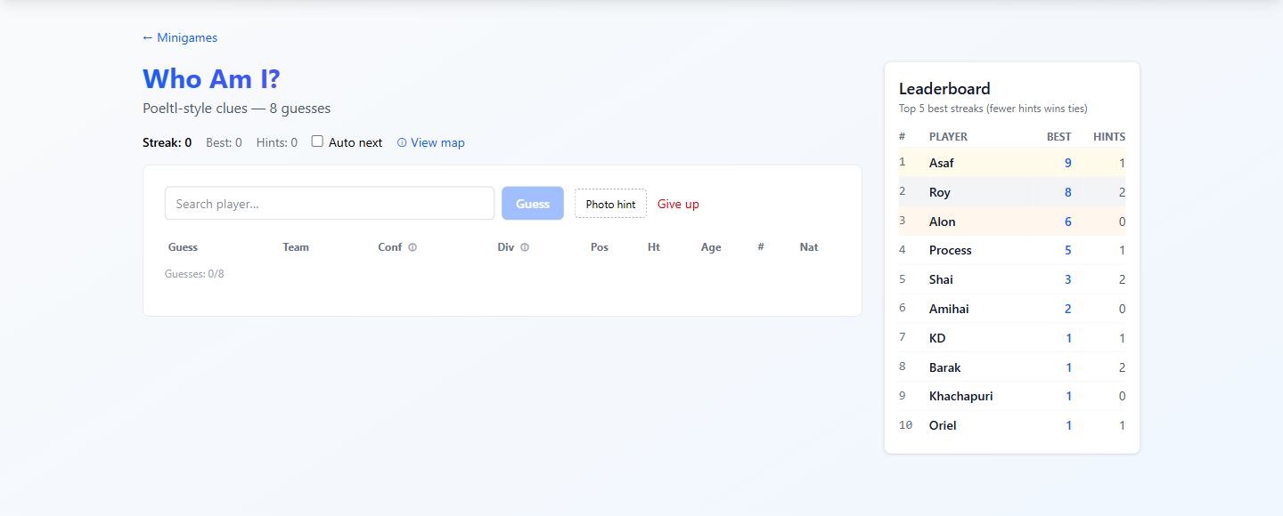
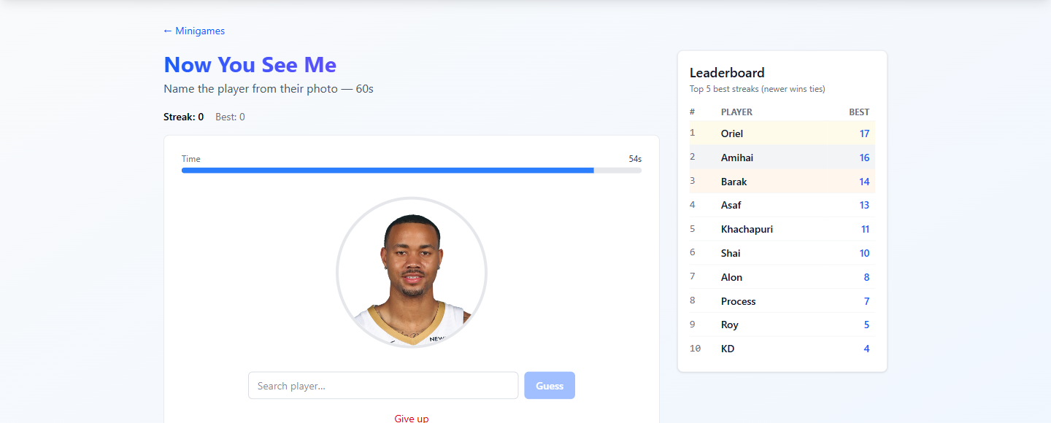
Minigames
3 / 3
Who Am I and Now You See Me
Who Am I — Poeltl-style clues, eight guesses.
Now You See Me — name him from the photo, 60s.
Hints cost you a place on the board.

Slide 20
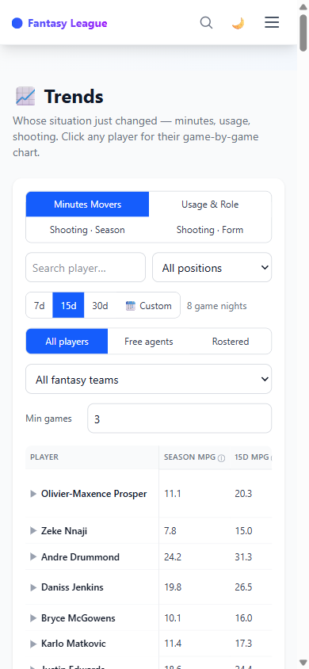
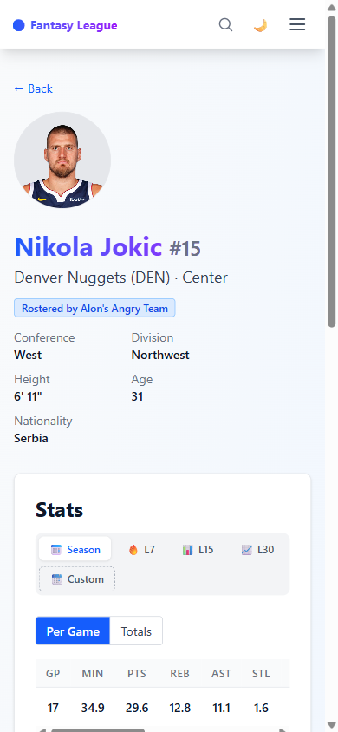
Mobile
All of it works on your phone
Built for a 390px screen, not shrunk
Tables scroll with the player column pinned
Charts, filters and pickers all reflow

Slide 21
Go break it
fantasyleagueinfo.onrender.com

