Slide 1
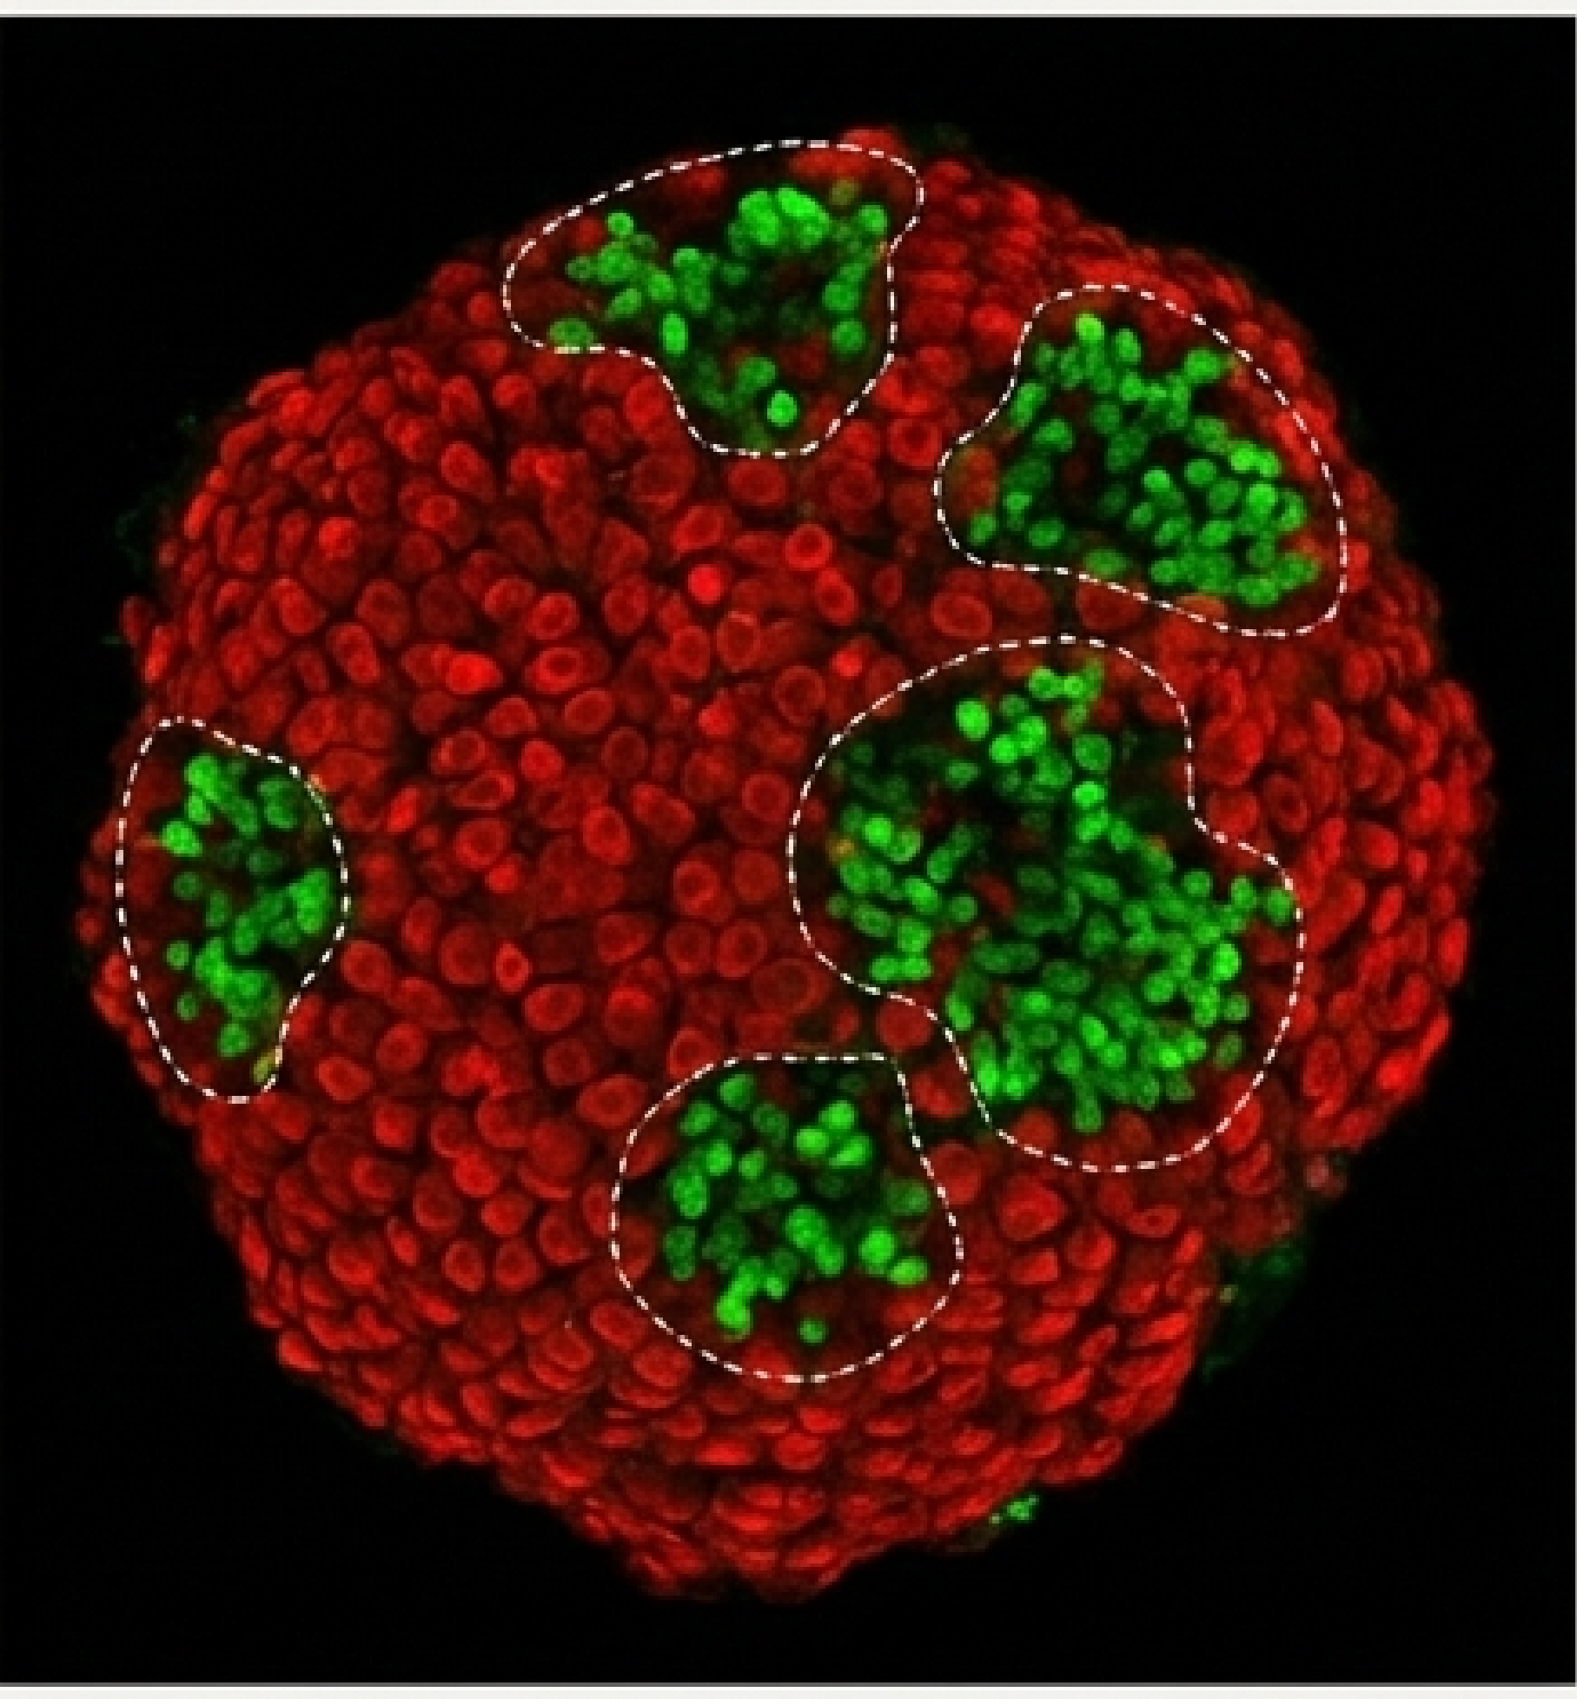
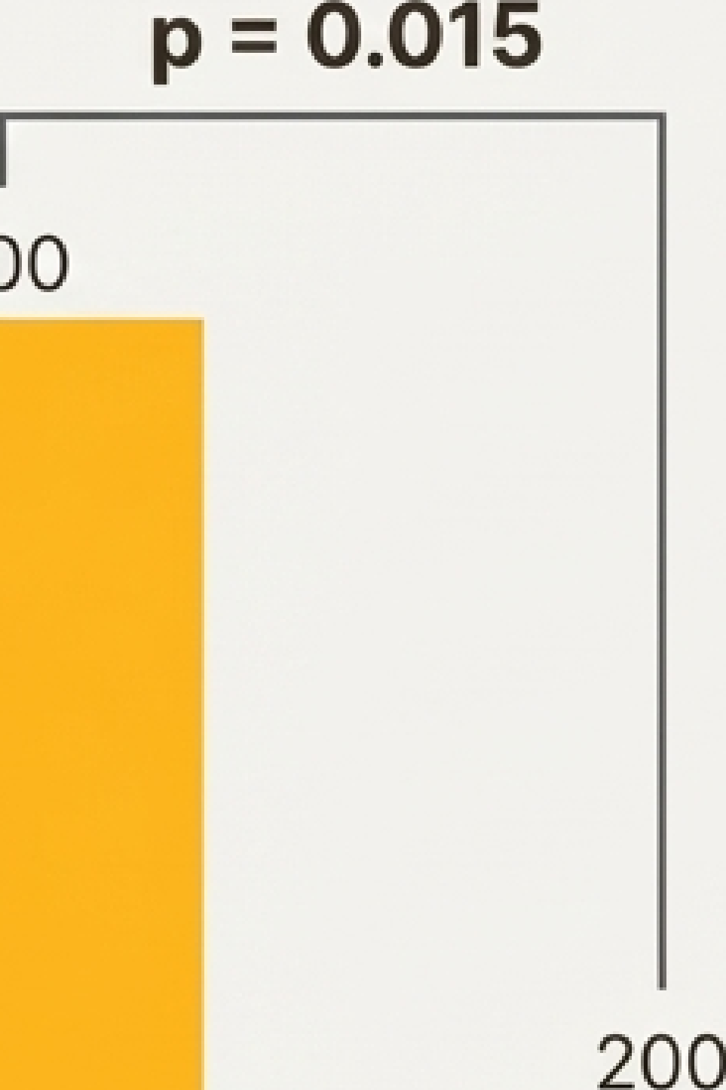
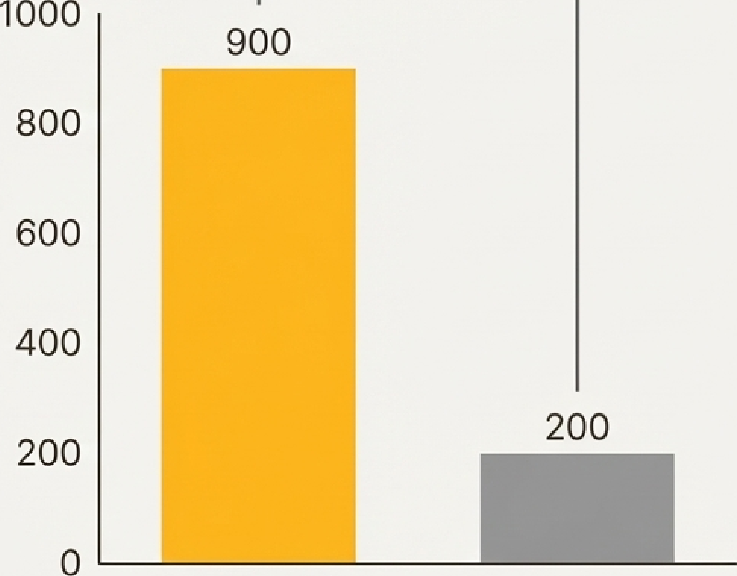

CRATERs Harbor the Highest Density of CD8+ T Cells in the Tumor.
CRATERs
Rest of Tumor
3D Confocal Projection of Zebrafish Tumor with CRATERs
A NotebookLM

