Slide 1
PropS Generic Proposition Extraction Gabriel Satanovsky Jessica Ficler Ido Dagan Yoav Goldberg Online Demo available at: http://u.cs.biu.ac.il/~stanovg/propextraction.html
Notes:
5 m

Slide 2
PropS motivation
Semantic application are primarily interested in the predicate-argument structure conveyed in texts
Commonly extracted from dependency trees
Yet it is often a non-trivial and cumbersome process, due to syntactic over-specification, and the lack of abstraction & canonicalization
Our goal:
Accurately get as much semantics as given by syntax
Stems from a technical standpoint
Yet raises some theoretic issues regarding the syntax – semantics interface
Over generalizing might result in losing important semantic nuances
Notes:
Cumbersome – due to syntactic over-specification it usually requires a stage of preprocessing before task specific computations

Slide 3
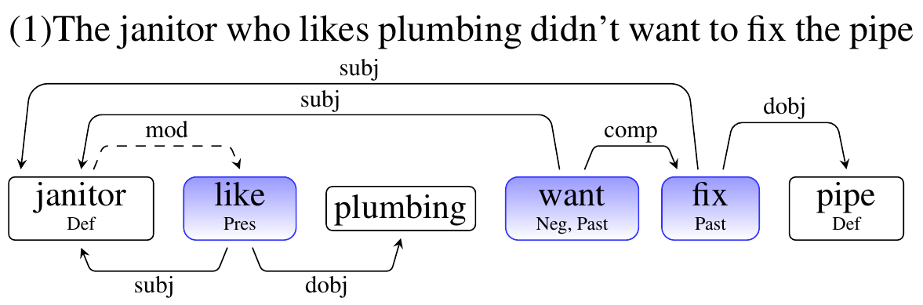
PropS
A simple, abstract and canonicalized sentence representation scheme
Nodes represent atomic elements of the proposition
Predicates, arguments or modifiers
Edges encode argument (solid) or modifier (dashed) relations
Notes:
- Similar spirit to dependency but more abstract
Features encode syntactic properties:
of modality, negation, definiteness, tense, passive or active voice, and other phenomena,
Abstracts over the ways in which these features are realized in the surface forms.

Slide 4
PropS Properties
Abstracts away syntactic variations
Tense, passive vs. active voice, negation variants, etc.
Unifies semantically similar constructions
Various types of predications
Different syntactic realizations of the same proposition
Differentiates over semantically different propositions
E.g. restrictive vs. non-restrictive modification, different types of appositions
Notes:
As oppose to dependencies, many types of predications are represented in a unified manner
Verbal
Adjectival
Non-lexical (appositions, possessives etc.)
In addition:
Canonicalizes different syntactic realizations of the same proposition:
- Differentiates appositives – Barack Obama, the U.S president (identity) vs. a drug, called Merck (provides more info).

Slide 5
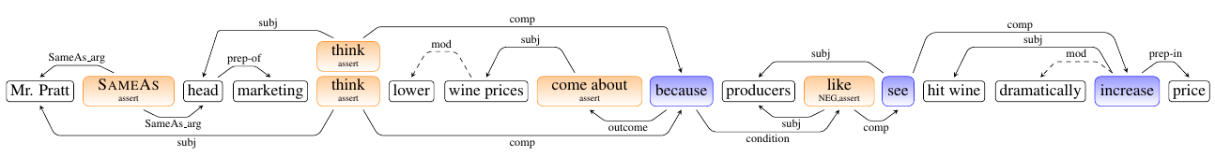
“Mr. Pratt, head of marketing, thinks that lower wine prices have come about because producers don’t like to see a hit wine dramatically increase in price.”
Props (17 nodes and 19 edges)
Dependency parsing (27 nodes and edges)
Notes:
Real world example,
Extracting propositions from In PropS involves traversing the subgraph rooted at each predicate node.
Extracting the same from a dependency tree requires non-trivial amount of processing.
Color coding:
Blue – attributed
Orange - asserted

Slide 6
“Mr. Pratt, head of marketing, thinks that lower wine prices have come about because producers don’t like to see a hit wine dramatically increase in price.”
Extracted propositions:
(1) lower wine prices have come about [asserted]
(2) hit wine dramatically increase in price
(3) producers see (2)
(4) producers don’t like (3) [asserted]
(5) Mr Pratt is the head of marketing [asserted]
(6) (1) happens because of (4)
(7) Mr Pratt thinks that (6) [asserted]
(8) the head of marketing thinks that (6) [asserted]
Notes:
Real world example,
Extracting propositions from In PropS involves traversing the subgraph rooted at each predicate node.
Extracting the same from a dependency tree requires non-trivial amount of processing.

Slide 7
PropS Methodology
Corpus based analysis
Taking semantic applications perspective
Focusing on the most commonly occurring phenomena
Covering most of them
Feasibility criterion
High accuracy “Gold Standard” would be feasibly derivable from available manual annotations
Reasonable accuracy for baseline parser from dependency parsing

Slide 8
PropS Handled Phenomena
Certain syntactic details are abstracted into node features
Modality
Negation
Definiteness
Tense
Passive or active voice
Restrictive vs. non restrictive modification
Implies different argument boundaries:
[The boy who was born in Hawaii] went home [restrictive]
[Barack Obama] who was born in Hawaii went home [non-restrictive]
Notes:
Restrictive vs non-restrictive is identified is determined by the POS of the modified entity (Proper noun ⬅➔ Non-restrictive)

Slide 9
PropS Handled Phenomena (cont.)
Distinguishing between asserted and attributed propositions
John passed the test
the teacher said that John passed the test
Distinguishing the different types of appositives and copulas
The company, Random House, didn’t report its earnings [appositive]
Bill Clinton, a former U.S president , will join the board [predicative]
Notes:
Assertion:
This is related to the attribution corpus (PARC), and can provide a useful starting point for applications trying to parse to its format.
Attribution is generally detected by nesting (nesting = attributed), yet there are certain exceptions:
Relative clauses
The boy who was laughing (laughing is nested, yet asserted)
Appositives
He likes Barack Obama, the president [Barack Obama is the president is asserted]
Certain conditional constructions:
Glaciers are melting because the temperature rises [both melting, and rises predicates are asserted]
Appositives:
The different types of appositions are identified by the definiteness of the elements participating the apposition: Iff both are definite then it’s appositive, otherwise it’s predicative.
In the example: “A former president” for instance, is not definite, so it serves as non-restrictive modifier of Bill clinton

Slide 10
PropS Handled Phenomena (cont.)
… and more:
Conditionals
Raising vs. control constructions
Non-lexical predications (expletives, possessives, etc.)
Temporal expressions
Adjectival modification
Notes:
Explitives (existentials): There are cookies in the jar

Slide 11
PropS Resources
Human annotated gold-standard
100 sentences from the PTB annotated with our gold structures
High-accuracy conversion of the WSJ
Computed (rule-based) on top of integration of several manual annotations
PTB Constituency
Propbank
Vadas et al(2007)’s NP structure
Baseline parser
Rule based converter over automatically generated dependency parse trees
Notes:
NP structure – Vadas and Curran 2007.
Provides, for example, structure in ((air force) contract) vs. the PTB’s flat representation.

Slide 12
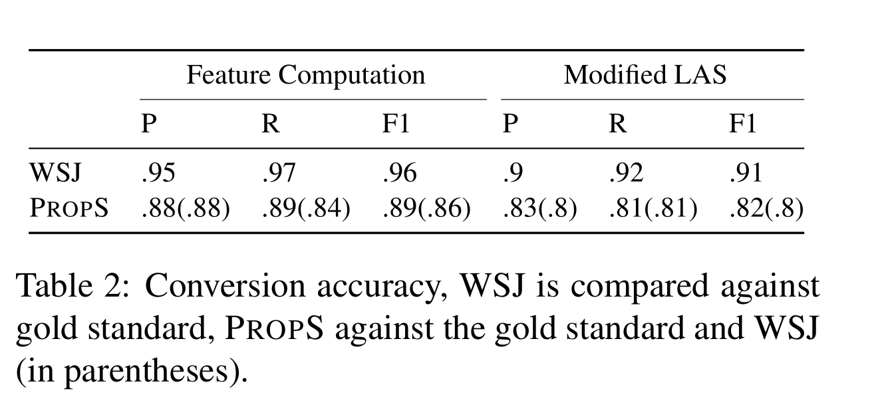
PropS Conversion Accuracy
http://u.cs.biu.ac.il/~stanovg/propextraction.html
Notes:
Traditional LAS was modified to account for non 1-1 correspondence between words and nodes

