Slide 1

College Management System
Database Systems - 10127
Asaf Ziv & Iness Goldes
Computer Science · Afeka College

Slide 2
OVERVIEW
Project Description
Our goal was to bridge the gap between OOP architecture and relational data modelling, transforming a Java based college system that is file based into an SQL environment built for long term reliability and scalability.
CRUD Operations
3NF Normalization
Full Create, Read, Update, and Delete support for Lecturers, Departments, and Committees.
We ensured atomic values (1NF), eliminated partial dependencies on composite keys (2NF), we separated dependent columns into their own tables to avoid redundancy (3NF).
Java & JDBC
PostgreSQL
Built with Java and JDBC (Java Database Connectivity) for reliable, standardized database access.
Backed by Postgres to guarantee data integrity, query efficiency, and scalable relational storage.

Slide 3
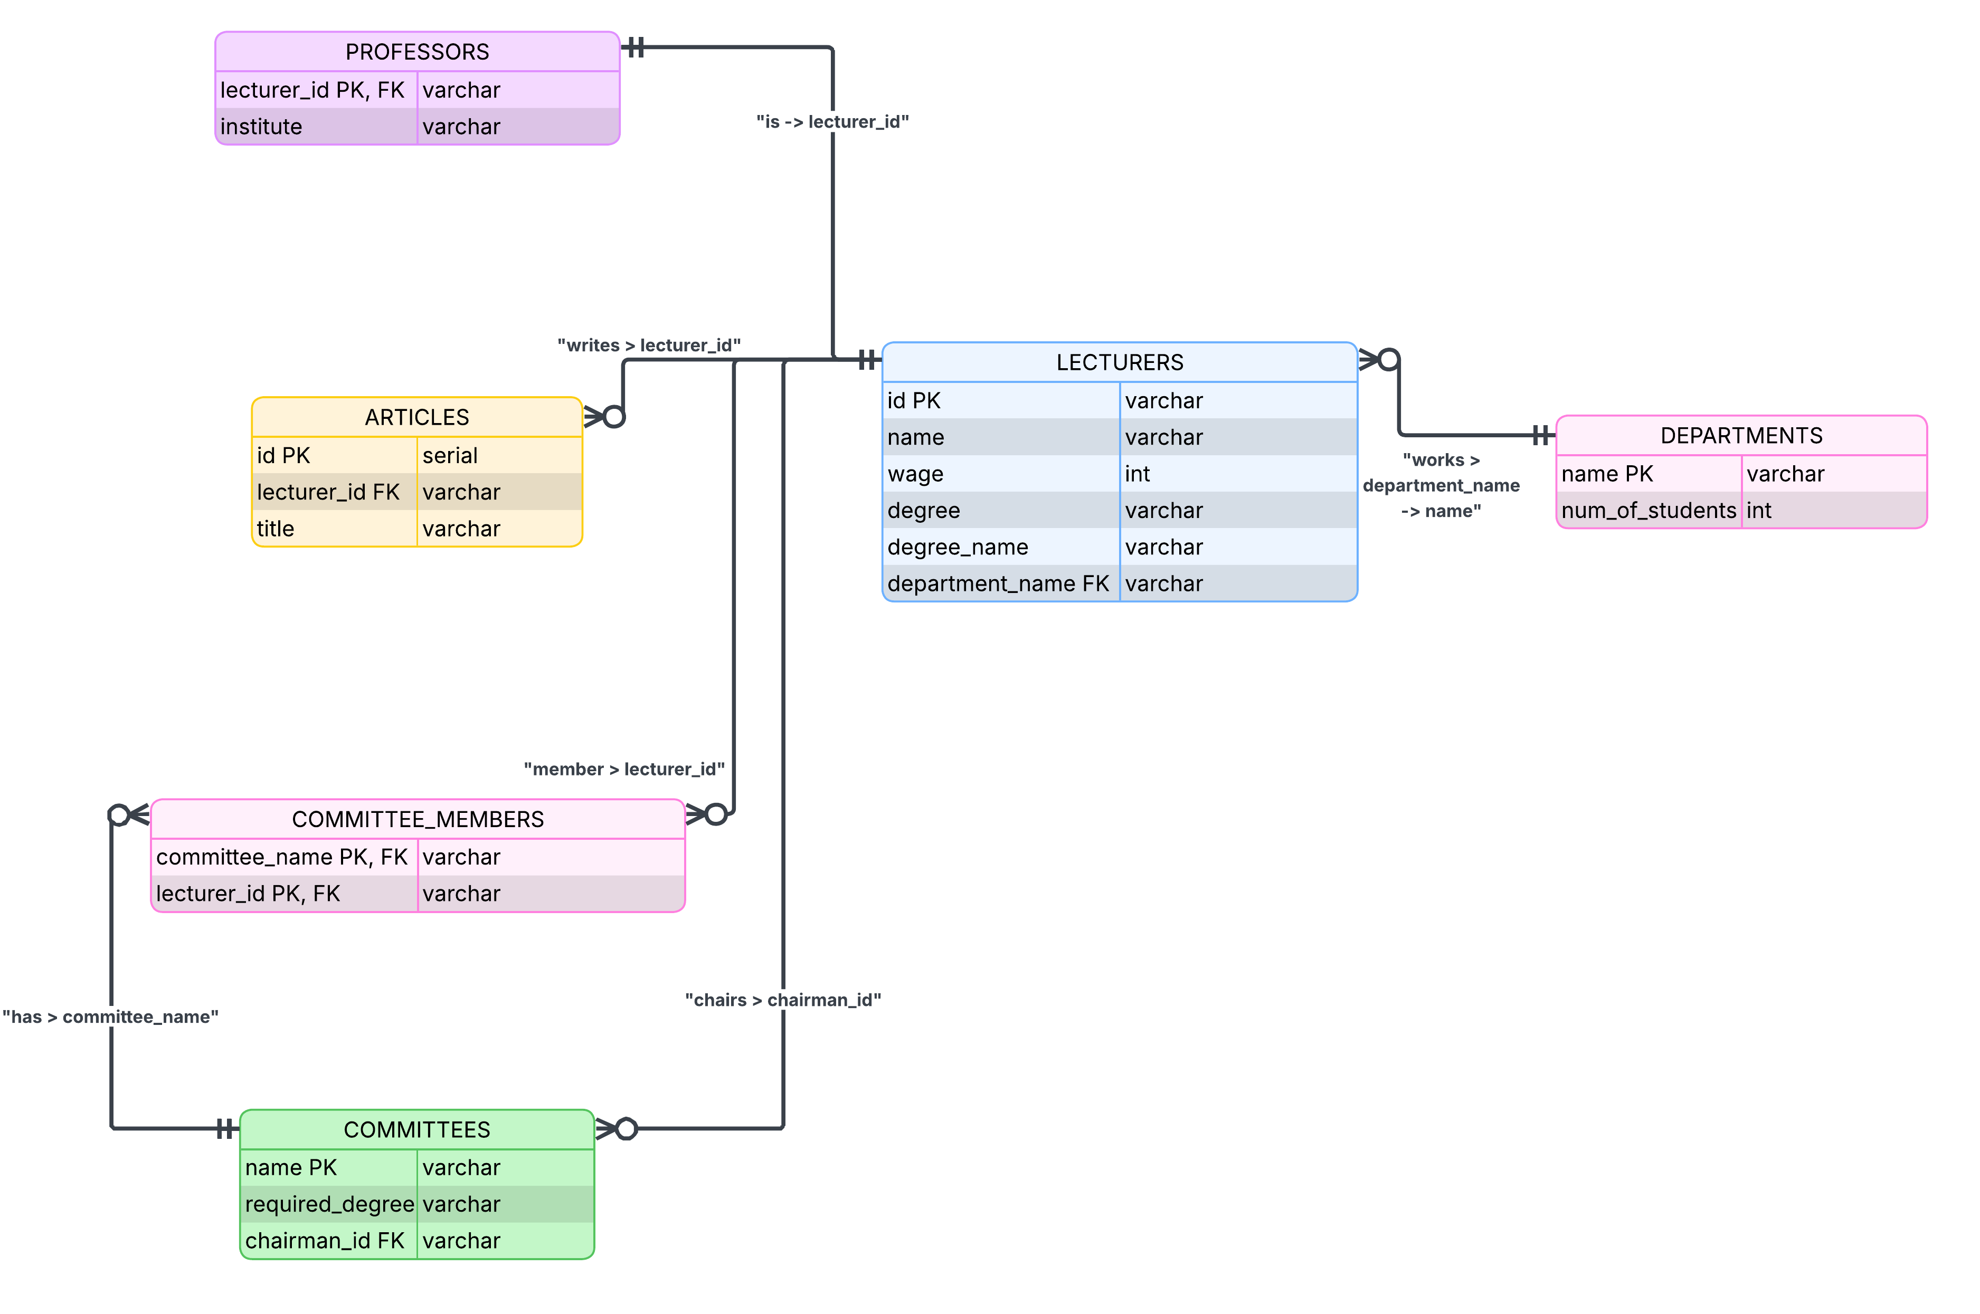
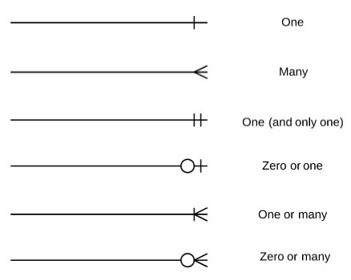
ERD
Entity Relationship Diagram
Cardinality

Slide 4
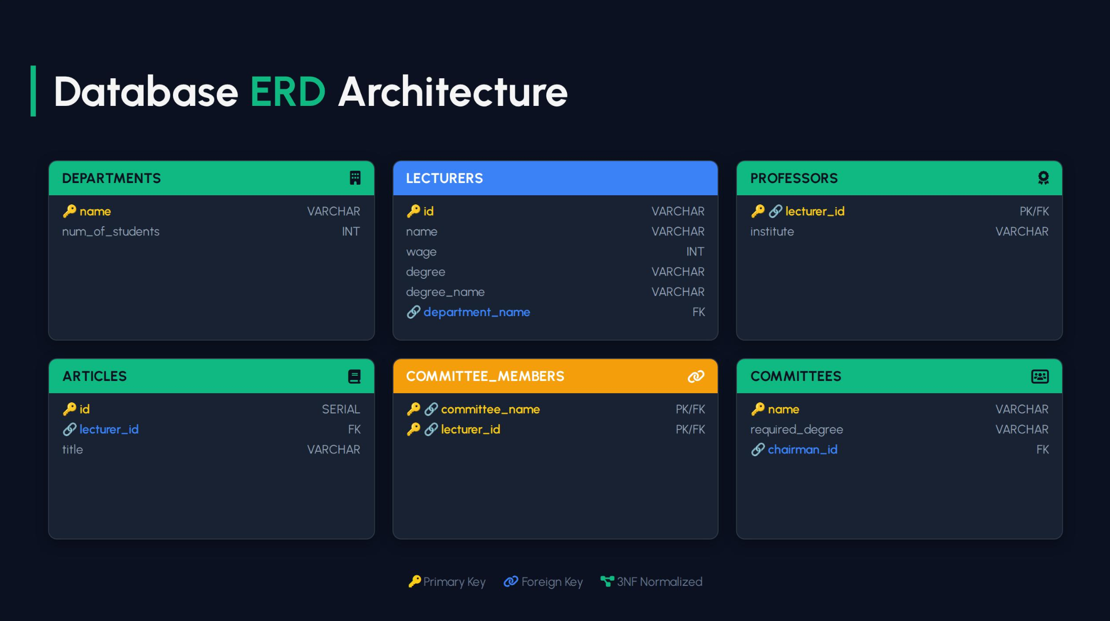

Slide 5

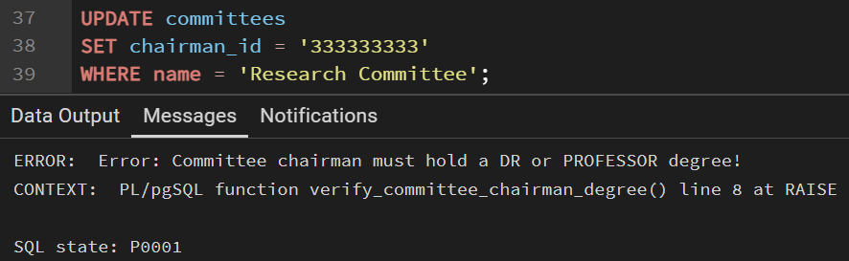
TRIGGER
Chairman Validation Trigger
This trigger ensures that any lecturer appointed as a committee chairman holds either a DR or PROFESSOR degree.
By enforcing this rule at the database level, it protects academic integrity and prevents unqualified leadership assignments.
Additionally, it reduces the need for redundant checks within the Java application. The result is stronger data quality and more reliable committee governance.
For example:

