Slide 1
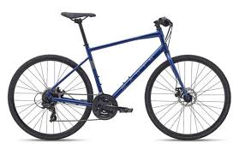
Bike Store Data Analysis Portfolio
Professional Insights on Sales, Customers, Products, and Store Performance
Presented by: Asaf Chechik

Slide 2
Overview
Objective: Analyze the Bike Store's Sales Performance, Customer Distribution, Product Trends, and Store Efficiency.
Key Metrics:
• Total Sales & Revenue
• Top Performing Products & Stores
• Customer Demographics & Trends

Slide 3
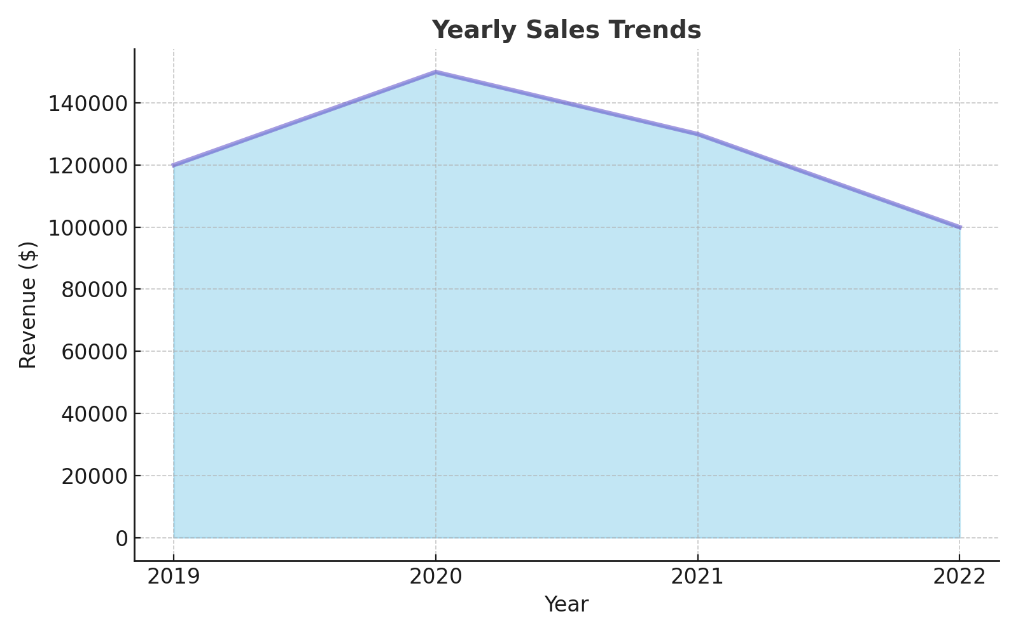
Yearly Sales Trends
Insight: Revenue peaked in 2020 at $150,000 but steadily declined, suggesting potential market shifts.

Slide 4
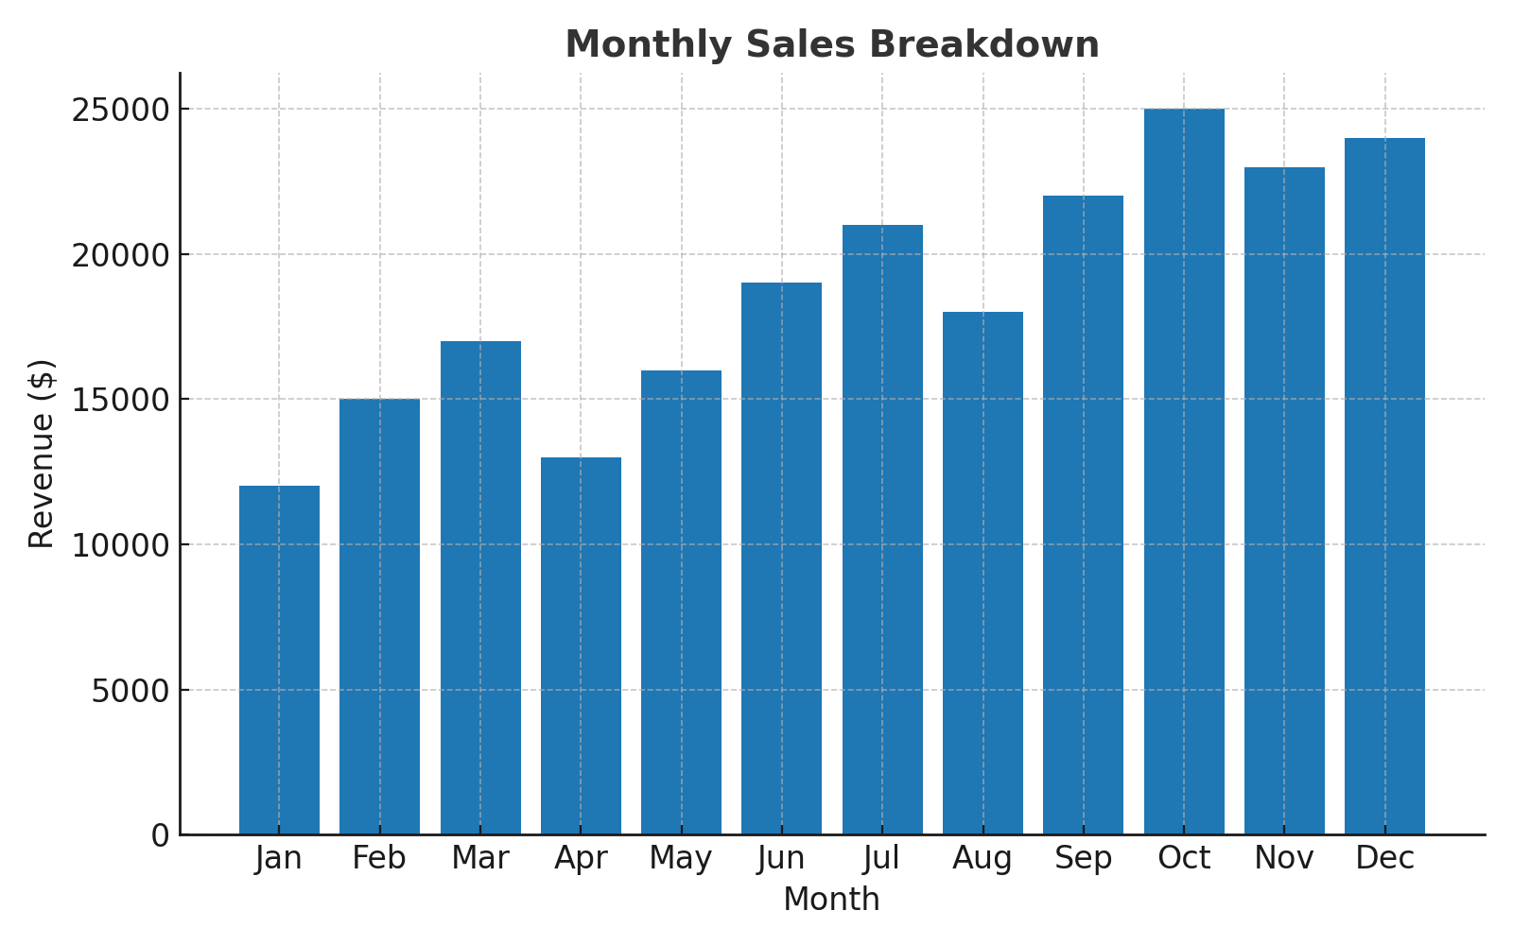
Monthly Sales Breakdown
Insight: Sales are consistently high in November and December due to holiday shopping.

Slide 5
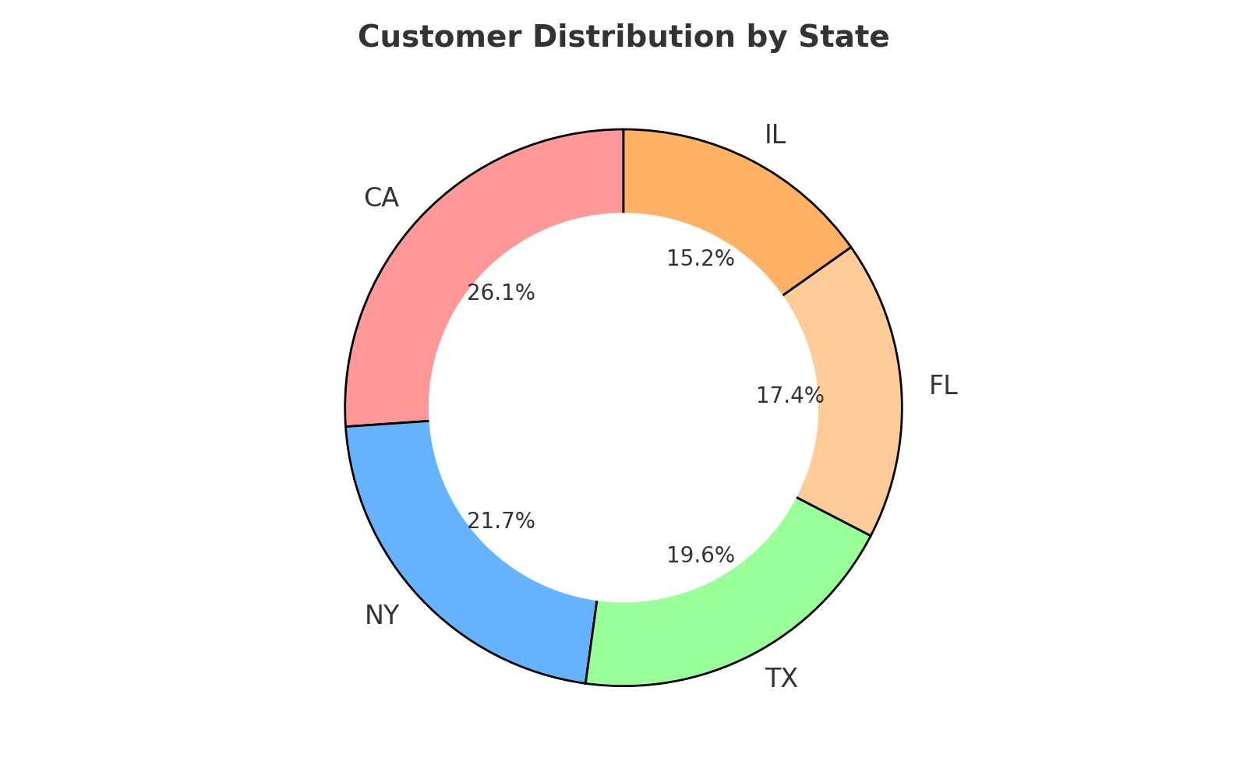
Customer Distribution by State
Insight: California leads sales, followed by New York and Texas. Focus on these states for marketing efforts.

Slide 6
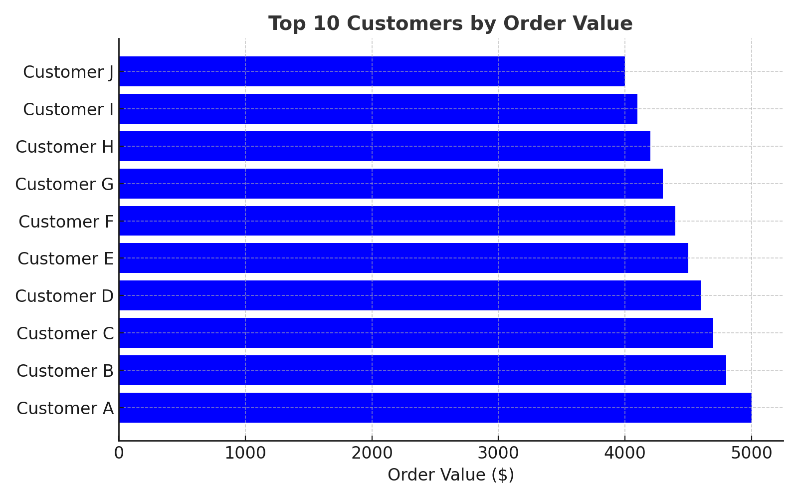
Top 10 Customers by Order Value
Insight: Customer A has the highest order value at $5,000. Focus on loyalty programs to retain these customers.

Slide 7
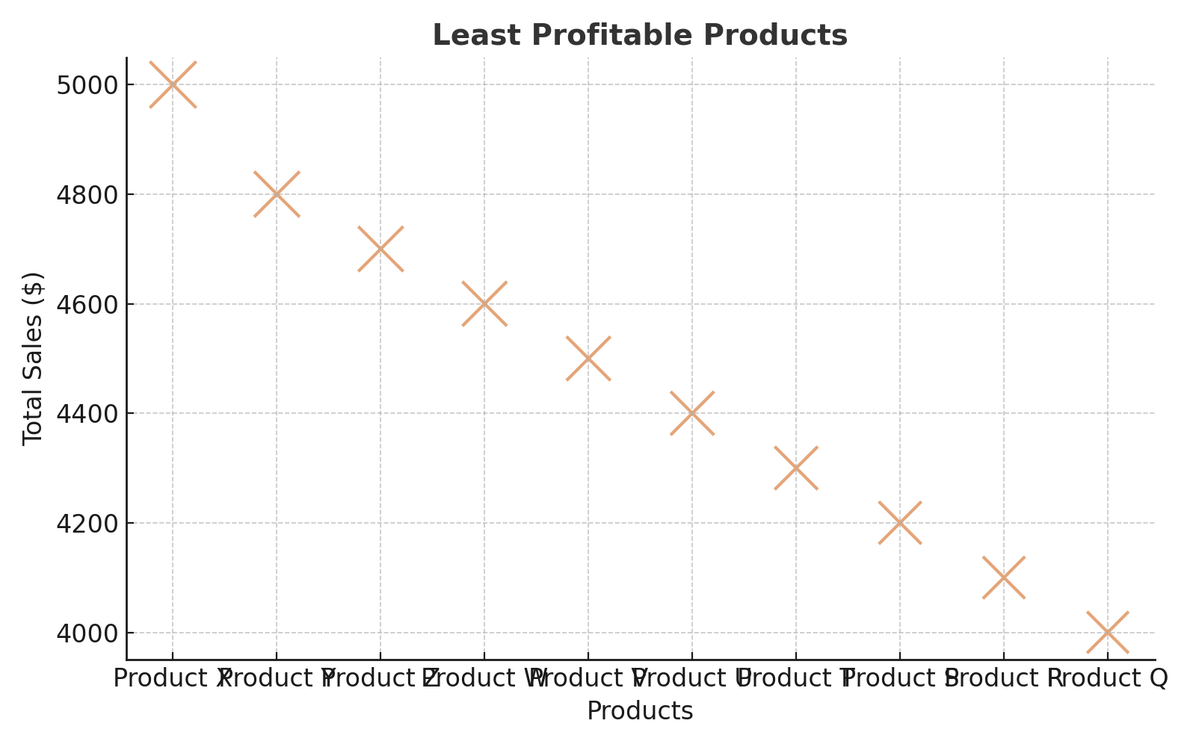
Least Profitable Products
Insight: Products like Product X and Y have the least sales and may need to be discontinued or rebranded.

Slide 8
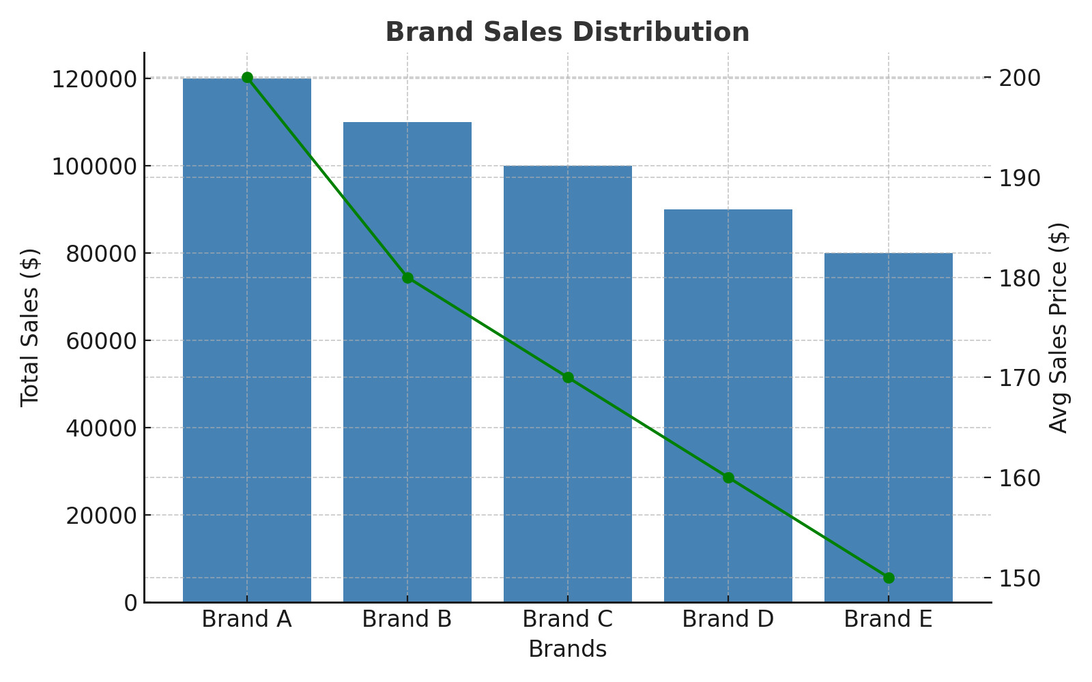
Brand Sales Distribution
Insight: Brand A generates the highest revenue. Consider increasing promotion for Brand A to drive further growth.

Slide 9
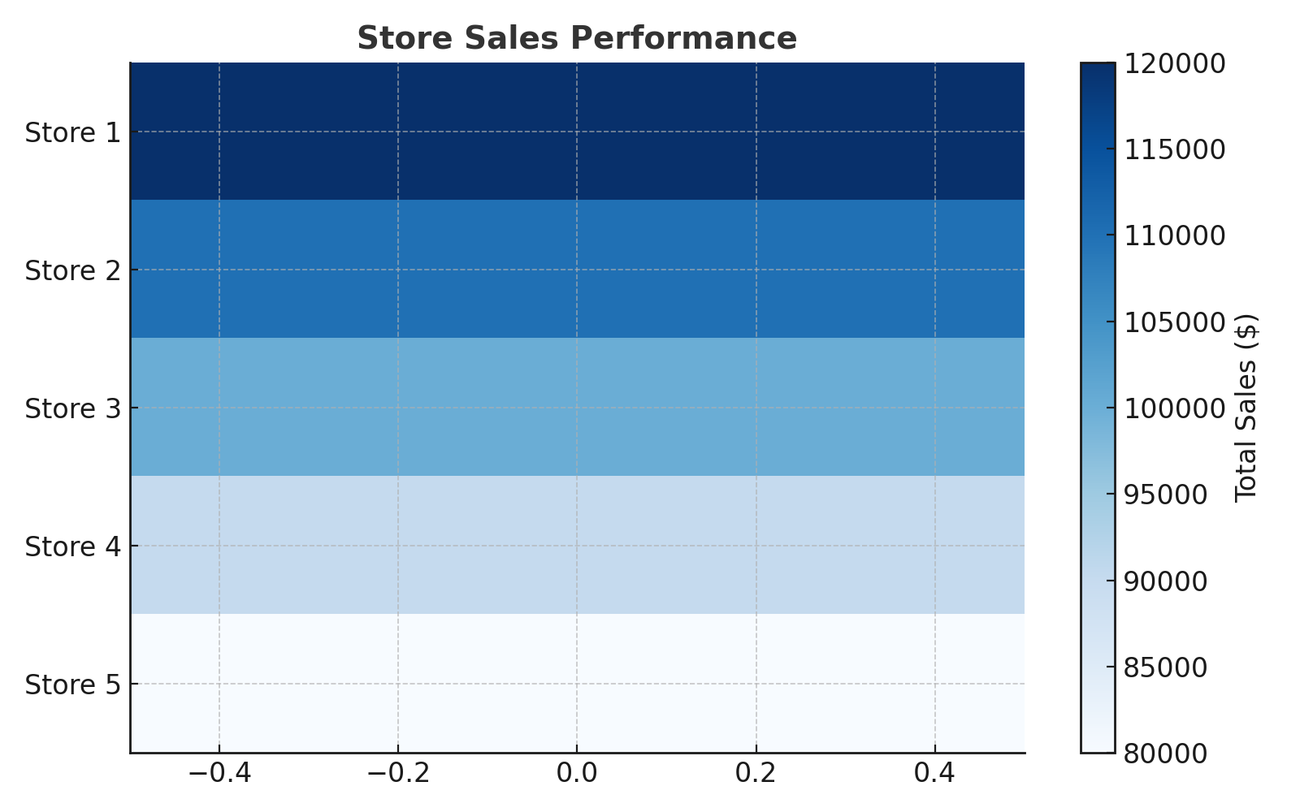
Store Sales Performance
Insight: Store 1 outperforms all others. Investigate its strategies and apply them to other stores to enhance overall sales.

Slide 10
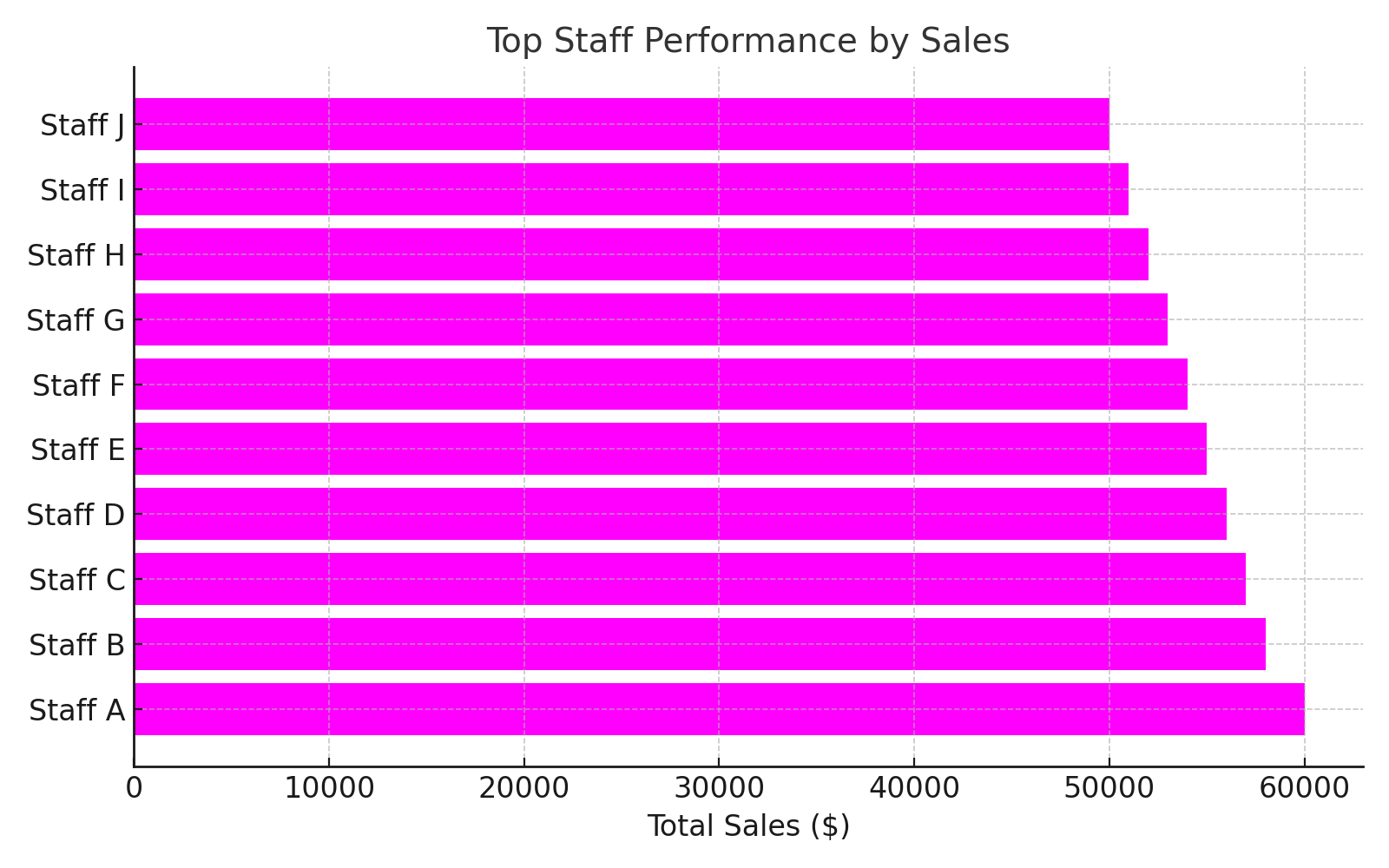
Top Staff Performance
Insight: Staff A generates the highest sales. Recognize and incentivize top performers to boost team performance.

Slide 11
Conclusion & Recommendations
Sales Trends:
• Yearly sales peaked in 2020 but have seen a decline since then. This suggests that market conditions or competition may have impacted sales. Maintaining a focus on high-performing months is key.
• Monthly sales show significant peaks during the holiday season (November-December). Planning promotional campaigns around these months will help capture maximum revenue.
Customer Insights:
• California is the leading region in terms of total sales. Focusing targeted marketing campaigns in this state and similar high-performing regions like New York and Texas will help increase market share.
Product Performance:
• Product A generates the most revenue, and keeping it well-stocked is crucial to maintaining sales. Conversely, Product X and Y underperformed and should be either rebranded or discontinued.
• Investing in promotions for high-demand products will further boost sales and attract repeat customers.
Store & Staff Performance:
• Store 1 significantly outperforms all other stores, suggesting that best practices from Store 1 should be analyzed and replicated. Staff training and operational improvements based on Store 1's success will elevate other stores.
• Staff A has set a high sales benchmark. Recognizing and rewarding top performers can enhance morale and push for better team results.
Future Opportunities:
• Continue focusing on promotions and inventory management during peak sales months (November and December). Expand loyalty programs to retain high-value customers.
• Strengthen relationships with suppliers to ensure that high-demand products like Product A are always available.
• Replicate the success of high-performing stores and staff across other locations to ensure consistent growth.

