Slide 1
TMDB’s TV-SHOWS ‘POPULARITY’ PREDICTION
ML DS17 Project
Sep 2024
Asaf Henig
Part of Bar-Ilan Univeristy ML/DS17 Course

Slide 2
Agenda
Project Introduction
Describing the dataset
Describing the Target Feature
Project Goal and major challenges
Project Description
Data Preparation: Reducing dataset and modifying large categories, clean text...
EDA - Data Pulling: Visualization, relations
EDA - Data Cleansing and One hot Encoding
Feature engineering – adding features, (PCA)
Model Selection and finetuning
Deployment and Beneficiaries of Machine Learning

Slide 3
Project Introduction – The Dataset
The Database: “Full TMDb TV Shows Dataset 2024 (150K Shows)” HERE
TMDB = ‘The Movie Database’ - Database of world-wide Movies and TV shows going back to 1917
Shape = 29 columns (2 x dates, 4 x int, 2 x float, 2 x boolean, 8 x string, 11 x categories) x 168640 rows
Important columns:
Id (int) , Name (string) = Identify the TV Show.
Number of Seasons (int), Number of Episodes (int) , episodes_run_time (int) – how long have the show been on the air and how long is the show
Original language (cat), languages (cat), spoken_languages (cat) = The original language (string), current languages (list), spken_languages (list) of the show
Vote-avg. (float) = Avg. vote rating for the TV show
Overview (string) = Overview or plot summary of the TV show.
Adult (Boolean), in_production (Boolean) = indicate if the TV_show is classified as Adult and whether it is currently in production
First Air Date (date), Last Air Date (date) = first aired and last aired
production_companies (string), networks (string) - who is producing the show and in which network you can see it
Genres (cat) – what is the show gener

Slide 4
Project Introduction – Target Feature
Target = ‘Popularity’ column:
Float64
Min 0. No real Max (in DB 3707) - score can increase indefinitely depending on engagement with TV-show.
Description: A score for the TV-show given by TMDB itself based on an unknown algorithm.
Represent the current level of interest and engagement by TMDB users (in the TMDB website) for the specific show - reflect how well the TV show is received by TMDb users.
Possible ‘Popularity’ score influencers:
Page Views: The number of times a TV show's page is visited on TMDB.
User Engagement: User actions like ratings, reviews, and watchlist additions.
Social Media Mentions: Activity and discussions about the TV show on social media platforms.
Search Frequency: How often the show is searched for on TMDB.
Recentness of Activity: Recent interactions are weighted more heavily than older ones.
External Traffic: Links from other websites driving traffic to the show's TMDB page.

Slide 5
Project Introduction – Goal & Challanges
Predicting ‘Popularity’ score given an input featrue-set similar (or subset) to the original 28 features and reasonably assuming that TMDB ‘popularity’ calculation algorithm is unknown
A ‘regression’ prediction challenge
Project challenges:
X-large dataset
Not clear that all ‘algorithm’ ingrediants (features) are in the dataset
Many features of type strings, e.g. overview, poster_path. Some in none english characters , e.g. original_name
Many large volume category features, e.g. networks
Many categories have list-type entries, e.g. production_companies, origin_country

Slide 6
Data Preperation – Dataset Reduction
Decisions was made to reduce the dataset size: from 169K entries to 71K (71371)
Removed entries representing shows that were first aired before 1/1/2015 and after 31/12/2023
10 features dropped out of the gate
‘tagline’, ‘created_by’ → 80% NULLs
‘backdrop_path’, ‘poster_path’ → location in TMDB repository – assuming no relations to ‘popularity’
‘spoken languages’ and ‘languages’ → identical columns with 30% NULL and large categorical (462)
‘production countries’ → similar to ‘origin countries’
‘original name’ → None English characters we cannot work with
#remove last_air_date and in_production columns due to large precentage of mistaks and per Orit instructions
'last_air_date’ and ‘in_production’ – dropped due to large amount of mistakes kept only ‘status’
Create a separate Text dataset for few strings: ‘overview’, ‘homepage’ (adding ‘name’ and ‘id’ for Id)
New dataset: 71371 x 17

Slide 7
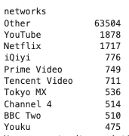
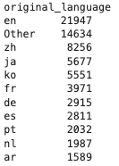
Data Preperation – Challanging categories
‘Networks’ (List → Names of networks that have aired the TV show)
List entries (tv-show aired on multiple networks) – replaced with single most popular_network in the list
Maintain top 10 Networks and a new category of ’Others’
Original_Languages - Maintain top 10 languages and a new category of ’Others’
Production_Companies (List → Names of production companies associated with the TV show)
replace column with a new column (num_of_production_companies) that features #production companies
Origin_Country (List → Country/countries of origin for the TV show)
Replace each list with the first mentioned country
Replace this with ‘Origin_Continent’ where each country is associated with its continent. NULLs are associated with ‘Other’
Genres: One-hot labeling (genres_Soap, genres_Westerns…) – 20 Genres instead of the original Genres feature
New dataset: 71371 x 36

Slide 8
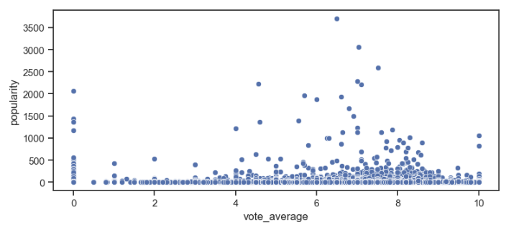
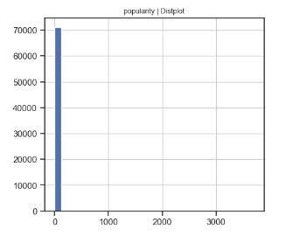
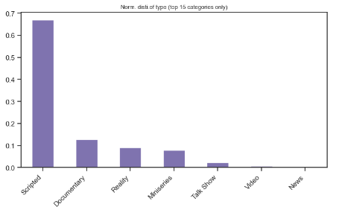
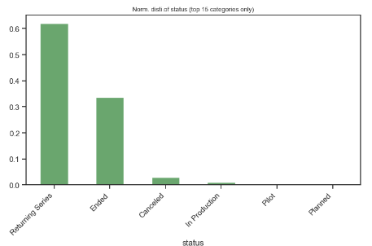
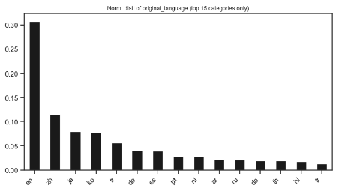
EDA - Data Pulling and Visualization
No clear relations between ‘Populairyt’ and ‘vote_avg.’
Most ‘popularity’ values are close to 0
Histogram of TV-shows types
Histogram of TV-shows status
Histogram of TV-shows original_languages

Slide 9
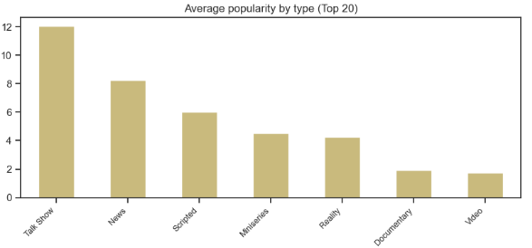
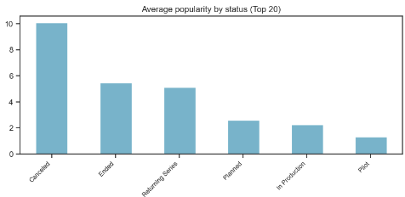
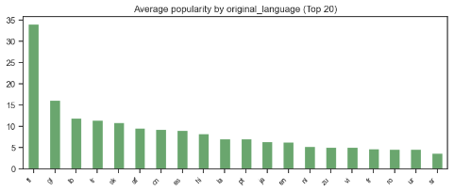
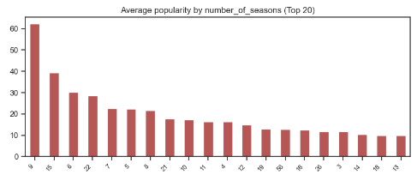
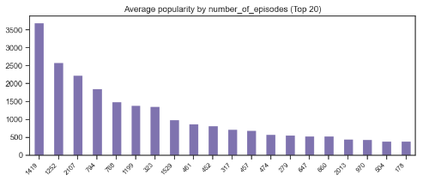
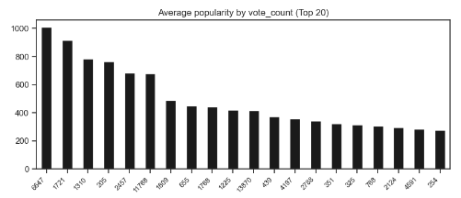
EDA - Data Pulling and Visualization
Avg. ‘Populariyt’ against various features – no clear correlation is found between popularity score and any feature

Slide 10
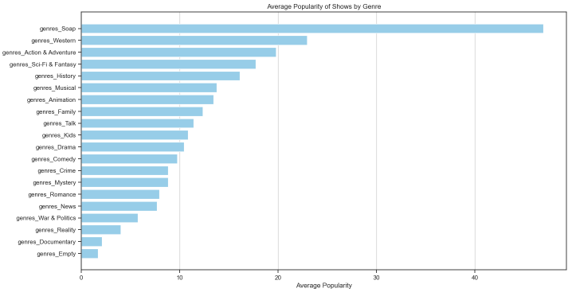
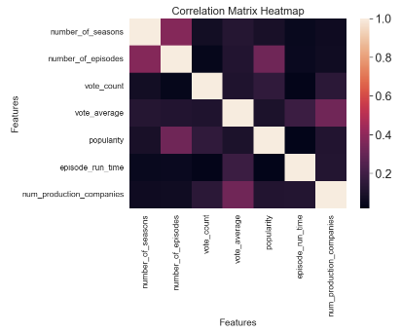
EDA - Data Pulling and Visualization
No strong relations between ‘Popularity’ and any feature except Genres Type. ‘Soap’ type TV-show received the highest popularity avg. Note ‘Soap’ have high number of Episodes

Slide 11
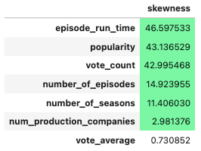
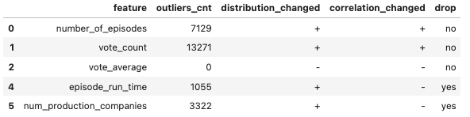

EDA - Data Cleansing and One-Hot encoding
Original distribution of all numerical featrues was not Normal and strongly right Skewed
For outliers presentation we’ve create a log (in base 10) numerical values version of the df
We have used IQR test to search for outliers and cleanse the dataset
We have decided to fix outliers (cleanse) in only two numerical features:
‘episode_run_time’ (1055 outliers) and ‘num_production_companies’ (3322 outliers)
Outliers values were turned to NULL and Imputation done through the MICE (Multiple Imputation by Chained Equations) algorithm
Dataset preparation for MICE included these feature modifications:
’Last_Air_Date’ was modified to 3 features: day, month, year
One-hot encoding on these categorial feature: 'type’, 'status’, 'networks', 'original_language', 'origin_continent’
New dataset: 71370 x 73

Slide 12
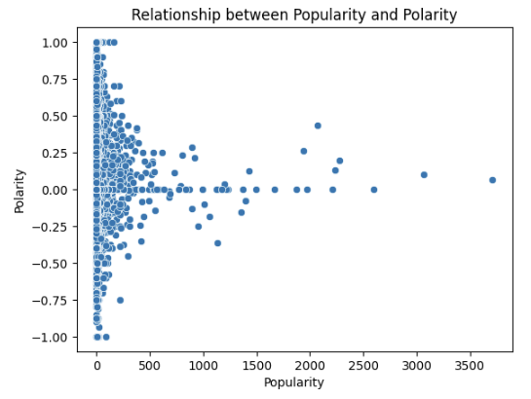
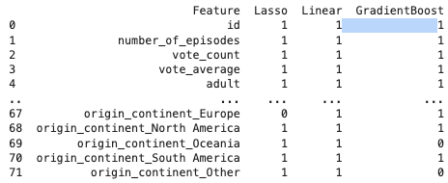
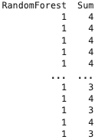
Feature Engineering and Feature Selection
Some feature-engineering was done in previous steps, e.g. spliting ‘last_air_date’ to ‘day’,’month’,’year’
Sentiment was calculated on each TV-show by examining the original ‘overview’ feature.
No relations was found between Popularity and Sentiment and new featrue was removed
Feature Selection was done using Multivariable Analysis with these algorithms: Lasso, Linear Regression, Random Forest, Gradient Boost
Filter the Dataframe where 'sum' is less than 3
16 columns filtered out
New dataset: 71370 x 57

Slide 13
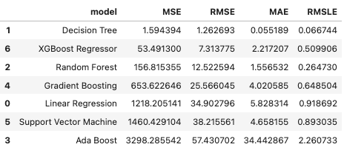
Model Selection and Fine-Tuning
Dataset was split between Training (70%), Validation (15%) and Test (15%)
Comparison between 7 models was done on the Training-set
Decision-Tree was chosen
Fine-tuning process was done using GridSearch on the validation dataset
No improvement was achieved and chosen model remained the basic Decision-Tree
Prediction was conducted using Test dataset with basic DecisionTree Model
Extremely poor results

Slide 14
Deployment and Beneficiaries of Machine Learning
Project code is found on the public ‘DS17_TMDB_Project’ repository in my Github account HERE
Repository include 4 python files represeting the below 4 steps
EDA Data Pulling and Visualization (ML_TMDB_PROJECT_EDA_1.ipynb)
EDA Data Cleansing and One hot Encoding (ML_TMDB_PROJECT_EDA_2.ipynb)
Feature engineering (ML_TMDB_PROJECT_EDA_3.ipynb)
Model Selection and finetuning (ML_TMDB_PROJECT_MODEL_SELECTION.ipynb)
Initial data preperation / fat-file creation is not included and instead the fat file itself can be found (tmdb_flat_file.pkl)
To use the code it is sufficent to run the model selection file (ML_TMDB_PROJECT_MODEL_SELECTION.ipynb) as it starts by loading pickle file from previous step (tmdb_EDA_feature_eng_file.pkl)
Any new TV-show for which popularity prediction is needed can use the chosen model provided that a dataset with 56 columns (57 – ‘popularity’ feature) is available. To run prediction:
Run this code: pupulairy_prediction = mod2.predict(New_TV_Show). mod2 is the DecisionTreeRegressor that run on the X_train/y_train
New_TV_Show – is the new dataset that includes the new TV-show with the 56 features

