Slide 1
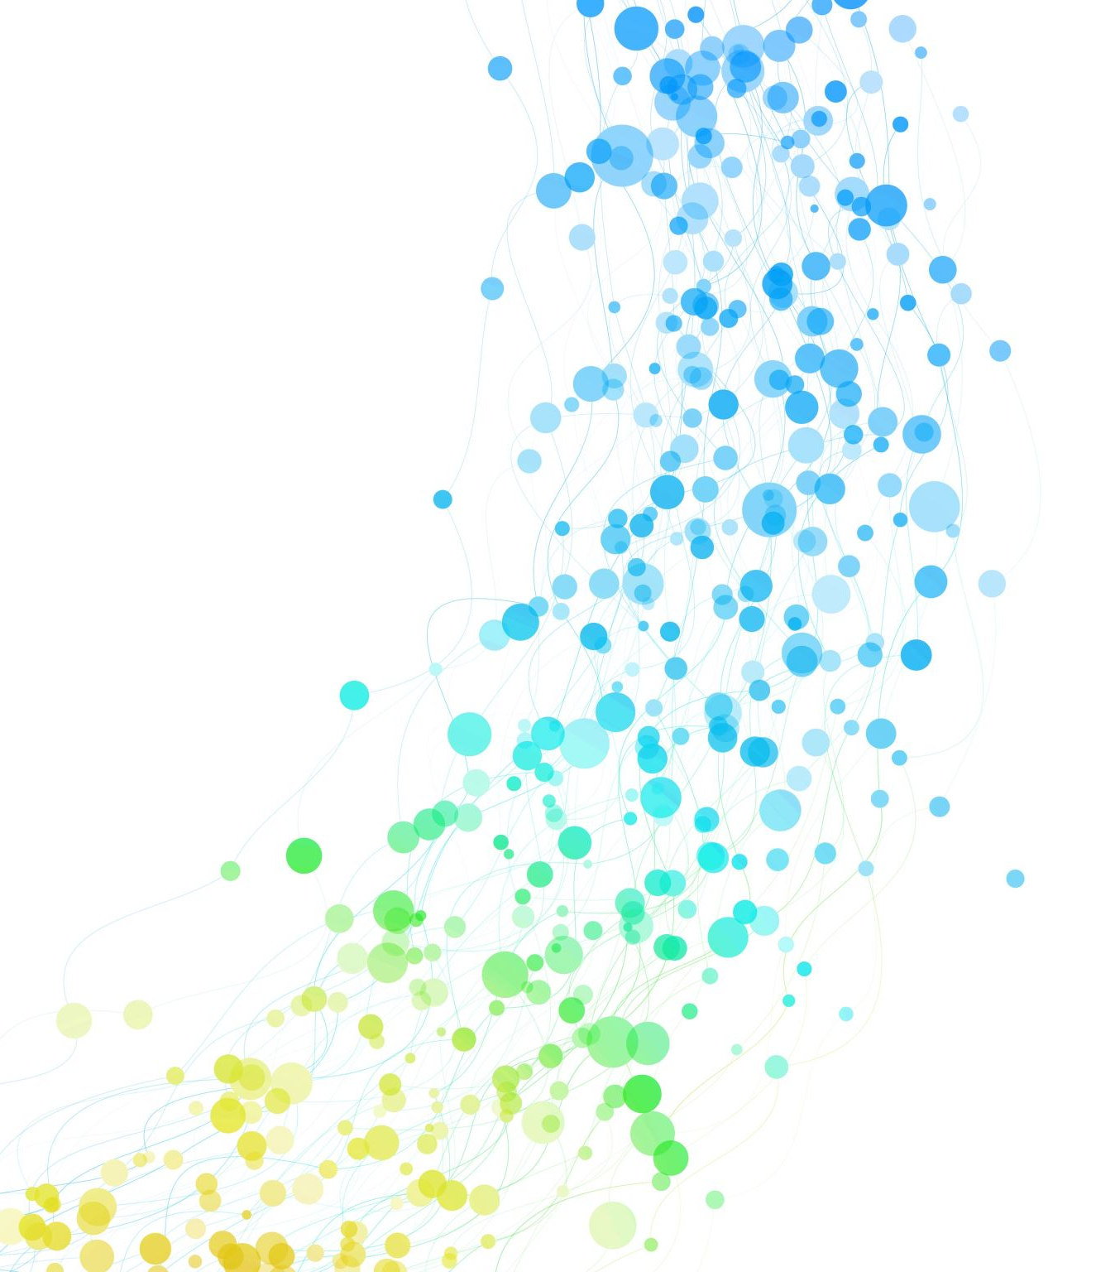
Pneumonia Detection using CNN
Authors:
1. Sakharkar, Aniket, sakharkar.a@northeastern.edu
2. Shah, Jwalit, shah.jwa@northeastern.edu
3. Sharma, Aarushi, sharma.aaru@northeastern.edu

Slide 2
OBJECTIVES
Develop an automated system for detecting Pneumonia in chest X-ray images using CNN and improve accuracy of pneumonia detection by reducing potential for human error or bias in diagnosis.
To train CNN model on a large dataset of chest X-ray images with labeled pneumonia cases and normal cases to extract relevant features and use them to make predictions on new, unseen images.
To explore the potential impact of using CNN for improving healthcare outcomes, such as reducing workload on radiologists, enabling faster and more efficient patient care.
The overall goal of the project is to develop a reliable and accurate pneumonia detection tool that can assist doctors in making more informed diagnoses and providing appropriate treatment.

Slide 3
DATA DESCRIPTION
The dataset consists of OCT Chest X-Ray images labelled as Normal or Pneumonia split into Training, Validation and Test set of independent patients.
Optical coherence tomography (OCT) is a technique for obtaining sub-surface images of translucent or opaque materials at a resolution equivalent to a low-power microscope.
There are 5,863 X-Ray images (JPEG) and 2 categories (Pneumonia/Normal).

Slide 4
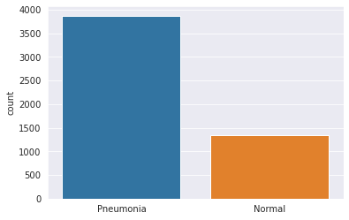
EXPLORATORY DATA ANALYSIS
The given visualization, shows that the data is imbalanced, with one class (Pneumonia) being more prevalent than the other (Normal).
To handle the imbalanced data, data augmentation has been performed.
Approaches that alter the training data in ways that change the array representation while keeping the label the same are known as data augmentation techniques.

Slide 5
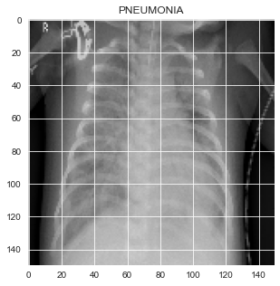
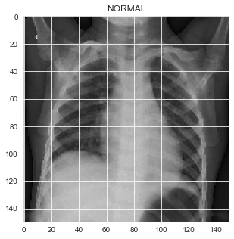
EXPLORATORY DATA ANALYSIS
Grayscale Normalization has been performed to reduce illumination differences.
Some popular augmentations people use are grayscales, horizontal flips, vertical flips, random crops, color jitters, translations, rotations, and much more.
By applying a couple of transformations to train data, number of training examples can easily be doubled or tripled, and a very robust model could be created.

Slide 6
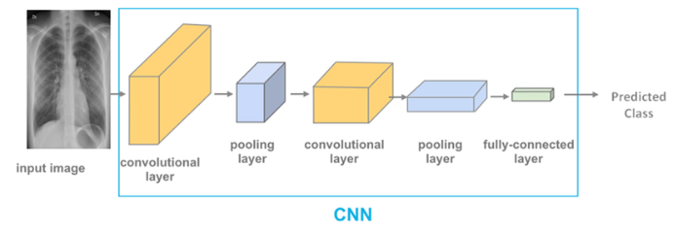
CNN Architecture

Slide 7
Results
Batch Size | Epochs | Learning Rate | Precision | Recall | Accuracy | Test Accuracy | F1-Score
32 | 6 | 0.000001 | 0.6161 | 0.6051 | 0.5176 | 0.8470 | 0.61055
32 | 6 | 0.000010 | 0.6183 | 0.6561 | 0.5320 | 0.8814 | 0.63664
32 | 6 | 0.000100 | 0.6252 | 0.6974 | 0.5496 | 0.8830 | 0.65933
32 | 12 | 0.000001 | 0.6157 | 0.6410 | 0.5256 | 0.8525 | 0.62810
32 | 12 | 0.000010 | 0.6265 | 0.6282 | 0.5336 | 0.8958 | 0.62735
32 | 12 | 0.000100 | 0.6210 | 0.6974 | 0.5448 | 0.8910 | 0.65699
32 | 18 | 0.000001 | 0.5969 | 0.6076 | 0.4983 | 0.8509 | 0.60220
32 | 18 | 0.000010 | 0.6433 | 0.6615 | 0.5592 | 0.8926 | 0.65227
32 | 18 | 0.000100 | 0.6127 | 0.6410 | 0.5224 | 0.8974 | 0.62653

Slide 8
Results
 | Precision | Recall | F1-Score
Pneumonia (Class 0) | 0.37 | 0.32 | 0.34
Normal (Class 1) | 0.62 | 0.68 | 0.65
Test Accuracy |  |  | 0.89
Accuracy |  |  | 0.54
Macro Average | 0.50 | 0.50 | 0.50
Weighted Average | 0.53 | 0.54 | 0.53

Slide 9
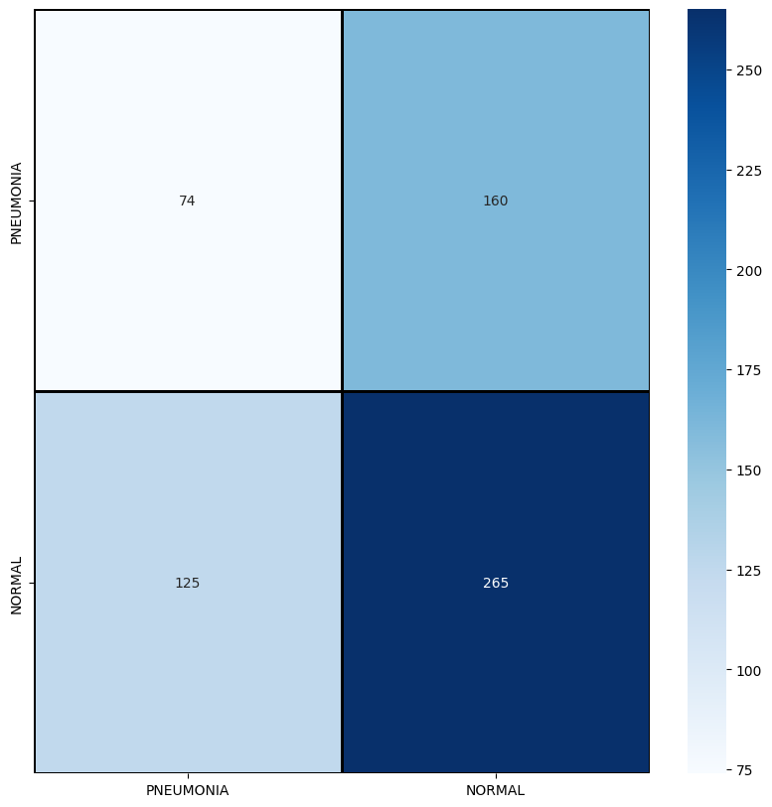
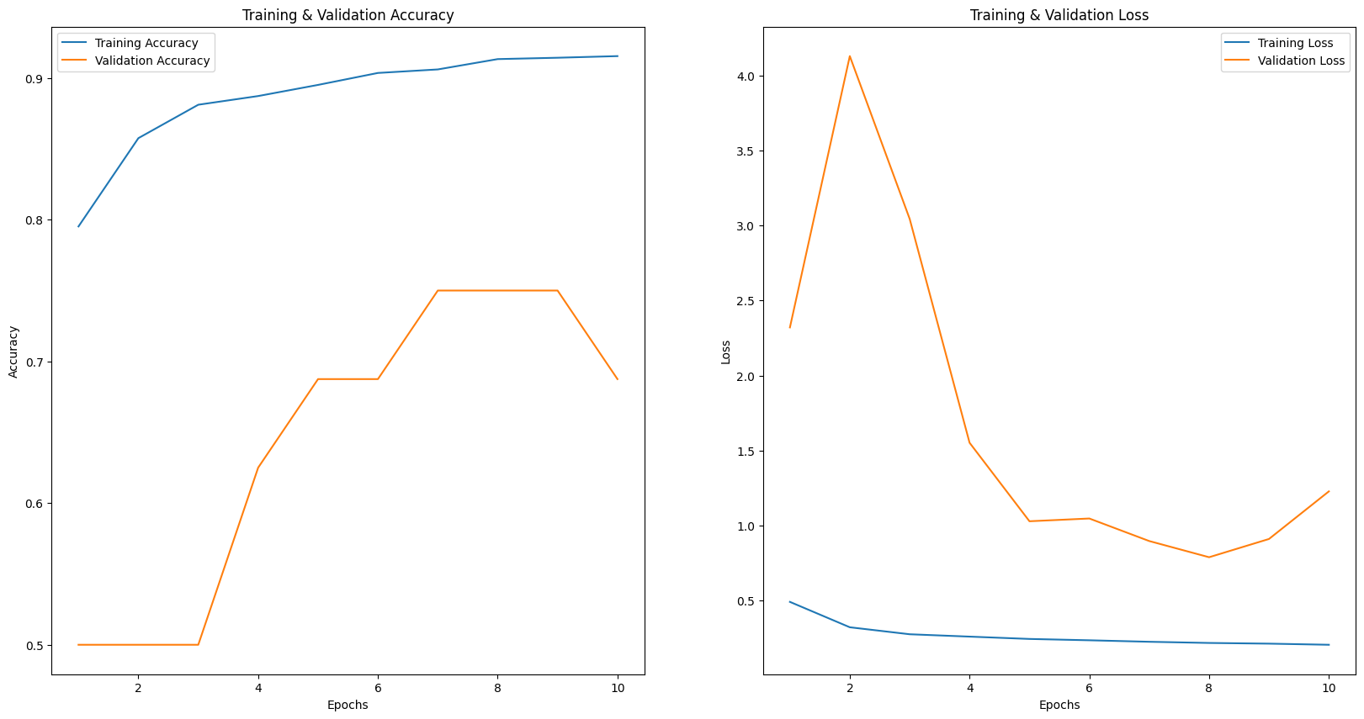
Results

Slide 10
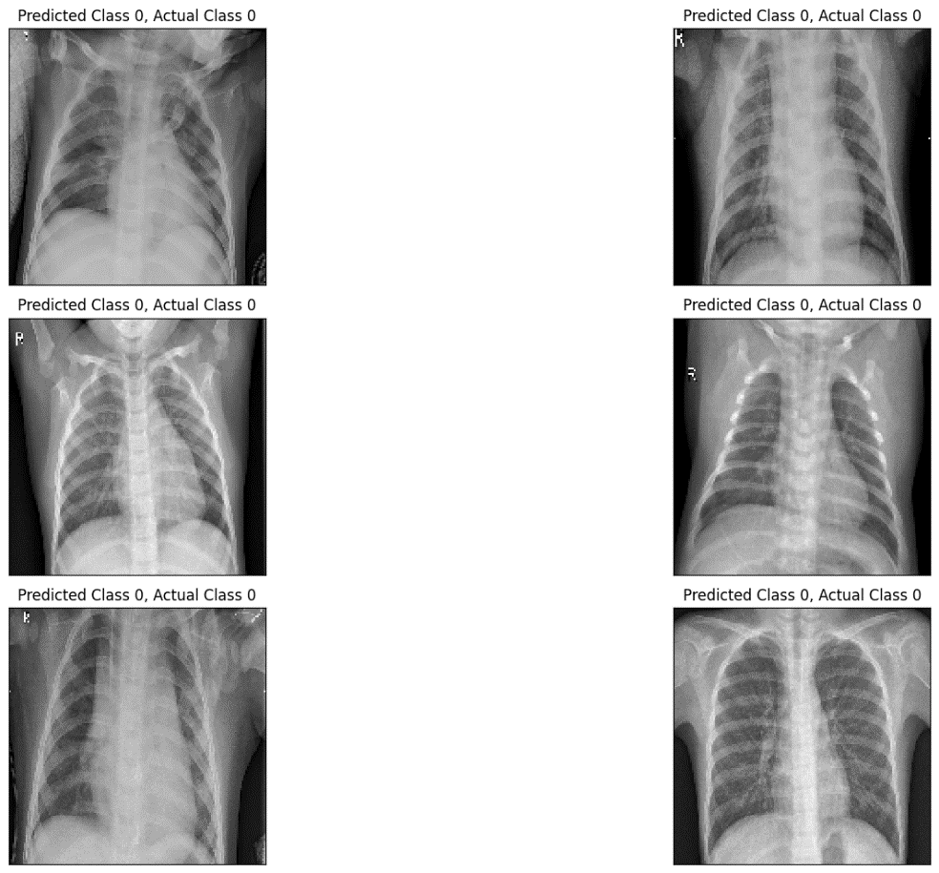
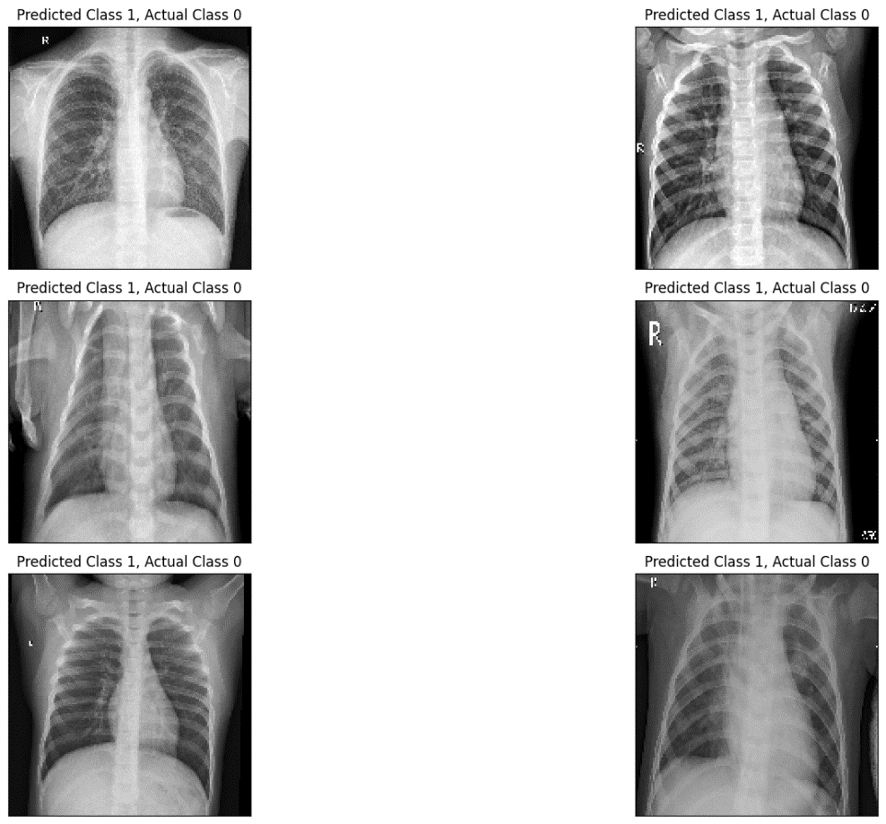
Conclusions and Future Work

Slide 11
Conclusions and Future Work
Based on the experiments conducted, we can conclude that the combination of :
Epoch = 10
Learning Rate = 0.00001
Batch Size = 32
Test Accuracy = 89%
Yielded the best Test Accuracy = 89%.
The preferred measure for evaluation was: F1-Score = 0.65 (For Normal) and F1-Score = 0.34 (For Pneumonia) which was used to assess the model's performance.

Slide 12

THANK YOU

