Slide 1
Design and Implementation of a
Digital Phonocardiography System
Cardiac sound acquisition, processing, BLE transmission, and visualization
IoMT prototype
PCG signal processing
Web platform
Laboratory of Internet of Medical Things
Academic year 2025-2026
Notes:
Open by stating the goal: we built a complete digital phonocardiography prototype that starts from acoustic heart sound acquisition and ends with visualization and signal-derived analysis outputs. Emphasize that it is an IoMT engineering prototype, not a clinical diagnostic device.

Slide 2
Outline
1
System Architecture
2
Hardware Design
3
Firmware and Acquisition
4
Communication Protocols
5
Signal Processing
6
Software Platform

Slide 3
01
System architecture
From heart sound acquisition to software visualization and analysis.
Notes:
Section transition: System architecture. Use this slide to tell the examiner what part of the system will be explained next and how it connects to the previous part.

Slide 4
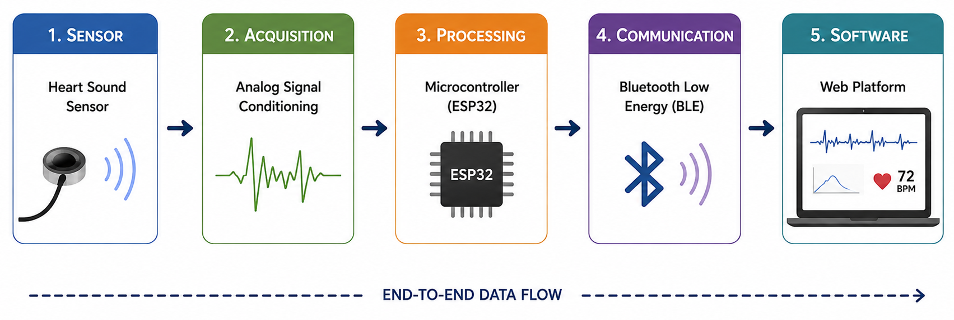
End-to-end system architecture
System architecture
Digital Phonocardiography System | Lab of Internet of Medical Things
Notes:
Use this slide as the reference architecture for the entire presentation. Point from left to right: acoustic signal, analog output, ADC acquisition, BLE transport, and software analysis.

Slide 5
02
Hardware design
Compact acquisition board integrating sensing, processing, display, and power.
Notes:
Section transition: Hardware design. Use this slide to tell the examiner what part of the system will be explained next and how it connects to the previous part.

Slide 6
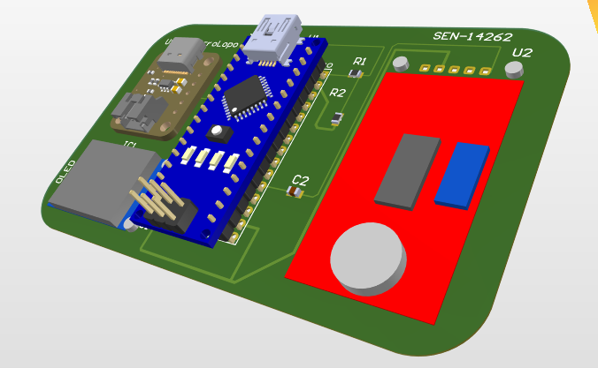
Hardware design
Hardware
From heart sound
to digital data
The board captures acoustic cardiac activity and prepares it for acquisition, BLE streaming, and software analysis.
Heart sound
→
Sensor
→
ESP32 ADC
→
BLE / software
Digital Phonocardiography System | Hardware section
Notes:
Opening: the hardware section answers how we turn heart sound into a usable electrical and digital signal. The sensor captures the sound, the ESP32 reads the analog signal, and the rest of the system sends and analyzes it.

Slide 7
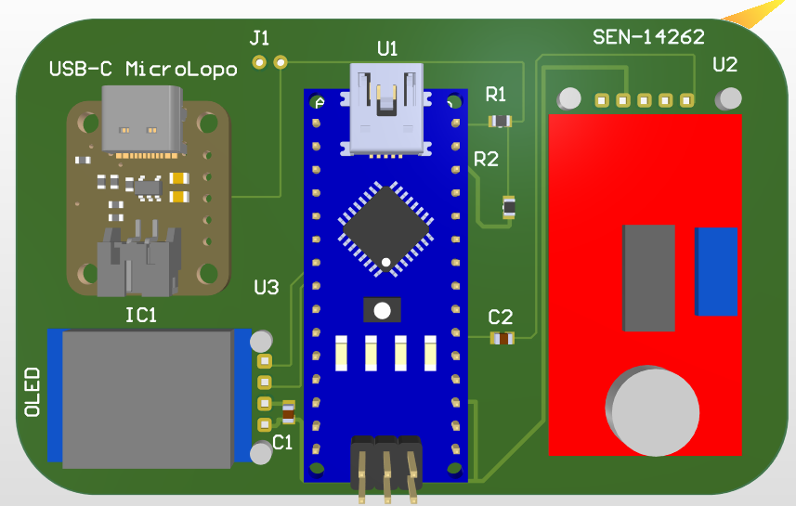
Hardware role and architecture
Hardware
One compact board,
four functions
ESP32 is central because it connects to almost every subsystem.
1 Sensing
SEN-14262 converts sound into an analog signal.
2 Processing
Arduino Nano ESP32 reads and controls the board.
3 Display
OLED gives local feedback through I2C.
4 Power
Battery connector + USB-C charger.
sensing
processing
display
power
Notes:
The board is modular: sensing, processing, display, and power. The ESP32 is central to reduce distances and simplify routing.

Slide 8
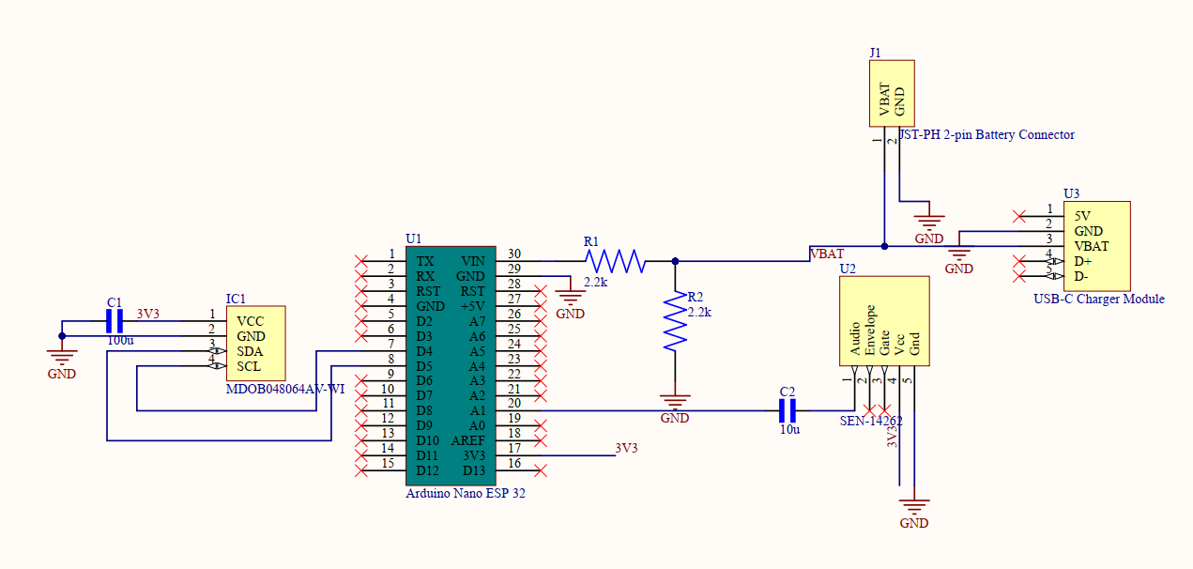
Signal path and battery protection
Hardware
Preserve the waveform. Protect the ADC.
Key design choices
Analog output
Full PCG waveform for filtering and S1/S2 detection.
C2 = 10 μF
Coupling capacitor removes unwanted DC component.
R1 = R2 = 2.2 kΩ
Voltage divider sends half of VBAT to the ADC.
VADC = ½ VBAT → VBAT ≈ 2 × VADC
safe battery-level estimation
Source figure: Report Fig. 1 — complete schematic
Notes:
The analog output is selected because PCG processing needs the full waveform. C2 removes DC offset. R1 and R2 protect the ADC by dividing VBAT by two.

Slide 9
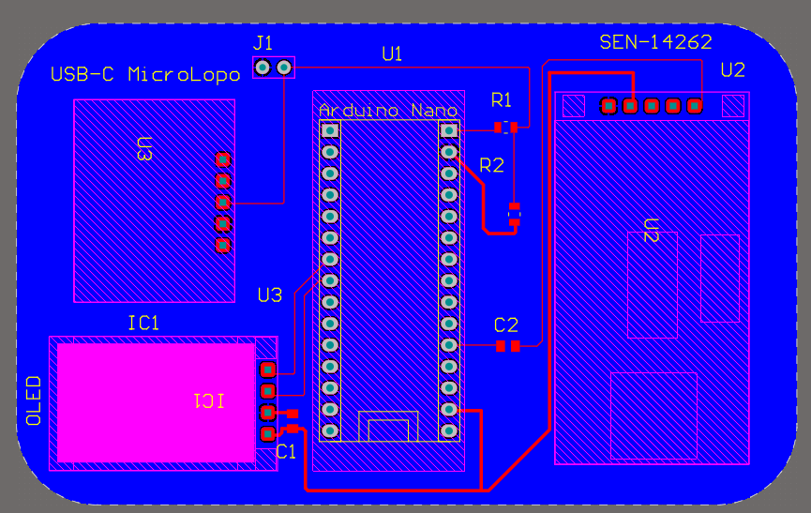
PCB layout decisions
Hardware
Organized for clarity,
short routing, and assembly
Center
ESP32 shortens routing to all modules.
Left side
Display and charger stay accessible.
Right side
Sensor stays functionally separated.
Routing
Wider power traces; direct sensor path.
SMD passives reduce area; module mounting improves manual assembly.
Source figure: Report Fig. 2 — two-dimensional PCB layout
Notes:
The layout follows function: display and charger on one side, ESP32 in the center, sensor on the opposite side. Wider power traces improve reliability. A direct sensor path helps reduce noise pickup.

Slide 10
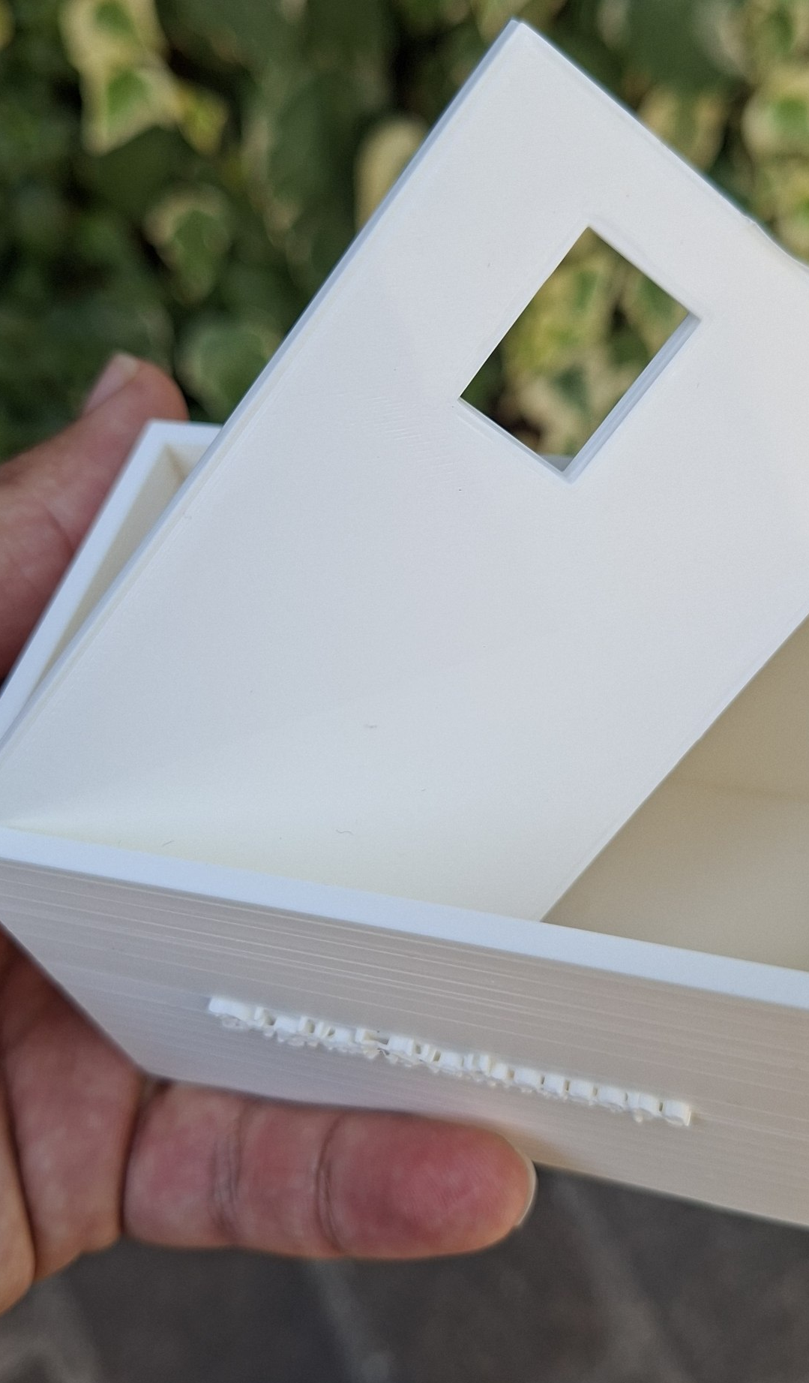
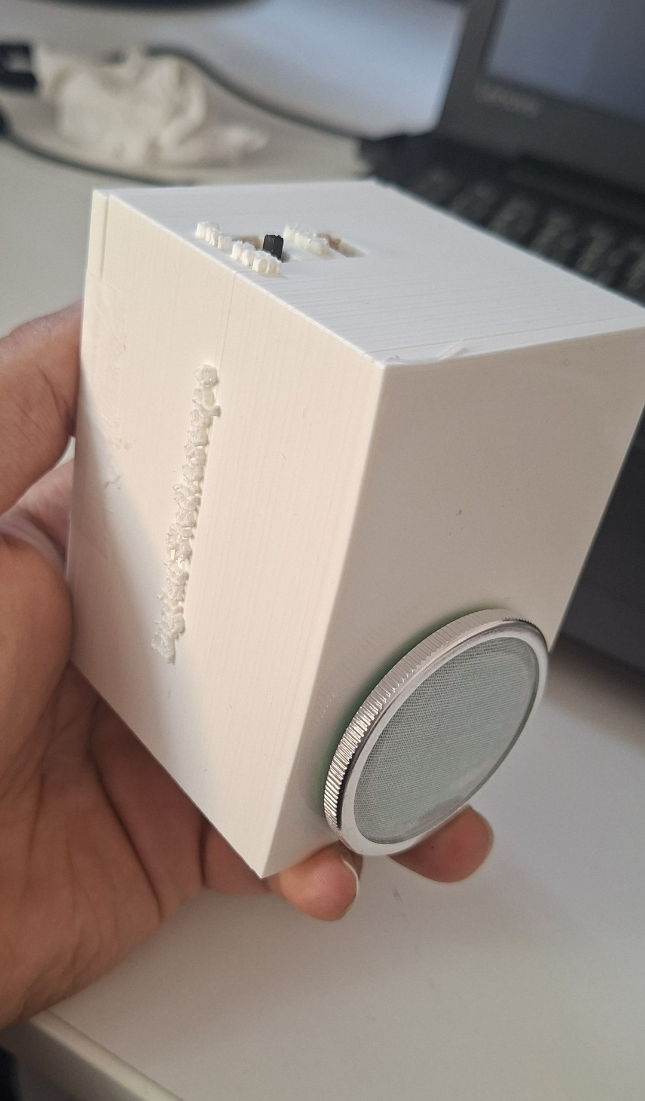
Fabrication-ready hardware
Hardware
Schematic → PCB → 3D → manufacturing package
3D PCB check
Box enclosure
Prototype
DRC
Gerber
NC Drill
BOM
Pick-place
0 violations
PCB layers
holes
components
coordinates
Source figures: Report Figs. 4 and 5 — 3D PCB and final product implementation
Notes:
The 3D view checks the physical design. The final DRC has zero violations. Gerber, NC Drill, BOM, and Pick-and-Place outputs make the design ready for fabrication and assembly.

Slide 11
03
Firmware and acquisition
Timer-driven sampling, oversampling, packetization, and BLE streaming.
Notes:
Section transition: Firmware and acquisition. Use this slide to tell the examiner what part of the system will be explained next and how it connects to the previous part.

Slide 12
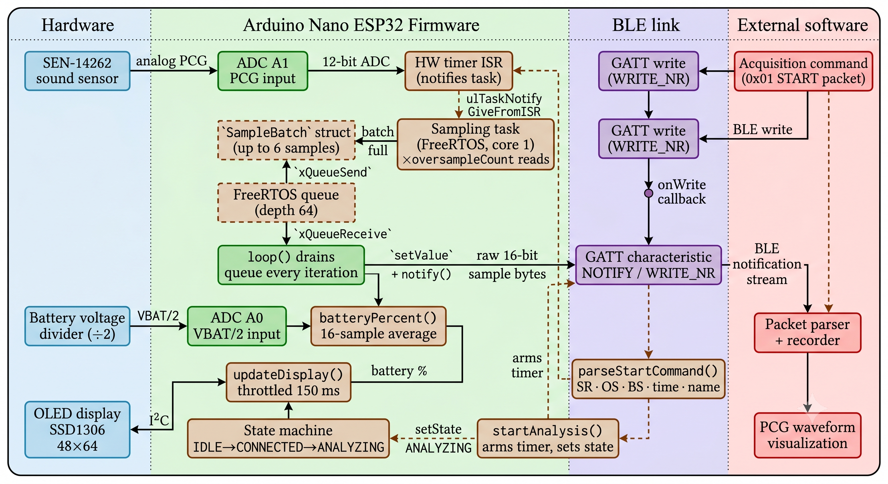
Firmware
Layered firmware architecture and data path
Source figure: Report Fig. 6
Notes:
Explain firmware as the glue between hardware and software. Mention that high-level PCG analysis is intentionally outside the firmware.

Slide 13
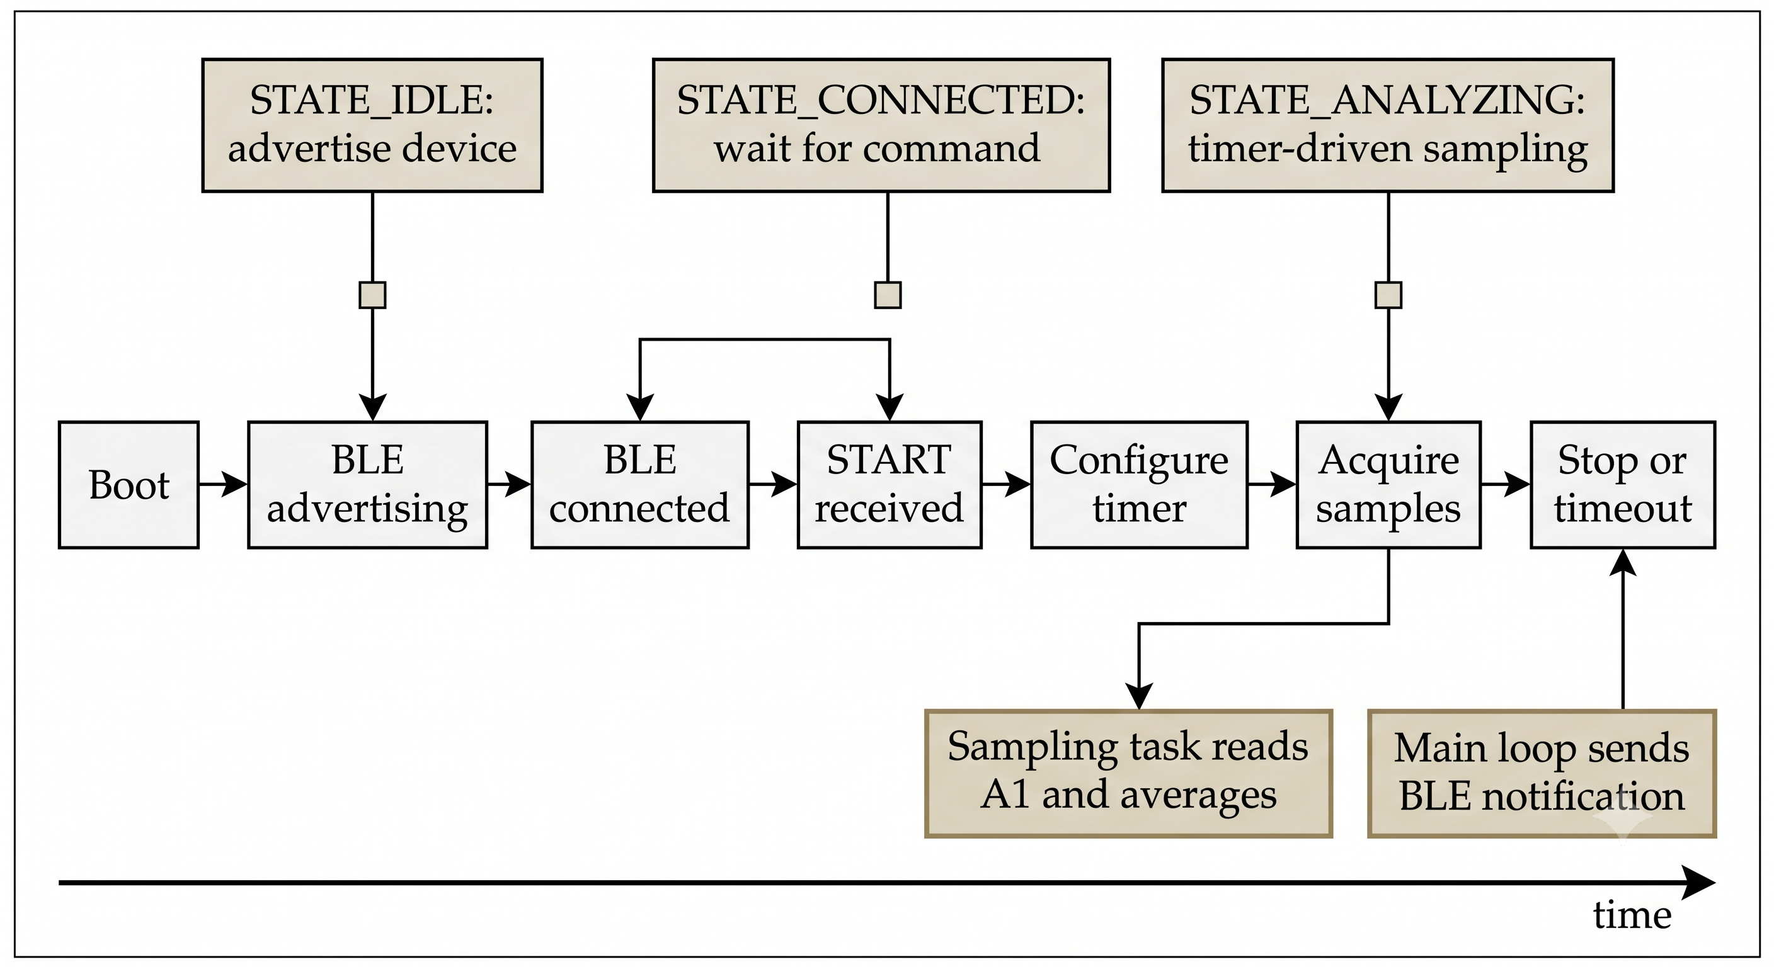
Firmware state machine
Firmware
INITIALIZING
IDLE
advertising
CONNECTED
wait for command
ANALYZING
sampling + streaming
Control sequence from boot to BLE acquisition stop
Source figure: Report Fig. 7
Notes:
The state machine shows predictable behavior: advertise, connect, wait for command, sample, stream, and stop on timeout.

Slide 14
BLE command and sample packet format
Firmware
0
type
1-4
sample rate
5-6
oversampling
7-8
batch size
9-12
duration
13-28
patient name
START command: minimum 29 bytes, decoded by parseStartCommand()
• BLE notification payload contains consecutive uint16_t raw ADC samples.
• Maximum deployed payload = 2 × batch size = 12 bytes.
• No application header, timestamp, sequence number, checksum, or explicit end marker in the deployed BLE stream.
• Receiver reconstructs time from the configured sampling rate.
Digital Phonocardiography System | Lab of Internet of Medical Things
Notes:
Separate the deployed protocol from the benchmark protocol. The final BLE stream is minimal and relies on BLE boundaries and the configured sampling rate.

Slide 15
05
Communication protocol
Selecting the transport layer through power, throughput, and packet-loss benchmarks.
Notes:
Section transition: Communication protocol. Use this slide to tell the examiner what part of the system will be explained next and how it connects to the previous part.

Slide 16
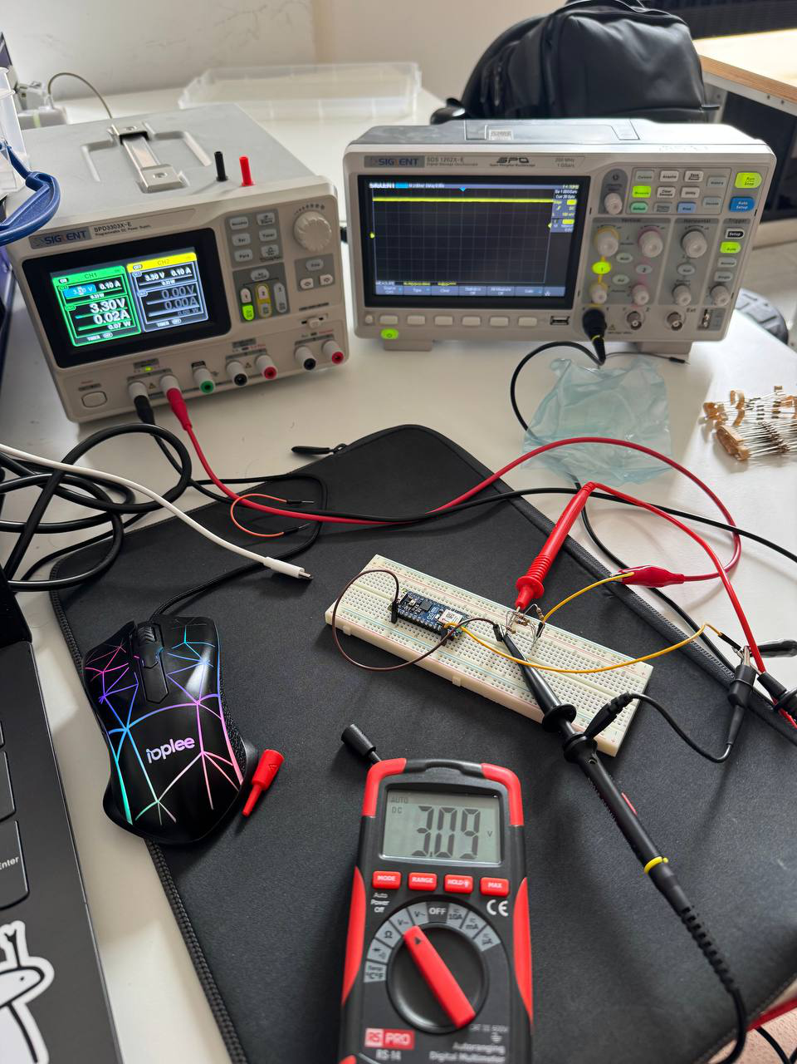
Experimental communication benchmark
Communication
• Four methods were compared: USB Serial, BLE, Wi-Fi UDP, and Wi-Fi TCP.
• All wireless benchmark variants used the same batch size, oversampling factor and structured packet format.
• The benchmark packet included header, sequence number, count, and 6 raw uint16 samples.
• Sequence number allowed receiver-side loss detection.
20 bytes
6
benchmark packet length
samples per packet
Power measurement laboratory bench
Notes:
Make clear that the structured benchmark packet is different from the deployed BLE packet. It was introduced only to measure packet loss fairly.

Slide 17
Power consumption comparison
Communication
• Serial and BLE connected were the lowest-power modes.
• Active Wi-Fi TCP/UDP required almost twice the power of BLE connected.
• BLE advertising power depends on advertising interval, but advertising is transient and stops after connection.
306 mW
600 mW
BLE connected
Wi-Fi UDP active
Notes:
This slide supports the BLE selection. Give exact values and emphasize that active Wi-Fi has substantially higher power.

Slide 18
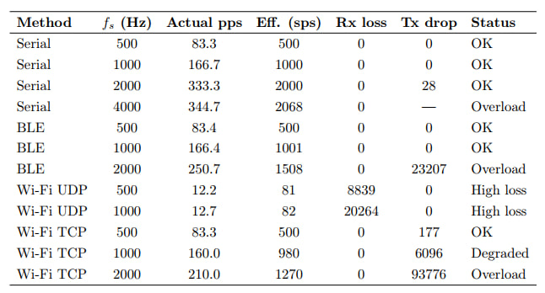
Throughput and packet-loss results
Communication
• At the selected 500 Hz operating point, Serial, BLE, and TCP delivered the target rate with no receiver-side loss.
• BLE also handled 1000 Hz correctly; at 2000 Hz the sender could not keep up.
• UDP showed high receiver-side loss in the tested broadcast configuration and requires unicast re-evaluation.
Notes:
Do not simply say BLE is fastest. The real conclusion is that BLE is sufficient at 500 Hz and has better power efficiency for the prototype goal.

Slide 19
BLE Advertising Interval Analysis
Communication
Power Consumption vs. Discovery Time Trade-off
Interval | Register | Power (mW) | Discovery
20 ms | 0x20 | ~380 | ~0.04s
40 ms | 0x40 | ~370 | ~0.08s
100 ms | 0xA0 | ~318 | ~0.2s
200 ms | 0xC8 | ~309 | ~0.4s
1000 ms | 0xFA | ~302 | ~2s
Why 100 ms?
✓ Balanced trade-off: Power ≈ 318 mW vs. 300 mW floor (only 18 mW overhead)
✓ Fast discovery: ~0.1–0.2 s typical, acceptable for medical use case
✓ Advertising is transient state: Device enters CONNECTED state quickly
✓ Lower intervals (20–40 ms) add 50–80 mW with minimal gain
✓ Higher intervals (200+ ms) save <10 mW but slow discovery significantly
✓ 100 ms provides optimal balance for wearable IoMT platform

Slide 20
Why BLE was selected
Communication
Serial
UDP
TCP
BLE
Stable but wired
Low-latency potential but high loss in current setup
Reliable ordering but higher power and earlier saturation
Sufficient throughput at 500 Hz + lowest wireless power
Selected communication method: BLE
• Matches the wearable/portable use case.
• Reliable at the acquisition rate used for PCG processing.
• Minimizes radio power compared with active Wi-Fi.
Digital Phonocardiography System | Lab of Internet of Medical Things
Notes:
Phrase the selection as an engineering trade-off. BLE is not universally best, but it is the right choice for this target: low-power short-range PCG streaming at 500 Hz.

Slide 21
04
Signal processing
From noisy PCG recording to S1/S2 detection, segmentation.
Notes:
Section transition: Signal processing. Use this slide to tell the examiner what part of the system will be explained next and how it connects to the previous part.

Slide 22
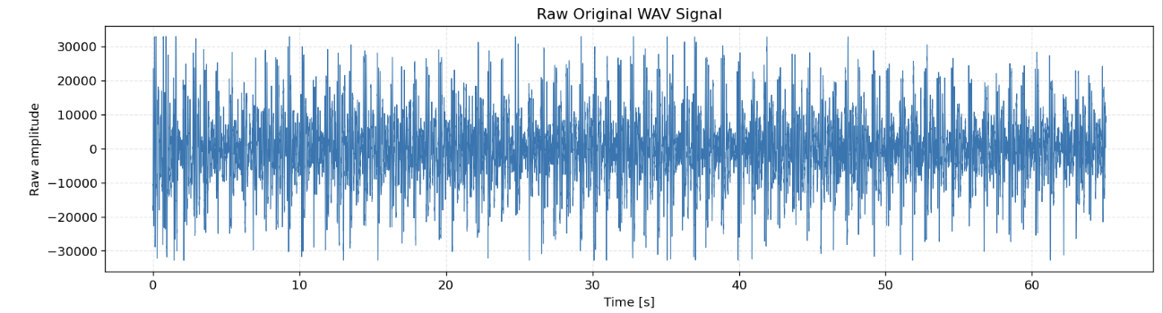
PCG signal-processing
Signal processing
Original raw PCG waveform
Raw PCG
Filtering
Envelope
S1/S2
Features
• Raw recordings can contain environmental noise, sensor movement, poor contact, and electrical interference. These noises make S1 and S2 detection difficult.
The pipeline first cleans the signal, then extracts an envelope, then applies physiological timing constraints.​
Digital Phonocardiography System | Lab of Internet of Medical Things
Notes:
Set up the reason for every processing block. The core difficulty is that the raw waveform contains rapid oscillations and noise, so we need an envelope and rules.

Slide 23
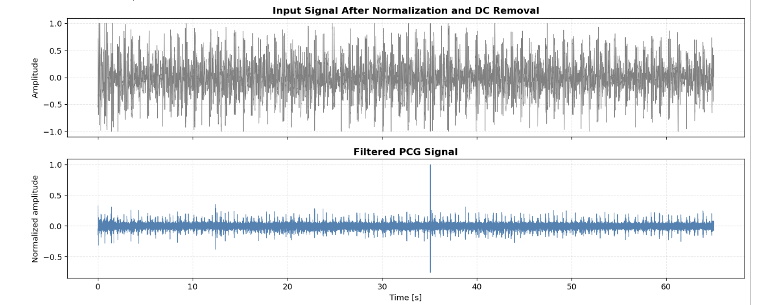
Preprocessing and filtering strategy
Signal processing
Normalized input vs filtered PCG signal
• Remove DC component by subtracting the mean.
• Normalize amplitude.
• Apply notch filters at 50, 100, and 150 Hz to suppress power-line components.
• Apply 25-200 Hz band-pass filtering, wavelet denoising.
Source figure: Report Fig. 11
Notes:
Explain that filtering preserves useful PCG activity mainly between 25 and 200 Hz while reducing interference and broadband artifacts.

Slide 24
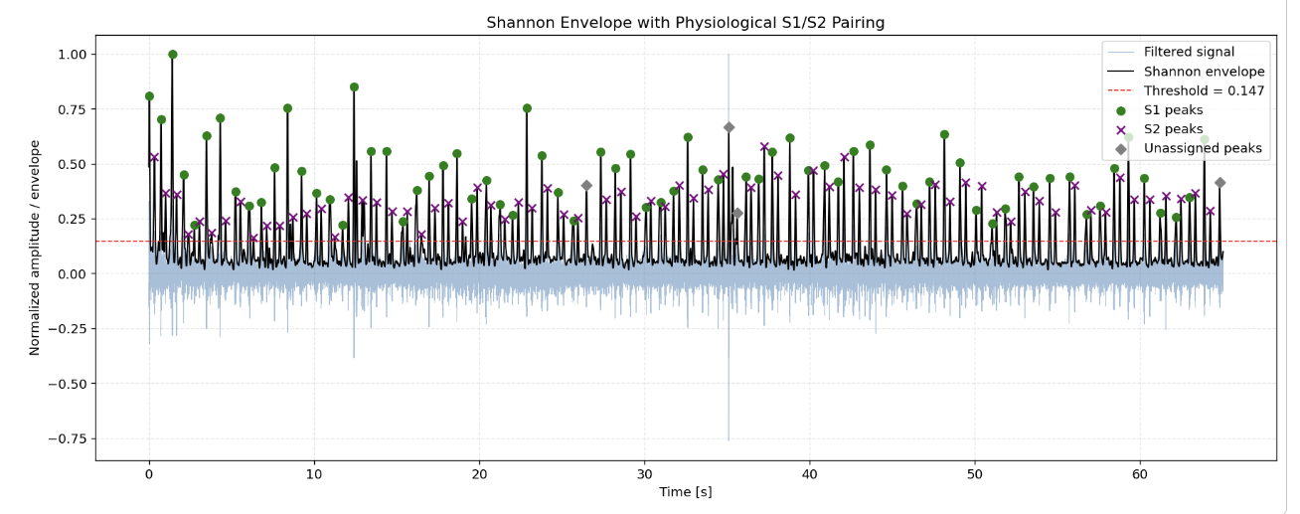
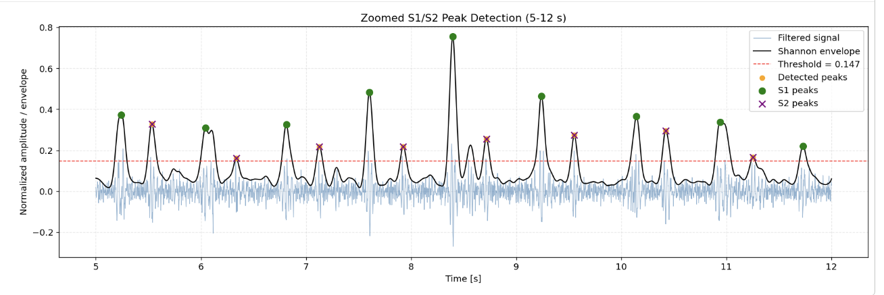
Shannon envelope and S1/S2 peak detection
Signal processing
• Envelope cutoff: 8 Hz.
• Candidate peaks are detected above the 75th-percentile threshold.
• Minimum peak distance prevents repeated detection of the same event.
• Physiological timing rules (0.07 ≤ tS1–S2 ≤ 0.50 s, 0.18 ≤ tS2–S1 ≤ 1.40 s ) classify peaks as S1 or S2.
• Detected peaks that do not satisfy the timing constraints remain unassigned.
S1/S2 detection from Shannon energy envelope
65.03 s
8000 Hz
72+ 72
recording duration
sampling rate
S1 and S2 peaks
68.8 bpm
HR from S1-S1 intervals
Zoomed S1/S2 detection from Shannon energy envelope
Source figure: Report Fig. 12, 13
Notes:
This is a key slide. Explain that the Shannon envelope emphasizes main heart sound events and makes peak detection easier than using the oscillating waveform directly.

Slide 25
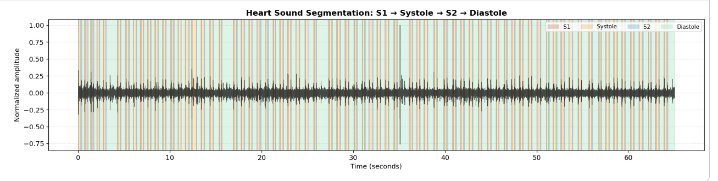
Four-state cardiac cycle segmentation
Signal processing
Segmentation into S1, systole, S2, and diastole
S1
Systole
S2
Diastole
• S1/S2 boundaries are estimated from the envelope using a relative boundary level of 40% of the peak height.
Source figure: Report Fig. 14
Notes:
Use the four-state sequence as a repeated anchor. This segmentation is the basis for temporal, energy, and murmur-like activity features.

Slide 26
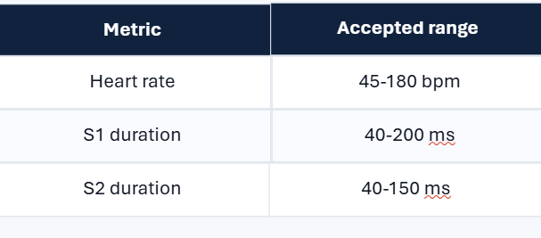
Cycle Features and Rule-Based Screening
Signal processing
65/66
98.5%
normal cycles
normal percentage
Extracted features:
• Heart rate from cycle duration
• S1 and S2 durations
• Systolic and diastolic intervals
• RMS energy
• S1/S2 amplitude ratio
1/66
1.5%
flagged cycles
flagged percentage
Rule-based screening checks whether cycle features fall inside expected physiological or quality ranges.
• Flagged cycles were mainly related to low S1/S2 amplitude ratio or slightly prolonged systolic interval.
• Flagged does not mean abnormal diagnosis; it means the signal-derived cycle should be inspected.
Digital Phonocardiography System | Lab of Internet of Medical Things
Notes:
Frame features as descriptors of timing, energy, morphology, and frequency behavior. Avoid claiming diagnosis.

Slide 27
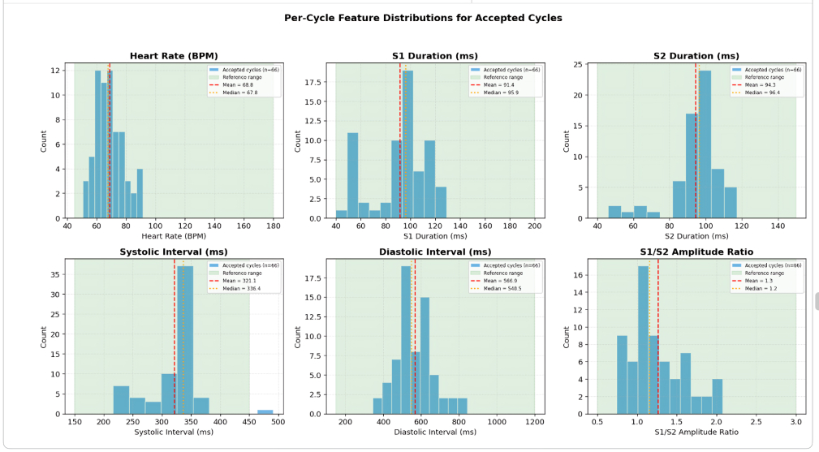
Per-cycle feature statistics
Results
Feature
Median
Range
Heart rate
67.75 bpm
50.67–91.38
S1 duration
95.94 ms
40.12–129.00
S2 duration
96.44 ms
46.12–117.38
Systolic interval
336.44 ms
216.50–491.38
Diastolic interval
548.50 ms
345.25–843.75
Feature distributions across accepted cycles
• S1 and S2 durations were relatively stable.
Data source: Report Table 13 and Fig. 21
Notes:
Mention that systolic and diastolic intervals are phase-specific descriptors made possible by segmentation.

Slide 28
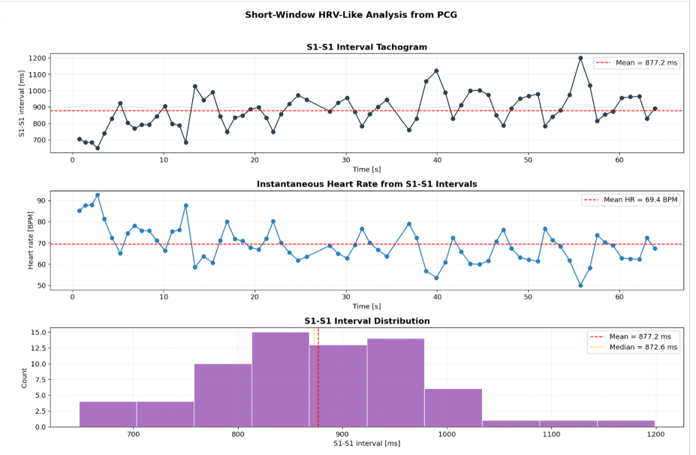
Heart rate and short-window HRV-like analysis
Signal processing
S1-S1 tachogram, instantaneous heart rate, interval distribution
Source figure: Report Fig. 22
Notes:
Be precise: these are HRV-like metrics. This distinction is important and shows scientific caution.

Slide 29
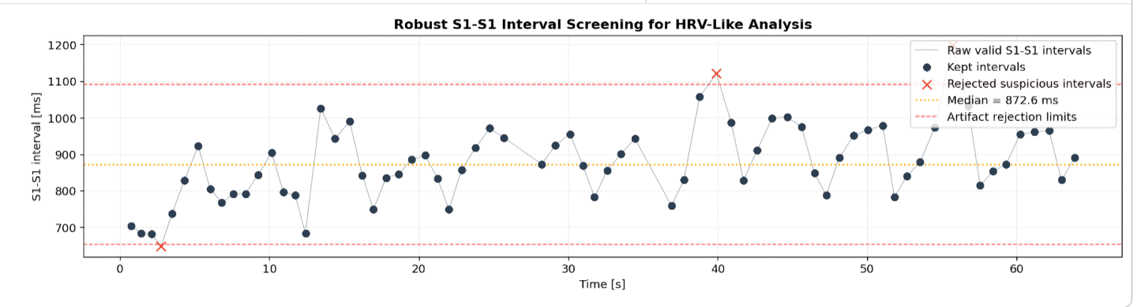
HRV-like metrics and robust artifact rejection
Results
Robust screening of S1-S1 intervals
Metric
Raw
Robust
Intervals
69
66 kept / 3 rejected
Mean NN
877.2 ms
872.1 ms
SDNN
104.5 ms
90.1 ms
RMSSD
101.1 ms
95.8 ms
Mean HR
69.4 bpm
69.6 bpm
Data source: Report Tables 15-16 and Fig. 23
Notes:
Say explicitly: these metrics are derived from PCG S1-S1 intervals, not ECG R-R intervals.

Slide 30
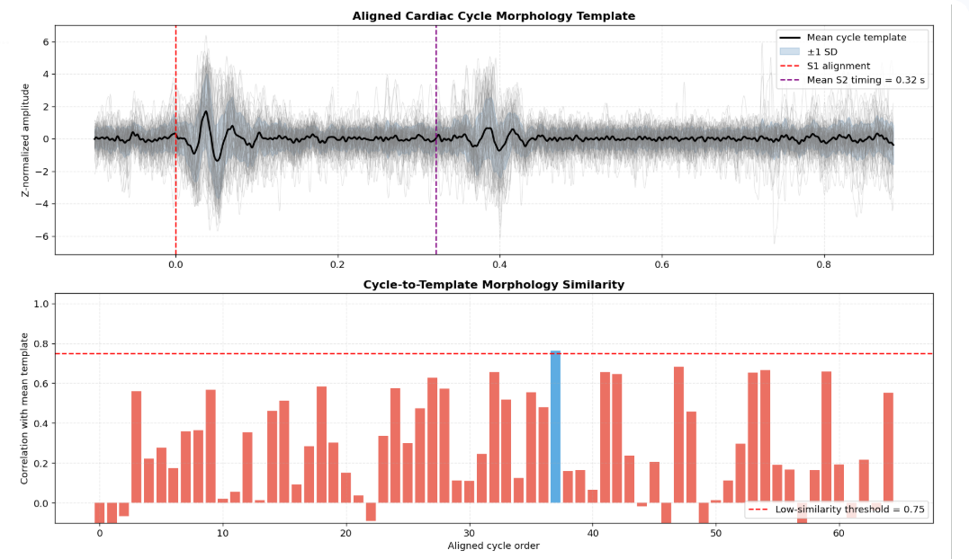
Cycle morphology consistency
Signal processing
Band
Energy share
25-60 Hz
68.71%
60-120 Hz
23.16%
120-200 Hz
8.12%
Low-similarity cycles
64/65
Aligned cycles and cycle-to-template similarity
Source figure: Report Fig. 16
Notes:
This slide distinguishes timing consistency from waveform-shape consistency. The project detected timing structure, but morphology varied across cycles.

Slide 31
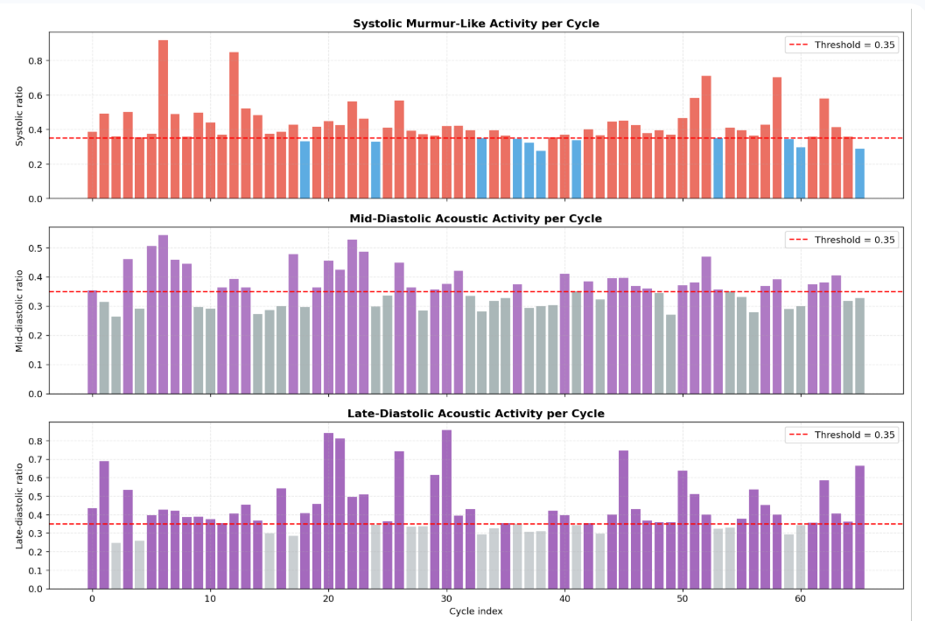
Murmur-like acoustic activity candidate detection
Signal processing
55/66
36/66
systolic active cycles
mid-diastolic candidates
78.8%
mid/late diastolic active %
Systolic and diastolic acoustic activity ratios
Source figure: Report Fig. 24
Notes:
This is where the phrase murmur-like must be handled carefully. Say candidate acoustic activity and avoid diagnostic language.

Slide 32
06
Software platform
Web-based acquisition control, storage, patient context, and analysis visualization.
Notes:
Section transition: Software platform. Use this slide to tell the examiner what part of the system will be explained next and how it connects to the previous part.

Slide 33
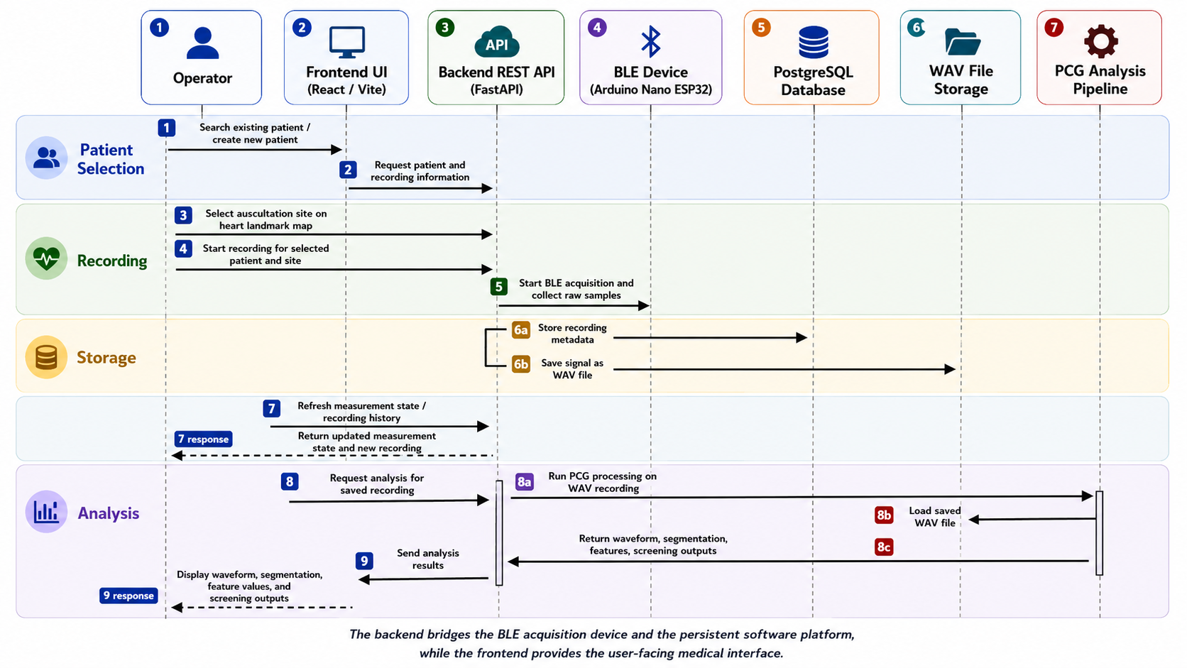
Software data flow sequence
Software
Source figure: Report Fig. 20
Notes:
Walk through the sequence: frontend request, backend recording command, BLE acquisition, WAV/database storage, analysis request, and frontend visualization.

Slide 34
Reference
Conclusion
Partovi, E., Babic, A., & Gharehbaghi, A. (2024). A review on deep learning methods for heart sound signal analysis. Frontiers in Artificial Intelligence, 7, 1434022.
Ren, Z., Chang, Y., Nguyen, T. T., Tan, Y., Qian, K., & Schuller, B. W. (2024). A comprehensive survey on heart sound analysis in the deep learning era. IEEE Computational Intelligence Magazine, 19(3), 42–57.
Hamza, M. F. A. B., & Sjarif, N. N. A. (2024). A comprehensive overview of heart sound analysis using machine learning methods. IEEE Access, 12, 117203–117217.
Zhu, B., Zhou, Z., Yu, S., Liang, X., Xie, Y., & Sun, Q. (2024). Review of phonocardiogram signal analysis: Insights from the PhysioNet/CinC Challenge 2016 database. Electronics, 13(16), 3222.
Gudigar, A., Raghavendra, U., Maithri, M., & Samanth, J. (2024). Automated system for the detection of heart anomalies using phonocardiograms: A systematic review. IEEE Access, 12, 138399–138428.
Arjoune, Y., Nguyen, T. N., Doroshow, R. W., & Shekhar, R. (2024). A noise-robust heart sound segmentation algorithm based on Shannon energy. IEEE Access, 12, 7747–7761.
Alquran, H., Al-Issa, Y., Alsalatie, M., & Tawalbeh, S. (2025). Deep learning models for segmenting phonocardiogram signals: A comparative study. PLOS ONE, 20(4), e0320297.
Abdessater, E., Balali, P., Pawlowski, J., Rabineau, J., Tordeur, C., Faoro, V., van de Borne, P., & Hossein, A. (2025). A novel method for ECG-free heart sound segmentation in patients with severe aortic valve disease. Sensors, 25(11), 3360.
Althaph, B., & Challa, N. P. (2025). Explainable attention-based deep learning for classification and interpretation of heart murmurs using phonocardiograms. Scientific Reports, 15, 37991.
Alturki, B., Abu Al-Haija, Q., Alsemmeari, R. A., et al. (2025). IoMT landscape: Navigating current challenges and pioneering future research trends. Discover Applied Sciences, 7, 26.
Gallo, G. D., & Micucci, D. (2025). Internet of Medical Things systems review: Insights into non-functional factors. Sensors, 25(9), 2795.
Bluetooth SIG. (2025). Bluetooth Core Specification Version 6.1.
SparkFun Electronics. (n.d.). Sound Detector Hookup Guide.
Arduino. (2025). Arduino Nano ESP32 User Manual.
Digital Phonocardiography System | Lab of Internet of Medical Things
Notes:
End with the integrated-system message. Reiterate that the prototype is complete as an engineering demonstration and that clinical validation is a future development.

Slide 35
Thank you
Questions?
Digital Phonocardiography System
IoMT prototype for cardiac sound monitoring
Notes:
If questions start, first listen carefully. For strict questions, answer with engineering evidence from the slides: component choices, firmware design, benchmark numbers, and signal-processing caution.

Slide 36
A
Appendix
Backup slides for technical questions.
Notes:
Section transition: Appendix. Use this slide to tell the examiner what part of the system will be explained next and how it connects to the previous part.

Slide 37
Appendix: signal-processing parameters
Appendix
Parameter
Value
Sampling rate
500 Hz
Band-pass range
25-200 Hz
Notch frequencies
50, 100, 150 Hz
Notch Q factor
35
Filter order
4
Wavelet
db6, level 4
Envelope cutoff
8 Hz
Minimum peak distance
0.25 s
S1-S2 valid range
0.07-0.50 s
S2-S1 valid range
0.18-1.40 s
Murmur-like threshold
0.35
Data source: Report Appendix A, Table 20
Notes:
Use this only if asked for exact parameter values.

Slide 38
Appendix: benchmark packet vs deployed BLE packet
Appendix
Benchmark packet
20 bytes
Deployed BLE packet
minimal raw stream
Header
2 bytes
Header
not present
Sequence number
4 bytes
Sequence number
not present
Sample count
2 bytes
Timestamp
not present
Sample payload
12 bytes
Payload
uint16 raw ADC samples
• The benchmark packet was intentionally structured to measure packet loss.
• The deployed BLE firmware uses a lower-overhead raw-sample notification format.
• The receiver reconstructs time from the configured sample rate.
Digital Phonocardiography System | Lab of Internet of Medical Things
Notes:
Use this backup slide if asked why packet formats differ in the report.

Slide 39
Appendix: main REST endpoints
Appendix
Method
Endpoint
Purpose
GET
/api/patients/search
Search patients
POST
/api/patients
Create patient
GET
/api/heart-measurements/current
Current measurement state
POST
/api/heart-measurements/{patientId}/record
Start and store recording
GET
/api/heart-recordings/{recordingId}/audio
Retrieve saved WAV
GET
/api/heart-recordings/{recordingId}/analysis
Run/retrieve analysis
DELETE
/api/heart-recordings/{recordingId}
Delete recording
GET/POST
/api/ble/...
BLE diagnostics/control
Data source: Report Table 11
Notes:
Use this backup slide if asked about software integration details.

Slide 40

Timer-driven acquisition algorithm
Firmware
• Hardware timer defines the sampling instants.
• Timer interrupt does not call analogRead directly; it only notifies a FreeRTOS sampling task.
• The sampling task reads A1 several times and averages them to produce one output sample.
• Batches are pushed into a FreeRTOS queue; the main loop sends BLE notifications.
Oversampling average
12-bit
1-32
≤ 6
ADC resolution
oversampling count
samples / batch
Digital Phonocardiography System | Lab of Internet of Medical Things
Notes:
This is a strong technical slide. Emphasize why the ISR is lightweight: it improves reliability on the ESP32 and avoids calling analogRead from interrupt context.

Slide 41
Backend responsibilities and REST API
Software
Responsibility
Role
Method
Endpoint
Patient management
Create/search patient profiles
GET
/api/patients/search
BLE ingestion
Collect raw ESP32 sample batches
POST
/api/patients
Recording action
Start fixed-duration acquisition
POST
/heart-measurements/{patientId}/record
Audio storage
Save mono WAV files
GET
/heart-recordings/{id}/analysis
PCG analysis
Run pipeline and return plot-ready results
GET/POST
/api/ble/...
• Python FastAPI exposes the REST routes.
• SQLAlchemy and Alembic support database access and migrations.
• PostgreSQL stores structured metadata; WAV files store the acquired signal.
Data source: Report Tables 10 and 11
Notes:
Use this slide if the examiner asks how the software is actually organized. It shows clear separation of route, schema, model, service, and configuration responsibilities.

