Slide 1
One battery, three revenue streams — siloed today.
Every EV has ~100 kWh of battery, idle 18–22 h/day. Arizona grid is stressed. AI wants distributed compute.
• Mobility: 25–40 kWh/day needed. Non-negotiable.
• V2G: ~10 grid stress events/year, $20–150 revenue.
• Inference: 150–250 participation days, $400–2,000 net.
•
• No platform today co-optimizes all three.
Challenge-stated flexible capacity per vehicle: 30–50 kWh Arizona events: 6 summer afternoons + 4 winter mornings Peak LMP during events: $0.20–$0.50/kWh Inference revenue: $0.20–$0.60/kWh-equivalent

Slide 2
One orchestrator. Four actions. Mobility risk priced, not walled.
• Actions per vehicle per hour: charge · discharge (V2G) · run inference · idle
• Mobility-miss penalty λ = $50/hour. The optimizer weighs missed-trip cost against grid/inference revenue instead of using a hard SoC wall.
• Rolling-horizon stochastic MILP: 24h horizon, hourly resolution, scenario-based.
• Three forecasters feed probabilistic scenarios: grid events, LMP, inference demand.
• Per-vehicle solves in parallel — architecture scales linearly to fleet size.

Slide 3
The math — stochastic MILP with priced mobility risk.
max E_s [ Σ_t LMP·discharge − LMP·charge + r_inf·P_inf·infer − (λ/reserve)·shortfall ] s.t. SoC[t+1,s] = SoC[t,s] + η_c·charge − (1/η_d)·discharge − P_inf·infer − trip_kwh SoC ∈ [0, capacity] charge, discharge, infer = 0 when vehicle not at home infer ≤ demand_available non-anticipativity: charge[0,s] = charge[0,0] ∀s (same for discharge, infer)
The λ term is the differentiator. Most V2G platforms use a hard SoC floor — which either over-reserves (leaving money on the table) or under-reserves (risking mobility). Pricing the miss lets the optimizer find the economic frontier.

Slide 4
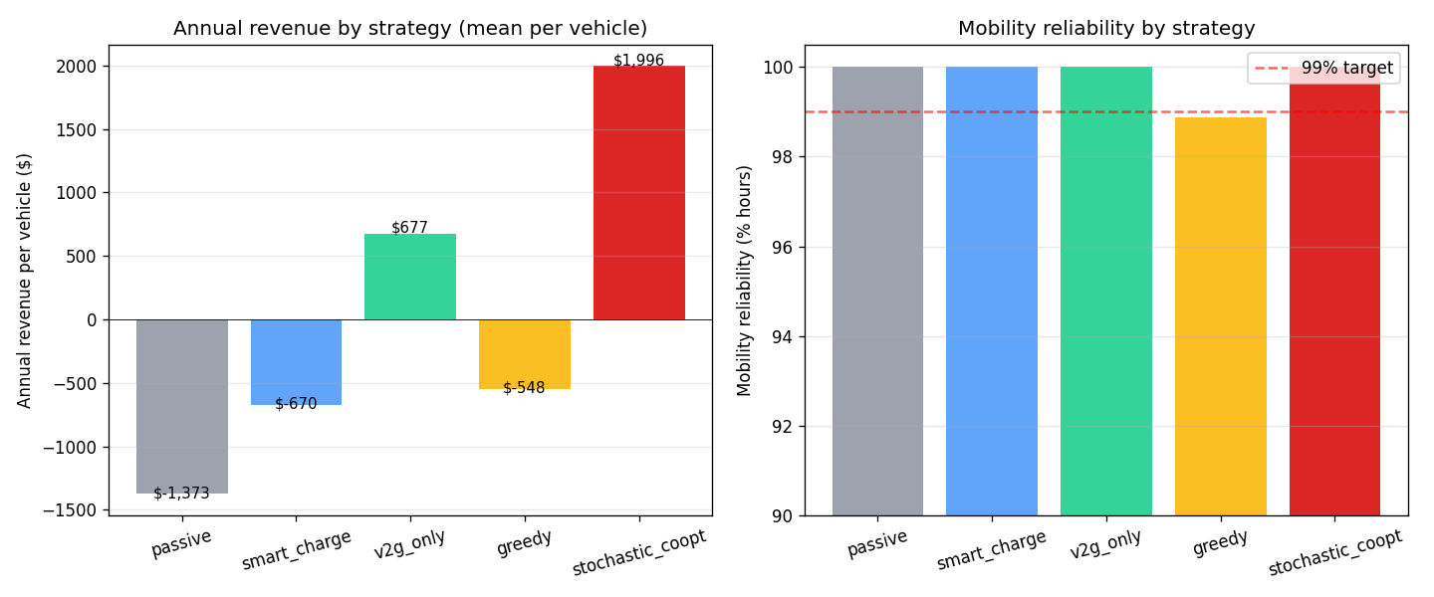
Results — stochastic co-opt beats every baseline on revenue.
1-year backtest on a 100-vehicle synthetic Phoenix fleet.
• Stochastic co-opt: $1,996/veh/yr
• Greedy baseline: $-548 (+464% headroom)
• V2G-only: $677
• Passive (dumb charge): $-1,373
• Mobility reliability: 100.0% of hours

Slide 5
Roadmap — from simulator to pilot to platform.
• Weeks 0–4: integrate with OpenVPP's DER orchestration layer — real LMP feed, driver-app opt-in
• Weeks 4–12: 20-vehicle Phoenix pilot — APS TOU rate, real V2G-capable home chargers
• Quarter 2: add ancillary services (frequency regulation, voltage support) — short-horizon revenue stacks on top
• Quarter 3: EV-fleet operator SDK — dispatch API for rideshare, delivery, municipal fleets
• Defensive: sensitivity slider in the dashboard. At $0 inference revenue, we're still a smart-charging + V2G platform.

