Slide 1
Ten Weeks In Production Support
An introspective experience by Robert Maloy and Shane Varnum
Notes:
(Robert)

Slide 2

Robert Maloy
Born and raised in Tampa, Florida
Computer Science major at Florida Polytechnic University in Lakeland, Florida specializing in Cybersecurity and Information Assurance; currently a junior.
My primary hobbies:
Collecting and restoring vintage personal microcomputers from the 1980s and 1990s.
Alternate History stories that deal in the consequences of alternative events in the course of human history.
Notes:
(Robert)

Slide 3

Shane Varnum
Born and raised in Ocala, Florida
Management of Information Systems major at the University of South Florida here in Tampa; specializing in data analytics; graduating in December.
My primary hobbies:
Discovering and learning about emerging technologies such as blockchain
Exploring Downtown Tampa’s vibrant culture.
Notes:
(Shane)

Slide 4
What is Production Support?
Production support is the practices and disciplines of supporting the IT systems/applications which are currently being used by the end users.
A production support person/team is responsible for monitoring and maintaining systems, receiving incidents and requests from end-users, analyzing these and either responding to the end user with a solution or escalating it to the other IT teams. These people can be developers, system engineers and database administrators, among other things.
In our internship we were part of the MSST (Markets and Securities Services Technology) Group, assisting in the support of many applications, but more specifically three core applications—SFE, SMI and GCCS.
Notes:
(Robert)

Slide 5
Custody Applications
According to internal figures, Custody and Clearing provide a number of functions, including acting as an intermediary for day-to-day trading operations for companies and entities in over sixty markets.
Custody is responsible for using systems such as SWIFT/MQ to assist clients in performing day trades through the most common and well-known stock markets across the globe. Below are just some of the applications they support on any given day:
Securities Front End, Latin America (SFE LATAM)
Securities Front End, Europe (SFE EMEA)
SMI Nexus Americas
Global Credit Control System (GCCS)
Client Services Desktop (CSD)
Sebill
SecRouter
Custody handles around 15 million trades per month that are worth more than $20bn per day.
Notes:
(Shane)

Slide 6
SWIFT messages
SecRouter
Internal transactions/direct clients
Citi Switch
SFE
TM
GCCS
SECORE
SMI
Markets
GIW
Sebill
CSD
Notes:
Shane

Slide 7
Application Flow
CitiSwitch: External SWIFT based messages are intercepted here
SecRouter: Developed as a cost effective option for smaller scale transactions within Citi or from clients directly
TM: Transaction Manager—option for clients to provide instructions to Citi directly.
Securities Front End: Receives client messages, validates data and sorts messages for downstream flow
Secore: Settles trades and pushes transactions through to GCCS, SMI, or Sebill, etc
GCCS: Calculates the risk associated with a trade based on criteria such as credit lines
Sebill: Billing application for trades/transactions
GIW: Serves as a data warehouse for trade data
CSD: Interface for internal clients to access transaction data for reporting purposes
SMI: Market interface that verifies whether a trade order can be matched by the market
Notes:
Shane

Slide 8
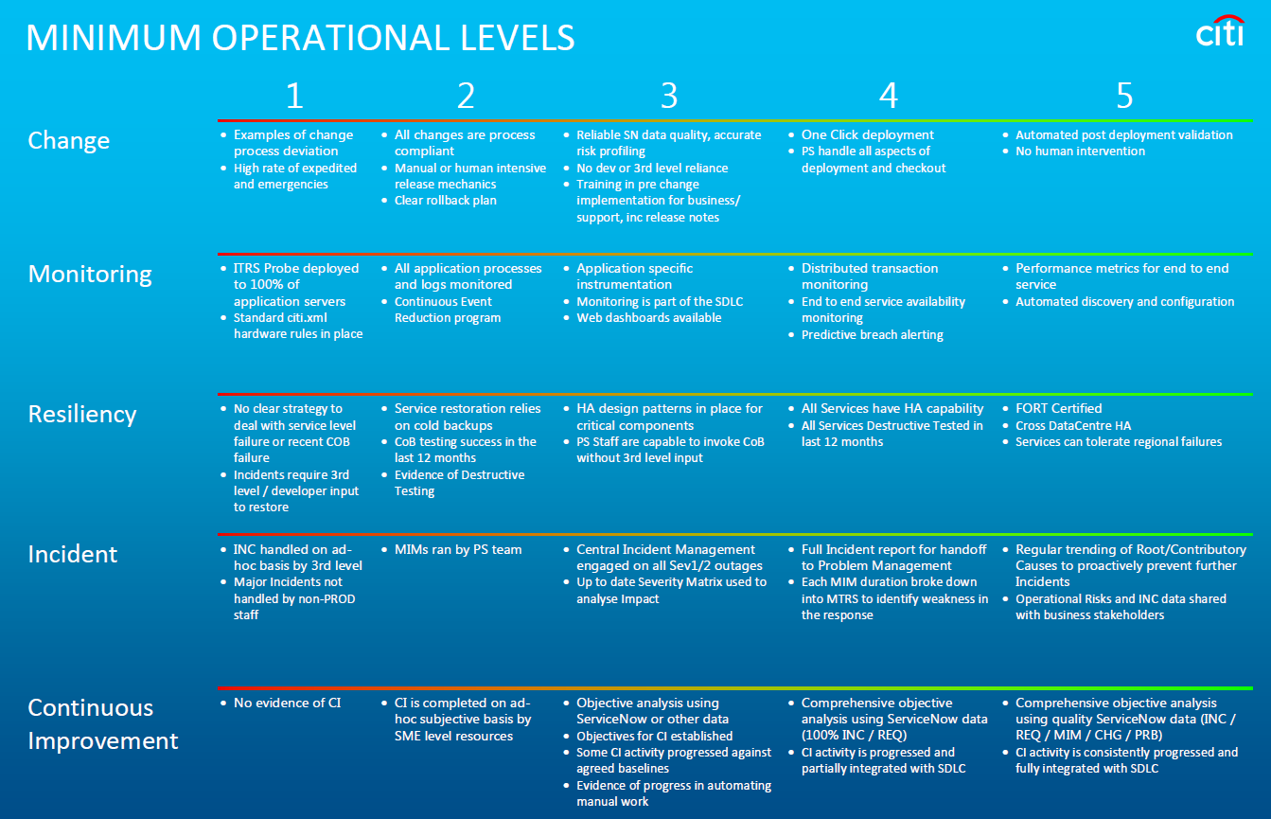
Notes:
(Shane)

Slide 9
What We Did
Our time was spent primarily learning and observing the daily business processes of Production Support; primarily the specifics on how the team deals with incidents, changes, and other issues that arise as well as efficient scripting and monitoring practices
The main objectives of our ten weeks were to gain an understanding of the business and tools PS utilizes, and just as important - the completion of our project
We also spent a portion of our time utilizing Udemy to refine our understanding and proficiency of technologies such as SQL Server and PowerShell
Notes:
(Robert)

Slide 10
The Role of Autosys
The AutoSys technology is facilitated by the JIL (Job Information Language) format, developed by the parent company to be explicitly user friendly and understandable like written word, lessening the requirement for deep background in CompSci to understand how it functions.
For internal deployments, Autosys and JIL are used to fashion scripts which execute at certain times on certain days to reduce the amount of manual labour required to facilitate a positive and speedy experience for our clients and employees.
Notes:
(Shane)

Slide 11
ServiceNow – Ticketing Made Easy
Basically anytime an there is a technical issue, someone will submit an incident ticket. This ticket is acknowledged by a support associate and they take it upon themselves to assess what caused the error, suggest a solution and if they cannot handle the problem it is appropriately rerouted to an employee or department that can resolve the issue.
ServiceNow is the lynchpin of support operations, as it helps the workers of the Production Support team maintain clear and concise documentation which not only gives a strong impression work done to facilitate maximum satisfaction, but also provides a reference log so that problems that arise in the future can be solved at an even quicker turn-around time, should something of similar nature appear between two incidents.
The importance of ServiceNow cannot be understated, as ServiceNow’s impact on the corporate support network has helped facilitate massive improvements to efficiency and continuity of business on all levels, from Level 1 to Level 3.
Notes:
(Shane)

Slide 12
ServiceNow Breakdown
Incidents: Standard/Major; acknowledgement, investigation, solutions, escalation
Severity and Priority are modifiers which decide the celerity in which a ticket is brought to completion by the assignee. Severity can depend on what the issue is.
Urgency also plays a factor in ticket resolution.
Changes: Regularly scheduled events that run between Friday afternoon and Sunday morning (“green zone”) which make large-scale modifications to the servers and applications. (ex: patching)—requires intense review and approvals before allowed to take place
Requests: Ticket created by a user to acquire a report from a system application, or acquire a particular dataset.
Incident Management: Solving the issue at hand and restoring full operational capacity.
Problem Management: Solve the underlying issue to prevent it from happening again.
Notes:
(Robert)

Slide 13
ServiceNow Breakdown—Major Incidents
Major incidents have a very serious effect on the ability for Citi to do business, and thus have three major factors in determining both their severity and if they are major or minor incidents.
The first: Financial impact—these incidents are overviewed to see the potential and actual financial loss that will be incurred as a result of downtime, and will necessitate celerity depending on how much can be lost.
Regulatory impact also plays a role—if a downtime runs against the law as laid down by government entities, restoring operations is key to preventing fines or other unfortunate things from happening.
Reputational impact is the third factor in major incidents—if the downtime or failure causes a PR hit or loss of reputation to Citi, it becomes an necessity to get it up and running as soon as humanly possible—thus necessitating a high severity major incident.
Notes:
(Robert)

Slide 14
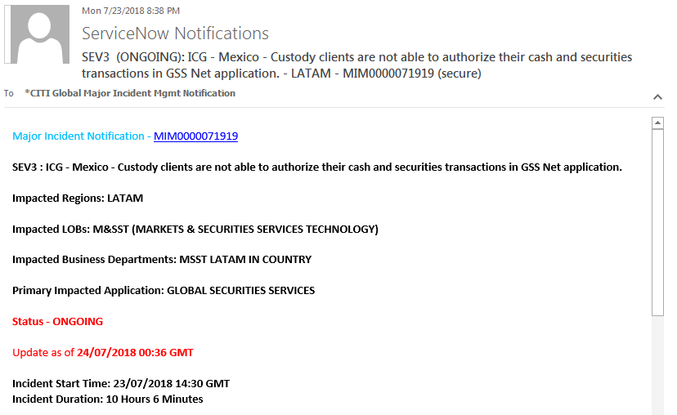
Notes:
(R)

Slide 15
Script Automation
The production support team automates various scripts and processes through technologies like AutoSys, and works to make monitoring systems for performance loss and financial risk as easy as humanly possible through these actions—such as creating SQL entities to quickly facilitate issue resolution.
Script automation has many uses; ranging from reducing the number of manual steps needed to be taken in any given support role, as well as increasing the frequency of top-tier support through alerts and triggers which keep the support staff on top of problems, and makes our support proactive, not reactive.
Notes:
(Robert)

Slide 16
Essential Tools and Utilities
Microsoft SQL Server is useful for diagnosing and solving issues in incidents.
As PS does not have access to code for the front-end systems, back-end investigations are required. By performing database analysis and searching for key pieces of information the team is better able to find answers to support questions.
PowerShell is an assistive aid to help improve the efficiency and technological usefulness of Windows Batch scripts due to PowerShell’s advanced feature set and modernity. In comparison to the DOS-based Windows Batch, and antiquated Visual Basic, PowerShell allows for an enhanced automation environment.
Notes:
(Robert)

Slide 17
Geneos ITRS – Monitoring Essential Operations
The Geneos ITRS software package is utilized by our team to assist in the monitoring and maintenance of essential server hardware, software and third-party services to ensure minimum downtime and by proxy, ensure the minimum possible financial risk to Citi as a whole.
Minimalizing problems for our internal users and clients leads to increased performance and satisfaction.
ITRS is based on a three-tier architecture that combines visualization, consolidation and instrumentation. This allows the team to see exactly what is going on, setup in depth monitoring and alerts, and measure system performance. ITRS supports database plugins and allows the execution of various scripts written in several languages to get even more out of your monitoring environment.
Notes:
(Shane)

Slide 18
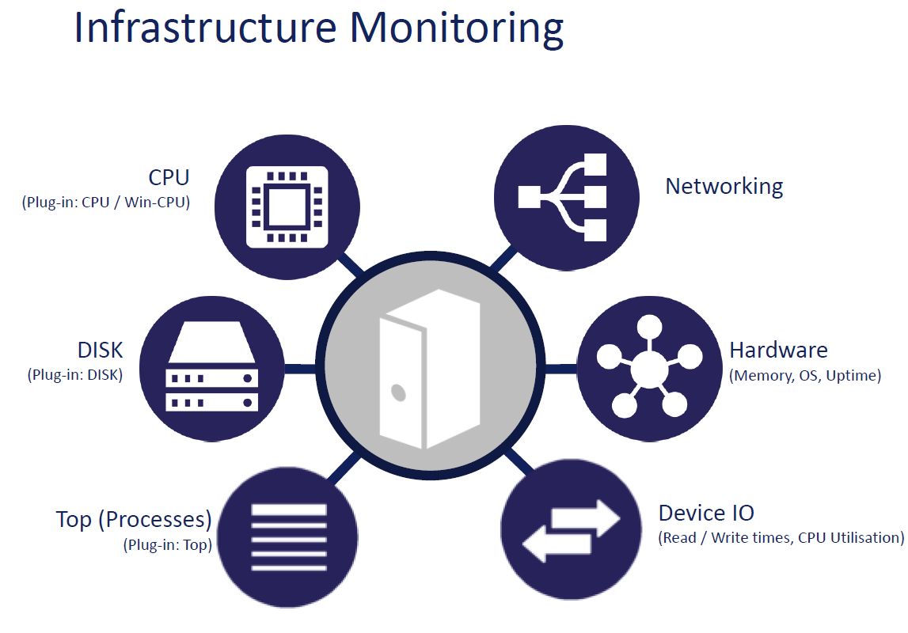
Notes:
(Shane)

Slide 19
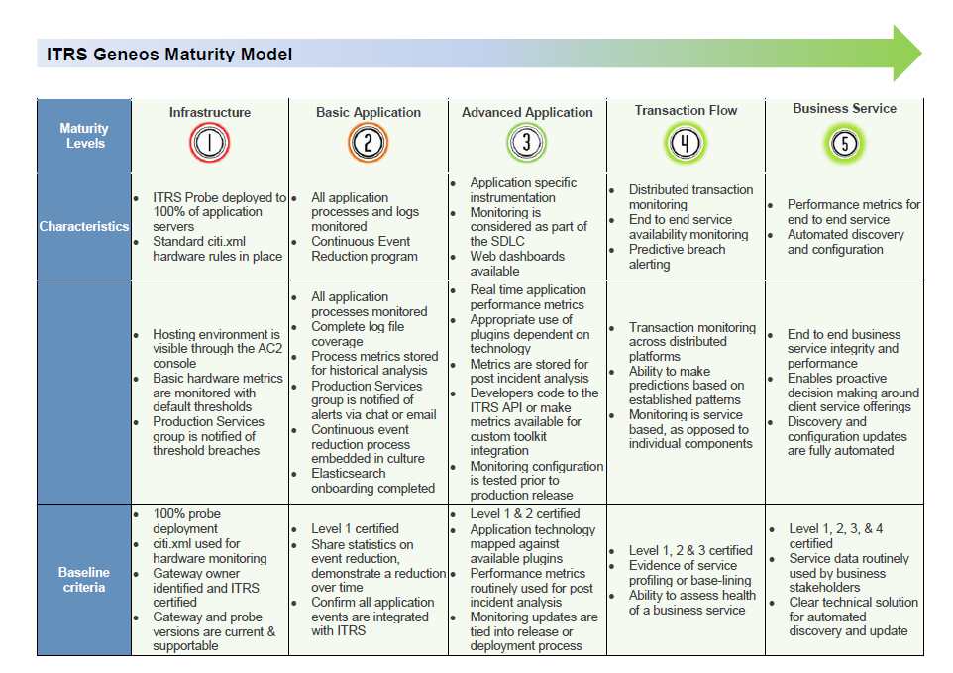
Notes:
(Shane)

Slide 20
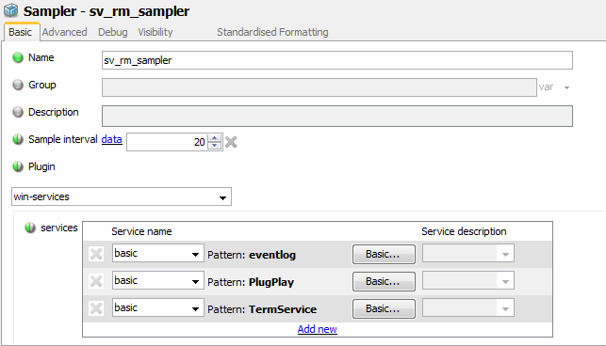
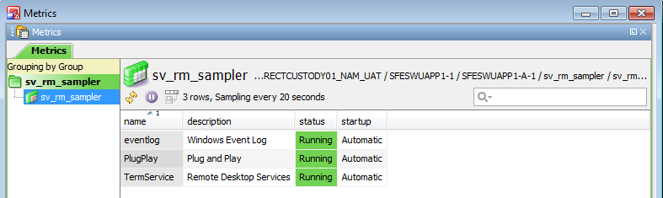
Example Sampler for monitoring Windows services, such as Event Log, Plug and Play, and Remote Desktop.
Notes:
(Shane)

Slide 21
Broadridge Automation Project
Broadridge is a third party institution who acts as an intermediary with securities trading. The scripts we worked on are related to the process in which they send us information about conducted trades.
In this case, the Broadridge scripts are based around the MT 565 message – a Corporate Action Instruction. This message is sent by an account owner(Broadridge) to an account servicer (Citi).
This process is and has always been owned by Production Support and has always been maintained by staff members on the PS Custody team.
Notes:
(Shane)

Slide 22
Broadridge Automation Project
With each iterative generation of improvements implemented into the scripts, the efficiency of the script decreased over time, and so when we arrived, the script was known for having some issues with iterative runs, consistently throwing errors or not doing all the required operations.
We discovered with Broadridge, that we had an immense opportunity to increase efficiency and improve the performance to prevent it from causing itself further issues in the future, through optimization and architectural retooling.
Notes:
(Robert)

Slide 23
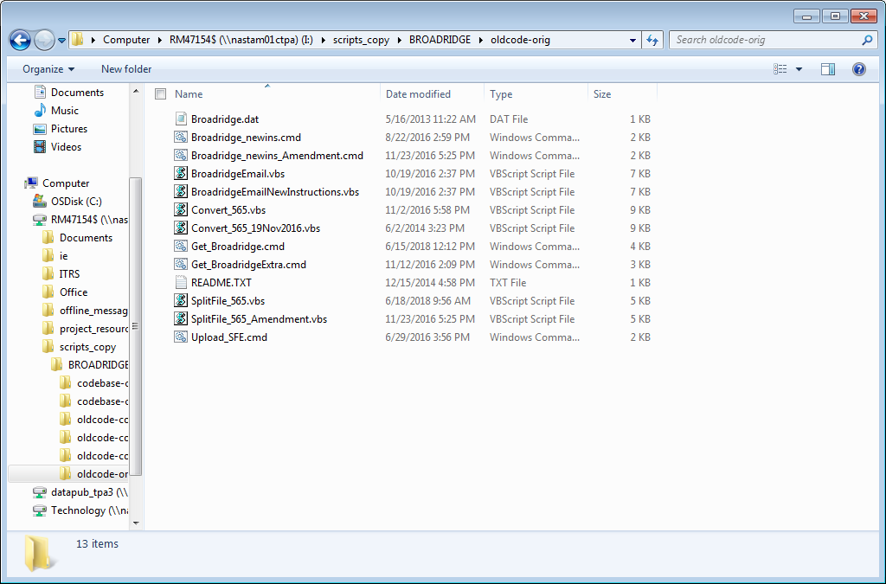
This is the original file structure
for the Broadridge script series, which is still in use by Citi today.
It largely relies on strictly Batch and Visual Basic files to complete the task given.
Notes:
(R)

Slide 24
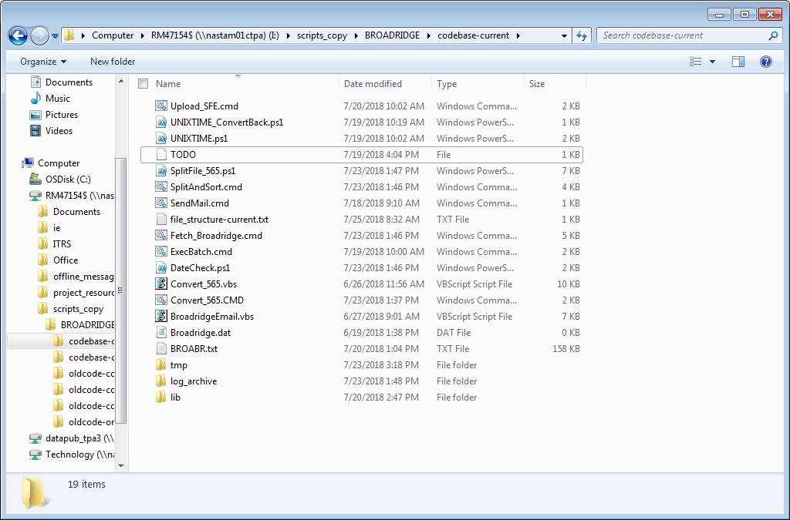
This is the new and improved Broadridge script file structure, as it currently stands (July 26, 2018). As you can see: It has been heavily expanded to feature new file directories, such as lib (libraries), log_archive (logs) and tmp (temporary). It also features PowerShell files, such as DateCheck.ps1, SplitFile_565.ps1 (which has been converted from VBA), and the two UNIXTime.ps1 files.
The directory is more crowded, but the code has been simplified and improved to be more efficient.
Notes:
®

Slide 25
Script Flow
-> Fetch_Broadridge.cmd
--> DateCheck.ps1
--> UNIXTIME.ps1
--> UNIXTIME_ConvertBack.ps1 (standalone non-dependency script)
-> SplitAndSort.cmd
--> SplitFile_565.ps1
-> ExecBatch.cmd
--> BATCHN or BATCHC
---> Convert_565.cmd
----> Convert_565.vbs
---> Upload_SFE.cmd
-> SendMail.cmd
--> BroadridgeEmail.vbs

Slide 26
Broadridge Automation Project
Based on the knowledge we have and the concepts we have learned as students, we worked to improve the architectural core of the script, and reduce some of the redundancies that the script was dealing with during operation.
For instance, moving to a combination of unique iterative identifiers (0001, 0002) and UNIX time (number of seconds passed since January 1, 1970; 12:00am UTC), these two aspects allow for us to have multiple unique executions of the script while maintaining continuity on a day to day basis.
We also streamlined the process of the scripts themselves in preparation for a new and refined Autosys job which will allow for PS to identify when/where the potential job fails, should it fail, this comes from the logging logic implemented into the script itself.
All these changes help improve the efficiency of the product, and improve the efficiency of the production support team.
Notes:
®

Slide 27
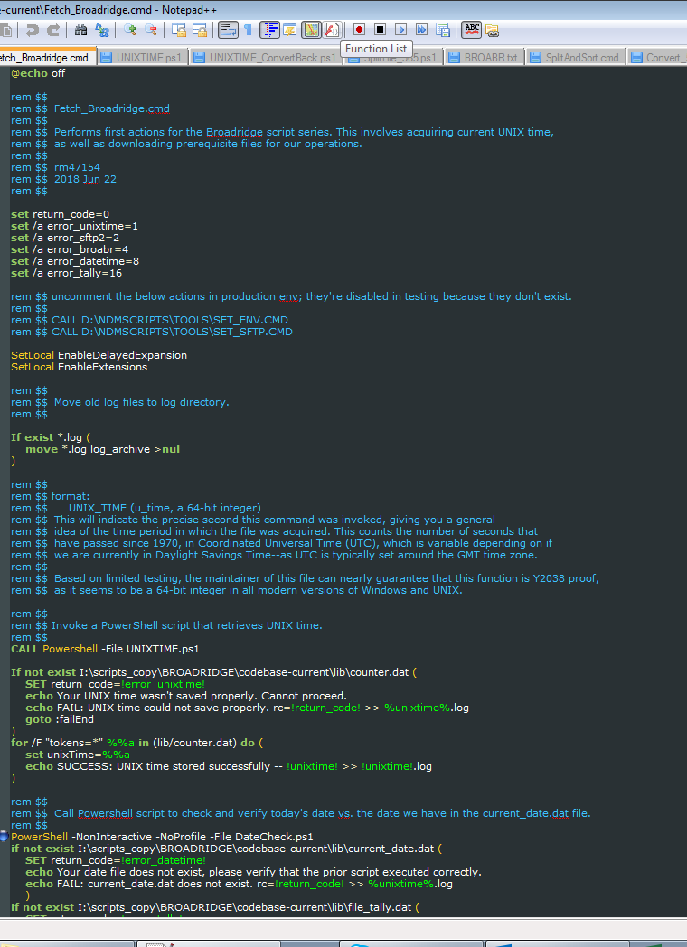
Fetch_Broadridge.cmd
The “core” of the script
Notes:
®

Slide 28
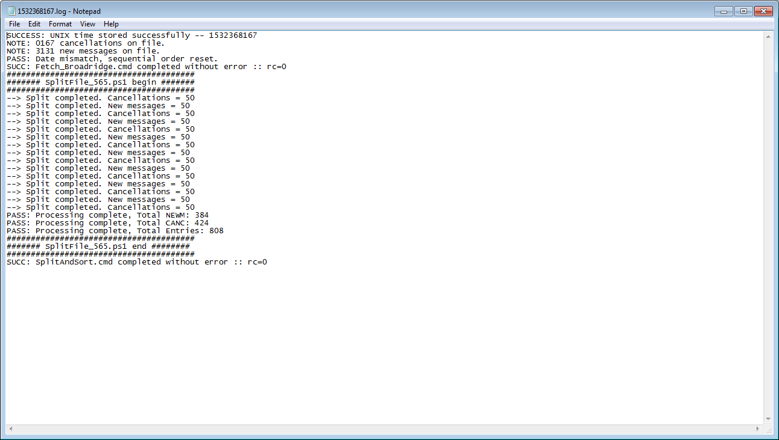
Example log generated during testing the script
Note: 1532368167 => 7/23/2018 1:49:27 PM (Local time)
If the script finds a date inaccuracy, it will reset the counter.
‘rc’ is return code, indicating error or success.
Processing swift messages from file
Notes:
®

Slide 29
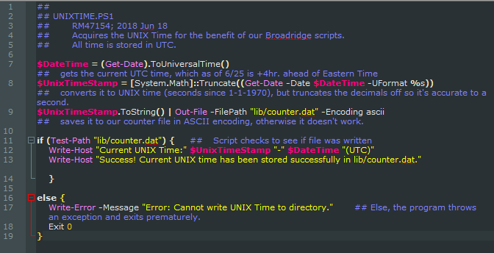
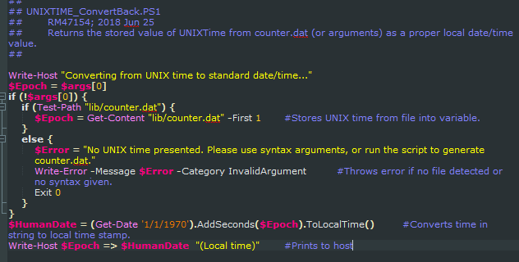
UNIXTIME.ps1
Generates UNIX timecode
Based on current seconds time
UNIXTIME_ConvertBack.ps1
Takes UNIX Timecode from file or string, and converts it to current time.
Notes:
®

Slide 30
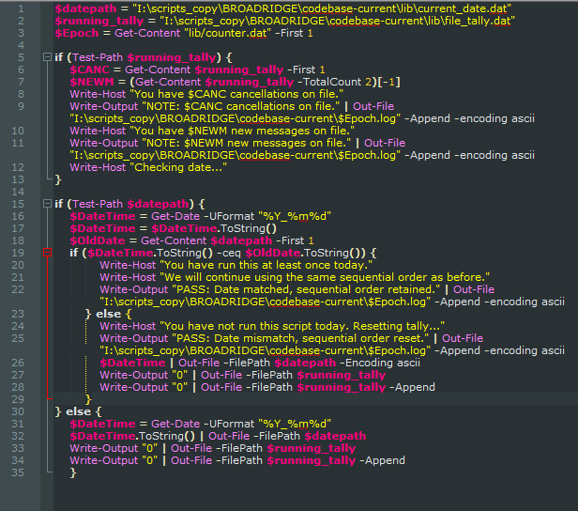
DateTime.ps1
Checks sequential order and date/time.
Notes:
®

Slide 31
Broadridge Automation Project
Key Improvements
Partitioning
Data logging
Performance improvements
Notes:
R start, S finish

Slide 32
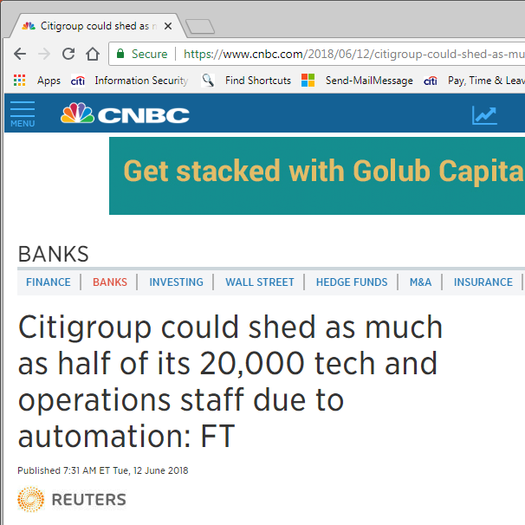
Analysis of Automation: Risks
Flaws of automated labour
Potential delay issues
Smaller human workforce could mean longer time to resolve unique situations
Ethical impact on workers
Workforce obsolescence
PR impact in-waiting: CNBC and Reuters reported on potential employment shrink for Citigroup on June 12, 2018.
Notes:
Shane

Slide 33
Analysis of Automation: Rewards
Automation is a treasure trove of potential for innovation as we move through the 21st century.
Building a company capable of providing top-tier experiences for our clients and partners across the globe, as well as building competent ‘22nd century jobs’.
Automation will be the arbiter of such a modern view, as it will allow for revolutionary changes in the way we work.
Notes:
R

Slide 34
“Forward 2033”: Citi and Automation
In this, we can recall Citi’s three “core” values—work in the client’s interest, do what creates economic value, and do what is systemically responsible—comply with the rules and regulations set out to ensure that the financial system does what it does in the smoothest possible way, with minimal risk of harm to the public at large.
Working in the client’s interest—Moving to automation would allow for an improved client experience by increasing efficiency, reducing time delay, and ensuring communication clarity and quality between client and Citi. Reducing turn-around time will ensure clients always return to Citi for their essential banking needs; whether that is within the GCB, or within ICG; or even the Private Bank.
Creating economic value—the cost reductions involved in automating, and the increased efficiency means less profit is lost, and the company can invest and expand more economic value into the global financial structure, or into internal structures.
Systemically responsible—one of the most important tenements of modern finance, following a system of automation allows for a more seamless regional integration of rules and regulations set forth by national organizations such as the OCC, or international organizations such as the European Union and their regulatory demands. Systemic responsibility is far easier to set up and manage with automated systems deployed across the globe, with a “one stop shop” solution often being the easiest.
Notes:
R

Slide 35
Impressions on the Role of PS
Production Support is one of the most essential functions of the corporate world, particularly in a heavily digital environment like Citi.
Scale of operations
Efficiency of workflow (rotational shifts vs round robin)
Quality of Documentation (onboarding constraints, Outdated tutorials/collaborate resources)
Notes:
(R start. S finish)

Slide 36
Final Thoughts
Notes:
Noodle

Slide 37
Thank you!

