Slide 1


RAJALAKSHMI ENGINEERING COLLEGE
(An Autonomous Institution, Affiliated to Anna University)
DEPARTMENT OF MECHATRONICS ENGINEERING
MT19621 - MINI PROJECT
Automated Secure Door Lock System using RFID
PRESENTED BY:
Gopala Krishnan M(191201013) Keerthivasan S(191201024)
Mohammed Asan Wazil A.K(191201026)
GUIDED BY:
Mr.G.Naresh Babu (Assistant Professor)

Slide 2
Abstract
Our project is to enhance the authenticity of the Security in India and make the safety more reliable and efficient.
Today’s Security is one of major concerning problem in India. Traditional process needs high concentration and attention to safeguard the things . It is not possible in this modern world in all time.
Our proposed system converts all conventional doors into automated door . It allows the system captures the user unique identifier (UID) and compares it with the stored UID for a match. If the user UID captured match with any of the stored UID, access is granted; otherwise access is denied.
1

Slide 3
Problem Statement:
The need for safety has been one of the primary factors behind people’s attempts to build security for their own things. Every schools, colleges, organizations and industries come up with confidential things to ensure having mechanisms or security measures in these places to control the access.Where doors come with locks.In an attempt to ensure security,various kinds of door locks such as mechanical or electronic, have been implemented.Even after using those kinds of locks, the crimes do happen due to the fact that such locks have well-known weak points of their own. Some locks can be picked and others can be disabled in some way. So there is a need to invent other kinds of locks which cannot be easily broken.
2

Slide 4
OBJECTIVE:
Security is a main concern in our everyday life. An access control for doors forms an essential part in our security pattern, By considering the problem stated above we come up with this Project “Automated Secure Door Lock System Using RFID” to implement the secure automated door lock which is intended to offer high security, easy access, and control. Therefore, thus proposed system makes use of RFID Reader and RFID Tags to implement a high secure and easy-to use system. It has the possibility to replace the traditional door lock system. By using the proposed method, the security of the things of the students, institutions and even the household can be enhanced at a very low cost.
3

Slide 5
Novelty Of The Work:
Doors locked using conventional locks are not as safe as they used to be, anyone can break in by breaking these locks. And also in colleges where mobile phones and smart watches or smart devices are not allowable to carry it for the exam hall so there is chance of getting lost of these devices if we are kept in bag. So We are not just making this project as a innovation to solve the problem of conventional lock in public places but also to secure our mobile phone and smart watches or devices during the exam hours in colleges from lost and also for hostellers to safely secure their belongings such as mobile phones,money, ornaments etc…
4

Slide 6
Literature Survey:
S.No | TITLE OF THE RESEARCH PAPER | INFERENCE ABOUT THE PAPER
1. | H. F. Alqahtani et al., "Automated Smart Locker for College," 2020 3rd International Conference on Computer Applications & Information Security (ICCAIS), 2020, pp. 1-6, doi: 10.1109/ICCAIS48893.2020.9096868. | In this study, the proposed Smart Locker based on the Bluetooth technique can be controlled remotely using a mobile phone application to design the interfaces that help to enhance security and convenience.
2. | M. Jeste, P. Gokhale, S. Tare, Y. Chougule and A. Chaudhari, "Two-point security system for doors/lockers using Machine learning and Internet Of Things," 2020 Fourth International Conference on Inventive Systems and Control (ICISC), 2020, pp. 740-744, doi 10.1109/ICISC47916.2020.9171080. | In this system access to the fingerprint (touch sensor) from mobile is proposed using an android app developed in android studio and authentication for the same is also proposed. On identification of both face and fingerprint together, access to door or locker is provided.
5

Slide 7
Literature Survey:
S.No | TITLE OF THE RESEARCH PAPER | INFERENCE ABOUT THE PAPER
3. | A. Chikara, P. Choudekar, Ruchira and D. Asija, "Smart Bank Locker Using Fingerprint Scanning and Image Processing," 2020 6th International Conference on Advanced Computing and Communication Systems (ICACCS), 2020, pp. 725-728, doi: 10.1109/ICACCS48705.2020.9074482. | The smart lock program will compare your image and fingerprint with the data already stored in the database. After checking the authenticity of the user, the microcontroller (Arduino) will give signal to the lock and it will open.
4. | A. Kumar, P. Sood and U. Gupta, "Internet of Things (IoT) for Bank Locker Security System," 2020 6th International Conference on Signal Processing and Communication (ICSC), 2020, pp. 315-318, doi: 10.1109/ICSC48311.2020.9182713. | The idea is to develop a Bank Locker Security system that permits the manager to see the occurrences from an isolated area and catch the..frame..depending on its..advantage.
6

Slide 8
Literature Survey:
S.No | TITLE OF THE RESEARCH PAPER | INFERENCE ABOUT THE PAPER
5. | M. Mathew and R. S. Divya, "Super secure door lock system for critical zones," 2017 International Conference on Networks & Advances in Computational Technologies (NetACT), 2017, pp. 242-245, doi: 10.1109/NETACT.2017.8076773 | The existing systems provide only single factor authentication that leads to less secure system. Thus, a secure door locking system with two-factor authentication and multiple encryptions using RFID, which can activate, authenticate, and validate the user and unlock the door in real time for secure access has been proposed
6. | D. Aswini, R. Rohindh, K. S. Manoj Ragavendhara and C. S. Mridula, "Smart Door Locking System," 2021 International Conference on Advancements in Electrical, Electronics, Communication, Computing and Automation (ICAECA), 2021, pp. 1-5, doi: 10.1109/ICAECA52838.2021.9675590 | In this paper, an RFID-based door lock system along with OTP driven technology is discussed to provide a high-security solution for households. In this device, the OTP is generated for door access and this OTP will expire after the expiration time provided.
7

Slide 9
Materials / Components Used:
Arduino UNO
RC522 RFID Module
RFID Tag
LCD Display
I2c module
Servo Motor
Latch
Frame
Batteries
8

Slide 10
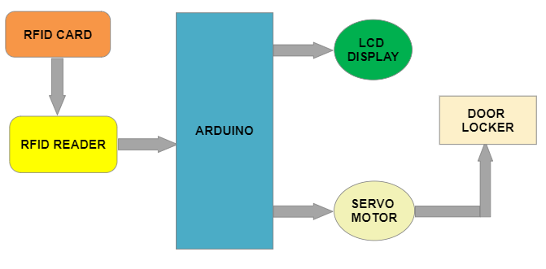
Block Diagram:
9

Slide 11
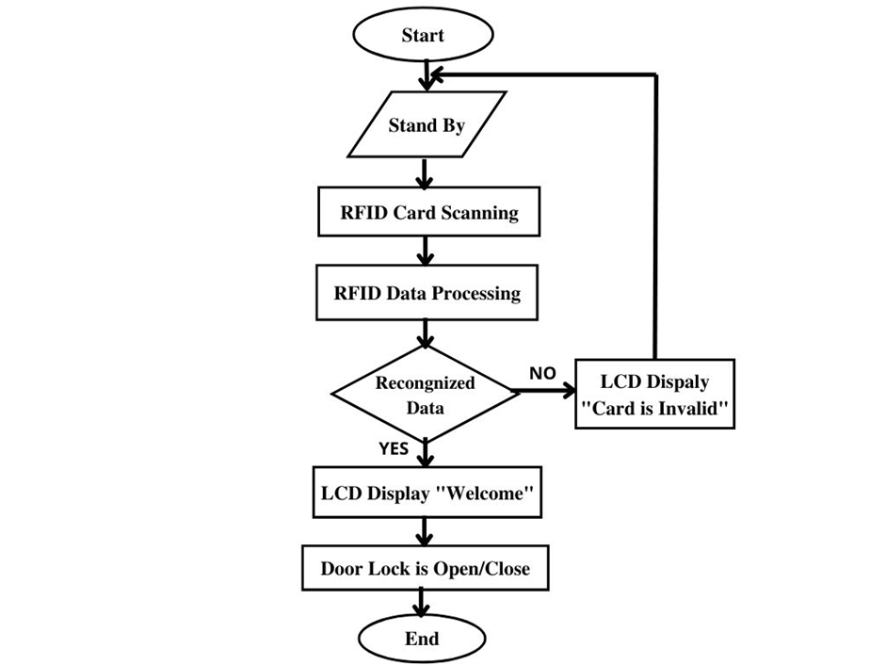
Flow Chart
10

Slide 12
Fabrication process
11

Slide 13
Methodology:
Similar to a barcode reader, RFID readers work by sending and receiving data, but instead of having to scan a code, the data is transmitted over radio frequencies. An RFID door locking system requires RFID tags, antennas, an RFID reader, and a transceiver in order to function as a complete system.
In an RFID door lock access control system, the user’s credential (usually a keycard or fob with an RFID chip) contains unique identifying information called a tag.
When the user comes within proximity of a reader, the reader’s signal locates the information stored on the user’s RFID tag, can access system. Once read, the system will either accept or deny the request to unlock the door.
Data programed from an Arduino-enabled system to automatically operate the servo motor, making it possible to control door locker system to secure the things.
12

Slide 14
Project Result
We have achieved the process of designing the Automated Secure Door Lock System by using RFID Reader that automatically opens and closes the latches of the door through servo motor by scanning the RFID tag which was already registered by their unique RFID tag, Which allow the permission to access the door otherwise it displays an invalid tag or invalid user. Thereby reducing the risk of larceny and the security of students, organizations and family devices and their belongings can be safely secured at the lowest possible cost.
13

Slide 15
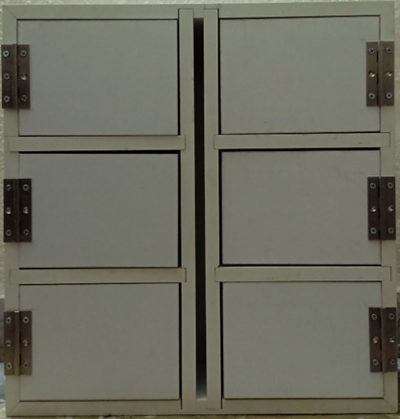
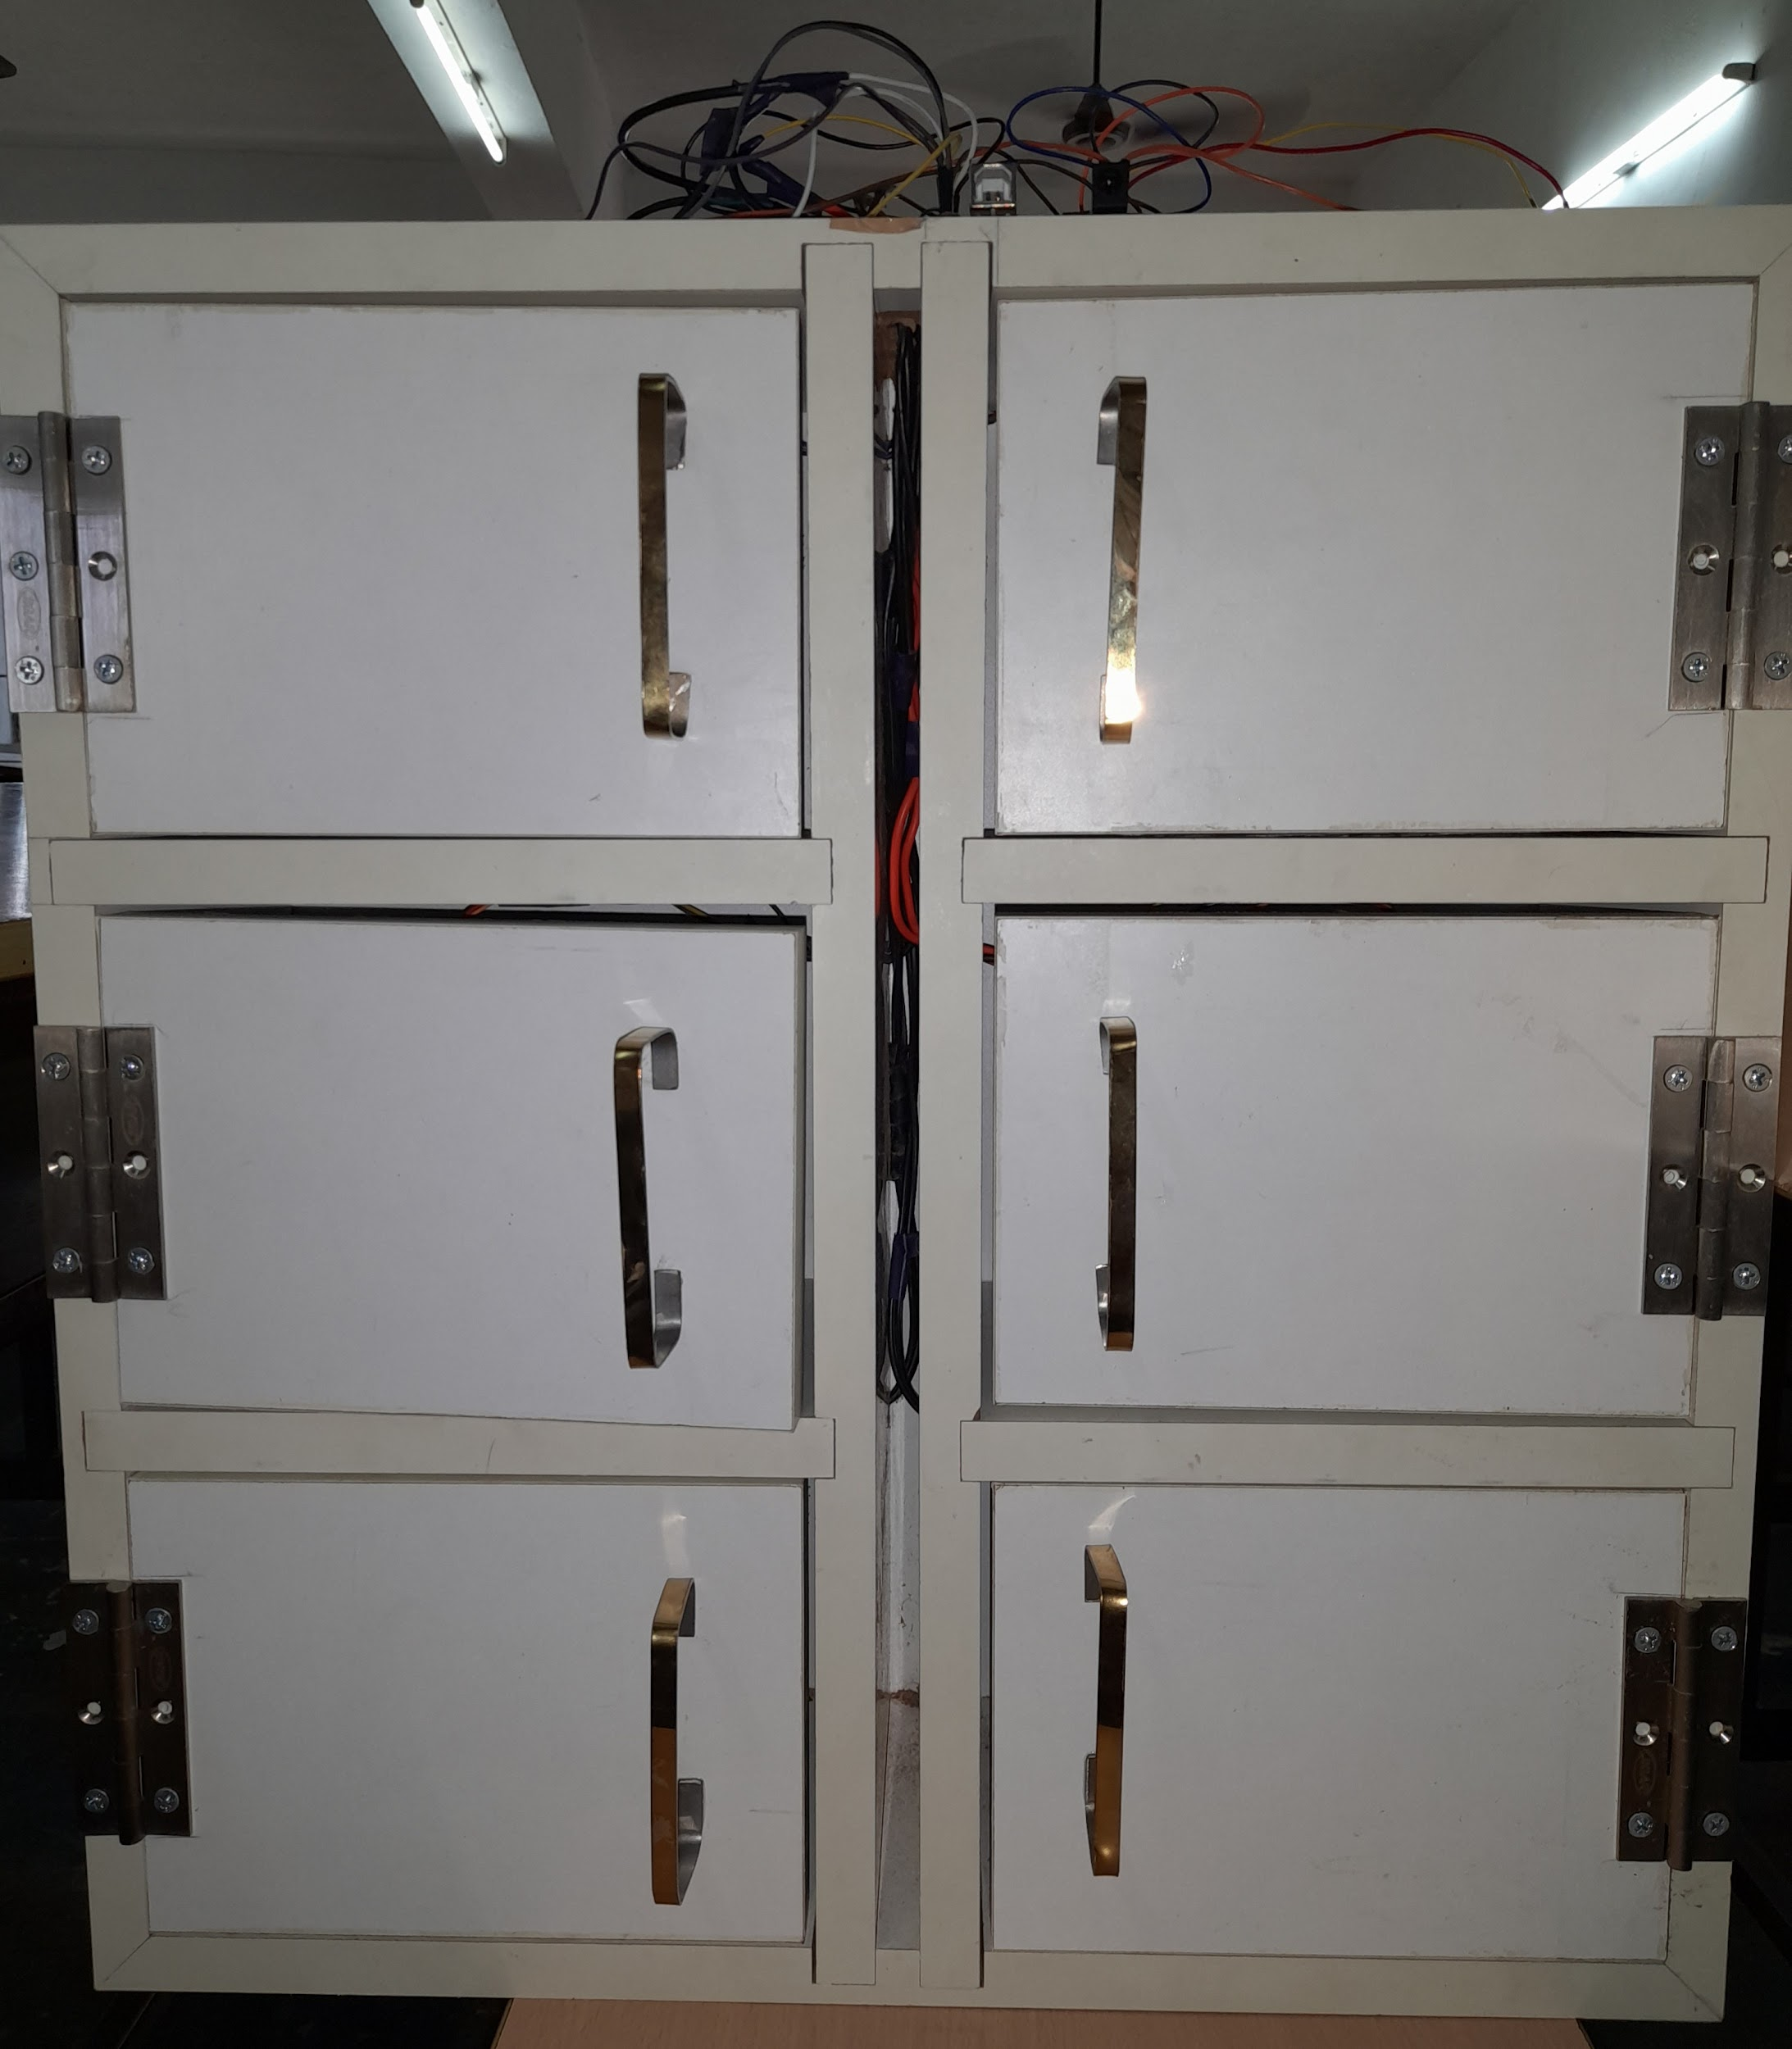
Sample result
Fig 1.1.Frame Exterior (a)
Fig 1.2 Frame Exterior (b)
14

Slide 16
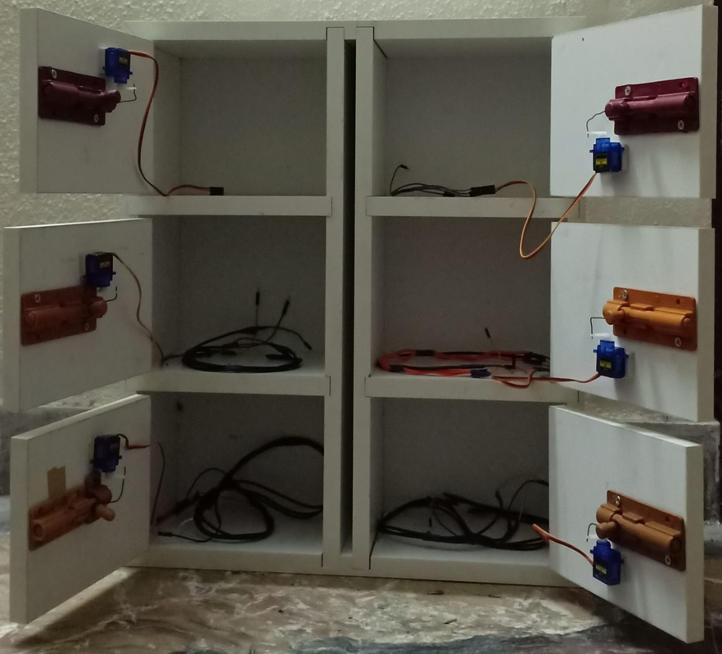
Sample result
Fig 1.3.Frame Interior
15

Slide 17
Deviations from the work with reasons:
In frame designing initially we have used acrylic sheet but the sheet was shatter during the halfway of the project then we have used wood for the framework.
The error in controlling the speed of the motor have noticed and we resolve it by changing the in the programme
we had observe problem in scanning the RFID card and eventually we had fix it.
16

Slide 18
Final outcome of the work:
The locker system had been examine with distinct RFID tag to guide the servo motor for apparent the door.
Each locker has unique RFID frequency so the user whose has been registered could access the locker using their own unique RFID tag . while the non user or the unknown person were unable to access the locker
Based on the implementation this system helps the students to improve the authentication approach to enhance the security , comfortability and privacy requirements.
17

Slide 19
Future Scope
Currently our project application is to provide the students, to secure their mobile phone, smart watches, and other devices during the exam hour in colleges and also for hostellers to safely secure their wallets, ornaments etc…
But Our future scope is to implement the project in the public places like Examination center, Industries, Malls, Provision Stores, Temple etc. So that people can safely kept their things in the public places.
RFID can also be used for bill payment in the stores, ATM machines, Game centers.
18

Slide 20
Conclusion
Thus hereby we would like to conclude that this Automated Secure Door Lock System uses passive RFID to construct a digital security system that includes a door lock mechanism. When the user places the tag in contact with the scanner, the door locking system activates in real time.This Secure Door Lock System provides a convenient way to automate the access control feature thereby enhancing security and enabling the owner of the property carefree. It is a low cost, flexible, and a very easy to install system with no overhead like planning, cabling, and construction works
19

Slide 21
THANK YOU
20

