Slide 1
Project Presentation of Industry Oriented Hands on Experience (22CS422)
On
Machine Learning Enabled Intrusion Detection for Intelligent Network Security
Saniya- 221099787
Mehak – 2210990571
Supervised By
Dr. Monika Aggarwal
Department of Computer Science and Engineering,
Chitkara University, Punjab

Slide 2
Introduction
Machine Learning Enabled Intrusion Detection for Intelligent Network Security is an intelligent cybersecurity system designed to detect malicious network activities and protect digital infrastructure in real time.
The system uses Machine Learning algorithms to analyze network traffic patterns, identify suspicious behavior, classify normal and attack traffic, and generate security alerts automatically.
Technologies:
AI & Machine Learning
Network Traffic Analysis
Real-Time Threat Detection
2

Slide 3
Problem Statement
Traditional network security systems and signature-based Intrusion Detection Systems (IDS) mainly depend on predefined attack patterns and manual rule updates, making them less effective against modern and evolving cyber threats. These systems often fail to detect unknown attacks in real time and generate a high number of false alarms.
Issues in Existing Systems:
Heavy dependence on signature-based detection
Unable to detect zero-day or unknown attacks
High false positive and false negative rates
Difficulty handling large-scale network traffic data

Slide 4
Solution
To overcome the limitations of traditional Intrusion Detection Systems, the following solution is proposed:
Proposed Solution
Develop an AI/ML-based Intrusion Detection System (IDS) for intelligent network security.
Analyze network traffic data in real time to identify suspicious activities.
Use data preprocessing techniques like feature scaling, encoding, and feature selection to improve model performance.
Classify network traffic into Normal and Malicious categories automatically.

Slide 5
Features
Real-Time Intrusion Detection – Continuously monitors network traffic and detects suspicious activities instantly.
Machine Learning-Based Detection – Uses intelligent ML models to identify attack patterns automatically.
Attack Classification – Classifies network traffic into Normal or Malicious categories.
Detection of Unknown Attacks – Can identify new and evolving cyber threats beyond predefined signatures.
High Detection Accuracy – Improves security performance with accurate attack prediction.

Slide 6
Tech Stack
The following technologies and tools were used in the research project :
Programming Language
Python – Used for implementation, model training, and data analysis.
Libraries & Frameworks
Pandas – Data handling and preprocessing.
NumPy – Numerical computations and array operations.
Scikit-learn – Model training and evaluation.
Matplotlib – Graphs and result visualization.
Seaborn – Confusion matrix and performance plots.
Machine Learning Algorithms
Logistic Regression
Support Vector Machine
Random Forest
Dataset
NSL-KDD Dataset – Used for training and testing the intrusion detection models
.

Slide 7
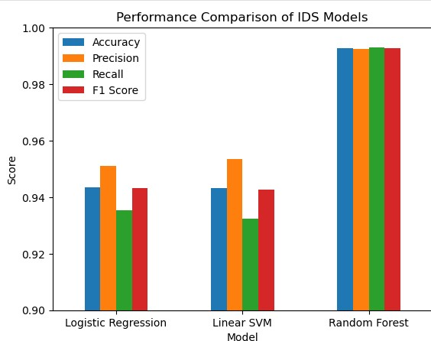
Results

Slide 8
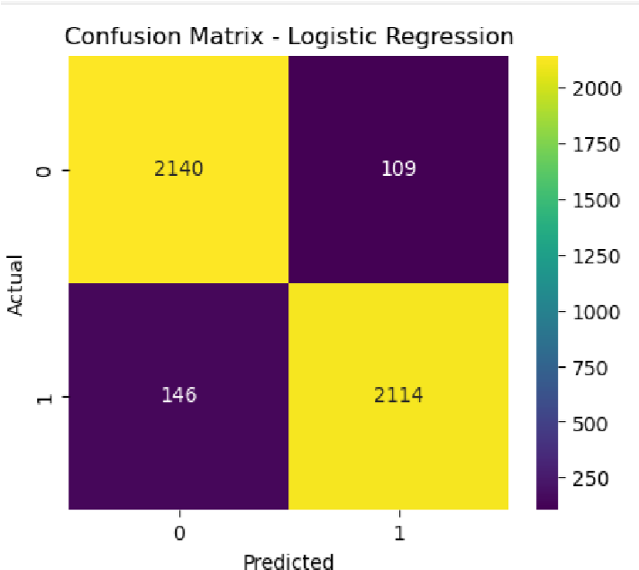
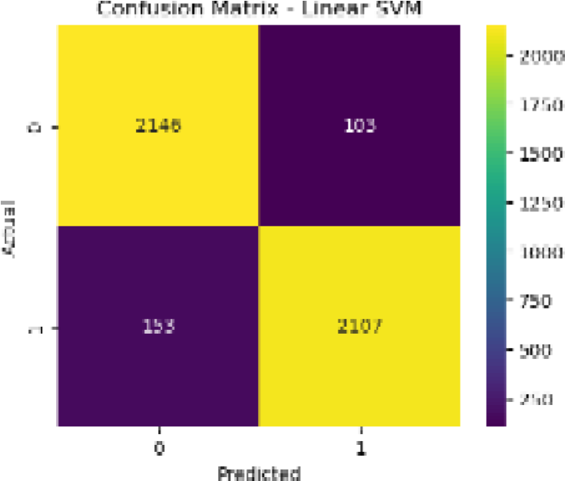

Slide 10
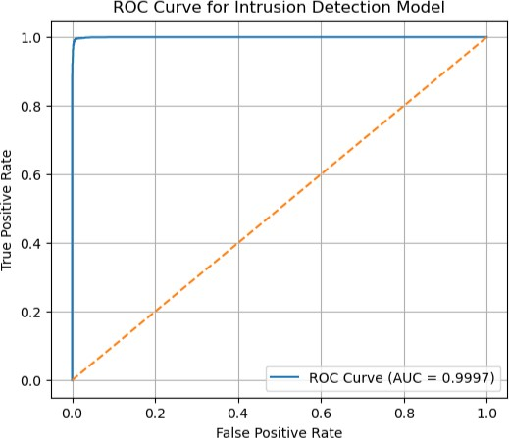

Slide 11
Conclusion
This research successfully developed a Machine Learning-based Intrusion Detection System for intelligent network security. The system accurately detected malicious network activities and improved threat detection performance. Among all models, Random Forest achieved the best result with 99.26% accuracy, proving that machine learning can enhance real-time cybersecurity and network protection.

Slide 12
Future Scope
Integration of Deep Learning models for improved detection accuracy.
Development of real-time intrusion detection for live network monitoring.
Deployment in Cloud and IoT security environments.
Use of modern datasets for detecting evolving cyber threats.
Implementation of automated threat response for faster security actions.

Slide 13
Thank You
13

