Slide 1
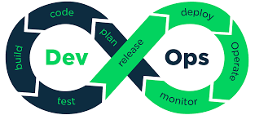
Francis Asante Nsiah

Slide 2
DEVOPS
Virtualization
Linux
Vagrant
Networking
Bash Scripting
Git
Containers
Maven

Slide 3
DEVOPS
AWS CI/CD PIPELINE
Elastic Beanstalk
Pipeline
CodeCommit
CodeBuild
CodeDeploy

