Slide 1
GM: Public Policy Analytics Development Plan
Team Lead: Andrew Sassine
Team: Andrew Sassine, Darbi Snider, Jonathan Pullum, Mazen Mirza, Rory Lange, Ali Nassar
GTA: Mohammad Roshani

Slide 2
Project Overview
Focus on leveraging public policy data to provide insight for automotive industry
Understand how politics shapes public policy in automotive section
Goal is to provide General Motors with actionable insight into future laws
Building a full stack web application to process and display data

Slide 3
Purpose, Scope, and Objectives
Develop an analytics tool for lobbyist and legislative dynamics
Focus on patterns in political data for impactful automotive legislation
Refactor existing code for better organization
Organize data in databases and directories for easier maintenance
Create simple dashboard to interact with data through visuals
Create a unified database and interactive dashboard
Enable insights discovery and simple integration of new data

Slide 4
Team Organization
Role | Lead | Secondary Lead
Team Lead | Andrew Sassine
Documentation Lead | Rory Lange | Darbi Snider
Presentation Lead | Darbi Snider | Ali Nassar
QA Lead | Ali Nassar | Mazen Mirza
Front-end Lead | Rei Pullum | Rory Lange
Back-end Lead | Mazen Mirza | Rei Pullum

Slide 5
Problem Resolution
For new technologies:
Consult client first, then GTA, then majority vote
For missing meetings or coding deadlines:
Three strike policy
For all other disputes:
Majority vote

Slide 6
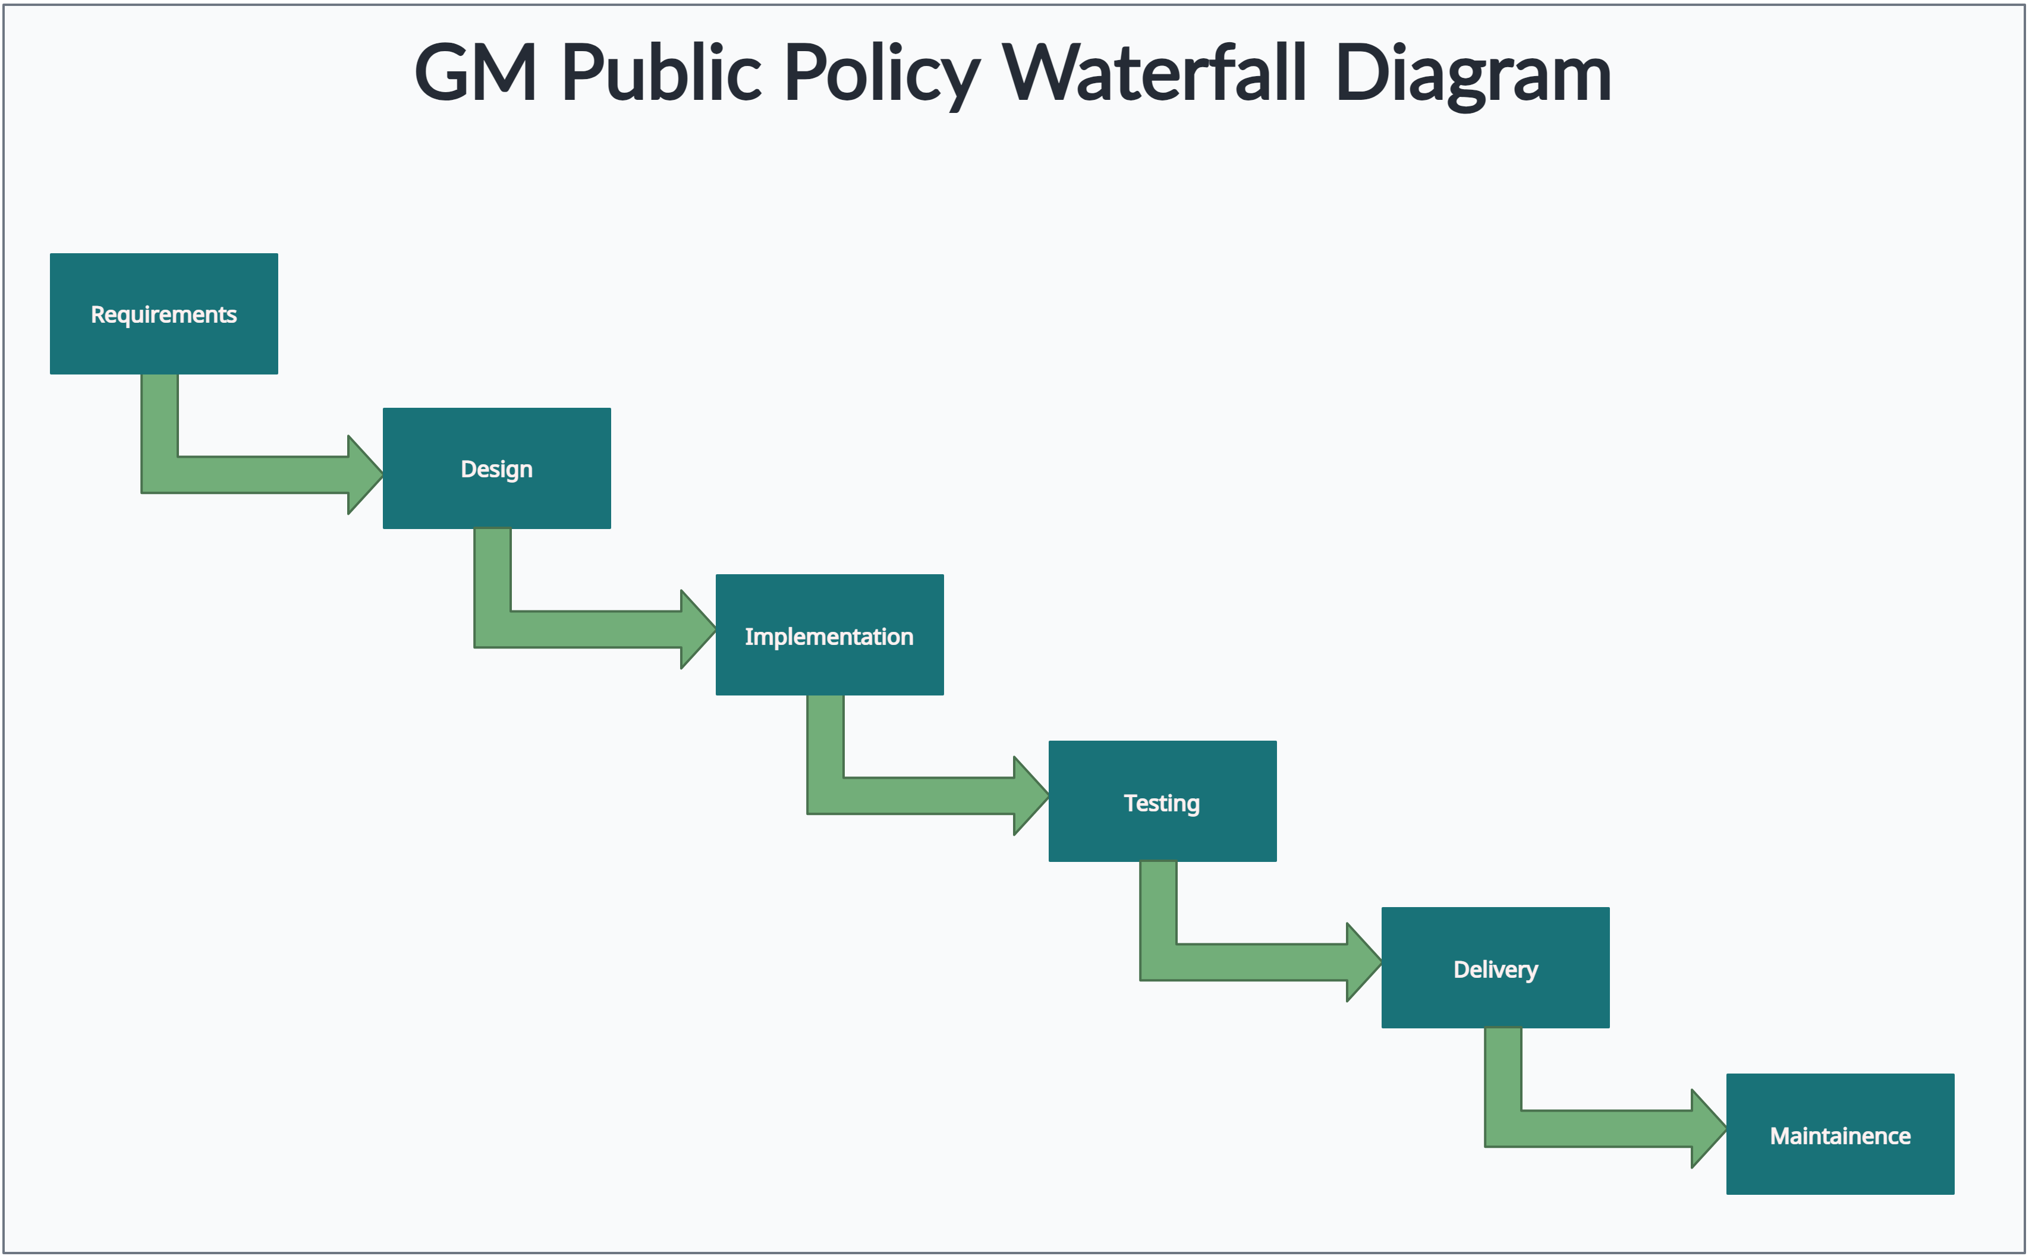
Project Plan
Created with: https://creately.com

Slide 7
Configuration Management
Allows us to track changes to codebase, communicate, and plan meetings
Development Tools
Git, GitHub, Jira
Version Control, Change Management, Code Review
Communication
Discord
Messaging, code sharing
Meeting Planning
MS Teams
Meetings, weekly meeting schedule, stand-ups, GM

Slide 8
Technologies
Database
PostgreSQL (replacing MySQL as per client preference)
Python to clean and insert data into PostgreSQL
Front-end
React framework for building the user interface
Back-end
Node.js for a scalable and efficient server-side application
Data Visualization
Power BI for generating data insights and reports
Makes it easier for clients to explore and understand the information

Slide 9
Questions?

