Slide 1
Pesticide Residue
Keen Koalas – Nautical Narwhals
INFM600 – Section 0101

Slide 2
Data
The Pesticides Data Program (PDP) is a national pesticide residue monitoring program which is implemented by United States Department of Agriculture and it produces the most comprehensive pesticide residue database in the U.S.
Over ten thousand samples of agricultural goods sold in the U.S are tested every year.
The PDP provides sampling and residue testing results data for the years 1992-2014.
These datasets include details such as where and when the item samples were collected, the types of processing the products had undergone, the types and amounts of residue, and whether the products had organic or pesticide-free claims.

Slide 3
Target Audience
Health conscious mothers with (young) children in middle-class families with enough money to consider more expensive produce options if they are better for their family. But, who still have budget constraints so they need to make educated and selective decisions.
Perhaps residing in suburban areas with access to health food stores.

Slide 4
Questions
The overall "big" question:
How to make the healthiest but economical choices when purchasing apples for your family and kids, especially if you have younger children who would be more at risk of potential side effects of pesticides? And if more expensive options (organic, premium, etc.) are worth the extra cost in terms of pesticide residue?
We answer the above by looking at the following with pesticide residue testing data from the USDA, focusing on Apples:
What are the most common pesticides found in apples (and the corresponding average concentrations), and have those changed from what they were a decade ago? What about organic apples?
Are there any differences in pesticide types and amounts in apples by variety, where they were produced (states, foreign countries, etc.), or when they are labeled as being of a higher grade (Premium, Extra Fancy, etc.)?

Slide 5
Relevance
A lot of apples are consumed per capita per year in the US (note: around 40 lbs or something I think. Get exact number and cite), and apple is frequently in the number 1 spot on the Dirty Dozen list for pesticide residue
Organics = much more expensive
Pesticide effects on children
Infants and children are more sensitive to the toxic effects of pesticides than adults. (npic.orst.edu)
Children often eat and drink more relative to their body weight than adults, which can lead to a higher dose of pesticide residue per pound of body weight. (npic.orst.edu)
Pesticide mixtures = might be worse
Affects metabolism and weight
endocrine disruptors - Chemical pesticides in food and water have been linked to increased BMI in children and insulin resistance in rodents.(ncbi article)

Slide 6
Pesticides – Top 10 in 2014
Names and effects
 | Group A | Group B
Class 1
Class 2
Class 3

Slide 7
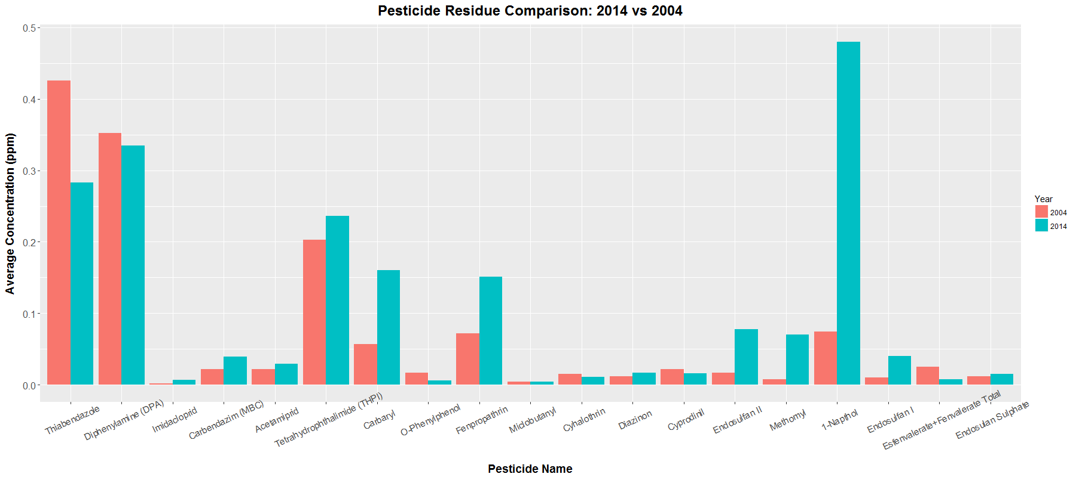
Analysis – 2014 vs 2004

Slide 8
Interpretation – 2014 vs 2004
Only 5 out of 19 pesticides declined in average concentration from 2004 to 2014.
Cyhalothrin, Cyphrodinil, Esfenvalerate+Fenvalerate Total, O-Phenylphenol, Thiabendazole
However, all other pesticides have average concentrations that increased from 2004 to 2014.

Slide 9
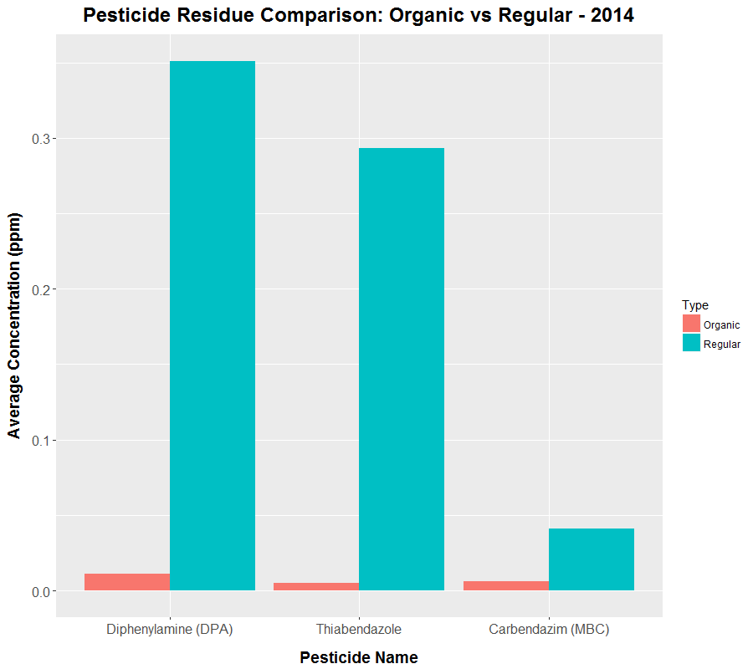
Analysis – Organic vs Conventional
Only 4 kinds of pesticides are detected on organic apples.
3 of which are also found on conventional apples.
43 types of pesticides detected on conventional apples.
Regular apples in 2014 had significantly higher average pesticide concentrations than their organic counterparts.

Slide 10
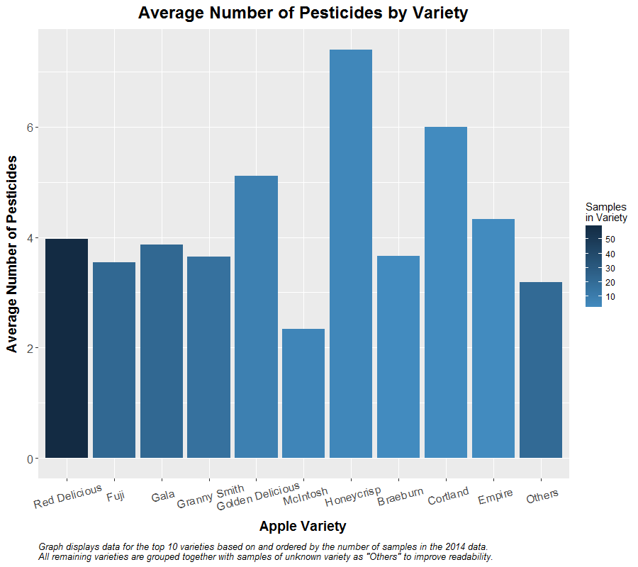
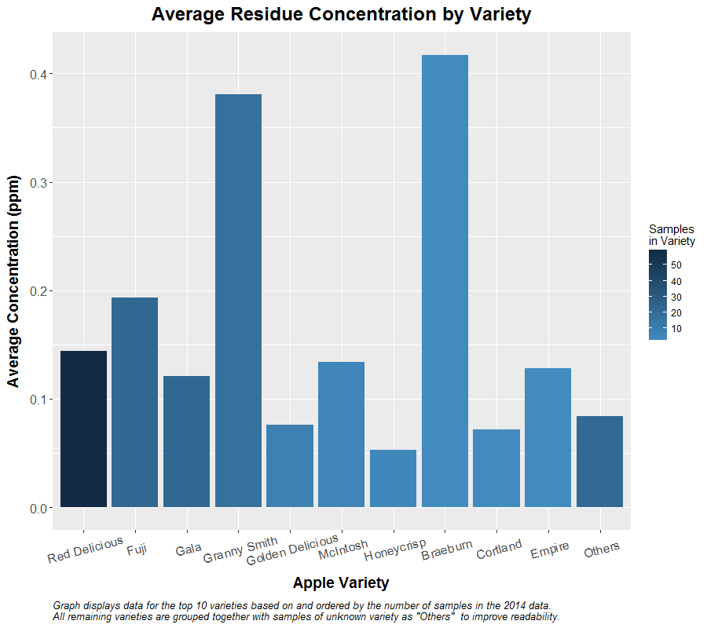
Analysis Results - Varieties

Slide 11
Interpretation - Varieties
The most common apple varieties seem to have an average of around 4 types of pesticide per sample, while Honeycrisp appears to have more per sample (7.4) compared to the other varieties.
Due to the wide range of concentration amounts, it is uncertain if a conclusion could be drawn from the average concentration when divided by variety, but Granny smith and Braeburn had the highest average concentrations of the top 10 varieties in 2014.
It is interesting to note that the residue concentration average for Honeycrisp appears to be on the low end at 0.053 ppm. So, they appear to have more types of pesticide but of low concentrations in the batches tested in 2014.

Slide 12
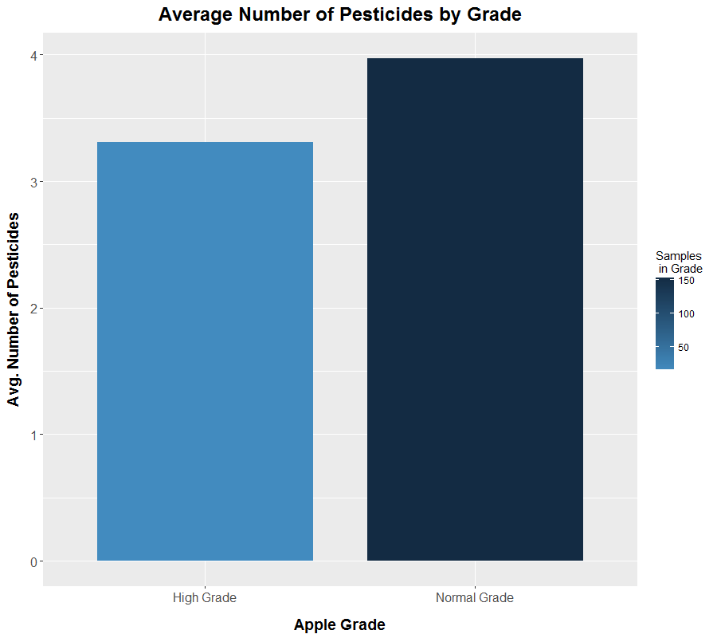
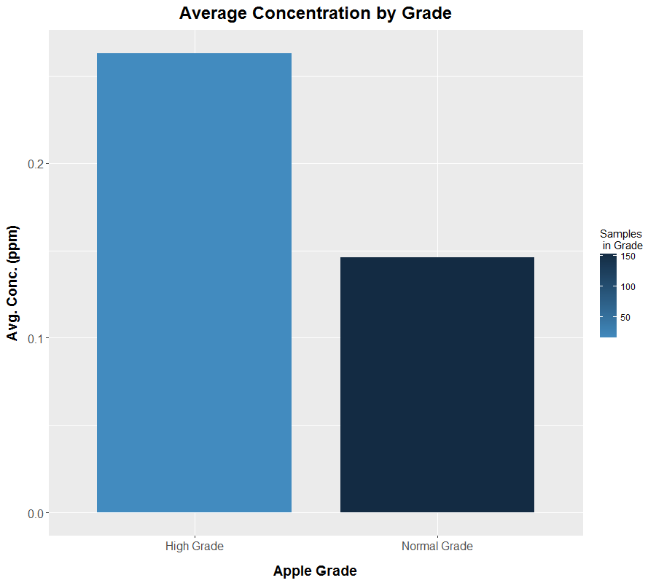
Analysis Results – Premium Grade

Slide 13
Interpretation - Grade
Pesticide concentration levels range between 0.103 and 0.263 parts per million.
Normal grade apples have on average 0.66 more pesticides than high grade apples, but with a significantly lower average concentration (0.146 compared to 0.263 for high grade apples).

Slide 14
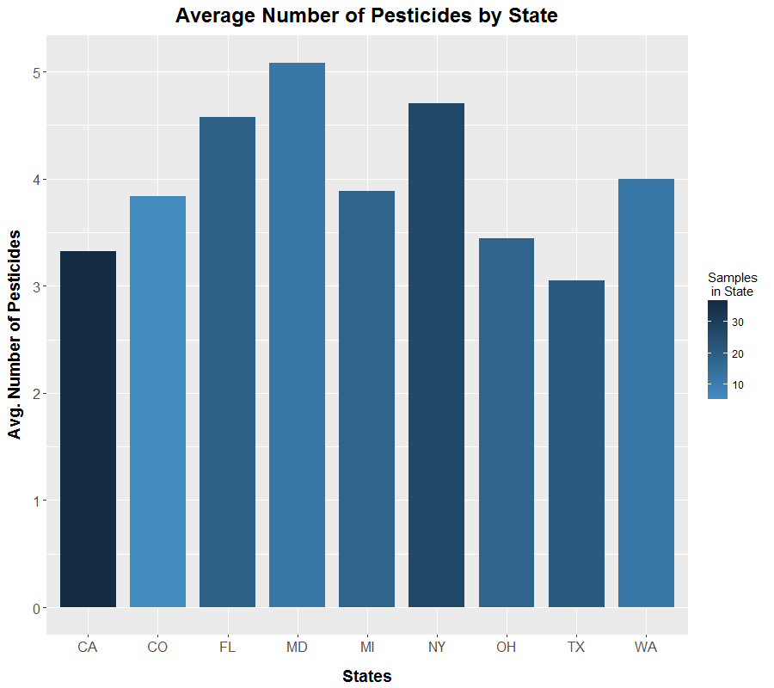
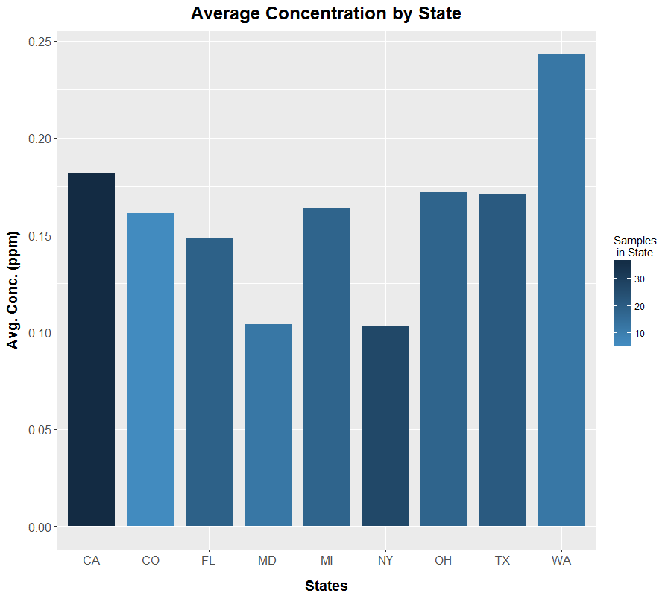
Analysis Results – States

Slide 15
Interpretation - State
The state with the lowest average concentration of pesticides was New York (0.103 ppm) and the highest was Washington (0.243 ppm).
In terms of number of pesticides, the state with the most on average was Maryland (5.083 pesticides) and the state with the least was Texas (3.048).
A weak inverse correlation between the number of pesticides found and the average concentration, with states with more pesticides per sample having a lower average concentration of pesticides. This is not true for all states, however.

Slide 16
Conclusion
While not pesticide-free, organic apples had significantly fewer numbers and average concentrations of pesticides found compared to conventional. (add % numbers)
A general increase in the average residue concentration from 2004 to 2014 for the majority of pesticides found on samples from both years.
Inverse correlation where samples with more pesticide types detected actually had lower average residue concentration.
Apples with higher grade labels had a slighter lower average number of pesticides but at almost double the concentration.

Slide 17
Recommendations
Highly recommend purchasing organic produce if the health effects of pesticides is a concern, especially for children conception.
Avoid premium grade apples due to the much higher average residue concentration.
Common premium grade labels: Fancy, Extra Fancy, Premium
Avoid varieties with higher than average numbers of pesticides to avoid potential risks of chemical mixtures.
Honeycrisp & Cortland
Consider avoiding varieties with extremely high average pesticide concentrations.
Granny Smith & Braeburn

Slide 18
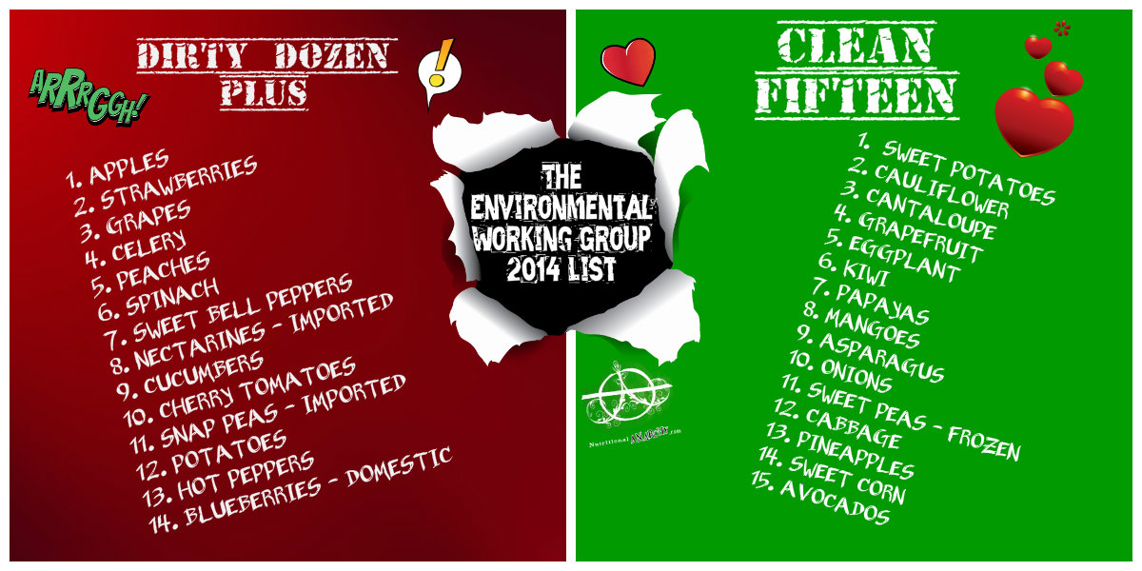
Recommendations – Dirty Dozen+ & Clean 15

Slide 19
References
United States Department of Agriculture, Agricultural Marketing Service. (2016). PDP Databases, 1992-2014. [ZIP archives with data files]. Retrieved September 9, 2016, from: https://www.ams.usda.gov/datasets/pdp/pdpdata
[Pesticide Dirty Dozen Plus & Clean Fifteen Lists]. (n.d.). Retrieved December 13, 2016, from: http://www.theorganicprepper.ca/the-good-the-bad-and-the-deadly-ewg-releases-2014-dirty-dozen-and-clean-fifteen-lists-04302014
http://npic.orst.edu/health/child.html
https://www.ncbi.nlm.nih.gov/pmc/articles/PMC3279464/

