Slide 1
Pesticide Residue
Keen Koalas – Nautical Narwhals
INFM600 – Section 0101

Slide 2
Target Audience
Health conscious mothers with (young) children in middle-class families with enough money to consider more expensive produce options if they are better for their family. But, who still have budget constraints so they need to make educated and selective decisions. Maybe in suburban areas with access to health food stores.

Slide 3
Questions
The overall "big" question:
How to make the healthiest but economical choices when purchasing apples for your family and kids, especially if you have younger children who would be more at risk of any potential side effects of pesticides? And if more expensive options (organic, premium, etc.) are worth the extra cost in terms of pesticide residue?
We answer the above by looking at the following:
What are the most common pesticides found in apples (and the corresponding average concentrations), and have those changed from what they were a decade ago? What about organic apples?
Are there any differences in pesticide types and amounts in apples by variety, where they were produced (states, foreign countries, etc.), or when they are labeled as being of a higher grade (Premium, Extra Fancy, etc.)?

Slide 4
Relevance
A lot of apples are consumed per capita per year in the US (note: around 40 lbs or something I think. Get exact number and cite), and apple is frequently in the number 1 spot on the Dirty Dozen list for pesticide residue
Organics = much more expensive
Pesticide effects on children
Infants and children are more sensitive to the toxic effects of pesticides than adults. (npic.orst.edu)
Children often eat and drink more relative to their body weight than adults, which can lead to a higher dose of pesticide residue per pound of body weight. (npic.orst.edu)
Pesticide mixtures = might be worse
Affects metabolism and weight
endocrine disruptors - Chemical pesticides in food and water have been linked to increased BMI in children and insulin resistance in rodents.(ncbi article)

Slide 5
Pesticides – Top 10 in 2014
Names and effects
 | Group A | Group B
Class 1
Class 2
Class 3

Slide 6
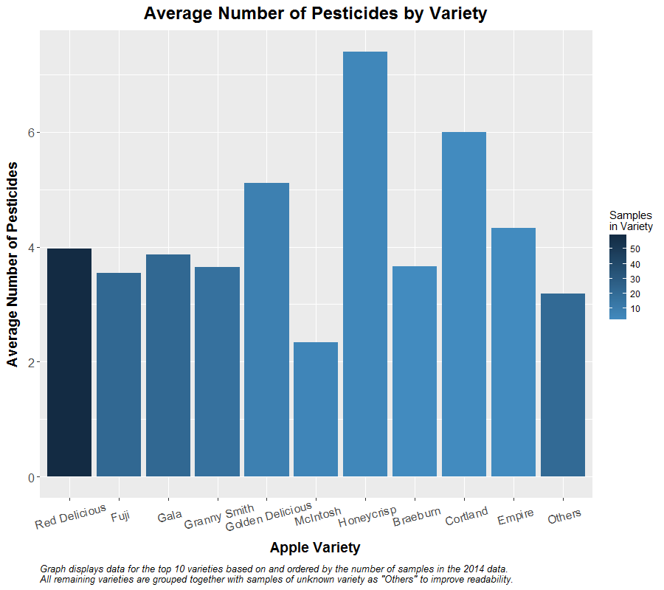
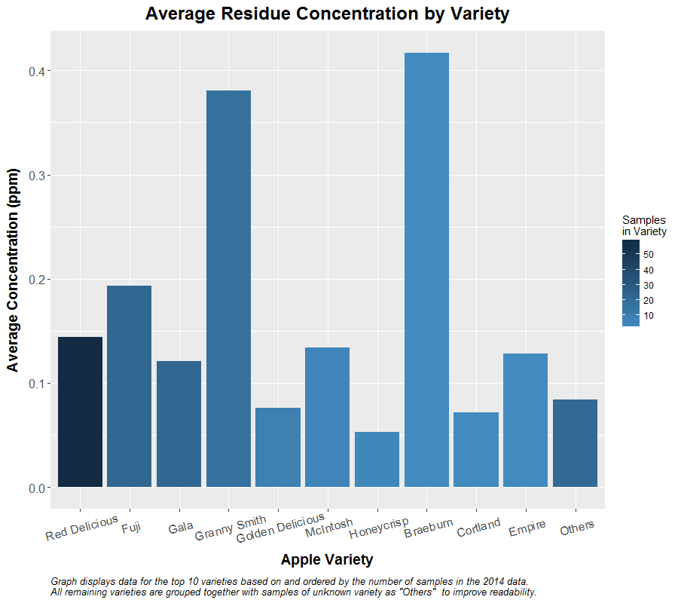
Analysis Results - Varieties

Slide 7
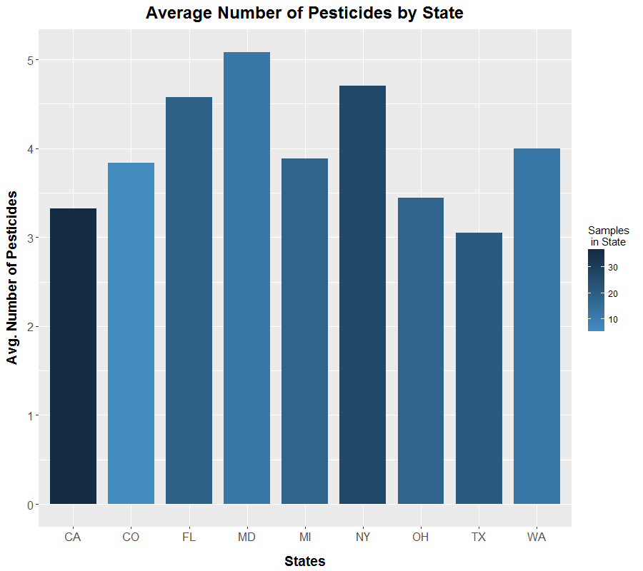
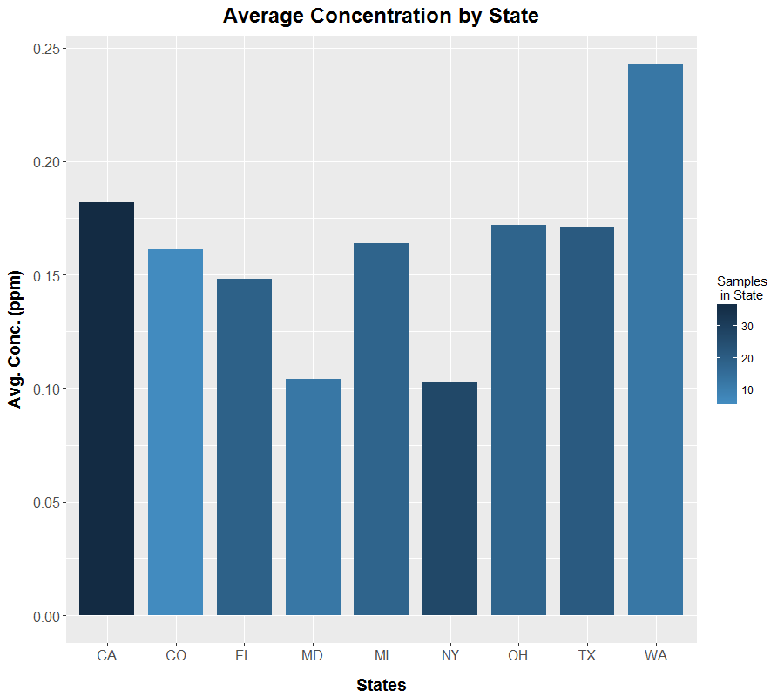
Analysis Results – States

Slide 8
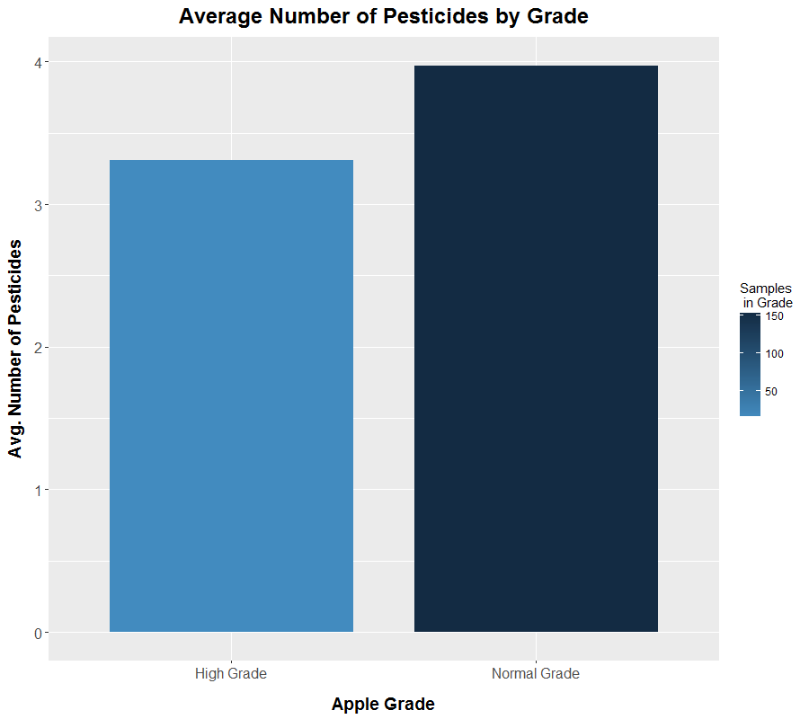
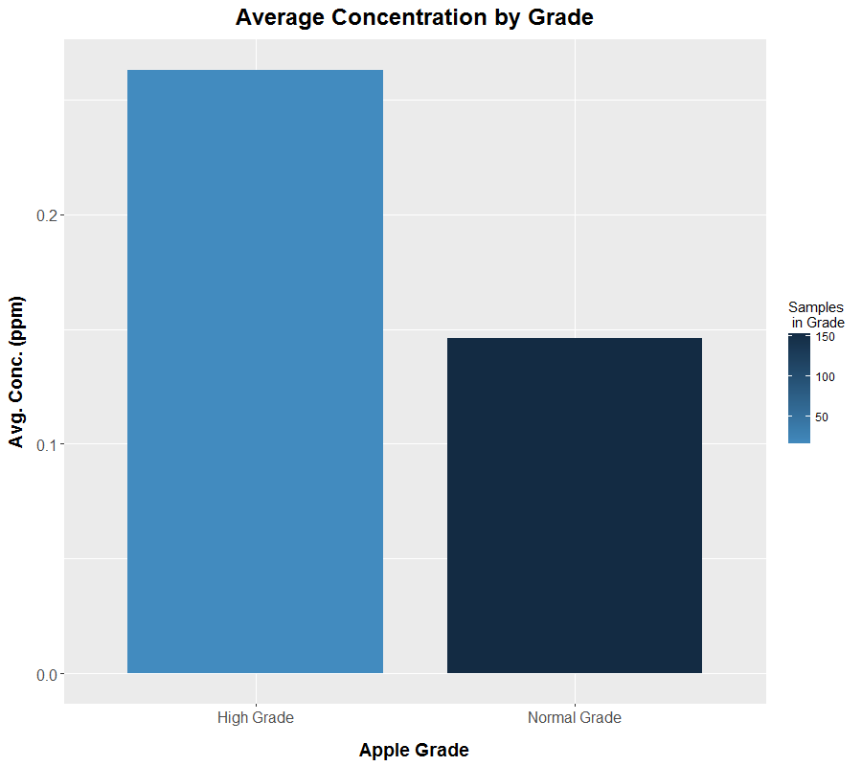
Analysis Results – Premium Grade

Slide 9
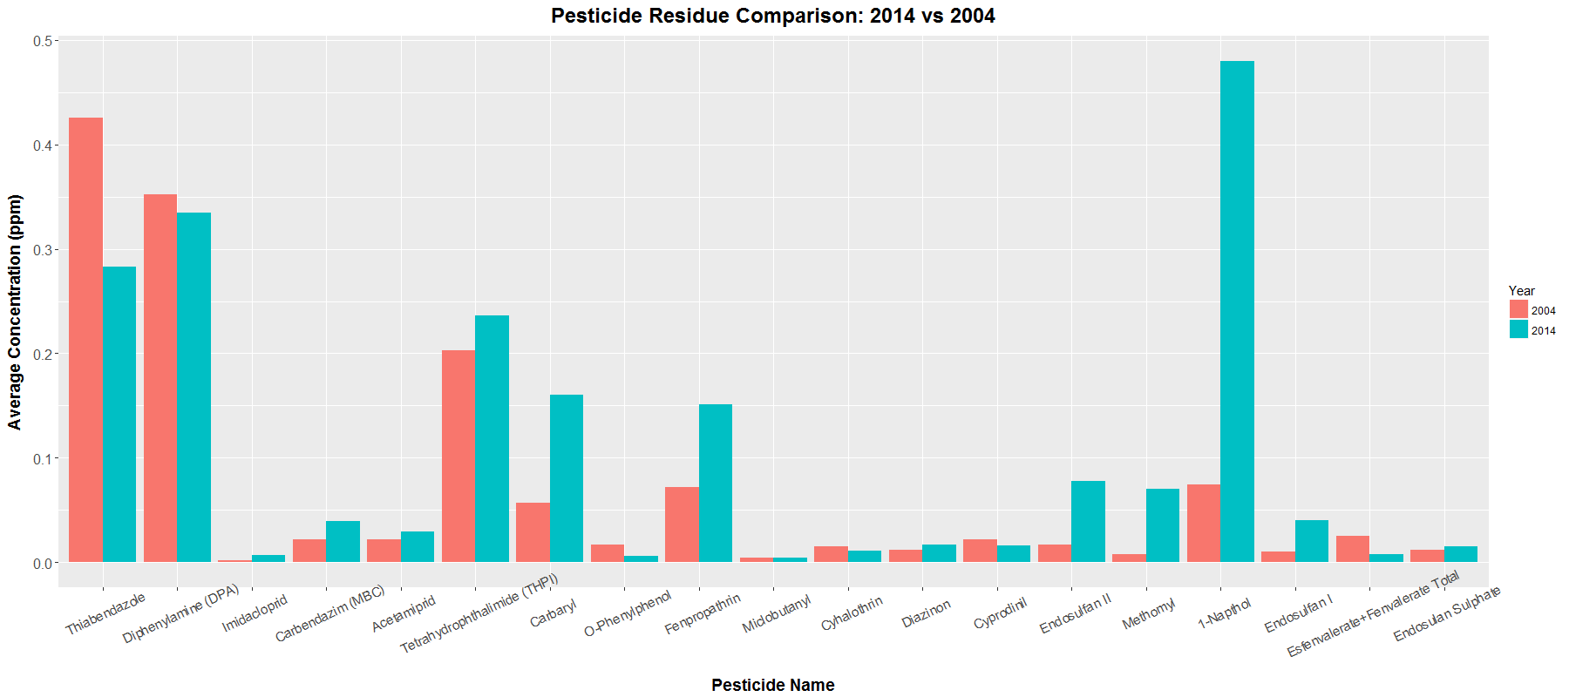
Analysis – 2014 vs 2004

Slide 10
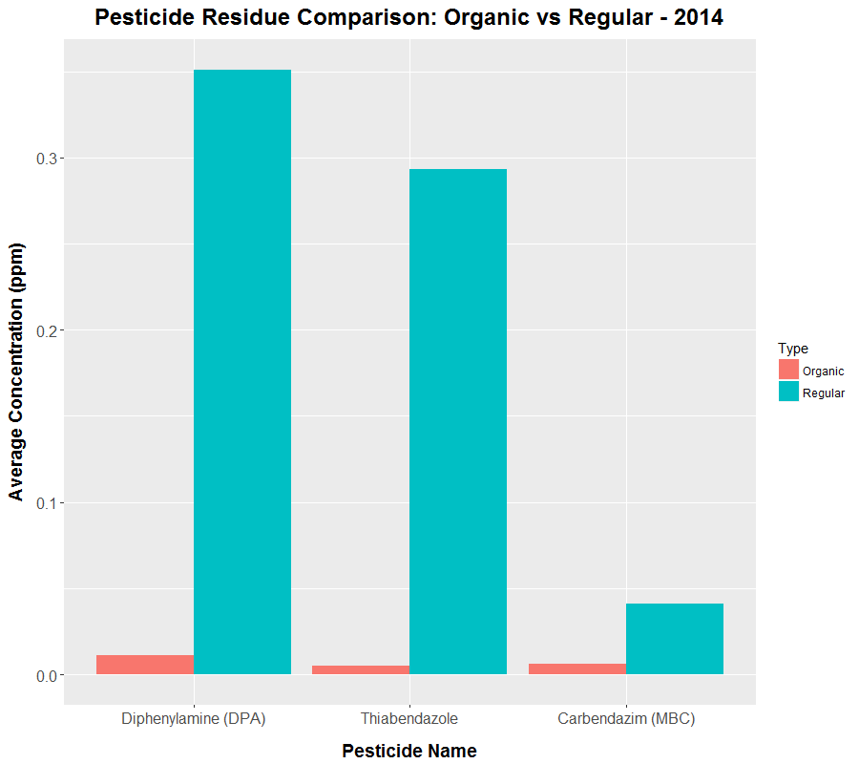
Analysis – Organic vs Conventional
4 detected in organic samples vs 43 in conventional
Significantly different concentration levels

Slide 11
Conclusion
While not pesticide-free, organic apples had significantly fewer numbers and average concentrations of pesticides found compared to conventional.
A general increase in the average residue concentration from 2004 to 2014 for a majority of the pesticides found on samples from both years.
Inverse correlation where samples with more pesticide types detected actually had lower average residue concentration.
Apples with higher grade labels had a slighter lower average number of pesticides but at almost double the concentration.

Slide 12
Recommendations
Buy organic if possible
Avoid premium grade produce
Avoid varieties with higher than average numbers of pesticides to avoid potential risks of chemical mixture

Slide 13
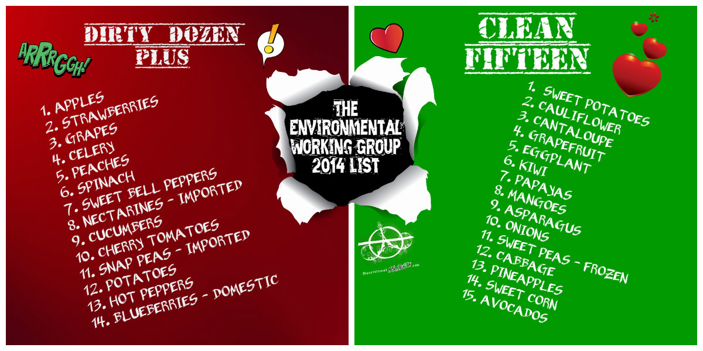
Recommendations – Dirty Dozen & Clean 15

Slide 14
References
United States Department of Agriculture, Agricultural Marketing Service. (2016). PDP Databases, 1992-2014. [ZIP archives with data files]. Retrieved September 9, 2016, from: https://www.ams.usda.gov/datasets/pdp/pdpdata
http://www.theorganicprepper.ca/the-good-the-bad-and-the-deadly-ewg-releases-2014-dirty-dozen-and-clean-fifteen-lists-04302014
http://npic.orst.edu/health/child.html
https://www.ncbi.nlm.nih.gov/pmc/articles/PMC3279464/

