Slide 1
Stream-2

Slide 2
The Stream Insertion << and Stream Extraction >> Operators
Formatted output is carried out on streams via the stream insertion << and stream extraction >> operators.
For example,
cout << value;
cin >> variable;
note : cin/cout shall be the left operand and the data flow in the direction of the arrows.
The << and >> operators are overloaded to handle fundamental types (such as int and double), and classes (such as string). You can also overload these operators for your own user-defined types.

Slide 3
Overloading<< and >> operators
In C++, stream insertion operator “<<” is used for output and extraction operator “>>” is used for input.
We must know following things before we start overloading these operators. 1) cout is an object of ostream class and cin is an object istream class 2) These operators must be overloaded as a global function. And if we want to allow them to access private data members of class, we must make them friend.

Slide 4
Why these operators must be overloaded as global?
In operator overloading, if an operator is overloaded as member, then it must be a member of the object on left side of the operator. For example, consider the statement “ob1 + ob2” (let ob1 and ob2 be objects of two different classes). To make this statement compile, we must overload ‘+’ in class of ‘ob1’ or make ‘+’ a global function.

Slide 5
The operators ‘<<' and '>>' are called like 'cout << ob1' and 'cin >> ob1'. So if we want to make them a member method, then they must be made members of ostream and istream classes, which is not a good option most of the time. Therefore, these operators are overloaded as global functions with two parameters, cout and object of user defined class.

Slide 6
The predefined object cin is an object of this class and thus may be reassigned at run time to a different istream object.

Slide 7
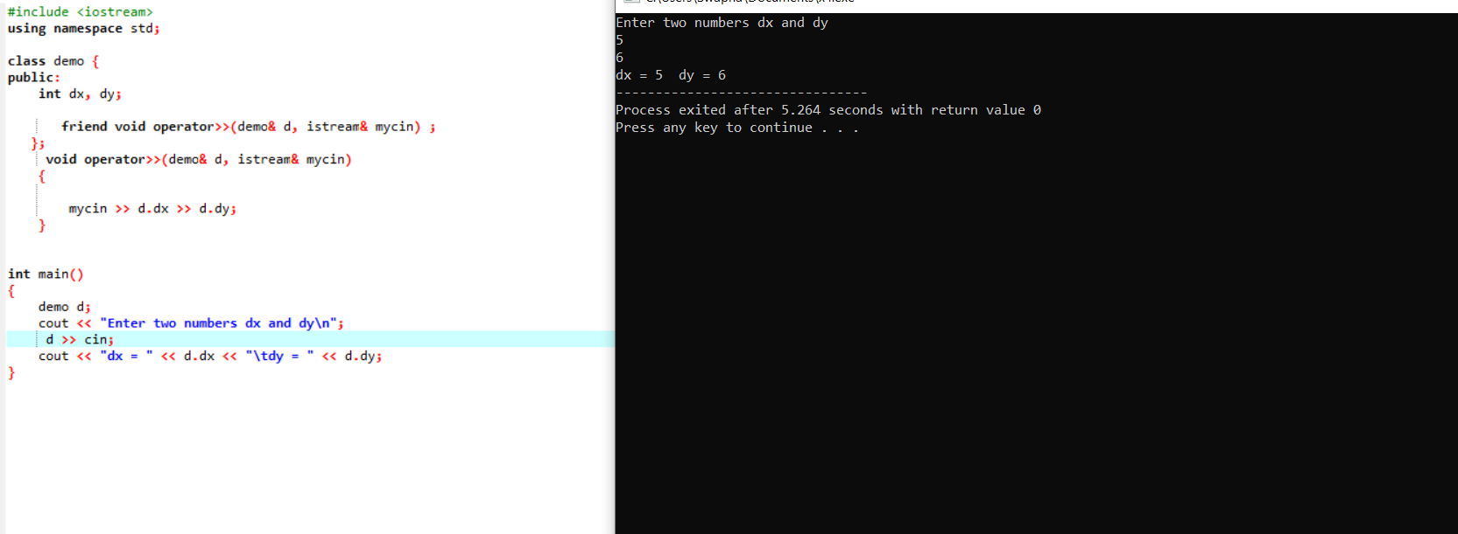

Slide 8
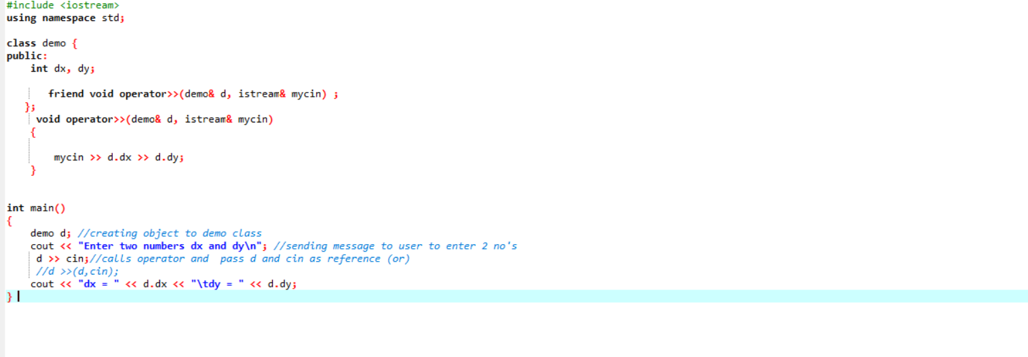

Slide 9
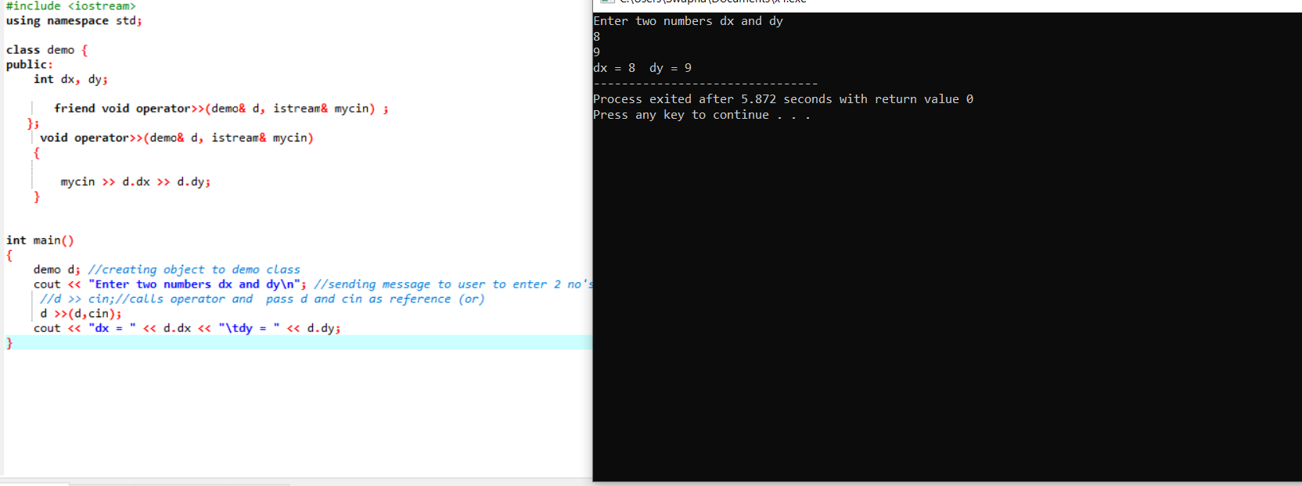

Slide 10
This class is variant of ostream that allows object assigment. The predefined objects cout, cerr, clog are objects of this class and thus may be reassigned at run time to a different ostream object.

Slide 11
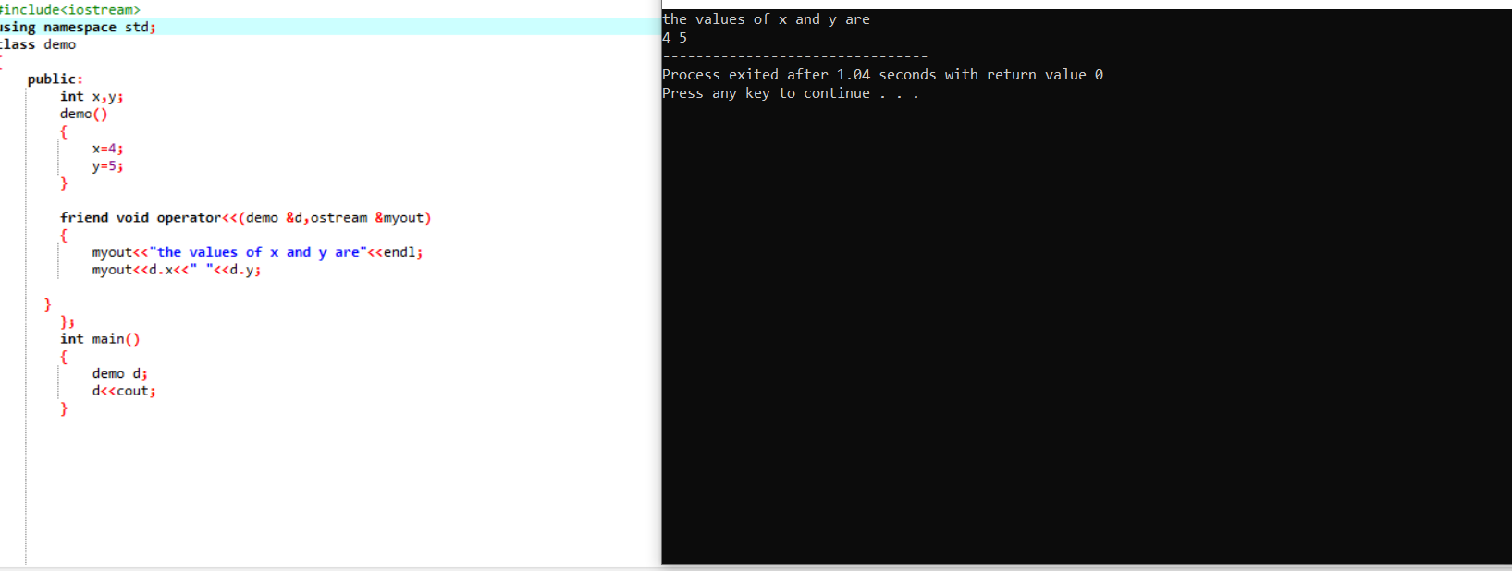

Slide 12
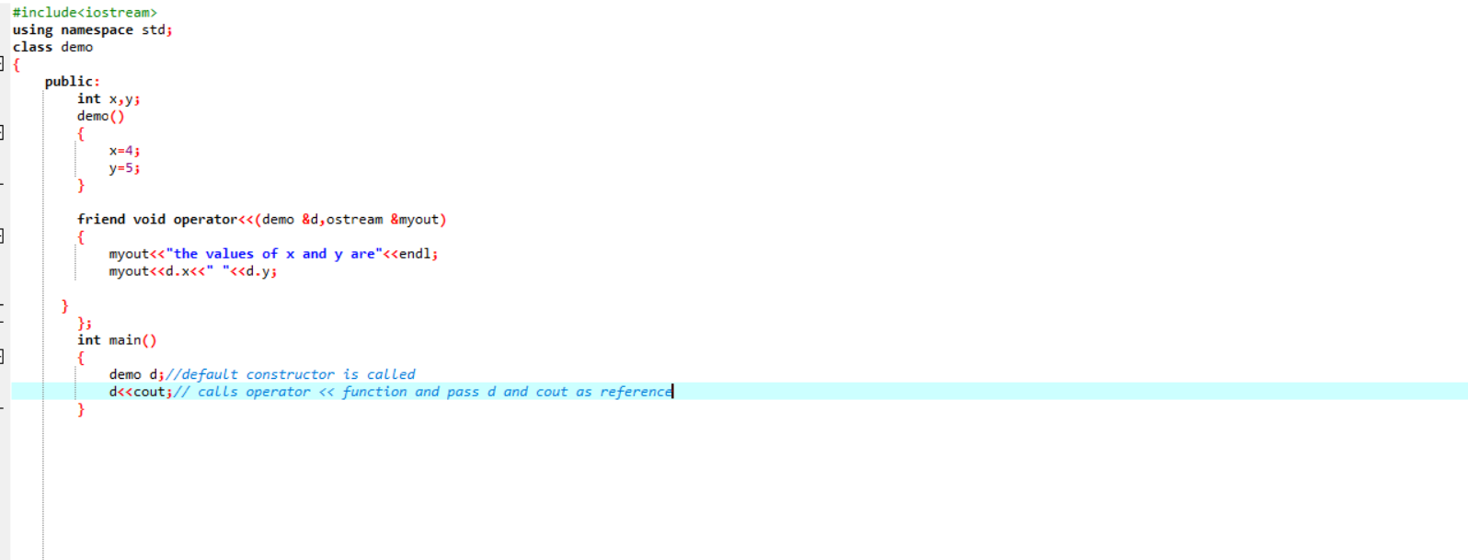

Slide 13
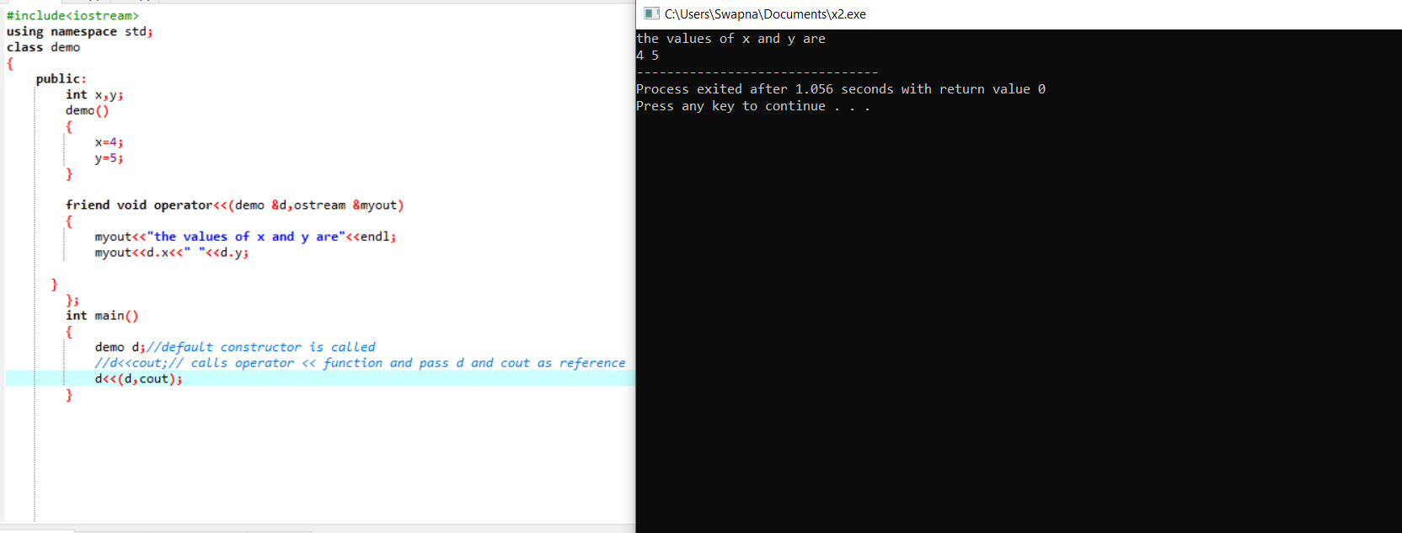

Slide 14
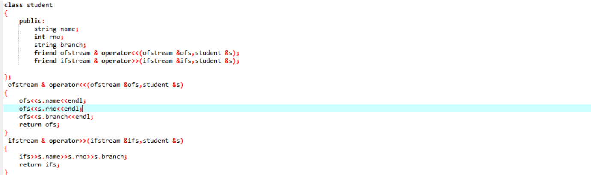
Student class program-1

Slide 15
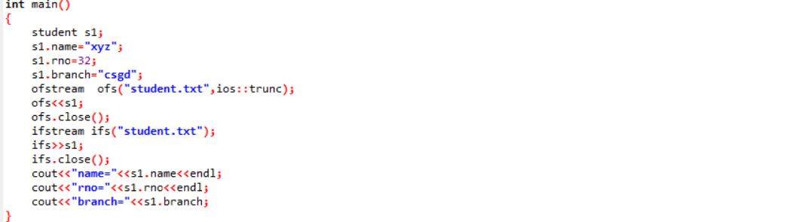

Slide 17
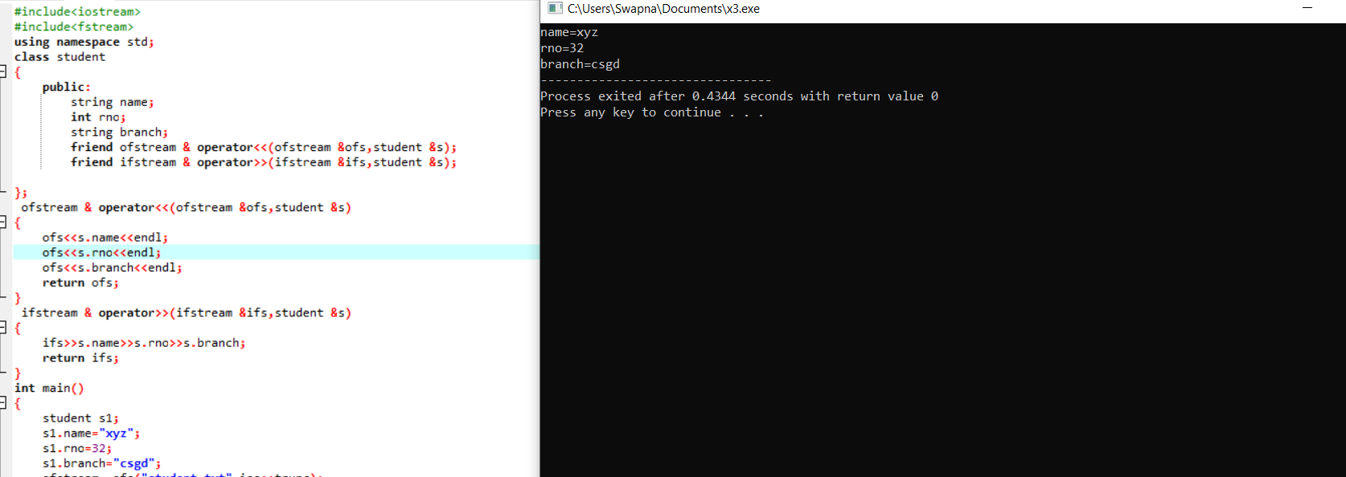

Slide 18
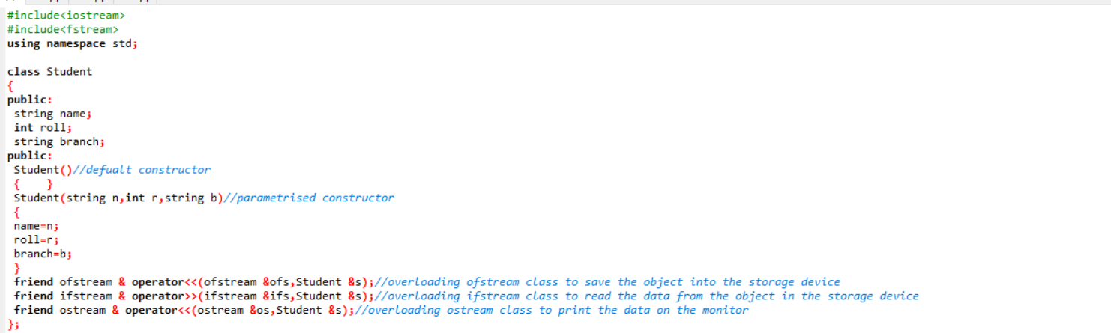
Student program -2by using constructors

Slide 19
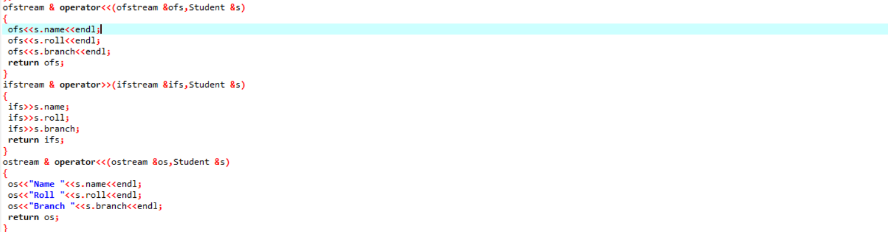

Slide 20
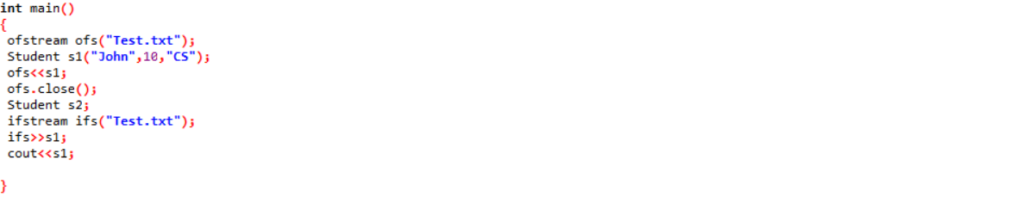

Slide 21
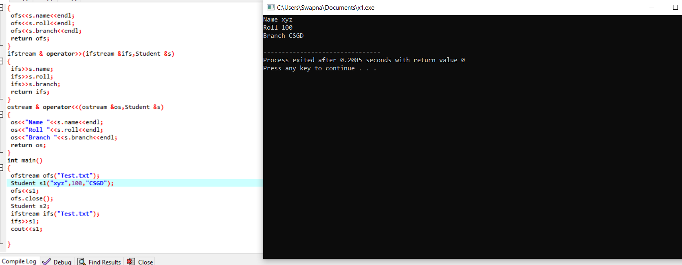

Slide 22
The ostream Class
The ostream class is a typedef to basic_ostream<char>. It contains two set of output functions: formatted output and unformatted output.
The formatted output functions (via overloaded stream insertion operator <<) convert numeric values (such as int, double) from their internal representations (e.g., 16-/32-bit int, 64-bit double) to a stream of characters that representing the numeric values in text form.
The unformatted output functions (e.g., put(), write()) outputs the bytes as they are, without format conversion.

Slide 23
This class is responsible for handling output stream. It provides number of function for handling chars, strings and objects such as write, put etc..

Slide 24
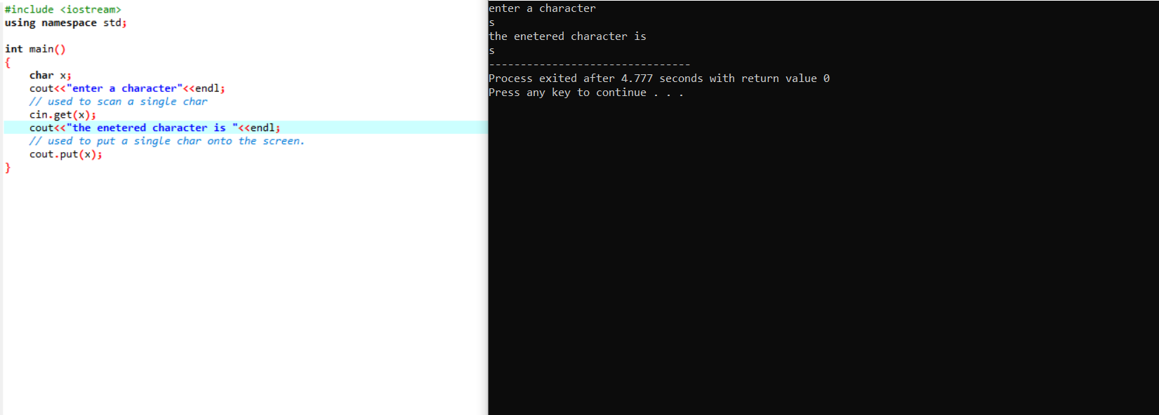

Slide 25
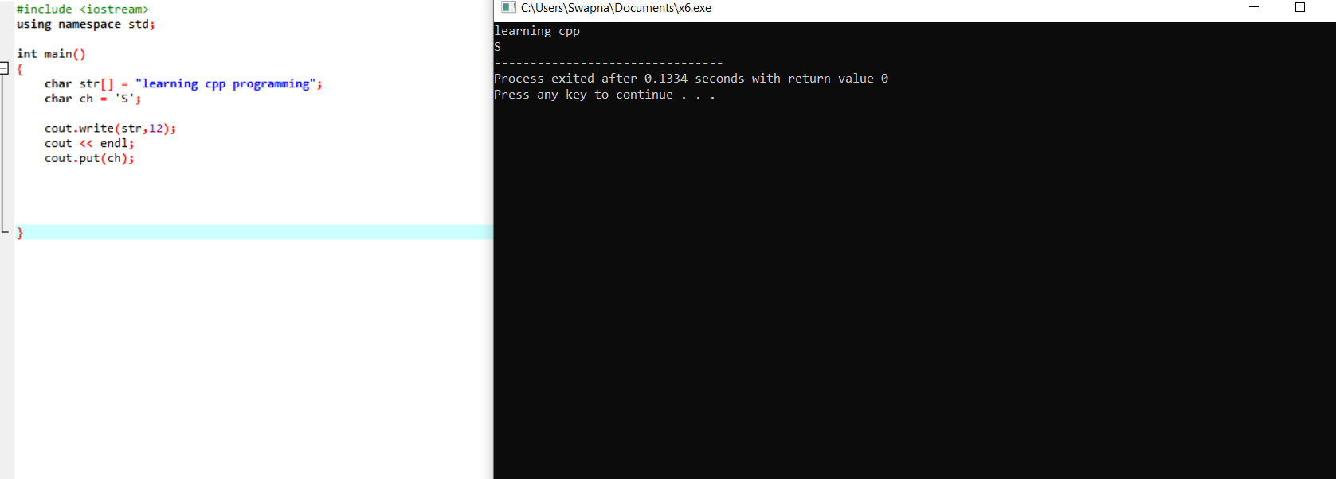

Slide 26
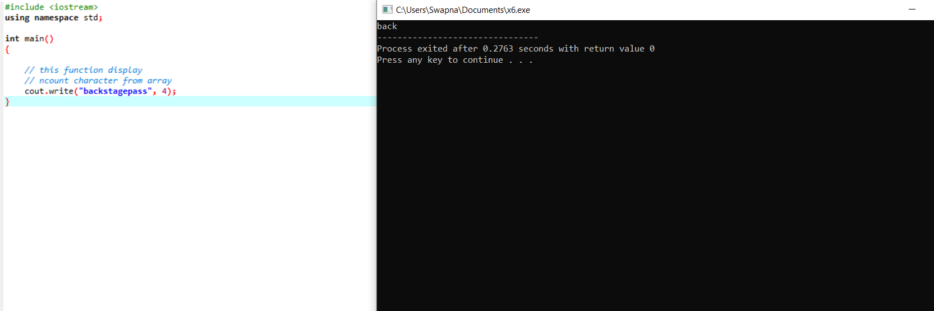

Slide 27
The istream class
imilar to the ostream class, the istream class is a typedef to basic_istream<char>. It also supports formatted input and unformatted input.
In formatting input, via overloading the >> extraction operator, it converts the text form (a stream of character) into internal representation (such as 16-/32-bit int, 64-byte double).
In unformatting input, such as get(), getlin(), read(), it reads the characters as they are, without conversion.

Slide 28
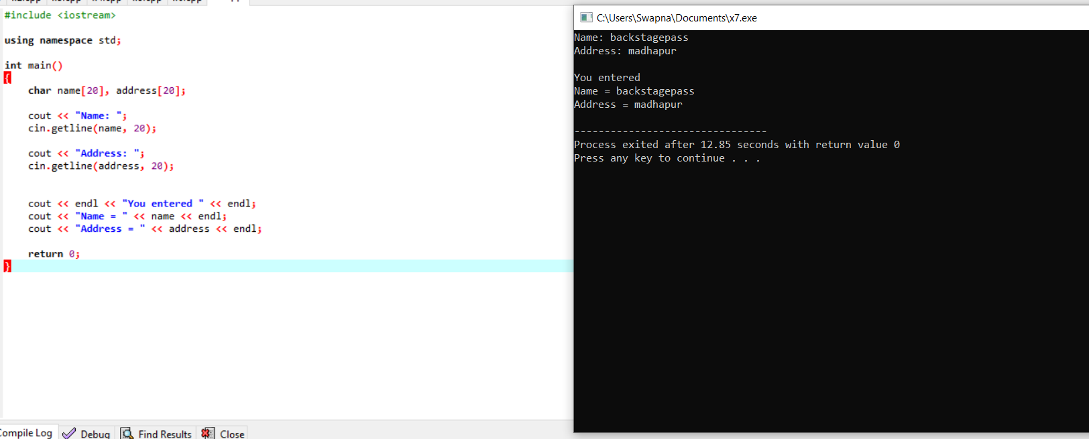

Slide 29
