Slide 1
C++ Exception Handling - try catch
An exception is a situation, which occured by the runtime error. In other words, an exception is a runtime error. An exception may result in loss of data or an abnormal execution of program.
Exception handling is a mechanism that allows you to take appropriate action to avoid runtime errors.

Slide 2
C++ provides three keywords to support exception handling.
Try : The try block contain statements which may generate exceptions.
Throw : When an exception occur in try block, it is thrown to the catch block using throw keyword.
Catch :The catch block defines the action to be taken, when an exception occur.

Slide 3
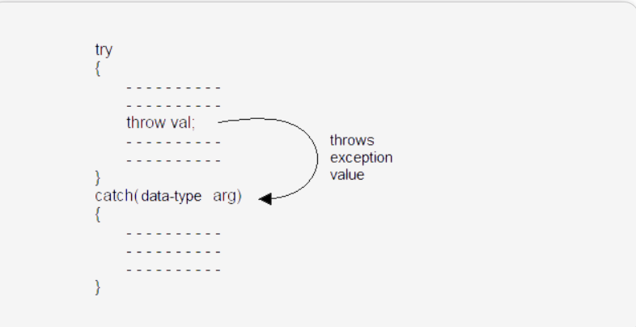
The general form of try-catch block in c++.

Slide 4
All about throw
int division(int x,int y)
{
if(y==0)
{
throw 1;
}
return x/y;
}

Slide 5
int division(int x,int y)
{
if(y==0)
{
throw 1.5f;
}
return x/y;
}
Catch(float e)
{
Cout<<“divsion by zero”<<endl;
}

Slide 6
int division(int x,int y)
{
if(y==0)
{
throw string(“div by 0”);
}
return x/y;
}
Catch(string e)
{
Cout<<“divsion by zero”<<endl;
}

Slide 7
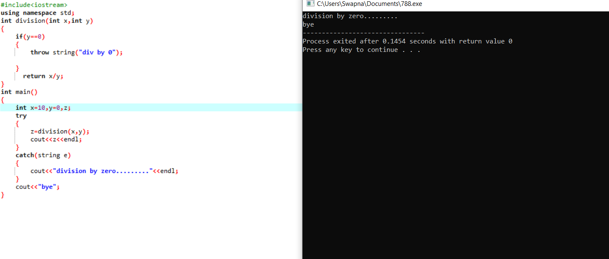

Slide 8
class myexception//creating our own exception class
{
};
int division(int x,int y)
{
if(y==0)
{
throw myexception();//throwing object of our exception
}
return x/y;
}

Slide 9
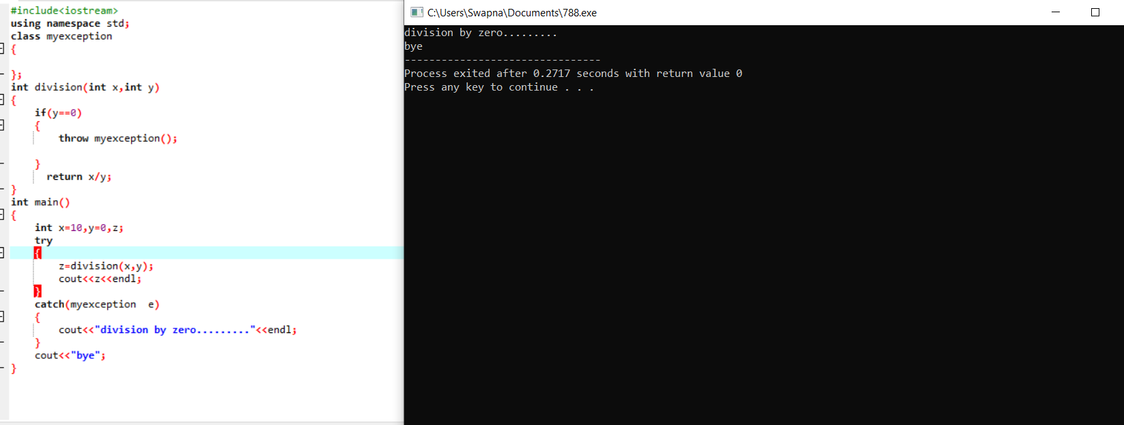

Slide 10
class myexception:public exception
{
char *what()//over ridden function
{
}
};
int division(int x,int y)
{
if(y==0)
{
throw myexception();//throwing object of our exception
}
return x/y;
}

Slide 11
int division(int x,int y)throw (int)
{
if(y==0)
{
throw 10;
}
return x/y;
}

Slide 12
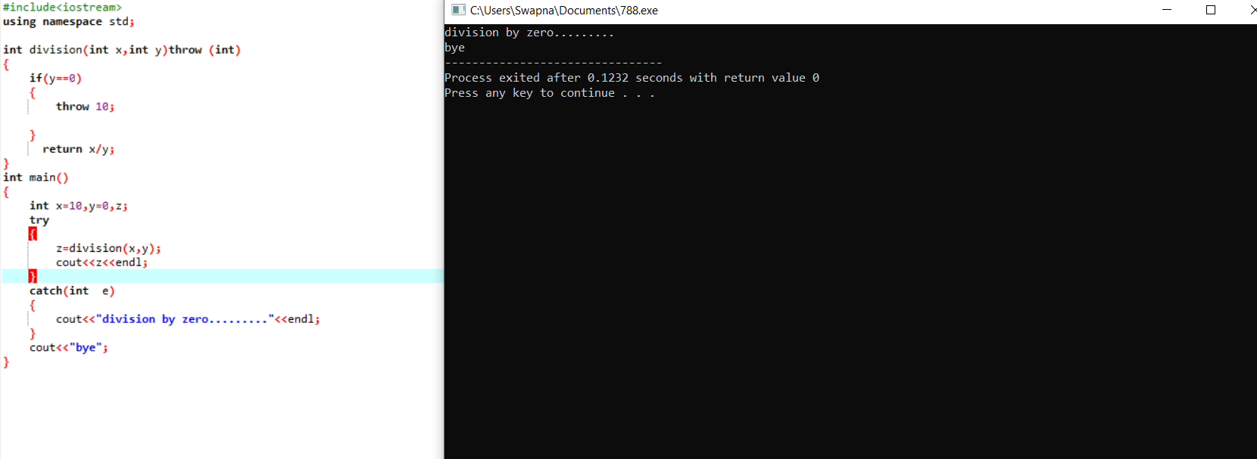

Slide 13
Class myexception:public exception
{
};
int division(int a,int b)throw(myexception)
{
if(b==0)
throw myexception();
return a/b;
}

Slide 14
Int division(int x,int y)throw()
{
Return x/y;
}
Int main()
{
Int x=10,y=5,z;
Z=division(x,y)
Cout<<z;
}

Slide 15
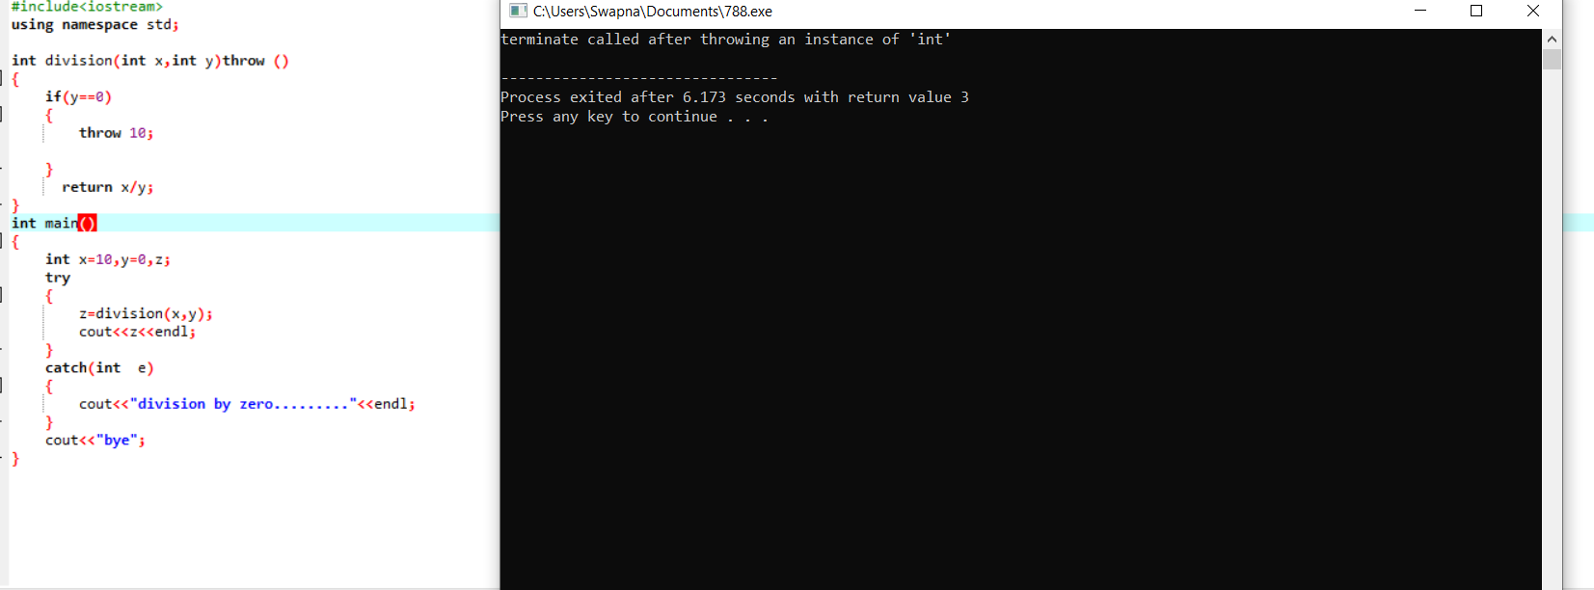

Slide 16
Multiple Catch Statements
A single try statement can have multiple catch statements. Execution of particular catch block depends on the type of exception thrown by the throw keyword. If throw keyword send exception of integer type, catch block with integer parameter will get execute.

Slide 17
Why multiple catch blocks are useful?
Multiple catch blocks are used when we have to catch a specific type of exception out of many possible type of exceptions i.e. an exception of type char or int or short or long etc.

Slide 18
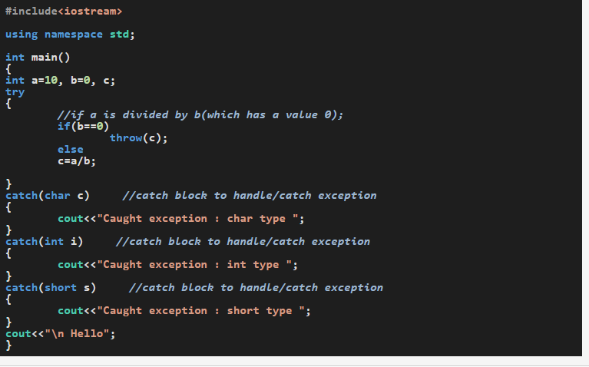

Slide 19
In this code, we have three catch blocks associated with one try block. At the runtime, compiler finds a division-by-zero problem, hence an exception of type int is thrown when a statement enclosed within the try block is executed. This exception type is matched with the declared exception type in every catch-block(matching starts with the first catch block). The catch block that matches with type of exception thrown is executed, while the rest of catch blocks are skipped. Let's see how -The first catch block has declared an exception of type char, which doesn't match with the exception int thrown by the try block, hence this catch-block is not executed.
The second catch block declared with an int matches with the exception int thrown by the try block and hence second catch block will be executed.
As, we have already found the matching catch block, hence, the third catch block with declared exception of type short is skipped, not checked and not executed.

Slide 20
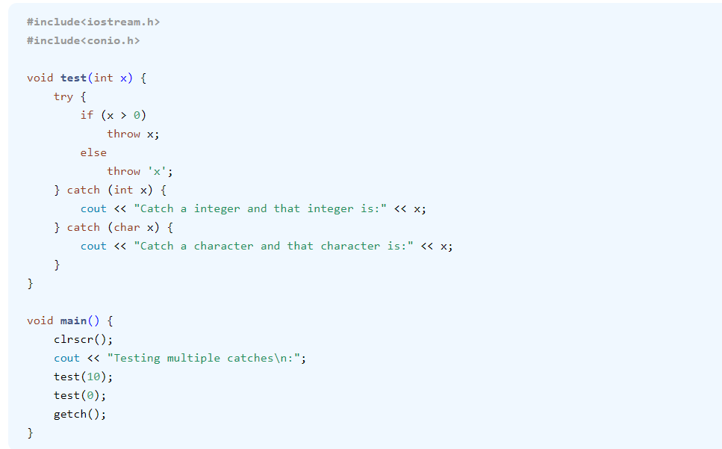

Slide 21
Catch All Exceptions
If an exception occur of long type, no catch block will get execute and abnormal program termination will occur. To avoid this, We can use the catch statement with three dots as parameter (...) so that it can handle all types of exceptions.

Slide 22
We could declare a catch block which catches all types of exceptions, irrespective of their types. In such catch block, instead of declaring the type of exception it can catch, we are going to use three dots(...) within its parenthesis

Slide 23
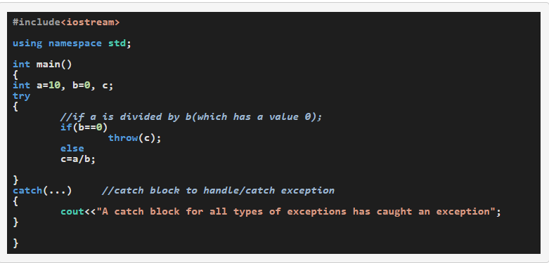

Slide 24
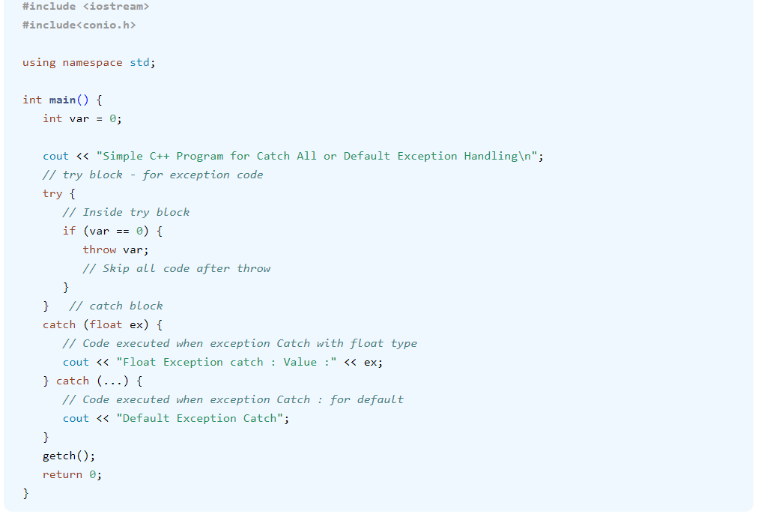

Slide 25
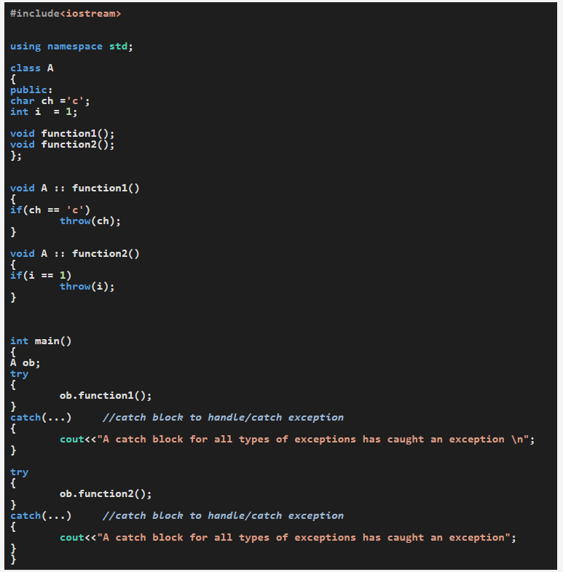

Slide 26
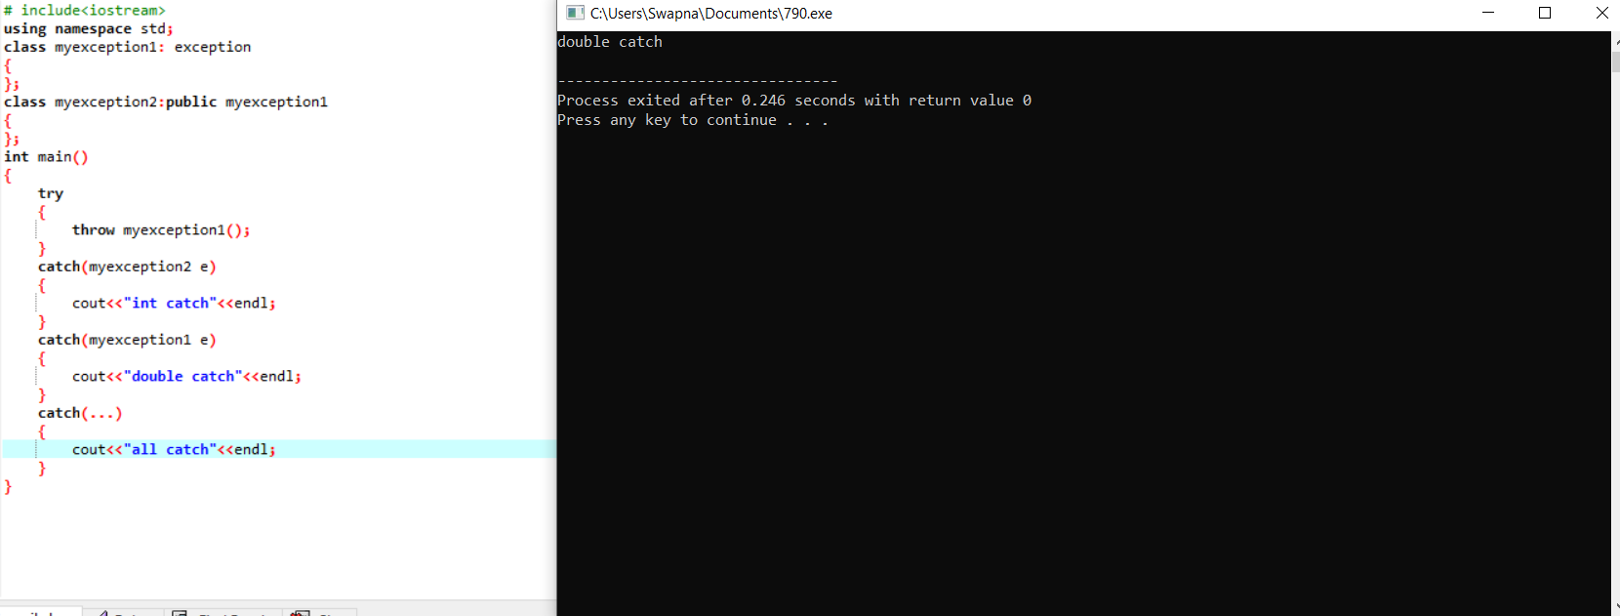

Slide 27
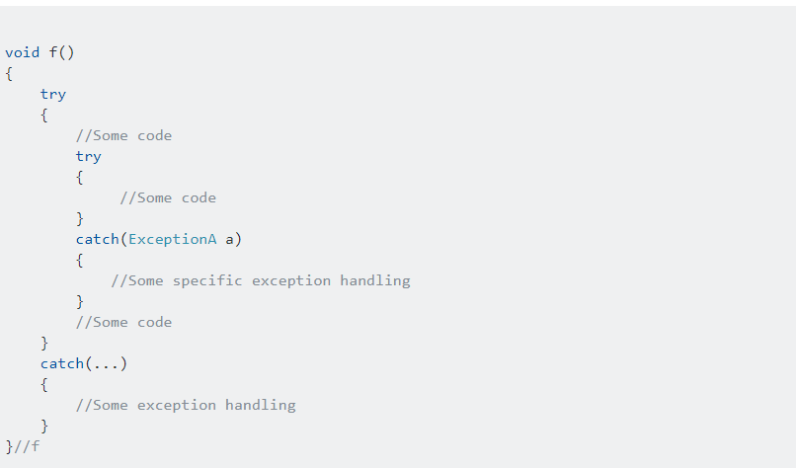
Nested try block in exception handling

Slide 28
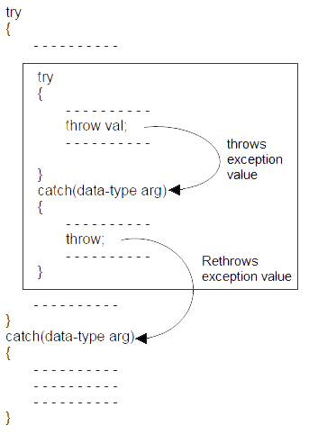
Syntax of re throwing exceptions

Slide 29
Rethrowing Exceptions
Rethrowing exception is possible, where we have an inner and outer try-catch statements (Nested try-catch). An exception to be thrown from inner catch block to outer catch block is called rethrowing exception.

Slide 30
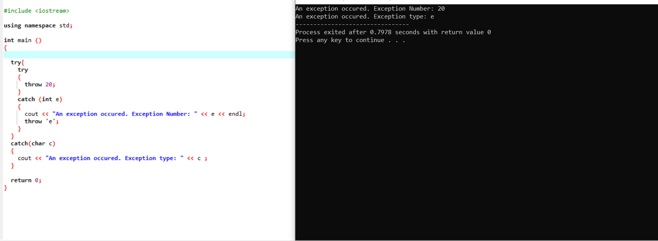

Slide 31
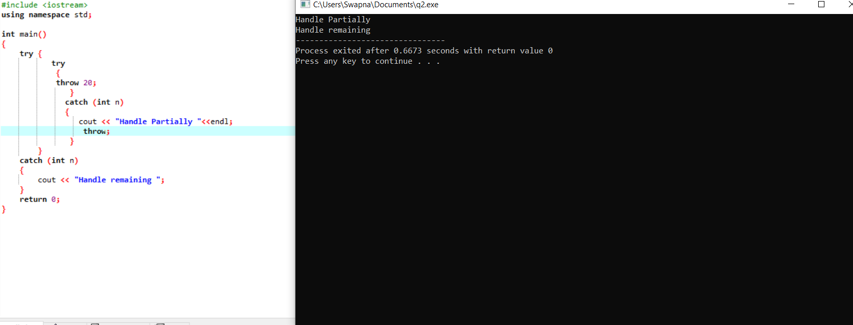

Slide 32
Restricting Exceptions
We can restrict the type of exception to be thrown, from a function to its calling statement, by adding throw keyword to a function definition.
Returntype functionname(arglist) throw()

Slide 33
Exception specification
. A dynamic exception specification follows the declaration of a function, appending a throw specifier to it. For example: double myfunction (char param) throw (int);
This declares a function called myfunction, which takes one argument of type char and returns a value of type double. If this function throws an exception of some type other than int, the function calls std::unexpected instead of looking for a handler or calling std::terminate. If this throw specifier is left empty with no type, this means that std::unexpected is called for any exception. Functions with no throw specifier (regular functions) never call std::unexpected, but follow the normal path of looking for their exception handler. 1 2 int myfunction (int param) throw(); // all exceptions call unexpected int myfunction (int param); // normal exception handling

Slide 34
Stack unwinding
When we call some functions, it stores the address into call stack, and after coming back from the functions, pops out the address to start the work where it was left of.
The stack unwinding is a process where the function call stack entries are removed at runtime. To remove stack elements, we can use exceptions. If an exception is thrown from the inner function, then all of the entries of the stack is removed, and return to the main invoker function

Slide 35
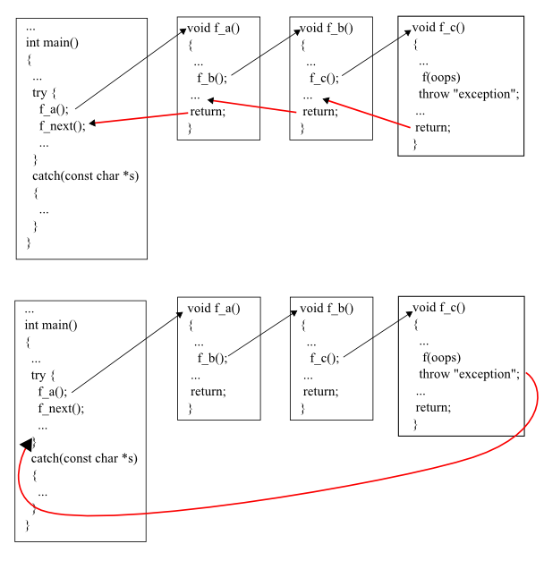

Slide 36
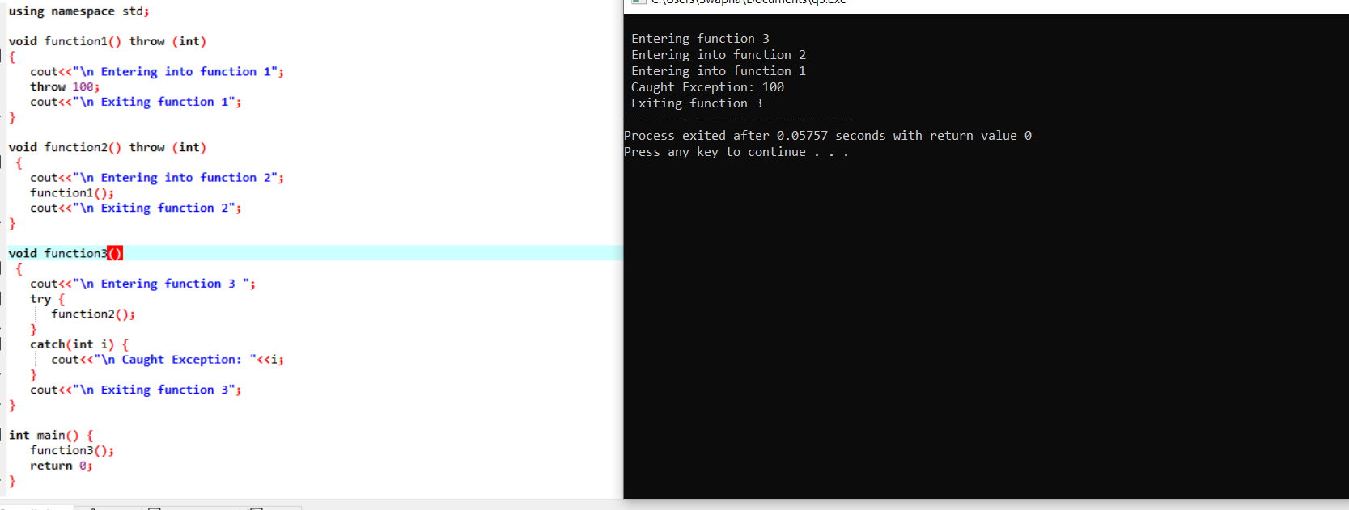

Slide 37
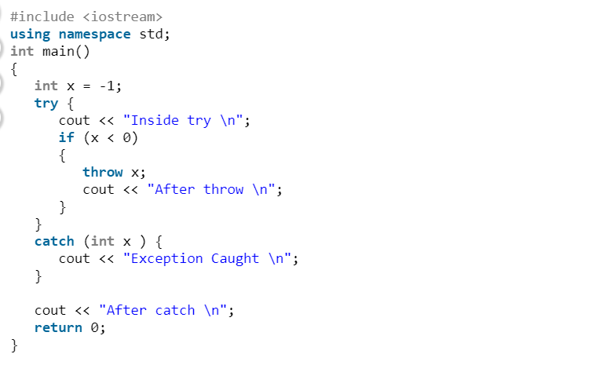

Slide 38
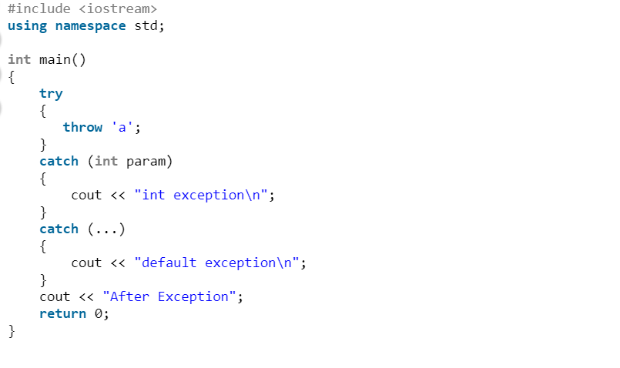

Slide 39
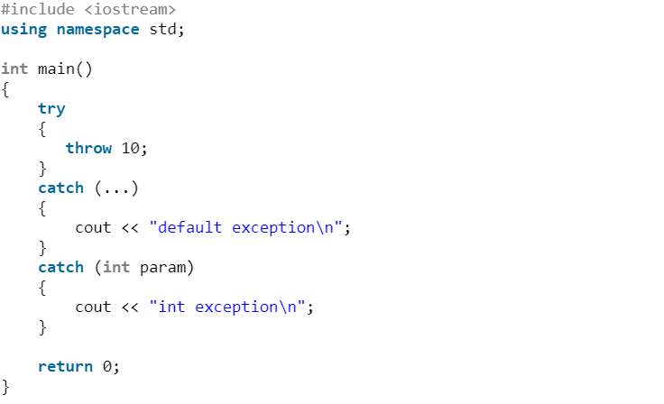

Slide 40
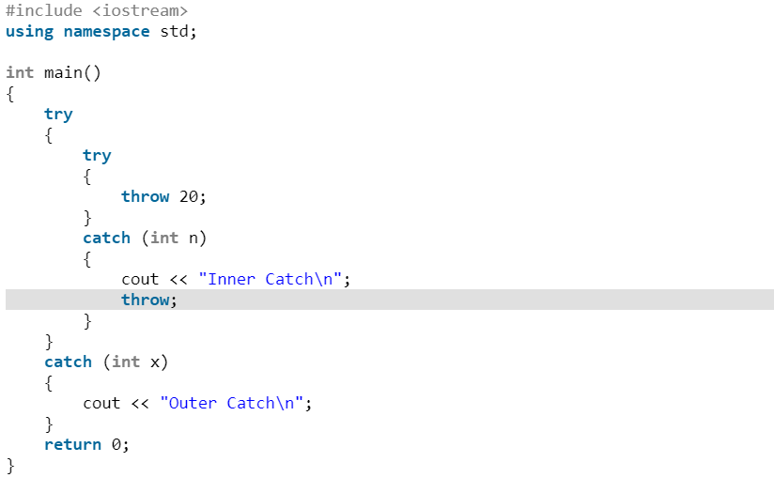

Slide 41
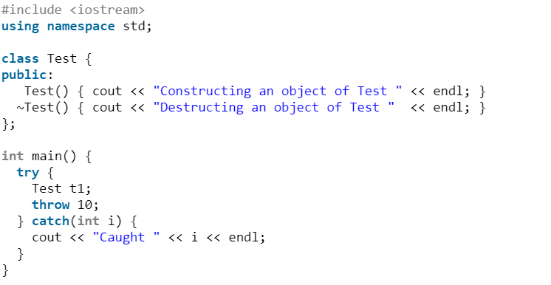

Slide 42
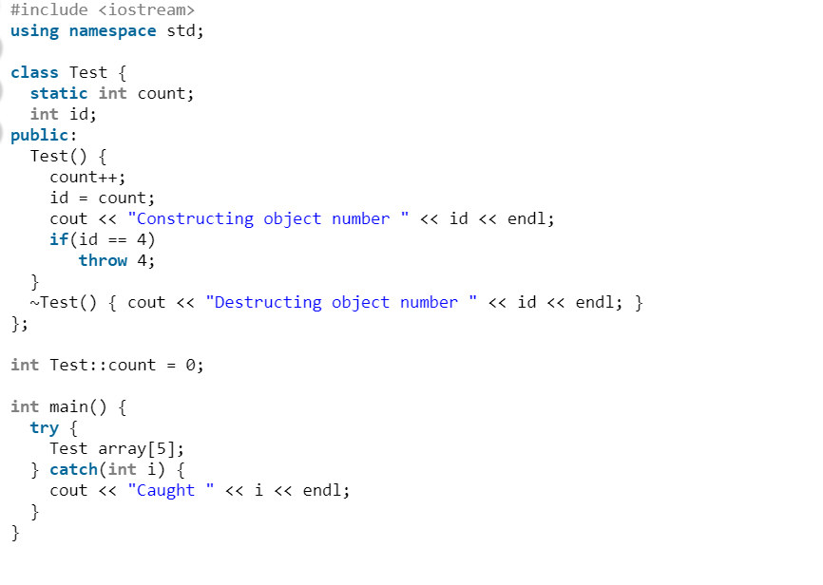

Slide 43
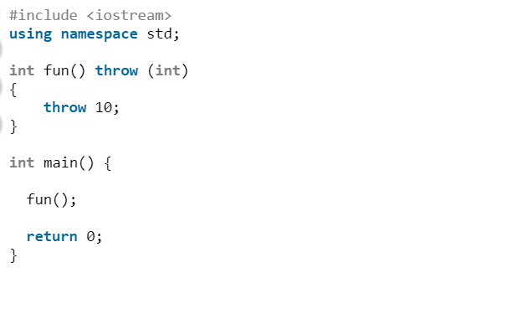

Slide 44
#include <iostream>
using namespace std;
int fun()
{
throw 10;
}
int main()
{
try
{
fun();
}
catch (int )
{
cout << "Caught";
}
return 0;
}

