Slide 1
Polymorphism
swapna naidu

Slide 2

Generalisation & specialisation
rectangle
cuboid
swapna naidu

Slide 3
specialization
Which one existing first?
Rectangle or cuboid
Rectangle was existing first then we have a specialised class cuboid
swapna naidu

Slide 4
Specialization ex
INNOVA
FORTUNER
swapna naidu

Slide 5
GENERALISATION
SHAPE
RECTANGLE
CUBOID
TRIANGLE
swapna naidu

Slide 6
GENERALISATION
CAR
SANTRO
MARUTI
BRV
swapna naidu

Slide 7
generalisation
Shape and car are virtual term/general term/generic term which does not exist
Can we find area and perimeter of shape?
No,it does not exist
Can we find area and perimeter of square?
yes
swapna naidu

Slide 8
specialisation | generalisation
Top down approarch- purpose inheritance | Bottom up approach-purpose-poymorphism
Parent class exists and the child get the data members and member function from parent class | Parent classdoes not exists and the child does not get the data members and member function from parent class
swapna naidu

Slide 9
Polymorphism-same name different forms
Rectangle-shape(we can call it as a shape)
Square-shape
Triangle-shape
Ex-2
Innova-car
Maruti-car
Brv-car
swapna naidu

Slide 10
Polymorphism
The word ‘poly’ originated from a Greek word meaning many and ’morphism’ from a Greek word form, and thus polymorphism means many forms.
Polymorphism is a process of defining a number of objects of different classes into a group and call the methods to carry out the operation of the object using different function calls.
Polymorphism refers to run time binding to pointer to a method.
swapna naidu

Slide 11
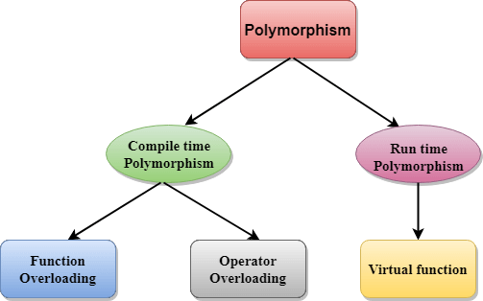
swapna naidu

Slide 12
Compile time polymorphism-early binding-static polymorphism
Run time polymorphism-late binding-dynamic polymorphism
swapna naidu

Slide 13
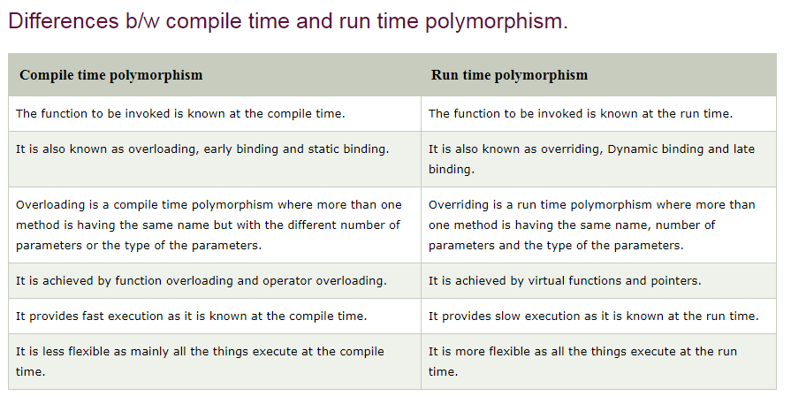
swapna naidu

Slide 14
Base class pointer derived class object
Class base
{
Public:
Void func1();
Void func2();
Void func3();
};
Class derived:public base
{
Public:
Void func4();
Void func5();
};
Int main()
{
Step1:
Base b;
b.func1();//possible-base class object can call all its functions
b.func2(); //possible
b.func3(); //possible
b.func4();//not possible because parent class object cannot call derived class functions
swapna naidu

Slide 15
Step 2
Derived d;// creating object to derived class and it can call both base class functions as well as derived class
d.func1();
d.func2();
d.func3();
d.func4();
d.func5();
Step 3:
Derived d;//creating object to derived class
Base *ptr;//creating pointer to base class
Ptr=&d;//initialiasation of pointer with the address of dervied class object
Ptr->func1();//possible
Ptr->func2(); //possible
Ptr->func3(); //possible
Ptr->func4();// not possible
Ptr->func5();//not possible
Step 4;
base b;
Derived *ptr;
Ptr=&b;// not possible
We cannot assign base class object address to derived class pointer
swapna naidu

Slide 16
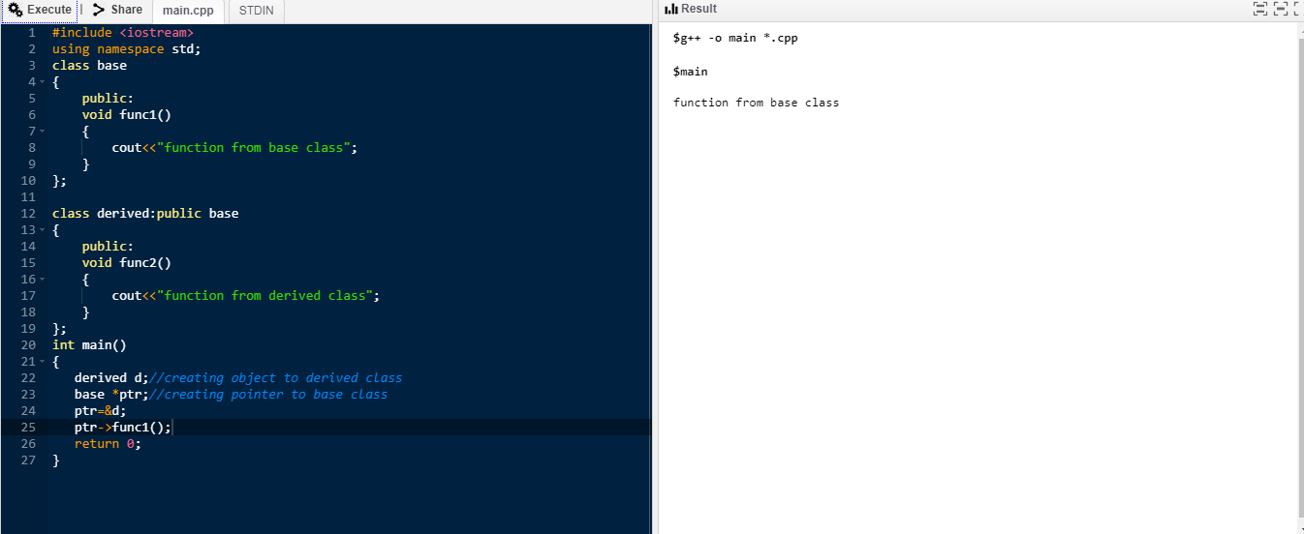
Base class pointer derived class object prg 1
swapna naidu

Slide 17
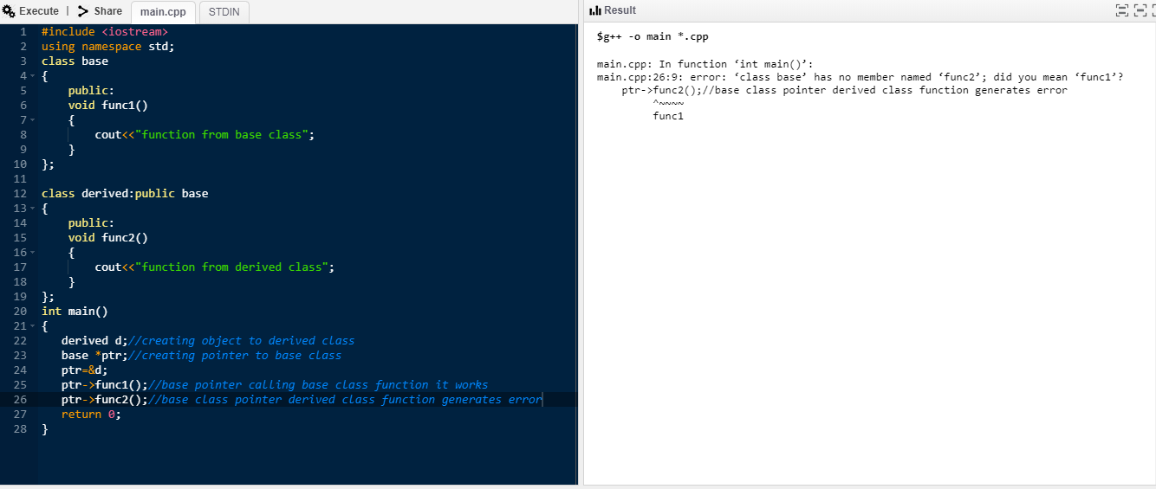
Base class pointer derived class object prg 2
swapna naidu

Slide 18
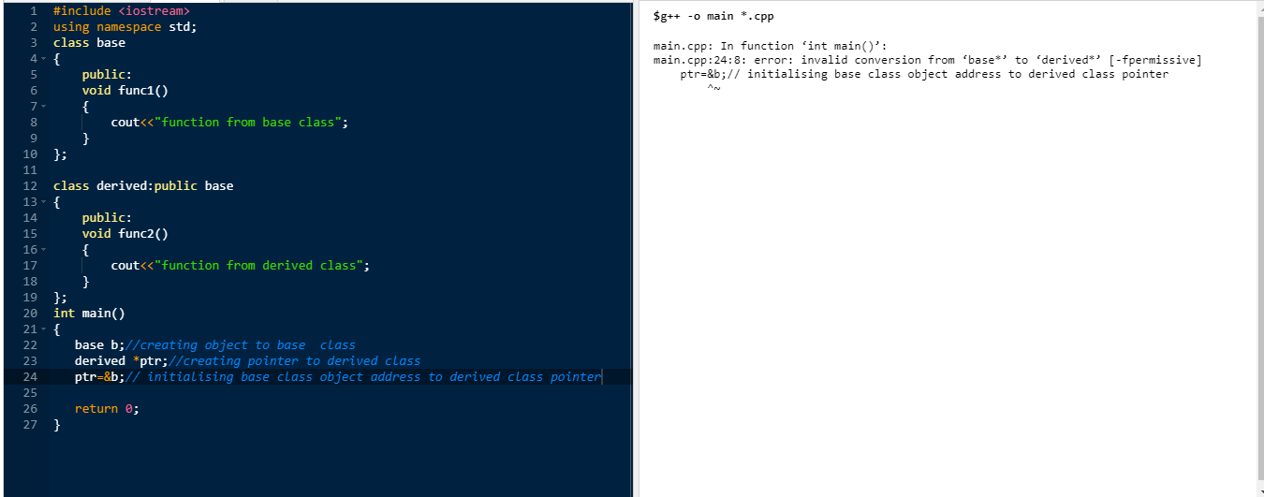
swapna naidu

