Slide 1
streams
C++ stream refers to the stream of characters that are transferred between the program thread and i/o.
Stream classes in C++ are used to input and output operations on files and io devices. These classes have specific features and to handle input and output of the program.
The iostream.h library holds all the stream classes in the C++ programming language.

Slide 2
Files:the information/data stored under a specific name on a storage device,is called a file.
Streams:a sequence of bytes.there are 2 types of streams
Text file:it is a file stores information in ASCII characters.in text files,each line of text is terminated with a special character EOL character or delimiter character.when this EOL character is read or written certain internal translations take place.
Binary file:it is a file that contains information in the same format as it is held in memory .in binary files,no delimiters are used for a line and no translations occur here

Slide 3
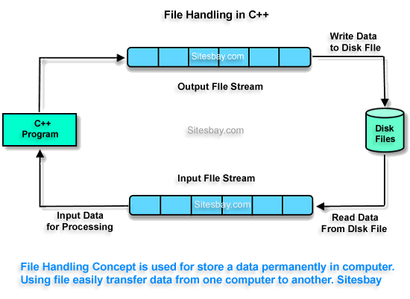

Slide 4
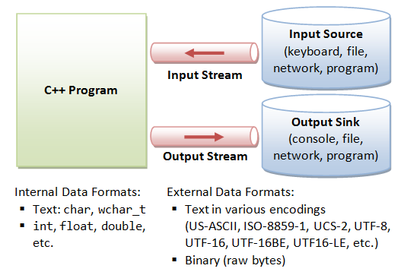

Slide 5
Classes for file stream
IOS
STREAMBUF
OSTREAM
ISTREAM
IOSTREAM
IFSTREAM
FSTREAM
OSTREAM

Slide 6
'stream' is internally a series of characters.
Streams work with built-in data types, and you can make user-defined types work with streams by overloading the insertion operator (<<) to put objects into streams, and the extraction operator (>>) to read objects from streams.

Slide 7
IOS is the base class
ISTREAM and OSTREAM inherit from IOS
IFSTREAM inherits from ISTREAM
OFSTREAM inherits from OSTREAM
IOSTREAM inherits from ISTREAM and OSTREAM.
FSTREAM inherits from IFSTREAM,IOSTREAM,and OFSTREAM

Slide 8
The ios class: The ios class is responsible for providing all input and output facilities to all other stream classes.
The istream class: This class is responsible for handling input stream. It provides number of function for handling chars, strings and objects such as get, getline, read, ignore, putback etc..
The ostream class: This class is responsible for handling output stream. It provides number of function for handling chars, strings and objects such as write, put etc..
The iostream: This class is responsible for handling both input and output stream as both istream class and istream class is inherited into it. It provides function of both istream class and istream class for handling chars, strings and objects such as get, getline, read, ignore, putback, put, write etc..

Slide 9
Writing data into the file
Ofstream outfile(“my.txt”);
Ofstream outfile(“my.txt”,ios::trunc);
Ofstream outfile(“my.txt”,ios::app);

Slide 10
Opening a file
A file must be opened before you can read from it or write to it. Either ofstream or fstream object may be used to open a file for writing. And ifstream object is used to open a file for reading purpose only.
Following is the standard syntax for open() function, which is a member of fstream, ifstream, and ofstream objects
void open(const char *filename, ios::openmode mode);
Here, the first argument specifies the name and location of the file to be opened and the second argument of the open() member function defines the mode in which the file should be opened.

Slide 11
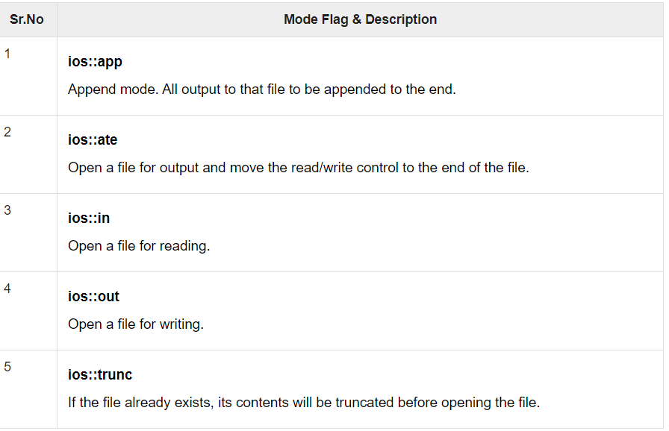

Slide 12
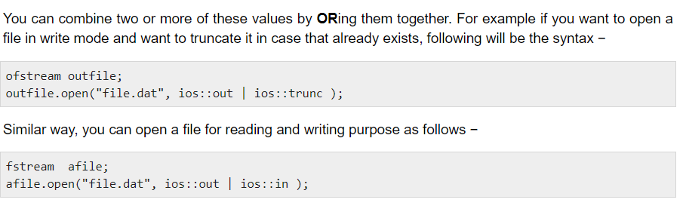

Slide 13
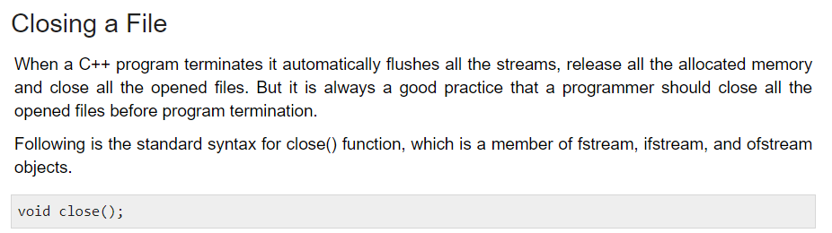

Slide 14
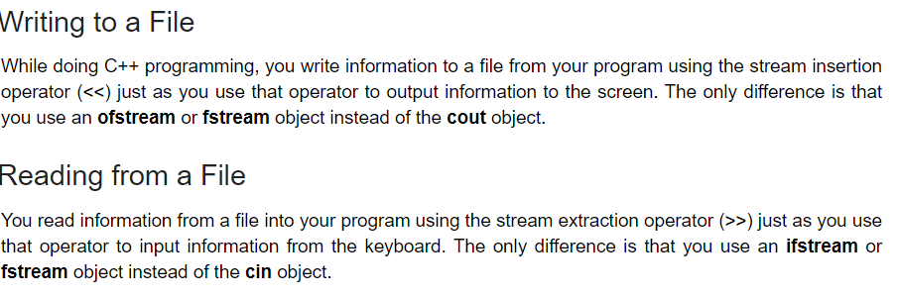

Slide 15
cin ofstream
cout ifstream
File storage
program
keyboard
program
monitor

Slide 16
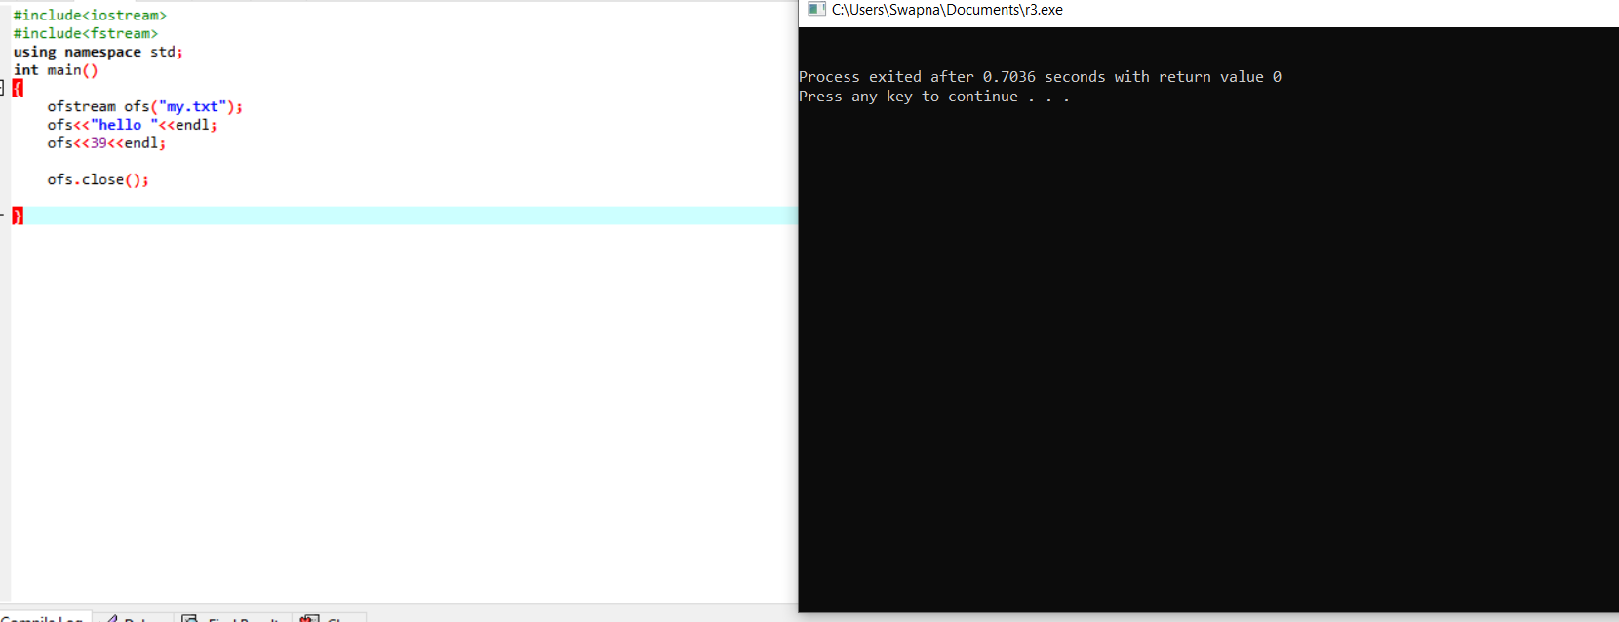
Writing data into the file

Slide 17
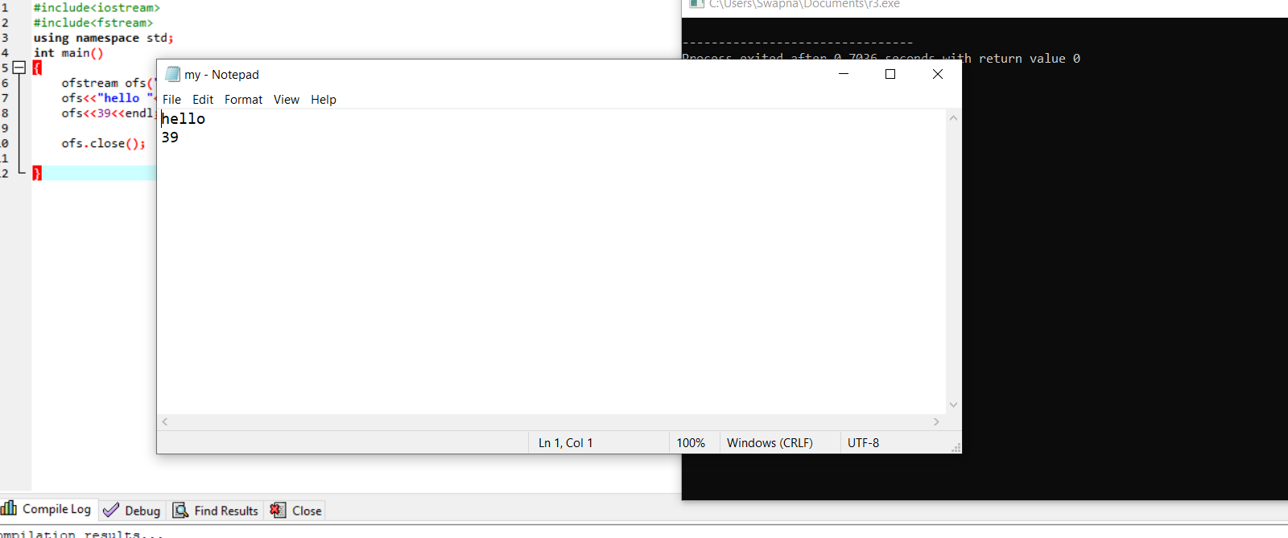
Checking whether the file is created or not

Slide 18
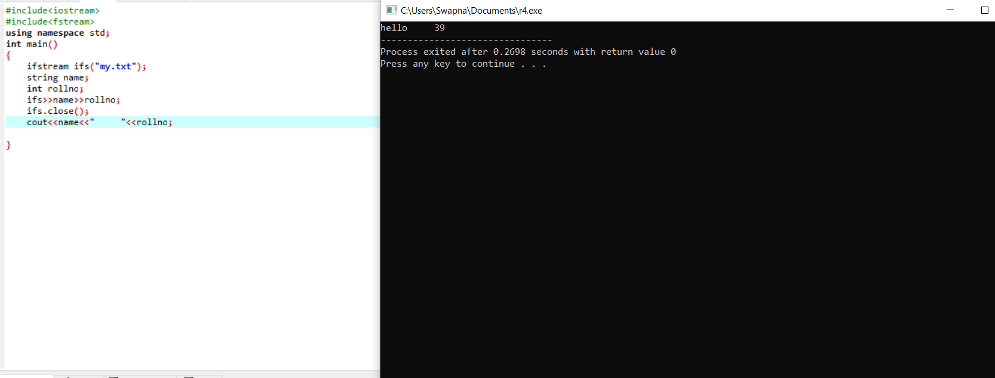
Reading data from the file and writing into output device

Slide 19
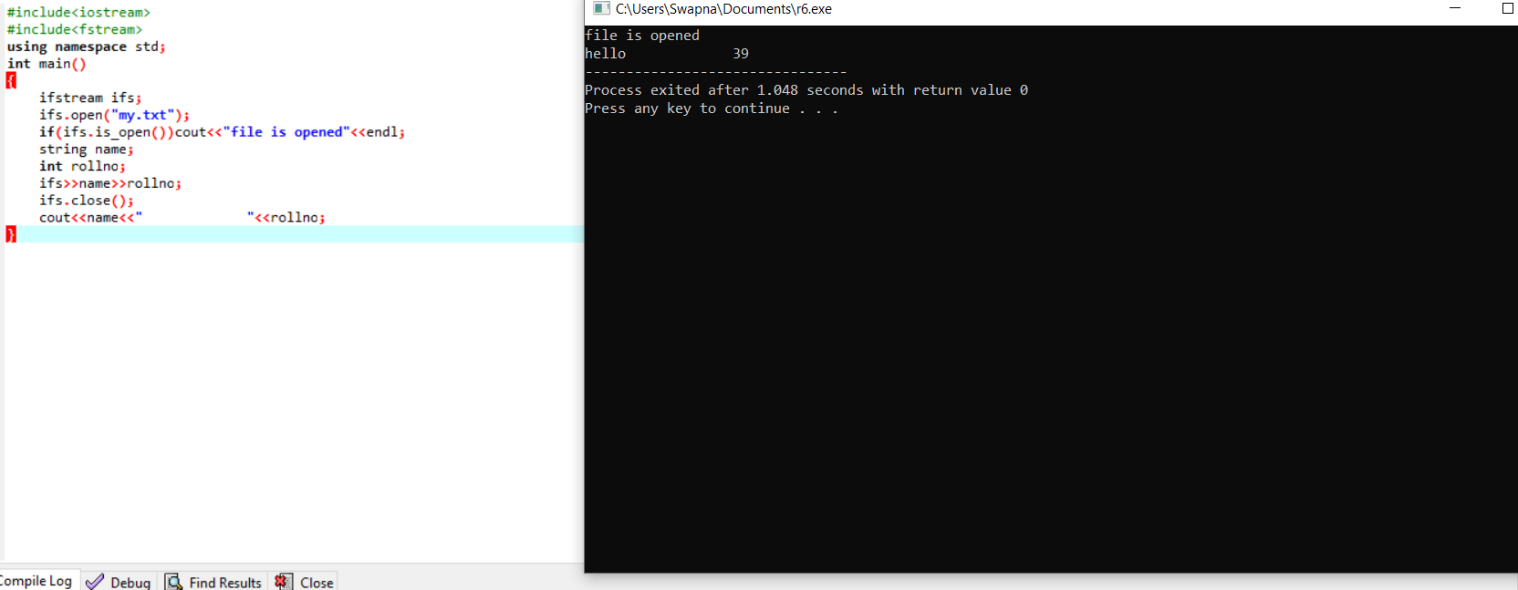

Slide 20


Slide 21


Slide 22
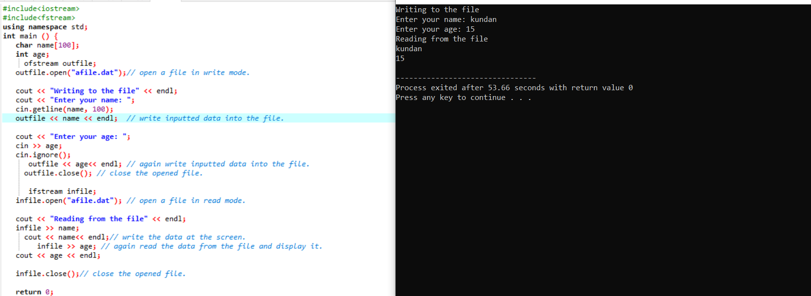

Slide 23
