Slide 1
Food Excess Analysis & Policy Framework
First causal evidence that bans without infrastructure fail — the Massachusetts model shows how to fix it
GW DSA Datathon 2026

Slide 2
The Scale of America's Food Waste Crisis
70.7M tons
23.0M tons
ZERO
221M MT CO2e
Annual Food Surplus
Sent to Landfill
Residential Donations
GHG Emissions
$384 billion in economic value
38.5% of all food waste — largest single destination
Despite $141B in surplus food and 23.5M tons
Equivalent to 48 million cars on the road
114.9B meals
Off track
Meals Wasted
2030 Goal Progress
While 44 million Americans face food insecurity
Per capita waste increased 6% from 2016-2019
Source: ReFED Food Waste Monitor, 2024 | Authors' analysis

Slide 3
A Four-Pillar Analytical Approach
1
2
3
4
National EDA
Machine Learning
Causal Inference
Policy Framework
9 charts exploring 70.7M tons across sectors, causes, and trends
XGBoost + SHAP on 216K observations; state clustering for targeting
DiD + Event Study + Synthetic Control on 15-year state panel
Three-tier recommendations calibrated from causal estimates
Each pillar builds on the last — EDA reveals patterns, ML quantifies drivers,
causal inference proves what works, and policy translates evidence into action.

Slide 4
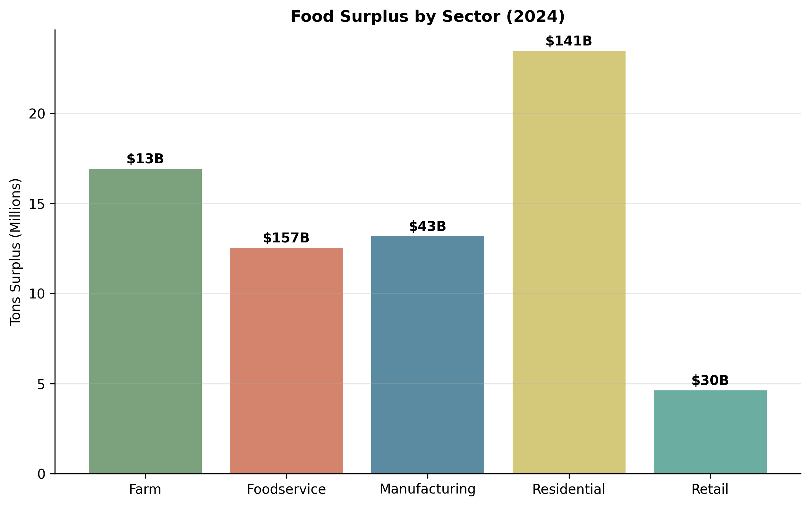
Where Food Waste Happens
Residential dominates: 33% of surplus ($141B), 49% of landfill waste, yet ZERO donations. Foodservice sends 42% of all waste to landfill despite only 18% of surplus.
48.7% of landfill waste is Residential
Source: ReFED Food Waste Monitor, 2024 | Authors' analysis

Slide 5
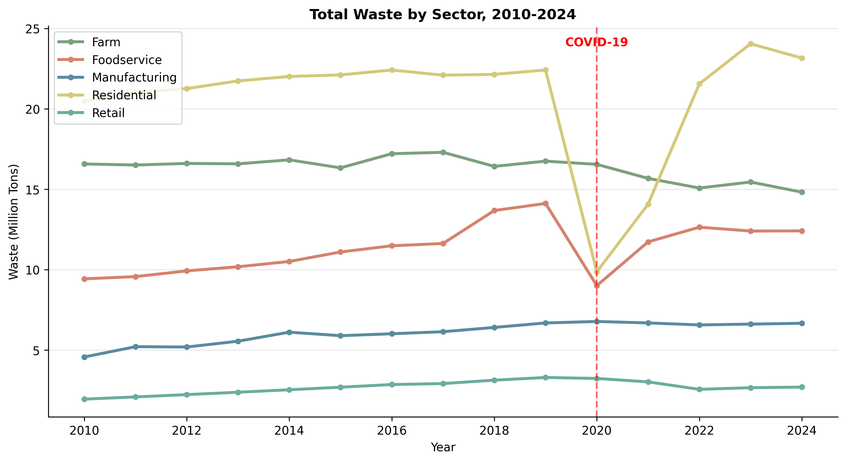
15 Years of Growing Waste
Surplus grew 14% (62M→70.7M tons) from 2010–2024. COVID caused a temporary drop in 2020, but waste rebounded sharply.

Slide 6
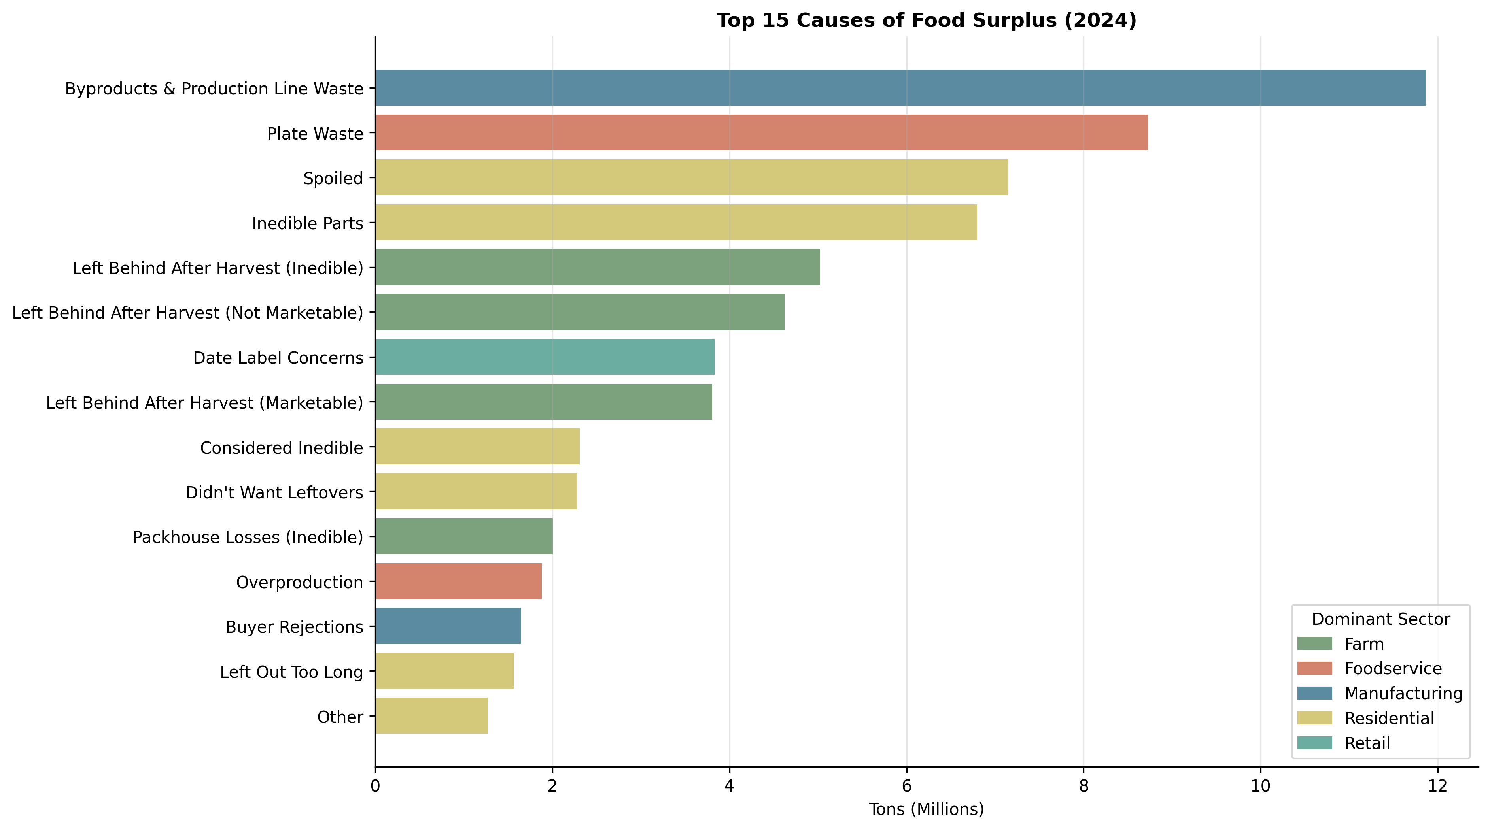
Why Food Goes to Waste
#1 Cause Byproducts & Production Line Waste 11.9M tons 90% of Manufacturing waste
Source: ReFED Food Waste Monitor, 2024 | Authors' analysis

Slide 7
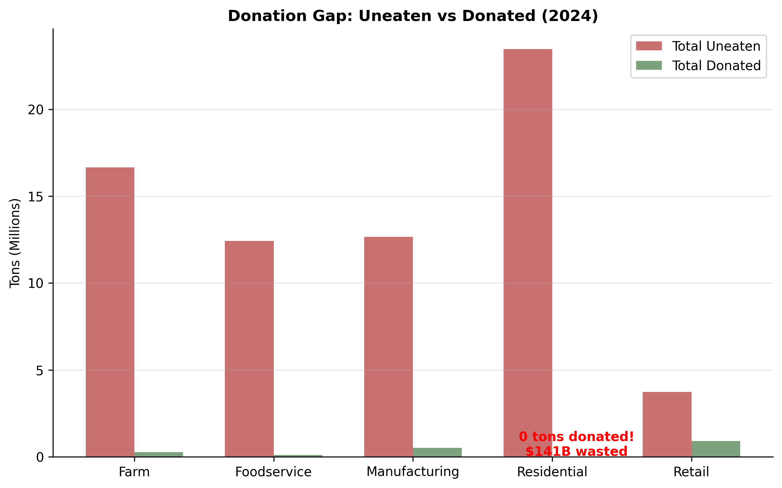
The $141 Billion Blind Spot
Residential Sector 23.5M tons surplus $141B value ZERO donations
Source: ReFED Food Waste Monitor, 2024 | Authors' analysis

Slide 8
Machine Learning Insights
What drives food waste to landfill?

Slide 9
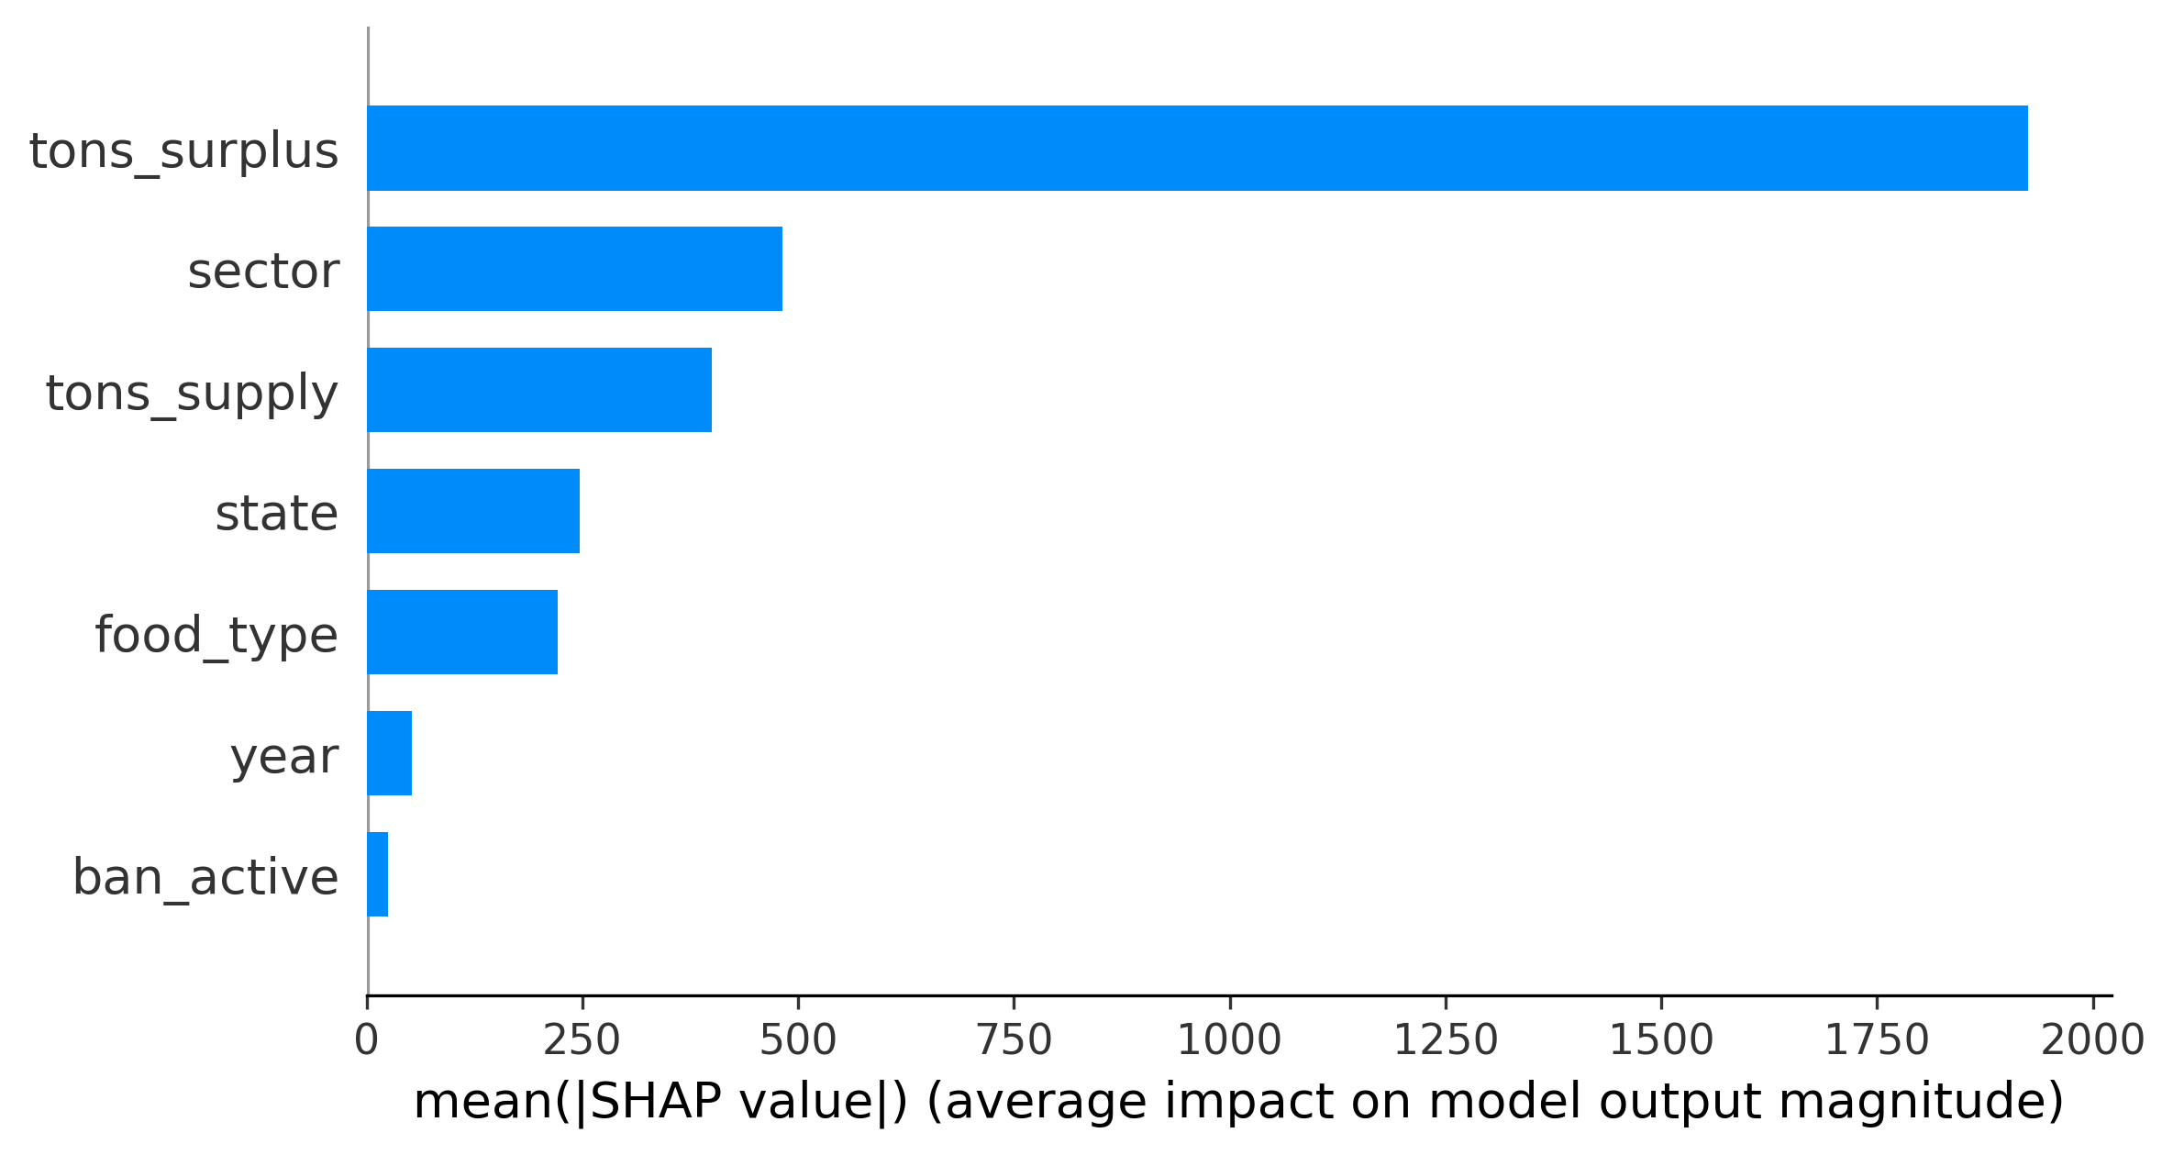
XGBoost + SHAP: Key Drivers of Landfill Waste
Key Insight State infrastructure is 6x more important than ban status for predicting diversion success State SHAP: 0.177
Ban SHAP: 0.028
Model CV R² = 0.9448 (landfill) | 0.9714 (diversion) | N = 216,930

Slide 10
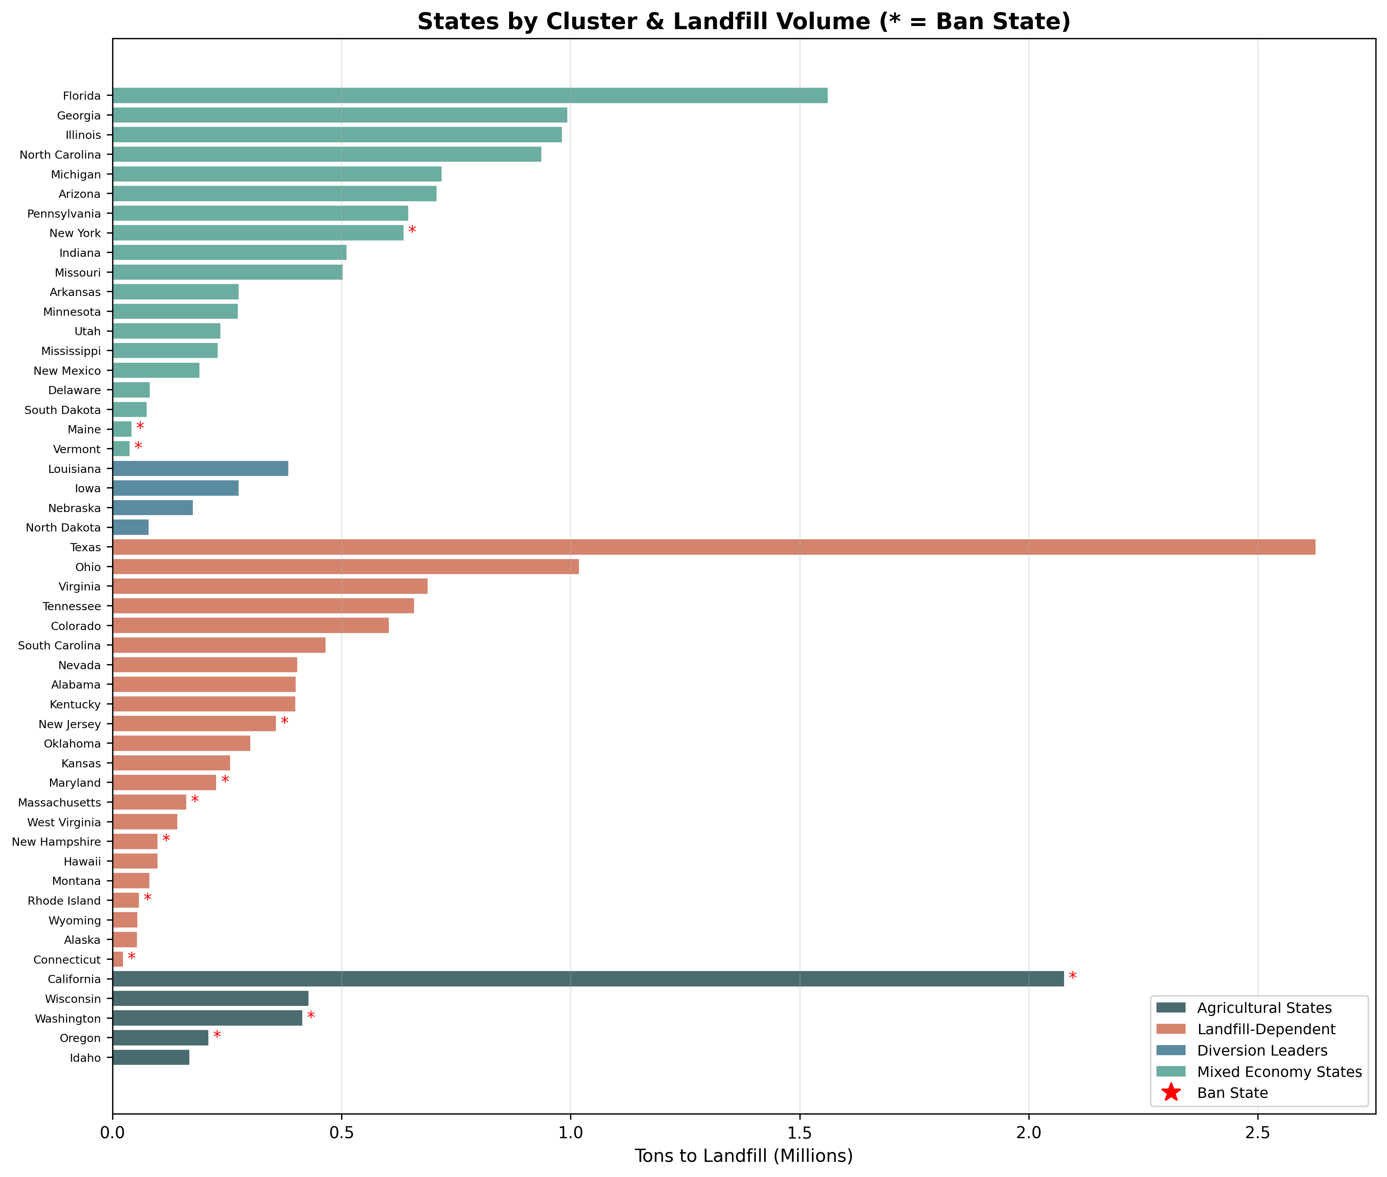
Four State Archetypes
Landfill-Dependent (22 states): 53.9% avg landfill rate — highest priority targets Agricultural States (5): 20.7% rate — policy leaders Mixed Economy (19): 43.4% rate — second priority tier Diversion Leaders (4): High diversion via agricultural infrastructure, no mandates
Source: ReFED Food Waste Monitor, 2024 | Authors' analysis

Slide 11
Causal Evidence
Do organic waste bans actually work?

Slide 12
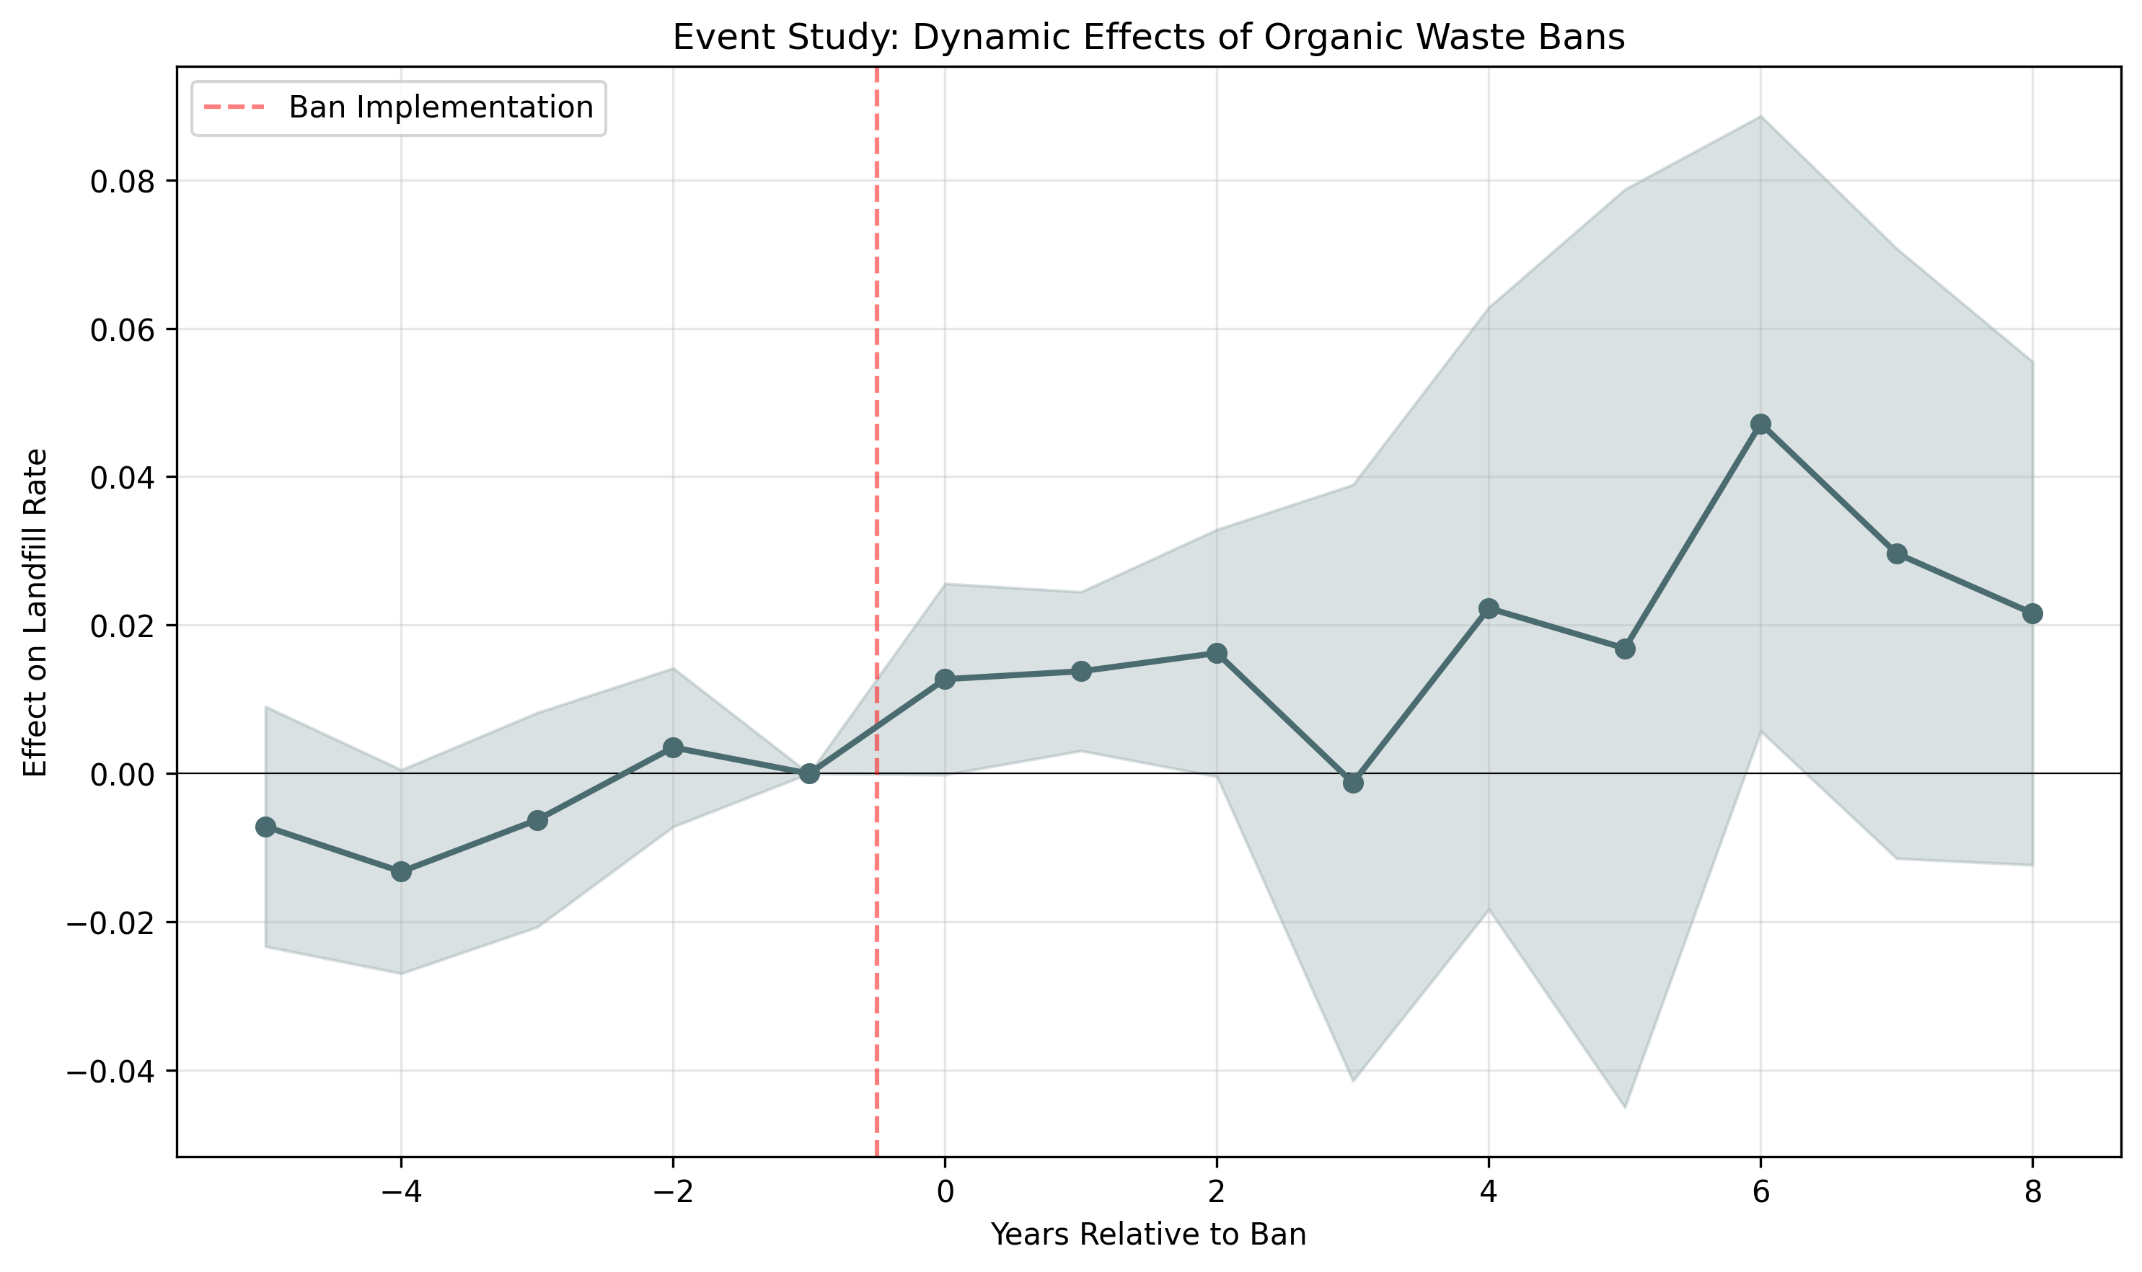
First Causal Evidence: Bans Alone Increase Landfill Rates
Difference-in-Differences β = +2.03 pp on landfill rate p = 0.008 | R² = 0.989 Method: Two-way FE DiD State-clustered SEs 12 treated, 38 control states 15 years (2010–2024) Pre-trends validated ✓ Effects grow to 4.72 pp at t+6

Slide 13
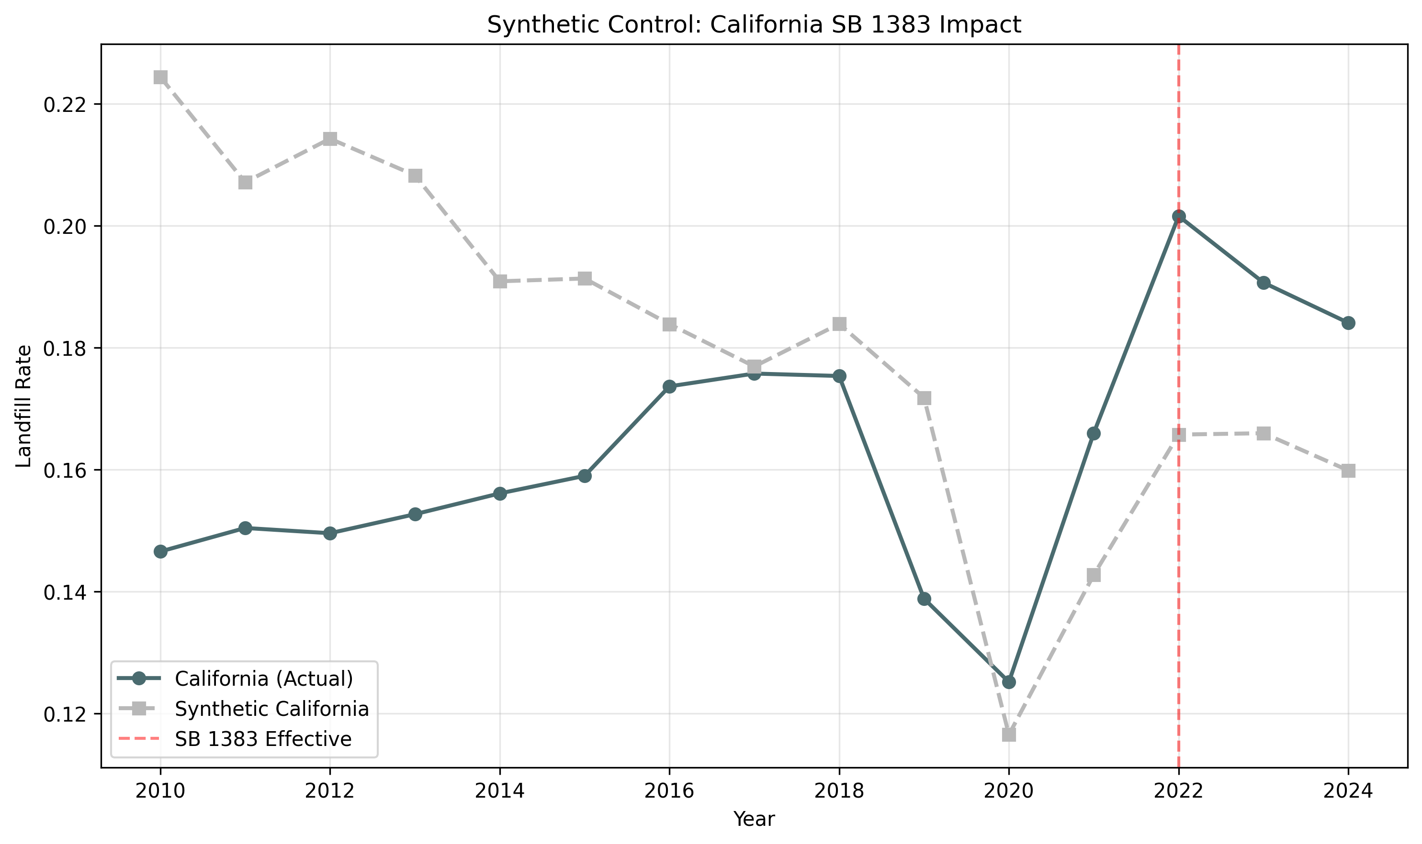
California Case Study: SB 1383 Impact
Post-2022 gap: +2.83 pp
landfill rate vs. counterfactual

Slide 14
Three-Tier Policy Framework
FEDERAL
STATE
SECTOR
Date Label Standardization 425K tons/yr | $1.82B net benefit Most cost-effective single intervention National Organic Waste Mandate 779K tons/yr shifted
Paired with infrastructure investment
Massachusetts model as template
Infrastructure-Backed Bans Expand to 38 non-ban states Priority: FL (86K), TX (83K), WI (54K) 22 'Landfill-Dependent' states first Donation & Composting Infra Close $141B residential gap
Curbside organics collection
Community food recovery hubs
Residential Labels + composting + education 33% of surplus, $141B, 0 donations Foodservice Waste tracking mandates 42% of landfill, 18% of surplus Farm Gleaning + secondary markets
13.4M tons not harvested

Slide 15
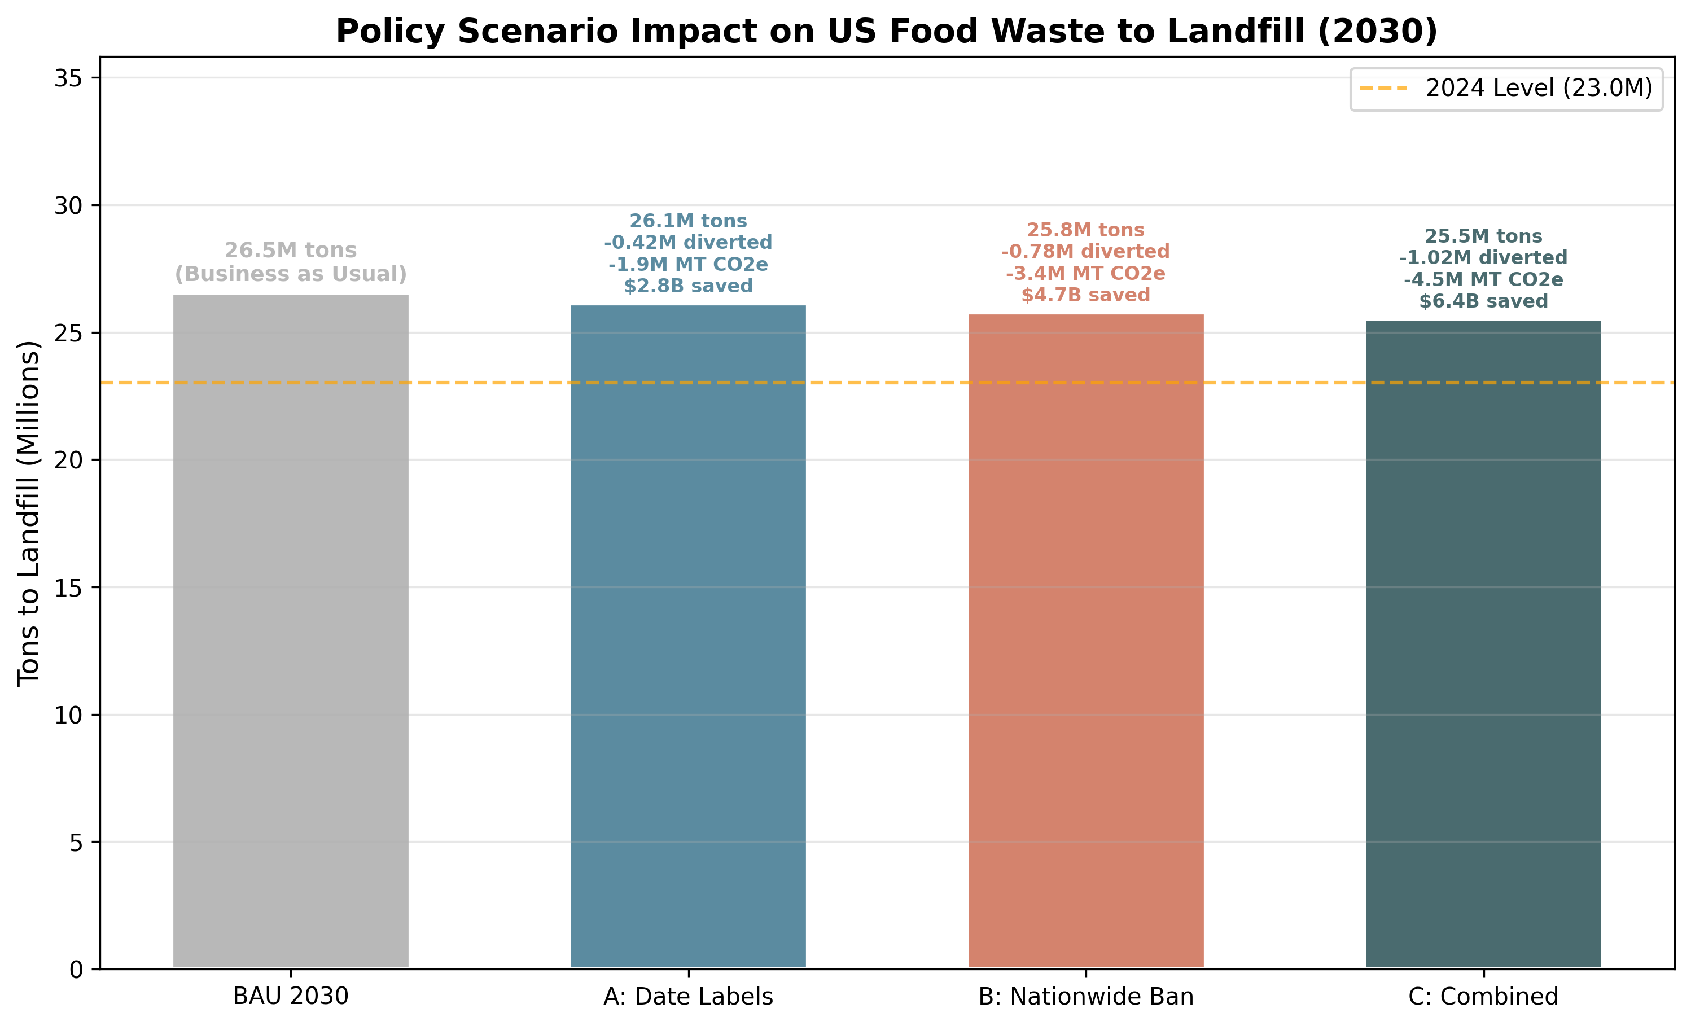
DiD-Calibrated Scenario Projections
Combined Impact 1,023,775 tons/yr diverted from landfills 4.47M MT CO2e saved 1.93B meals recovered $6.37B economic value 15% overlap discount applied
Calibrated from causally estimated treatment effects, not hypotheticals

Slide 16
Real-World Evidence Base
Our DiD Analysis: Bans increase landfill rate by 2.03 pp (p=0.008) — mandates alone insufficient
UCSD / Science (2024): Only Massachusetts succeeded among 5 ban states — infrastructure is key
Massachusetts Model: 350K tons diverted, $194M value, 1,670+ jobs from infrastructure-backed ban
ReFED Cost-Benefit: Date labels: 425K tons, $1.82B net benefit — most cost-effective intervention
Vermont Act 148: 51–57% recovery rate, 40% donation increase, 43% household composting
France Donation Law: 20%+ donation increase, 10M additional meals/yr from supermarket mandate

Slide 17
Every year of inaction sends 23M more tons to landfills
The evidence is causal. The framework is proven. Act now.
1M+ tons diverted | 4.5M MT CO2e saved | $6.4B value | 1.9B meals recovered
Thank You
GW DSA Datathon 2026

