Slide 1
Speculative Decoding
Acceleration for LLMs
target
verifies
Benchmarking Gemma Speculative Decoding and EAGLE-3 on Mid-Tier GPU Hardware
draft
tokens
faster
Core idea
Use a draft model or draft head to propose candidate tokens, then verify them with the target model.
Venkatesh Nagarjuna · Jeongmin An · Manoj Kodihalli

Slide 2
Problem Selection
Why speculative decoding is a meaningful NLP systems problem
LLMs generate text autoregressively: one token at a time.
Before
After
Each new token requires another decoding step, so inference can become slow and memory-bandwidth bound.
one token / pass
→
several tokens / step
We selected this because:
Speculative decoding uses a draft component to propose candidate tokens, and the target model verifies them. If the candidates are accepted, generation can advance by multiple tokens in one step.
• It addresses a real inference bottleneck in autoregressive LLM generation.
• Most benchmarks use flagship GPUs, leaving less guidance for A10G-style hardware.
• It connects core NLP concepts: autoregressive decoding, probability distributions, and sampling.
Speculative Decoding Project | 2

Slide 3
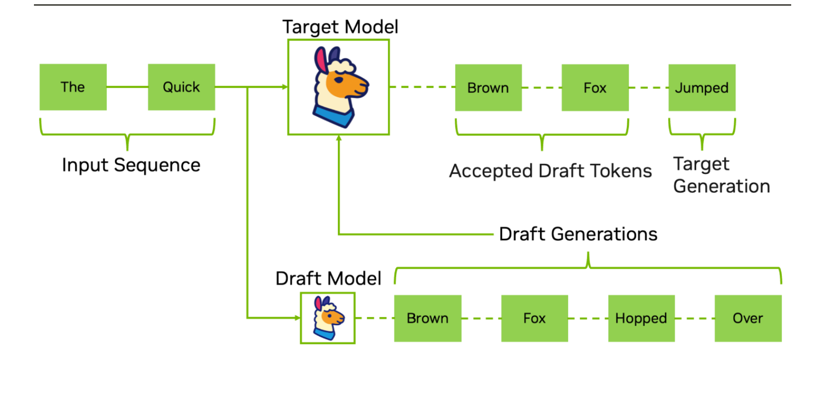
How Standard Speculative Decoding Works
Draft first, verify once, then continue from the accepted prefix
Step-by-step logic
1
Input context
Both models start from the current prefix.
2
Draft proposal
The draft model proposes γ candidate tokens.
3
Parallel verification
The target evaluates the proposal in one batched step.
4
Accept or resample
Accepted tokens are appended; the process repeats.
Key variable: γ
γ controls how many draft tokens are proposed before verification.
Speculative Decoding Project | 3

Slide 4
Final Gemma Experimental Scope
Final report focuses on two completed acceleration modules for Gemma-3-12B
Final configurations
Pair
Method
Target
Draft / Head
VRAM
Why the shift matters
F
• Early model-selection trials narrowed the scope. The final report focuses on completed Gemma-3-12B results: Pair F standard speculative decoding and EAGLE-3 draft-head acceleration.
This creates a clear comparison between a separate draft model and a learned draft head.
Standard
gemma-3-12B
gemma-3-1B
< 10GB
I
EAGLE-3
gemma-3-12B
trained draft head
< 10GB
Hardware target
AWS g5.2xlarge · NVIDIA A10G · 24 GB VRAM
Module 1: Standard speculative decoding
Pair F uses Gemma-3-12B-it as the target and Gemma-3-1B-it as the separate draft model. The module tests whether a smaller Gemma draft can improve throughput for the larger target.
Module 2: EAGLE-3 draft head
EAGLE-3 replaces the full separate draft model with a learned draft head operating on the target model’s hidden states. This tests a more compact acceleration path.
Speculative Decoding Project | 4

Slide 5
Datasets
Four task domains test when speculative decoding helps or hurts
We evaluate acceptance behavior across prompt sets with different output predictability.
HumanEval
Trivia QA
CNN/DailyMail
WritingPrompts
Code completion
Question answering
Summarization
Creative writing
50 prompts
50 prompts
50 prompts
50 prompts
highly structured
knowledge-focused
moderately constrained
high entropy
Structured output
High-entropy output
All prompt sets use 50 prompts sampled with seed 42 from Hugging Face Datasets.
Speculative Decoding Project | 5

Slide 6
Module 1: Standard Speculative Decoding
We vary speculation length and randomness across all tasks
Control variables
Active configuration
Pair
Target
Draft
Quantization
γ values
1
3
5
7
10
F
Gemma-3-12B-it
Gemma-3-1B-it
4-bit target; BF16 draft
temperature
0.0
0.6
1.0
Run flow
tasks
HumanEval
TriviaQA
CNN/DM
Writing
load prompts
4 task x 50 prompts
↓
run baseline
target only; no draft tokens
Metrics captured
↓
run speculative
γ × temperature × task
acceptance rate
accepted length
speedup
TTFT
↓
summarize CSV
peak VRAM
draft overhead
TPS / throughput
↓
visualize comparison
Goal
Find when the speed gained from accepted draft tokens outweighs the extra draft-model cost.
Speculative Decoding Project | 6

Slide 7
Model Setup
We vary speculation length and randomness across all tasks
Setup overview
Model Comparison: Pair F
• Benchmark runtime: around 10 hours
• Pair F: target = Gemma-3-12B-it, draft = Gemma-3-1Bit
• Bothe models come from the same Gemma instruction – tuned family
• Similar model family helps align token distributions between draft and target
🎯
Target Model
⚙️ Parameters: ~12B parameters
💾 Precision: 4-bit quantized
Gemma-3-12B-it
📌 Note: Lower GPU memory usage
✈️
Draft Model
⚙️ Parameters: ~1B parameters
💾 Precision: BF16
Gemma-3-1B-it
📌 Note: stable and efficient generation
4-bit quantization stores each weight with fewer bits, which reduces GPU memory usage while keeping the same model size in parameters.
GOAL: Keep the target model strong, fit the setup on available GPU memory, and use a smaller draft model for efficient candidate generation
Speculative Decoding Project | 7

Slide 8
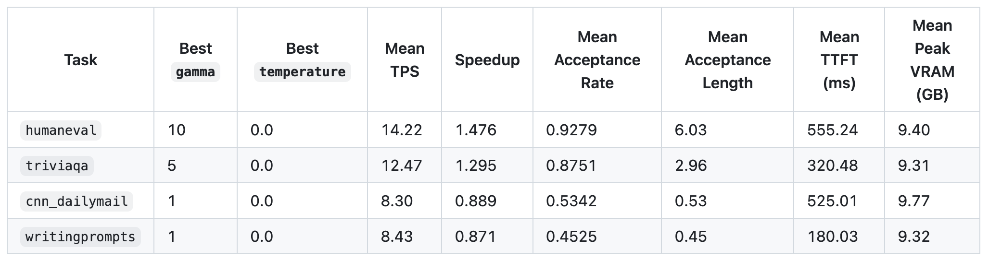
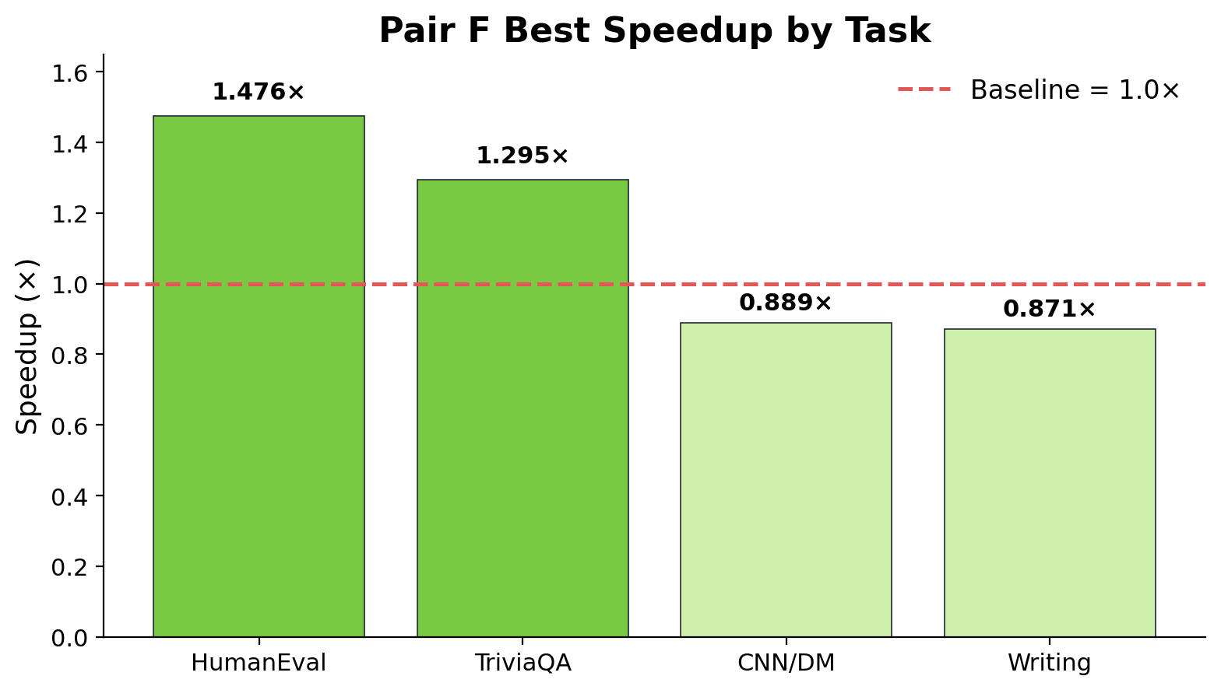
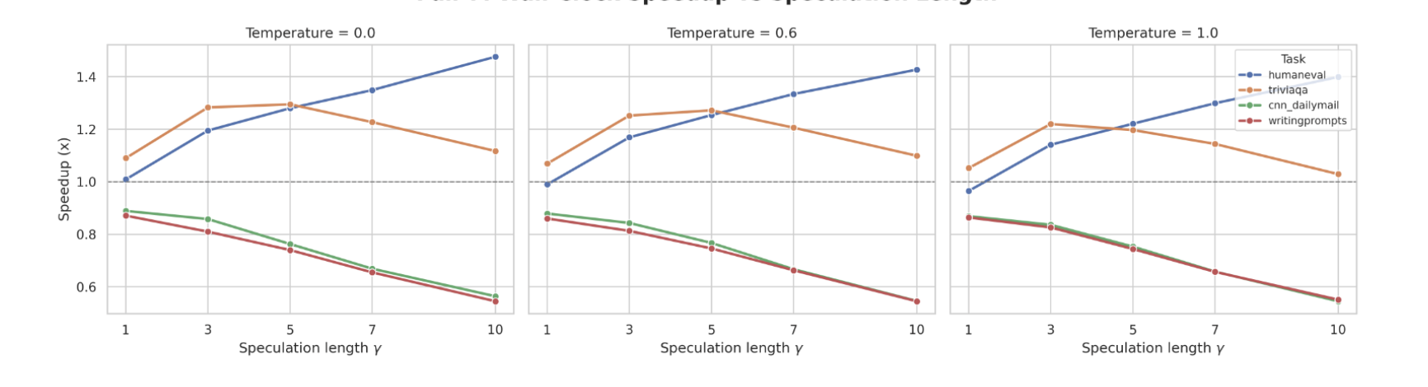
Pair F Results: Speedup Is Task-Dependent
Structured tasks exceed baseline, while open-ended tasks do not
Takeaway
• HumanEval and TriviaQA exceed baseline, while CNN/DailyMail and WritingPrompts fall below baseline.
• Increasing γ does not always improve speedup; it helps only when the extra drafted tokens are actually accepted.
Speculative Decoding Project | 8

Slide 9
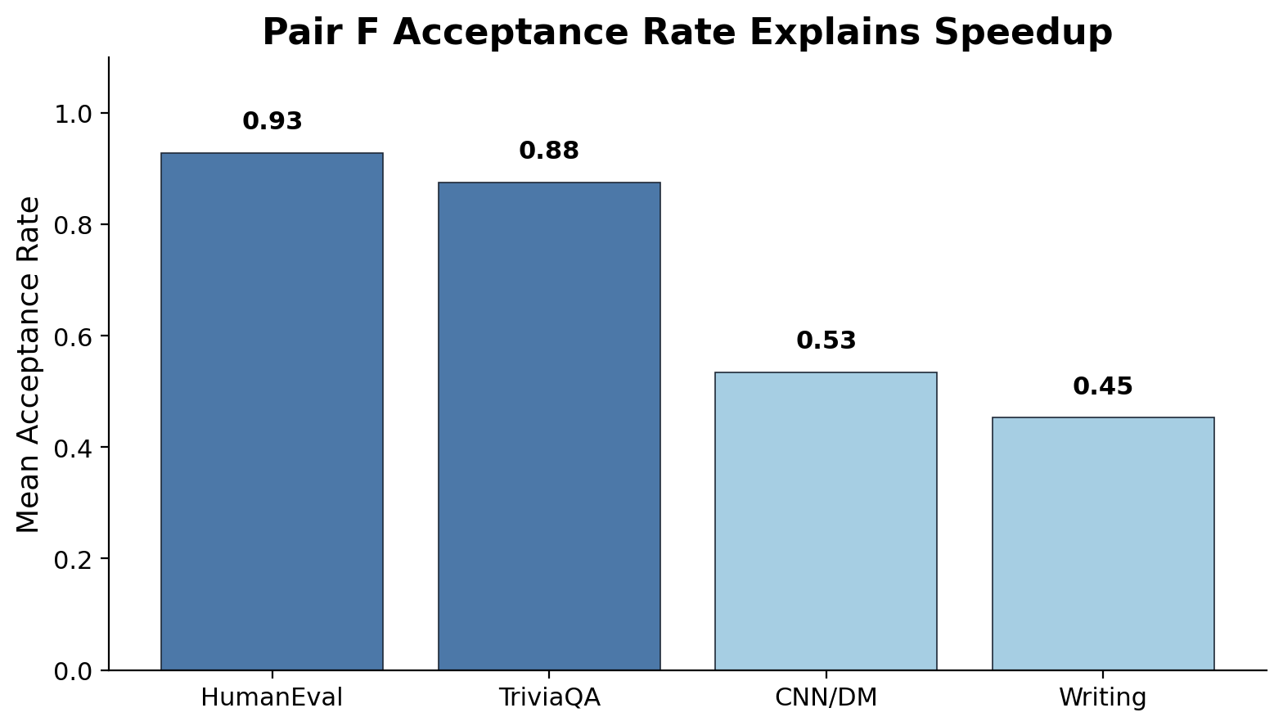
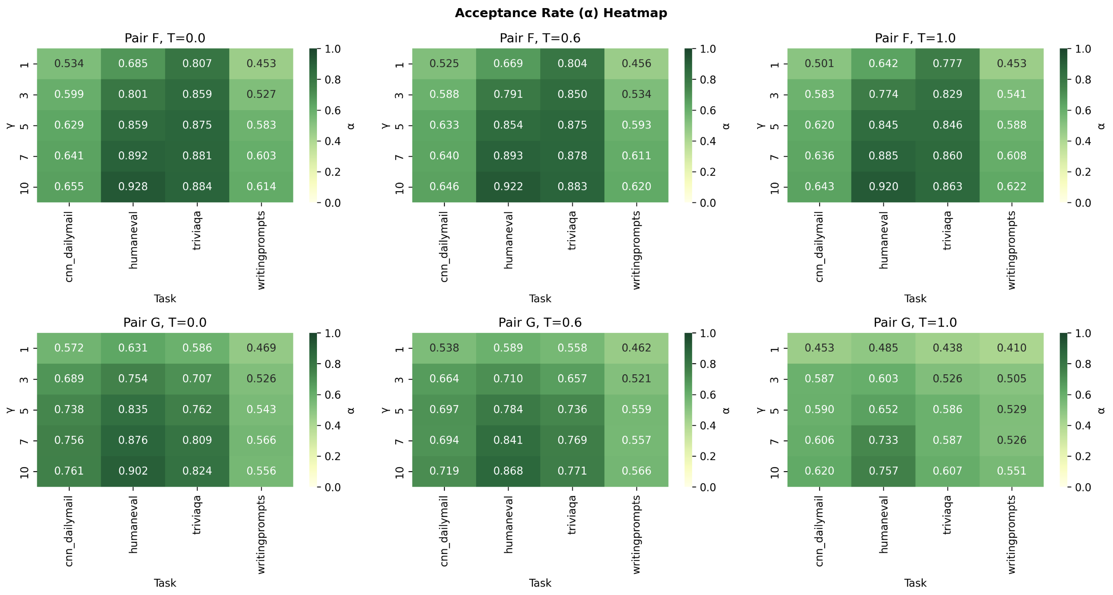
Pair F Observation: Acceptance Explains Speedup
Higher draft-target agreement produces stronger throughput gains
Takeaway
• HumanEval and TriviaQA maintain higher acceptance rates, while CNN/DailyMail and WritingPrompts remain lower.
• When acceptance is low, many draft tokens are rejected, so extra draft-model work can make decoding slower instead of faster.
Speculative Decoding Project | 9

Slide 10
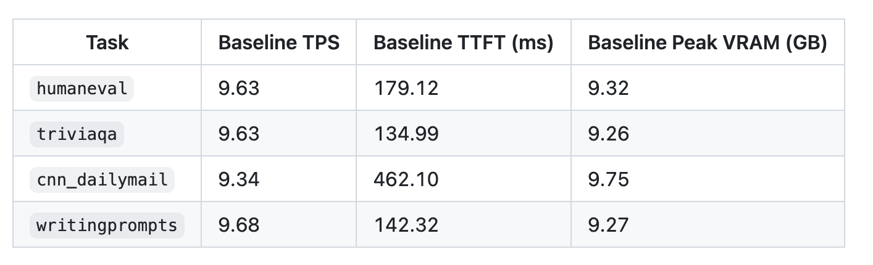
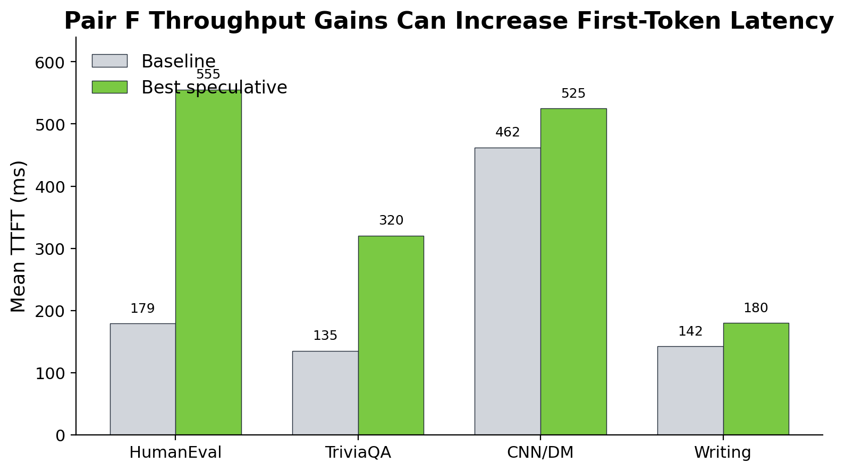
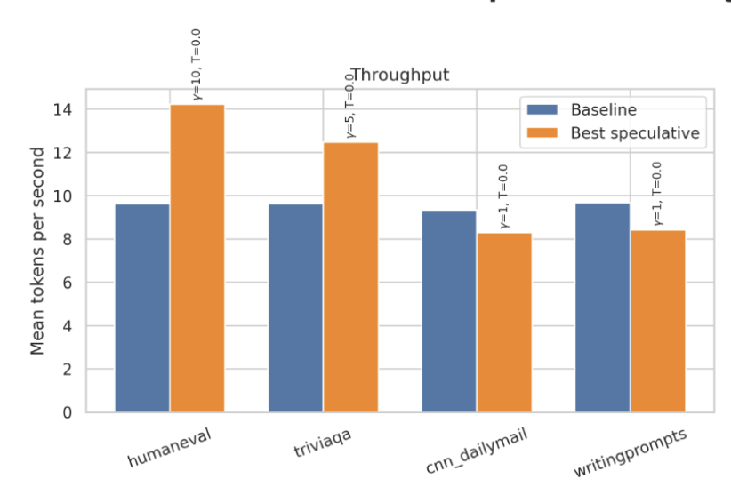
Pair F Observation: Throughput–Latency Trade-off
Best speculative settings can improve throughput but increase TTFT
Baseline
Speculative
Takeaway
• Pair F can improve sustained throughput on structured tasks, but the best speedup settings can substantially increase TTFT.
Pair F task-level throughput
Pair F task-level TTFT
Speculative Decoding Project | 10

Slide 11
Module 2: EAGLE-3 Draft Head
A learned draft head built on Gemma target hidden states
Active configuration
Pair
Target
Draft Component
Quantization
Quantization
I
Gemma-3-12B-it
trained EAGLE-3 draft head
4-bit frozen target
target hidden states
fused hidden features
draft head
candidate tokens
Objective
Model ingredients
Replace the separate full draft model with a learned draft head.
three target hidden layers
fusion + input projections
Train a draft head that predicts future tokens from target hidden states.
target embedding layer
one copied decoder layer
Use a 4-bit frozen Gemma-3-12B target during training and inference.
frozen norm + LM head
Speculative Decoding Project | 11

Slide 12
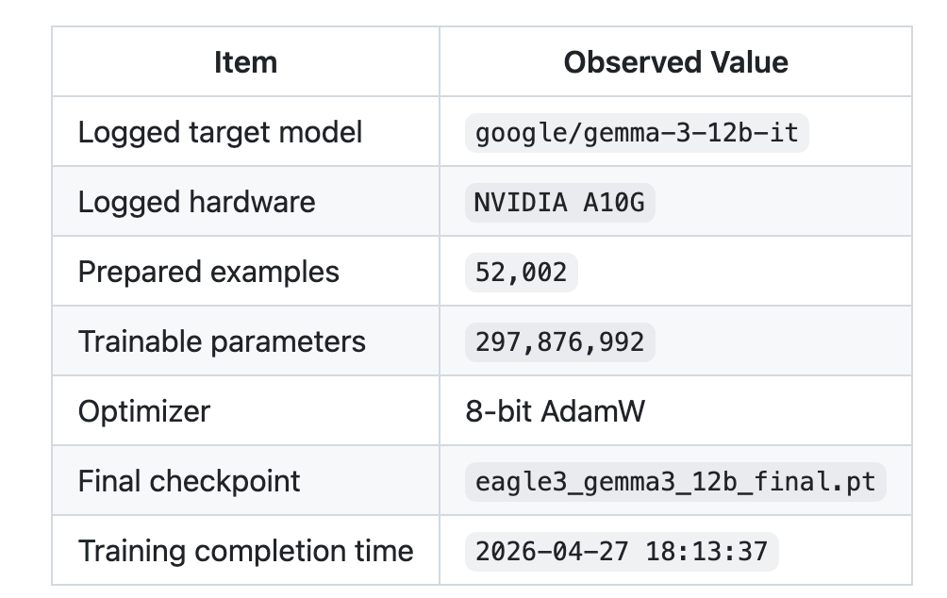
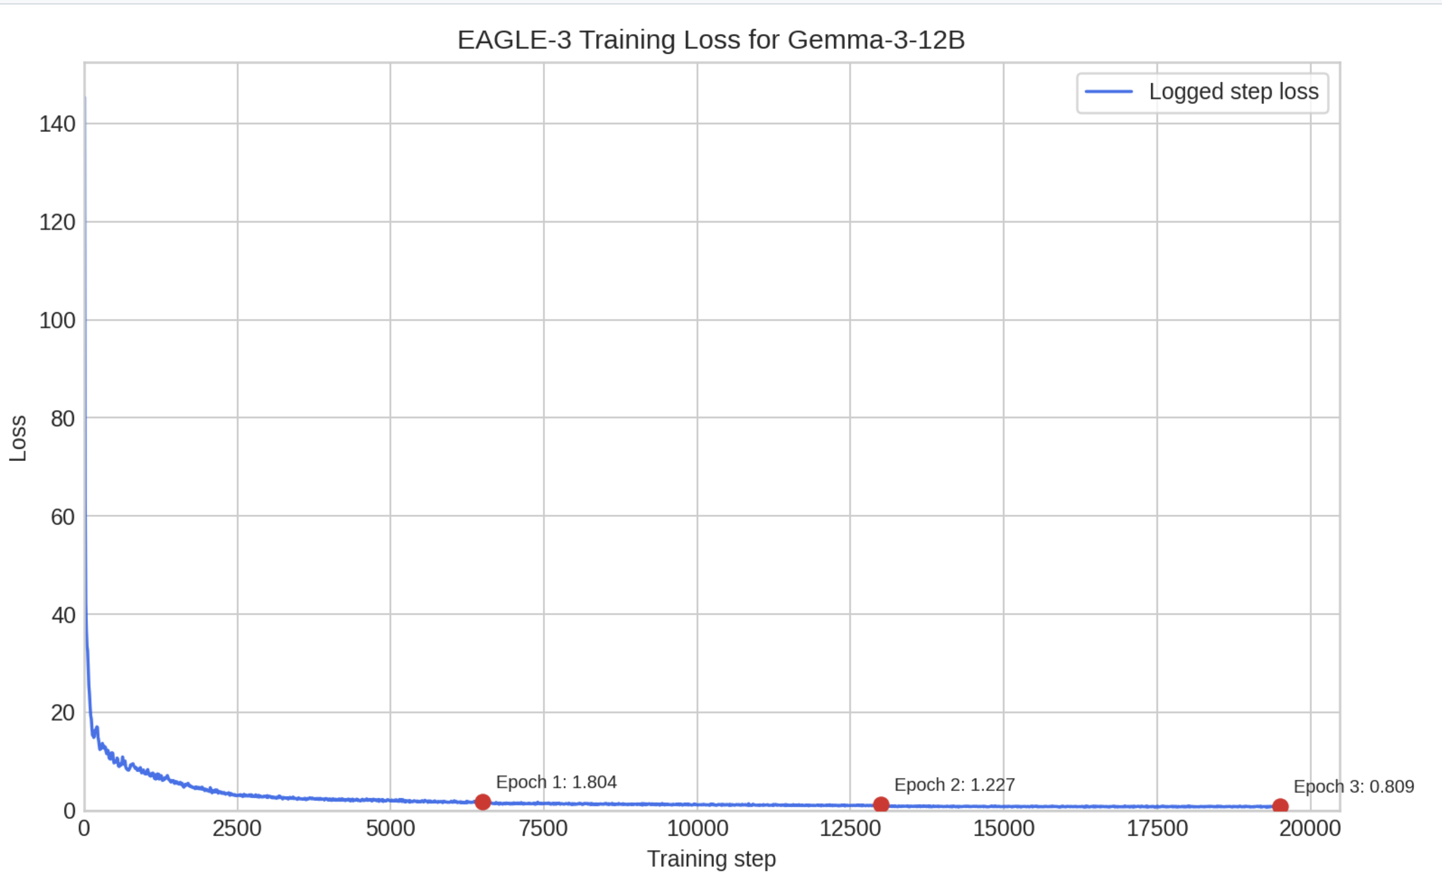
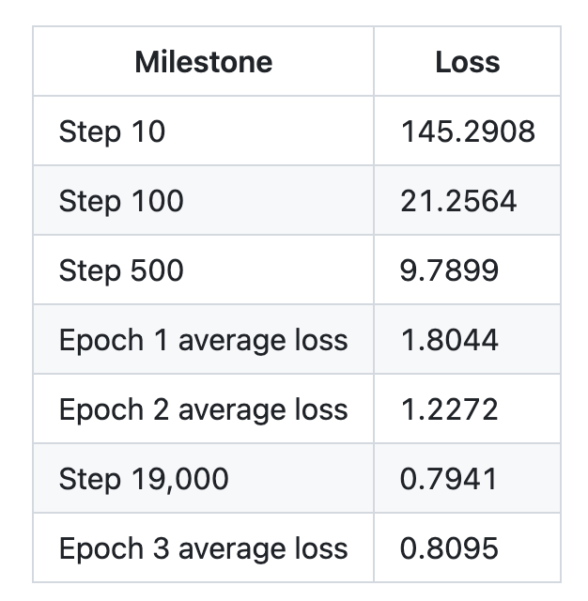
Pair I : EAGLE-3 Training Results
Module 2: EAGLE-3 Draft Head Training Draft Head
Takeaway
• Training completed successfully: loss dropped from 145.3 at step 10 to below 1.0 by the final epoch, producing a usable EAGLE-3 checkpoint.
Speculative Decoding Project | 12

Slide 13
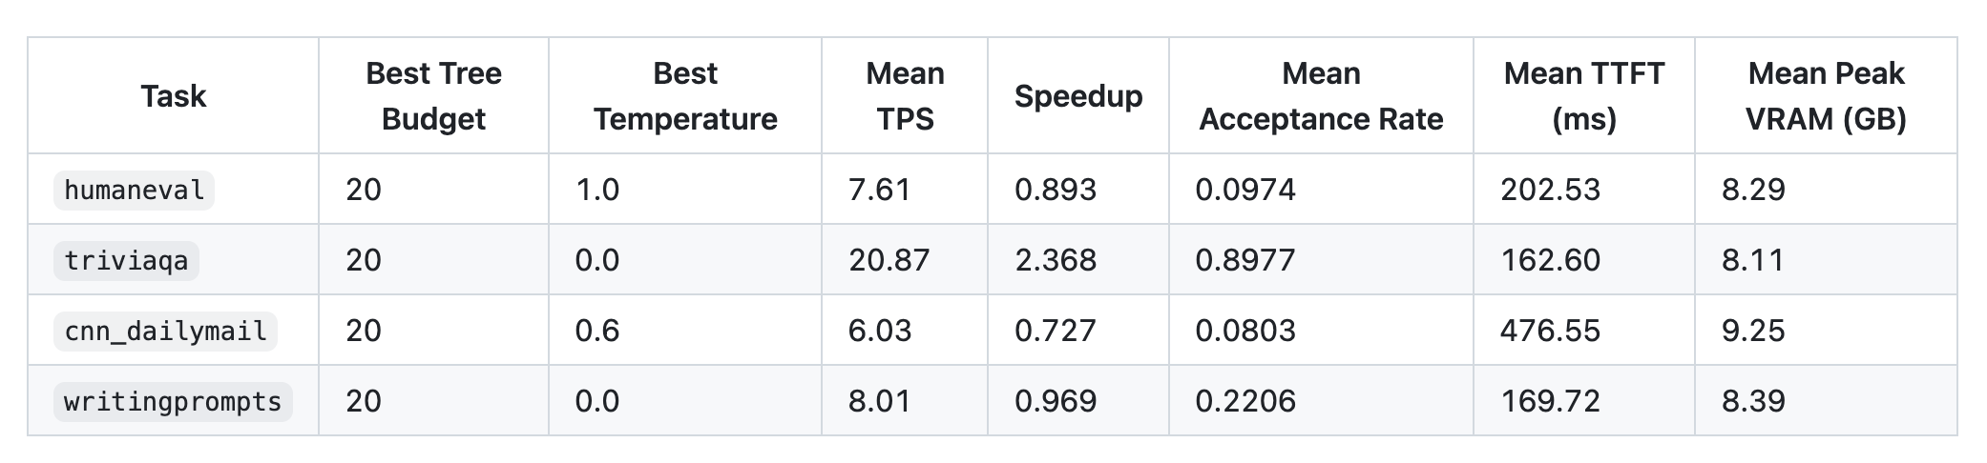
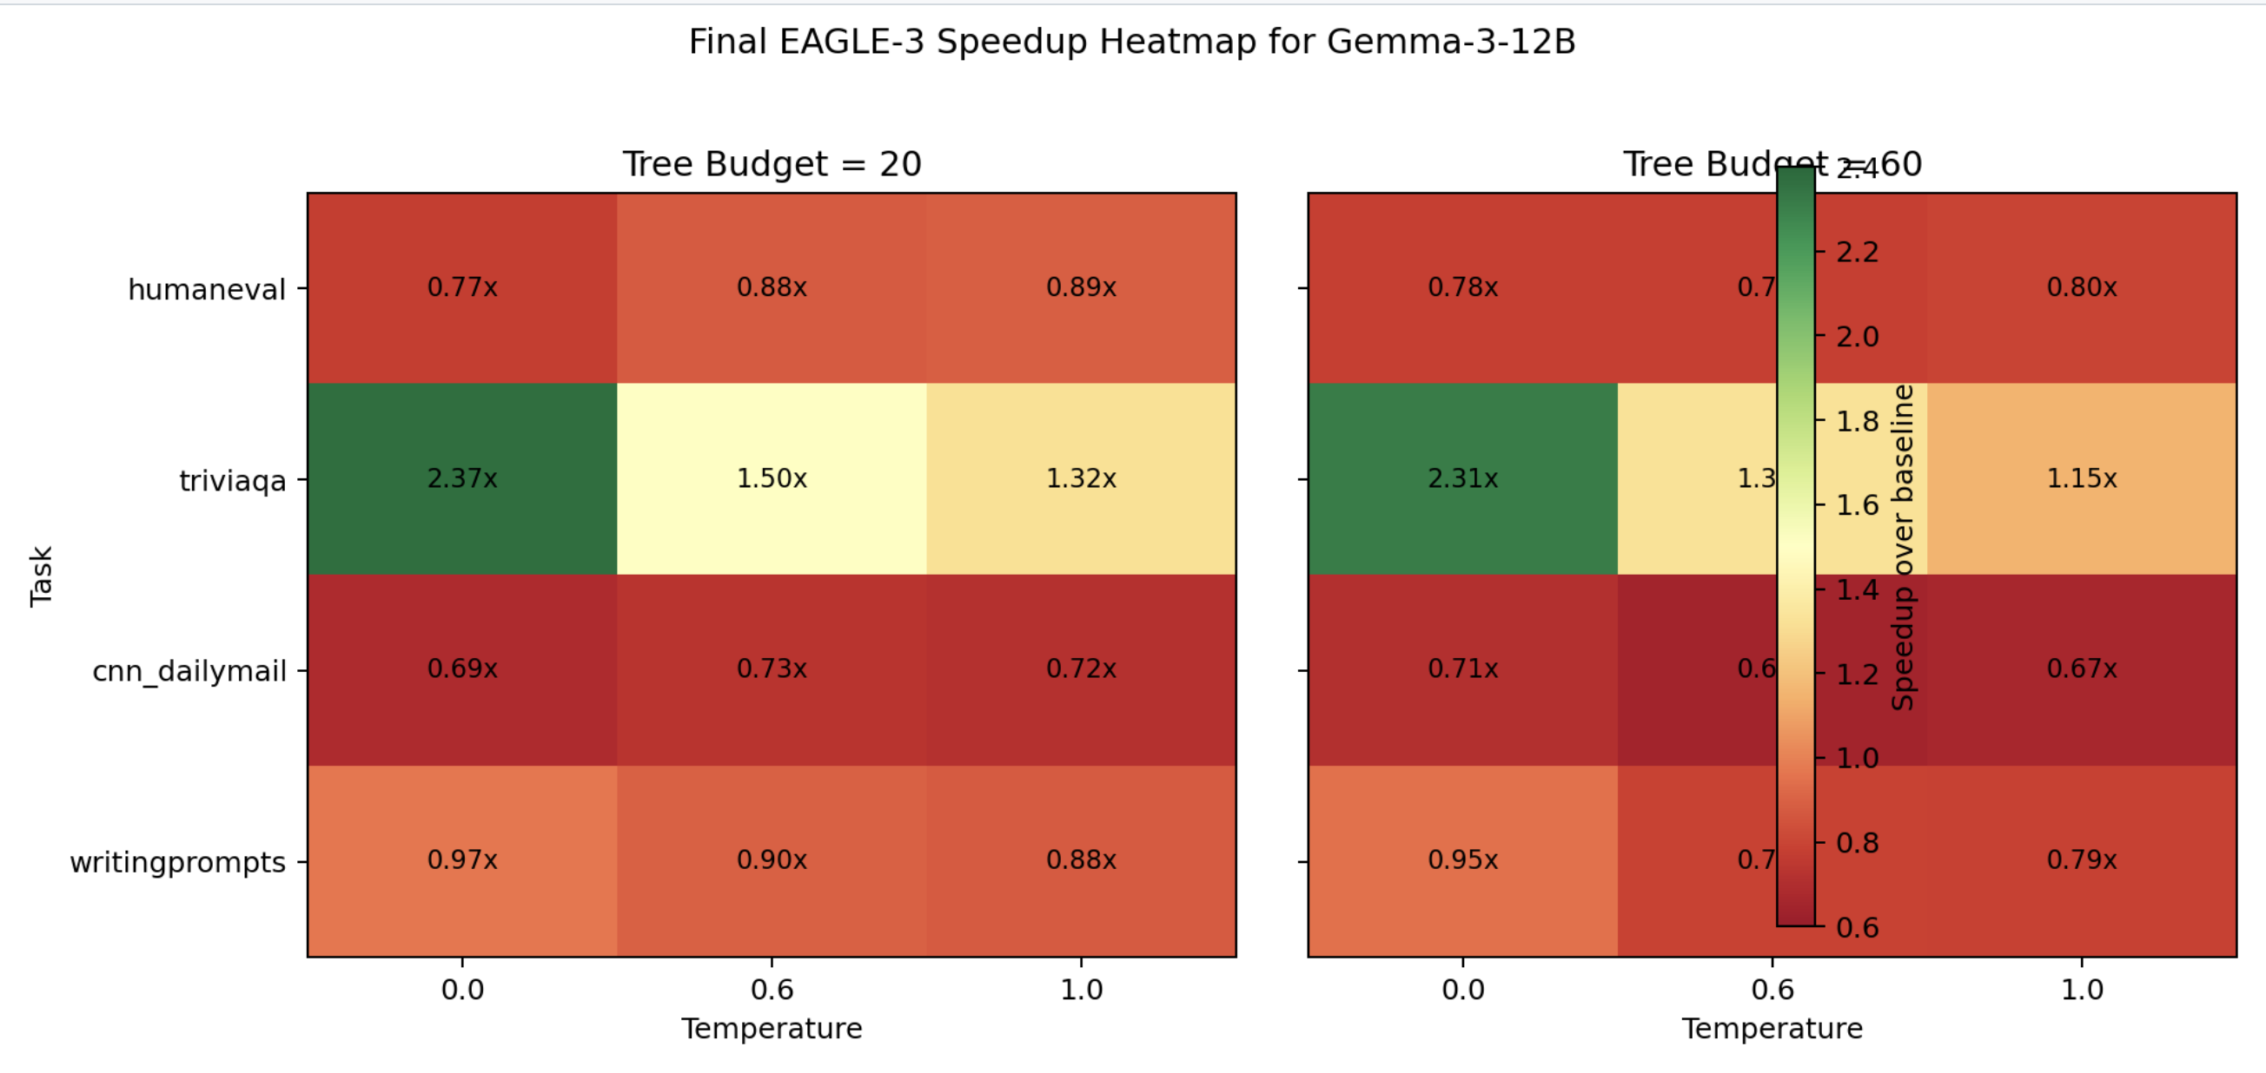
Pair I Results: EAGLE-3 Helps Selectively
Module 2: EAGLE-3 Draft Head
Takeaway
• TriviaQA is the strongest EAGLE task by far, peaking at 2.368x speedup for tree budget = 20 and temperature = 0.0
• WritingPrompts gets close to baseline, but HumanEval and CNN/DailyMail remain below baseline.
• CNN/DailyMail remains the hardest case, suggesting long-context verification is still a limitation.
Speculative Decoding Project | 13

Slide 14
Conclusion
The final results show when Gemma inference acceleration helps in practice
Takeaways
1
Pair F and EAGLE-3 provide two completed paths for Gemma inference acceleration.
2
Speedup depends on draft-target agreement; low acceptance can eliminate the benefit.
3
Practical deployment requires balancing throughput, TTFT, VRAM, and engineering constraints.
Next step
Improve long-context EAGLE verification for CNN/DailyMail-style tasks.
Speculative Decoding Project | 14

Slide 15
Thank you
Speculative Decoding Project | 15

