Slide 1
Operating Systems
Processes
Lecture 3 Michael O’Boyle
1

Slide 2
Overview
Process
Process control block
Process state
Context switch
Process creation and termination
1

Slide 3
What is a “process”?
The process is the OS’s abstraction for execution
A process is a program in execution
Simplest (classic) case: a sequential process
An address space (an abstraction of memory)
A single thread of execution (an abstraction of the CPU)
A sequential process is:
The unit of execution
The unit of scheduling
The dynamic (active) execution context
vs. the program – static, just a bunch of bytes
thread
address space
1

Slide 4
What’s “in” a process?
A process consists of (at least):
An address space, containing
the code (instructions) for the running program
the data for the running program (static data, heap data, stack)
CPU state, consisting of
The program counter (PC), indicating the next instruction
The stack pointer
Other general purpose register values
A set of OS resources
open files, network connections, sound channels, …
In other words, everything needed to run the program
or to re-start, if interrupted
1

Slide 5
A process’s address space (idealized)
0xFFFFFFFF
stack
(dynamic allocated mem)
SP
address space
heap
(dynamic allocated mem)
static data (data segment)
code (text segment)
PC
0x00000000
1

Slide 6
The OS process namespace
The particulars depend on the specific OS, but the principles are general
The name for a process is called a process ID (PID)
An integer
The PID namespace is global to the system
Only one process at a time has a particular PID
Operations that create processes return a PID
E.g., fork()
Operations on processes take PIDs as an argument
E.g., kill(), wait(), nice()
1

Slide 7
Representation of processes by the OS
The OS maintains a data structure to keep track of a process’s state
Called the process control block (PCB) or process descriptor
Identified by the PID
OS keeps all of a process’s execution state in (or linked from) the PCB when the process isn’t running
PC, SP, registers, etc.
when a process is unscheduled, the state is transferred out of the hardware into the PCB
(when a process is running, its state is spread between the PCB and the CPU)
1

Slide 8
The PCB
The PCB is a data structure with many, many fields:
process ID (PID)
parent process ID
execution state
program counter, stack pointer, registers
address space info
UNIX user id, group id
scheduling priority
accounting info
pointers for state queues
In Linux:
defined in task_struct (include/linux/sched.h)
over 95 fields!!!
1

Slide 9
This is (a simplification of) what each of those PCBs looks like inside
Process ID
Pointer to parent
List of children
Process state
Pointer to address space descriptor
Program counter stack pointer (all) register values
uid (user id) gid (group id) euid (effective user id)
Open file list
Scheduling priority
Accounting info
Pointers for state queues
Exit (“return”) code value
1

Slide 10
PCBs and CPU state
When a process is running, its CPU state is inside the CPU
PC, SP, registers
CPU contains current values
When the OS gets control because of a …
Trap: Program executes a syscall
Exception: Program does something unexpected (e.g., page fault)
Interrupt: A hardware device requests service
the OS saves the CPU state of the running process in that process’s PCB
10

Slide 11
PCBs and CPU state
When the OS returns the process to the running state
it loads the hardware registers with values from that process’s PCB
eg general purpose registers, stack pointer, instruction pointer
The act of switching the CPU from one process to another is called a context switch
systems may do 100s or 1000s of switches/sec.
takes a few microseconds on today’s hardware
Still expensive relative to thread based context switches
Choosing which process to run next is called scheduling
10

Slide 12
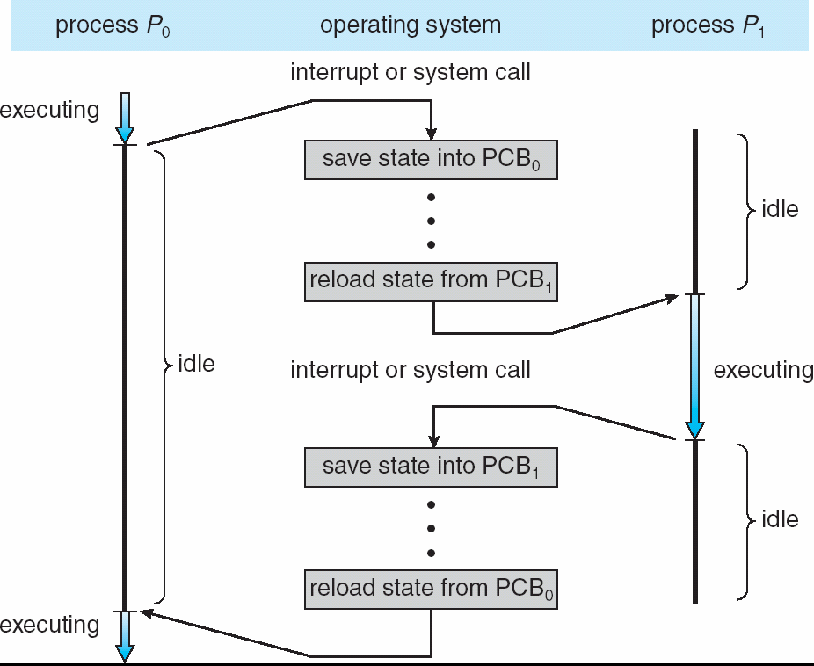
Process context switch
1
2

Slide 13
Process execution states
Each process has an execution state, which indicates what it’s currently doing
ready: waiting to be assigned to a CPU
could run, but another process has the CPU
running: executing on a CPU
it’s the process that currently controls the CPU
waiting (aka “blocked”): waiting for an event, e.g., I/O completion, or a message from (or the completion of) another process
cannot make progress until the event happens
As a process executes, it moves from state to state
UNIX: run top, STAT column shows current state
which state is a process in most of the time?

Slide 14
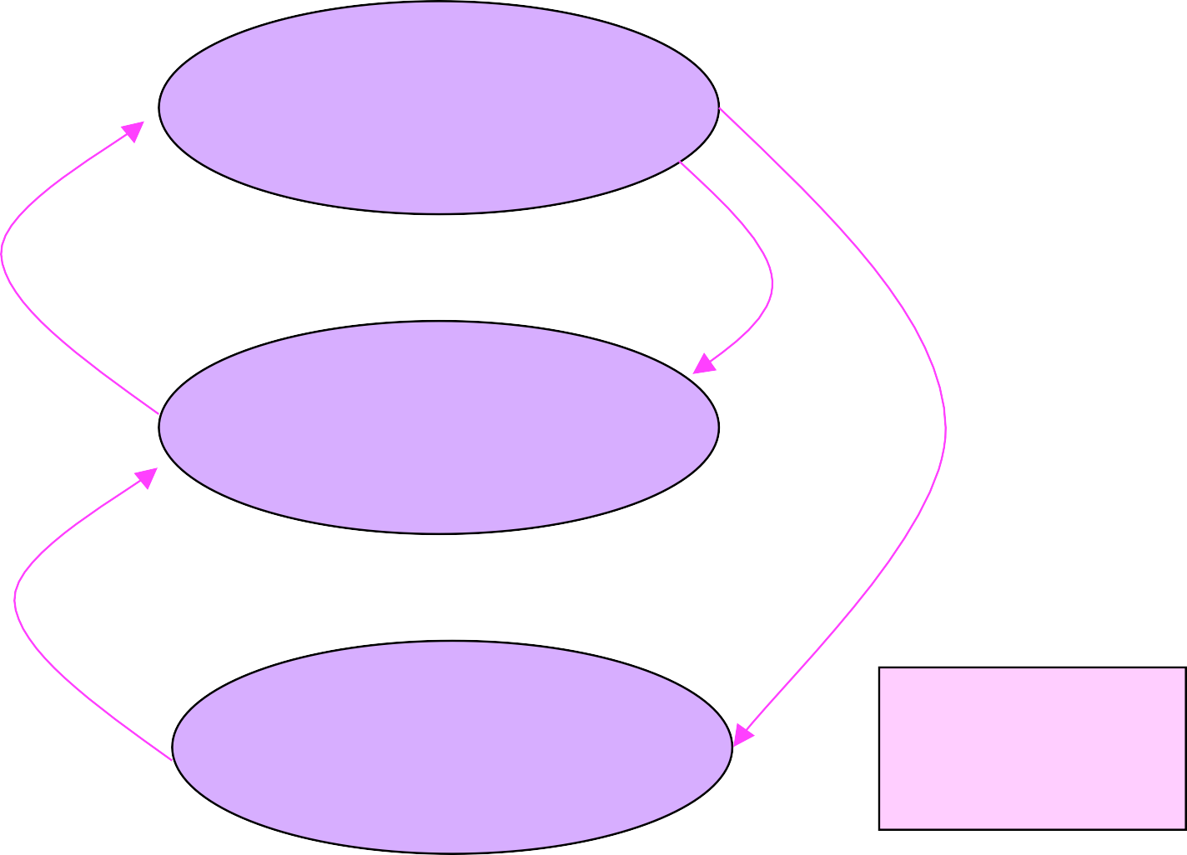
Process states and state transitions
terminate
running
dispatch / schedule
interrupt (unschedule)
create
ready
trap or exception (I/O, page fault, etc.)
interrupt (I/O complete)
You can create and destroy processes
blocked

Slide 15
State queues
The OS maintains a collection of queues that represent the state of all processes in the system
typically one queue for each state
e.g., ready, waiting, …
each PCB is queued onto a state queue according to the current state of the process it represents
as a process changes state, its PCB is unlinked from one queue, and linked onto another
The PCBs are moved between queues, which are represented as linked lists

Slide 16
State queues
These are PCBs
Ready queue header
head ptr
firefox (1365)
emacs (948)
ls (1470)
tail ptr
Wait queue header
head ptr
cat (1468)
firefox (1207)
tail ptr
There may be many wait queues, one for each type of wait (particular device, timer, message, …)

Slide 17
PCBs and state queues
PCBs are data structures
dynamically allocated inside OS memory
When a process is created:
OS allocates a PCB for it
OS initializes PCB
(OS does other things not related to the PCB)
OS puts PCB on the correct queue
As a process computes:
OS moves its PCB from queue to queue
When a process is terminated:
PCB may be retained for a while (to receive signals, etc.)
eventually, OS deallocates the PCB

Slide 18
Process creation
New processes are created by existing processes
creator is called the parent
created process is called the child
UNIX: do ps -ef, look for PPID field
what creates the first process, and when?

Slide 19
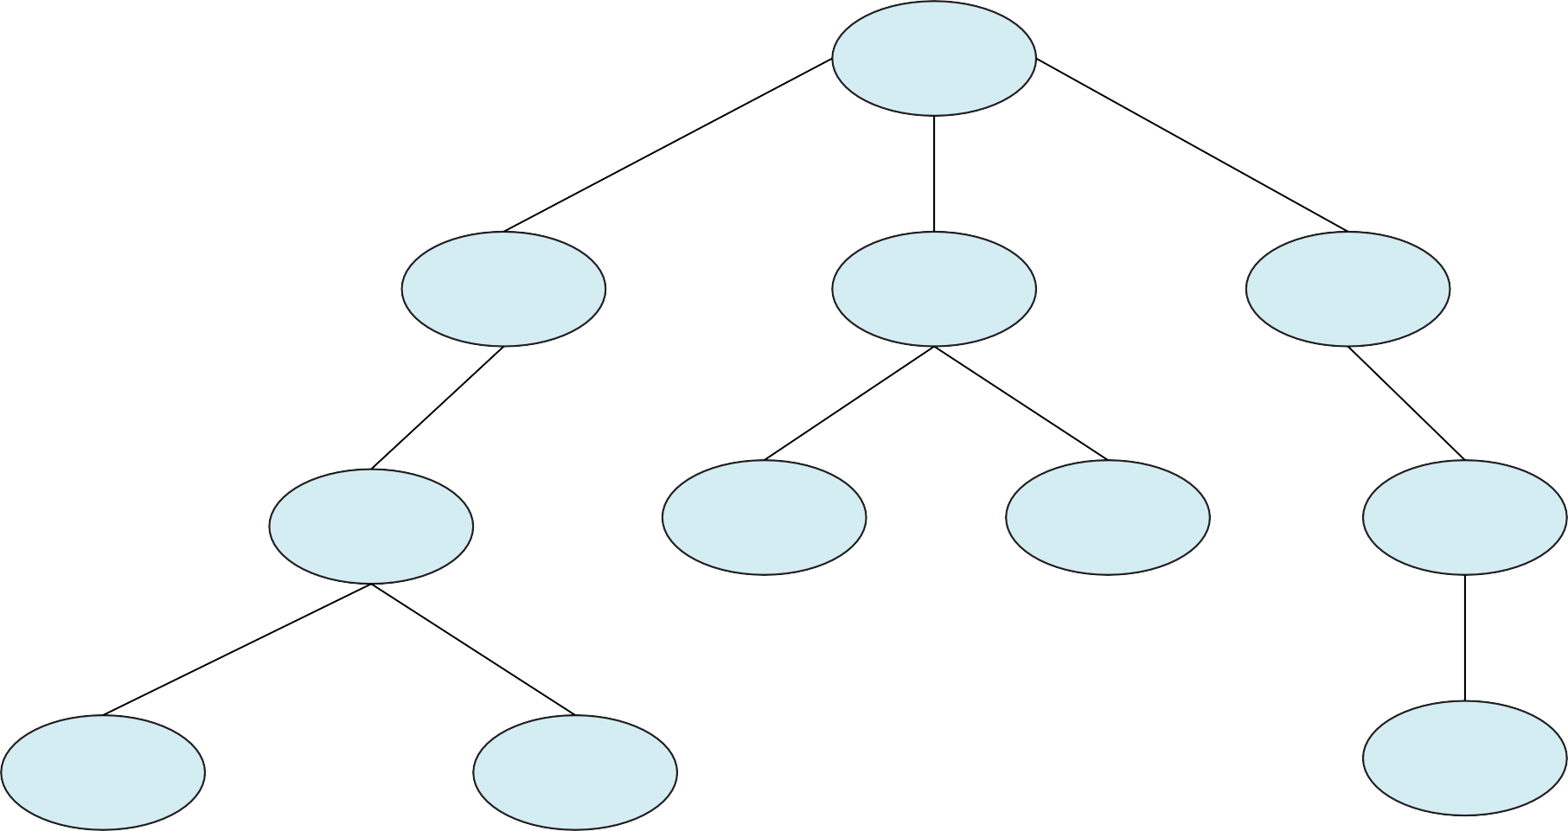
init pid = 1
login pid = 8415
kthreadd pid = 2
sshd pid = 3028
bash pid = 8416
khelper pid = 6
pdflush pid = 200
sshd pid = 3610
ps
pid = 9298
emacs pid = 9204
tcsch pid = 4005

Slide 20
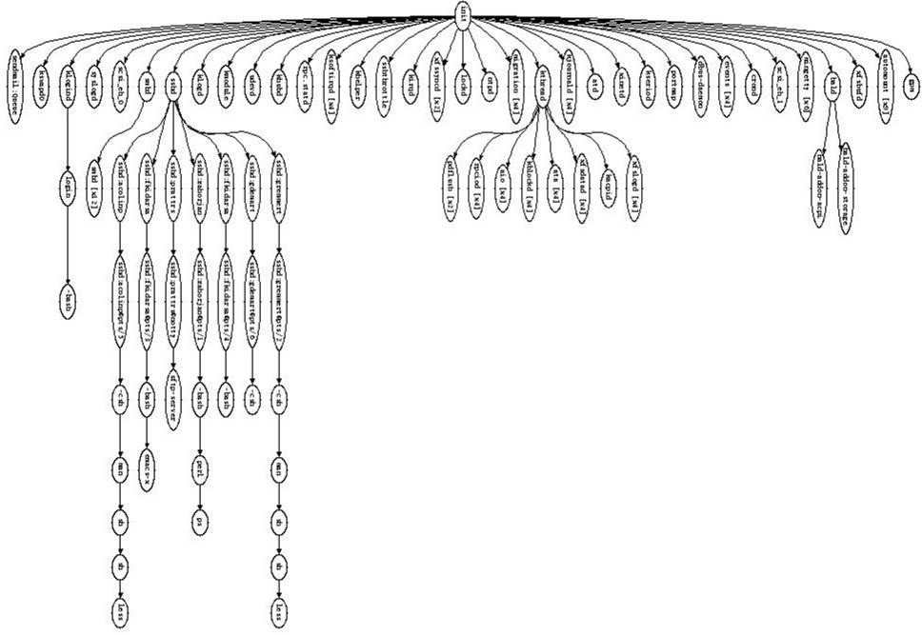

Slide 21
Process creation semantics
(Depending on the OS) child processes inherit certain attributes of the parent
Examples:
Open file table: implies stdin/stdout/stderr
On some systems, resource allocation to parent may be divided among children
(In Unix) when a child is created, the parent may either wait for the child to finish, or continue in parallel

Slide 22
UNIX process creation details
UNIX process creation through fork() system call
creates and initializes a new PCB
initializes kernel resources of new process with resources of parent (e.g., open files)
initializes PC, SP to be same as parent
creates a new address space
initializes new address space with a copy of the entire contents of the address space of the parent
places new PCB on the ready queue
the fork() system call “returns twice”
once into the parent, and once into the child
returns the child’s PID to the parent
returns 0 to the child
fork() = “clone me”

Slide 23
Parent PCB
Parent address space
(code, static data, heap, stack)

Slide 24
Parent PCB
Child PCB
similar, but different in key ways
Parent address space
(code, static data, heap, stack)
Child address space
(code, static data, heap, stack)
identical copy (with sole exception of PID argument on the top of the stack)

Slide 25
testparent – use of fork( )
#include <sys/types.h> #include <unistd.h> #include <stdio.h>
int main(int |  | argc, char |  | **argv)
{
char *name |  | = argv[0];
int pid = fork();
 | if (pid == 0) {
 | printf(“Child of |  | %s | is %d\n”, name, pid);
 | return 0;
 | } else {
 | printf(“My child |  | is | %d\n”, pid);
 | return 0;
 | }
}

Slide 26
testparent output
spinlock% gcc -o testparent testparent.c spinlock% ./testparent
My child is 486
Child of testparent is 0 spinlock% ./testparent
Child of testparent is 0 My child is 571

Slide 27
exec() vs. fork()
Q: So how do we start a new program, instead of just forking the old program?
A: First fork, then exec
int exec(char * prog, char * argv[])
exec()
stops the current process
loads program ‘prog’ into the address space
i.e., over-writes the existing process image
initializes hardware context, args for new program
places PCB onto ready queue
note: does not create a new process!

Slide 28
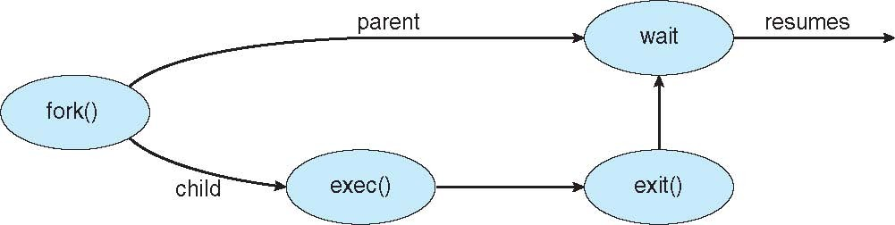
exec() and fork()

Slide 29
Parent PCB
Child PCB
similar, but different in key ways
Parent address space
(code, static data, heap, stack)
Child address space
(code, static data, heap, stack)
identical copy (with sole exception of PID argument on the top of the stack)

Slide 30
Child PCB
Parent PCB
Parent address space
(code, static data, heap, stack)
Child address space
(code, static data, heap, stack)

Slide 31
Making process creation faster
The semantics of fork() say the child’s address space is a copy of the parent’s
Implementing fork() that way is slow
Have to allocate physical memory for the new address space
Have to set up child’s page tables to map new address space
Have to copy parent’s address space contents into child’s address space
Which you are likely to destroy with an exec()

Slide 32
Method 1: vfork()
vfork() is the older (now uncommon) of the two approaches we’ll discuss
Instead of “child’s address space is a copy of the parent’s,” the semantics are “child’s address space is the parent’s”
With a “promise” that the child won’t modify the address space before doing an execve()
Unenforced! You use vfork() at your own peril
When execve() is called, a new address space is created and it’s loaded with the new executable
Parent is blocked until execve() is executed by child
Saves wasted effort of duplicating parent’s address space

Slide 33
Child PCB
Parent PCB
similar, but different in key ways
Parent address space
(code, static data, heap, stack)
Vfork()

Slide 34
Method 2: copy-on-write
Retains the original semantics, but copies “only what is necessary” rather than the entire address space
On fork():
Create a new address space
Initialize page tables with same mappings as the parent’s (i.e., they both point to the same physical memory)
No copying of address space contents have occurred at this point – with the sole exception of the top page of the stack
Set both parent and child page tables to make all pages read-only
If either parent or child writes to memory, an exception occurs
When exception occurs, OS copies the page, adjusts page tables, etc.

Slide 35
UNIX shells
int main(int argc, char **argv)
{
while (1) { printf (“$ “);
char *cmd = get_next_command(); int pid = fork();
if (pid == 0) {
exec(cmd); panic(“exec failed!”);
} else {
wait(pid);
}
}
}
35

Slide 36
Summary
Process
Process control blocck
Process state
Context switch
Process creation and termination
Next time
– threads
36

