Slide 1
Operating Systems
Threads
Lecture 4 Michael O’Boyle
1

Slide 2
Overview
Process vs threads
how related
Concurrency
why threads
Design space of process/threads
a simple taxonomy
Kernel threads
more efficient
User-level threads
even faster
1

Slide 3
What’s “in” a process?
A process consists of (at least):
An address space, containing
the code (instructions) for the running program
the data for the running program
Thread state, consisting of
The program counter (PC), indicating the next instruction
The stack pointer register (implying the stack it points to)
Other general purpose register values
A set of OS resources
open files, network connections, sound channels, …
Decompose …
address space
thread of control (stack, stack pointer, program counter, registers)
OS resources
1

Slide 4
Thread: Concurrency vs. Parallelism
Threads are about concurrency and parallelism
Concurrent execution on single-core system:
single core
time
Parallelism on a multi-core system:
core 1
T₁ | T₂ | T₃ | T₄ | T₁ | T₂ | T₃ | T₄ | T₁ | …
T₁ | T₃ | T₁ | T₃ | T₁ | …
core 2
T₂ | T₄ | T₂ | T₄ | T₂ | …
time

Slide 5
Motivation
Threads are about concurrency and parallelism
One way to get concurrency and parallelism is to use multiple processes
The programs (code) of distinct processes are isolated from each other
Threads are another way to get concurrency and parallelism
Threads “share a process” – same address space, same OS resources
Threads have private stack, CPU state – are schedulable
5

Slide 6
What’s needed?
In many cases
Everybody wants to run the same code
Everybody wants to access the same data
Everybody has the same privileges
Everybody uses the same resources (open files, network connections, etc.)
But you’d like to have multiple hardware execution states:
an execution stack and stack pointer (SP)
traces state of procedure calls made
the program counter (PC), indicating the next instruction
a set of general-purpose processor registers and their values
5

Slide 7
How could we achieve this?
Given the process abstraction as we know it:
fork several processes
cause each to map to the same physical memory to share data
see the shmget() system call for one way to do this
This is really inefficient
space: PCB, page tables, etc.
time: creating OS structures, fork/copy address space, etc.
5

Slide 8
Can we do better?
Key idea:
separate the concept of a process (address space, OS resources)
… from that of a minimal “thread of control” (execution state: stack, stack pointer, program counter, registers)
This execution state is usually called a thread, or sometimes, a lightweight process
thread
5

Slide 9
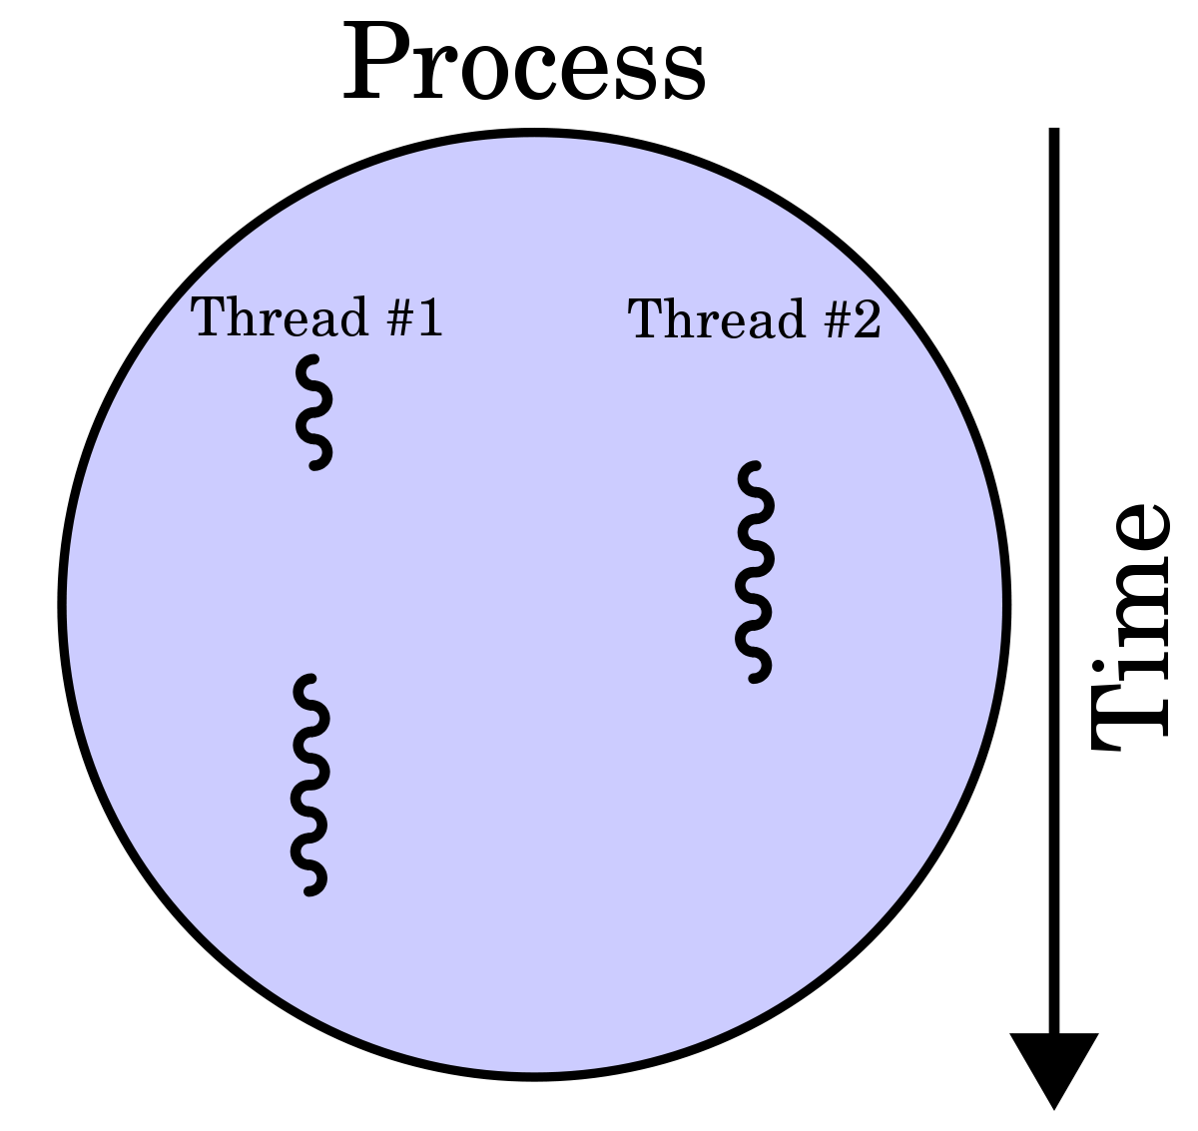
Threads and processes
Most modern OS’s (Mach (Mac OS), Chorus, Windows, UNIX) therefore support two entities:
the process, which defines the address space and general process attributes (such as open files, etc.)
the thread, which defines a sequential execution stream within a process
A thread is bound to a single process / address space
address spaces, however, can have multiple threads executing within them
sharing data between threads is cheap: all see the same address space
creating threads is cheap too!
Threads become the unit of scheduling
processes / address spaces are just containers in which threads execute
5

Slide 10
Single and Multithreaded Processes
code
data
files
code
data
files
registers
stack
registers
registers
registers
stack
stack
stack
thread
thread
single-threaded process
multithreaded process

Slide 11

Communication
Threads are concurrent executions sharing an address space (and some OS resources)
Address spaces provide isolation
If you can’t name it, you can’t read or write it
Hence, communicating between processes is expensive
Must go through the OS to move data from one address space to another
Because threads are in the same address space, communication is simple/cheap
Just update a shared variable!

Slide 12





The design space
Key
address space
thread
older UNIXes
MS/DOS
one thread per process
one process
one thread per process many processes
Java
Mach, NT, Chorus,
Linux, …
many threads per process
many threads per process one process
many processes

Slide 13
(old) Process address space
0xFFFFFFFF
stack
(dynamic allocated mem)
SP
address space
heap
(dynamic allocated mem)
static data (data segment)
code (text segment)
PC
0x00000000

Slide 14
(new) Address space with threads
thread 1 stack
SP (T1)
0xFFFFFFFF
thread 2 stack
SP (T2)
thread 3 stack
SP (T3)
address space
heap
(dynamic allocated mem)
static data (data segment)
0x00000000
code (text segment)
PC (T2)
PC (T1)
PC (T3)
© 2012 Gribble, Lazowska, Levy, Zahorjan
14
14

Slide 15
Process/thread separation
Concurrency (multithreading) is useful for:
handling concurrent events (e.g., web servers and clients)
building parallel programs (e.g., matrix multiply, ray tracing)
improving program structure (the Java argument)
Multithreading is useful even on a uniprocessor
even though only one thread can run at a time
Supporting multithreading – that is, separating the concept of a process (address space, files, etc.) from that of a minimal thread of control (execution state), is a big win
creating concurrency does not require creating new processes
“faster / better / cheaper”

Slide 16
Terminology
Just a note that there’s the potential for some confusion …
Old : “process” == “address space + OS resources + single thread”
New: “process” typically refers to an address space + system resources + all of its threads …
When we mean the “address space” we need to be explicit
“thread” refers to a single thread of control within a process / address space
A bit like “kernel” and “operating system” …
Old: “kernel” == “operating system” and runs in “kernel mode”
New: “kernel” typically refers to the microkernel; lots of the operating system runs in user mode

Slide 17
Where do threads come from?
Natural answer: the OS is responsible for creating/managing threads
For example, the kernel call to create a new thread would
allocate an execution stack within the process address space
create and initialize a Thread Control Block
– stack pointer, program counter, register values
stick it on the ready queue
We call these kernel threads
There is a “thread name space”
Thread id’s (TID’s)
TID’s are integers

Slide 18
Kernel threads
Mach, NT, Chorus, Linux, …
address space
os kernel
thread
CPU
(thread create, destroy, signal, wait, etc.)

Slide 19
Kernel threads
OS now manages threads and processes / address spaces
all thread operations are implemented in the kernel
OS schedules all of the threads in a system
if one thread in a process blocks (e.g., on I/O), the OS knows about it, and can run other threads from that process
possible to overlap I/O and computation inside a process
Kernel threads are cheaper than processes
less state to allocate and initialize
But, they’re still pretty expensive for fine-grained use
orders of magnitude more expensive than a procedure call
thread operations are all system calls
context switch
argument checks
must maintain kernel state for each thread

Slide 20
Cheaper alternative
There is an alternative to kernel threads
Threads can also be managed at the user level (within the process)
a library linked into the program manages the threads
the thread manager doesn’t need to manipulate address spaces (which only the kernel can do)
threads differ (roughly) only in hardware contexts (PC, SP, registers), which can be manipulated by user-level code
the thread package multiplexes user-level threads on top of kernel thread(s)
each kernel thread is treated as a “virtual processor”
we call these user-level threads

Slide 21




User-level threads
user-level thread library
(thread create, destroy, signal, wait, etc.)
address space
os kernel
thread
CPU
Now thread id is unique within the context of a process, not unique system-wide

Slide 22
User-level threads: what the kernel sees
address space
os kernel
thread
CPU

Slide 23
User-level threads
user-level thread library
(thread create, destroy, signal, wait, etc.)
Mach, NT, Chorus, Linux, …
address space
os kernel
kernel threads
thread
CPU
(kernel thread create, destroy, signal, wait, etc.)
One problem: If a user-level thread blocked due to I/O, all other blocked

Slide 24
User-level threads
User-level threads are small and fast
managed entirely by user-level library
E.g., pthreads (libpthreads.a)
each thread is represented simply by a PC, registers, a stack, and a small thread control block (TCB)
creating a thread, switching between threads, and synchronizing threads are done via procedure calls
no kernel involvement is necessary!
User-level thread operations can be 10-100x faster than kernel threads as a result

Slide 25
OLD Performance example
On a 700MHz Pentium running Linux 2.2.16 (only the relative numbers matter; ignore the ancient CPU!):
Processes
fork/exit: 251 μs
– Kernel threads
Why?
pthread_create()/pthread_join(): 94 μs (2.5x faster)
User-level threads
pthread_create()/pthread_join: 4.5 μs (another 20x faster)
Why?

Slide 26
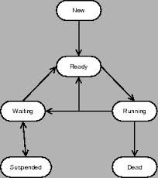
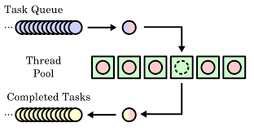
User-level thread implementation
The OS schedules the kernel thread
The kernel thread executes user code, including the thread support library and its associated thread scheduler
The thread scheduler determines when a user-level thread runs
it uses queues to keep track of what threads are doing: run, ready, wait
just like the OS and processes
but, implemented at user-level as a library

Slide 27

Thread interface
This is taken from the POSIX pthreads API:
rcode = pthread_create(&t, attributes, start_procedure)
creates a new thread of control
new thread begins executing at start_procedure
pthread_cond_wait(condition_variable, mutex)
the calling thread blocks, sometimes called thread_block()
pthread_signal(condition_variable)
starts a thread waiting on the condition variable
pthread_exit()
terminates the calling thread
pthread_join(t)
waits for the named thread to terminate

Slide 28
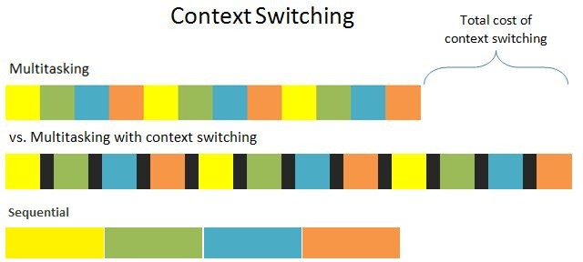
Thread context switch
Very simple for user-level threads:
save context of currently running thread
push CPU state onto thread stack
restore context of the next thread
pop CPU state from next thread’s stack
return as the new thread
execution resumes at PC of next thread
Note: no changes to memory mapping required
This is all done in assembly language
it works at the level of the procedure calling convention

Slide 29
How to keep a user-level thread from hogging the CPU?
Strategy 1: force everyone to cooperate
a thread willingly gives up the CPU by calling yield()
yield() calls into the scheduler, which context switches to another ready thread
what happens if a thread never calls yield()?
Strategy 2: use preemption
scheduler requests that a timer interrupt be delivered by the OS periodically
usually delivered as a UNIX signal (man signal)
signals are just like software interrupts, but delivered to user- level by the OS instead of delivered to OS by hardware
at each timer interrupt, scheduler gains control and context switches as appropriate

Slide 30
What if a thread tries to do I/O?
The kernel thread “powering” it is lost for the duration of the (synchronous) I/O operation!
The kernel thread blocks in the OS, as always
It maroons with it the state of the user-level thread
Could have one kernel thread “powering” each user-level thread
“common case” operations (e.g., synchronization) would be quick
Could have a limited-size “pool” of kernel threads “powering” all the user-level threads in the address space
the kernel will be scheduling these threads, obliviously to what’s going on at user-level

Slide 31
Multiple kernel threads “powering” each address space
user-level thread library
(thread create, destroy, signal, wait, etc.)
address space
kernel threads
os kernel
thread
CPU
(kernel thread create, destroy, signal, wait, etc.)

Slide 32
Summary
Multiple threads per address space
Kernel threads are much more efficient than processes, but still expensive
all operations require a kernel call and parameter validation
User-level threads are:
much cheaper and faster
great for common-case operations
creation, synchronization, destruction
can suffer in uncommon cases due to kernel obliviousness
I/O
preemption of a lock-holder

