Slide 1

🌐 Web Automation
📱 Mobile Automation
🔌 API Orchestration
🤖 Agentic AI Agents
🔁 Self-Healing Loop
📊 Enterprise Reporting
Agentic AI Test Automation Framework
One-stop agentic solution for Web, API & Mobile automation
Ascendion QE Circle Innovation — transforming fragmented automation into a governed, traceable, self-healing enterprise delivery pipeline.
Viplove | Ascendion QE Circle | May 2026
© 2026 Ascendion | QE Circle Innovation | Confidential

Slide 2
The Problem — Fragmented Automation
Requirements → Tests
Script Creation
Web vs Mobile vs API
Maintenance Burden
Reporting & Traceability
Manual effort to convert Jira stories into structured test cases. No standard, no traceability, no speed.
Automation engineers write scripts from scratch for every story. Reuse is minimal; selectors break constantly.
Separate tools, separate teams, separate pipelines. No unified framework or shared context.
Every app change breaks selectors. Triage is manual, slow, and burns QE capacity.
Results scattered across CI logs, TestRail, and Jira. No end-to-end visibility from requirement to result.
© 2026 Ascendion | QE Circle Innovation | Confidential

Slide 3
Solution — One-Stop Agentic Automation Framework
Web UI / IDE Agent / Jira API
LAYER 1 — INPUT
📥
Story + Platform + Context → Normalised Test Intent
application.md · domain.md · framework.md · platform.md
LAYER 2 — CONTEXT
📋
Platform Resolver → selects Playwright (Web) or Mobilewright (Android/iOS)
Planner Agent · Generator Agent · Healer Agent
LAYER 3 — AI ENGINE
🤖
Multi-framework code gen (POM) powered by Claude Opus / GPT-5 / Sonnet 4.6
Playwright (Chrome/WebKit/Firefox) · Mobilewright (Android/iOS emulator & device)
LAYER 4 — EXECUTION
▶️
Pass → Update TestRail & Jira | Fail → AI Error Analysis → retry with updated code
Playwright HTML · Mobilewright HTML · JSON Results
LAYER 5 — REPORTING
📊
TestRail integration · Workflow UI live logs · GitHub Actions step summary
© 2026 Ascendion | QE Circle Innovation | Confidential

Slide 4
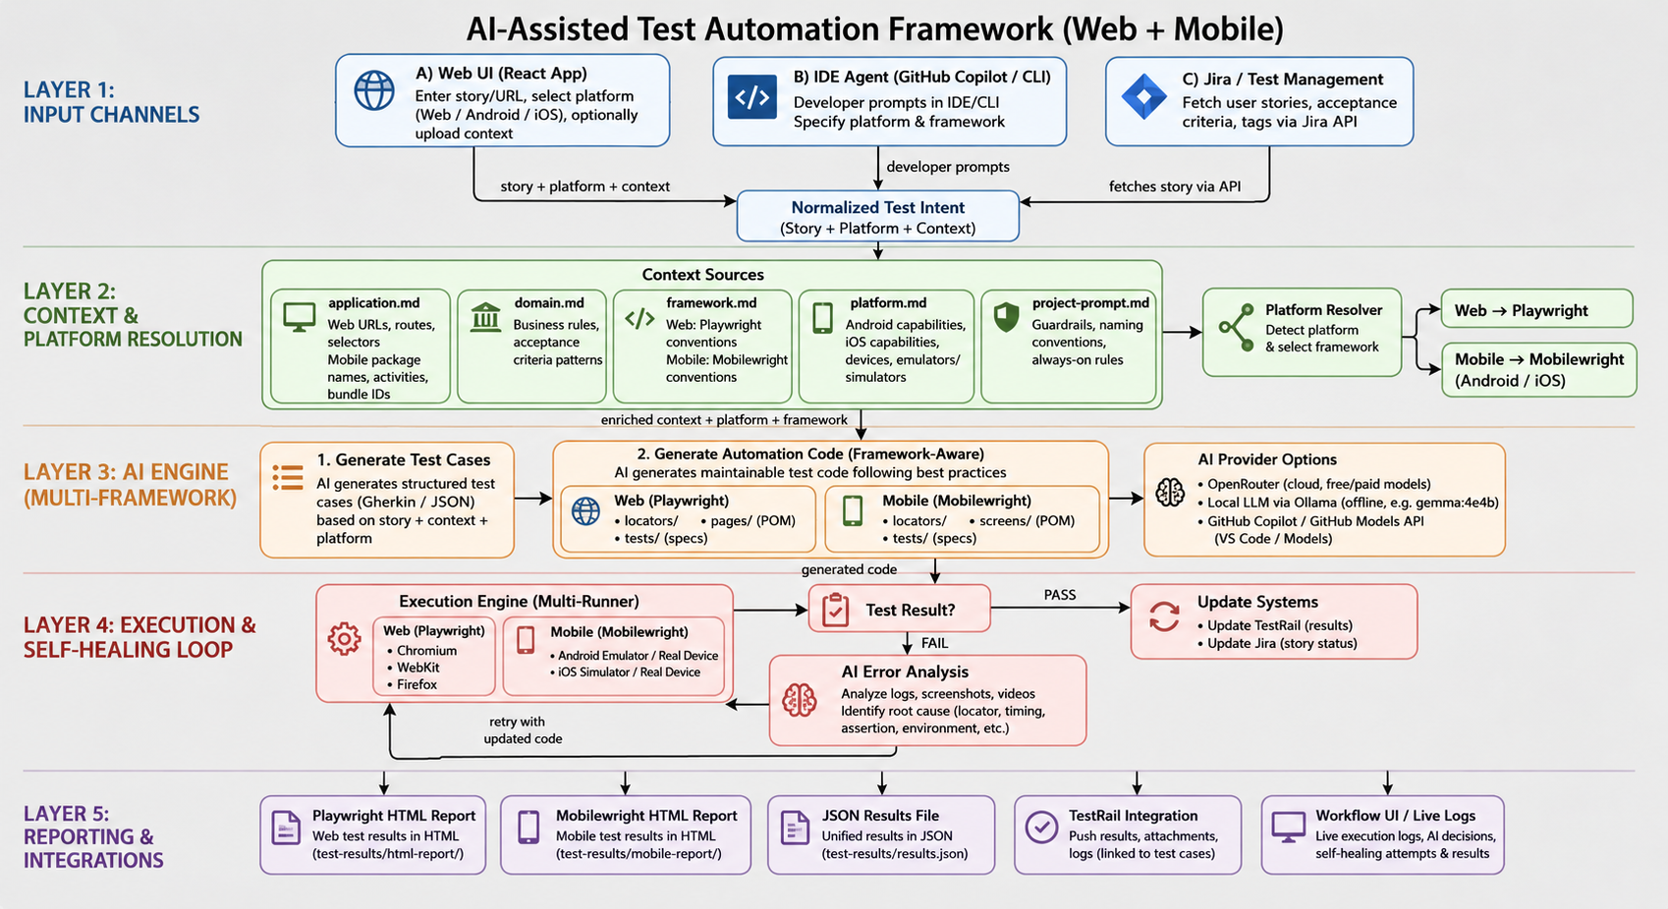
Framework Architecture — End-to-End Agentic Workflow
© 2026 Ascendion | QE Circle Innovation | Confidential

Slide 5
Phase-by-Phase Agent Workflow
1
2
3
4
5
6
7
→
→
→
→
→
→
Load Context
Audit Assets
TestRail Sync
Live Inspect
Generate Code
Execute & Heal
Report & Update
Reads application.md, domain.md, framework.md, platform.md
Scans existing locators, pages, specs — reuse before creating
Parses ACs → pushes cases to TestRail → embeds [Cxxx] in every test title
Navigates live app / device, confirms selectors against real DOM / a11y tree
Produces 3 POM files per story: locators · page object · spec
Runs tests; on failure AI analyses logs + screenshots → retries with fix
Pushes results → TestRail + Jira Emails HTML report → CI step summary
© 2026 Ascendion | QE Circle Innovation | Confidential

Slide 6
Change-Aware Lifecycle — When Requirements Change, Framework Adapts
📝
🔍
➕➖
⚙️
✅
Jira Ticket Updated
Compare with TestRail
Add / Update / Delete Cases
Update Automation Scripts
Re-Execute & Report
PM updates AC in Jira; agent detects change automatically
→
Framework reads current cases; identifies gaps or conflicts
→
New ACs → new TestRail cases Removed ACs → cases archived
→
Generator re-runs on changed ACs; updates POM assets and specs
→
Runs impacted tests; pushes results back to Jira & TestRail
🔁 Fully traceable: Jira Ticket → TestRail Case [Cxxx] → Automation Spec → Execution Result → Jira/Test Rail Update -> Report
© 2026 Ascendion | QE Circle Innovation | Confidential

Slide 7
AI Engine & LLM Strategy
Why powerful LLMs matter for deterministic automation output
Claude Opus 4
GPT-5.x Coding
Sonnet 4.6
Local LLM (Ollama)
Planning, complex reasoning, context-rich test scenario generation
Highly accurate POM code generation; minimal hallucination on structured tasks
Fast, cost-effective generation for high-frequency healing and retry loops
Offline / air-gapped mode; gemma:4e4b or llama3.2 for CI environments
⚡ Using advanced models over older-generation LLMs reduces human rework, improves output determinism, and enables code generation that is production-ready on first attempt rather than requiring extensive manual correction.
© 2026 Ascendion | QE Circle Innovation | Confidential

Slide 8
Guardrails, Quality Gates & Self-Healing
🚫 No duplicate code
🔁 Self-healing selectors
Agent audits existing locators, pages, and specs before creating new files.
On failure: AI regenerates selector from live DOM and retries automatically.
📐 Framework conventions
📸 Failure analysis
File naming, assertion rules, and import paths enforced by context files.
Screenshots, videos, and logs are fed to Healer Agent for root-cause analysis.
🏷️ TestRail traceability
⏱️ Retry with updated code
Every test title carries a [Cxxx] ID parsed by the reporter after execution.
Healer rewrites the failing assertion or action and re-executes the spec.
🔒 Selector guardrails
📊 Flaky detection
Priority: data-testid → role → text → CSS. XPath and coordinates blocked.
Logging reporter marks tests passing after ≥1 retry as [FLAKY] for review.
🛡️ No raw selectors in specs
🔄 CI loop
Selectors must live in locator files. Specs call page-object methods only.
GitHub Actions smoke + regression on every push; TestRail results auto-posted.
© 2026 Ascendion | QE Circle Innovation | Confidential

Slide 9
Client Demonstrations & Reception
StarHub
UnionDigital Bank
OCBC
Singapore
Philippines
Singapore
Tech stack & scope
Tech stack & scope
Tech stack & scope
Telco e-commerce SPA Mobile device purchase flow Chromium + dynamic content
BSP-licensed digital bank Next.js mobile-first website Multi-lang (EN/FIL)
Enterprise banking platform API & UI coverage Strict compliance requirements
Outcome
Outcome
Outcome
Positive feedback on selector resilience and POM reuse. POC discussion initiated.
Appreciated traceability from AC → TestRail → spec. Brownfield agent adopted.
Guardrails and governance model highlighted as key differentiator.
✅ Multiple clients have expressed interest to implement this framework in their own environments — POC engagements are in progress.
© 2026 Ascendion | QE Circle Innovation | Confidential

Slide 10
Results & Impact
🚀
Requirement to Automation
♻️
Asset Reuse
🔁
Self-Healing
Reduced test design-to-script cycle from days to hours using agentic workflow
POM-first design prevents duplication; existing locators reused across stories
Failing selectors auto-repaired; reduced manual triage significantly
📋
Traceability
🌐
Coverage
🤝
Client Interest
100% of generated tests carry [Cxxx] TestRail case ID
Web + API + Mobile unified in one framework, one pipeline
3+ clients demonstrated; POC conversations started
© 2026 Ascendion | QE Circle Innovation | Confidential

Slide 11
One Framework. Agentic. Governed. Self-Healing.
Contact
Ready to scale across Ascendion client engagements.
Viplove Bisen Ascendion QE Circle GitHub: Ascen-dion poc_mobile_automation_mobile_wright
🎯
Adopt in client projects
github.com/Ascen-dion/ AI-Assisted-Playwright-Automation-Framework
Re-use context + agent structure for any web / mobile project
📢
Submit to Agentic AI Champion
Nomination backed by 3+ client demos and POC interest
🤝
Engage QE Circle
Share framework as a reusable Ascendion QE accelerator
© 2026 Ascendion | QE Circle Innovation | Confidential

