Slide 1
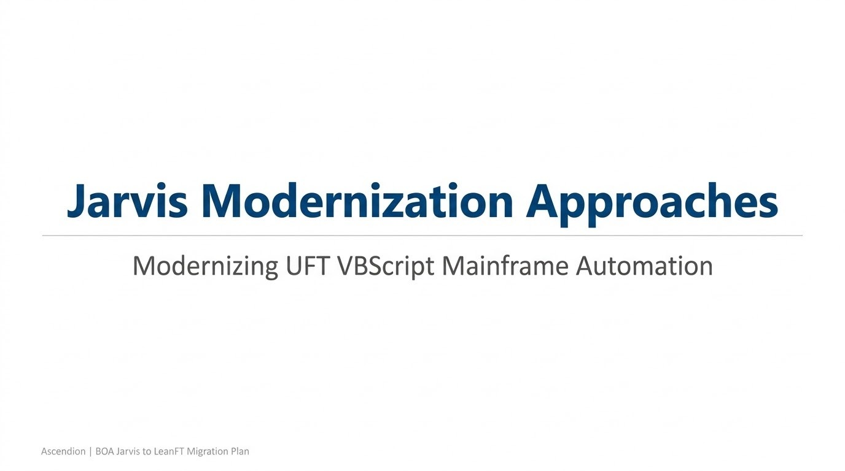

Slide 2
Jarvis Modernization Approaches
Three POC options tried to modernize UFT VBScript mainframe automation:
LeanFT JavaScript
Python py3270
LeanFT Java
Approach 1: LeanFT JavaScript
Approach 2: Python py3270
Approach 3: LeanFT Java
VS Code, Jasmine, and JavaScript-based LeanFT framework.
Strong fit when the team wants modern scripting with LeanFT support.
Open-source, zero-license option using pytest and direct TN3270 socket access.
Strong fit when BOA prefers a lower-cost, headless automation model.
Java, TestNG, and Maven-based LeanFT implementation.
Strong fit when BOA prefers a typed enterprise Java stack.
Ascendion | BOA Jarvis to LeanFT JavaScript Migration Plan
1

Slide 3
Approach 1 : Jarvis to LeanFT JavaScript Migration Plan
Objective
Modernizing UFT VBScript mainframe automation
to a VS Code, Jasmine, and LeanFT engineering model
Preserve the layered Jarvis design
Modernize language, tooling, and CI/CD
Show a practical migration factory approach
What this POC proves
POC flows in scope
Evidence used for this deck
LeanFT JavaScript can drive TN3270 through an existing HLLAPI-capable emulator.
Jarvis concepts map cleanly into driver, keyword, object repository, data, config, and reporting layers.
Login
Account Inquiry
Funds Transfer
Jenkins execution across SIT and UAT
Architecture docs in docs/01 and docs/02
Framework context files
Actual runner.js, terminalHelper.js, screens.js, and Jasmine spec implementation
Ascendion | BOA Jarvis to LeanFT JavaScript Migration Plan
1

Slide 4
Executive Summary
The migration does not require rethinking the testing model. It modernizes the implementation stack and delivery flow.
Current-state constraint
Target-state shift
Business outcome
Jarvis depends on VBScript, UFT artifacts, XML flows, and binary object repository assets that are harder to diff, review, and scale.
The new framework keeps the same layered design but uses LeanFT JavaScript, Jasmine, plain-text screen definitions, JSON or Excel-backed test data, and Jenkins-ready execution.
Faster onboarding, cleaner Git visibility, better IDE support, and an AI-assisted migration pattern.
What remains familiar
What improves materially
Layered automation design
Keyword-driven mainframe interactions
Central object repository and external configuration
Data-driven execution and Jenkins orchestration
VBScript to modern JavaScript
Binary assets to plain-text source-controlled files
UFT-centric authoring to VS Code + GitHub Copilot
Manual migration effort reduced by a deterministic BOA migration agent
Ascendion | BOA Jarvis to LeanFT JavaScript Migration Plan
2

Slide 5
Current State Architecture: Jarvis / UFT / VBScript
Pain points
The current model is modular, but several layers are implemented with older and more opaque technologies.
Test Suite
Test Flows
Test Data
VBScript deprecation risk
Harder Git diff and code review experience
Less developer-friendly tooling
Manual migration of legacy assets is slower without structured accelerators
Spreadsheet-driven suite definitions
Execution entry point for business scenarios
XML flow orchestration
Externalized step sequencing
Spreadsheet-based data sets
Separate from scripts
Execution Engine
Libraries
Object Repository
Jarvis / UFT driver-runner model
Scenario coordination and playback
.qfl VBScript keyword libraries
Reusable screen actions
UFT .tsr or .mtr assets
Binary-style repository management
Configuration
Reporting
CI/CD
Config templates and runtime settings
UFT HTML reports and zipped results
Jenkins integration present, but framework tooling remains UFT-centric
Ascendion | BOA Jarvis to LeanFT JavaScript Migration Plan
3

Slide 6
Migration Mapping: Jarvis Components to the New Framework
The POC preserves the business testing intent while swapping each legacy layer for a modern equivalent.
Jarvis component | Current technology | Target component | Target technology
Test Suite | Excel spreadsheet | spec/ftdtest_jasmine_spec.js | Jasmine JavaScript spec
Test Flow | XML | describe / it blocks | Native JavaScript structure
Test Data | Excel spreadsheet | testdata JSON + xlsx support | JSON or Excel via Node.js
Execution Engine | UFT proprietary runner | driver/runner.js | LeanFT SDK lifecycle
Libraries | .qfl VBScript | libraries/terminalHelper.js | Reusable JS keywords
Object Repository | UFT .tsr / .mtr | objectrepository/screens.js/.tsrx | Plain-text screen metadata
Configuration | Config templates | config/settings.js | Node module + env vars
Reporting | UFT report | results/ LeanFT report | HTML report with snapshots
CI/CD | Jenkinsfile | Jenkinsfile | Parameterized SIT / UAT execution
This is a migration with continuity, not a rewrite with loss of control.
Ascendion | BOA Jarvis to LeanFT JavaScript Migration Plan
4

Slide 7
Target Architecture: LeanFT JavaScript Framework
The implementation already present in the POC follows a modern, reviewable, and modular structure.
Test Suite
Driver / Runner
Action Layer
Object Repository
Jasmine spec
Business scenarios and assertions
LeanFT init / cleanup
Shared TE session lifecycle
terminalHelper.js keywords
Mainframe business actions
screens.js
Identifiers, fields, and key maps
Test Data
Configuration
Reporting
CI/CD
JSON default
Excel support via xlsx
settings.js
TE short name, env, timeouts
LeanFT HTML report
Snapshots and pass/fail logging
Jenkins SIT / UAT
Filterable suite execution
IBM Mainframe through an existing HLLAPI-capable terminal emulator
Important architecture note: LeanFT does not open TN3270 directly; it automates an already-running emulator session via HLLAPI.
Ascendion | BOA Jarvis to LeanFT JavaScript Migration Plan
5

Slide 8
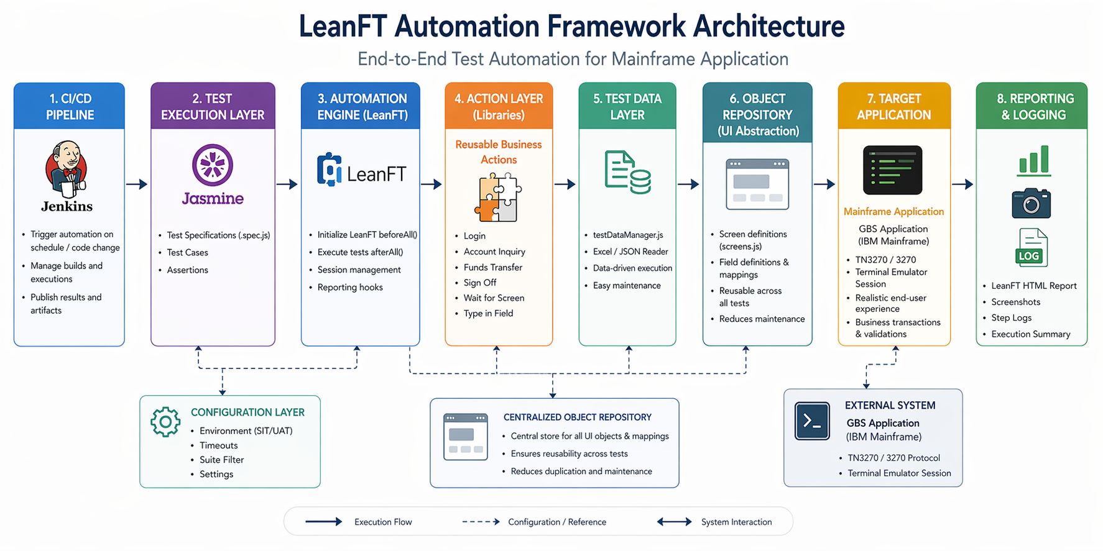

Slide 9
Why This Framework Is Better for Delivery
The technical modernization is paired with a better authoring and migration experience for the QE team.
Engineering benefits
Acceleration benefits
JavaScript is closer to VBScript than Java or C#, which reduces training friction.
VS Code provides a lightweight and familiar IDE with Git-native workflows.
Plain-text repository assets are easier to review, diff, branch, and promote.
Jasmine plus npm gives a simple, CI-friendly execution model.
JSON-first test data can still coexist with Excel input when needed.
GitHub Copilot can assist with routine coding, refactoring, and test authoring inside VS Code.
The repo includes a BOA migration agent that reads project context, maps VBScript constructs, generates Jasmine skeletons, and flags only the steps that need manual intervention.
The agent provides a migration delta report, giving traceability from automated translation to remaining manual work.
The target stack improves both automation maintainability and migration throughput.
Ascendion | BOA Jarvis to LeanFT JavaScript Migration Plan
6

Slide 10
Suggested Migration Approach
A factory model is safer than a big-bang conversion. The POC and BOA migration agent support this sequence.
1. Assess
2. Map
3. Baseline
4. Pilot
5. Industrialize
6. Scale
Inventory current suites, libraries, flows, data, and object repository dependencies.
Map Jarvis constructs to the LeanFT JavaScript framework and identify manual-only gaps.
Stabilize target framework layers, CI settings, reporting, and environment conventions.
Migrate representative high-value flows such as login, account inquiry, and funds transfer.
Use Copilot and the migration agent to accelerate repetitive conversions with guardrails.
Expand by application area, validate SIT and UAT behavior, and retire legacy suites in waves.
How the accelerator helps
Operating principle
Loads framework and migration context before translation
Maps known VBScript and UFT constructs deterministically
Creates skeletons, keyword translations, and a migration delta report
Automate the known mappings
Flag anything that requires live environment confirmation
Do not guess locators, credentials, or environment-specific identifiers
Ascendion | BOA Jarvis to LeanFT JavaScript Migration Plan
7

Slide 11
Migration Risks and How to Control Them
The main risks are known upfront and can be managed with the right pilot discipline.
Risk or dependency | Mitigation in the proposed plan
Screen locators must match live emulator labels | Capture and validate attachedText values using the LeanFT Object Identification Center; do not guess them in code.
Screen identifiers can vary by environment | Validate identifiers in SIT and UAT during pilot onboarding and keep them centralized in screens.js.
Credentials and sensitive data must not be embedded | Keep credentials out of specs and use managed external test data and environment configuration.
Some custom Jarvis keywords may not have a direct map | Use the migration agent to flag keyword gaps and implement them once in terminalHelper.js for reuse.
Citrix or non-3270 surfaces may require separate treatment | Keep the first migration wave focused on standard TN3270 automation; assess exceptional channels separately.
Execution still depends on a running emulator session | Document emulator setup, session short names, and Jenkins runtime configuration as part of environment readiness.
Ascendion | BOA Jarvis to LeanFT JavaScript Migration Plan
8

Slide 12
Approach 2: Python / py3270 Open-Source POC
A second branch demonstrates a lower-cost modernization path using Python, pytest, and direct TN3270 connectivity.
What this POC is
Architecture in one line
Advantage
Branch: python_based_open_source_poc
Stack: Python 3.10+, py3270, pytest, pytest-html
Direct TN3270 over s3270 subprocess, no LeanFT, no HLLAPI, no emulator license
pytest suite -> runner.py -> terminal_helper.py -> py3270 -> s3270 -> TN3270 socket -> mainframe
The same layered model is retained: config, driver, action layer, object repository, test data, reporting, and Jenkins CI
Zero licensing cost
Headless execution model suited for CI
Useful as an alternate modernization option if BOA prefers open-source tooling
Key differences from the LeanFT POC
Python instead of JavaScript
pytest instead of Jasmine
Direct socket connectivity instead of emulator-driven HLLAPI automation
This as an optional open-source alternate path, not a replacement for the primary LeanFT migration story unless BOA wants a no-license model.
Ascendion | BOA Jarvis to LeanFT JavaScript Migration Plan
10

Slide 13
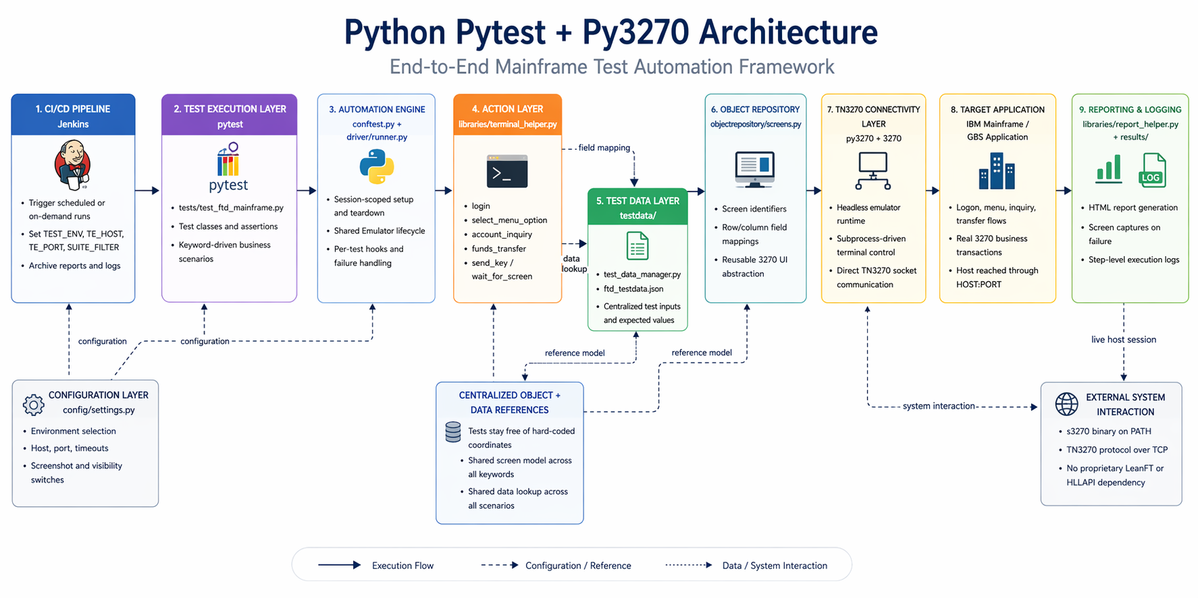

Slide 14
Approach 3: Java / LeanFT POC
This branch also shows a Java-based LeanFT implementation for teams that prefer a Java and Maven stack.
What this POC is
Architecture in one line
Why mention it to the client
Stack: Java 11+, LeanFT runtime engine, TestNG, Maven
Main files: BaseTest.java, TerminalHelper.java, Screens.java, FtdMainframeTest.java
LeanFT HTML reporting with screenshots and step logs
TestNG suite -> BaseTest -> TerminalHelper -> LeanFT TE SDK -> terminal emulator session -> mainframe
The same layered model is preserved with config, data provider, object repository, action layer, reporting, and Jenkins CI
Suitable if BOA has stronger Java engineering alignment
Fits enterprise Maven and TestNG delivery patterns
Still modernizes Jarvis while staying within the LeanFT ecosystem
Key characteristics
Java instead of JavaScript or Python
TestNG and Maven instead of Jasmine or pytest
Requires LeanFT runtime and terminal emulator-based execution
This is a second LeanFT-based option for teams that want a typed Java stack and Maven-style enterprise delivery rather than the JavaScript implementation.
Ascendion | BOA Jarvis to LeanFT JavaScript Migration Plan
11

Slide 15
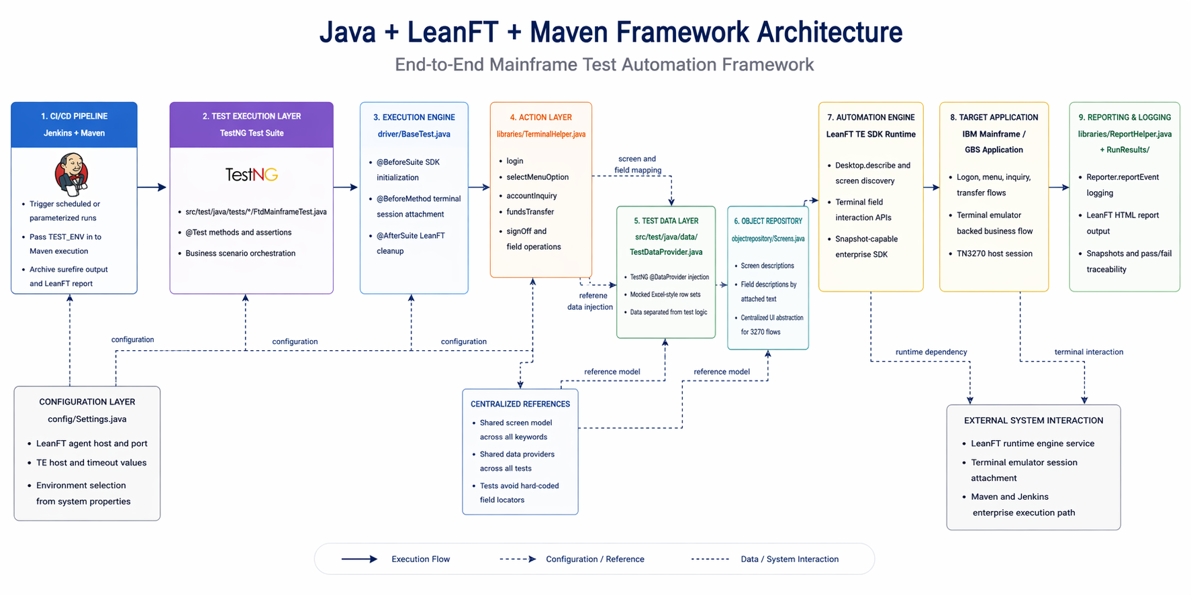

Slide 16
Recommended Pilot and Next Steps
Use the current POC as the demonstration baseline, then move into a controlled pilot migration wave.
Pilot scope
Success criteria
Immediate next steps
3 to 5 representative business flows
At least one login or navigation pattern
At least one inquiry flow
At least one transaction flow
SIT and UAT execution through Jenkins
Functional parity with selected Jarvis flows
Stable object repository and environment settings
Repeatable CI execution and report publication
Measured reduction in migration effort for each additional script
Confirm pilot scope and environments
Capture live locators for pilot screens
Prioritize Jarvis suites by reuse and business value
Define governance for AI-assisted migration review
Ascendion | BOA Jarvis to LeanFT JavaScript Migration Plan
9

Slide 17
What we need from Bank of America to continue
Dependencies and open questions for next steps
Access to a BOA test environment with the actual mainframe application and representative user journeys.
One BOA-side SME, tester, or engineer working closely with us to validate screens, navigation, and expected results. Once we are inside BOA network.
Support to configure the terminal emulator, session short names, host connectivity, and any environment-specific runtime settings.
Which BOA environments are available for SIT, UAT, or pilot execution?
What emulator, access controls, credentials handling, and network prerequisites are required?
Which flows, test data, and application variants should be the first migration wave?
Are there any BOA-specific dependencies such as Citrix, middleware hops, or security approvals we should plan for?
To move beyond the current POC, one of the team members should work with BOA in the real environment to complete setup, validate locators, and industrialize the migration path.

Slide 18
BOA Mainframe Migration Agent: Jarvis → LeanFT JavaScript
A context-aware VS Code Copilot agent that automates the Jarvis VBScript → LeanFT JS migration lifecycle end-to-end
What the Agent Does
6-Phase Agent Process
How to Use It (4 Scenarios)
• Migrates UFT/Jarvis VBScript → LeanFT JavaScript (Jasmine)
• Loads all 5 context files at startup before acting
• Maps known constructs automatically — flags unknowns explicitly
• Generates spec files, keywords & object repo stubs
• Produces a Migration Delta Report for every migration
• Enforces all project guardrails on every generated file
PHASE 0 Load all 5 context files (mandatory gate)
PHASE 1 Intake & Analysis — parse VBScript, list constructs
PHASE 2 Construct Mapping — map each step to JS equivalent
PHASE 3 Skeleton Generation — Jasmine spec structure
PHASE 4 Keyword Translation — translate each test step
PHASE 5 Guardrail Check — validate against all project rules
PHASE 6 Output + Migration Delta Report
S1: Migrate a VBScript file
Prompt: "Migrate this VBScript test file to LeanFT JavaScript: [paste file]"
S2: Add a new screen
Prompt: "Add a new screen called PAYMENT_HISTORY to screens.js with fields: ..."
S3: Add a keyword
Prompt: "Add a new keyword viewPaymentHistory(win, acct) to terminalHelper.js"
S4: Add a test case
Prompt: "Add a new test case 'should view payment history' to the spec file"
✅ AUTO
Fully translated. Review & approve.
⚠️ PARTIAL
Has TODO comments. Complete manually.
🔴 LOCATOR_MANUAL
No locator found. Capture with OIC.
🔴 TESTDATA_MANUAL
Test data key missing. Add to JSON file.
⛔ NOT_APPLICABLE
No 3270 equivalent. Remove from scope.
Migration Flag Codes
Ascendion | BOA Jarvis to LeanFT JavaScript POC | Migration Agent
10

Slide 19
Comparison Table (Focused only on mainframe capability)
Tool | Type | Cost | Mainframe Support | Approach | Difficulty | Reality in 2026
UFT | Commercial | Paid | Strong | Terminal emulator add-in | Medium | Legacy but still used
LeanFT (UFT Developer) | Commercial | Paid | Strong | Code-based (Java/JS) | Medium | Legacy but still used
UiPath | Commercial + Free | Free + Paid | Strong | CV + text scraping | Medium | Modern standard
Blue Prism | Commercial | Expensive | Strong | Surface automation | Hard | Banking-heavy
Automation Anywhere | Commercial | Paid | Strong | AI + screen | Medium | Cloud-first
IBM Personal Communications | Commercial | Paid | Native | HLLAPI/EHLLAPI | Hard | Very reliable
Rocket BlueZone | Commercial | Paid | Native | API-based | Medium | Strong alternative
py3270 | Open-source | Free | Strong | Direct terminal API | Hard | Best OSS option
s3270 | Open-source | Free | Strong | Scriptable terminal | Hard | Low-level control

Slide 20
TypeScript vs JavaScript for LeanFT Mainframe Automation
VERDICT: LeanFT officially supports Java, C# and JavaScript only. TypeScript is NOT an official SDK target.
What TypeScript Would Require
Recommendation: Stay with JavaScript
• tsconfig.json with "allowJs": true + "module": "commonjs"
• Add // @ts-check at top of key files for type validation
• Hand-written .d.ts type definitions for all ~18 LeanFT packages
• Use JSDoc annotations (@param, @returns) for IntelliSense
• ts-node or tsc compile step added to the CI/CD pipeline
• Enable "checkJs": true in jsconfig.json for workspace-wide checks
• Convert every .js file (specs, helpers, screens, runner) to .ts
• Achieves ~80% of TypeScript safety with zero migration risk
• No OpenText vendor support if anything breaks in TypeScript mode
• No build step needed — Jasmine runs .js files directly
Side-by-Side: TypeScript vs JavaScript for This Project
Concern | JavaScript (Current) | TypeScript (Hypothetical)
LeanFT SDK support | Official — ships JS packages | None — no .d.ts files in SDK
Type definitions | Not needed | Must hand-write for ~18 packages
Build step | None — jasmine runs .js directly | Requires ts-node or tsc compile
CI pipeline impact | Zero changes needed | Extra compile stage in Jenkinsfile
OpenText vendor support | Full support | Unsupported configuration
Team ramp-up | JS is the migration target | Additional TypeScript learning needed
Migration agent output | Directly runnable | Needs post-processing transpile step
Risk level | LOW | MEDIUM-HIGH
Ascendion | BOA Jarvis to LeanFT JavaScript POC | TypeScript Feasibility Assessment
21

Slide 21
Proposed Conversion Approach: VBScript Key Components to Each Language
All four options follow the same proven 6-step factory model: Assess → Map → Baseline → Pilot → Industrialize → Scale
JavaScript (LeanFT)
Python (py3270)
Java (LeanFT)
TypeScript (LeanFT¹)
• VBScript .qfl → JS keyword functions
• UFT XML flows → Jasmine describe/it
• UFT .tsr/.mtr → plain JS objects
• Excel data → JSON + xlsx npm
• Config templates → Node.js modules
• Migration agent auto-converts ~70%
• Remaining 30%: manual + Copilot assist
• VBScript .qfl → Python helper functions
• UFT flows → pytest test functions
• Object repo → Python dict / dataclass
• Excel data → JSON / pandas / openpyxl
• Config → YAML / .env + python-dotenv
• Manual rewrite required (no auto agent)
• py3270 wraps s3270 for direct TN3270
• VBScript .qfl → Java helper classes
• UFT flows → TestNG @Test methods
• Object repo → Java POJOs / enums
• Excel data → TestNG DataProvider + poi
• Config → Maven profiles / properties
• Manual rewrite required (no auto agent)
• LeanFT TE SDK for emulator interaction
• Same as JS + add tsconfig.json
• Write .d.ts for all ~18 LeanFT pkgs
• Rename .js → .ts, add type annotations
• Needs ts-node or tsc compile step
• No official SDK types from OpenText
• No migration agent support today
• ¹ Not an official LeanFT target language
Key point: All options share the same layered architecture — only the language, runner and SDK bindings differ.
Ascendion | BOA Jarvis to LeanFT JavaScript Migration Plan
22

Slide 22
Quickest Win Analysis: Risk, Effort, Cost & Time to Value
Which option gets to production fastest with the lowest combined risk?
Dimension | JavaScript (LeanFT) | Python (py3270) | Java (LeanFT) | TypeScript (LeanFT)
Migration effort | LOW – closest syntax to VBScript; agent auto-converts ~70% | MEDIUM – full rewrite; different paradigm | MEDIUM-HIGH – full rewrite; verbose boilerplate | MEDIUM – same as JS + write .d.ts for 18 packages
Time to first test running | 1–2 weeks (POC already running) | 3–4 weeks (needs s3270 infra setup) | 3–4 weeks (Maven + LeanFT config) | 2–3 weeks (JS POC + TS conversion)
Licensing cost | LeanFT license (already available) | FREE – fully open-source | LeanFT license (already available) | LeanFT license (already available)
Mainframe connectivity | HLLAPI via LeanFT TE SDK | Direct TN3270 socket (no emulator) | HLLAPI via LeanFT TE SDK | HLLAPI via LeanFT TE SDK
Vendor support | Full OpenText support | Community only | Full OpenText support | NONE – unsupported config
AI acceleration | Migration agent + Copilot | Copilot only (can create new agent to generate scripts) | Copilot only (can create new agent to generate scripts) | Migration agent + Copilot
Team ramp-up | LOW – JS closest to VBScript | MEDIUM – new language | MEDIUM – Java + Maven learning | MEDIUM – JS + TS type system
Risk level | LOW | MEDIUM | MEDIUM | HIGH
Overall: Time to Value | FASTEST | MODERATE | MODERATE | Fast BUT Risky
⭐ Recommendation: JavaScript / LeanFT is the clear quickest win — lowest risk, fastest delivery, with AI-assisted migration.
Ascendion | BOA Jarvis to LeanFT JavaScript Migration Plan
23

Slide 23
Detailed Pros & Cons of Each Conversion Approach
Option 1: JavaScript / LeanFT (Recommended)
Option 2: Python / py3270 (Open-Source)
PROS
PROS
• Closest syntax to VBScript → easiest migration
• Migration agent automates ~70% of conversion
• POC already running end-to-end (proven)
• Full OpenText vendor support
• GitHub Copilot + migration agent ready
• Simple npm/Jasmine CI — no build step
• Existing LeanFT license covers this option
• Zero licensing cost — fully open-source
• Direct TN3270 — no emulator dependency
• Rich ecosystem (pandas, requests, etc.)
• Headless execution ideal for CI/CD
CONS
• Full manual rewrite (no migration agent)
• py3270/s3270 is community-supported only
• Different paradigm from VBScript (steeper curve)
• No LeanFT reporting integration
• s3270 infrastructure setup required
CONS
• Requires LeanFT license (already in place)
• Dynamic typing (mitigated with JSDoc/@ts-check)
• Needs terminal emulator running for HLLAPI
Option 3: Java / LeanFT
Option 4: TypeScript / LeanFT
PROS
PROS
• Strong typing — catches errors at compile time
• Enterprise Maven/TestNG pattern familiar to Java shops
• Full OpenText vendor support
• Good fit if BOA has strong Java engineering teams
• Static typing on top of JavaScript
• Better IDE auto-complete and refactoring
• Compiles down to JS — same runtime
CONS
CONS
• Full manual rewrite — no migration agent
• Verbose boilerplate vs. JavaScript
• Maven + JDK setup adds CI complexity
• Farthest syntax from VBScript → hardest migration
• Requires LeanFT license + terminal emulator
• NOT an official LeanFT SDK language
• Must hand-write .d.ts for ~18 LeanFT packages
• No OpenText support for TS configuration
• Extra tsc / ts-node build step in CI
• Migration agent does not emit TypeScript
• Fragile on SDK version upgrades
JavaScript / LeanFT offers the best balance of risk, effort, cost and time-to-value for mainframe automation at BOA.
Ascendion | BOA Jarvis to LeanFT JavaScript Migration Plan
24

Slide 24


