Slide 1
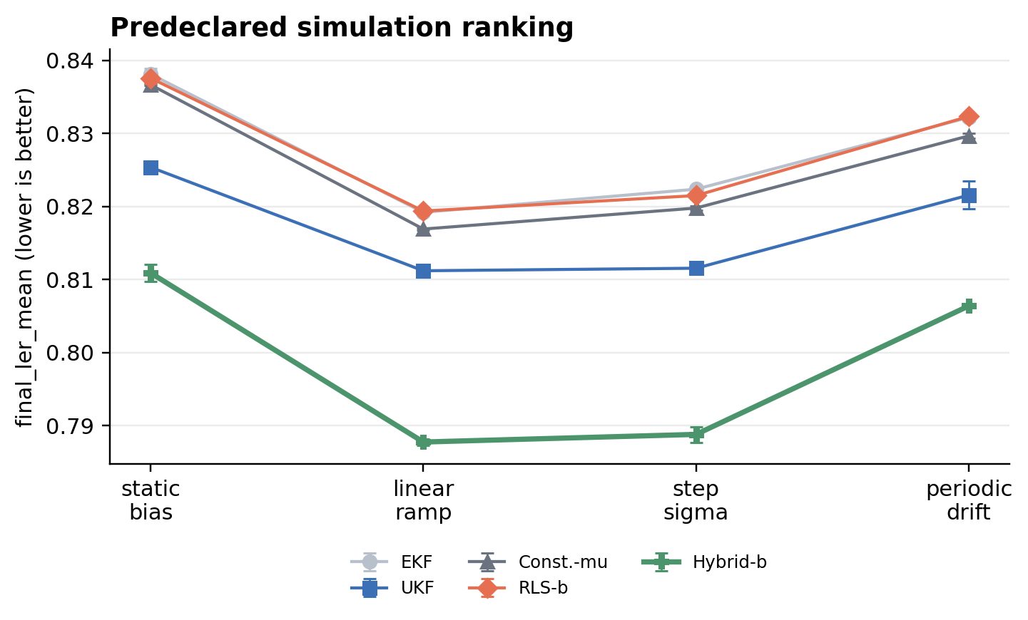
???????????????????????
????
?? CNN_FPGA_GKP_submission_draft.tex?????? simulation-first / software-HIL
?? = K?s? + b?
???? / ??
? shot ??? 2?2 ?? + clip
4 mult + 4 add?6 ??????Q4.20 ??????? 10?? ????????? FPGA latency?
LER
????????????? mean final_ler
?? UKF ?????????? 1.8?2.9%???? 2.3%????? repeats ??????????
??? / ????
??? residual-boundary surrogate
q/p ??????????????????? finite-energy logical-channel fidelity ? process fidelity?
Source: Fig. 2 main software-HIL results?n=2 descriptive, not CI/p-value
??????
????? syndrome statistics ?? (K,b)
static / ramp / step / periodic drift ?? controlled software-HIL?holdout stress ??????? robustness proof?
???????????CNN ?????????????????????????????????????????????????
Boundary: no real-board execution success, no measured FPGA timing/resource/power, no deployment closure.
Notes:
?????????????????? simulation-first systems-method claim?LER ?????????? software-HIL ???????????????????? Q4.20 ????????????? residual-boundary surrogate?????? controlled drift ?????????

Slide 2
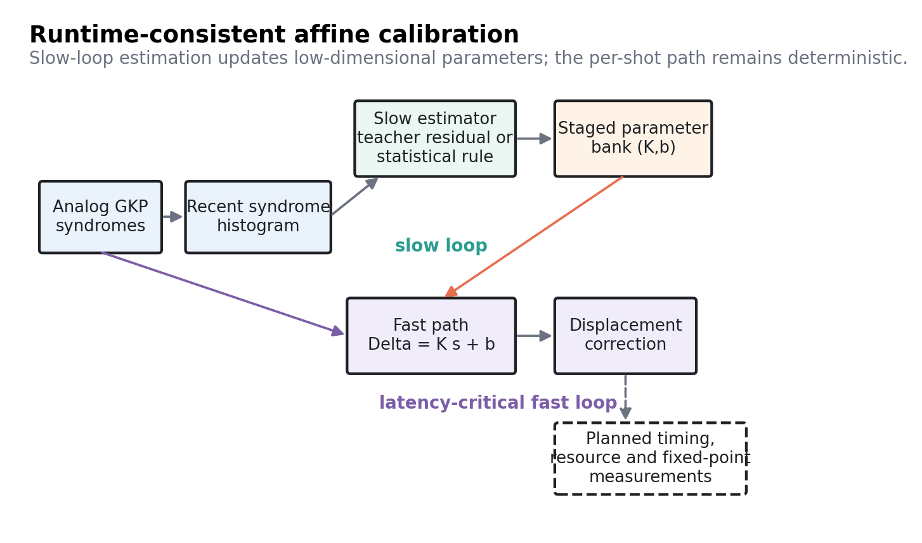
?????FPGA ????????????????
?????????????? / ????????????? per-shot critical path
?????
???????
? software-HIL ????
? ?? fast-path ????
? Q4.20 ???? parity
? runtime counters / source-data
? board logs / device path
? bitstream ? RTL hash
? DMA / MMIO evidence
? latency / resource / power
????? HIL ?????
??????? measurement surface
Source: Fig. 1 dual-loop architecture
1
syndrome s?
2
active bank
3
FPGA fast path
4
correction
5
slow estimator
6
commit gate
GKP ?????? syndrome??? q/p analog ??
?????????? K?,b??? bank ???
?? = K?s? + b??Q4.20 / clip / ????
??????????overflow?commit ??
CNN / teacher / statcalib ?????????????
stage ? validate ? commit???? rollback / hold
?????????? per-shot ??????commit ??? hold/rollback
Engineering boundary: board_backend remains placeholder; no board-level timing, resource, power, DMA/MMIO, or source-vs-board result is claimed.
Notes:
????????????? FPGA ???? CNN??????? posterior???????? K,b ????? 2x2 ????????? clip???????? counters ?????????????? syndrome histogram?teacher ?????????????? stage/validate/commit ????? bank???????? software-HIL??????Q4.20 ?? parity ? runtime observability??? FPGA ????????bitstream/RTL hash?DMA/MMIO ??? measured latency/resource/power?

