Slide 1


Hands-On Workshop :
Embedded Systems with MATLAB
Presented by:
Ascendas Systems Thailand Ltd
Pattarapol S.
Application Engineering

Slide 2
Prerequisite
Install MATLAB 2025b
Check ver –support
MATLAB
Simulink
MATLAB coder
Simulink coder
Embedded coder
Arduino Hardware support package
Wiring diagram
[Suggestion] MATLAB Onramp + Simulink Onramp

Slide 3
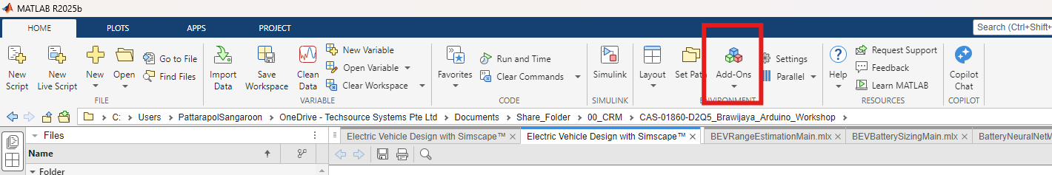
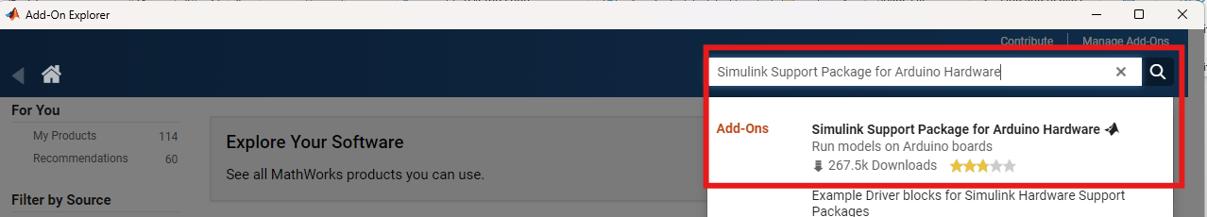
Prerequisite Install “Simulink Support Package for Arduino Hardware”
Go to Add Ons
Searching for “Simulink Support Package for Arduino Hardware”

Slide 4
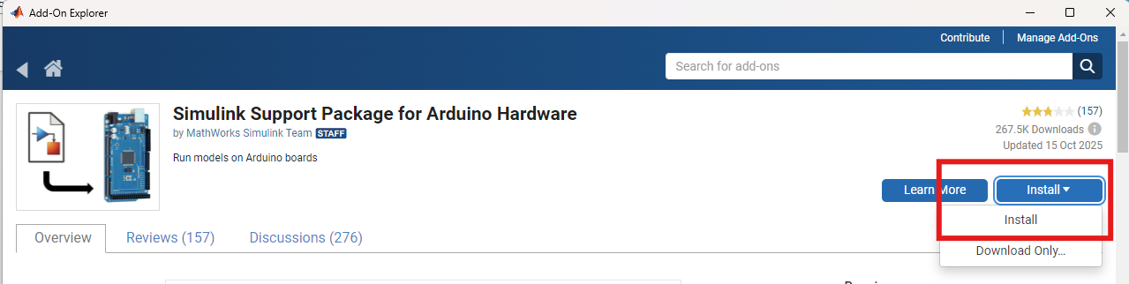
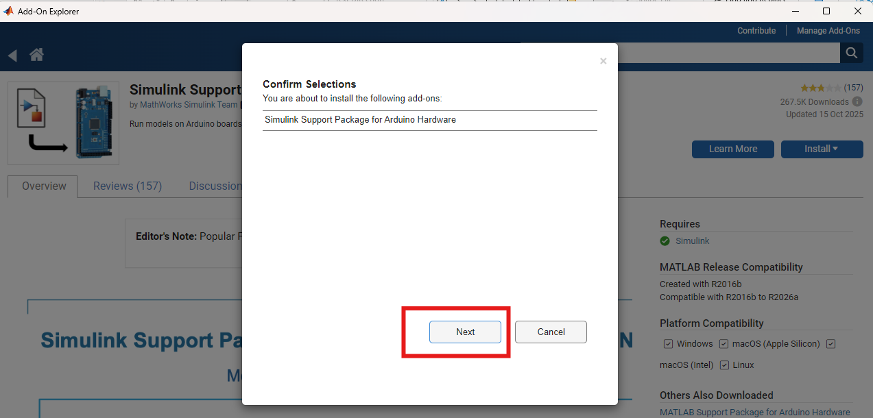
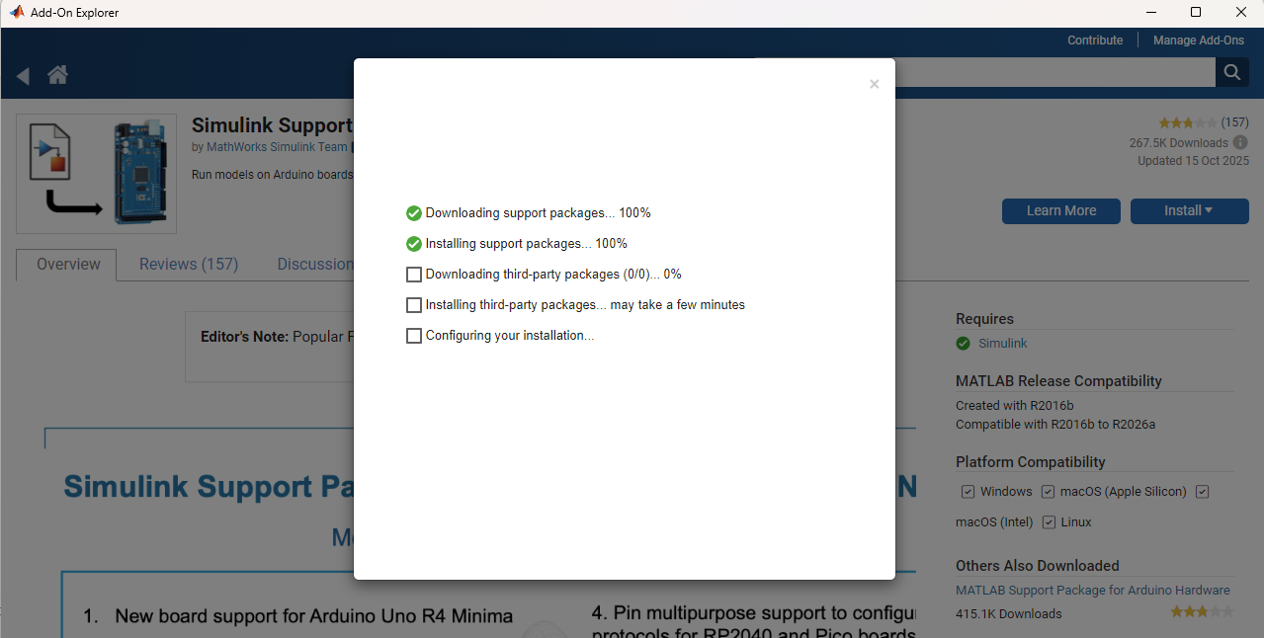
Prerequisite Install “Simulink Support Package for Arduino Hardware”
Go to “Install” and Click “Install”
Confirm Selection → Wait until the installation process finished

Slide 5
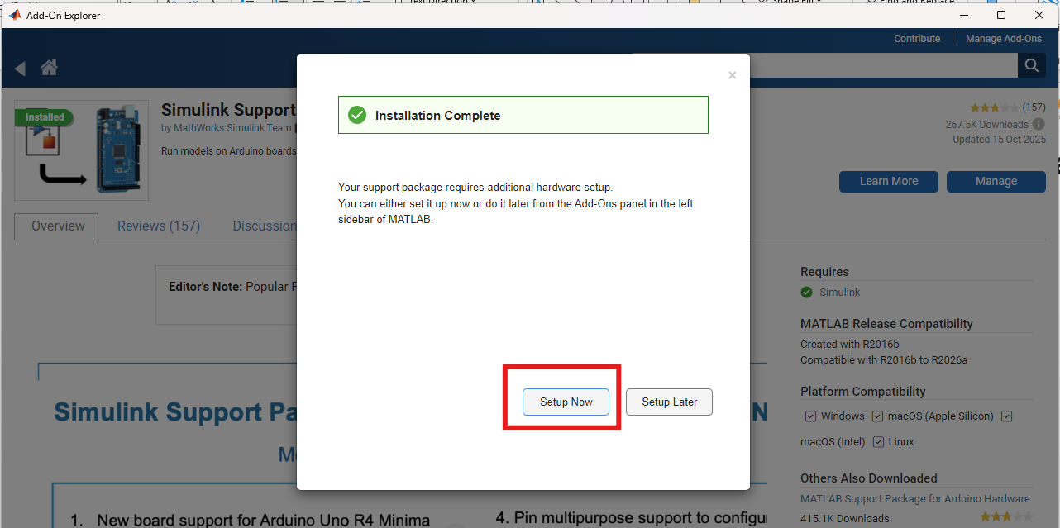
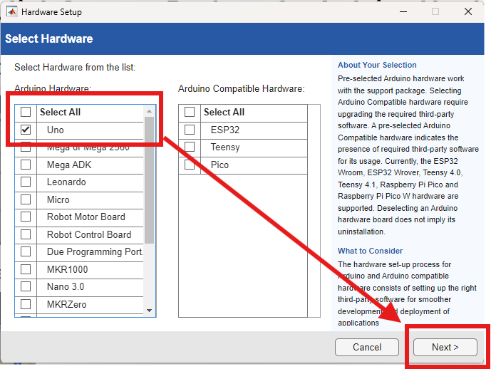
Prerequisite Install “Simulink Support Package for Arduino Hardware”
After installation complete → Click “Setup now”
Select hardware option → Click “Next”

Slide 6
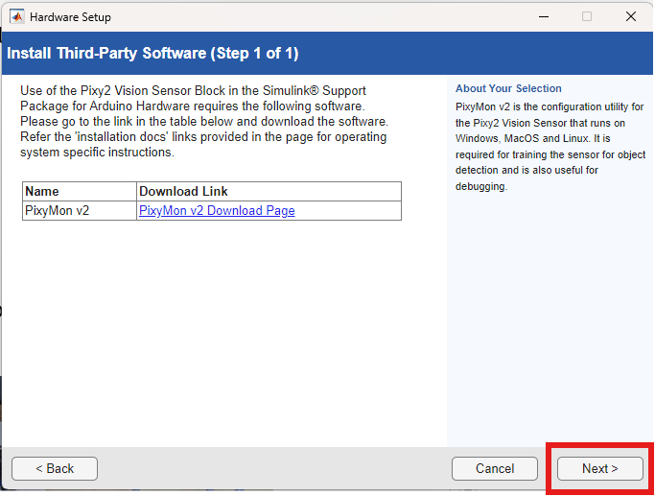
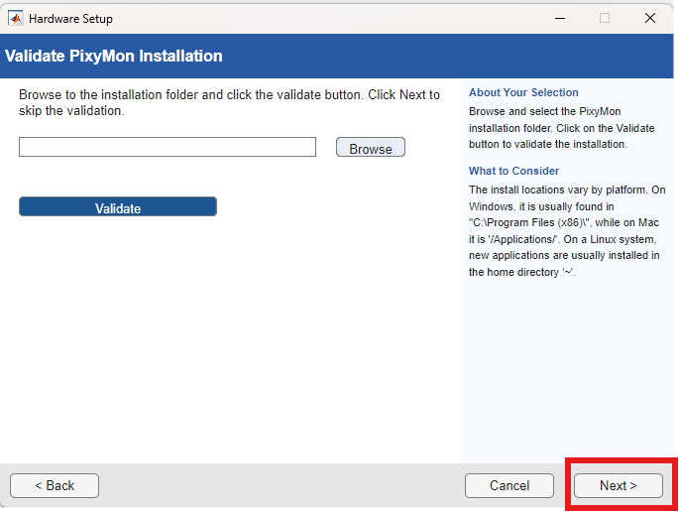
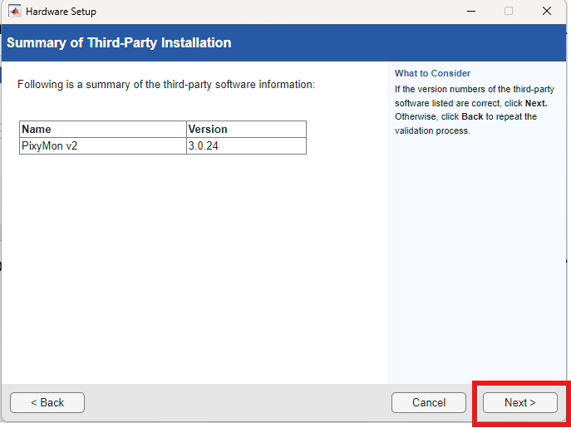
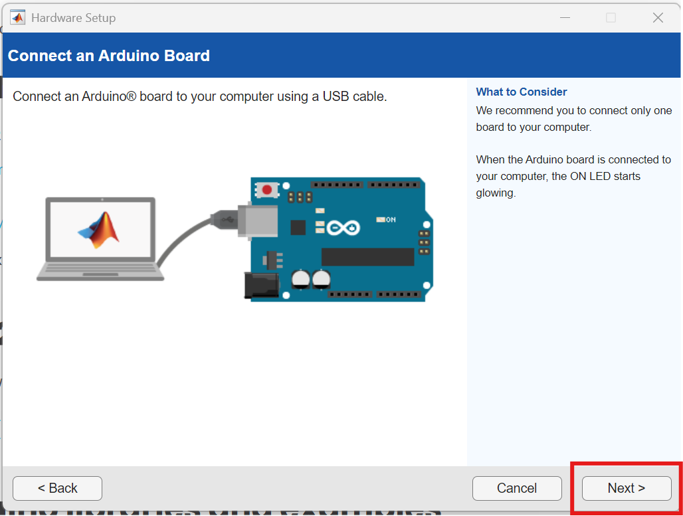
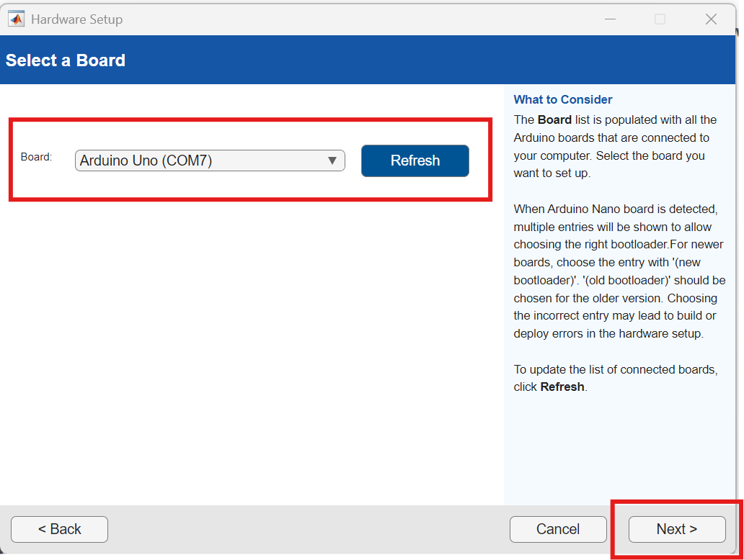
Prerequisite Install “Simulink Support Package for Arduino Hardware”
Software may ask you if you want to install “PixyMon V2” *Skipped by Click Next*
Connect your Arduino to your laptop → Confirm the COM port

Slide 7
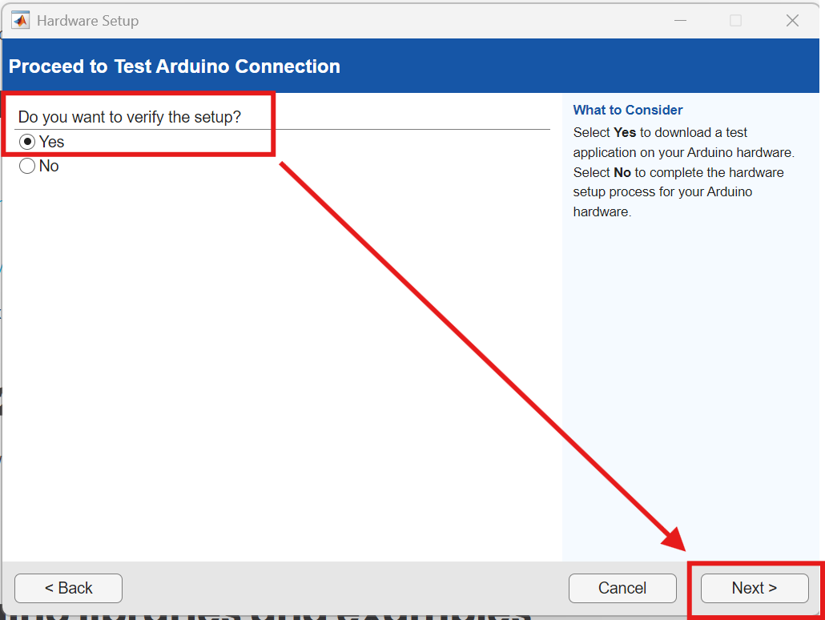
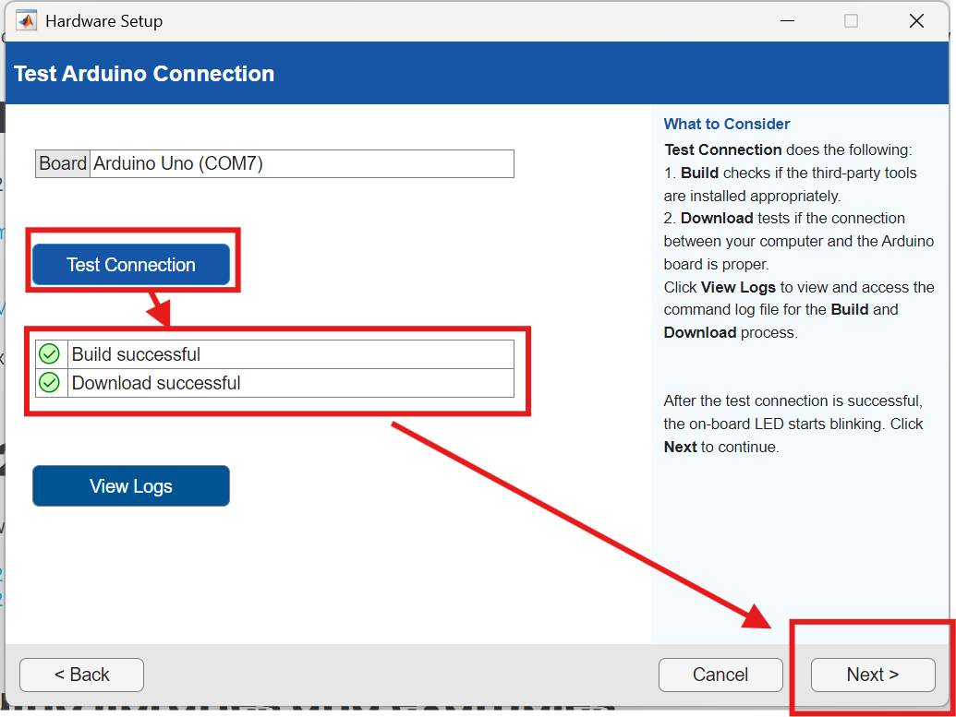
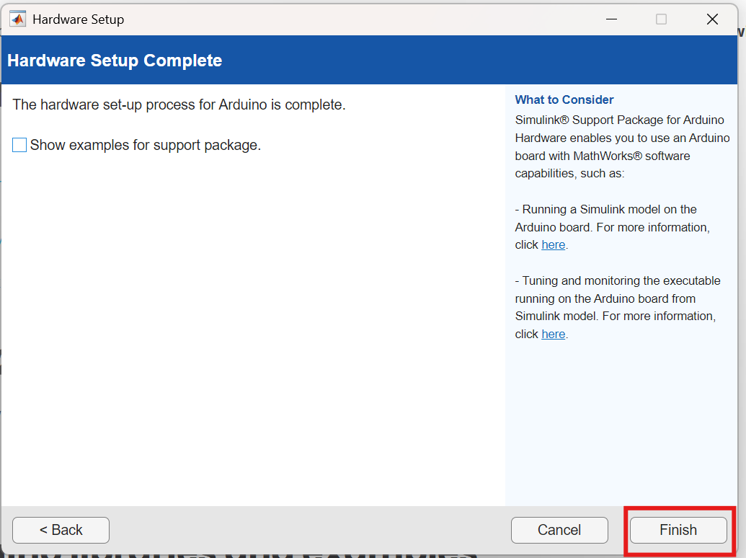
Prerequisite Install “Simulink Support Package for Arduino Hardware”
Select “Verify the setup” → Click “Next” and “Test Connection”
Click “Finish” → Hardware setup completed

Slide 8
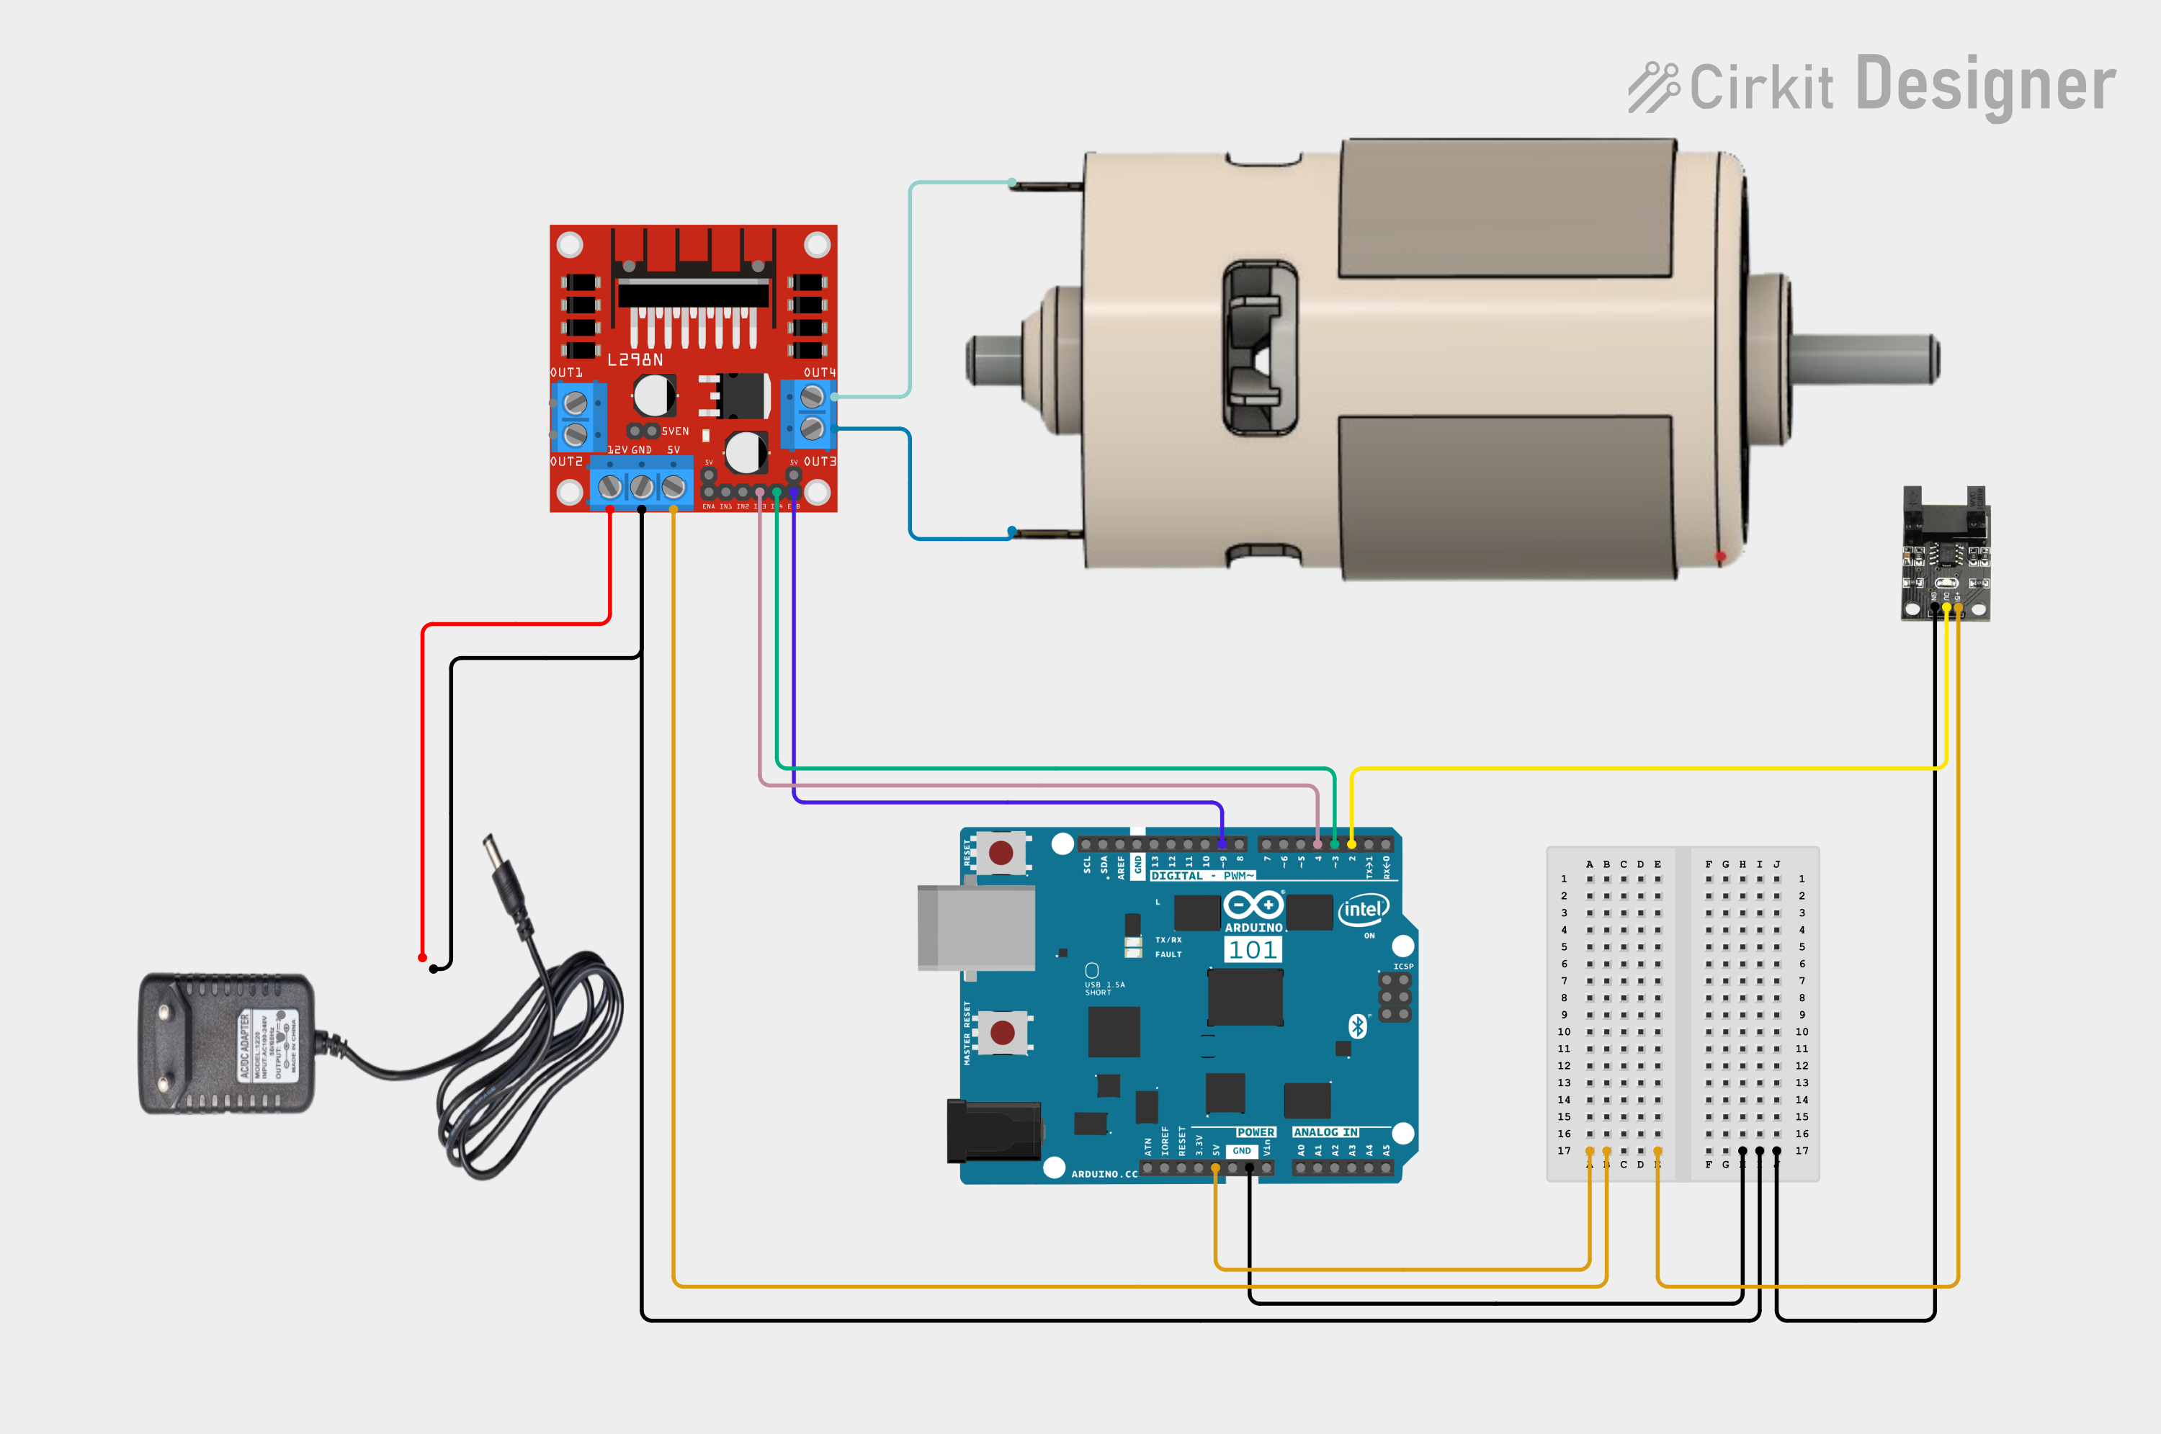
Prerequisite Wiring Diagram
12V Line
12 V+ [Adaptor] | --> | 12 V+ [L298N]
12 V- [Adaptor] | --> | 12 V- [L298N]
GND [Arduino] | --> | 12 V- [L298N]
5V Line
5V [Arduino] | --> | 5V [Encoder]
5V [Arduino] | --> | 5V [L298N]
GND [Arduino] | --> | GND [Encoder]
12V Motor
M+ [Motor] | --> | OUT3 [L298N]
M- [Motor] | --> | OUT4 [L298N]
Motor control
D3 [Arduino] | --> | IN3 [L298N]
D4 [Arduino] | --> | IN4 [L298N]
D9 [Arduino] | --> | ENB [L298N]
Encoder
D2 [Arduino] | --> | OUT [Encoder]

