Slide 1
Lesson 9 Hands-On
By Alexander Olvera

Slide 2
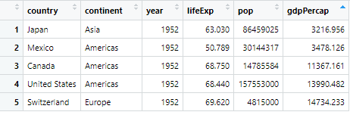
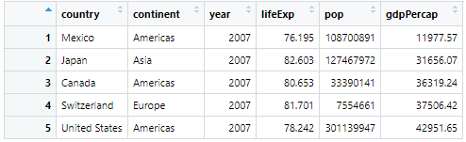
Countries chosen: United States, Canada, Mexico, Japan, Switzerland
Which country of the five you chose has the lowest per capita GDP in 1952? In 2007? Japan, Mexico
Which has the highest per capita GDP in 1952? In 2007? Switzerland, United States
1952 GDP (Ascending)
2007 GDP (Ascending)

Slide 3
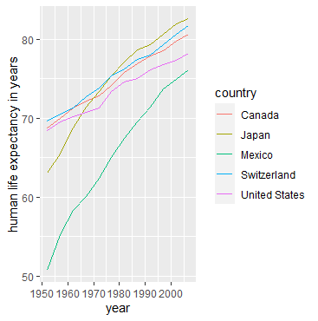
Create a line plot with year on the horizontal axis and lifeExp on the vertical axis for the five countries; give each country a different color line. Describe the variations in life expectancy between the countries.
All other countries except Mexico seem to follow a similar life expectancy growth from 1952 to 2007. Japan has made the highest growth of the 4 countries described. Mexico started with the lowest life expectancy in 1952. However, Mexico has made the biggest increase in life expectancy out of all 5 countries studied from 1952 to 2007.

Slide 4
On the entire gapminder data frame, compute the median of lifeExp for each year. For what years is the life expectancy for your five countries above the median life expectancy for the entire gapminder data frame?
Year | medlifeExp | United States | Canada | Mexico | Japan | Switzerland
1952 | 45.1355 | 68.440 | 68.750 | 50.789 | 63.030 | 69.620
1957 | 48.3605 | 69.490 | 69.960 | 55.190 | 65.500 | 70.560
1962 | 50.8810 | 70.210 | 71.300 | 58.299 | 68.730 | 71.320
1967 | 53.8250 | 70.760 | 72.130 | 60.110 | 71.430 | 72.770
1972 | 56.5300 | 71.340 | 72.880 | 62.361 | 73.420 | 73.780
1977 | 59.6720 | 73.380 | 74.210 | 65.032 | 75.380 | 75.390
1982 | 62.4415 | 74.650 | 75.760 | 67.405 | 77.110 | 76.210
1987 | 65.8340 | 75.020 | 76.860 | 69.498 | 78.670 | 77.410
1992 | 67.7030 | 76.090 | 77.950 | 71.455 | 79.360 | 78.030
1997 | 69.3940 | 76.810 | 78.610 | 73.670 | 80.690 | 79.370
2002 | 70.8255 | 77.310 | 79.770 | 74.902 | 82.000 | 80.620
2007 | 71.9355 | 78.242 | 80.653 | 76.195 | 82.603 | 81.701

Slide 5
Code used
library(dplyr)
library(ggplot2)
library(gapminder)
levels(gapminder$country)
View(gapminder)
q1 <- gapminder %>% filter(country %in% c("United States", "Canada", "Mexico", "Japan", "Switzerland")) %>%
View(q1)
q1952 <- q1 %>% filter(year %in% ("1952"))
View(q1952)
q2007 <- q1 %>% filter(year %in% ("2007"))
View(q2007)
ggplot(q1) + geom_line(aes(x = year, y = lifeExp, color=country)) + ylab("human life expectancy in years")
median <- gapminder %>% select(year,lifeExp) %>% group_by(year) %>% summarise(medlifeExp = median(lifeExp))
View(median)

