Slide 1
College Social App
Austin Schladant
Kyle Riley
BoFei Wang

Slide 2
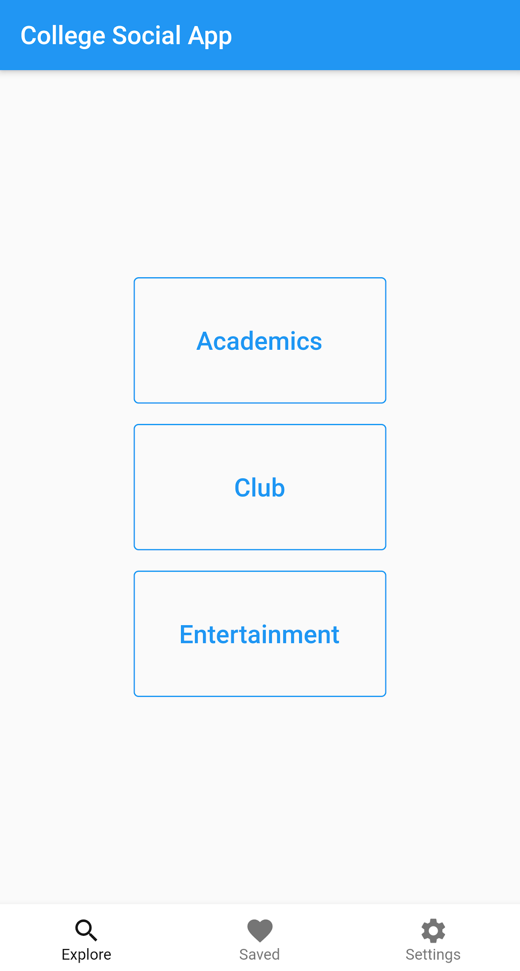
RECAP
Chatroom style messaging application for University students
Three core topics to easily find chat rooms tailored to a student’s interests
Programmed using Dart and Firebase Cloud Storage

Slide 3

ACTORS
Account Holders
Has access to all application functions
Non-Account Holders
Has access to only account creation and login
Firebase Database
Stores user information, chatrooms, and messages
Notes:
Description of the actors that can interact with the system

Slide 4
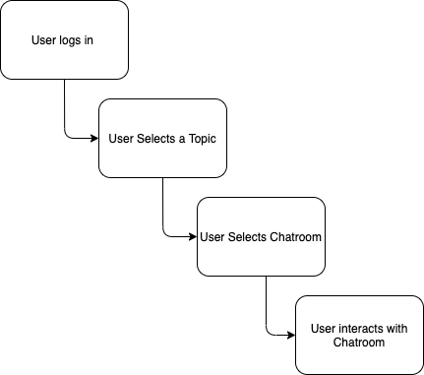
System Overview
Notes:
Pipeline:
(1) the user logs in, or signs up if an account isn’t made, (2) the user edits their profile if they need to change password or update/add profile picture (3) the user explores chat rooms depending on what subject they select, (4) the user enters a chat room, (5) the user sends and reads messages in the chat room, (6) the user saves the chat room if they want.

Slide 5
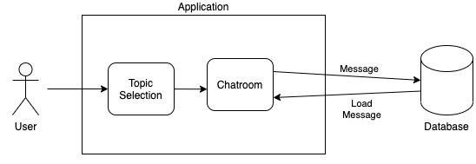
SYSTEM OVERVIEW
Main System Components:
Topic Selection and Chatroom
Notes:
Description of the system’s components using the system diagram
Two main components:
Chatroom Selection, Chatroom
Chatrooms and chats stored using firebase
Briefly mention the architecture, will go into more depth later
Architecture:
Chatroom: Model-View Controller Architecture
Navigation of Applicataion: Event-Driven Architecture

Slide 6
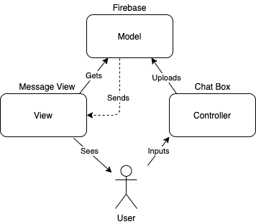
ARCHITECTURE STYLE
Event-Driven Architecture
Application acts accordingly to events caused by the user
Model-View-Controller (MVC) Architecture
Model: Firebase Database
View: Message Texts
Notes:
Description and justification of the architectural style selected (this may be brought up earlier when the system diagram is explained)
The flow of this architecture is: the user inputs a message into the controller, the controller then handles this message and sends it to the model, then the model saves the message, and finally, the view grabs the message and displays it in the chatroom.
Model
The central component of the pattern. It is the application's dynamic data structure, independent of the user interface.^{[5]} It directly manages the data, logic and rules of the application.
View
Any representation of information such as a chart, diagram or table. Multiple views of the same information are possible, such as a bar chart for management and a tabular view for accountants.
Controller
Accepts input and converts it to commands for the model or view.

Slide 7
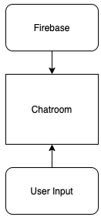
DESIGN PATTERNS
Mediator Pattern
Encapsulates communication between Database object and User object with Mediator object
Factory Method
Implements Chatroom Selection Object superclass
Depending on User input, different subclasses are instantiated
Notes:
Description and justification of the design patterns that could be applicable to the project
Using mediator pattern reduces dependencies between communicating objects, reducing coupling , meaning the degree to which these difference objects rely on each other. Lowering the measure of how closely connected two routines/modules are to each other.
Factory Method is a creational design pattern that provides an interface for creating objects in a superclass, but allows subclasses to alter the type of objects that will be created.

Slide 8

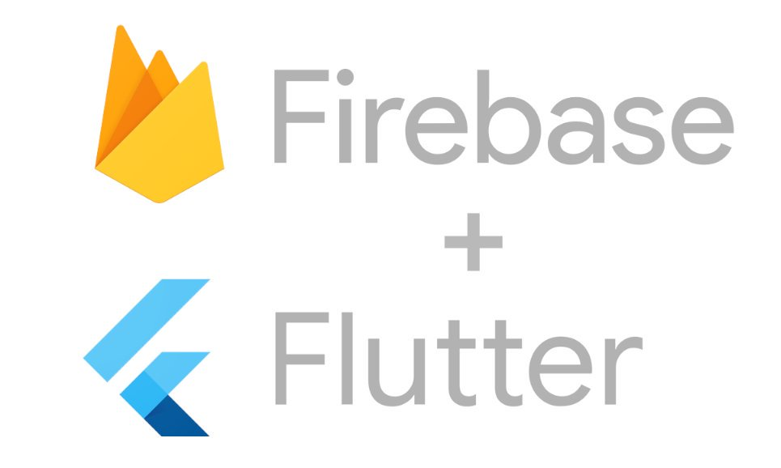
FRAMEWORKS
Flutter UI toolkit, written with Dart programming language
Powerful UI toolkit by Google for creating applications
Firebase API
Allows easy storage of data in realtime
Notes:
Description and justification of the frameworks proposed (if any)
This application is going to be using the Flutter UI toolkit and the Firebase API. Using Flutter and Dart will allow the program to interact with Firebase storage to allow users to message each other in chat rooms.

Slide 9
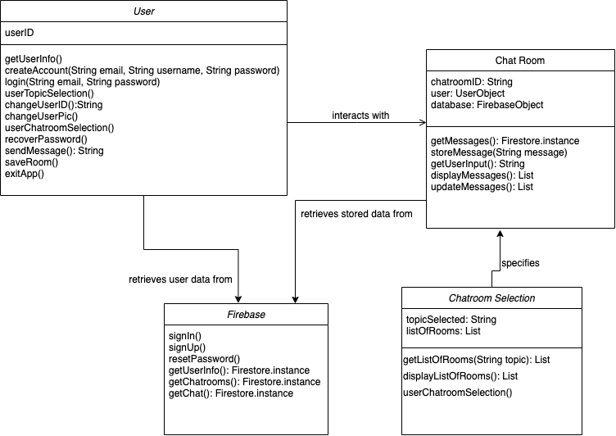
CLASS DIAGRAM
Notes:
Description of the class diagram

Slide 10
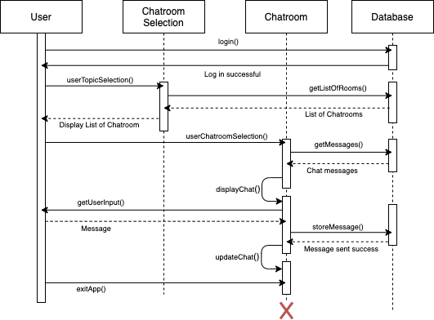
SEQUENCE DIAGRAM
Notes:
Description of the sequence diagram(s)
When the user logs in, their email and password authenticated using the Firebase API.
After the user logs in, they have the option to select a topic, and once they do that, the Chatroom Selection then accesses Firebase to get the list of chatrooms under that topic and displays it to the user.
The user then has the option to select any of the chatrooms that are displayed. Once selected, the Chatroom object is called, and the Chatroom gets the messages from Firebase and displays the chatroom.
The Chatroom object then waits for the user input. When the user inputs a message, the Chatroom object then stores the message in Firebase, and updates the chat.

Slide 11
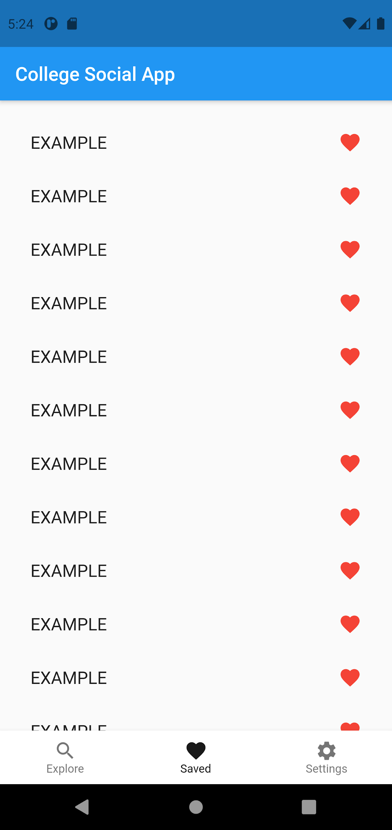
PROJECT MOCK-UP

Slide 12
Questions
https://github.com/Aschladant/team14-social-app
Notes:
Closing slide and github link

