Slide 1
Introduction to Parallel Architectures
5 Hours

Slide 2
Topics covered:
Generation of Computer Systems
Introduction to Parallel Processing
Parallel Computer Structures
Architectural Classification Schemes
GPU as Parallel Computers
Architecture of a Modern GPU
Need for Parallelism
Parallel Programming Languages and Models
Please click on the links in following slides to display the relevant figures and web pages

Slide 3
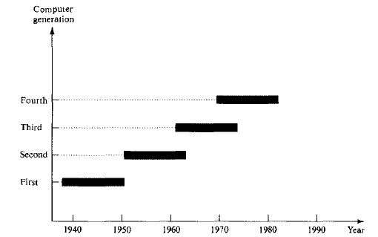
Generation of Computer Systems

Slide 4
The first generation (1938-1953)
Electromechanical relays(1940s) and Vacuum tubes(1950s) were used as switching devices
Devices were interconnected by insulated wires
CPU structure was bit-serial (arithmetic is done on a bit-by-bit fixed-point basis)
Binary-coded machine language was used

Slide 5
The second generation (1952-1963)
Transistors and Diodes were used as the building blocks
Usage of Printed Circuit Board(PCB)
Usage of Magnetic core memory
Assembly language was initially used and then appeared the High-level programming languages(Fortran, Algol, Cobol)
Batch processing was popular, providing sequential execution of user programs

Slide 6
The third generation (1962-1975)
Usage of Small-scale integrated (SSI) and Medium-scale integrated (MSI) circuits as the basic building blocks
Usage of Multi-layered PCB
Usage of intelligent compilers
Multiprogramming is used to allow simultaneous execution of many program segments
Time-sharing operating system became available
Virtual memory was developed

Slide 7
The fourth generation (1972-present)
Usage of Large-scale integrated (LSI) circuits for both logic and memory sections
High-level languages are capable of handling both Scalar and Vector data
Pipelining and Multiprocessing become the common approaches for achieving parallelism

Slide 8
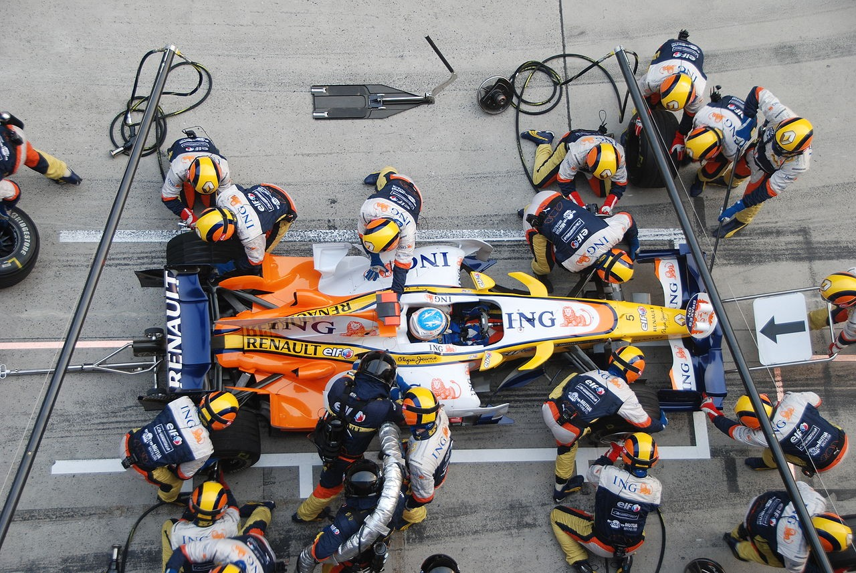
Parallel Programming Analogy

Slide 9
Realistic Expectations
Ex. – Your program takes 20 days to run
95% can be parallelized
5% cannot (serial)
What is the fastest this code can run?
As many CPU’s as you want!
1 day!
(5/100)*20
Amdahl’s Law
The performance improvement to be gained from using some faster mode of execution is limited by the fraction of the time the faster mode can be used

Slide 10
Speedup (S)
S = Speed(new) / Speed(old)
S = Work/time(new) / Work/time(old)
S = time(old) / time(new)
S = time(before improvement) /
time(after improvement)

Slide 11
Example
20 hours
A
B
must walk
200 miles
Walk 4 miles /hour
Bike 10 miles / hour
Car-1 50 miles / hour
Car-2 120 miles / hour
Car-3 600 miles /hour

Slide 12
Example
20 hours
A
B
must walk
200 miles
Walk 4 miles /hour → 50 + 20 = 70 hours S = 1
Bike 10 miles / hour → 20 + 20 = 40 hours S = 1.8
Car-1 50 miles / hour → 4 + 20 = 24 hours S = 2.9
Car-2 120 miles / hour → 1.67 + 20 = 21.67 hours S = 3.2
Car-3 600 miles /hour → 0.33 + 20 = 20.33 hours S = 3.4

Slide 13
Introduction to Parallel Processing
The trends towards parallel processing can be seen from:
Application point of view
Operating system point of view

Slide 14
Application point of view
The computers are experiencing a trend of four ascending levels of sophistication:
Data Processing → Data objects include numbers, characters, images, audio, video,
multidimensional measures etc.
Information Processing → Information item is a collection of data objects that are
related by some syntactic structure or relation
Knowledge Processing → Knowledge consists of information items plus some semantic
meanings
Intelligence Processing → Intelligence is derived from a collection of knowledge items.
Data-space

Slide 15
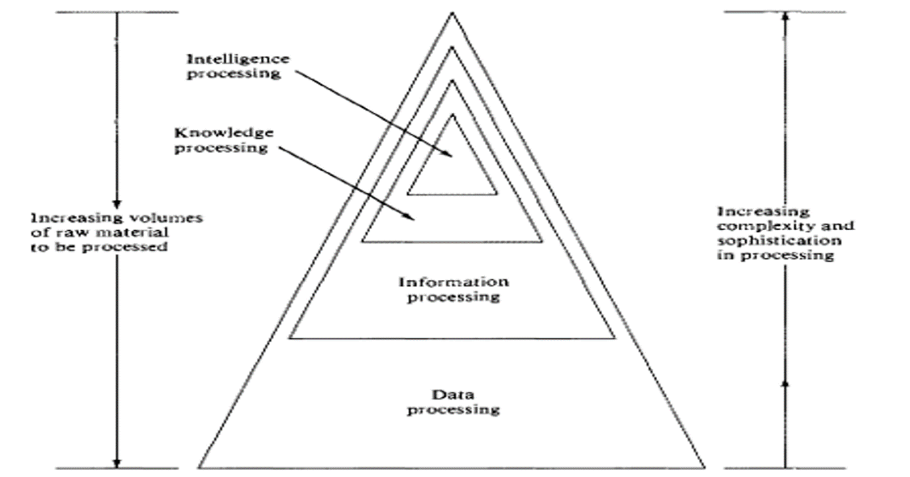

Slide 16
2. Operating system point of view
The computer systems have improved chronologically in four phases:
Batch Processing
Multiprogramming
Time Sharing
Multiprocessing
Parallel processing of information increases sharply by exploiting concurrent events
Concurrency → Implies parallelism, simultaneity, and pipelining
Parallelism→ Parallel events may occur in multiple resources during the same time interval
Simultaneity→ Simultaneous events may occur at the same time instant
Pipelining→ Pipelined events may occur in overlapped time spans

Slide 17
Degree (level) of parallel processing
Job or Program level →The highest level of parallel processing is conducted among multiple jobs or programs through multiprogramming, time sharing and multiprocessing
Task or Procedure level →The next highest level of parallel processing is conducted among procedures or tasks (program segments)
Inter-instruction level → The third level exploit concurrency among multiple instructions
Intra-instruction level → The final last level exploit concurrency within each instruction
The highest level of parallelism is often conducted algorithmically and the lowest level is implemented by hardware means

Slide 18
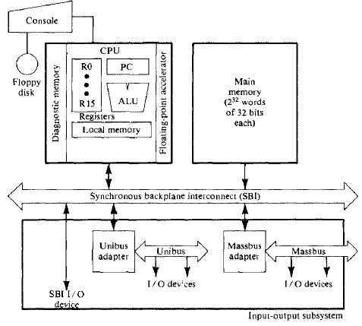
Parallelism in uniprocessor systems
A typical uniprocessor computer consists of three major components: the main memory, the central processing unit (CPU), and the input-output (I/O) subsystem.
Ex: Super minicomputer VAX-11/780
There are sixteen 32-bit general purpose registers, one of which serves as program counter (PC)
Through SBI, all I/O devices communicate with each other, with the CPU, or with the memory

Slide 19
Parallel processing mechanisms in uniprocessor computers
Parallelism in uniprocessor systems can be achieved through following mechanisms:
Multiplicity of functional units
Parallelism and pipelining within the CPU
Overlapped CPU and I, O operations
Use of a hierarchical memory system
Balancing of subsystem bandwidths
Multiprogramming and time sharing

Slide 20
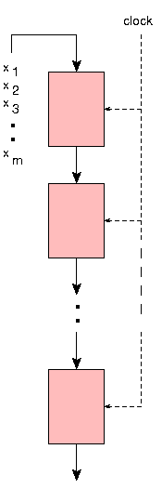
Temporal parallelism
Temporal parallelism or pipelining refers to the execution of a task as a 'cascade' of sub-tasks
There exists one functional unit to carry out each sub-task
All these successive units can work at the same time, in an overlapped fashion
As data are processed by a given unit U_{i} , they are sent to the next unit U_{i+1} and the unit U_{i} restarts its processing on new data, analogously to the flow of work in a car production line. Each functional unit can be seen as a "specialized" processor in the sense that it always execute the same sub-task
U_{i}
U_{i+1}
U_{n}
X_{i} = X_{i+1,} X_{i+2}, …. X_{n}

Slide 21
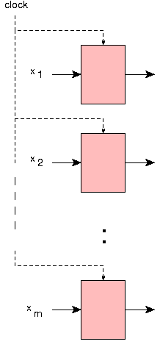
Spatial parallelism
Spatial parallelism refers to the simultaneous execution of tasks by several processing units
At a given instant, these units can be executing the same task (or instruction) or different tasks. The former case is called SIMD (Single Instruction stream, Multiple Data stream), whereas the later is called MIMD (Multiple Instruction stream, Multiple Data stream)
U₁
U₂
U_{n}
X_{i} = X_{i+1,} X_{i+2}, …. X_{n}

Slide 22
Parallel Computer Structures
Parallel computers are those systems that emphasize parallel processing. Parallel computers are divided into three architectural configurations:
1. Pipeline computers → Perform overlapped computations to exploit temporal parallelism
2. Array processors → Use multiple synchronized arithmetic logic units to achieve spatial parallelism
3. Multiprocessor systems → Use a set of interactive processors with shared resources(memory, etc.) to achieve asynchronous parallelism

Slide 23
Pipeline computers
Normally, the process of executing an instruction in a digital computer involves four major steps:
1. Instruction Fetch (IF)→ fetching instruction from the main memory
2. Instruction Decoding (ID) → identifying the operation to be performed
3. Operand Fetch (OF) → fetching the operands is needed in the execution
4. Execution (EX) → Execution of the decoded arithmetic-logic operation
In a nonpipelined computer, these four steps must be completed before the next instruction can be issued
ln a pipelined computer, successive instructions are executed in an overlapped fashion. The Four pipeline stages, lF, ID, OF, and EX, are arranged into a linear cascade
The two space-time diagrams in the next slide show the difference between overlapped instruction execution (pipelining) and sequentially nonoverlapped execution (non-pipelining)

Slide 24
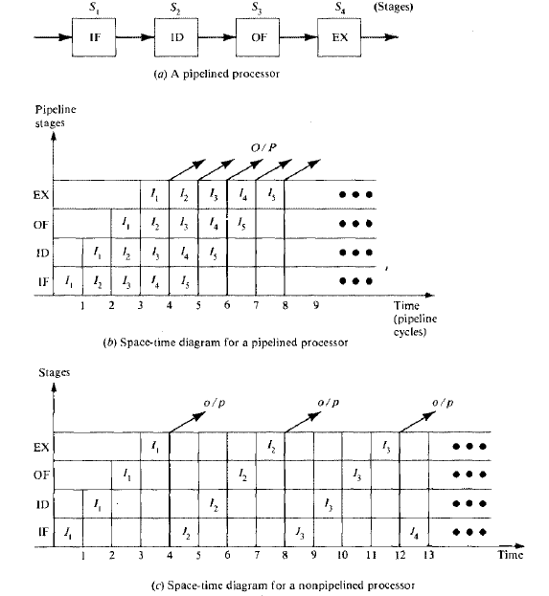
Pipeline computers
A pipeline cycle can be set equal to the delay of the slowest stage
The flow of data (input operands, intermediate results, and output results) from stage to stage is triggered by a common clock of the pipeline
The operation of all stages is synchronized under a common clock control
Interface latches are used between adjacent segments to hold the intermediate results
The instruction cycle has been effectively reduced to one-fourth of the original cycle time by such overlapped execution.

Slide 25
Pipeline computers
Due to the overlapped instruction and arithmetic execution, it is obvious that pipeline machines are better tuned to perform the same operations repeatedly through the pipeline.
Whenever there is a change of operation, say from add to multiply, the arithmetic pipeline must be drained and reconfigured, which will cause extra time delays.
Therefore, pipeline computers are more attractive for vector processing, where component operations may be repeated many times.
Pipeline computer

Slide 26
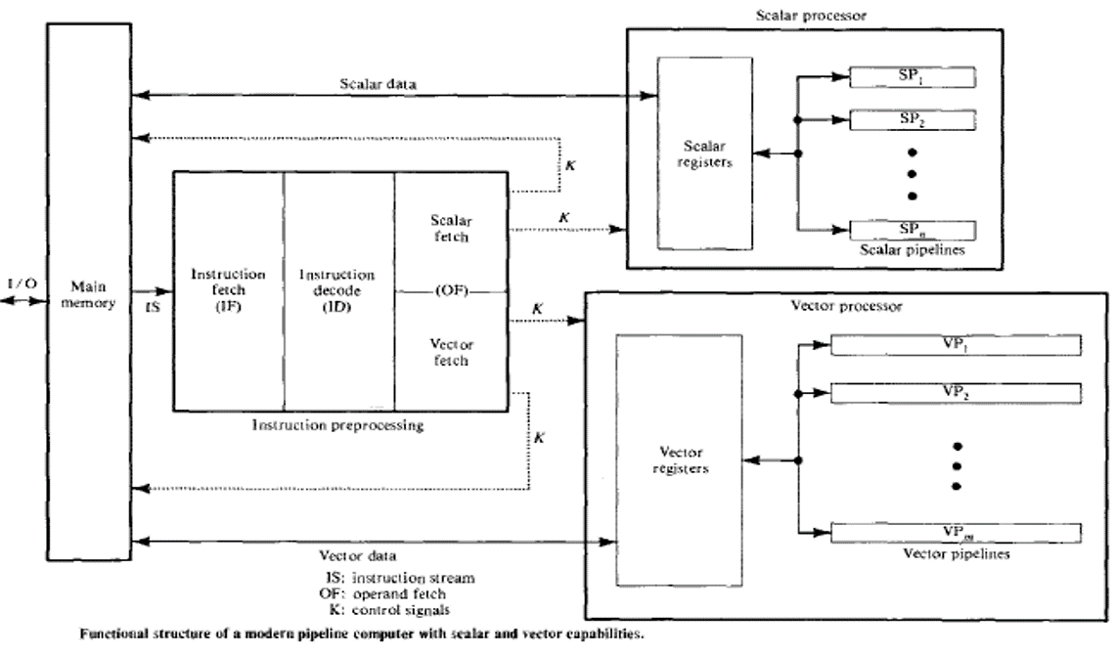

Slide 27
2. Array computers
An array processor is a synchronous parallel computer with multiple arithmetic logic units, called processing elements(PE), that can operate in parallel in a lock- step fashion
By replication of ALUs, we can achieve the spatial parallelism
The PEs are synchronized to perform the same function at the same time
Scalar and control-type instructions are directly executed in the control unit (CU)
Each PE consists of an ALU with registers and a local memory
Array computer
The PEs are inter connected by a data-routing network
Vector- instructions are broadcast to the PEs for distributed execution over different component operands fetched directly from the local memories.
Instruction fetch (from local memories or from the control memory) and decode is done by the control unit. The PEs are passive devices without instruction decoding capabilities.

Slide 28
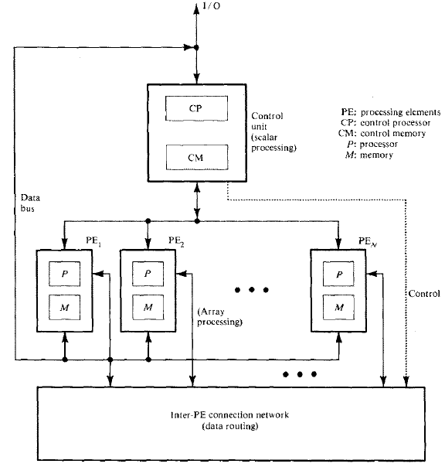

Slide 29
3. Multiprocessor systems
Research and development of multiprocessor systems are aimed at improving throughput, reliability, flexibility, and availability
A basic multiprocessor organization is conceptually depicted in this figure Multiprocessor systems
The system contains two or more processors of approximately comparable capabilities
All processors share access to common sets of memory modules, I/O channels, and peripheral devices

Slide 30
Multiprocessor systems
Most importantly, the entire system must be controlled by a single integrated operating system providing interactions between processors and their programs at various levels
Besides the shared memories and I/O devices, each processor has its own local memory
Interprocessor communications can be done through the shared memories or through an interrupt network
The interconnection structure between the memories and processors can be implemented using:
Time-shared common bus
Crossbar switch network
Multiport memories

Slide 31
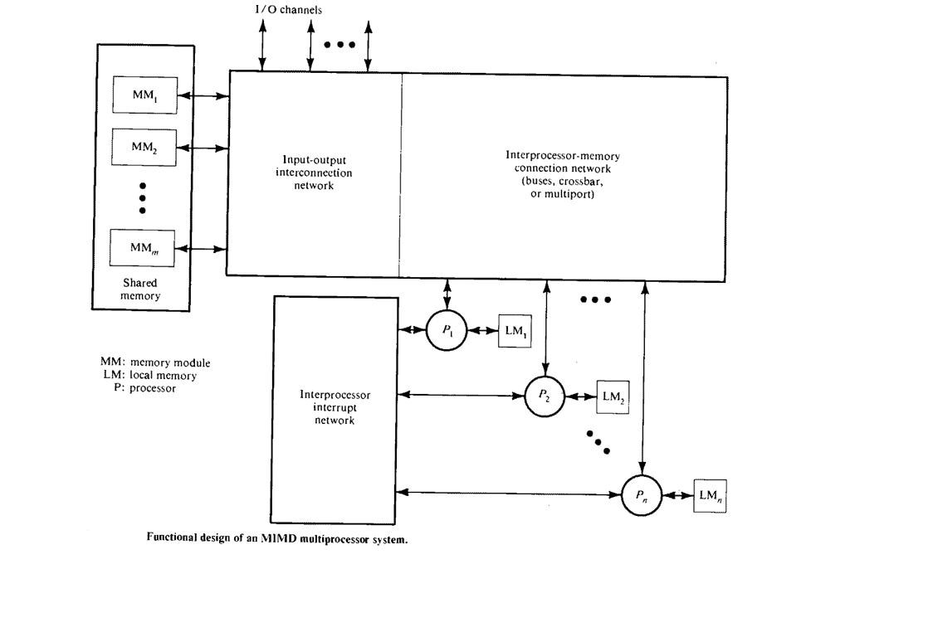

Slide 32
Architectural classification scheme
In general, digital computers may be classified into four categories, according to the multiplicity of instruction and data streams (Flynn’s classification)
An instruction stream is a sequence of instructions as executed by the machine; a data stream is a sequence of data including input, partial, or temporary results called for by the instruction stream
There are four categories of digital computers based on the multiplicity of instruction and data streams:
Single instruction stream-single data stream (SISD)
Single instruction stream-multiple data stream (SIMD)
Multiple instruction stream-single date stream (MISD)
Multiple instruction stream-multiple data stream (MIMD)
Conceptually, only three types of system components are needed in the illustration. Both instructions and data are fetched from the memory modules. Instructions are decoded by the control unit, which sends the decoded instruction stream to the processor units for execution
Each instruction stream is generated by an independent control unit. Multiple data streams originate from the subsystem of shared memory modules

Slide 33
SISD computer organization
SISD
This organization represents most serial computers available today
Instructions are executed sequentially but may be overlapped in their execution stages (pipelining)
An SISD computer may have more than one functional unit in It. All the functional units are under the supervision of one control unit
Applications:
Whatever we do with our personal computers today

Slide 34
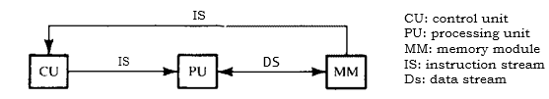

Slide 35
2. SIMD computer organization
SIMD
In this organization, there are multiple processing elements supervised by the same control unit
All PEs receive the same instruction broadcast from the control unit but operate on different data sets from distinct data streams
The SIMD model of parallel computing consists of two parts:
A front-end computer of the usual von Neumann style
And a processor array
Applications:
Image processing
Matrix manipulations
Sorting

Slide 36
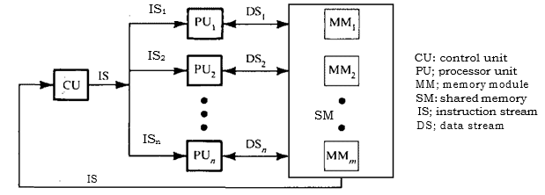

Slide 37
3. MISD computer organization
MISD
In this organization, there are n processor units, each receiving distinct instructions operating over the same data stream and its derivatives
The results (output) of one processor become the input (operands) of the next processor in the macropipe.
This structure has received much less attention and has been challenged as impractical by some computer architects. No real embodiment of this class exists.
Applications:
Space shuttle flight control computers
Robot vision

Slide 38
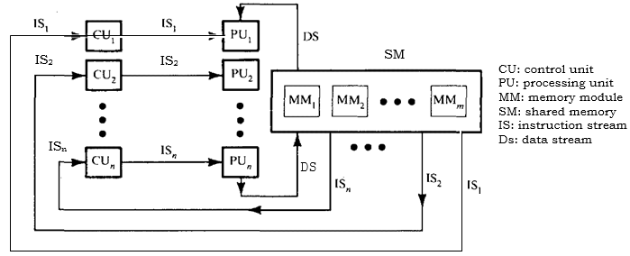

Slide 39
3. MIMD computer organization
MIMD
Most multiprocessor systems and multiple computer systems can be classified in this category
An intrinsic MIMD computer implies interactions among the n processors
An intrinsic MIMD computer is tightly coupled if the degree of interactions among the processors is high. Otherwise, we consider them loosely coupled
Most commercial MIMD computers are loosely coupled.
Applications:
Computer-aided design/computer-aided manufacturing
Simulation, modeling
Communication switches

Slide 40
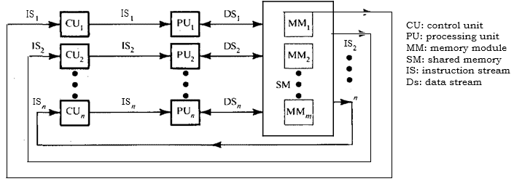

Slide 41
GPU as Parallel Computers
Since 2003, the semiconductor industry has settled on two main trajectories for designing microprocessor (MP):
The multi-core trajectory:
It seeks to maintain the execution speed of sequential programs while moving into multiple cores.
Multicore trajectory began as two-core processors, with the number of cores doubling every generation of MP.
Eg: Intel Corei7 MP which has 4 processor cores, each of which is an out-of-order, multiple instruction issue processor implementing the full x86 instruction set.
This MP supports hyperthreading with two hardware threads per core and is designed to maximize the exec speed of sequential programs.

Slide 42
2. The many-core (many-thread) trajectory:
It focuses more on the execution throughput of parallel applications
The many-cores began as a large number of much smaller cores, and, once again, the number of cores doubles with each generation
Eg: The NVIDIA GeForce GTX 280 graphics processing unit (GPU) with 240 cores, each of which is a heavily multithreaded
Many-core processors, especially the GPUs, dominated the race of Floating-point (FP) performance. The ratio between many-core GPUs and multicore CPUs for peak floating-point calculation throughput is about 10 to 1.
GPU vs CPU FP performance
This gap has motivated many app developers to move the computationally intensive parts of their software to GPUs for execution.
When there is more work to do, there is more opportunity to divide the work among cooperating parallel workers.

Slide 43
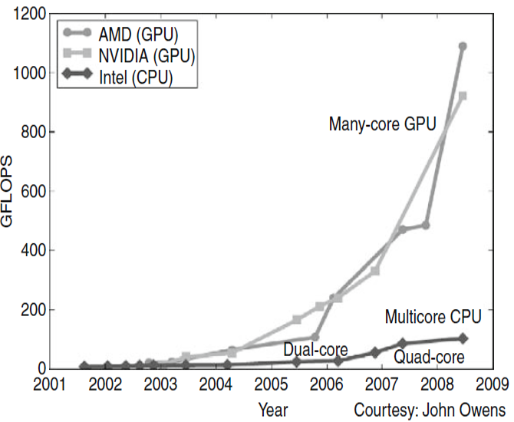

Slide 44
Why there is such a large performance gap between many-core GPUs and general-purpose multicore CPUs?
The answer lies in the differences in the fundamental design philosophies between the two types of processors
GPU vs CPU architecture
CPU design principle:
The design of a CPU is optimized for sequential code performance
It makes use of sophisticated control logic to allow instructions from a single thread of execution to execute in parallel
The large cache memories are provided to reduce the instruction and data access latencies of large complex applications → latency-oriented design
Memory bandwidth limit the speed of applications by limiting the rate at which data can be delivered from the memory system to processors.

Slide 45
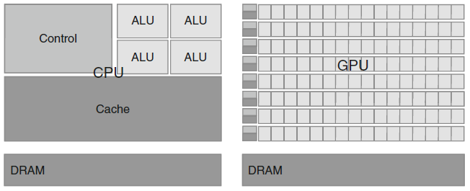
Why there is such a large performance gap between many-core GPUs and general-purpose multicore CPUs?

Slide 46
Why there is such a large performance gap between many-core GPUs and general-purpose multicore CPUs?
GPU design principle:
The design philosophy of the GPUs is shaped by the fast growing video game industry, which requires the ability to perform a massive number of floating-point calculations per video frame
GPU performs well by executing massive numbers of threads
GPU hardware takes advantage of a large number of execution threads to find work to do when some of them are waiting for long-latency memory accesses
Small cache memories are provided to help the bandwidth requirements of applications, so multiple threads that access the same memory data need not always access the DRAM → throughput-oriented design
Most apps will use both CPUs and GPUs, executing the sequential parts on the CPU and numerically intensive parts on the GPUs

Slide 47
Factors to be considered by the application developers to choose the processors for running their applications
Along with the performance, there are several other factors which an application developer has to look upon when selecting a processor.
Installation base:
The processors of choice must have a very large presence in the marketplace. The cost of software development is reduced significantly with a very large customer population
2. Practical form factors and easy accessibility:
The parallel software applications should be easily accessible to customers and should provide the solutions to a large set of common customer needs
3. Support for the IEEE floating-point standard:
The standard makes it possible to have predictable results across processors from different vendors

Slide 48
Factors to be considered by the application developers to choose the processors for running their applications
4. Ease of programming for accessing the GPU cores:
Early GPU programmers had to use the equivalent of graphics API functions to access the GPU cores (tedious task)
This practice was called general-purpose programming using GPU (GPGPU)
These APIs limit the kinds of applications that one can actually write for these chips
5. Introduction of CUDA:
NVIDIA released CUDA (Compute Unified Device Architecture) and devoted silicon area in GPU to facilitate the ease of parallel programming
Along with the change in software, additional hardware was added to the chip
CUDA programs do not go through the graphics interface at all. Instead, a new general-purpose parallel programming interface on the silicon chip serves the requests of CUDA programs
All of the other software layers were redone so the programmers can use the familiar C/C++ programming tools

Slide 49
Architecture of a Modern GPU
Modern GPU architecture
It is organized into an array of highly threaded streaming multiprocessors (SMs)
In the figure, two SMs form a building block; however, the number of SMs in a building block can vary from one generation of CUDA GPUs to another generation
Each SM has a number of streaming processors (SPs) that share control logic and instruction cache
Each GPU currently comes with up to 4 GB of graphics double data rate (GDDR) DRAM, referred to as global memory
GDDR DRAMs
The GDDR DRAMs differ from the system DRAMs on the CPU motherboard in that they are essentially the frame buffer memory that is used for graphics processing
For graphics applications, GDDR DRARs hold video images, and texture information for three-dimensional (3D) rendering
For normal computing they function as very-high-bandwidth, off-chip memory, though with somewhat more latency than typical system memory. For massively parallel applications, the higher bandwidth makes up for the longer latency
CUDA-paper

Slide 50
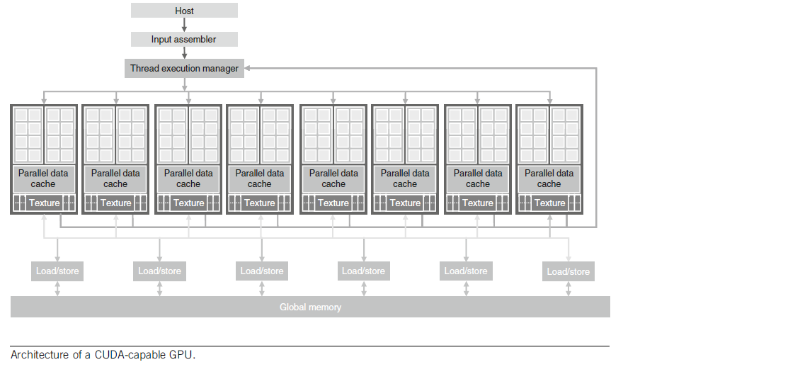
Architecture of a Modern GPU

Slide 51
Need for Parallelism – Why do we need ??
Many applications that we have today will continue to demand for increased speed in future
When an application is suitable for parallel execution, a good implementation on a GPU can achieve more than 100 times speedup over sequential execution
Many applications of the future will be what we currently consider to be supercomputing applications (Superapps)
The limitations of todays scientific experiments can be effectively addressed by incorporating a GPU enabled computational model to simulate the underlying activities. From the simulation we can measure even more details and test more hypotheses than with traditional instruments

Slide 52
Need for Parallelism – Why do we need ??
In the future, new functionalities such as view synthesis and high-resolution display of low-resolution videos will demand that televisions have more computing power
future versions of user interfaces will incorporate higher definition, three-dimensional perspectives, voice and computer vision based interfaces, requiring even more computing speed
With increased computing speed, the future games can be based on dynamic simulation rather than pre-arranged scenes
Applications handling bigdata will require exploiting parallelism in datasets

Slide 53
Parallel processing applications
Predictive Modeling and Simulations
Weather forecasting
Oceanography and astrophysics
Socioeconomics and government use
Engineering Design and Automation
Finite-element analysis
Computational aerodynamics
Artificial intelligence and automation
Remote sensing applications
Energy Resources Exploration
Seismic exploration
Reservoir modeling
Plasma fusion power
Nuclear reactor safety
Medical, Military, and Basic Research
Computer-aided diagnosis
Genetic engineering
Weapon research and defense
Basic Research Problems

Slide 54
Parallel Programming Languages and Models
Some of the most popular software frameworks/standards that allow general-purpose programming using GPU (GPGPU) to accelerate processing in applications are:
MPI (Message Passing Interface)
OpenMP (Open Multi-Processing)
CUDA (Compute Unified Device Architecture)
OpenCL (Open Computing Language)
GPGPU is the utilization of a GPU (graphics processing unit), which would typically only handle computer graphics, to assist in performing tasks that are traditionally handled solely by the CPU (central processing unit)

Slide 55
Parallel Programming Languages and Models
MPI (most of the versions are open source)
Used for scalable cluster computing
The computing nodes in a cluster do not share memory
All data sharing and interaction among the nodes must be done through explicit message passing
MPI have been known to run successfully on cluster computing systems with more than 100,000 nodes
The amount of effort required to port an application into MPI can be extremely high due to lack of shared memory across computing nodes
OpenMP (open source)
Used for shared-memory multiprocessor systems
An openMP implementation consists of a compiler and a runtime
A programmer specifies directives (commands) and pragmas (hints) about a loop to the openMP compiler. With these directives and pragmas, openMP compiler generate parallel code. The runtime system supports the execution of the parallel code by managing parallel threads and resources
In OpenMP, compilers do more of the automation in managing parallel execution

Slide 56
Parallel Programming Languages and Models
CUDA (NVIDIA proprietary)
Aspects of CUDA are similar to both MPI and OpenMP in that the programmer manages the parallel code constructs
CUDA provides shared memory for parallel execution in the GPU
CUDA achieves much higher scalability with simple, low-overhead thread management and no cache coherence hardware requirements
many super-applications fit well into the simple thread management model of CUDA and thus enjoy the scalability and performance
OpenCL (open source)
Several major industry players, including Apple, Intel, AMD/ATI, and NVIDIA, have jointly developed a standardized programming model called OpenCL
Similar to CUDA, the OpenCL programming model defines language extensions and runtime APIs to allow programmers to manage parallelism and data delivery
The level of programming constructs in OpenCL is still at a lower level than CUDA and much more tedious to use
Also, the speed achieved in an application expressed in OpenCL is still much lower than in CUDA on the platforms that support both
OpenCL is a standardized programming model in that applications developed in OpenCL can run without modification on all processors that support the OpenCL language extensions and API
In comparison to CUDA, OpenCL relies more on APIs and less on language extensions

Slide 57
Parallel Programming Languages and Models
CUDA vs OpenCL
CPU vs GPU

