Slide 1
MOALU
Di Lieto Gabriele | 874143 | g.dilieto@campus.unimib.it

Slide 2
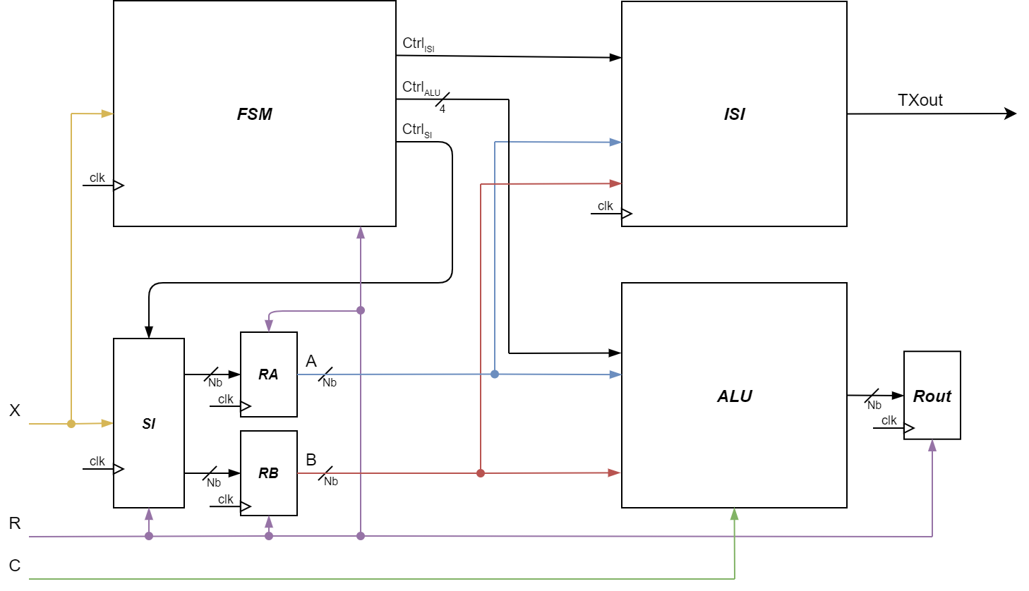
MOALU | Block Scheme
Txout
Rout
Nb
clk

Slide 3
MOALU | Specification
Signal name | Direction | Resolution | Comments
X | input | 1 bit | Serial input
R | input | 1 bit | Reset
C | input | 1 bit | Complement selector for SUB and C2 states
clk | input | 1 bit | Clock
TXout | output | 1 bit | Serial output for TX state
Rout | output | N bit | Parallel out for ALU operation result

Slide 4
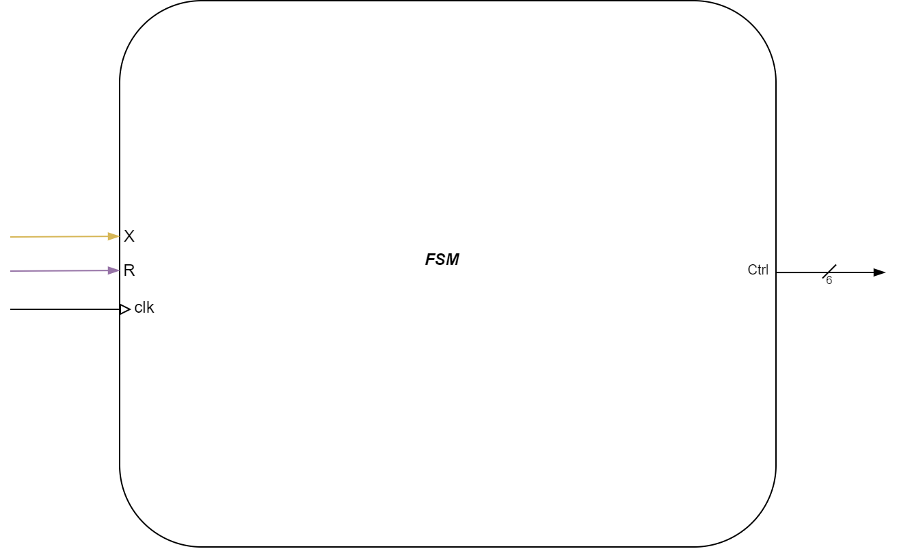
FSM
Signal name | Direction | Resolution | Comments
X | input | 1 bit | State transaction serial input
R | input | 1 bit | Reset
clk | input | 1 bit | Clock
Ctrl | input | 6 bit | Operation enabling output

Slide 5
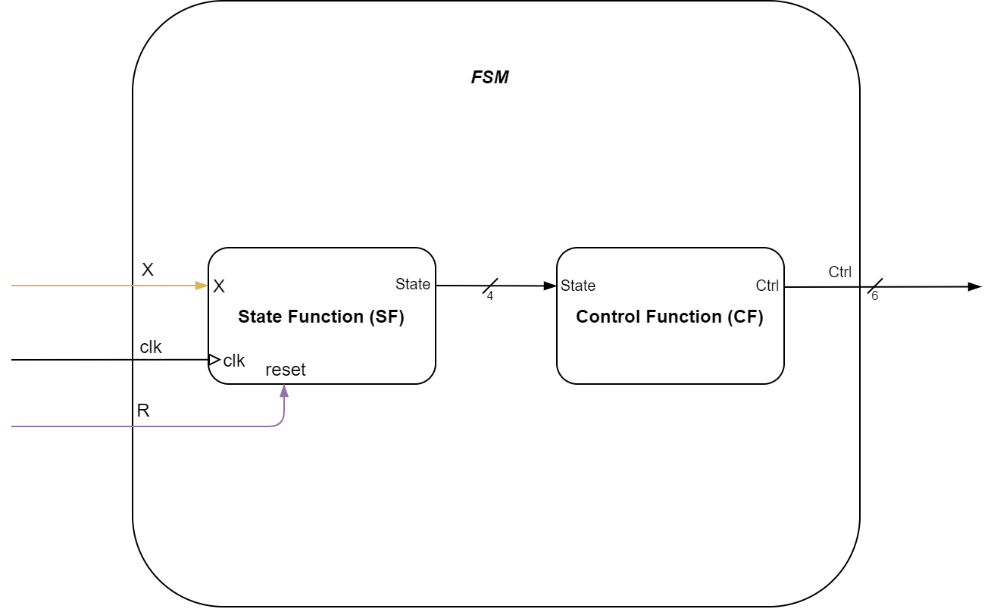
FSM | Block Scheme

Slide 6
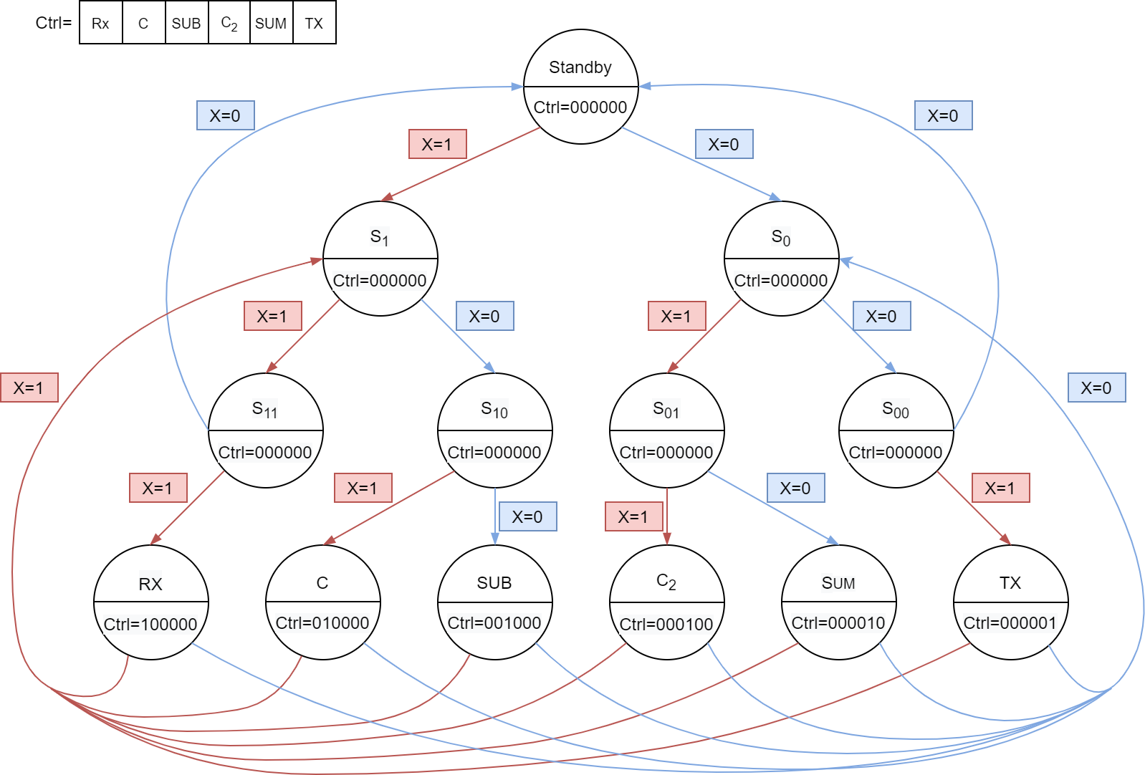
FSM | State Diagram

Slide 7
FSM | State Table
Actual State | Input | Next State | Output
SB | X=1 | S1 | Ctrl=000000
SB | X=0 | S0 | Ctrl=000000
S1 | X=1 | S11 | Ctrl=000000
S1 | X=0 | S10 | Ctrl=000000
S0 | X=1 | S01 | Ctrl=000000
S0 | X=0 | S00 | Ctrl=000000
S11 | X=1 | RX | Ctrl=100000
S11 | X=0 | SB | Ctrl=000000
S10 | X=1 | C | Ctrl=010000
S10 | X=0 | SUB | Ctrl=001000
S00 | X=1 | TX | Ctrl=000001
S00 | X=0 | SB | Ctrl=000000
S01 | X=1 | C2 | Ctrl=000100
S01 | X=0 | SUM | Ctrl=000010
Actual State | Input | Next State | Output
RX | X=1 | S1 | Ctrl=000000
RX | X=0 | S0 | Ctrl=000000
C | X=1 | S1 | Ctrl=000000
C | X=0 | S0 | Ctrl=000000
SUB | X=1 | S1 | Ctrl=000000
SUB | X=0 | S0 | Ctrl=000000
C2 | X=1 | S1 | Ctrl=000000
C2 | X=0 | S0 | Ctrl=000000
SUM | X=1 | S1 | Ctrl=000000
SUM | X=0 | S0 | Ctrl=000000
TX | X=1 | S1 | Ctrl=000000
TX | X=0 | S0 | Ctrl=000000

Slide 8
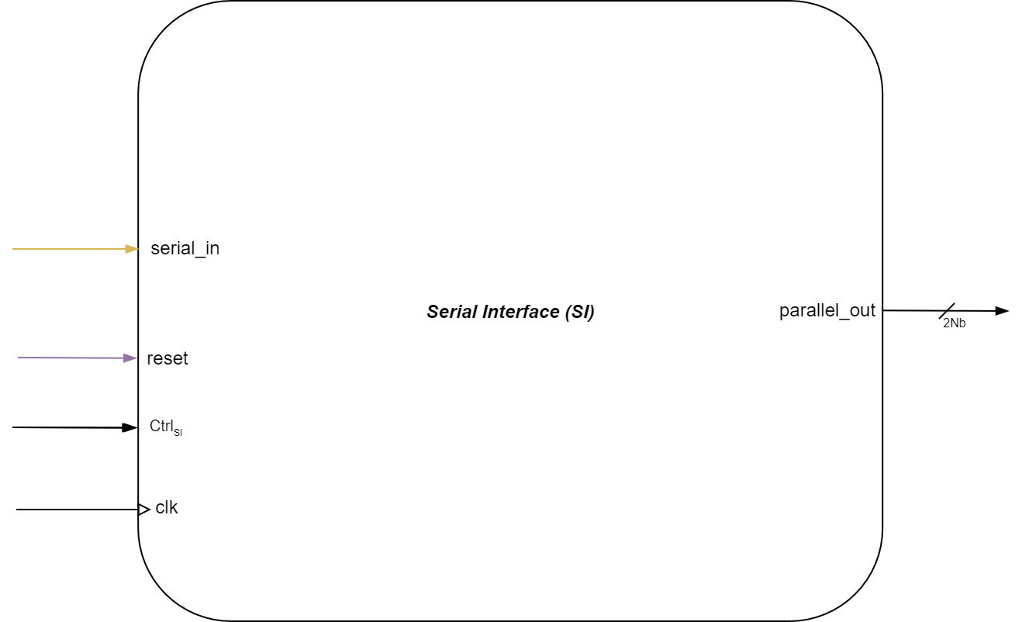
SI
Signal name | Direction | Resolution | Comments
serial_in | input | 1 bit | Input to parallelize
reset | input | 1 bit | Reset
CtrlSI | input | 1 bit | Operation enabler
clk | input | 1 bit | Clock
parallel-out | output | 2·Nb | Output parallelized after 2·Nb clock cycles

Slide 9
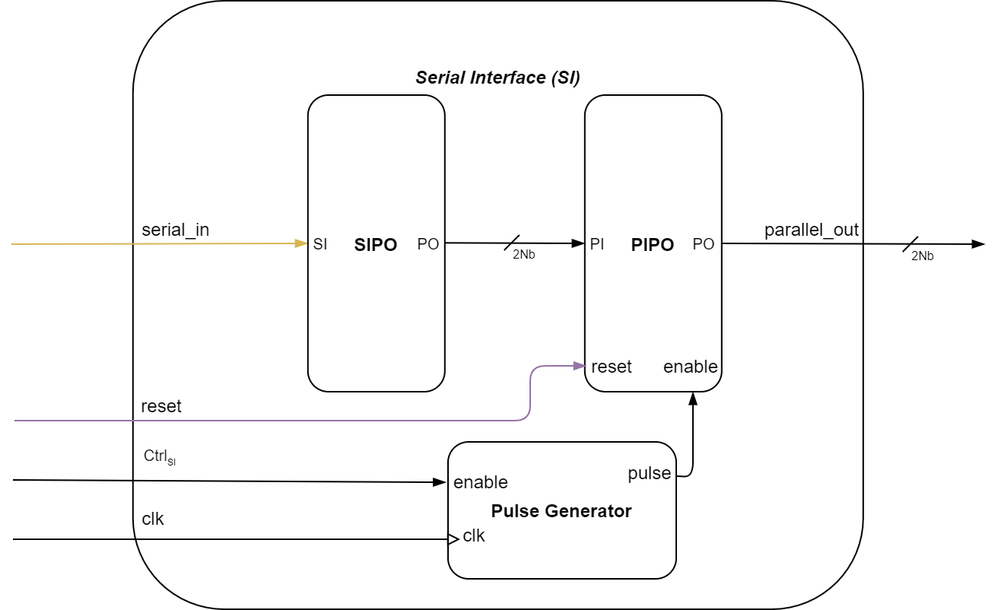
SI | Block Scheme

Slide 10
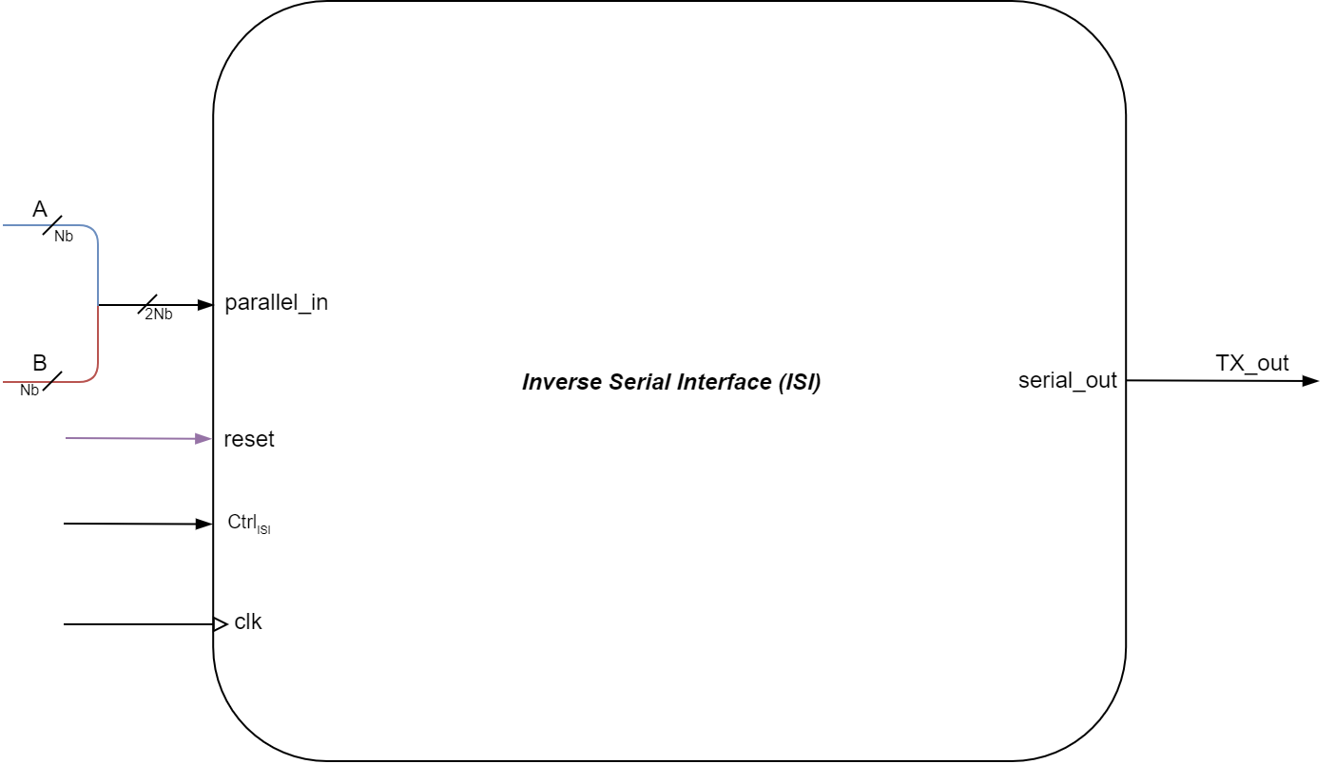
ISI
Signal name | Direction | Resolution | Comments
parallel_in | input | 2·N bit | Input to serialize
reset | input | 1 bit | Reset
CtrlISI | input | 1 bit | Operation enabler
clk | input | 1 bit | Clock
serial_out | output | 1 bit | Output serialized from bit 1 to 2·N of parallel_in for each clock cycle

Slide 11
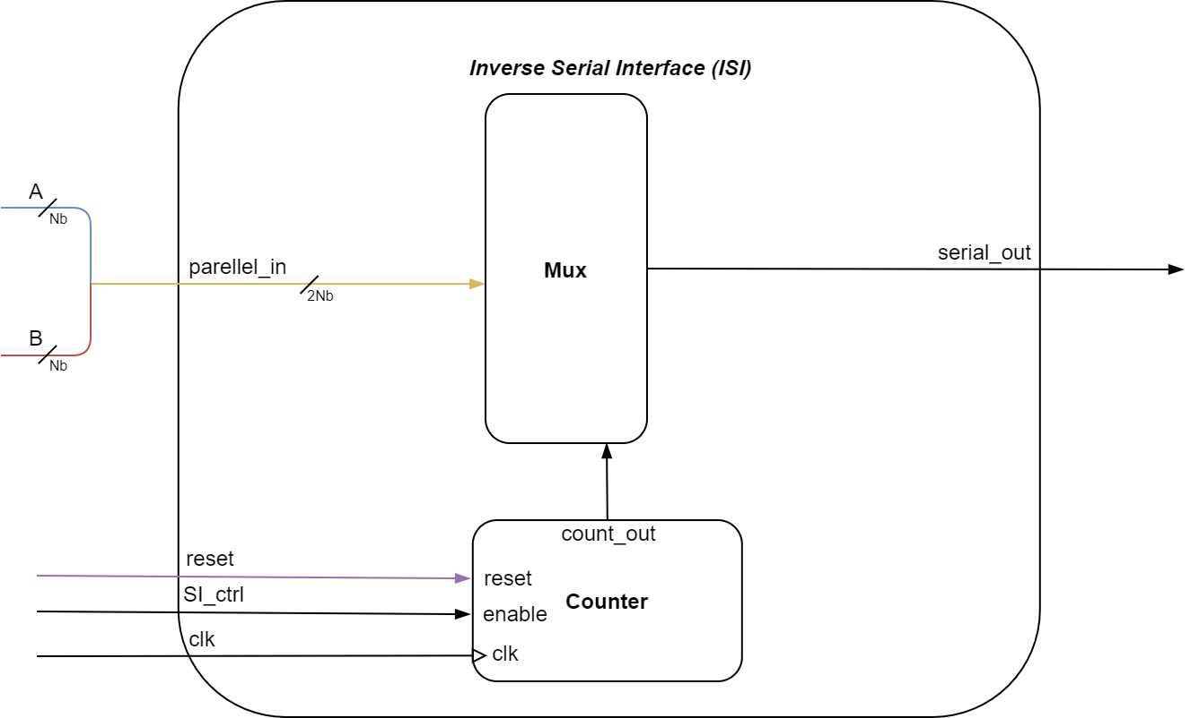
ISI | Block Scheme
CtrlISI

Slide 12
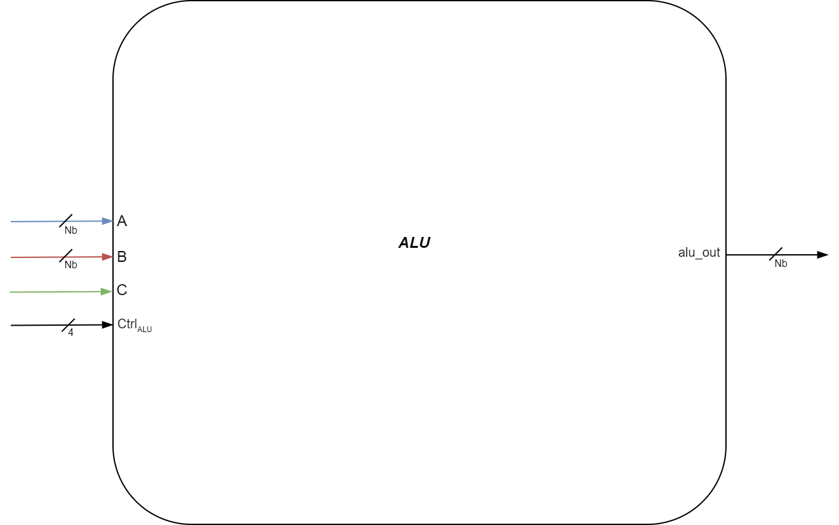
ALU
Signal name | Direction | Resolution | Comments
A | input | 1 bit | First operand input
B | input | 1 bit | First operand input
C | input | 1 bit | C2/Sub selection input
CtrlALU | input | 4 bit | Operation enabler (only one bit out of 4 can be 1)
alu_out | output | Nb | Output based on the computed operation

Slide 13
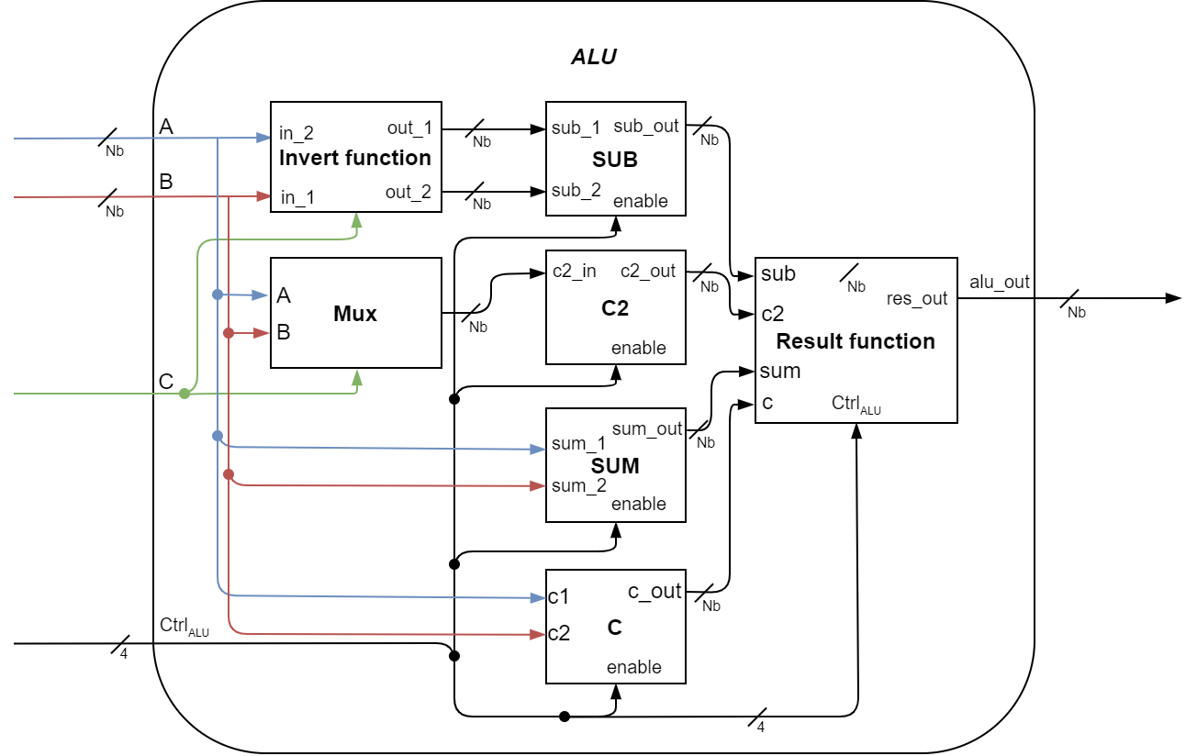
ALU | Block Scheme

Slide 14
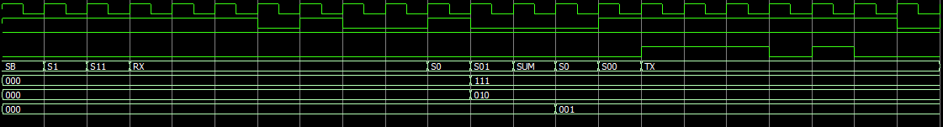
Time diagram | Simulation 1
clk
X
C
TXout
state
RA
RB
Rout
SB
RX
SUM
TX
Read X=1 1 1
Read A=1 1 1 e B=0 1 0
Read X=0 1 0
Read X=0 0 1
Transmit A=1 0 1 e B=0 1 0
Saves A in RA register and B in RB register
Compute A (111) + B (010) = 001
Saves 001 in Rout register

Slide 15
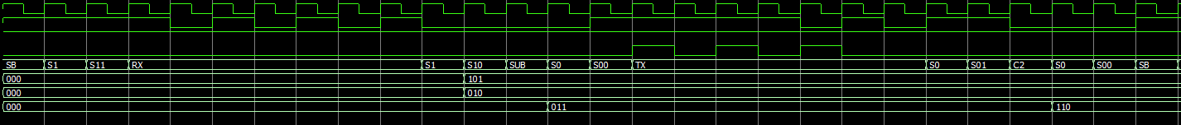
Time diagram | Simulation 2
clk
X
C
TXout
state
RA
RB
Rout
SB
RX
Read A=1 0 1 e B=0 1 0
Read X=0 0 1
SUB
TX
Transmit A=1 0 1 e B=0 1 0
Read X=0 1 1
C2
SB
Read X=1 1 1
Read X=0 0 1
Read X=0 0 0
Saves A in RA register and B in RB register
Compute C2(B) = 101 +1 = 110
Compute A (111) + B (010) = 001
Saves A in RA register and B in RB register
Compute C2(B) = 101 +1 = 110
Compute A + C2(B) = 101 + 110 = 011
Saves 001 in Rout register
Saves 110 in Rout register
Saves 011 in Rout register

Slide 16
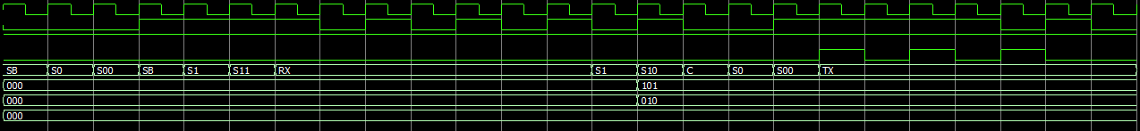
Time diagram | Simulation 3
clk
X
C
TXout
state
RA
RB
Rout
SB
SB
RX
Read A=1 0 1 e B=1 0 1
Read X=1 0 1
C
TX
Read X=0 0 0
Read X=1 1 1
Read X=0 0 1
Transmit A=1 0 1 e B=0 1 0
Saves A in RA register and B in RB register
Compute A==B = 0
Saves 000 in Rout

Slide 17
GRAZIE PER L’ATTENZIONE

