Slide 1
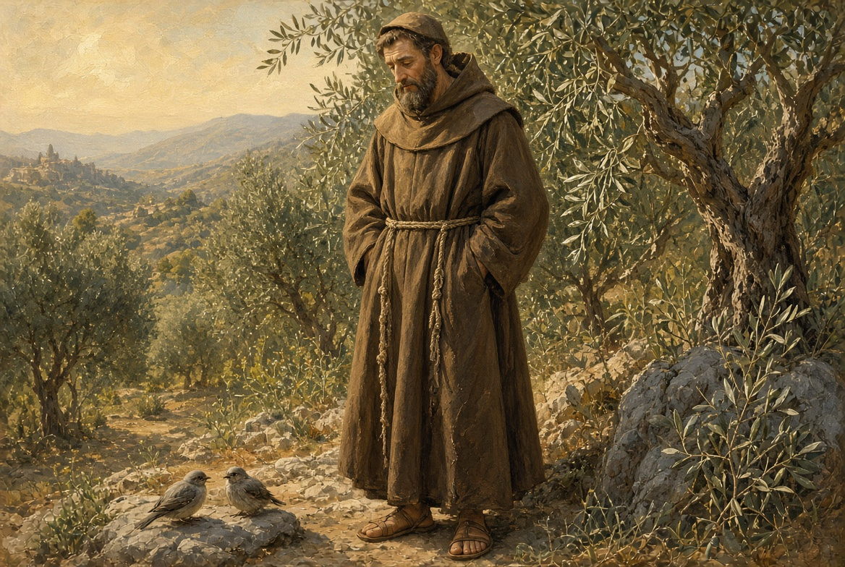
JUBILEE YEAR OF ST. FRANCIS · 2026–2027
Creation Care
in the Classroom
Tips and strategies for Catholic teachers of grades K–5.
A 50-minute professional learning session.
Presented by Lauren Sebastian
Inspired by the 800th anniversary of St. Francis of Assisi
Notes:
MAC PRESENTER VIEW PowerPoint for Mac: Slide Show → Presenter View (or Option + Return). Notes appear on the laptop; slides go to the projector. Keynote: Open the .pptx, then Play → Play Slideshow in Presenter Display. Prefer keeping this file in PowerPoint if she has Microsoft 365. OPENING (0:00–1:00) Welcome colleagues. Introduce yourself briefly. Do not read the title slide. Say: "This year the Church has given us a rare gift: a special Jubilee Year of St. Francis. We are going to spend the next 50 minutes turning that gift into something we can actually use on Monday morning with K–5 children." Then invite them to stand or remain seated for a short prayer on the next slide.

Slide 2

01 · BEGIN IN PRAISE
A word from the Song
From the Song of the Creatures, St. Francis of Assisi, 1225
Praised be You, my Lord, with all Your creatures,
especially Sir Brother Sun, who is the day
and through whom You give us light.
Praised be You, my Lord, through Sister Water,
who is very useful and humble and precious and chaste.
Praised be You, my Lord, through our Sister Mother Earth,
who sustains and governs us,
and who produces various fruit with colored flowers and herbs.
Let us pray. Lord, open our eyes to Your gift of creation, and make us teachers who help children love what You have made. Amen.
CREATION CARE IN THE CLASSROOM · K–5 CATHOLIC TEACHERS
02 / 30
Notes:
PRAYER (1:00–3:30) Read the Song slowly. Pause after each stanza. Invite a one-sentence silent thank-you for something created that each teacher noticed this week. Close with the short prayer on the slide. Point out: Francis wrote this while ill and nearly blind. Praise was not a luxury for him. It was how he saw the world.

Slide 3




02 · PURPOSE
What you will leave with today
A Franciscan why
A simple pedagogy
Connect the Jubilee Year of St. Francis to the daily work of a K–5 Catholic classroom.
Use four movements—Wonder, Gratitude, Stewardship, Action—that scale from kindergarten to fifth grade.
Ready strategies
A Catholic frame
Walk away with routines, grade-banded activities, and a 30-day starter plan you can begin next week.
Root the work in Church teaching, liturgy, and best practice—not in slogans or one-off Earth Day lessons.
CREATION CARE IN THE CLASSROOM · K–5 CATHOLIC TEACHERS
03 / 30
Notes:
OUTCOMES (3:30–5:00) Read the four outcomes quickly. Emphasize the last one: this is not a science unit bolted onto religion. It is Catholic formation. Creation care is a virtue, not an extracurricular.

Slide 4
03 · HOW WE WILL USE 50 MINUTES
A working session, not a lecture
0–7 min
Foundation
Prayer, the Jubilee Year, and why Francis still teaches children.
7–15 min
Catholic frame
Best practice in Catholic schools and a four-movement pedagogy.
15–23 min
Move & engage
Four Corners stand-up: pray, teach, habit, or go outside — then one try this month.
23–38 min
Classroom craft
K–2 and 3–5 strategies, routines, Season of Creation, families, guardrails.
38–50 min
Commit & close
30-day plan, school action plan + award, pledge, survey.
CREATION CARE IN THE CLASSROOM · K–5 CATHOLIC TEACHERS
04 / 30
Notes:
AGENDA (5:00–6:00) Tell teachers they will talk, not only listen. There are two short turn-and-talks later. Invite them to jot one idea they can try this week.

Slide 5
04 · WHY THIS YEAR IS DIFFERENT
A special Jubilee Year of St. Francis
WHEN
January 10, 2026 – January 10, 2027
The Holy Father’s reminder
Peace with God, peace among people, and peace with creation are inseparable dimensions of a single call to universal reconciliation.
WHY
800 years since Francis entered eternal life on October 3, 1226
WHO
Proclaimed by Pope Leo XIV for the whole Church
GIFT
A plenary indulgence, and a call to become witnesses of peace
Pope Leo XIV, letter for the Franciscan Jubilee
For a classroom, that means we do not separate religion, kindness, and care of the earth. They are one formation.
CREATION CARE IN THE CLASSROOM · K–5 CATHOLIC TEACHERS
05 / 30
Notes:
JUBILEE (6:00–9:00) Keep this short. Teachers need the hook, not a history lecture. Key line to say: "This is not an environmental awareness week. It is a year the Church has set aside so we can become more like Francis—poor in spirit, at peace, and at home with God’s creatures." Mention Oct 4, 2026: Feast of St. Francis and the 800th anniversary of his passing. Perfect school liturgy date.

Slide 6



05 · THE SAINT WHO STILL TEACHES CHILDREN
Francis saw a family, not a resource
Kinship
Praise first
The poor and the earth
Simplicity
Brother Sun, Sister Moon, Sister Water, Mother Earth. Children grasp this immediately. Creation is not stuff. Creation is family.
The Song begins in praise, not in panic. K–5 formation should do the same. Wonder and gratitude come before problem-solving.
Francis held the leper and the lark with the same love. Care for creation and care for the vulnerable are one Gospel.
He returned creation better than he received it by wanting less, noticing more, and treating every creature as a gift.
CREATION CARE IN THE CLASSROOM · K–5 CATHOLIC TEACHERS
06 / 30
Notes:
FRANCIS'S VISION (9:00–12:00) Tell one child-ready story: preaching to the birds, or the wolf of Gubbio as a story of making peace. Caution: do not turn Francis into a garden gnome. He was a radical disciple of Jesus. His love of creatures flowed from his love of the Crucified. Turn-and-talk (60 seconds): "Which of these four is already alive in your classroom?"

Slide 7
06 · THE CHURCH HAS NOT BEEN SILENT
From Assisi to your classroom
1225
Song of the Creatures
Francis praises God through every creature.
The line that changes a faculty meeting
1979
Patron of ecology
Living our vocation to be protectors of God’s handiwork is essential to a life of virtue; it is not an optional or a secondary aspect of our Christian experience.
St. John Paul II names Francis patron of those who promote ecology.
2015
Laudato Si’
Pope Francis writes to every person on care for our common home.
2023–26
Laudate Deum & Jubilee
The call deepens. Pope Leo XIV places peace with creation at the center of this year.
Laudato Si’, 217
Today
The K–5 classroom
If it is essential to virtue, it belongs in every Catholic classroom.
Teachers form the next generation of stewards before habits harden.
CREATION CARE IN THE CLASSROOM · K–5 CATHOLIC TEACHERS
07 / 30
Notes:
TEACHING THREAD (12:00–15:00) Read LS 217 aloud. This is the warrant for the whole session. Mention the new Mass for the Care of Creation, confirmed in English in August 2026. Schools can ask pastors about using it during Season of Creation.

Slide 8
07 · BEST PRACTICE IN CATHOLIC SCHOOLS
What our schools uniquely offer
A Catholic worldview
Integral ecology
Across every subject
NCEA and the National Standards and Benchmarks ask schools to form the whole person. Care for creation is stewardship of a gift, not a political brand.
We hold together God, neighbor, the poor, and the earth. A clean campus that ignores a hungry child is not Franciscan. Neither is activism without prayer.
Best-practice schools embed this in religion, science, literacy, math, and art—not only in an April bulletin board.
Culture, not a unit
Partnership with families
Hope, not fear
Recycling bins, school gardens, outdoor prayer, and student green teams work when adults live the same habits.
Parents are the first educators. Classroom pledges travel home. Newsletters teach without preaching.
K–5 children should leave more in love with the world God made, not more anxious about it.
CREATION CARE IN THE CLASSROOM · K–5 CATHOLIC TEACHERS
08 / 30
Notes:
BEST PRACTICE (15:00–18:00) Name sources lightly: USCCB on stewardship, NCEA guidance on sustainability education, Catholic Climate Covenant, Alliance for Catholic Education (Notre Dame). The distinctive Catholic contribution is theological: creation is gift, the human person has dignity, the poor suffer first, and hope is a virtue.

Slide 9
08 · A PEDAGOGY THAT FITS K–5
Four movements, one formation
01
02
03
04
Wonder
Gratitude
Stewardship
Action
Slow down. Look. Name what God has made. Nature walks, window watching, close observation, story.
Praise is the Franciscan first language. Thank-you prayers, blessing of pets and plants, journals of gifts.
Genesis 2:15 — till and keep. Children learn they are keepers, not owners. Jobs, care of class pets, water, paper.
Small, real, repeatable. Plant. Sort. Repair. Share. Write a letter. Bless the garden. Invite a family.
Skip a movement and the lesson thins out. Wonder without action is tourism. Action without wonder is a chore chart.
CREATION CARE IN THE CLASSROOM · K–5 CATHOLIC TEACHERS
09 / 30
Notes:
PEDAGOGY (18:00–21:00) This is the spine of the rest of the session. Every activity later maps to one of these four. Example: a first-grade nature walk is Wonder. The thank-you prayer on the rug is Gratitude. Watering the class plant is Stewardship. Making a seed bomb for a bare patch is Action.

Slide 10
MID-SESSION · 8 MINUTES · NO PREP
Stand with Creation
01
02
03
04
Pray with creation
Teach it in a lesson
Change a classroom habit
Take students outside
A verse, a blessing, or a moment of wonder. Walk here if this is already part of your week.
Fold care for creation into a subject you already teach. No new unit required.
Lights, paper, water, waste, the daily rhythm. One habit children can keep.
Five minutes on the grounds counts. Notice, name, return.
Facilitator: 0:00 stand by the corner you already do · 1:00 one sentence with neighbors · 3:00 move to the corner you will try this month · 3:30 pair, name the first step · 6:30 sit, two voices share.
CREATION CARE IN THE CLASSROOM · K–5 CATHOLIC TEACHERS
10 / 30

Slide 11
09 · LAUDATO SI’ ACTION PLATFORM
Seven goals, scaled for elementary
Cry of the Earth
Ecological Education
1
5
Protect the gift: water, soil, creatures, school grounds.
Teach it on purpose, in every subject, every year.
Cry of the Poor
Ecological Spirituality
2
6
Notice who is hurt first when creation is wounded.
Find God in what He has made. Pray outdoors.
Ecological Economics
Community Resilience
3
7
Ask: is this purchase needed? Can we share or repair?
Do this with parish, families, and neighborhood.
Sustainable Lifestyles
Teachers keep the framework. Children meet the goals as habits, stories, and jobs—not as a list of seven titles.
4
Daily habits: lights, paper, lunch waste, walking.
CREATION CARE IN THE CLASSROOM · K–5 CATHOLIC TEACHERS
11 / 30
Notes:
SEVEN GOALS (21:00–23:00) Do not teach all seven to kindergartners by name. Teachers use the framework; children meet it as stories and habits. For K–2 emphasize 1, 5, and 6. For 3–5 add 2 and 4. Goals 3 and 7 belong more to faculty and school leadership, with student voice.

Slide 12
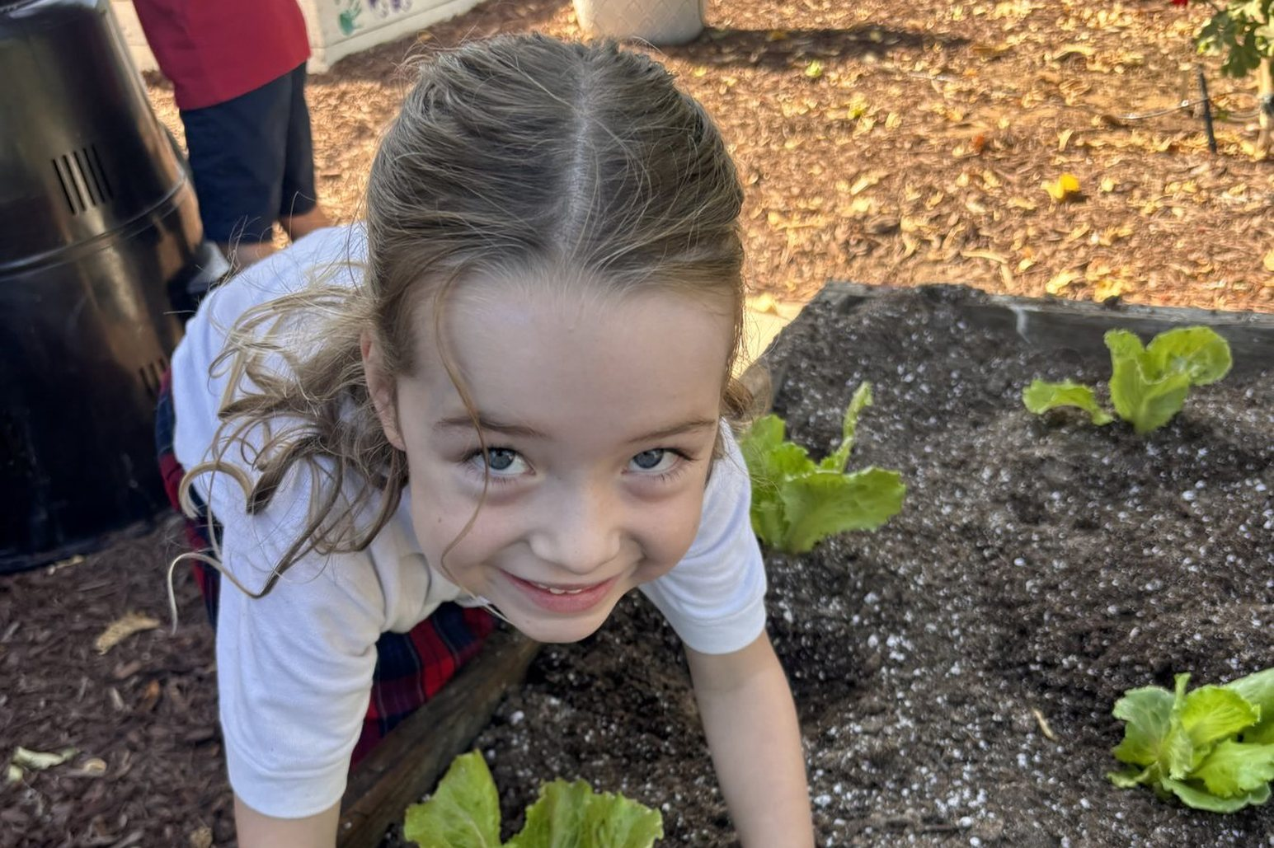
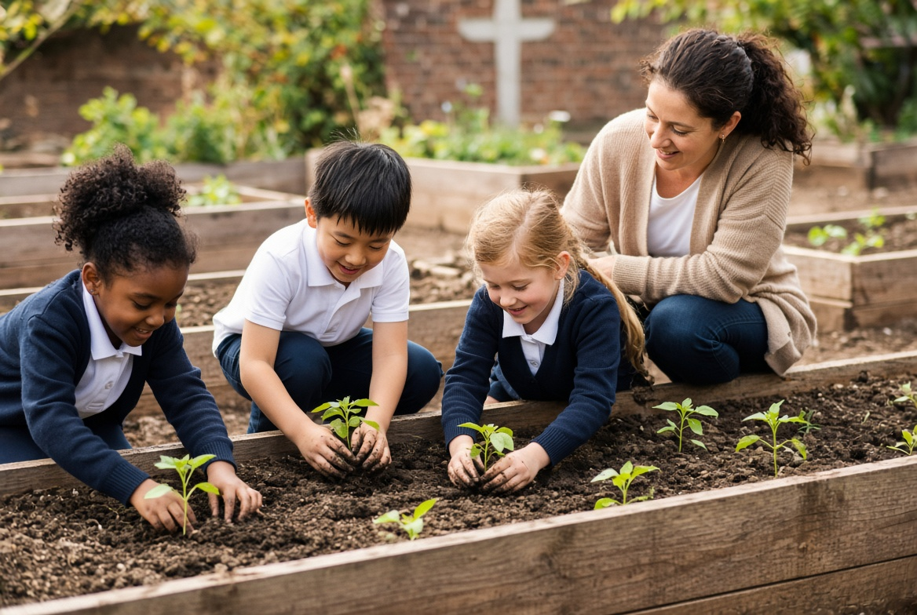
10 · GRADES K–2
Wonder is the curriculum
Creation walks
Ten minutes. Five senses. One question: What did God make that you did not notice yesterday?
Class creature care
A plant, a worm bin, or a class pet with a roster of keepers and a short blessing.
Picture-book theology
Genesis 1, Noah, the Good Shepherd, plus stories of Francis and the birds.
Liturgical noticing
Holy water, beeswax candles, palms, ashes, flowers at Mary’s altar—creation already in the Church year.
Young children do not need a crisis. They need a relationship. Name the sparrow. Bless the rain. Let them get dirt under their nails.
Tiny jobs with dignity
Lights monitor, paper saver, water-the-plant, compost helper. Virtue is practiced, not announced.
CREATION CARE IN THE CLASSROOM · K–5 CATHOLIC TEACHERS
12 / 30
Notes:
K–2 (23:00–27:00) Spend time here. Most teachers over-explain and under-experience. Practical: a "creation shelf" with pinecones, shells, seed pods, a small plant, and a card that says "God looked at it and saw that it was good." Avoid graphic climate imagery with this age.

Slide 13
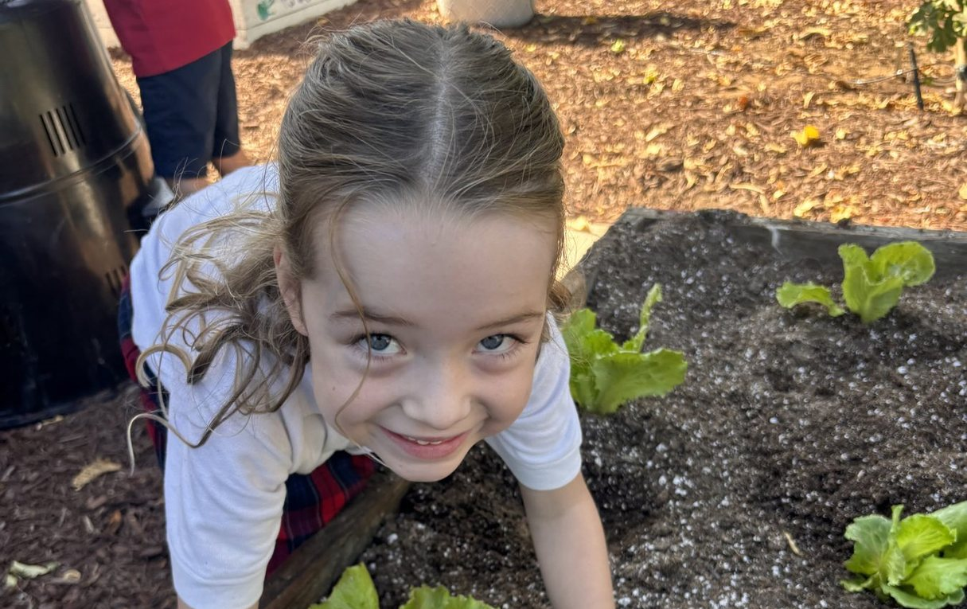
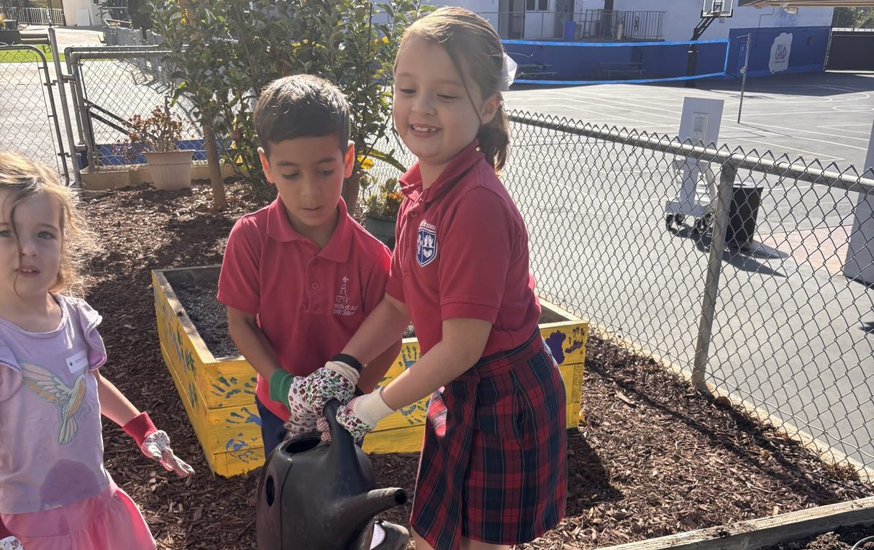
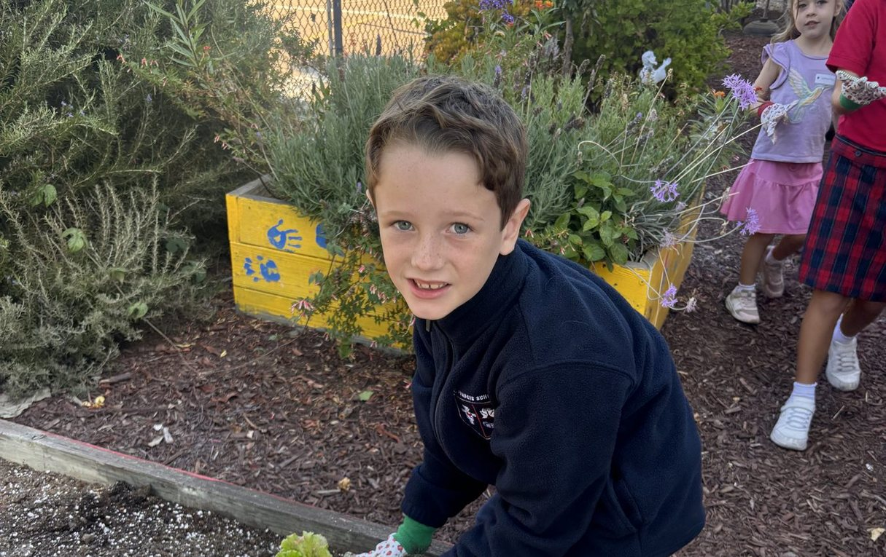
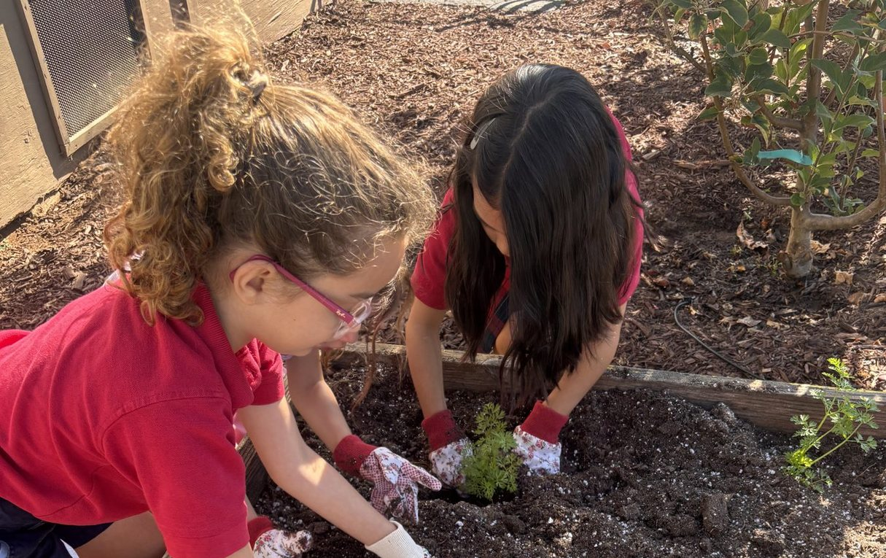
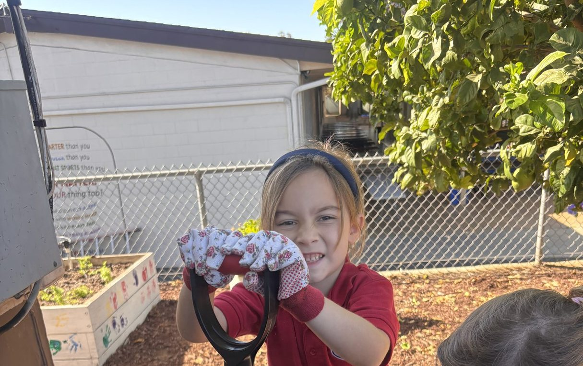
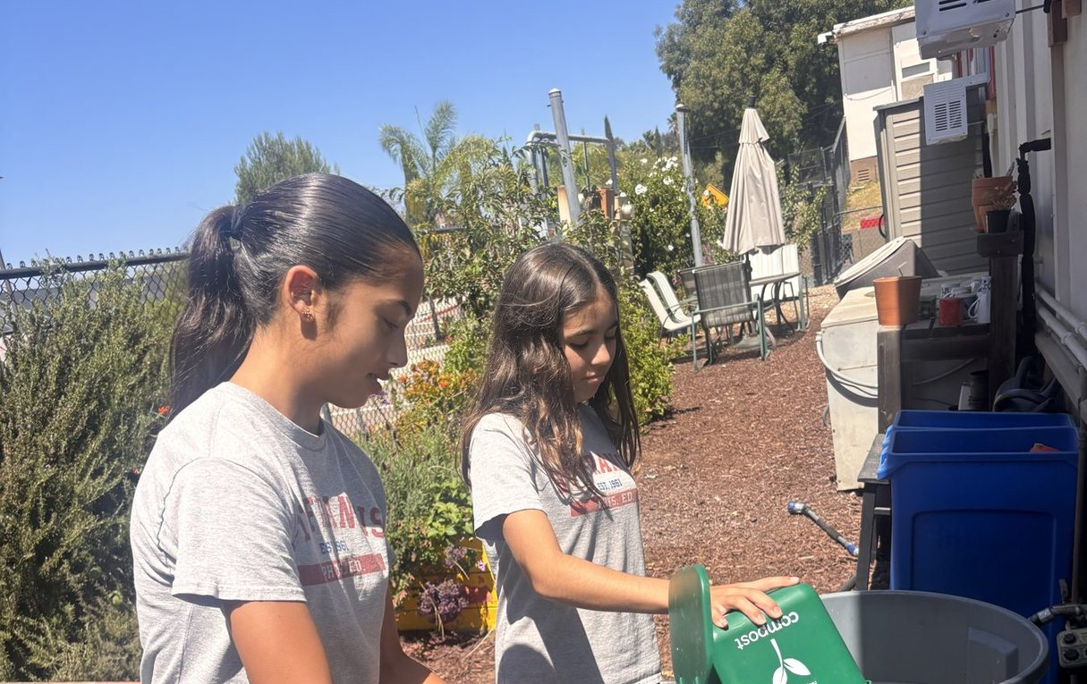
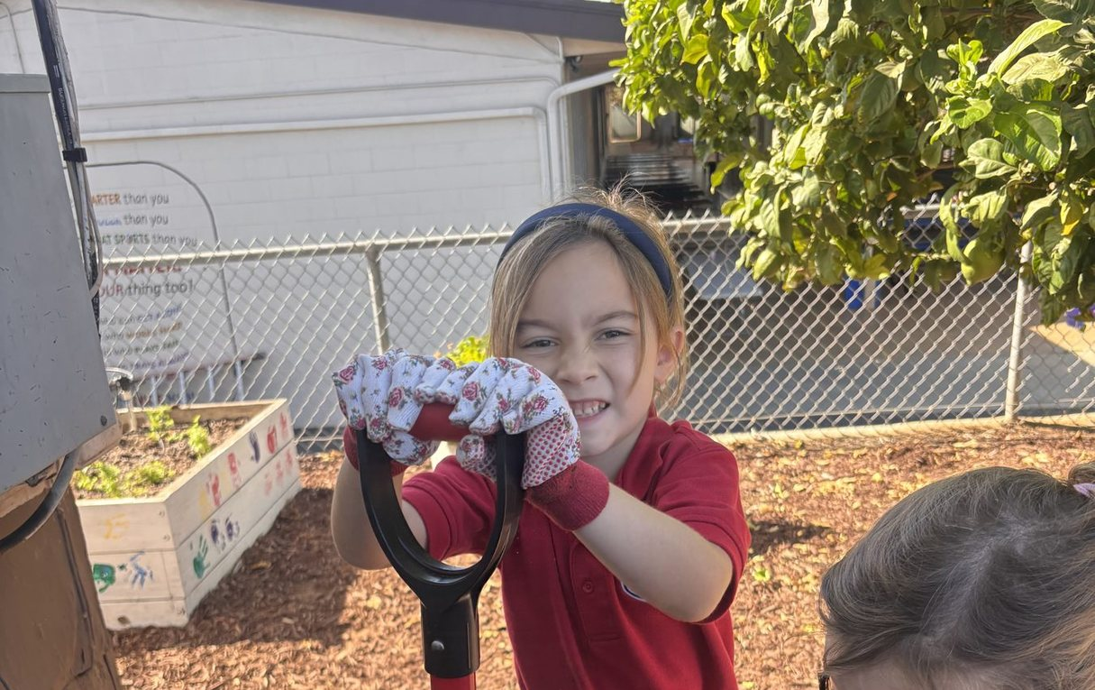
THIS WEEK AT ST. FRANCIS
Creation care is already happening here
Wonder — hands in the soil
Living water — watering the beds
Stewardship — one plant, one child
Action — planting together
Compost — nothing is thrown away
Older students leading the work
CREATION CARE IN THE CLASSROOM · K–5 CATHOLIC TEACHERS
13 / 30
Notes:
OUR SCHOOL GARDEN (show 60–90 seconds)
These photographs are from Lauren’s campus this week — planting, watering, and composting.
Do not narrate every photo. Say: "This is what Wonder, Stewardship, and Action look like with real children, in a real Catholic school garden."
Invite teachers to notice the painted planter boxes, the gloves, the mixed ages. Culture is visible.

Slide 14
11 · GRADES 3–5
From noticing to responsible love
See, Judge, Act
Water as this year’s teacher
Saints of creation
The Cardijn method used across Catholic schools. See a local place. Judge it in the light of faith. Act in a way a child can finish.
Season of Creation 2026 is Living Water. Trace water from tap to storm drain. Bless water. Measure use. Read Ezekiel 47 simply.
Francis and Clare, Kateri Tekakwitha, Hildegard, Isidore the Farmer. Children need holy friends, not only facts.
Science with a soul
Student voice
Hopeful honesty
Habitats, food webs, weather, soil. Then the Catholic question: What is my duty to what I now understand?
A Green Team or Creation Care Crew with real jobs: audit lunch waste, tend a garden bed, lead a decade of the Rosary outdoors.
Name waste and habitat loss without despair. Always pair a hard truth with a concrete good the class can do.
CREATION CARE IN THE CLASSROOM · K–5 CATHOLIC TEACHERS
14 / 30
Notes:
GRADES 3–5 (27:00–31:00) Upper elementary can handle cause and effect. They still need beauty first. Good project: a two-week water inquiry during September. Map school water use. Interview the custodian. Write a class covenant. Present at assembly on Oct 4.

Slide 15
12 · CULTURE IS BUILT IN MINUTES
Routines that form disciples
DAILY
WEEKLY
SEASONAL
Morning offering that names one gift of creation
Ten-minute outdoor prayer or nature observation
Season of Creation, Sept 1–Oct 4
Lights and paper monitors with a 20-second rationale
One literacy or science block that touches creation
St. Francis feast and blessing of animals
A plant or pet check before dismissal
Classroom waste sort with a quick count
Advent simplicity, Lent repair-and-give, Easter garden
CREATION CARE IN THE CLASSROOM · K–5 CATHOLIC TEACHERS
15 / 30
Notes:
ROUTINES (31:00–33:30) The point: teachers are already busy. Do not add a new program. Attach creation care to rituals that already exist. Ask: "Which daily ritual in your room could carry one sentence of praise or one act of care?"

Slide 16





13 · NOT AN ADD-ON
Where creation care already lives
Religion
Science
Literacy
Genesis 1–2, Psalms 8 and 104, parables of seed and vineyard, saints, examination of conscience on waste and kindness.
Observation journals, habitats, water cycle, soil, pollinators. End every unit with a stewardship question.
Nature poems, retellings of the Song, persuasive notes to the principal, read-alouds that train attention.
Math
Art & music
Community
Measure rainfall, graph lunch waste, count birds, compare water used with tap off vs. tap on.
Illustrate Brother Sun and Sister Moon. Learn the Song. Make instruments from safe reused materials.
Campus clean-up as service, not punishment. Visit a parish garden. Write thank-you notes to custodians.
CREATION CARE IN THE CLASSROOM · K–5 CATHOLIC TEACHERS
16 / 30
Notes:
CROSS-CURRICULAR (33:30–36:00) Give one concrete example per subject if time is short. Math: 25 children leave the tap running 10 extra seconds. That is a measurable, moral, and mathematical problem. Religion: an examination of conscience can include "Did I treat God’s world as a gift today?"

Slide 17
14 · THE CLASSROOM AS ORATORY
Prayer, liturgy, and holy matter
Morning
Before meals
One line from the Song, rotated weekly. Children can lead it by October.
Bless the food and the earth that grew it. Name farmers and cafeteria staff.
Outdoors
School Mass
A decade of the Rosary under a tree. Stations of Creation on the playground.
Petitions for clean water, farmers, and children who lack both. Use creation hymns with care.
New Mass texts
Sacramentals
The Mass for the Care of Creation was confirmed in English in August 2026. Ask your pastor about Sept 1 or Oct 4.
Holy water, blessed soil, a class plant on the prayer table. Matter matters in a sacramental Church.
CREATION CARE IN THE CLASSROOM · K–5 CATHOLIC TEACHERS
17 / 30
Notes:
PRAYER (36:00–38:00) This is often the missing piece in "green school" programs. Catholic schools already have the language. Offer a sample petition: "For Sister Water, that we may keep her clean and share her with those who thirst, we pray to the Lord."

Slide 18
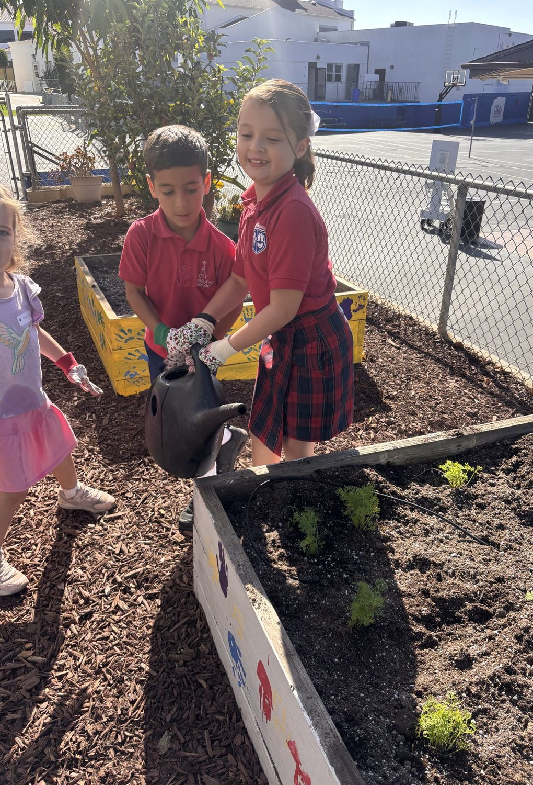
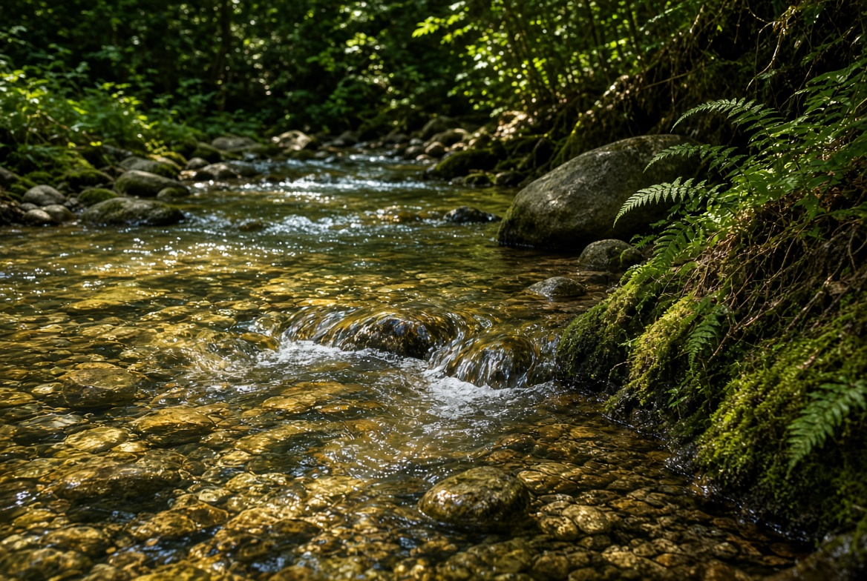
15 · THIS SEASON
Season of Creation 2026
September 1 – October 4 · Theme: Living Water
Week of Sept 1
World Day of Prayer for Creation. Class blessing of water. Read a child-friendly line from Ezekiel 47.
Weeks of Sept
One water inquiry: Where does our classroom water come from? Who lacks it? How do we waste it?
Oct 3–4
Vigil of Francis’s passing and his feast. Blessing of animals. Class song. Assembly or school Mass.
Keep it local
A creek, a garden hose, a drinking fountain, a drought-tolerant planter. Living water is already on campus.
18 / 30
Notes:
SEASON OF CREATION (38:00–40:30) This is the most time-sensitive slide. Season of Creation begins September 1. Give teachers a 4-week skeleton they can drop into September plans. Scripture: Ezekiel 47 — water from the temple growing deeper, bringing life. Jesus as living water in John 4 can be used with grades 3–5.

Slide 19
16 · NO GRANT REQUIRED
High impact, low cost
$0
$0
$0–10
Attention
Language
Prayer table
Window watch. Silence for birdsong. A gratitude circle. Lights-off last child.
Change “throw away” to “where does this go?” Rename monitors as stewards.
A cloth in earth colors, a plant, a stone, a bowl of water, a printed verse.
$0–20
Shared
Free PDFs
Repair corner
Campus
Curriculum
Tape, needle, glue. Teach children to mend a book, a folder, a stuffed mascot.
Ask facilities for a neglected planter. Adopt it. That is a year-long lab.
Catholic Climate Covenant, Archdiocese of New York PK–6 plans, Caritas CST units.
CREATION CARE IN THE CLASSROOM · K–5 CATHOLIC TEACHERS
19 / 30
Notes:
LOW COST (40:30–42:00) Relieve the objection "we do not have money or a garden." Francis had neither. He had attention. The repair corner is surprisingly powerful with 3–5. It teaches resistance to throwaway culture in a way a poster cannot.

Slide 20
17 · THE DOMESTIC CHURCH
Invite families without adding homework
Send the why, not a lecture
A take-home noticing card
Blessing of animals
A four-sentence newsletter note: Francis, the Jubilee Year, one class habit, one optional home idea.
“This week look for Sister Water.” Photo optional. Share at morning meeting.
Invite families on or near Oct 4. Keep it short, joyful, and clearly a prayer, not a pet show.
One family service
Grandparents as memory
Respect the home
A Saturday campus or parish clean-up. Children lead a two-minute prayer first.
Ask how gardens, mending, and wasting less used to work. Wisdom before apps.
Never shame a family’s car, lunch, or lawn. Model. Invite. Leave room for different capacities.
CREATION CARE IN THE CLASSROOM · K–5 CATHOLIC TEACHERS
20 / 30
Notes:
FAMILIES (42:00–43:30) Pastoral tone matters. Some families are already stretched. Creation care at home must feel like a gift, not a grade. Offer a sample newsletter paragraph in Q&A if asked.

Slide 21
18 · TEACH WITH PRUDENCE
Guardrails for Catholic teachers
Do not baptize a political program
Protect children from despair
We teach stewardship, the common good, and the poor. We do not conscript children into adult culture wars.
K–5 is not the place for catastrophe slideshows. Form lovers of creation first. Hope is a theological virtue.
Avoid one-and-done
Tell the whole truth about Francis
Earth Day alone is not formation. A weak habit practiced daily beats a spectacular April assembly.
He is not only the bird saint. He is the poor man of Assisi who loved the Crucified. Keep Christ at the center.
Include the custodian
Measure what you start
The people who already care for the building are co-teachers. Consult them before launching a waste plan.
If you begin a garden, name who waters in June. Abandoned projects teach the opposite of stewardship.
CREATION CARE IN THE CLASSROOM · K–5 CATHOLIC TEACHERS
21 / 30
Notes:
GUARDRAILS (43:30–45:00) This slide earns trust. Teachers have seen programs that felt ideological or unsustainable. Say plainly: Catholic creation care is older than the modern environmental movement. It is Genesis, the Psalms, Francis, and the social encyclicals.

Slide 22
19 · STEAL THESE TOMORROW
A ready activity bank
Grade
Activity
How it works
K–1
Creation mural
Draw where we see God in the world. Caption: It was very good.
K–2
Sister Water tray
Pebbles, a bowl, a dropper. Practice gentle use. Pray the water stanza.
1–3
Francis story circle
Tell the birds or the wolf. Children retell with puppets or drawings.
2–4
Waste audit
One lunch. Sort. Count. Graph. Choose one change for two weeks.
3–5
Living Water map
Trace school water. Interview facilities. Propose one saving habit.
3–5
Song booklet
Each child illustrates one stanza. Bind as a class prayer book.
K–5
Steward of the week
A real job, a badge, a 30-second report on Friday.
K–5
Outdoor Rosary
One decade. Intention: our common home and children who go without water.
CREATION CARE IN THE CLASSROOM · K–5 CATHOLIC TEACHERS
22 / 30
Notes:
ACTIVITY BANK (45:00–46:00) Do not read every row. Point to two: Sister Water tray for primary, Living Water map for 3–5. Invite teachers to star one row.

Slide 23
20 · START SMALL, FINISH THE MONTH
A 30-day classroom plan
Days 1–7
Wonder
Pray the verse daily. Take two short noticing walks. Start a class creation shelf.
Days 8–14
Gratitude
Children write or draw thank-yous. Bless the class plant. Send a family noticing card.
Days 15–21
Stewardship
Assign steward jobs. Do one lunch or paper audit. Meet the custodian.
Days 22–30
Action
Choose one lasting change. Celebrate St. Francis. Share the story at assembly or with families.
CREATION CARE IN THE CLASSROOM · K–5 CATHOLIC TEACHERS
23 / 30
Notes:
30-DAY PLAN (46:00–47:00) This is the "do this after the workshop" slide. Encourage teachers to pair up across grade levels so K–2 and 3–5 share a feast-day moment on Oct 4.

Slide 24
OUR SCHOOL · CLICK TO OPEN
Plan the work. Aim for the award.
School Action Plan
Creation Care Award
How Creation Care lives here — not a one-day lesson. Find one item you can run in your room this month.
Open the school action plan →
The award our school is working toward. Classroom moves from this session count toward it.
See the award file →
How to use these
Say this out loud
After strategies, send teachers here. Plan = the work. Award = the recognition. Keep the ask small: one item, one room, this month.
Both links open after the session.
“Here is our school plan. Here is the award we are aiming for. Pick one classroom move that helps both.”
Then point back to the 30-day plan.
CREATION CARE IN THE CLASSROOM · K–5 CATHOLIC TEACHERS
24 / 30

Slide 25
21 · CLICK ANY TITLE OR ADDRESS TO OPEN
Monday-ready resources
Catholic Climate Covenant
Archdiocese of New York
St. Francis Pledge, Feast of Francis programs, and God’s Creation Waits workbook for grades 2–5.
catholicclimatecovenant.org
Free Caring for Creation lesson plans for PK–K, grades 1–3, and grades 4–6.
archny.org/caring-for-creation
Alliance for Catholic Education
Caritas / CAFOD
Notre Dame guidance for bringing Laudato Si’ into daily classroom life.
ace.nd.edu
See-Judge-Act units and primary Laudato Si’ Goals slides written for children.
caritas.org.au/resources/school-resources
USCCB
Season of Creation
Mass for the Care of Creation texts, now confirmed in English and Spanish.
usccb.org/resources/mass-for-the-care-of-creation
2026 Celebration Guide and Living Water theme materials.
seasonofcreation.org/resources
CREATION CARE IN THE CLASSROOM · K–5 CATHOLIC TEACHERS
25 / 30
Notes:
RESOURCES (47:00–47:45)
All six titles and web addresses on this slide are live links. After the session, send the PowerPoint file so teachers can click through.
Mention two by name: God’s Creation Waits (printable, grades 2–5) and the New York Archdiocese plans (already grade-banded).
Links:
Catholic Climate Covenant — https://catholicclimatecovenant.org/resources/gods-creation-waits/
Archdiocese of New York — https://www.archny.org/caring-for-creation
ACE Notre Dame — https://ace.nd.edu/blog/how-incorporate-popes-encyclical-laudato-si-your-classroom
Caritas primary LS Goals — https://www.caritas.org.au/resources/school-resources/the-laudato-si-goals-primary/
USCCB Mass texts — https://www.usccb.org/resources/mass-for-the-care-of-creation
Season of Creation 2026 — https://seasonofcreation.org/resources/

Slide 26
22 · A CHILD-SIZED COVENANT
A classroom St. Francis Pledge
As friends of Jesus and of St. Francis, we promise to:
Pray
Thank God every day for the world He made.
Notice
Look closely at creatures, weather, water, and one another.
Care
Treat our classroom, campus, and supplies as gifts on loan.
Share
Remember children and families who have less than we do.
Act
Do one small good thing for creation and keep doing it.
CREATION CARE IN THE CLASSROOM · K–5 CATHOLIC TEACHERS
26 / 30
Notes:
PLEDGE (47:45–48:30) This is adapted from the Catholic Climate Covenant St. Francis Pledge into child language. Invite teachers to copy it, illustrate it with the class, and sign it on Oct 4. Adult version for faculty: pray, learn, assess, act, advocate.

Slide 27
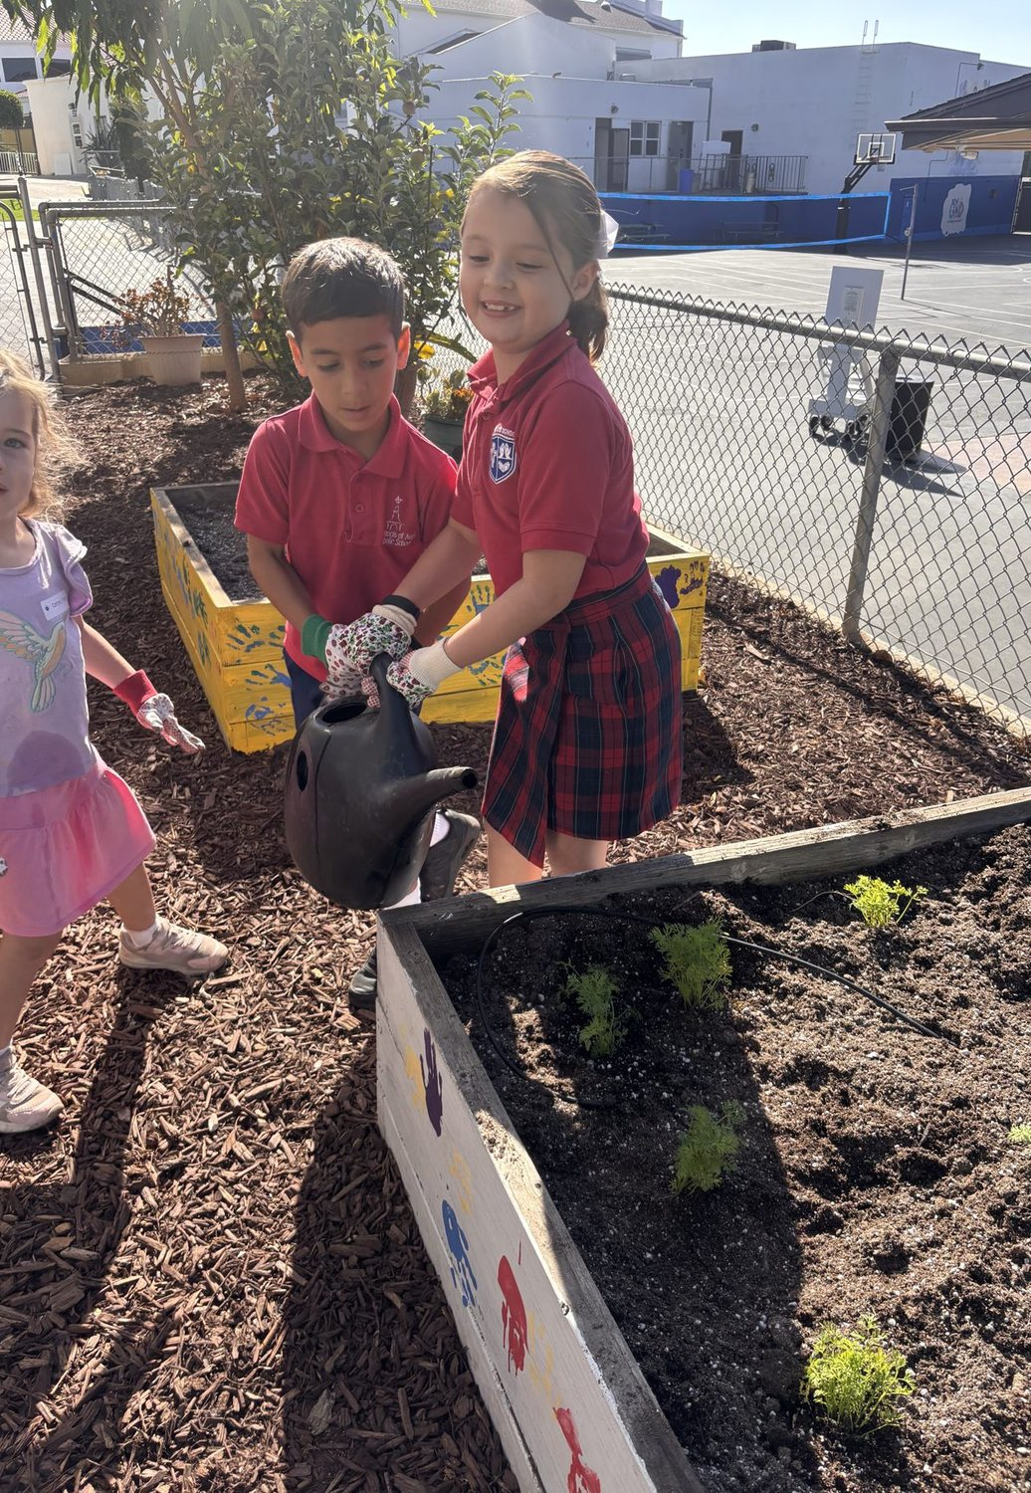
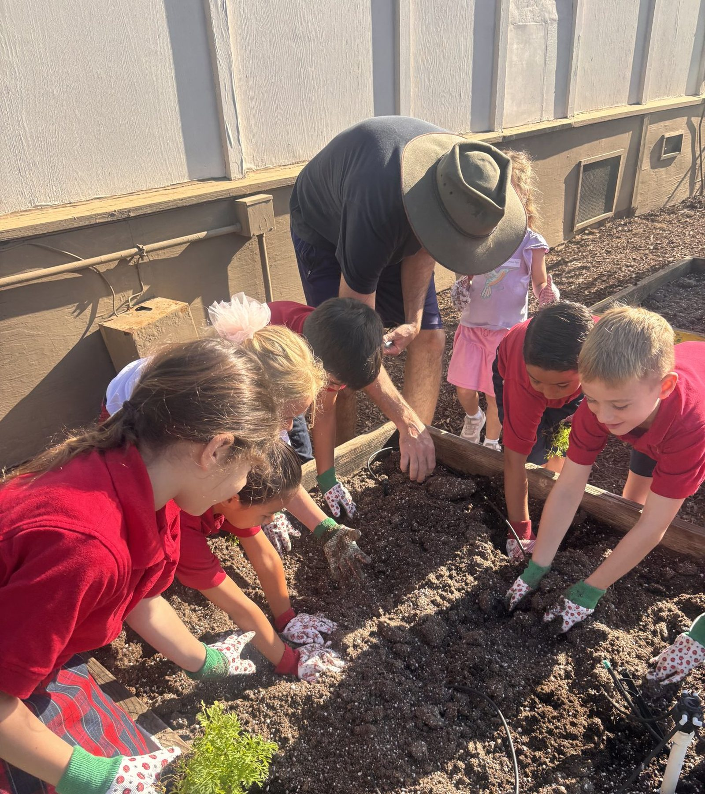
WHY ACTION FIRST
We need heroes. We need to win people over. And you don’t do that by talking. You do it by taking action that improves their lives—now.
Arnold Schwarzenegger
The same is true in a K–5 classroom. Children learn to care for creation by doing it—today, with dirt under their nails.
CREATION CARE IN THE CLASSROOM · K–5
27 / 30
Notes:
QUOTE (45 seconds)
Lauren asked for this line. Read it once. Then the bridge sentence.
The point is action now — the fourth movement of the pedagogy.

Slide 28
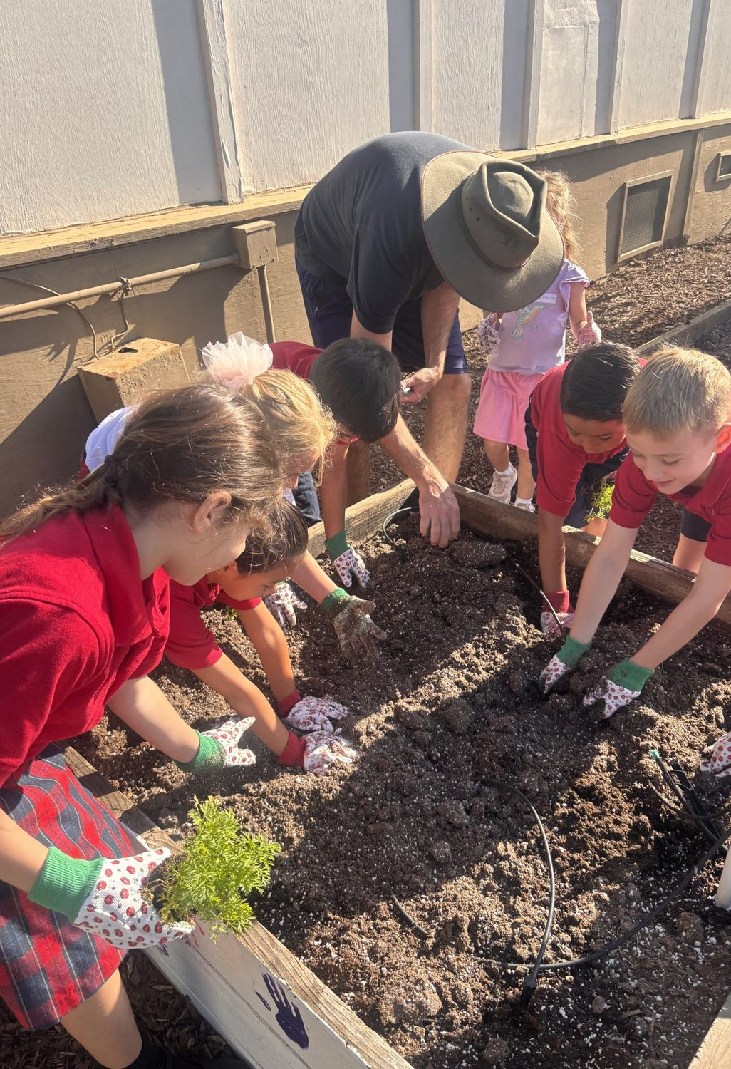
23 · SEND FORTH
Return creation
better than we
received it.
That Franciscan principle is simple enough for a kindergartner and demanding enough for a faculty.
The Jubilee Year will end. The children in front of you will not forget the teacher who taught them to praise, to notice, and to keep.
CREATION CARE IN THE CLASSROOM · K–5 CATHOLIC TEACHERS
28 / 30
Notes:
CLOSING (48:30–49:15) Read the title line. Pause. Then the last paragraph. If time, ask each teacher to write one sentence: "By the Feast of St. Francis my class will…" and pair-share.

Slide 29
Questions
If you leave with only three things
1
2
3
Praise first.
Practice daily.
Keep Christ central.
Begin with the Song,
not with a crisis.
A two-minute habit beats
a once-a-year unit.
Francis loved creation
because he loved the Creator.
Praised be You, my Lord, through all Your creatures.
CREATION CARE IN THE CLASSROOM · K–5 CATHOLIC TEACHERS
29 / 30
Notes:
Q&A (49:15–50:00+)
Hold questions here. If none come, prompt:
- What is one barrier in your room?
- How might specials teachers join this?
- What would Oct 4 look like schoolwide?
Thank them. End on the verse, not on logistics.

Slide 30
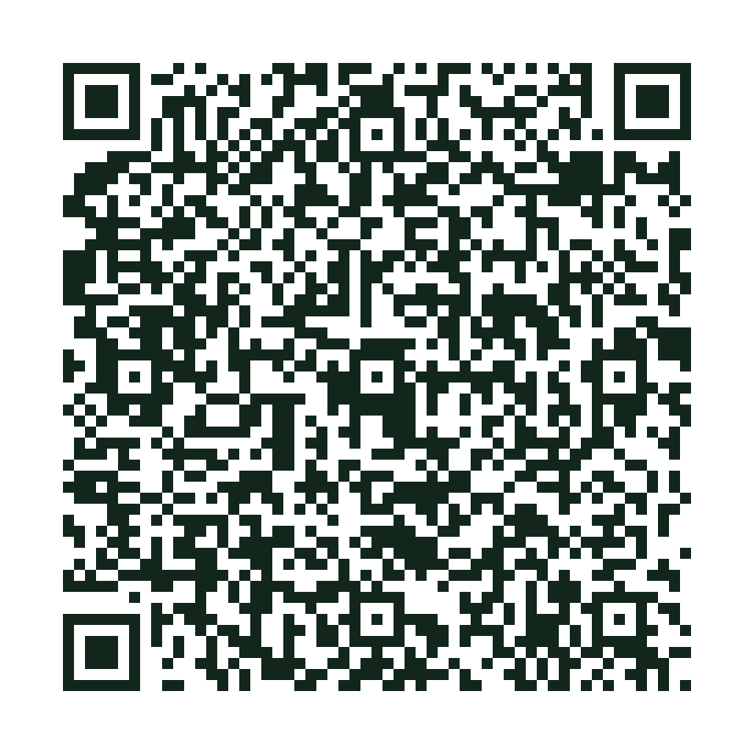
BEFORE YOU GO
Please take the survey
Scan the code or tap the link. It takes about one minute.
Leave this slide up while colleagues scan.
Open the survey
https://docs.google.com/forms/d/e/1FAIpQLSd5lC1_X4yT2Uja4ZbCoZG7He5HpTSp-irsQlJRoglL8VqGHA/viewform
Scan with your phone camera
CREATION CARE IN THE CLASSROOM · K–5 CATHOLIC TEACHERS
30 / 30
Notes:
SURVEY CLOSE
Leave this slide up. Do not click away until people have scanned.
Say: Thank you. Before you go, please take the session survey. Scan the code or tap the link if you have the file.
One minute. Then we are done.
URL: https://docs.google.com/forms/d/e/1FAIpQLSd5lC1_X4yT2Uja4ZbCoZG7He5HpTSp-irsQlJRoglL8VqGHA/viewform

