Slide 1
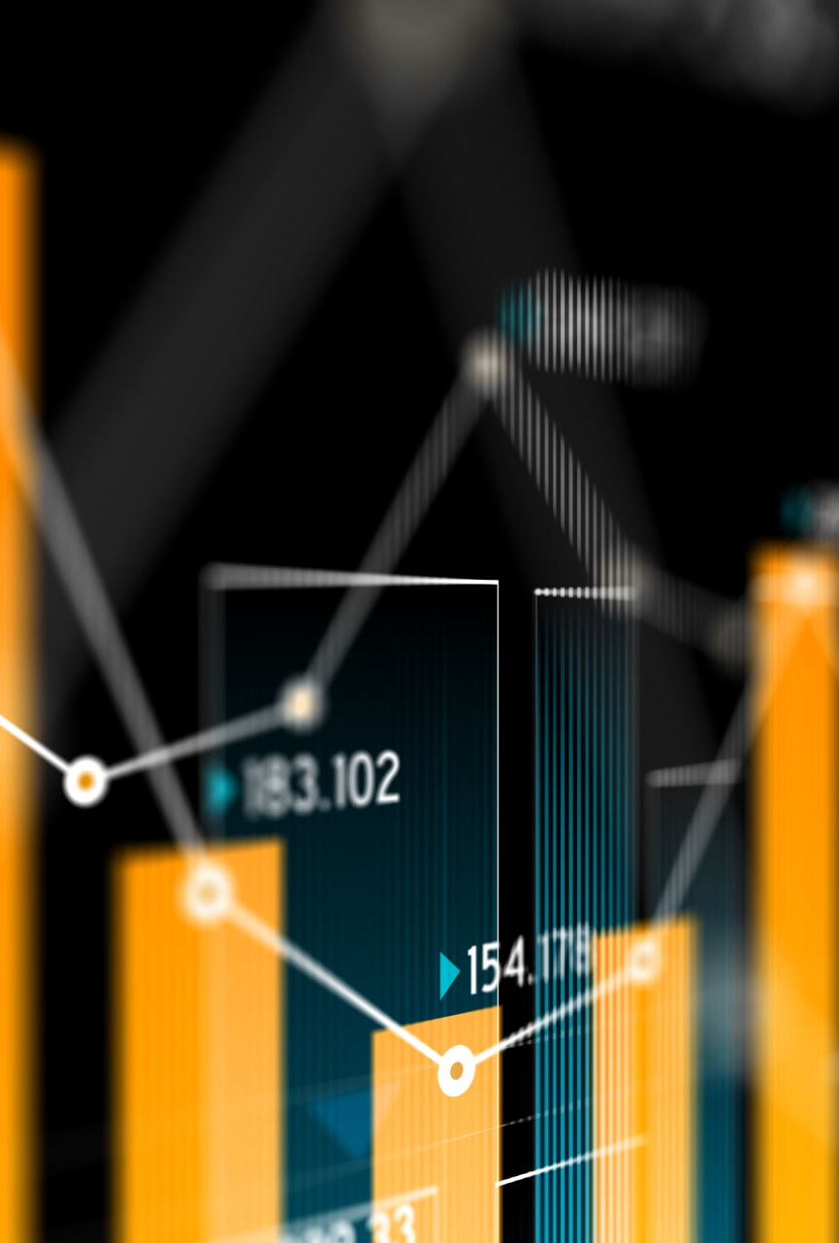
Linear Regression
It is a linear approach that follows to model the relationship between the numerical response and one or more explanatory variables. Linear regression using linear dragon functions, in which indicators or variables of unknown models are estimated by reference to the data.
These models are called linear models. Like other regression analysis methods, “linear regression” focuses on the distribution of conditional probabilities of the response due to the predictors’ values, rather than From the distribution of the common probability of all these indicators or variables, as this is stated in the field of (multivariate analysis).

