Slide 1
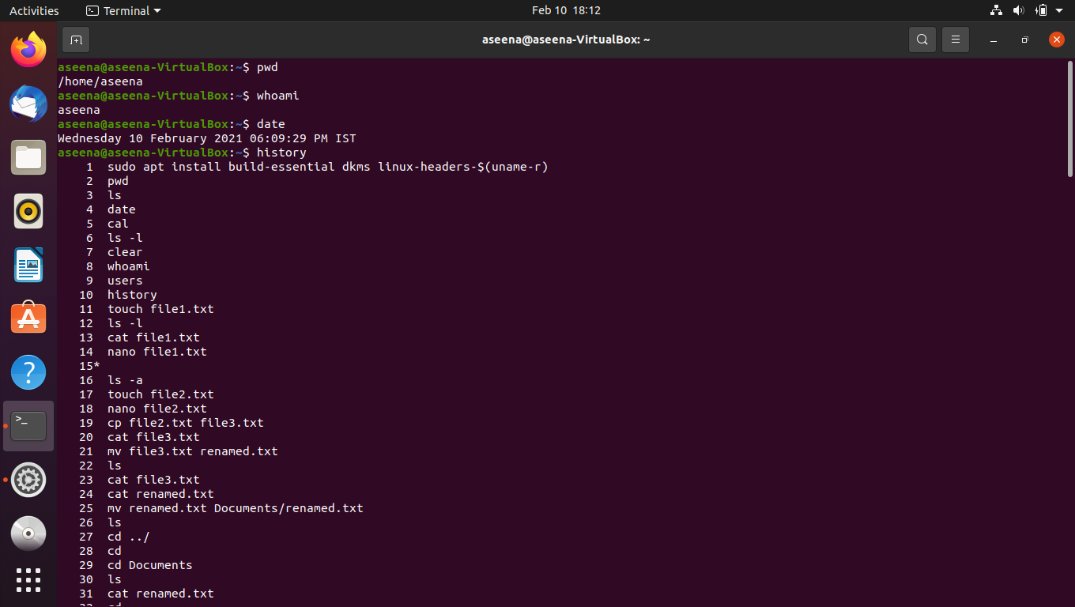
Linux commands
pwd: gives present working directory
whoami: gives current user name
date: gives date and current time
history: lists all commets typed recently

Slide 2
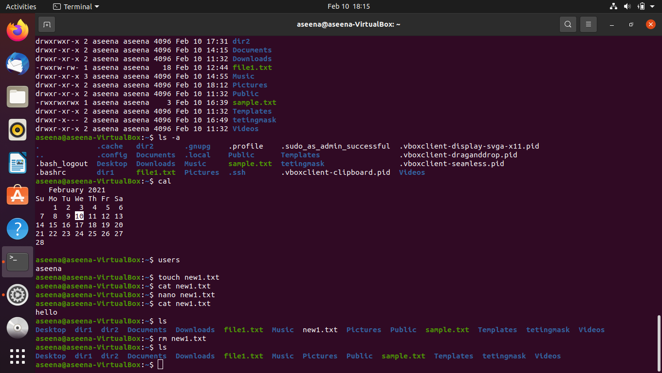
Linux commands
ls : list out files and folders in pwd
ls –s: list out al the hidden files
ls –l: gives complete details of files and folders in pwd
cal: views calender
users: lists how many users are there in the system
touch: to create a file timetamp
cat: to create/open file with content
nano: to open text editor
rm: to remove a file or folder

Slide 3
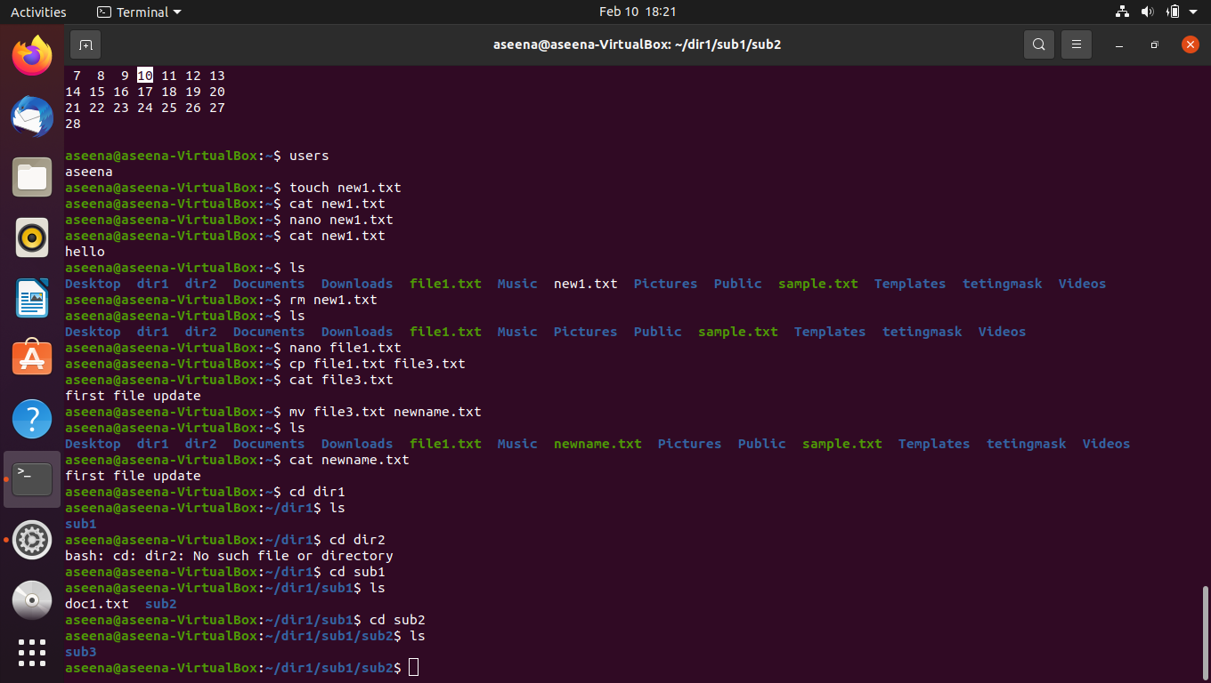
Linux commands
cp: to copy contents of one file/folder to other
mv : to move the contents of a file/folder(like renaming)
cd: change directory(to navigate across directories)
cd ../: to navigate back to parent directory
cd ~: to go to home directory

Slide 4
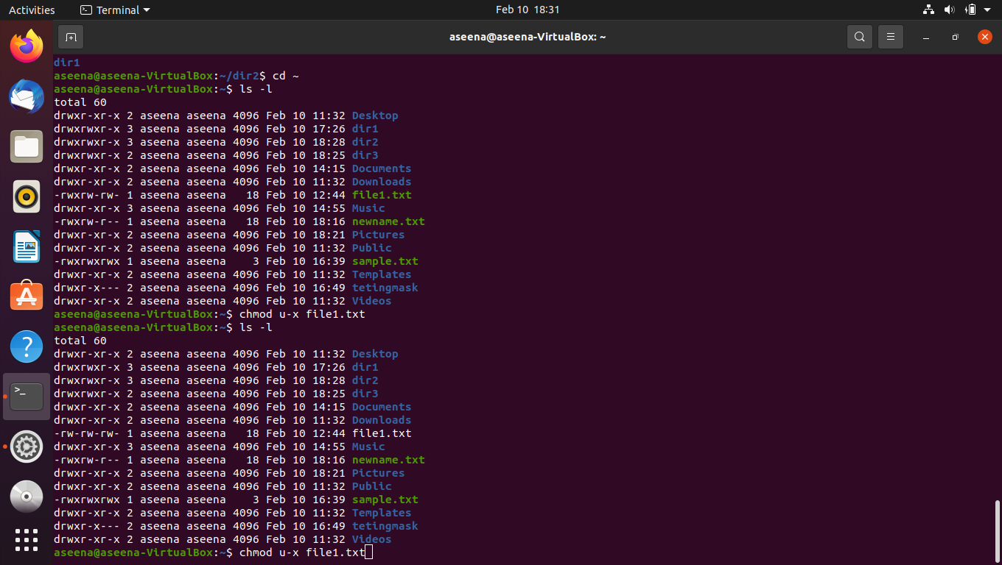
chmod : to change the default access permisiions
2 types:
Symbolic
Octal

Slide 5
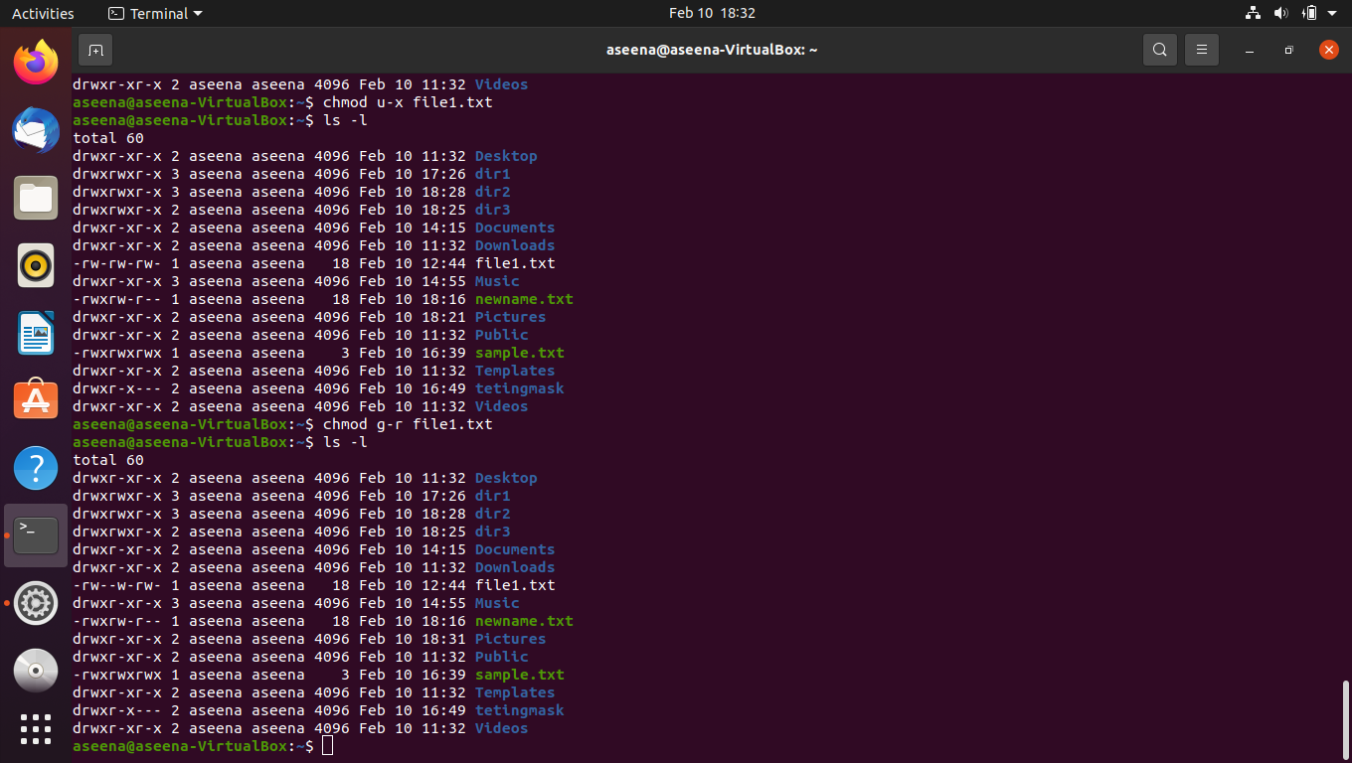
Linux commands
Symbolic:
use operators
+: adds permission
-: removes permsn
=: set permission
Eg:chmod u+x file.txt: give permision to execite for hthe file
chmod g-r file.txt: remove read permission of the group

Slide 6

Linux commands
chmod a=rwx file.txt: gives user,group and others to read write and execute

Slide 7

Linux commands
octal:
use octal number for giving access permissions(0-7)

Slide 8
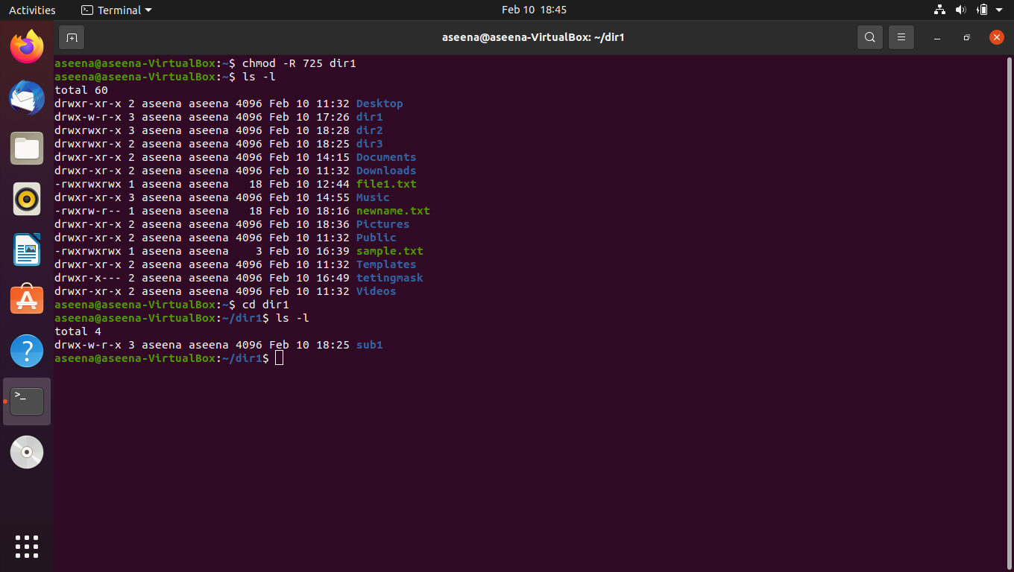
Linux commands
chmod –R <directoryname>: gives the children of that directory the same access permisision as that of parent

Slide 9
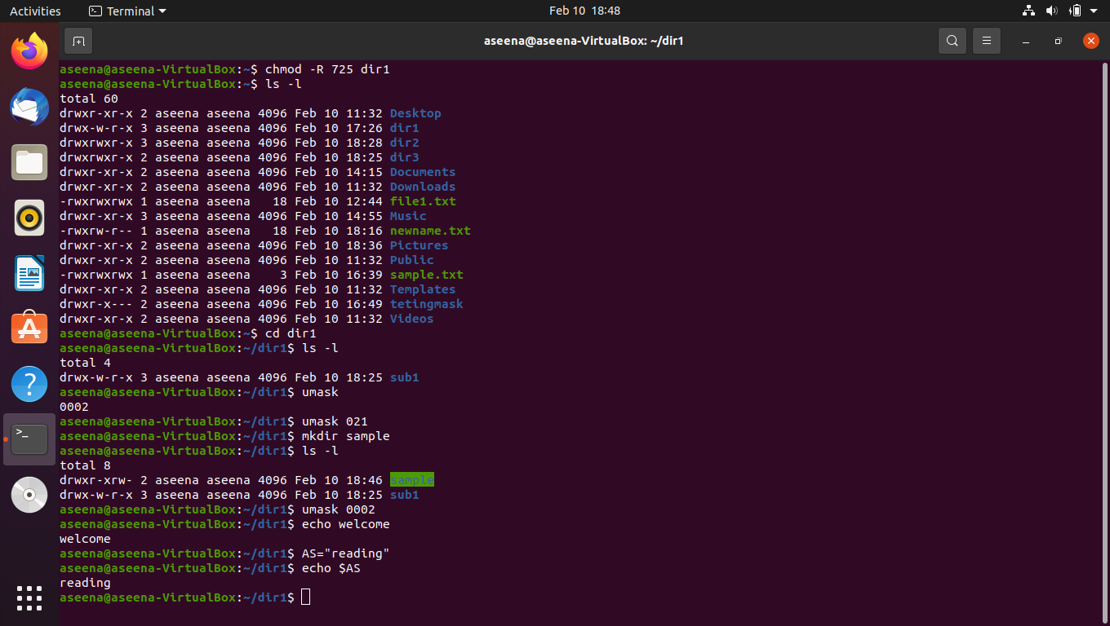
Linux commands
umask: the defalt pemission is fiven by subtracting umask from actual permissions
We can also change umask vaue
echo: prints what i written after it in termnal
To print variable values use $ followed by variable name

