Slide 1
Data Backup Application
Presented By:
Asess Khurana (MT23024)
Devkul Sahu (MT23116)
Mazhar Sayed (MT23124)

Slide 2
Application Overview
Automatically back up files from the Downloads directory that haven't been accessed in a set timeframe to Firebase Storage.
This process respects device constraints such as battery and network availability to ensure efficient operation without disrupting user experience.
Key operations:
scanning for old files
uploading them to the cloud
updating local and cloud databases with the backup status.

Slide 3
MainActivity
MainActivity: It is the entry point of the application. It hosts the primary user interface that users interact with when they open the app.
Functionality:
Displays options to navigate to BackupActivity or RestoreActivity.
Provides a visual interface for initiating the backup and restore processes.
MainActivity uses the Android lifecycle to manage the initiation of background tasks and ensures the user can navigate through different functionalities efficiently.

Slide 4
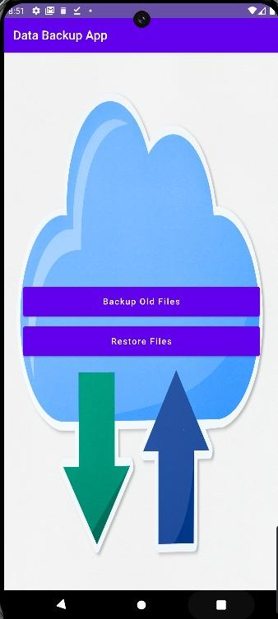
MainActivity Screenshot

Slide 5
BackupActivity
BackupActivity serves as the main user interface of the app for backing up files. It allows users to start the backup process and displays the progress through a progress bar.
Functionality:
Checks and requests necessary permissions.
Initiates the scanning of the Downloads directory for old files.
Displays real-time progress of the backup operation.
This activity uses the DeviceStatusUtils to check battery and network status before starting the backup process.

Slide 6
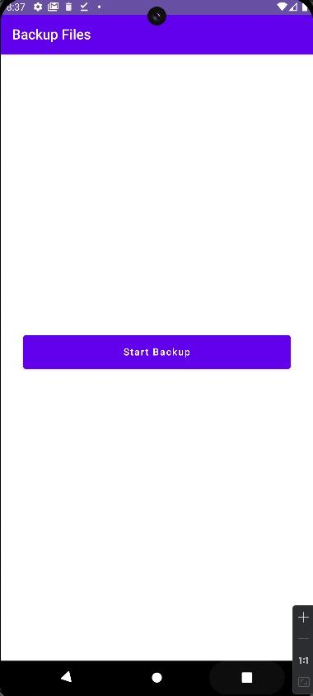
BackupActivity Screenshot

Slide 7
RestoreActivity
RestoreActivity is responsible for the user interface and functionality related to restoring files from Firebase Storage back to the device.
Functionality:
Allows users to view and select backed-up files stored in Firebase.
Initiates the download and restoration of selected files.
This activity provides feedback on the restoration progress and ensures files are correctly restored to their original locations.

Slide 8
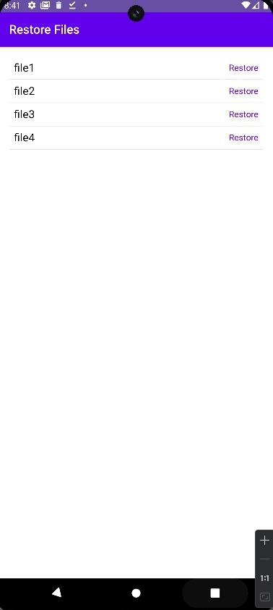
RestoreActivity Screenshot

Slide 9
FileEntity and FileRepository
FileEntity represents the metadata of files to be backed up, including the name, path, and backup status.
FileRepository manages local database interactions to store and update the backup status of files.
These components work together to track which files have been backed up and which are pending backup, aiding in efficient data management.

Slide 10
FirebaseDBHelper
FirebaseDBHelper is responsible for interacting with Firebase. It uploads files to Firebase Storage and updates the Firebase Database with file metadata.
This helper ensures that all file uploads are tracked in the cloud database, providing a reliable backup solution and enabling easy restoration if needed.

Slide 11
Additional Android Features Used
Permission: Dynamic permission checks for READ_EXTERNAL_STORAGE to ensure the app can access and scan the download directory.
Battery and Network Checks: Uses DeviceStatusUtils to verify battery levels and network availability before starting the backup process to avoid disrupting the user’s device usage.
Coroutines and Multithreading: Manges intensive I/O operations using coroutines, ensuring smooth UI operation by offloading heavy tasks to background threads.
Firebase Integration: Utilizes Firebase Storage for cloud backups and Firebase Database for metadata storage, demonstrating cloud interaction capabilities.

Slide 12
Technologies Used
Kotlin
Android Jetpack Compose
Firebase Storage
Firebase Realtime Database
Android SDK Platform Tools
Coroutines & Kotlin Flow
Material Design Components
Data Binding & View Binding
Device Status Utils (Battery and Network Checks)

Slide 13
Conclusion
The Backup Application presents a comprehensive solution for automating the backup process of files that haven't been accessed within a specified timeframe, enhancing user convenience and data security. By integrating Firebase Storage and Database, the application offers seamless cloud storage capabilities while dynamically managing permissions and respecting device constraints.

Slide 14
Thank You !

