Slide 1



IP Fraud
Detector
Mind Matrix

Slide 2
Introduction
Problem Statement
Detect suspicious users or bots by analyzing IP behavior, frequency, and geo-location to prevent fraud on websites.
Significance
Enhances online security, protects user data, reduces financial losses, and maintains trust in digital platforms.

Slide 3
Dataset
Source - Custom dataset created by combining safe IPs (e.g., Google DNS, Cloudflare) and suspicious IPs
Features - IP address (split into octets), country, organization, ISP, timezone.
Preprocessing - Handled missing data with "Unknown" values, encoded categorical features using LabelEncoder.

Slide 4
Methodology
Model Selection - Random Forest Classifier chosen for its robustness, ability to handle categorical data, and resistance to overfitting.
Training Process - Split data into 80% training and 20% testing, tuned hyperparameters with GridSearchCV, used class weights to address imbalance.

Slide 5
Implementation
Web Application
Built with Flask (backend), HTML/CSS/JavaScript (frontend).
Functionality
Users input an IP to get real-time fraud predictions.
Admin dashboard tracks all IP checks, displays stats, and allows flagging suspicious IPs.

Slide 6
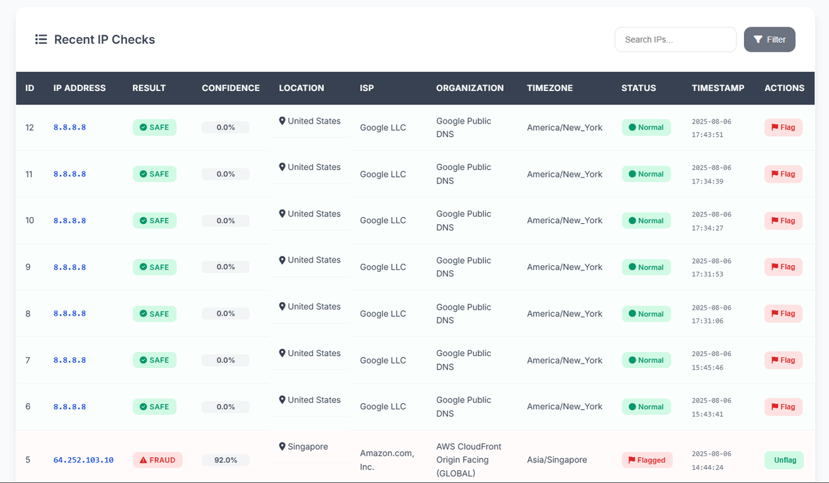
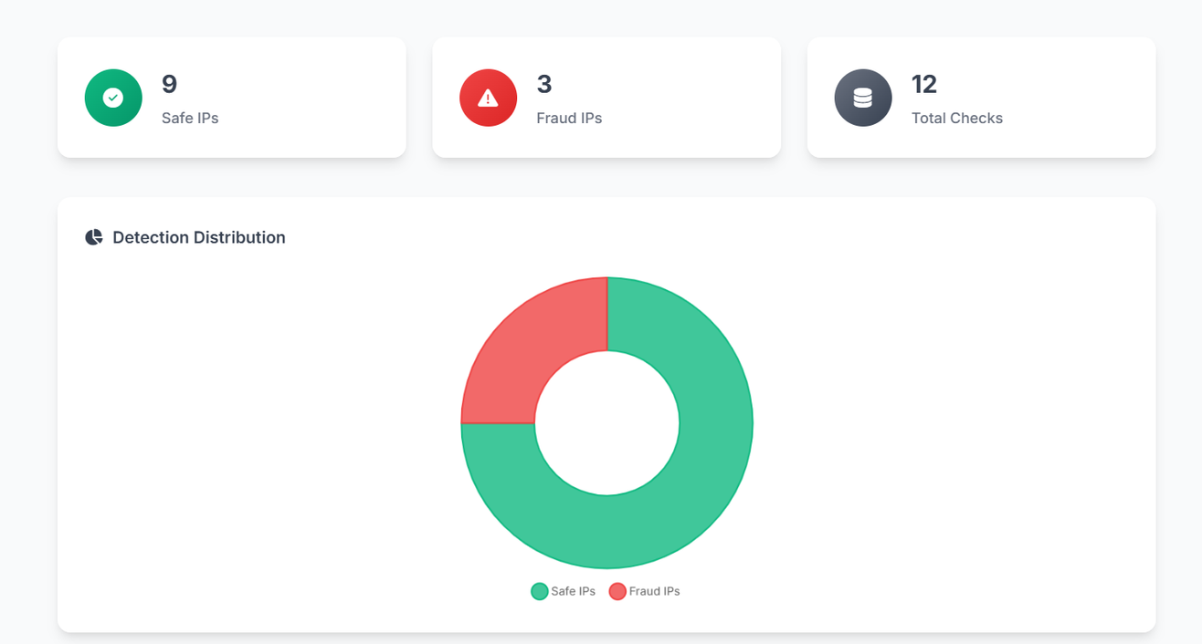

Slide 7
Results
Model Performance - Achieved 0.81 accuracy, with precision of 0.79 (class 0) and 0.82 (class 1), recall of 0.79 (class 0) and 0.82 (class 1), and F1-scores of 0.79 (class 0) and 0.82 (class 1). Macro and weighted averages are 0.81 for precision, recall, and F1-score, with a total support of 74.
Visualizations - Confusion matrix and feature importance chart show model effectiveness and key predictors specific confusion matrix values and feature importances to be updated from model_training.ipynb.

Slide 8
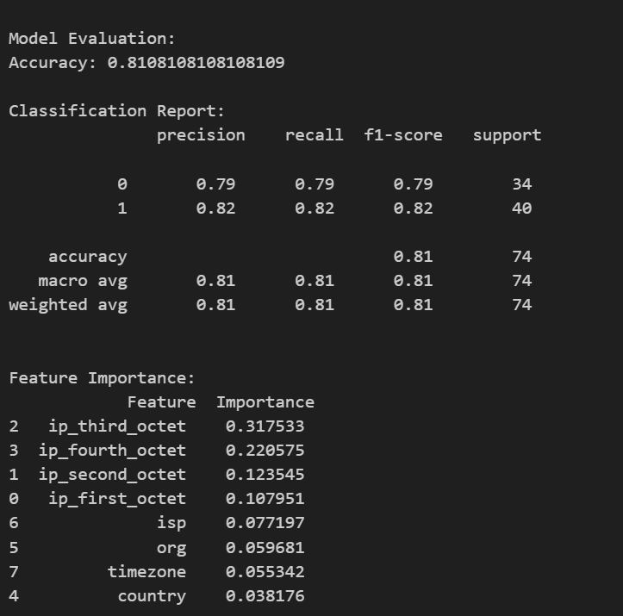
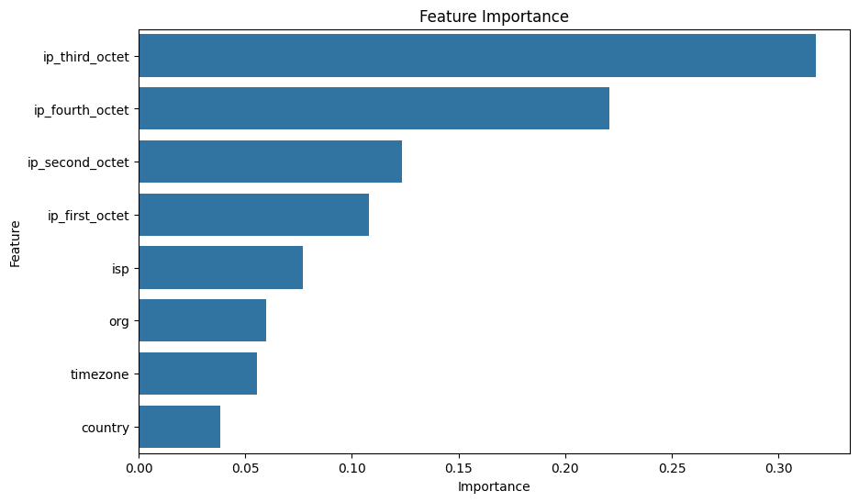

Slide 9
Challenges and Solutions
Challenges
Imbalanced dataset
API rate limits for IP info fetching.
Model optimization
Solutions
Applied class weights in Random Forest.
Cached API responses to reduce requests.
Used GridSearchCV for hyperparameter tuning.

Slide 10
Conclusion
Summary - Developed an effective ML-based fraud detection system integrated into a web app, meeting all MVP requirements.
Future Work - Add more features (e.g., user behavior), explore deep learning models, and use real-time data.

Slide 11
Team Contributions
Data collection and preprocessing - 21ug1040 / 21ug1000
Model training and evaluation - 21ug1031 / 21ug0987 / 21ug1192
Backend development (Flask) - 21ug1021 / 21ug0956
Frontend development (HTML/CSS/JS) - 21ug1036 / 21ug0926
Project management & documentation - 21ug1313 / 21ug1142

