Slide 1
IR Wireless Underwater Communication System
By:
Mahmoud Yasser Mostafa

Slide 2
IR Wireless Underwater Communication System:-
Underwater wireless communications system
comprising first and second communications modules
which transmit and receive data utilizing infrared
radiation. Each module has a transmitter/receiver which
converts each received data.

Slide 3
Advantages :-
1) is not expensve
2) transmitter or receiver can be showed to another location with least distraction
3) This system is used for easy communication with transmitter and receiver in underground water

Slide 4
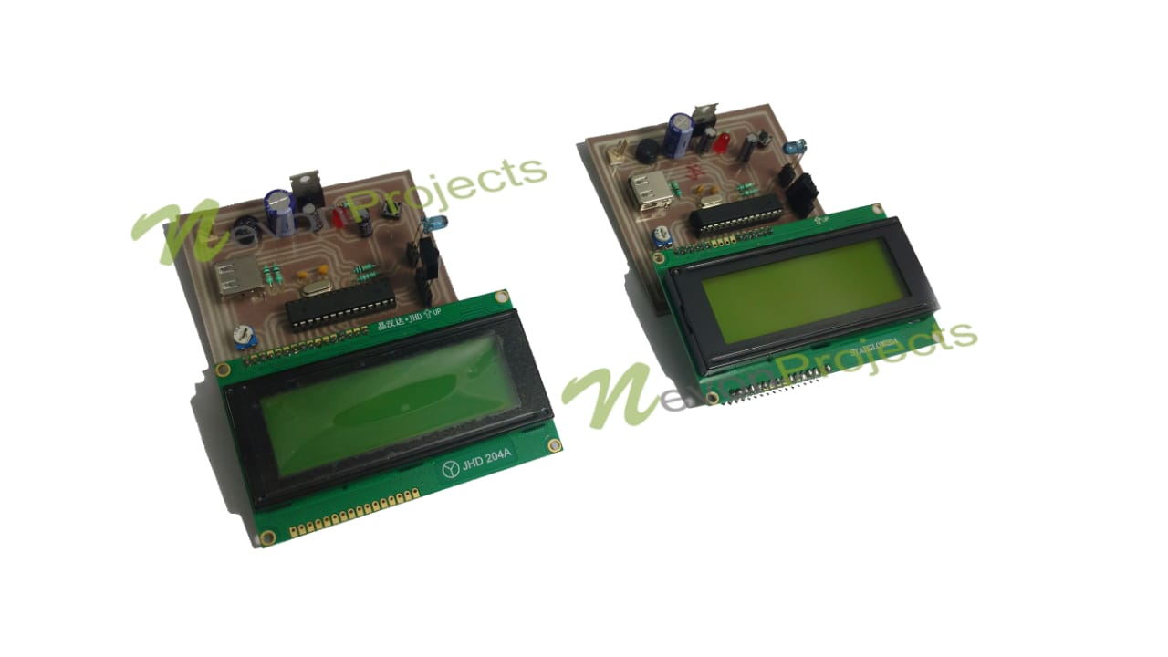
Design Hardware Specifications :-
Arduino Uno
IR LED’s
TSOP1738 IR Receiver
Computer keyboard
LCD’s
Crystal Oscillator
Resistors Capacitors
Transistors
Cables & Connectors
Diodes
PCBLED’s Transformer/Adapter
Push Button

Slide 5
Software Specifications:-
Arduino compiler
MC Programming Language: C

