Slide 1

ROBOT MANIPULATOR
2. ROBOT MANIPULATOR
D E S I G N A N D A P P L I C AT I O N S O F I N D U S T R I A L R O B O T S
S A B A R I G I R I VA S A N . R
I S B N 978-81-908268- 0- 8

Slide 2
Robot Manipulator
Manipulator is also known as robotic arm.
The arm is made up of a finite number of individual rigid segments.
Each rigid segment is called as a Link.
Links are connected to each other by joints.
Links move with respect to its joint.
2

Slide 3
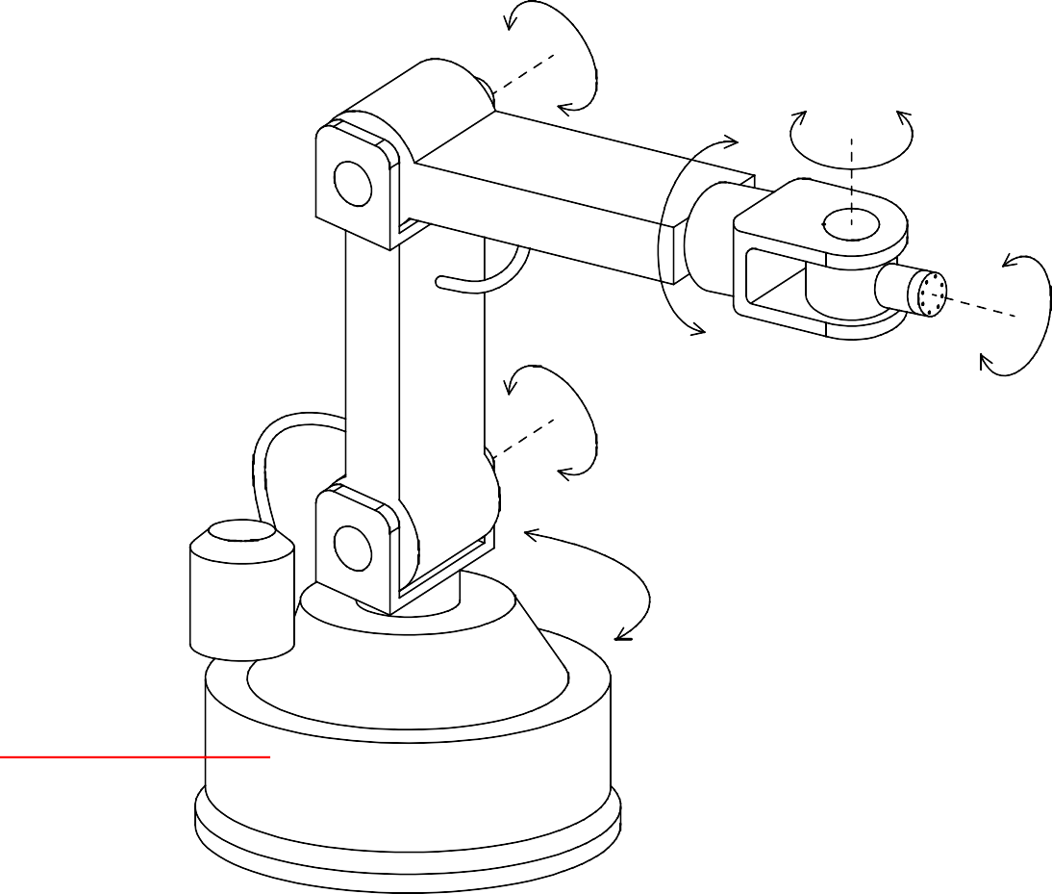
Robotic Arm
Robotic Arm
Upper arm
Joint Link Lower arm
Power cable
Wrist
Motor
Waist Base
Gripper mounting flange
3

Slide 4
Types of Joints
Joints are of two types
Linear joint – links move in linear fashion with respect to its joint when actuated.
Rotary joint – links move in rotary fashion with respect to its joint when actuated.
4

Slide 5



Types of Joints
Types of Joints
Link – 1
Link – 1
Joint
Joint
Link
Link
(a) Rotary joint
(b) Linear joint
5

Slide 6
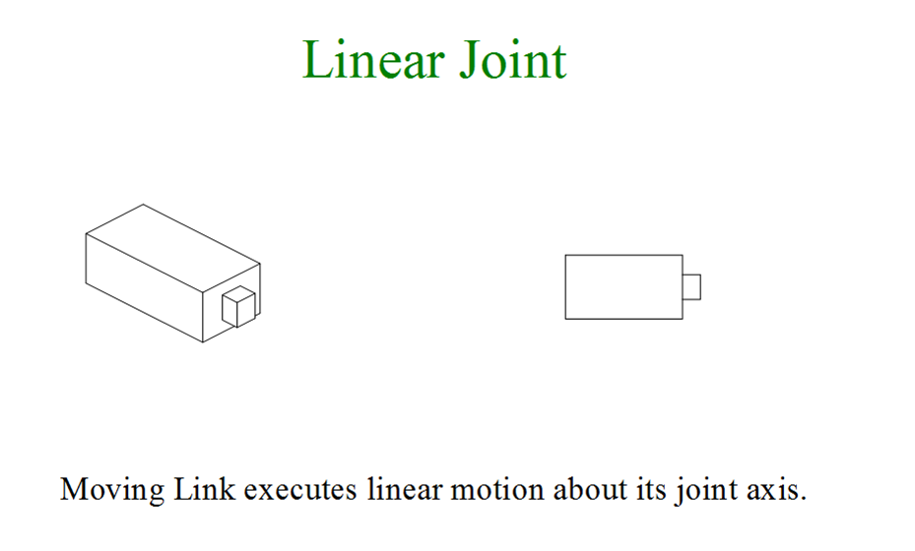
Types of Joints
6

Slide 7
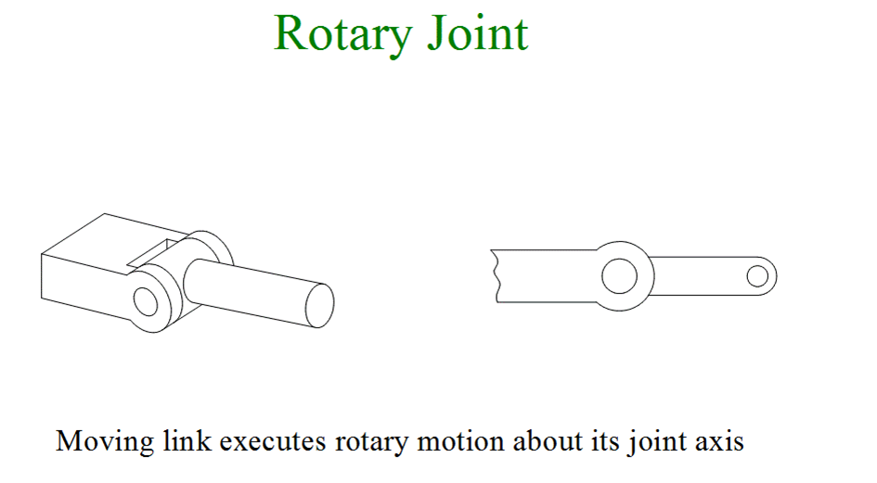
Types of Joints
7

Slide 8
Degrees of Freedom
Degrees of freedom (DOF) is defined as the ability of a joint to produce linear or rotary movement when actuated.
Number of DOF for a robot is equal to the number of joint axes in the robotic arm.
8

Slide 9
Lower Pair Joints
A lower pair joint is the joint in which two contacting surfaces can slide over with one another in rotary or linear manner.
They are of six types
Revolute joint – 1 DOF
Prismatic joint – 1 DOF
Screw joint – 1 DOF
Cylindrical joint – 2 DOF
Planar joint – 3 DOF
Spherical joint – 3 DOF
9

Slide 10










Lower Pair Joints
Lower Pair Joints
(a)
(b)
Revolute joint
Prismatic joint
Screw joint
Cylindrical joint
(c)
(d)

Slide 11


Lower Pair Joints
Lower Pair Joints
(e)
(f)
Planar joint
Spherical joint

Slide 12
Link Parameters
Link length – 𝑎
Twist angle – 𝛼
Joint angle – 𝜃
Link offset – 𝑑

Slide 13
Wrist Motion
Yaw – Rotary motion executed about 𝑧 axis. Causes movement in left and right directions.
Pitch – Rotary motion executed about 𝑦 axis. Causes movement in up and down directions.
Roll – Rotary motion executed about 𝑥
axis.

Slide 14




Wrist Motion
Wrist Motion
Robot wrist
𝑧
Yaw
Pitch
𝑦
𝑥
Roll
14

Slide 15
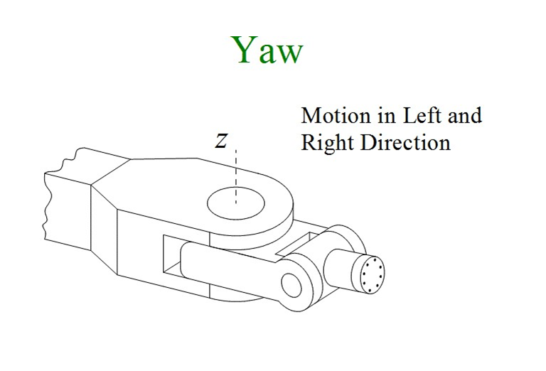
Wrist Motion

Slide 16
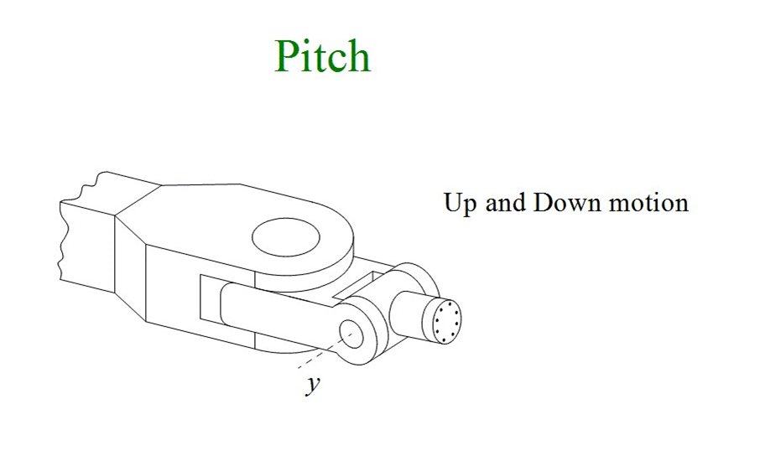
Wrist Motion

Slide 17
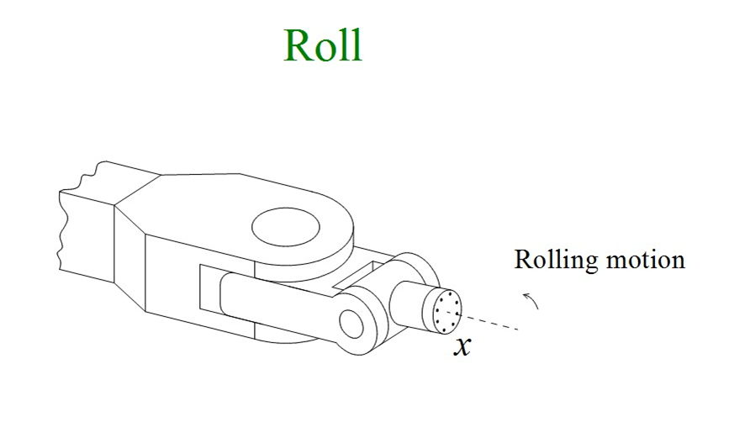
Wrist Motion

Slide 18
Robot’s Work Volume
The three dimensional space around the robot where it can sweep its wrist end within the points of maximum and minimum reach is called as Robot’s work Volume.
Maximum Reach is the point where the wrist end can go as far as possible from its base.
Minimum reach is the point where the wrist end can go as close as possible to its base.
18

Slide 19




Robot Reach
Robot Reach
Work envelope
Robot
Endeffector
Robot base
Maximum reach
Minimum reach
19

Slide 20
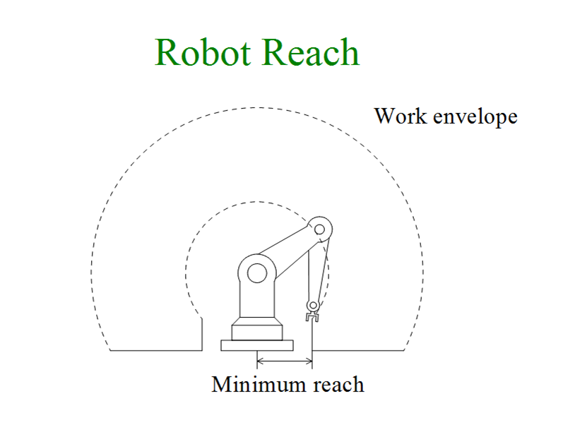
Robot Reach

Slide 21
Classification of Manipulator
Cartesian coordinate robot system
Cylindrical robot system
Polar robot system
Pendulum robot system
Articulated or Jointed arm robot system
Horizontal axis jointed arm
Vertical axis jointed arm
Multiple joint robot system

Slide 22
Cartesian Coordinate Robot System
Cartesian Coordinate Robot System
(a)
(b)
Cartesian coordinate robot system
Gantry style (area gantry)
Rectangular work envelope
(c)
22

Slide 23
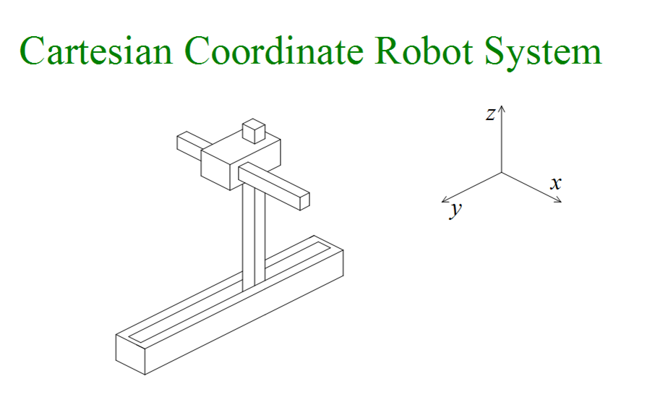
Cartesian Coordinate Robot System

Slide 24
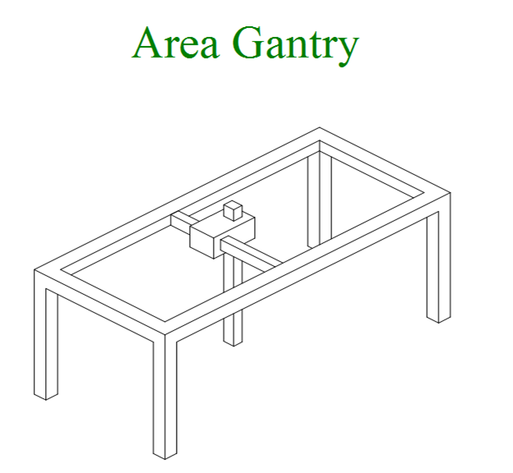
Cartesian Coordinate Robot System

Slide 25


Cylindrical Robot System
Cylindrical Robot System
(a) Cylindrical robot system
(b) Cylindrical work envelope
25

Slide 26
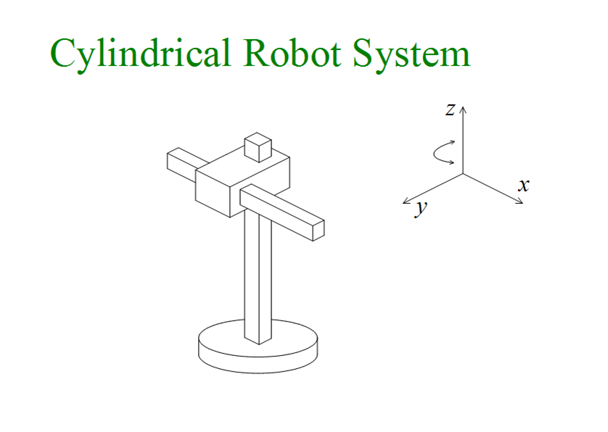
Cylindrical Robot System
26

Slide 27


Polar Robot System
Polar Robot System
(a) Polar robot system
(b) Spherical work envelope
27

Slide 28
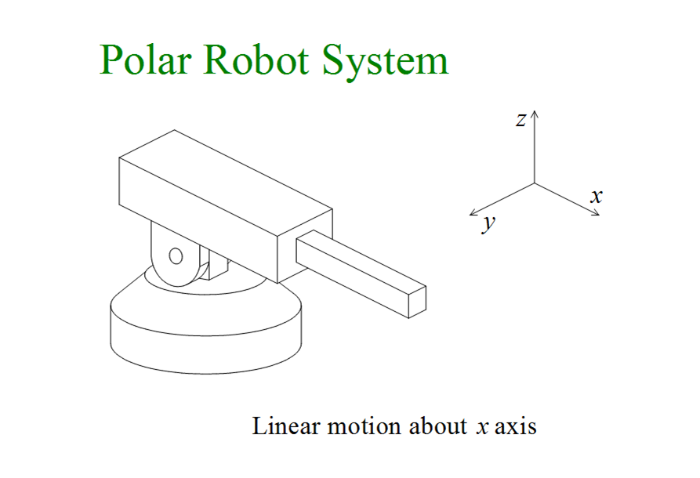
Polar Robot System
28

Slide 29
Pendulum Robot System
Pendulum Robot System
(a) Pendulum robot system
(b) Partially spherical work envelope
D E S I G N A N D A P P L I C A T I O N S O F I N D U S T R I A L R O B O T S S A B A R I G I R I V A S A N . R
29

Slide 30
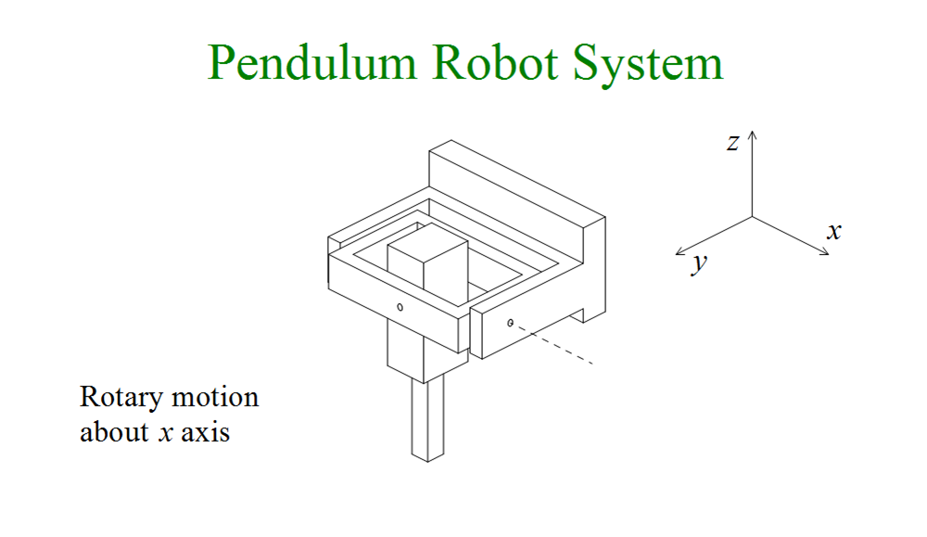
Pendulum Robot System
30

Slide 31











Horizontal Axis Jointed Arm
Horizontal Axis Jointed Arm
(a) Horizontal axis robot system
(b) Spherical work envelope
31

Slide 32
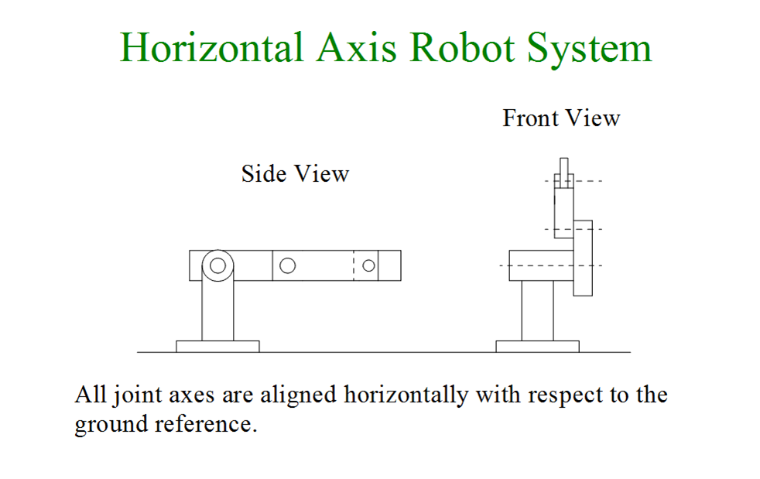
Horizontal Axis Jointed Arm

Slide 33
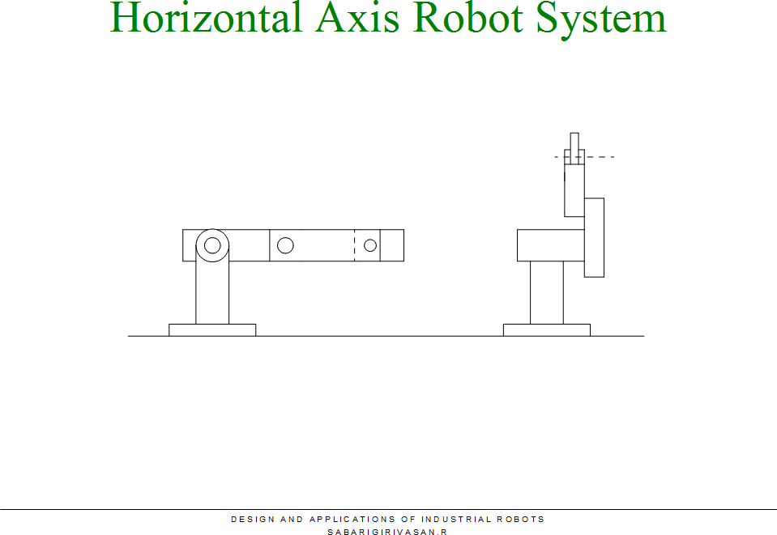
Horizontal Axis Jointed Arm
Animation

Slide 34



Vertical Axis Jointed Arm
Vertical Axis Jointed Arm
(a) Vertical axis robot system
(b) Cylindrical work envelope
34

Slide 35
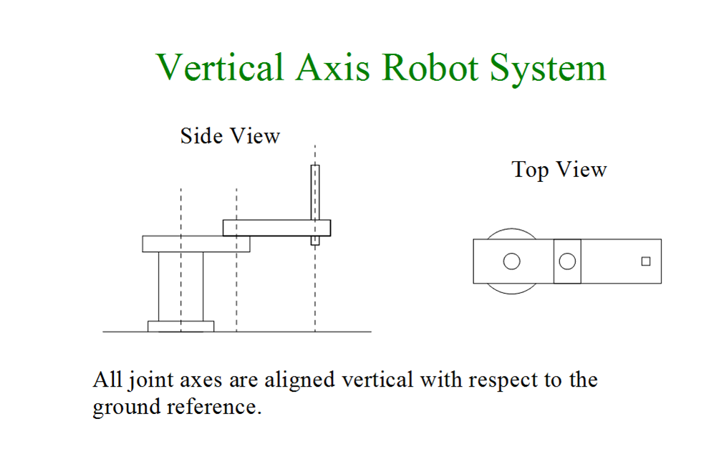
Vertical Axis Jointed Arm

Slide 36
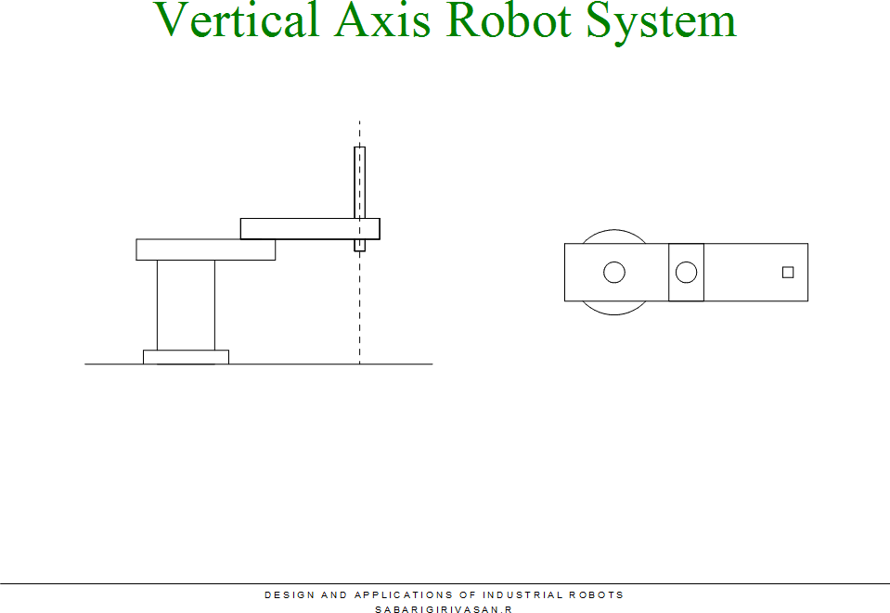
Vertical Axis Jointed Arm
Animation

Slide 37






Multiple Joint Robot System
Multiple Joint Robot System
(a) Spine robot system
(b) Spherical work envelope
37

Slide 38
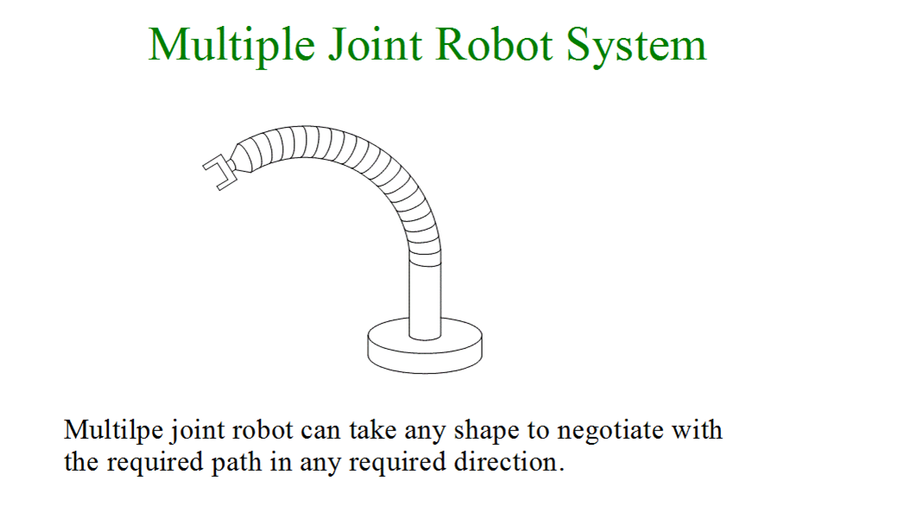
Multiple Joint Robot System

Slide 39
Manipulator Kinematics
Kinematics deals with the study of motion without considering the forces acting on the robot structure.
Forward Kinematics
Required position and orientation is determined from a given set of joint angles.
Inverse Kinematics
Joint angles of all joints in the arm are determined from the given position and orientation.

Slide 40
Homogeneous Transformation
Translation
Translation is the linear displacement made by a point along a straight line about x, y or z axis.
Rotation
Rotation is the angular displacement made by a point about x, y or z axis.

Slide 41
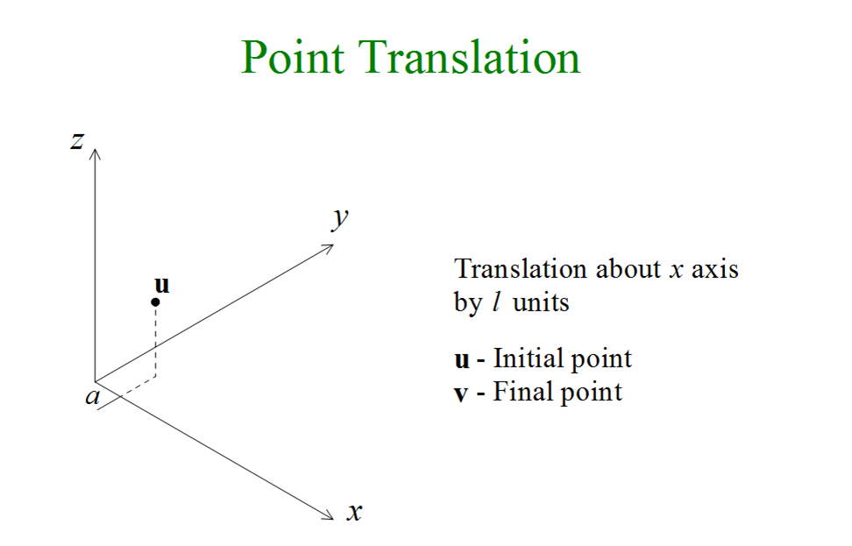

Slide 42
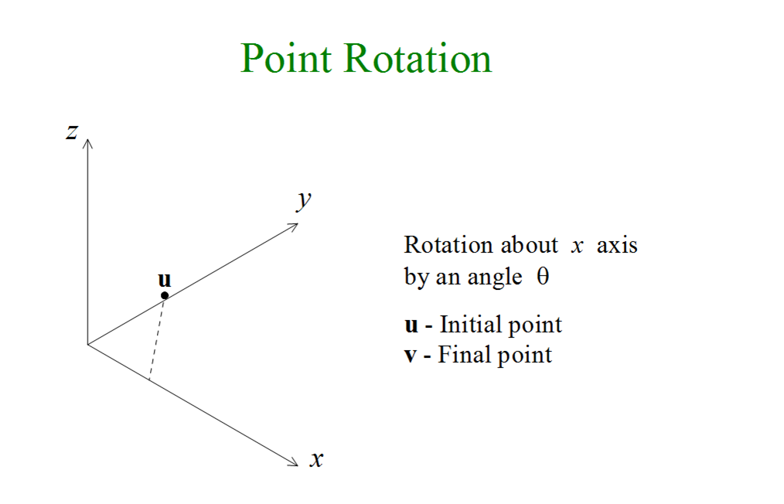

Slide 43
Manipulator Dynamics
Dynamics deals with the study of forces acting on the robot structure while it is in action.
Lagrange – Euler equation is formulated based on the kinetic and potential energies of the system.
Difference between the kinetic and potential energies of the system is known as Lagrangian function.

Slide 44
Disturbances Acting on the Links
Action of gravity
Centripetal forces
Centrifugal forces
Coriolis forces

Slide 45
Robot Motion
Point to point motion – The path has no importance.
Continuous path motion – The path taken is very important.

Slide 46
Trajectories
Path taken by the robot endeffector within the work volume is known as trajectory.
Trajectory planning.
Joint interpolated trajectory planning.
Cartesian path trajectory planning.

Slide 47
End of the Presentation

