Slide 1
Robotics 1
Robot components:
Proprioceptive sensors
1

Slide 2
Properties of measurement systems - 1
accuracy
agreement of measured values with a given reference standard (e.g., ideal characteristics)
repeatability
capability of reproducing as output similar measured values over consecutive measurements of the same constant input quantity
stability
capability of keeping the same measuring characteristics over time/temperature (similar to accuracy, but in the long run)
2

Slide 3








Accuracy and Repeatability
average value
measurements
*
*
***
*
*
*
*
***
*
*
target value (ground truth)
low accuracy low repeatability
low accuracy high repeatability
high accuracy high repeatability
better components!
calibration!
Robotics 1
3

Slide 4
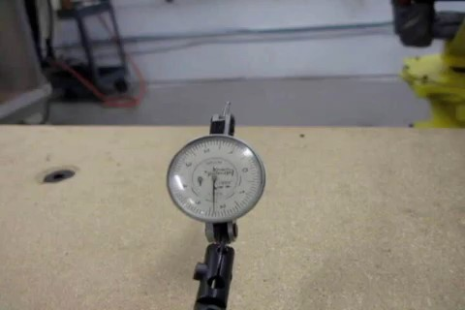
Accuracy and Repeatability
in robotics
accuracy is how close a robot can come to a given point in its workspace
depends on machining accuracy in construction/assembly of the robot, flexibility effects of the links, gear backlash, payload changes, round-off errors in control computations, ...
can be improved by (kinematic) calibration
repeatability is how close a robot can return to a previously taught point
depends only the robot controller/measurement resolution
both may vary in different areas of the robot workspace
standard ISO 9283 defines conditions for assessing robot performance
limited to static situations (recently, interest also in dynamic motion)
robot manufacturers usually provide only data on “repeatability”
video
simple test on repeatability of a Fanuc ArcMate100i robot (1.3 m reach)
4

Slide 5
Properties of measurement systems - 2
linearity error
maximum deviation of the measured output from the straight line that best fits the real characteristics
as % of the output (measurement) range
offset error
value of the measured output for zero input
sometimes not zero after an operation cycle, due to hysteresis
resolution error
maximum variation of the input quantity producing no variation of the measured output
in absolute value or in % of the input range
5

Slide 6

Linearity, Offset, Resolution
Y
Y_{m}
δX = resolution
output range
ΔY Y_{m}
= linearity error
Y₀ = offset
X_{m}
X
input range
Robotics 1
6

Slide 7
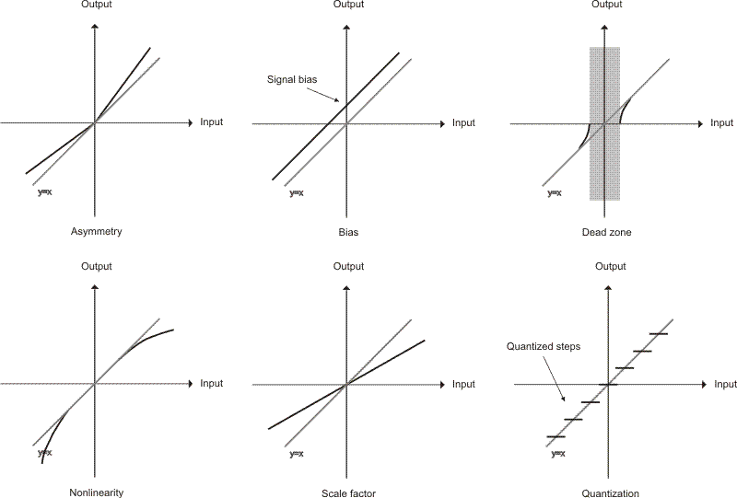
Sensor measurements
some non-idealities
Asymmetry
Bias
Dead zone
Nonlinearity
Scaling factor
Quantization

Slide 8
Classes of sensors for robots
proprioceptive sensors measure the internal state of the robot (position and velocity of joints, but also torque at joints or acceleration of links)
kinematic calibration, identification of dynamic parameters, control
exteroceptive sensors measure/characterize robot interaction with the environment, enhancing its autonomy
(forces/torques, proximity, vision, but also sensors for sound, smoke, humidity, …)
control of interaction with the environment, obstacle avoidance in the workspace, presence of objects to be grasped, …
mobile-base robots: localization in a map, navigation in unknown environments, …

Slide 9


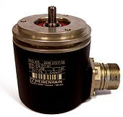
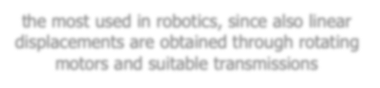

Position sensors
provide an electrical signal proportional to the displacement (linear or angular) of a mechanical part with respect to a reference position
linear displacements: potentiometers, linear variable- differential transformers (LVDT), inductosyns
angular displacements: potentiometers, resolvers, syncros (all analog devices with A/D conversion), optical encoders (digital), Hall sensors, ...
the most used in robotics, since also linear displacements are obtained through rotating motors and suitable transmissions

Slide 10
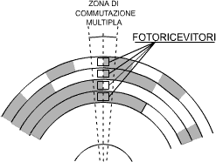
Absolute encoders
Photo-emitter
rotating optical disk, with alternate transparent and opaque sectors on multiple concentric tracks
(infrared) light beams are emitted by leds and sensed by photo-receivers
light pulses are converted into electrical pulses, electronically processed and transmitted in output
Optical disc
Photo-receiver
multiple bit “race” zone
o
N_{t} = # tracks = # bits (min 12 in robotics)
resolution = 360 / 2
N_{t}
Photo-receiver
digital encoding of absolute position
when the optical disk is rotating fast, the use of binary coding may lead to (large) reading errors, in correspondence to multiple transitions of bits

Slide 11
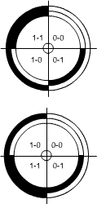
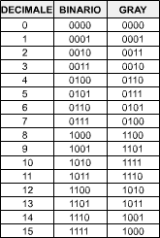


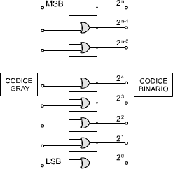




Absolute encoding
binary coding
optical disks with 2 bits
Gray coding
DECIMAL BINARY GRAY
XOR
GRAY CODE
BINARY CODE
8-bit Gray-coded absolute encoder
adjacent codes differ by just one bit

Slide 12
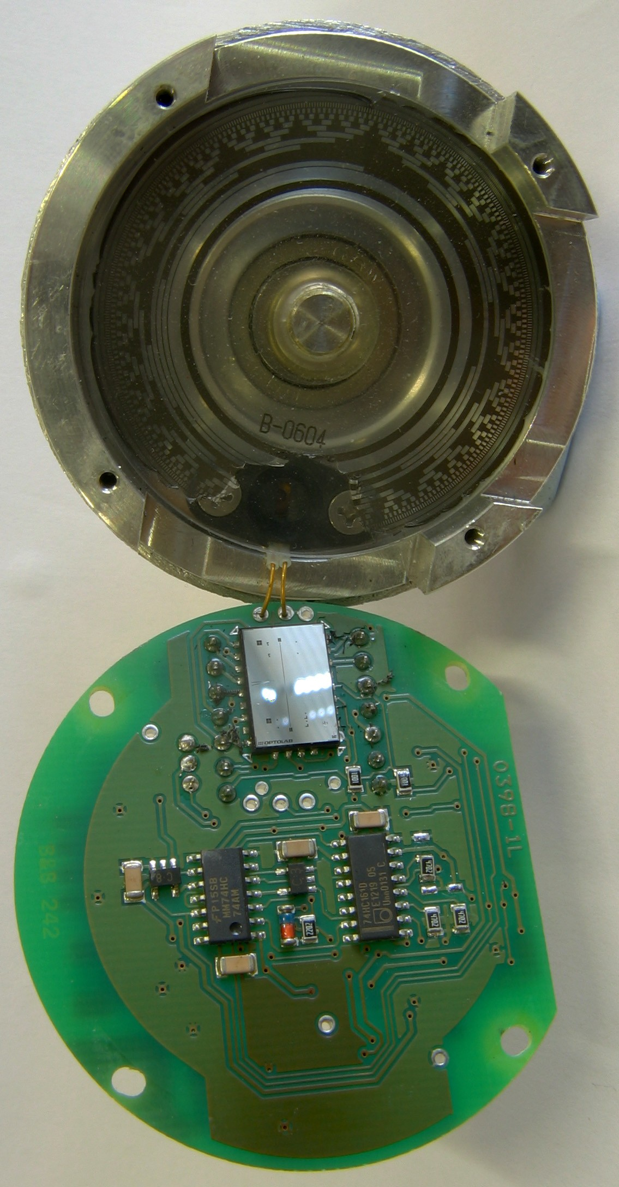
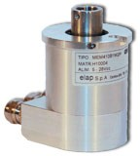
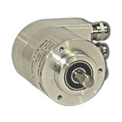
Use of absolute encoders
ready to measure at start (no “homing”)
two modes for permanent operation
when switching off the drive, position parameters are saved on a flash memory (and brakes activated)
battery for the absolute encoder is always active, and measures position even when the drive is off
data memory > 20 years
single-turn or multi-turn versions, e.g.
13-bit single-turn has 2¹³ = 8192 steps per revolution (resolution = 0.044º)
29-bit multi-turn has 8192 steps/revolution
+ counts up to 2¹⁶ = 65536 revolutions
aluminum case with possible interface to field bus systems (e.g., CANopen or PROFIBUS)
typical supply 5/28V DC @1.2 W
hollow shaft
round flange
13-bit absolute encoder opened: Gray-coded disk and electronics

Slide 13
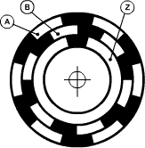
Incremental encoders
Photo-emitter
optical rotating disk with three tracks, alternating
Optical disk
transparent and opaque areas: measures incremental angular displacements by counting trains of N_{e} pulses (“counts”) per turn (N_{e} = 100÷5000)
the two A and B tracks (channels) are in quadrature (phase shift of 90º electrical), allowing to detect the direction of rotation
a third track Z is used to define the “0” reference position, with a reset of the counter (needs “homing” at start)
some encoders provide as output also the three phases needed for the switching circuit of brushless motors
Photo-receiver
The three tracks on an optical disk (here N_{e} = 6)

Slide 14
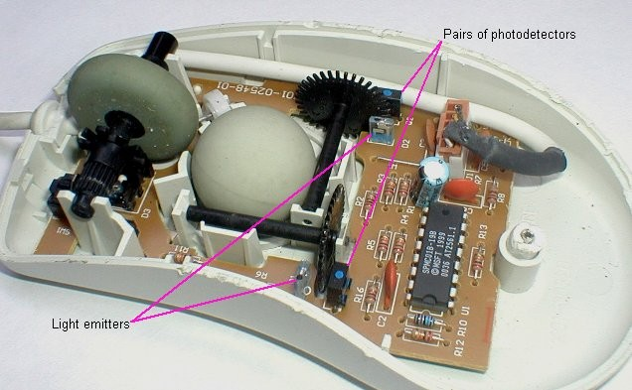
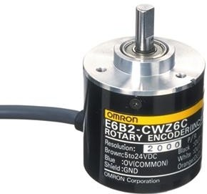
Incremental encoders
two (cheap) incremental encoders inside a mouse
a OMRON incremental encoder with 2000 pulses/turn
diameter ∅ 40 mm mass m ≈ 100 g inertia J = 1⋅10⁻⁶ kg m²

Slide 15
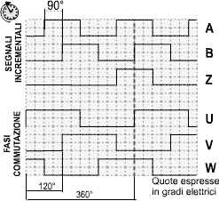







Signal processing
“fractions of a cycle” of each pulse train are measured in “electrical degrees”
1º electrical = 1º mechanical/N_{e} 360º mechanical = 1 turn
signals are fed in a digital counter, with a D-type flip-flop to sense direction + reset
to improve resolution (4×), the leading and trailing edges of signals A and B are used
the sequence of pulses C will clock now the counter (increments or decrements)
C
signals on channels
commutation phases for AC motors
electrical degrees
Ch A Ch B
time delay
Δ ≈ 45° electrical
CCW/CW
Ch B
D Q
cl
0 = CCW
1 = CW
Ch B
D Q
cl
U/D
cl reset
Ch A
Ch A
⇒
n bits
C
Ch Z
R
a
C
a

Slide 16
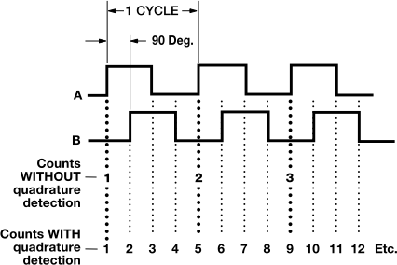
Count multiplication
example of quadrature detection
an incremental encoder with N_{e} = 2000 (electrical) cycles provides a count of N = 8000 pulses/turn after electronic multiplication
its final resolution is (mechanical) 360º/8000 = .045º (= 0º 2’ 42’’)
needs a 13-bit counter to cover a full turn without reset (2¹³ = 8192)

Slide 17
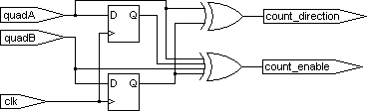
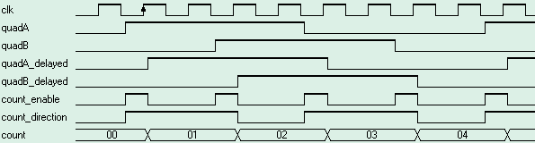
Quadrature detection in incremental encoders
a more complete implementation
D (delay) flip-flops
NOTE: since in practice A and B signals may
not be synchronous to the clock signal, two extra D flip-flops per input should be used
to avoid meta-stable states in the counters
XOR gates
90° electrical
it is assumed that an oversampling clock "clk” (e.g., as provided by a FPGA) is available, which is faster than the two quadrature signals A and B
the digital count output will have a resolution multiplied by 4

Slide 18

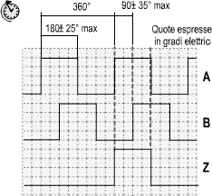

Accuracy in incremental encoders
...apart from quantization errors
electrical degrees
division error: maximum displacement between two consecutive leading/trailing edges, typically within max
± 25º electrical
the phase shift of the two channels, nominally equal to 90º electrical, is typically within max ± 35º electrical (quadrature error)

Slide 19
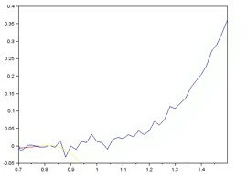

Indirect measure of velocity
numerical differentiation of digital measures of position
to be realized on line with Backward Differentiation Formulas (BDFs)
convolution filtering is needed because of noise and position quantization
use of non-causal filters (e.g., Savitzky-Golay) helps, but introduces delays
Kalman filter for on line state estimation (optimal, assuming Gaussian noise)
𝑞
1
1-step BDF (Euler): 𝑞̇ = 𝑞̇ 𝑘𝑇 = 𝑞 − 𝑞
directly from incremental encoder
⟺ 𝑞̇ =
01
2
⟸
' ' '-.
'
1 25
4-step BDF: 𝑞̇ = 𝑞
𝑇
3
' '
− 4𝑞
+ 3𝑞 − ⁴ 𝑞 + ¹ 𝑞
'-. '-: '-; '-<
𝑇 12 3 4
problems of peaks at low speed
𝑞
̇ 𝑞̇&
animation of Savitzky-Golay filter with cubic polynomials
Robotics 1
19

Slide 20

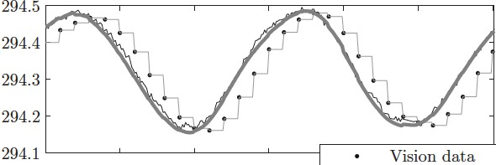
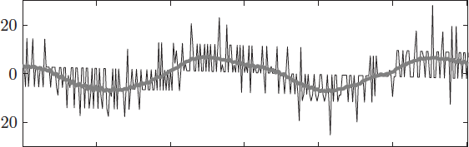
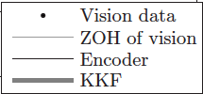
Kinematic Kalman Filter
for velocity estimation
motion and sensing discrete-time model for estimation
= sampling time
zero mean Gaussian noises with (co)variances (a matrix) and
actual state
unmeasured velocity
noisy position measure (encoder output)
of the model state
using the optimal Kalman gain
design a (linear) Kalman filter providing an estimate
(a priori) prediction correction (based on the measured output)
position measure and its filtered version numerical velocity and its filtered estimate
[mm]
[mm/s]

Slide 21





Velocity sensor: Tachometer
always mounted on the (electrical) motor axis
principle of operation (single coil)
θ
V
ω
ω
N
S
Σ
B = cost
permanent magnet
coil with area Σ
magnetic field:
flux through the coil is Φ(B) = |B|Σ cos θ = |B|Σ cos ωt
V = - dΦ/dt = |B|Σ ω sin ωt
⇒ to reduce ripples, use m coils rotated regularly by 180º/m
amplitude V μ ω

Slide 22
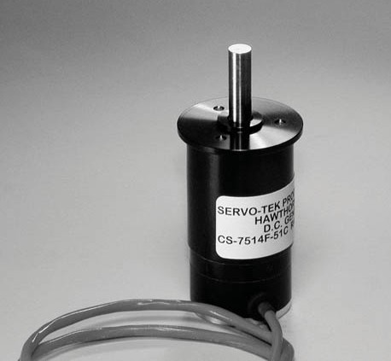
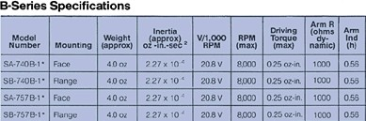
DC tachometer
an example
Servo-Tek Tach Generator (B series)
bi-directional
output voltage 11÷24 V @1000 RPM
low ripple: < 3% peak-to-peak of DC value (with 72 KHz filter)
weight = 113 g, diameter = 2.9 cm
linearity error < 0.1% (at any speed)
stability 0.1% (w.r.t. temperature)
Robotics 1
1.75 mNm (as a load)
22

Slide 23
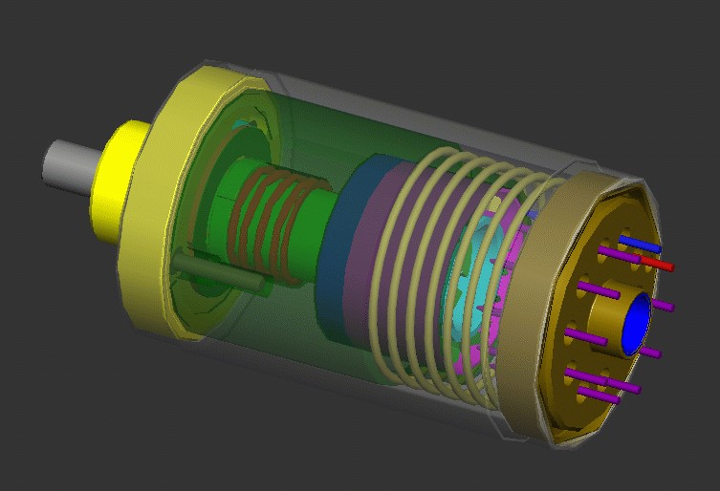
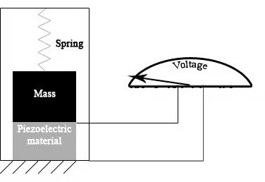
Accelerometers
measure of linear acceleration based on inertial forces (no “touch”)
units: [m/s²] or gravitational acceleration [g] (non-SI unit: 1g ≈ 9.81 m/s²)
different principles for converting mechanical motion in an electrical signal
piezoelectric: piezoceramics (PZT) or crystals (quartz), better linearity & stability, wide dynamic range up to high frequencies, no moving parts, no power needed
piezoresistive: for high-shocks, measures also static acceleration (g₀), needs supply
capacitive: silicon micro-machined sensing element, superior in static to low frequency range, can be operated in servo mode, cheap but limited resolution
modern solution: small MEMS (Micro Electro-Mechanical Systems)
multiple applications: from vibration analysis to long range navigation
animation of measurement principle in a piezoelectric accelerometer

Slide 24
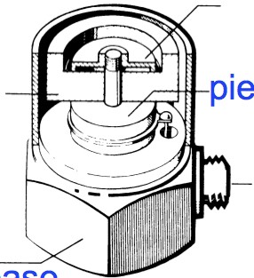








Operation principle
seismic accelerometer
accelerometer
spring
case
seismic mass
piezoelectric element
𝑑:𝑧
measure
𝑎 = _{𝑑𝑡:}
sensor
𝑎
>
output
seismic mass
𝛿
base
© Brüel & Kjaer
surface of moving (or vibrating) body
accelerometer plate
𝐴>(𝑠) _{= 𝐾}
𝑀
𝑀𝑎 = 𝑀𝛿̈ + 𝐷𝛿̇ + 𝐾𝛿
𝑎> = 𝐾_{D} 𝛿
by Laplace
transform
𝐴(𝑠)
^{D} 𝑀𝑠: + 𝐷𝑠 + 𝐾
L_{M}
=
N^{O}P R⁄S NP L⁄S

Slide 25
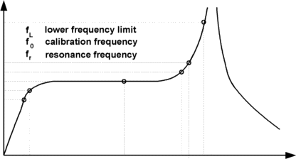

Frequency characteristics
of a piezoelectric accelerometer
_{𝐹 𝑠 =} U_{V}(N) ₌
L_{M}
N^{O}P R⁄S NP L⁄S
𝜔 =
𝐾_{Y}
𝜁 = ^{𝐷}
1_{Y}
U(N)
X
𝑀
2
𝐾𝑀
resonance frequency
damping factor
𝐹(𝑗𝜔)
model valid above this
frequency
1.1
0 dB = 1
- 3 db = 0.7071
^{ω}low
low frequency limit
of piezoelectric use (≤ 1 Hz)
B_{u}
ω_{r}
^{B}-3
bandwidth
useful bandwidth 𝐵] ≈ 0.3𝜔_{X}
for 10% error

Slide 26
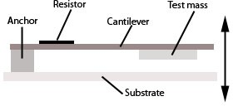
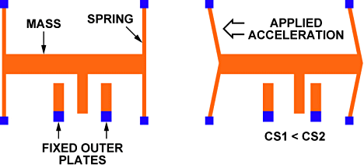
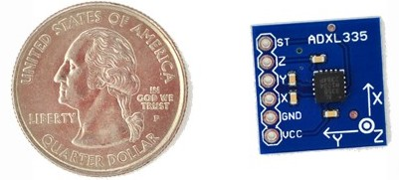
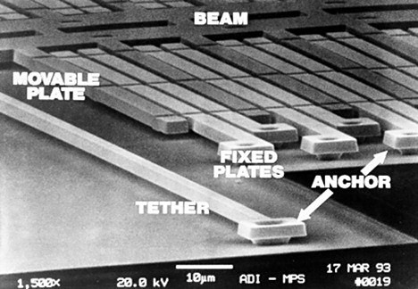
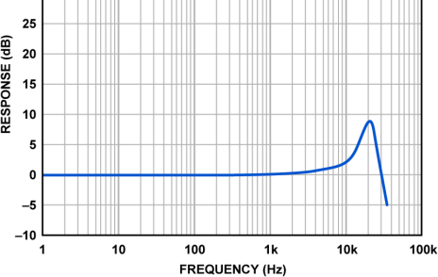
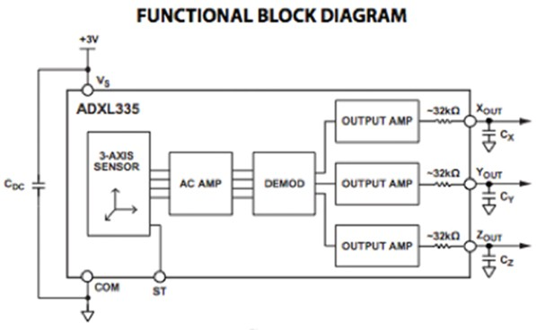
MEMS accelerometers
very simple MEMS (a cantilever beam with a test mass, with damping from the residual gas sealed in the device), single- or tri-axial, very small and light
cross-couplings among acceleration sensing directions should be limited ≤ 3%
ADXL335 3-axis, small, low power, ±3g, with signal conditioned voltage outputs

Slide 27
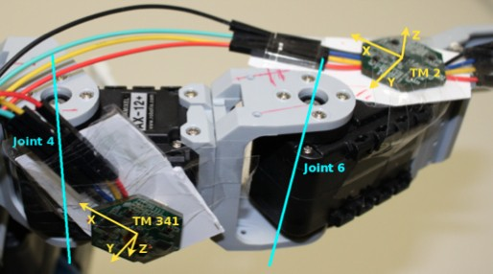
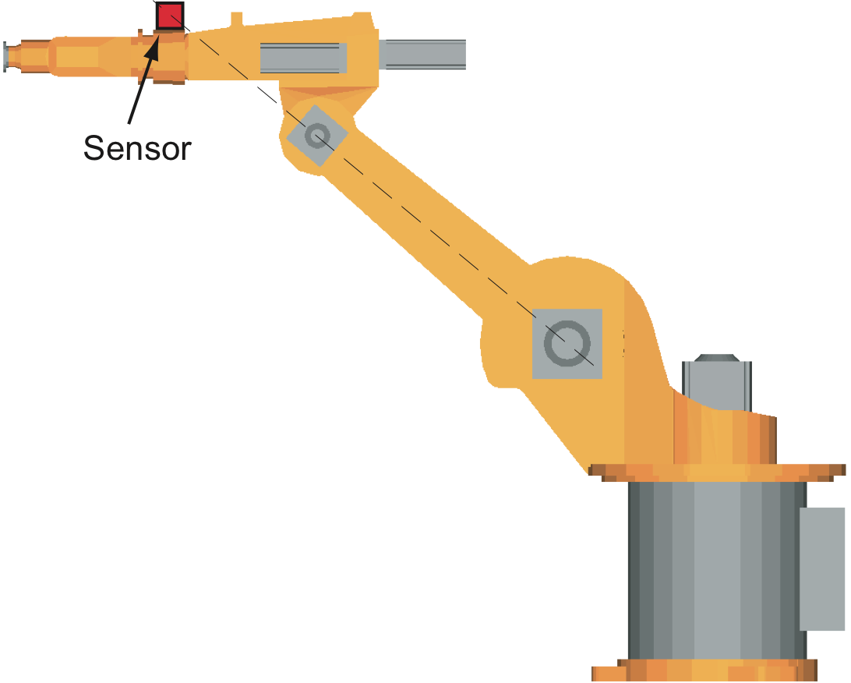
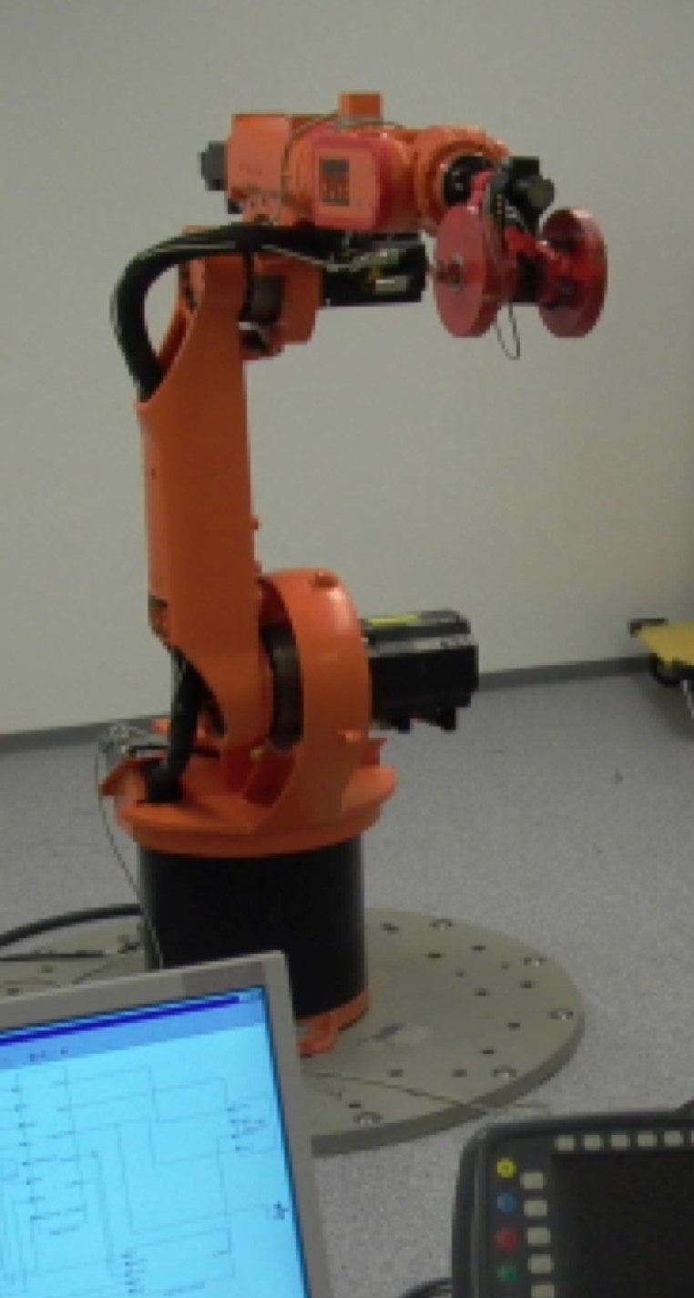
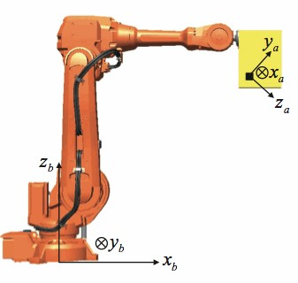
Mounting accelerometers on robots
Bosch BMA 150 3-axial accelerometers integrated in two larger Tactile Modules on the links of a Bioloid humanoid left arm [TUM, 2011]
3-axial MEMS accelerometer on the forearm
of a KUKA KR15/2
[DLR/Sapienza, 2007]
3-axial capacitive accelerometer on end-effector tool of an ABB robot (Crossbow Technology: 2g range,
1V/g output, 0-50 Hz, ±2° align error) [Linköping, 2012]

