Slide 1
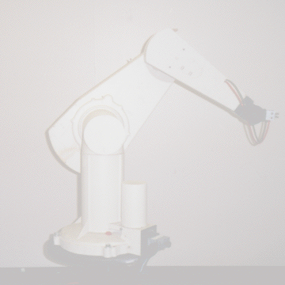
An Introduction to Robot Kinematics

Slide 2
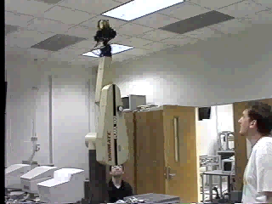
Kinematics studies the motion of bodies

Slide 3
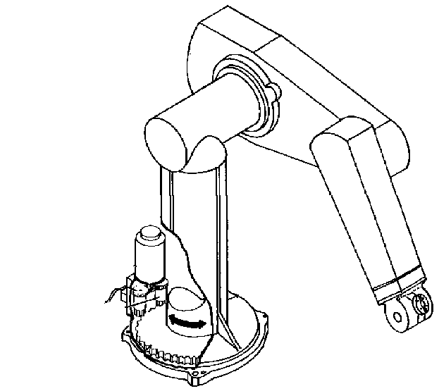
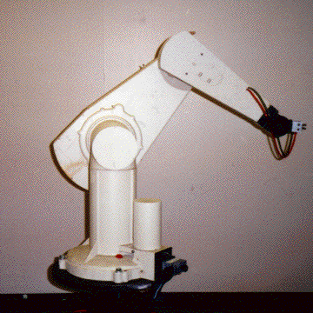
An Example - The PUMA 560
2
3
4
1
There are two more joints on the end effector (the gripper)
The PUMA 560 has SIX revolute joints
A revolute joint has ONE degree of freedom ( 1 DOF) that is defined by its angle

Slide 4
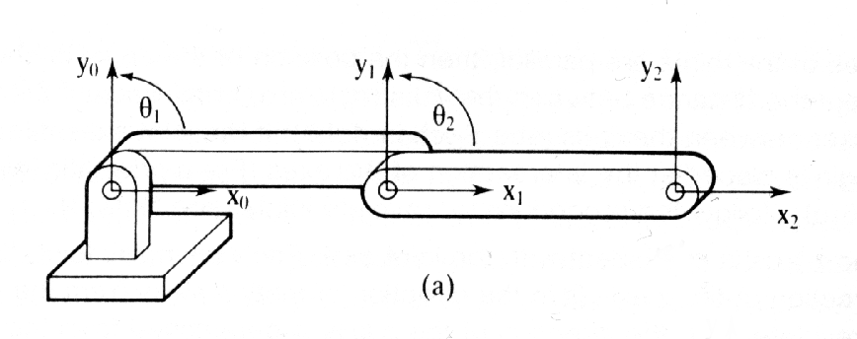
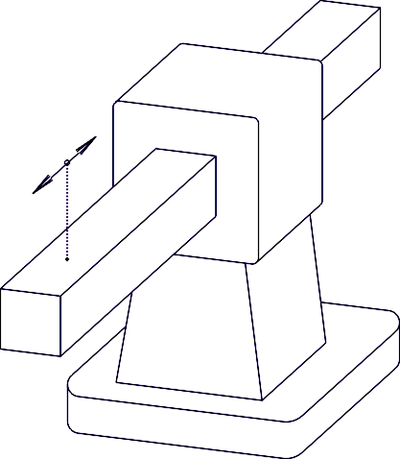
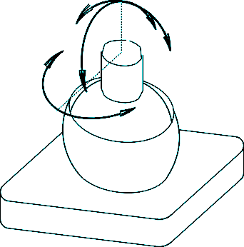
Other basic joints
Revolute Joint
1 DOF ( Variable - )
Prismatic Joint
1 DOF (linear) (Variables - d)
Spherical Joint
3 DOF ( Variables - ₁, ₂, ₃)

Slide 5
We are interested in two kinematics topics
Forward Kinematics (angles to position)
What you are given: The length of each link
The angle of each joint
What you can find: The position of any point
(i.e. it’s (x, y, z) coordinates
Inverse Kinematics (position to angles)
What you are given: The length of each link
The position of some point on the robot
What you can find: The angles of each joint needed to obtain
that position

Slide 6






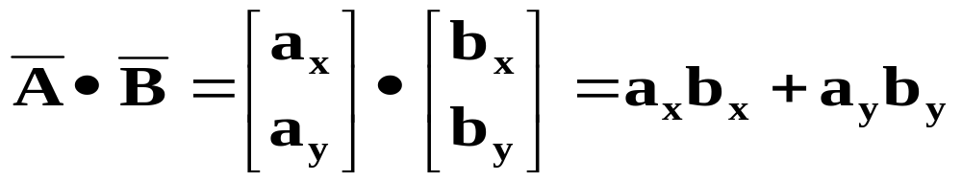
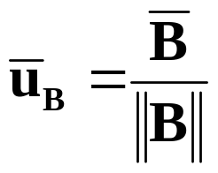

Quick Math Review
Dot Product:
Geometric Representation:
Matrix Representation:
Unit Vector
Vector in the direction of a chosen vector but whose magnitude is 1.

Slide 7
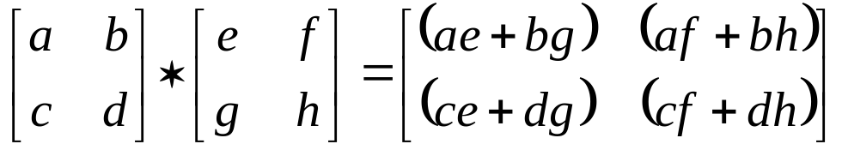
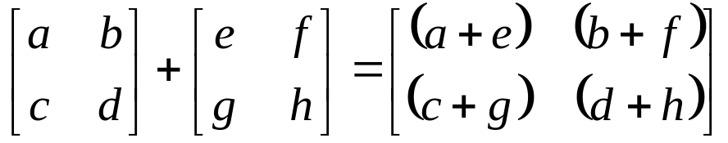
Quick Matrix Review
Matrix Multiplication:
An (m x n) matrix A and an (n x p) matrix B, can be multiplied since the number of columns of A is equal to the number of rows of B.
Non-Commutative Multiplication
AB is NOT equal to BA
Matrix Addition:

Slide 8
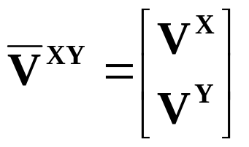
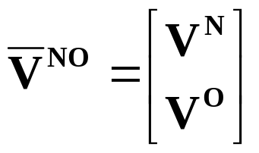
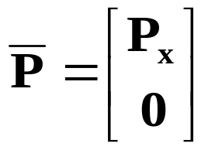
Basic Transformations
Moving Between Coordinate Frames
Translation Along the X-Axis
Y
O
(V^{N},V^{O})
V^{XY}
V^{NO}
V^{O}
P
N
X
V^{N}
P_{x}
P_{x} = distance between the XY and NO coordinate planes
Notation:

Slide 9


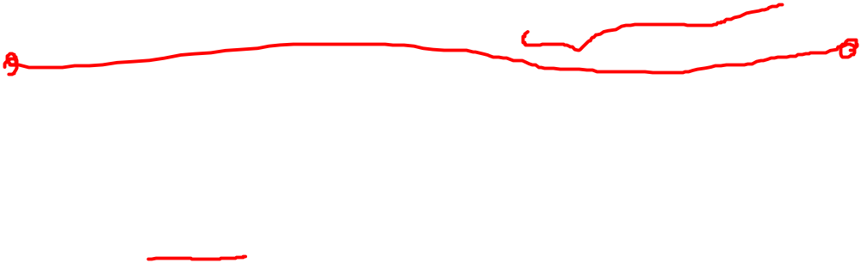
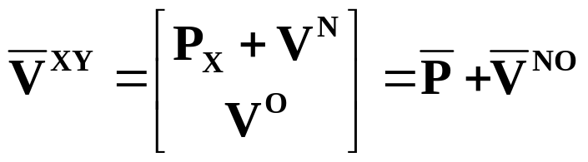
Writing in terms of
Y
O
V^{XY}
V^{NO}
V^{O}
P

X
V^{N}
N

Slide 10
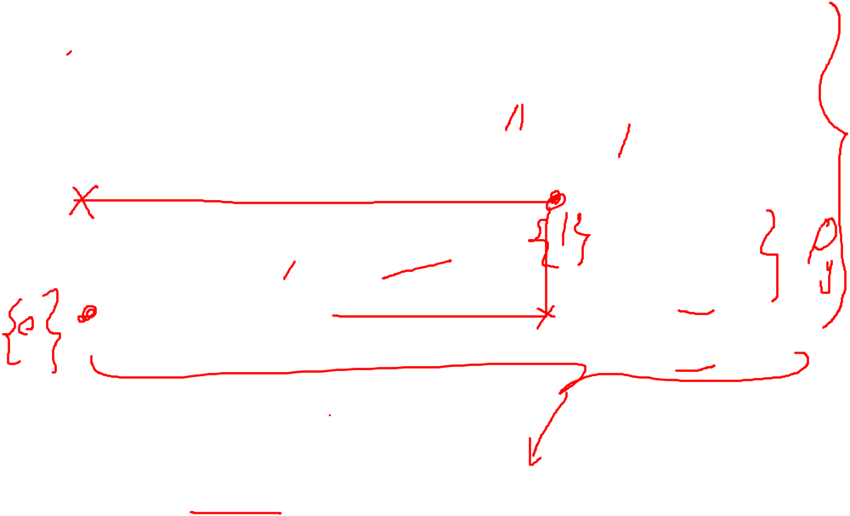
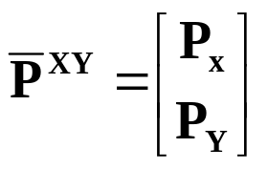
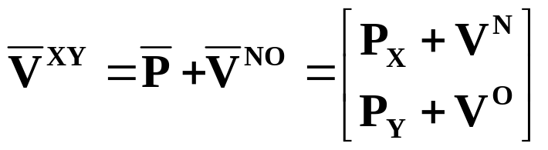
O
Translation along the X-Axis and Y-Axis
Y
V^{NO}
V^{O}
V^{XY}
N
V^{N}
P^{XY}
X

Slide 11
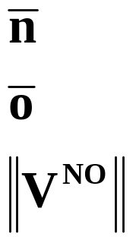



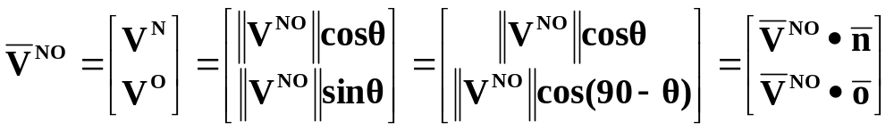
Using Basis Vectors
Basis vectors are unit vectors that point along a coordinate axis
O
Unit vector along the N-Axis
Unit vector along the N-Axis
V^{NO}
V^{O}
Magnitude of the V^{NO} vector
V^{N}
N

Slide 12
Y
Rotation (around the Z-Axis)
Z
X
Y
O
V^{O}
V
N
V^{Y}
V^{N}

X
V^{X}
 = Angle of rotation between the XY and NO coordinate axis

Slide 13





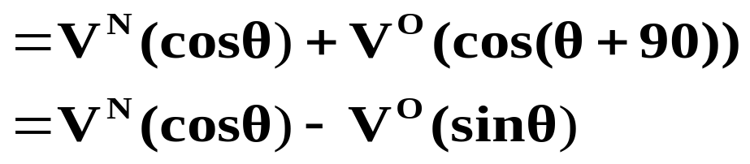
Y
Unit vector along X-Axis
O
Can be considered with respect to
the XY coordinates or NO coordinates
V
V^{O}
N
V^{Y}

V^{N}

V^{X}
X
(Substituting for V^{NO} using the N and O components of the vector)

Slide 14


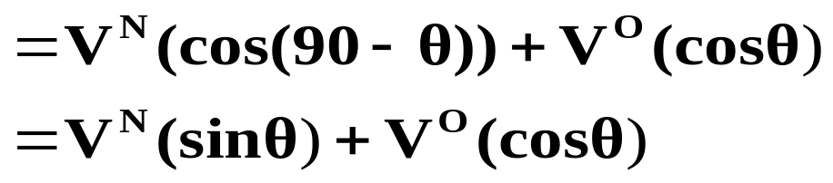


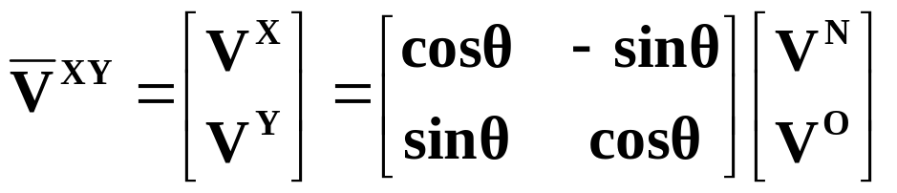
Similarly….
So….
Written in Matrix Form
Rotation Matrix about the z-axis

Slide 15
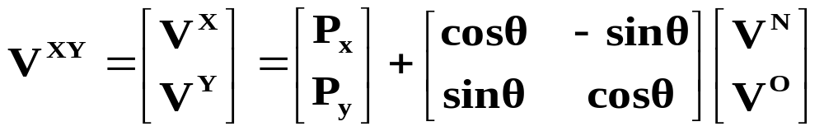
Y¹
O
(V^{N},V^{O})
Y⁰
V^{NO}
N
V^{XY}

P
X¹
Translation along P followed by rotation by θ
X⁰
(Note : P_{x}, P_{y} are relative to the original coordinate frame. Translation followed by rotation is different than rotation followed by translation.)
In other words, knowing the coordinates of a point (V^{N},V^{O}) in some coordinate
frame (NO) you can find the position of that point relative to your original
coordinate frame (X⁰Y⁰).

Slide 16
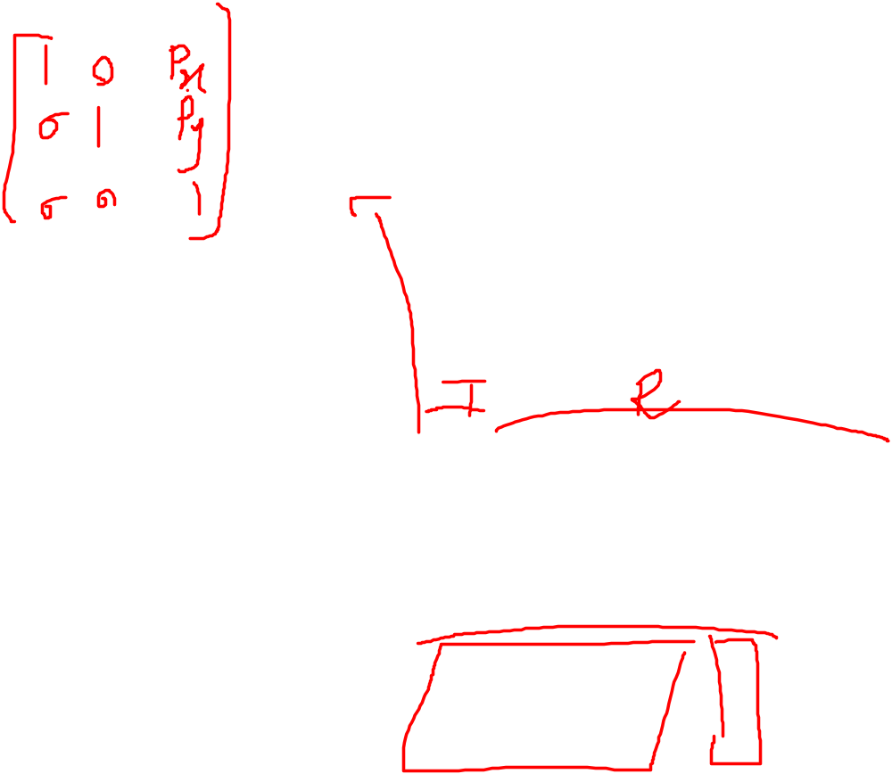
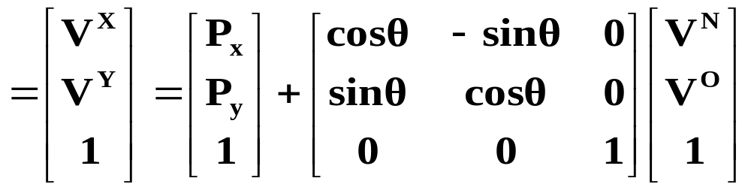
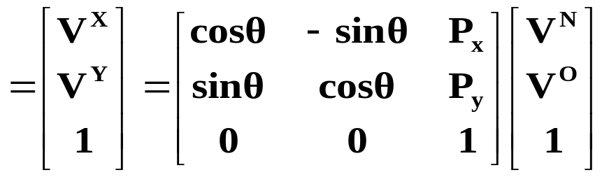
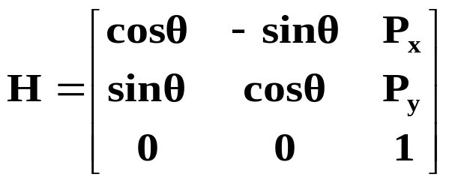
HOMOGENEOUS REPRESENTATION
Putting it all into a Matrix
What we found by doing a translation and a rotation
Padding with 0’s and 1’s
Simplifying into a matrix form
Homogenous Matrix for a Translation in XY plane, followed by a Rotation around the z-axis

Slide 17

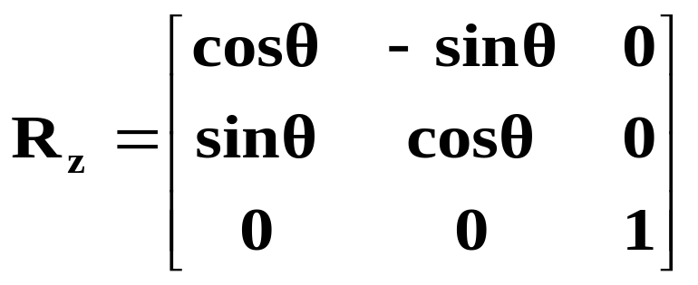
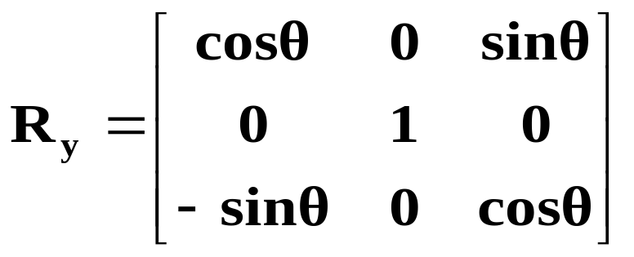
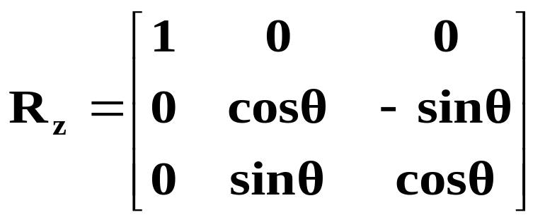
Rotation Matrices in 3D – OK,lets return from homogenous repn
Rotation around the Z-Axis
Rotation around the Y-Axis
Rotation around the X-Axis

Slide 18
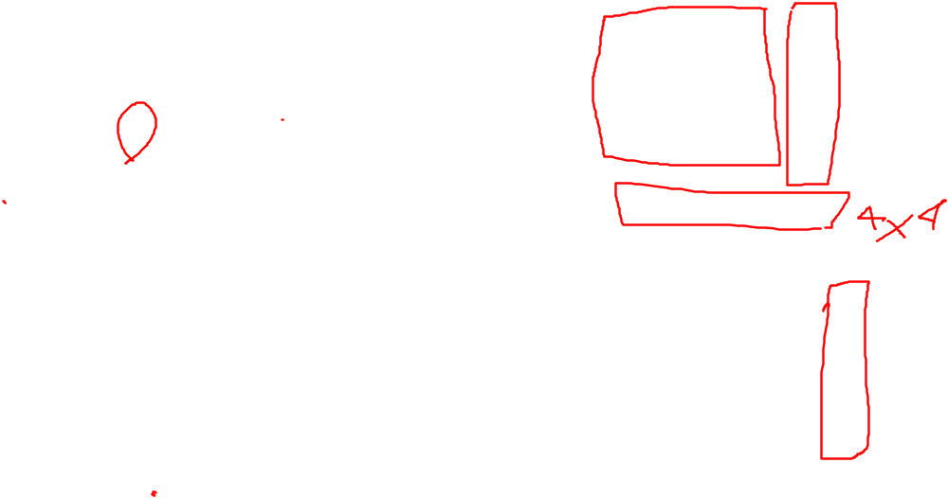
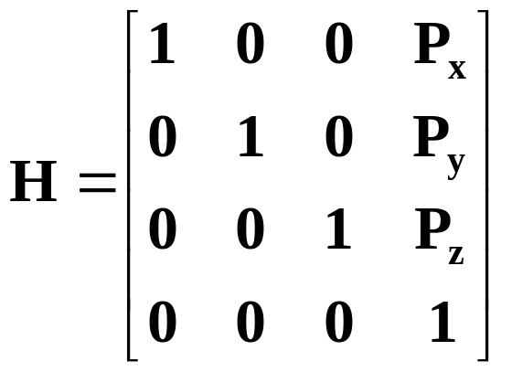
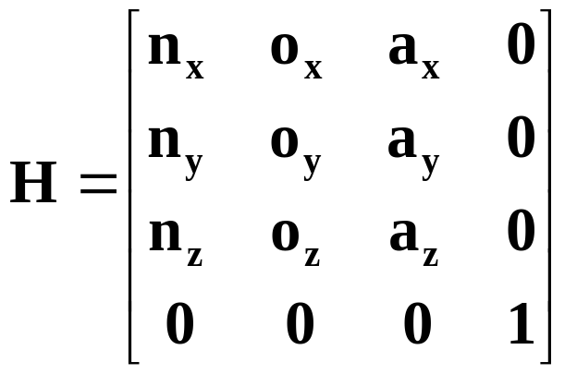
Homogeneous Matrices in 3D
H is a 4x4 matrix that can describe a translation, rotation, or both in one matrix
O
Y
N
P
X
A
Translation without rotation
Z
Y
O
N
X
Rotation part:
Could be rotation around z-axis, x-axis, y-axis or a combination of the three.
Z
Rotation without translation
A

Slide 19
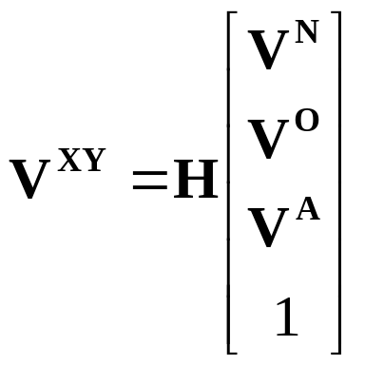
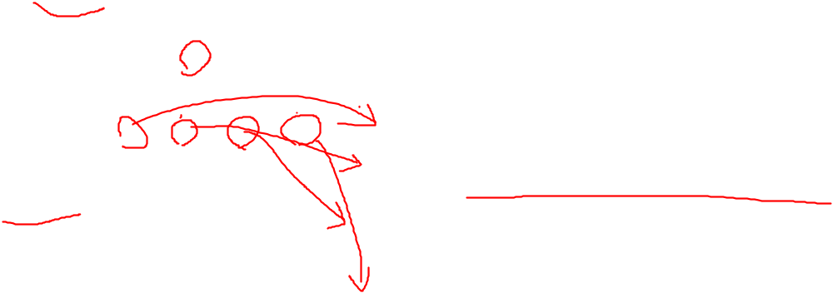
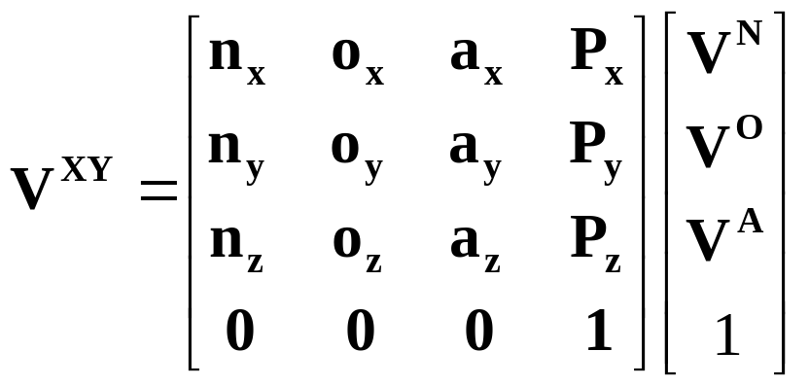

Homogeneous Continued….
The (n,o,a) position of a point relative to the current coordinate frame you are in.
The rotation and translation part can be combined into a single homogeneous matrix IF and ONLY IF both are relative to the same coordinate frame.

Slide 20
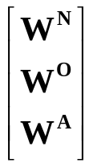

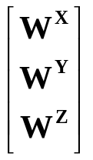
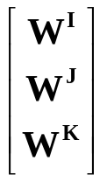
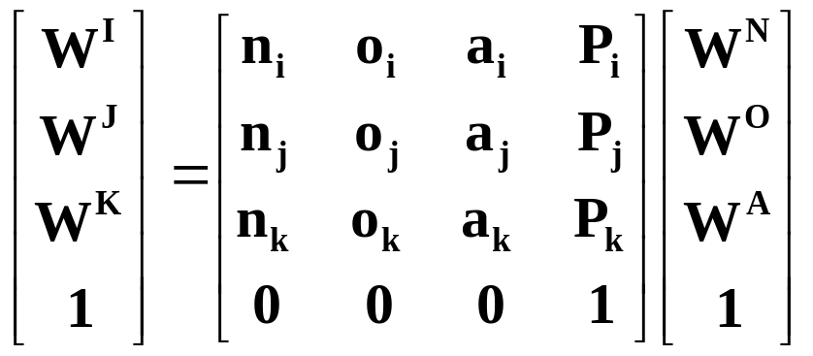
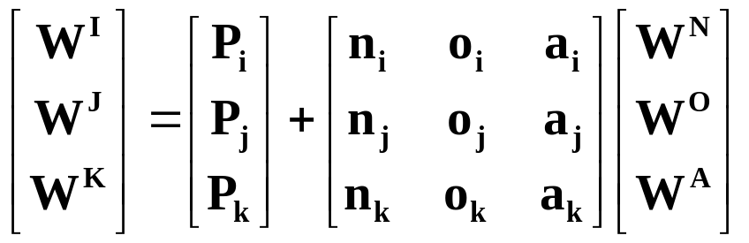
Finding the Homogeneous Matrix
EX.
J
Y
N
I
T
P
X
K
A
O
Z
Point relative to the
X-Y-Z frame
Point relative to the
I-J-K frame
Point relative to the
N-O-A frame

Slide 21
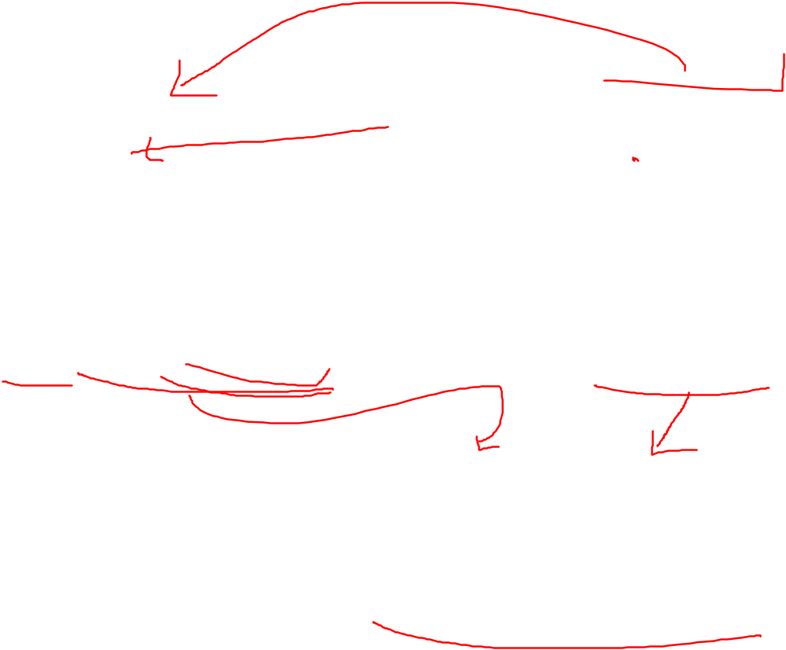
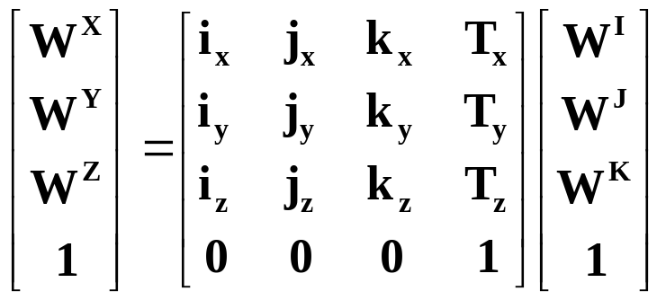
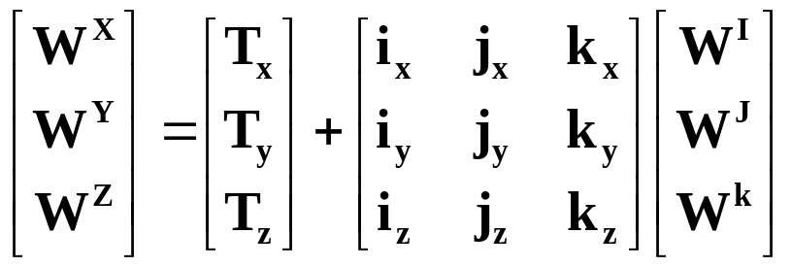
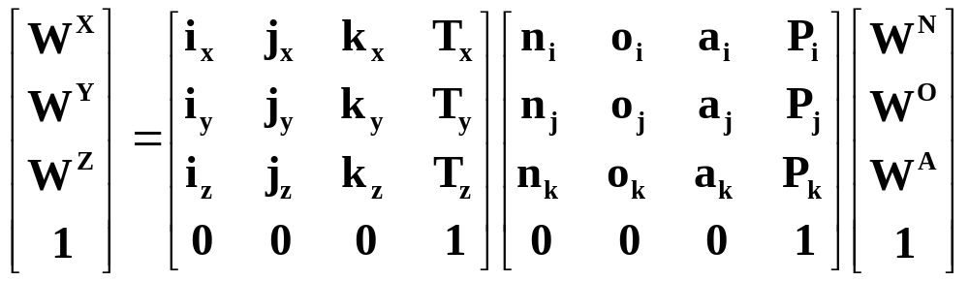
J
Y
I
N
T
X
P
K
A
O
Z
Substituting for

Slide 22
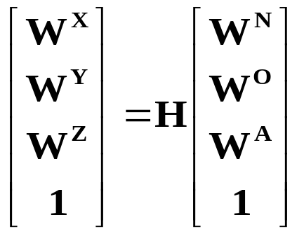
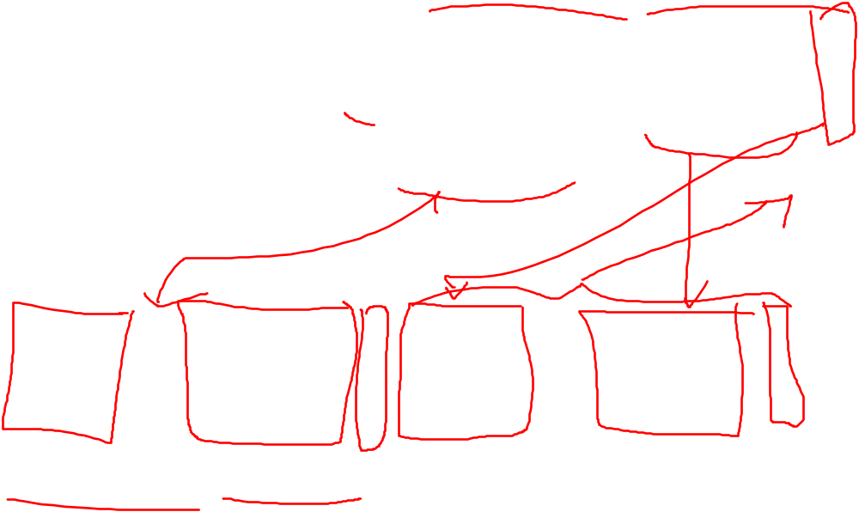
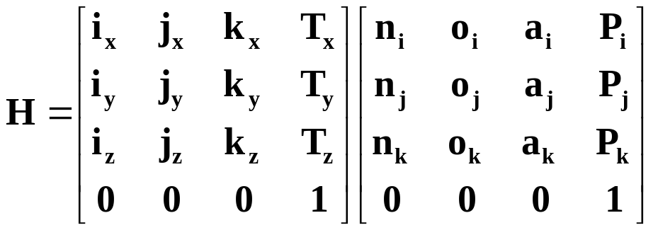

Product of the two matrices
Notice that H can also be written as:
H = (Translation relative to the XYZ frame) * (Rotation relative to the XYZ frame)
* (Translation relative to the IJK frame) * (Rotation relative to the IJK frame)

Slide 23
The Homogeneous Matrix is a concatenation of numerous translations and rotations
J
I
Y
N
T
X
P
K
A
O
Z
One more variation on finding H:
H = (Rotate so that the X-axis is aligned with T)
* ( Translate along the new t-axis by || T || (magnitude of T))
* ( Rotate so that the t-axis is aligned with P)
* ( Translate along the p-axis by || P || )
* ( Rotate so that the p-axis is aligned with the O-axis)
This method might seem a bit confusing, but it’s actually an easier way to solve our problem given the information we have. Here is an example…

Slide 24
F o r w a r d K i n e m a t i c s

Slide 25


The Situation:
You have a robotic arm that starts out aligned with the x_{o}-axis.
You tell the first link to move by ₁ and the second link to move by ₂.
The Quest:
What is the position of the end of the robotic arm?
Solution:
1. Geometric Approach
This might be the easiest solution for the simple situation. However, notice that the angles are measured relative to the direction of the previous link. (The first link is the exception. The angle is measured relative to it’s initial position.) For robots with more links and whose arm extends into 3 dimensions the geometry gets much more tedious.
2. Algebraic Approach
Involves coordinate transformations.

Slide 26

Example Problem:
You are have a three link arm that starts out aligned in the x-axis. Each link has lengths l₁, l₂, l₃, respectively. You tell the first one to move by ₁ , and so on as the diagram suggests. Find the Homogeneous matrix to get the position of the yellow dot in the X⁰Y⁰ frame.
Y³
₃
Y²
2
X³
3
₂
X²
H = R_{z}(₁ ) * T_{x1}(l₁) * R_{z}(₂ ) * T_{x2}(l₂) * R_{z}(₃ )
i.e. Rotating by ₁ will put you in the X¹Y¹ frame.
Translate in the along the X¹ axis by l₁.
Rotating by ₂ will put you in the X²Y² frame.
and so on until you are in the X³Y³ frame.
The position of the yellow dot relative to the X³Y³ frame is
(l₁, 0). Multiplying H by that position vector will give you the
coordinates of the yellow point relative the the X⁰Y⁰ frame.
Y⁰
1
X¹
Y¹
₁
X⁰

Slide 27


Slight variation on the last solution:
Make the yellow dot the origin of a new coordinate X⁴Y⁴ frame
Y³
₃
Y⁴
Y²
2
X³
3
₂
X²
X⁴
H = R_{z}(₁ ) * T_{x1}(l₁) * R_{z}(₂ ) * T_{x2}(l₂) * R_{z}(₃ ) * T_{x3}(l₃)
This takes you from the X⁰Y⁰ frame to the X⁴Y⁴ frame.
The position of the yellow dot relative to the X⁴Y⁴ frame is (0,0).
Y⁰
1
X¹
Y¹
₁
X⁰
Notice that multiplying by the (0,0,0,1) vector will equal the last column of the H matrix.

Slide 28
More on Forward Kinematics…
Denavit - Hartenberg Parameters

Slide 29


Denavit-Hartenberg Notation
Z_{(i - 1)}
Y_{(i -1)}
Y _{i}
Z _{i}
X _{i}
a _{i}
a_{(i - 1 )}
d _{i}
X_{(i -1)}
 _{i}
_{( i - 1)}
IDEA: Each joint is assigned a coordinate frame. Using the Denavit-Hartenberg notation, you need 4 parameters to describe how a frame (i) relates to a previous frame ( i -1 ).
THE PARAMETERS/VARIABLES: , a , d, 

Slide 30

The Parameters
You can align the two axis just using the 4 parameters
Z_{(i - 1)}
Y_{(i -1)}
Y _{i}
Z _{i}
X _{i}
a _{i}
a_{(i - 1 )}
d _{i}
X_{(i -1)}
 _{i}
_{( i - 1)}
1) a_{(i-1)}
Technical Definition: a_{(i-1)} is the length of the perpendicular between the joint axes. The joint axes is the axes around which revolution takes place which are the Z_{(i-1)} and Z_{(i)} axes. These two axes can be viewed as lines in space. The common perpendicular is the shortest line between the two axis-lines and is perpendicular to both axis-lines.

Slide 31

a_{(i-1) cont...}
Visual Approach - “A way to visualize the link parameter a_{(i-1)} is to imagine an expanding cylinder whose axis is the Z_{(i-1)} axis - when the cylinder just touches the joint axis i the radius of the cylinder is equal to a_{(i-1).}” (Manipulator Kinematics)
It’s Usually on the Diagram Approach - If the diagram already specifies the various coordinate frames, then the common perpendicular is usually the X_{(i-1)} axis. So a_{(i-1)} is just the displacement along the X_{(i-1)} to move from the (i-1) frame to the i frame.
If the link is prismatic, then a_{(i-1)}
is a variable, not a parameter.
Z_{(i - 1)}
Y_{(i -1)}
Y _{i}
Z _{i}
X _{i}
a _{i}
a_{(i - 1 )}
d _{i}
X_{(i -1)}
 _{i}
_{( i - 1)}

Slide 32

2) _{(i-1)}
Technical Definition: Amount of rotation around the common perpendicular so that the joint axes are parallel.
i.e. How much you have to rotate around the X_{(i-1)} axis so that the Z_{(i-1)} is pointing in the same direction as the Z_{i} axis. Positive rotation follows the right hand rule.
3) d_{(i-1)}
Technical Definition: The displacement
along the Z_{i} axis needed to align the a_{(i-1)}
common perpendicular to the a_{i} common
perpendicular.
In other words, displacement along the
Z_{i} to align the X_{(i-1)} and X_{i} axes.
4) _{i}
Amount of rotation around the Z_{i} axis needed to align the X_{(i-1)} axis with the X_{i} axis.
Z_{(i - 1)}
Y_{(i -1)}
Y _{i}
Z _{i}
X _{i}
a _{i}
a_{(i - 1 )}
d _{i}
X_{(i -1)}
 _{i}
_{( i - 1)}

Slide 33

The Denavit-Hartenberg Matrix
Just like the Homogeneous Matrix, the Denavit-Hartenberg Matrix is a transformation matrix from one coordinate frame to the next. Using a series of D-H Matrix multiplications and the D-H Parameter table, the final result is a transformation matrix from some frame to your initial frame.
Put the transformation here
Z_{(i - 1)}
Y_{(i -1)}
Y _{i}
Z _{i}
a_{(i - 1 )}
X _{i}
a _{i}
X_{(i -1)}
d _{i}
_{( i - 1)}
 _{i}

Slide 34

3 Revolute Joints
Y₂
Z₂
Z₀
Z₁
X₂
d₂
X₀
X₁
Y₀
Y₁
Denavit-Hartenberg Link Parameter Table
a₀
a₁
Notice that the table has two uses:
1) To describe the robot with its variables and parameters.
2) To describe some state of the robot by having a numerical values for the variables.

Slide 35



Y₂
Z₂
Z₀
Z₁
X₂
d₂
X₀
X₁
Y₀
Y₁
a₀
a₁
Note: T is the D-H matrix with (i-1) = 0 and i = 1.

Slide 36



This is just a rotation around the Z₀ axis
This is a translation by a₁ and then d₂ followed by a rotation around the X₂ and Z₂ axis
This is a translation by a₀ followed by a rotation around the Z₁ axis

Slide 37
I n v e r s e K i n e m a t i c s
From Position to Angles

Slide 38



A Simple Example
Revolute and Prismatic Joints Combined
Finding :
More Specifically:
(x , y)
arctan2() specifies that it’s in the first quadrant
Y
S
₁
Finding S:
X

Slide 39

Inverse Kinematics of a Two Link Manipulator
(x , y)
Given: l₁, l₂ , x , y
Find: ₁, ₂
Redundancy:
A unique solution to this problem does not exist. Notice, that using the “givens” two solutions are possible.
Sometimes no solution is possible.
₂
l₂
l₁
₁
l₂
(x , y)
l₂
l₁
l₁

Slide 40




The Geometric Solution
(x , y)
Using the Law of Cosines:
l₂
₂
l₁
α
₁
Using the Law of Cosines:
Redundant since θ₂ could be in the first or fourth quadrant.
Redundancy caused since θ₂ has two possible values

Slide 41



The Algebraic Solution
l₂
(x , y)

₂
l₁
₁
Only Unknown

Slide 42



We know what θ₂ is from the previous slide. We need to solve for θ₁ . Now we have two equations and two unknowns (sin θ₁ and cos θ₁ )
Substituting for c₁ and simplifying many times
Notice this is the law of cosines and can be replaced by x²+ y²

