Slide 1
Transfer function, Poles and Zeros

Slide 2
Transfer Function
Transfer Function is the ratio of Laplace transform of the output to the Laplace transform of the input.
Where is the Laplace operator.
Plant
u(t)
y(t)

Slide 3
Transfer Function
Then the transfer function G(S) of the plant is given as
G(S)
U(S)
Y(S)

Slide 4
Why Laplace Transform?
By use of Laplace transform we can convert many common functions into algebraic function of complex variable s.
For example
Or
Where s is a complex variable (complex frequency) and is given as

Slide 5
Laplace Transform of Derivatives
Not only common function can be converted into simple algebraic expressions but calculus operations can also be converted into algebraic expressions.
For example

Slide 6
Laplace Transform of Derivatives
In general
Where is the initial condition of the system.

Slide 7
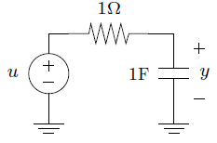
Example: RC Circuit
If the capacitor is not already charged then y(0)=0.
u is the input voltage applied at t=0
y is the capacitor voltage

Slide 8
Laplace Transform of Integrals
The time domain integral becomes division by s in frequency domain.

Slide 9
Calculation of the Transfer Function
Consider the following ODE where y(t) is input of the system and x(t) is the output.
or
Taking the Laplace transform on either sides

Slide 10
Calculation of the Transfer Function
Considering Initial conditions to zero in order to find the transfer function of the system
Rearranging the above equation

Slide 11

Example
Find out the transfer function of the RC network shown in figure-1. Assume that the capacitor is not initially charged.
Figure-1
2. u(t) and y(t) are the input and output respectively of a system defined by following ODE. Determine the Transfer Function. Assume there is no any energy stored in the system.

Slide 12
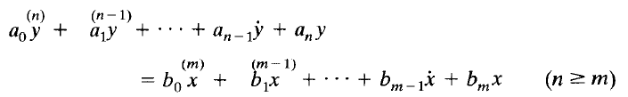
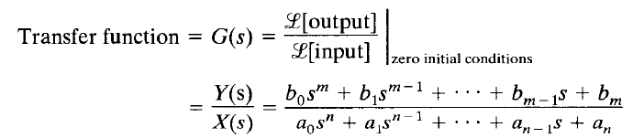
Transfer Function
In general
Where x is the input of the system and y is the output of the system.

Slide 13
Transfer Function
When order of the denominator polynomial is greater than the numerator polynomial the transfer function is said to be ‘proper’.
Otherwise ‘improper’

Slide 14
Transfer Function
Transfer function helps us to check
The stability of the system
Time domain and frequency domain characteristics of the system
Response of the system for any given input

Slide 15
Stability of Control System
There are several meanings of stability, in general there are two kinds of stability definitions in control system study.
Absolute Stability
Relative Stability

Slide 16
Stability of Control System
Roots of denominator polynomial of a transfer function are called ‘poles’.
And the roots of numerator polynomials of a transfer function are called ‘zeros’.

Slide 17
Stability of Control System
Poles of the system are represented by ‘x’ and zeros of the system are represented by ‘o’.
System order is always equal to number of poles of the transfer function.
Following transfer function represents n^{th} order plant.

Slide 18
Stability of Control System
Poles is also defined as “it is the frequency at which system becomes infinite”. Hence the name pole where field is infinite.
And zero is the frequency at which system becomes 0.

Slide 19
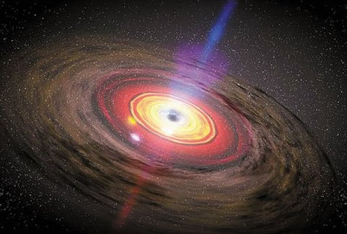
Stability of Control System
Poles is also defined as “it is the frequency at which system becomes infinite”.
Like a magnetic pole or black hole.

Slide 20
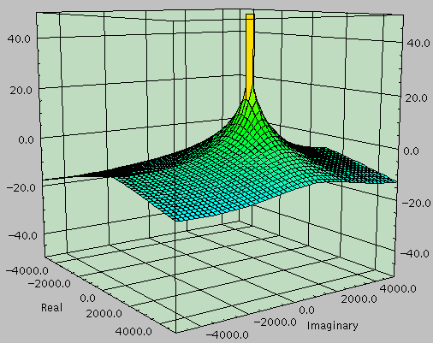
Relation b/w poles and zeros and frequency response of the system
The relationship between poles and zeros and the frequency response of a system comes alive with this 3D pole-zero plot.
Single pole system

Slide 21
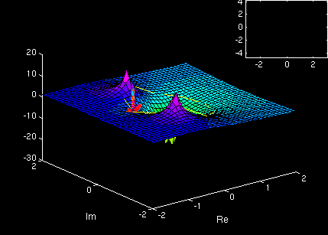
Relation b/w poles and zeros and frequency response of the system
3D pole-zero plot
System has 1 ‘zero’ and 2 ‘poles’.

Slide 22
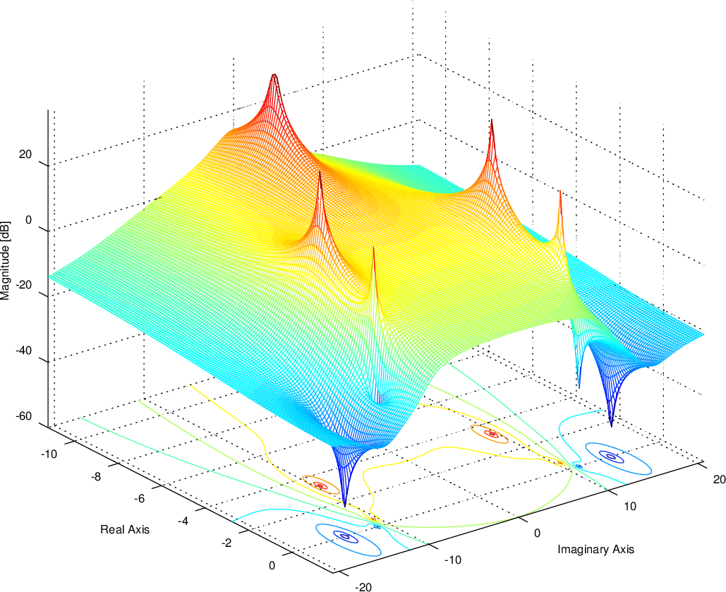
Relation b/w poles and zeros and frequency response of the system

Slide 23
Example
Consider the Transfer function calculated in previous slides.
The only pole of the system is

Slide 24
Examples
Consider the following transfer functions.
Determine
Whether the transfer function is proper or improper
Poles of the system
zeros of the system
Order of the system
i)
ii)
iii)
iv)

Slide 25
Stability of Control Systems
The poles and zeros of the system are plotted in s-plane to check the stability of the system.
LHP
RHP
s-plane

Slide 26
Stability of Control Systems
If all the poles of the system lie in left half plane the system is said to be Stable.
If any of the poles lie in right half plane the system is said to be unstable.
If pole(s) lie on imaginary axis the system is said to be marginally stable.
LHP
RHP
If all the poles
s-plane

Slide 27
Stability of Control Systems
For example
Then the only pole of the system lie at
LHP
RHP
X
-3
s-plane

Slide 28
Examples
Consider the following transfer functions.
Determine whether the transfer function is proper or improper
Calculate the Poles and zeros of the system
Determine the order of the system
Draw the pole-zero map
Determine the Stability of the system
i)
ii)
iii)
iv)

