Slide 1




Feedback Control Systems Performance and Characteristics

Slide 2
outline
Response of Second Order Systems.
2

Slide 3
Table 3.1 Summary of response of a LTI first order system
input:
output:
r(t) = u₋₂ (t)
c(t) = t −τ (1− e^{−t /τ} )
unite ramp
d
dt
d
dt
unite step
r(t) = u(t) = u₋₁(t)
c(t) = 1− e^{−(t /τ )}
d
dt
d
dt
r(t) = δ (t) = u (t)
_{c(t) =} ¹ _{e}−(t /τ )
unite impulse
0
τ
16

Slide 4

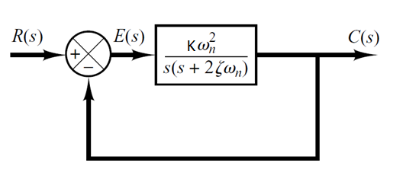


Second Order Systems
A general second-order system (without zeros) is characterized by the following transfer function.
$$K{ω_{n}}^{2}$$
G(s) =
s(s + 2ζω_{n} )
➔ Open-Loop Transfer Function
C(s)
$$K{ω_{n}}^{2}$$
₌
R(s)
s² + 2ζω _{n}s + ω ²
➔ Closed-Loop Transfer Function
n
17

Slide 5

Second Order Systems
C(s)
$$K{ω_{n}}^{2}$$
₌
_{s}2
R(s) + 2
ζω s + ω
2
n n
ζ ➔ damping ratio of the second order system, which is a measure of the degree of resistance to change in the system output.
ω_{n} ➔un-damped natural frequency of the second order system, which is the frequency of oscillation of the system without damping
18

Slide 6

Example#2
Determine the un-damped natural frequency and damping ratio of the following second order system.
C(s) ₌ 4
R(s)
s² + 2s + 4
Compare the numerator and denominator of the given transfer function
with the general 2nd order transfer function.
C(s)
$$K{ω_{n}}^{2}$$
₌
R(s)
_{s}2
+ 2ζω s + ω²
n n
ω ² = 4 ⇒ ω
= 2 rad / sec
⇒ 2ζω _{n}s = 2s
⇒ ζω _{n} = 1
⇒ ζ = 0.5
n
n
s² + 2ζω _{n}s + ω² = s² + 2s + 4
n
19

Slide 7
Example#3
Example 3: For the second order system described by the closed loop transfer function T(s), ω_{n} and ξ .
24 6
T (s) = ^{C(s)} =
=
_{s}2
R(s) 4s² + 12s + 256 + 3s + 64
Compare with the standard equation we have:
Since
ω² = 64 2ζ ω = 3
and
n n
==> ω = 8 , ζ = ³ = 0.8
n
16
20

Slide 8

Second Order Systems - Poles
The second order system Transfer function is
C(s)
$$K{ω_{n}}^{2}$$
₌
_{s}2
ζω s + ω
2
R(s) + 2
n n
The characteristic polynomial of a second order system is:
_{s}2
+ 2ζω s + ω
2
= (s − s₁ )(s − s₂ ) = 0
n n
The closed-loop poles of the system are
− 2ζ ω ± ζ
2
4
2
n
− 4
2
n
ω ω
s , s =
n
= −ζ ω ± ω
ζ ² −1
1 1
2
n
n
s₁ = − ω_{n}ζ + ω
ζ ² − 1
n
s₂ = − ω_{n}ζ − ω_{n} ζ − 1
2
21

Slide 9
Response of Second Order Systems
According the value of ζ
of the four categories:
Case 1: Over damped response (ξ > 1)
Case 2: Critically damped response (ξ = 1)
Case 3: Under damped response (0 < ξ <1)
Case 4: No damped response (ξ = 0)
, a second-order system can be set into one
22

Slide 10
Unit-Step Response of Second Order Systems
Case 1: Over damped response (ξ > 1)
The two roots of the characteristic equation s1 and s2 are real and distinct.
jω
s = − ω ζ + ω ζ ² − 1
1 n n
δ
s₂ = − ω_{n}ζ − ω_{n} ζ − 1
2
Example#4: Calculate and plot the output of the system with the following transfer function:
Solution: With unit step input, its response is:
2
T (s) =
_{s}2
+ 3s + 2
1
− 2 1
C(s) = R(s)T (s) =
= ¹ +
+
s(s² + 3s + 2)
s s + 1 s + 2
23

Slide 11

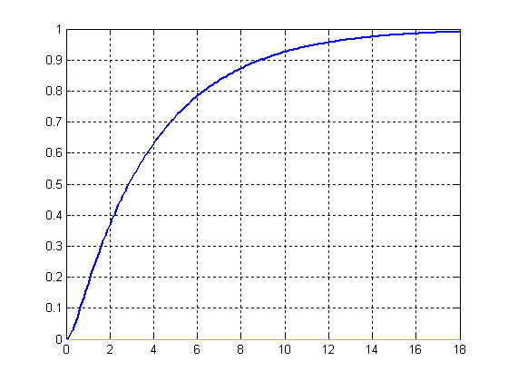
Unit-Step Response of Second Order Systems
The corresponding time domain output is given by:
c(t) = L⁻¹{C(s)} = [1 − 2 e^{−t} + e^{−2t} ]u(t)
ζ > 1
time [sec]
output signal
24

Slide 12
Unit-Step Response of Second Order Systems
Case 2: Critically damped response (ξ = 1)
The two roots of the characteristic equation s1 and s2 are real and equal.
jω
δ
^{s}1,2
= −ω_{n}
Example#5: Calculate and plot the output of the system with the following transfer function:
Solution: With unit step input, its response is:
5s + 4
T (s) =
_{s}2
+ 4s + 4
5s + 4
−1 3
C(s) = R(s)T (s) =
= ¹ + +
s s + 2 (s + 2)²
s(s² + 4s + 4)
25

Slide 13

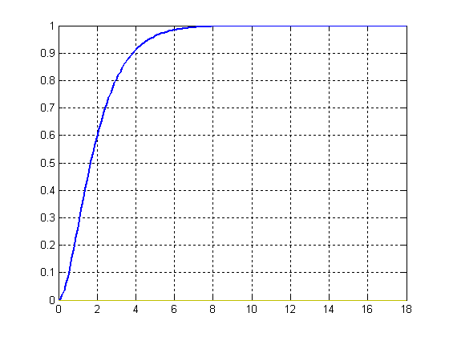
Unit-Step Response of Second Order Systems
The corresponding time domain output is given by:
c(t) = L⁻¹{C(s)} = [1 − e^{−2t} + 3 t e^{−2t} ]u(t)
ζ = 1
time [sec]
output signal
26

Slide 14
Unit-Step Response of Second Order Systems
Case 3: Under damped response (ξ < 1)
The two roots of the characteristic equation s1 and s2 are complex conjugates of on another.
jω
s = −ωζ± jω 1−ζ²
n n
1,2
δ
^{s}1,2
= −ω_{n}ζ± jω_{d}
Example#6: Calculate and plot the output of the system with the following transfer function:
Solution: With unit step input, its response is:
4
T (s) =
_{s}2
+ 2s + 4
1
s(s² + 2s + 4) ⁼ s ⁺
4
− s − 2
C(s) = R(s)T (s) =
_{s}2
+ 2s + 4
27

Slide 15

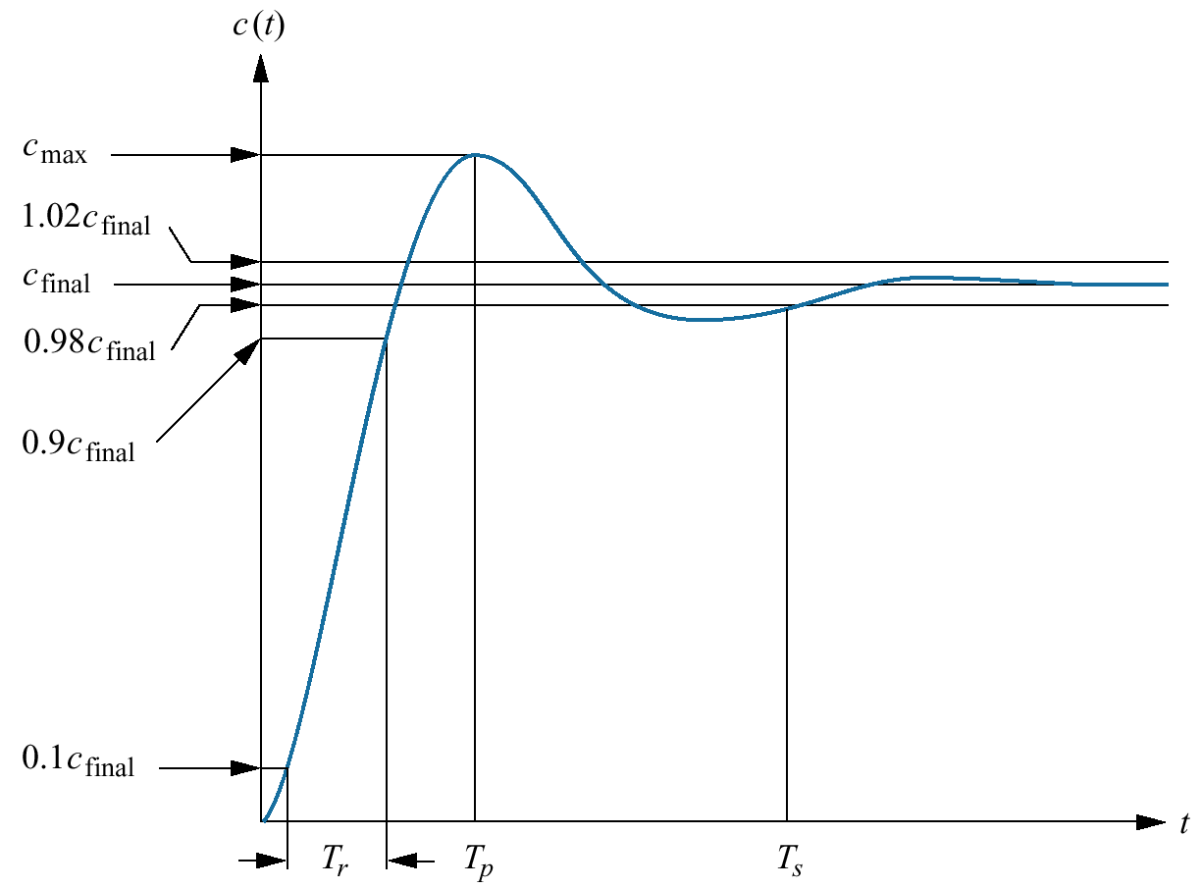
Unit-Step Response of Second Order Systems
The corresponding time domain output is given by:
⎛ ⎞
⎜ ⎟
1 − 𝜉²
𝜉
1
₂ e
−ζω t
−1
ω t +θ
c(t) = L {C(s)} = 1−
sin(
) ⎟ u(t)
𝑤ℎ𝑒𝑟𝑒 𝜃 =
⎜
n
⎜
1−ζ
d
⎟
⎝ ⎠
ζ < 1
output signal
time [sec]
28

Slide 16
Unit-Step Response of Second Order Systems
Case 4: Undamped response (ξ = 0)
The two roots of the characteristic equation s1 and s2 are imaginary poles.
jω
^{s}1,2
= ± jω_{n}
δ
Example#7: Calculate and plot the output of the system with the following transfer function:
Solution: With unit step input, its response is:
4
T (s) =
_{s} 2
+ 4
= L {C(s)} = ( ω t))u(t)
==> c(t)
−1
1− sin(
4
1 − s
n
C(s) = R(s) T (s) =
_{s}2
s(s² + 4) ⁼ s ⁺ + 2²
29

Slide 17

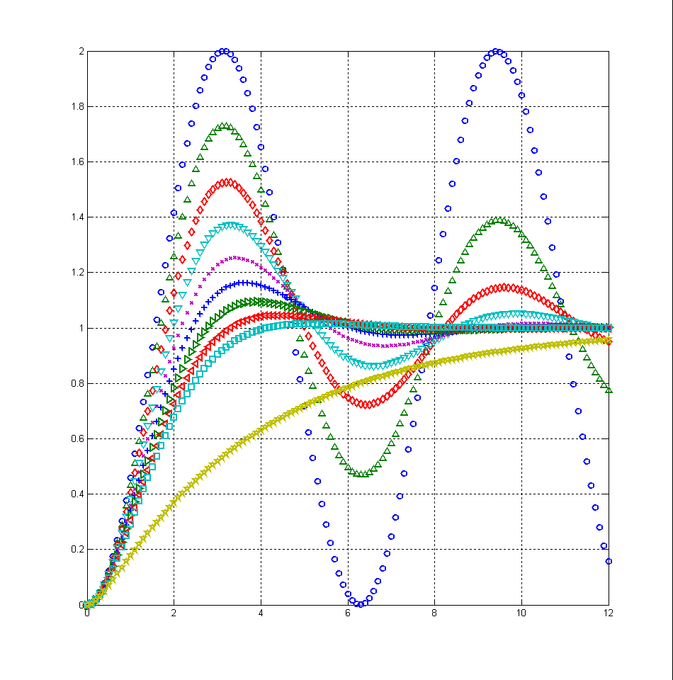
The transient response as a function of the damping ratio ξ
ζ = 0.5
ζ = 0.6
ζ = 0.7
ζ = 0
ζ = 0.1
ζ = 0.3
ζ = 0.4
ζ = 0.2
output signal
ζ = 2
ζ = 0.8
time [s]
30

Slide 18

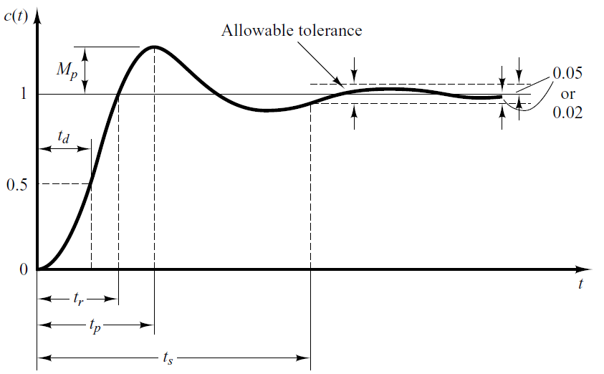
Time-Domain Specification
For 0< ξ <1 and ω_{n} > 0, the 2nd order system’s response due to a unit step input looks like
31

Slide 19

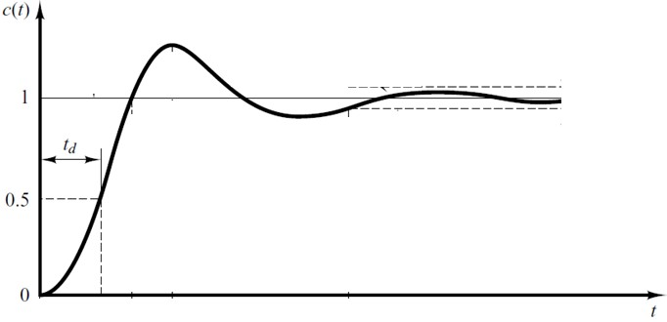
Time-Domain Specification – Delay Time
Delay-Time (Td): The delay (T_{d}) time is the time required for the response to reach half the final value the very first time.
32

Slide 20

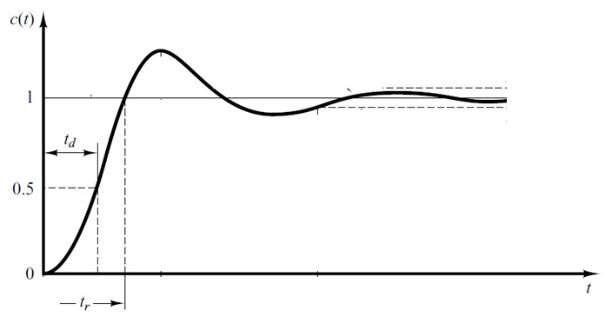
Time-Domain Specification – Rise Time
Rise-Time (TR): The rise time is the time required for the response to rise from
10% to 90% of its final value, ➔ over damped systems
5% to 95% of its final value, ➔ Critical damped systems
or 0% to 100% of its final value. ➔ under damped systems
_{t =} π − θ
r
ω
d
⎛ _{ω}
1 − ζ ^{2 ⎞}
θ = tan^{−1 ⎜ n ⎟}
⎜ ⎟
ζω_{n}
⎝
⎠
33

Slide 21

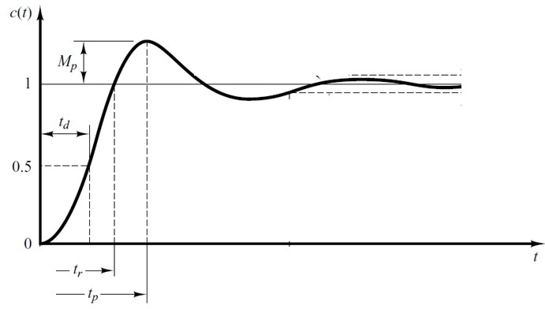
Time-Domain Specification – Peak Time
Peak Time (Tp): The peak time is the time required for the response to reach the first (maximum) peak of the overshoot.
₌ π
t
p
ω
d
34

Slide 22

Time-Domain Specification – Maximum Overshoot
Maximum Overshoot (MP): is the maximum peak value of the response curve measured from unity.
Maximum percent overshoot (P.O): is defined as follows:
MP = _{e}
ζ
)π
−(
1−ζ ²
Mp
P.O =
x100%
final value
₋ ζπ
P.O = e
1−ζ ²
x100%
35

Slide 23

Time-Domain Specification – Rise Time
The settling time (Ts): is the time required for the response curve to reach and stay within a range about the final value of size specified by absolute percentage of the final value (usually 2% or 5%).
Settling Time (2%)
4
ζω
t =
s
n
Settling Time (5%)
3
ζω
t =
s
n
36

Slide 24
Example#7
For the control system shown in Figure, determine k and a that satisfies the following requirements:
Maximum percentage overshoot P.O =10%.
The 5% settling time ts = 1 sec.
R(s) T (s)
1
s + 2
C(s)
+
k
-
s + a
Solution: The closed loop transfer function is given by
k 1
⎛ ⎞⎛ ⎞
C(s)
⎜ s + a ⎟⎜ s + 2 ⎟
k
k
₌ ⎝ ⎠⎝ ⎠ ₌
=
R(s)
⎛
k 1
(s + a)(s + 2) + k
_{s}2
+ s(a + 2) + (2a + k )
⎞⎛ ⎞
^{1 + ⎜} s + a ⎟⎜ s + 2 ⎟
37
⎝
⎠⎝
⎠

Slide 25
Example#7
The maximum percent overshoot (P.O )is given by:
₋ ζπ
10
ζ = 0.6
1−ζ
2
P.O = e =
100
For 5%, the settling time ts is given by:
_{t =} 3 ₌ 3 ₌ ₁
ω = 5
s
τ
ζω
n
e
n
a + 2 = 2ζω
&
2a + k = ω² = 0.305
n n
From these two equations we get a + 2 = 6 then a = 4
and k = 17
38

