Slide 1
Adaptive Optimal control Section I: Control System

Slide 2
Objectives
The student will be able to:
Understand classifications of control system.
Understand Steady state, time response, and frequency response analysis.
Analyze the Stability of control system using RH criteria.
Understand the fundamentals and diff. Hardware parts of PLC.

Slide 3
Module-I Introduction to Control
System

Slide 4
Specific Objectives
Explain different types of control system
Develop transfer functions
Differentiate between 1st& 2nd order of system
Develop and solve block diagram of control system

Slide 5
Module I – Introduction to Control System
Introduction to Control systems
Control System – Definition and Practical Examples
Classification of Control System : Open Loop and Closed Loop Systems – Definitions, Block diagrams, practical examples, and Comparison, Linear and Non-linear Control System, Time Varying and Time In-varying Systems
Servo System : Definition, Block Diagram, Classification (AC and DC Servo System), Block diagram of DC Servo System.
(4 Marks)
Laplace Transform and Transfer Function
Laplace Transform : Signifiance in Control System
Transfer Function : Definition, Derivation of transfer functions for Closed loop Control System and Open Loop Control System, Differential Equations and transfer functions of RC and RLC Circuit
(4 Marks)
Block Diagram Algebra (8 Marks)
Order of a System : Definition, 0,1,2 order system Standard equation, Practical Examples
Block Diagram Reduction Technique: Need, Reduction Rules, Problems

Slide 6
Input
Input
The stimulus or excitation applied to a control system from an external source in order to produce the output is called input
6

Slide 7
Output
Input
Output
The actual response obtained from a system is called output.
7

Slide 8
“System”
SYSTEM
Input
Output
A system is an arrangement of or a combination of different physical components connected or related in such a manner so as to form an entire unit to attain a certain objective.
8

Slide 9
Control
It means to regulate, direct or command a system so
that the desired objective is attained
9

Slide 10
Combining above definitions
System + Control = Control System
10

Slide 11
Control System
CONTROL SYSTEM
Input
Output
It is an arrangement of different physical elements connected in such a manner so as to regulate, direct or command itself to achieve a certain objective.
11

Slide 12
Difference between System and Control System
Input
System
Proper
Input
Control System
Desired
Output
Output
(May or may not
be desired)
12

Slide 13

Difference between System and Control System
An example : Fan
230V/50Hz
Fan (System)
Air Flow
Input
Output
AC Supply
13

Slide 14

A Fan: Can't Say System
A Fan without blades cannot be a “SYSTEM” Because it cannot provide a desired/proper output
i.e. airflow
Input Output
230V/50Hz
No Airflow
AC Supply
(No Proper/ Desired Output)
14

Slide 15
A Fan: Can be a System
A Fan with blades but without regulator can be a “SYSTEM” Because it can provide a proper output i.e. airflow
But it cannot be a “Control System” Because it cannot provide desired output i.e. controlled airflow
Input Output
230V/50Hz
Airflow
AC Supply
(Proper Output)
15

Slide 16

A Fan: Can be a Control System
A Fan with blades and with regulator can be a “CONTROL SYSTEM” Because it can provide a Desired output.
i.e. Controlled airflow
Control Element
Input
Output
230V/50Hz
Controlled Airflow
AC Supply
(Desired Output)
16

Slide 17
Module I – Introduction to Control System
Introduction to Control systems
Control System – Definition and Practical Examples
Classification of Control System : Open Loop and Closed Loop Systems – Definitions, Block diagrams, practical examples, and Comparison, Linear and Non-linear Control System, Time Varying and Time In-varying Systems
Servo System : Definition, Block Diagram, Classification (AC and DC Servo System), Block diagram of DC Servo System.
(4 Marks)
Laplace Transform and Transfer Function
Laplace Transform : Signifiance in Control System
Transfer Function : Definition, Derivation of transfer functions for Closed loop Control System and Open Loop Control System, Differential Equations and transfer functions of RC and RLC Circuit
(4 Marks)
Block Diagram Algebra (8 Marks)
Order of a System : Definition, 0,1,2 order system Standard equation, Practical Examples
Block Diagram Reduction Technique: Need, Reduction Rules, Problems
25

Slide 18
Classification of Control System
Classification of Control System
(Depending on control action)
Open Loop Control System
Closed Loop Control System
18

Slide 19
Open Loop Control System
Definition:
“A system in which the control action is totally independent of the output of the system is called as open loop system”
Controlled o/p
c(t)
Reference I/p
 | Controller
Process
r(t)
u(t)
Fig. Block Diagram of Open loop Control System
19

Slide 20

OLCS Examples
Electric hand drier – Hot air (output) comes out as long as you keep your hand under the machine, irrespective of how much your hand is dried.
20

Slide 21
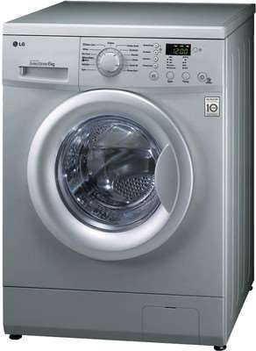
OLCS Examples
Automatic washing machine
– This machine runs according to the pre-set time irrespective of washing is completed or not.
21

Slide 22
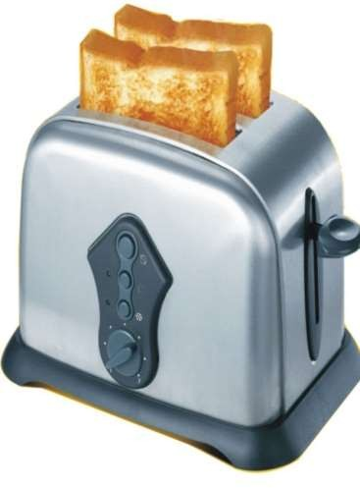
OLCS Examples
Bread toaster | - | This
machine runs | as | per
adjusted |  | time
irrespective of toasting is completed or not.
22

Slide 23
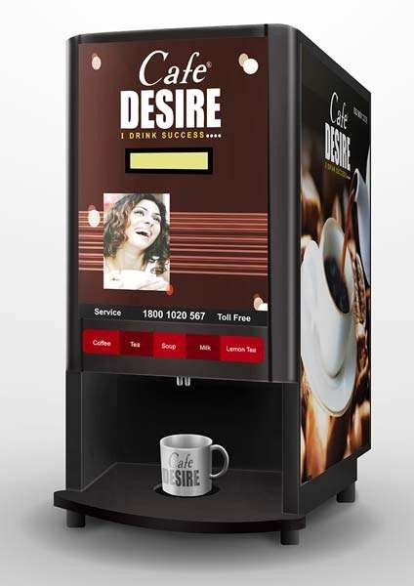
OLCS Examples
Automatic tea/coffee Vending Machine – These machines also function for pre adjusted time only.
23

Slide 24
OLCS Examples
Light switch – lamps glow whenever light switch is on irrespective of light is required or not.
Volume on stereo system – Volume is manually irrespective of output volume level.
adjusted
24

Slide 25
Advantages of OLCS
Simple in construction and design.
Economical.
Easy to maintain.
Generally stable.
Convenient to use as output is difficult to measure.
25

Slide 26
Disadvantages of OLCS
They are inaccurate
They are unreliable
Any change in automatically.
output cannot be corrected
26

Slide 27
Closed Loop System
Definition:
“A system in which the control action is somehow dependent on the output is called as closed loop system”
27

Slide 28
Block Diagram of CLCS
Forward Path
Command
Error Signal
Manipulated
Controlled O/p
I/p
Reference Transducer
Controller
Signal
Plant
r(t)
e(t)
m(t)
c(t)
Reference I/p
Feedback
Transducer
Feedback Signal
b(t)
c(t)
Feedback Path
28

Slide 29
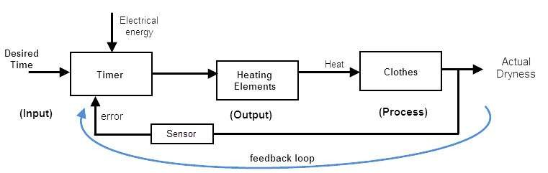

CLCS Examples
Automatic Electric Iron- Heating elements are controlled by output temperature of the iron.
29

Slide 30
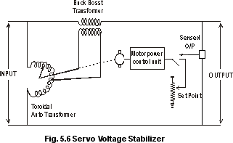
CLCS Examples
Servo voltage stabilizer – Voltage controller operates depending upon output voltage of the system.
30

Slide 31
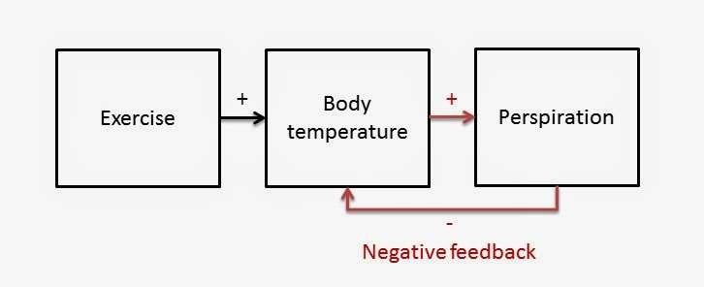
CLCS Examples
Perspiration
31

Slide 32
Advantages of CLCS
Closed loop control systems are more accurate even in the presence of non-linearity.
Highly accurate as any error arising is corrected due to presence of feedback signal.
Bandwidth range is large.
Facilitates automation.
The sensitivity of system may be made small to make system more stable.
This system is less affected by noise.
32

Slide 33
Disadvantages of CLCS
They are costlier.
They are complicated to design.
Required more maintenance.
Feedback leads to oscillatory response.
Overall gain is reduced due to presence of feedback.
Stability is the major problem and more care is needed to design a stable closed loop system.
33

Slide 34
Difference Between OLCS & CLCS
Open Loop Control System Closed Loop Control System
1. The open loop systems 1. The are simple & economical.
closed loop systems
are complex and costlier
2. They | consume | less | 2. | They | consume | more
power. |  |  |  | power.
3. The OL easier to
systems
are
3. The CL systems are not
construct
easy to construct because
because of less number of components required.
of more number of
components required.
4. The open loop systems are inaccurate &
4. The closed loop are accurate &
systems
more
unreliable
reliable.
34

Slide 35
Difference Between OLCS & CLCS
Open Loop Control System Closed Loop Control System
5. Stability problem systems.
is not a major in OL control
5. Stability is a major problem in closed loop systems & more care is needed to design a stable closed loop system.
Generally OL
systems are stable.
Small bandwidth.
Feedback element is absent.
Output measurement is not necessary.
Large bandwidth.
Feedback element is present.
Output measurement is necessary.
35

Slide 36
Difference Between OLCS & CLCS
Open Loop Control System Closed Loop Control System
9. The changes in the output due to external disturbances are not corrected automatically. So they are more sensitive to noise and other disturbances.
9.The changes in the output due to external disturbances are corrected automatically. So they are less sensitive to noise and other disturbances.
10. Examples:
10. Examples:
Coffee Maker,
Guided Missile,
Automatic Toaster,
Temp control of oven,
Hand Drier.
Servo voltage stabilizer.
36

Slide 37
Module I – Introduction to Control System
Introduction to Control systems
Control System – Definition and Practical Examples
Classification of Control System : Open Loop and Closed Loop Systems – Definitions, Block diagrams, practical examples, and Comparison, Linear and Non-linear Control System, Time Varying and Time In-varying Systems
Servo System : Definition, Block Diagram, Classification (AC and DC Servo System), Block diagram of DC Servo System.
(4 Marks)
Laplace Transform and Transfer Function
Laplace Transform : Signifiance in Control System
Transfer Function : Definition, Derivation of transfer functions for Closed loop Control System and Open Loop Control System, Differential Equations and transfer functions of RC and RLC Circuit
(4 Marks)
Block Diagram Algebra (8 Marks)
Order of a System : Definition, 0,1,2 order system Standard equation, Practical Examples
Block Diagram Reduction Technique: Need, Reduction Rules, Problems
45

Slide 38
Classification of Control System
Classification of Control System
Linear Control System
Non-linear Control System
38

Slide 39
Linear Control System
When an input X1 produces an output Y1 & an input X2 produces an output Y2, then any
combination should produce an
α X1+ β X 2
output αY1+ βY 2 . In such case system is linear. Therefore, linear systems are those where the principles of superposition and proportionality are obeyed.
39

Slide 40
Non-linear Control System
Non-linear systems do not obey law of superposition.
The stability of non-linear systems depends on root location as well as initial conditions & type of input.
Non-linear systems exhibit self sustained oscillations of fixed frequency.
40

Slide 41
Difference Between Linear & Non-linear System
Linear System Non-linear System
Obey superposition.
Can be analyzed by standard test signals
Stability depends only on
root location
Do not obey superposition
Cannot be analyzed by standard test signals
3. Stability depends on root locations, initial conditions &
type of input
Exhibits limit cycles
Exhibits hysteresis/ jump resonance
Cannot be analyzed by Laplace transform, z- transform
Do not exhibit limit cycles
Do not exhibit hysteresis/
jump resonance
Can be analyzed by Laplace transform, z- transform
41

Slide 42
Classification of Control System
Classification of Control System
Time Varying Control System
Time Invarying Control System
42

Slide 43
Time varying/In-varying Control System
Systems whose parameters vary with time are called time varying control systems.
When parameters do not vary with time are called Time Invariant control systems.
43

Slide 44
Time varying/In-varying Control System
The mass of missile/rocket reduces as fuel is burnt and hence the parameter mass is time varying and the control system is time varying type.
44

Slide 45
Module I – Introduction to Control System
Introduction to Control systems
Control System – Definition and Practical Examples
Classification of Control System : Open Loop and Closed Loop Systems – Definitions, Block diagrams, practical examples, and Comparison, Linear and Non-linear Control System, Time Varying and Time In-varying Systems
Servo System : Definition, Block Diagram, Classification (AC and DC Servo System), Block diagram of DC Servo System.
(4 Marks)
Laplace Transform and Transfer Function
Laplace Transform : Signifiance in Control System
Transfer Function : Definition, Derivation of transfer functions for Closed loop Control System and Open Loop Control System, Differential Equations and transfer functions of RC and RLC Circuit
(4 Marks)
Block Diagram Algebra (8 Marks)
Order of a System : Definition, 0,1,2 order system Standard equation, Practical Examples
Block Diagram Reduction Technique: Need, Reduction Rules, Problems
53

Slide 46
Servo System
Definition:
Servo system is defined as automatic feedback control system working on error signals giving the output as mechanical position, velocity or acceleration.
Servo system is one type of feedback control system in which control variable is the mechanical load position & its time derivatives like velocity and acceleration.
46

Slide 47
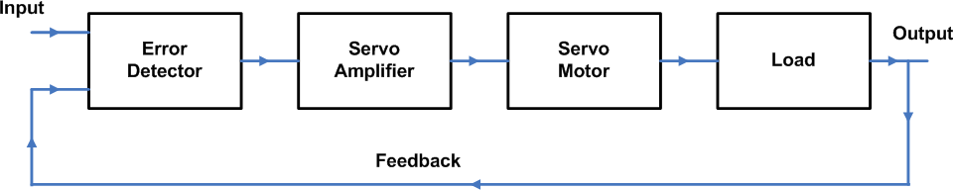
General block diagram of Servo System
47

Slide 48
Difference between Servo System
AC servo System DC servo System
Efficiency is low
Low power output
It requires less
Efficiency is high
High power output
It requires frequent
maintenance
4. Less problems
maintenance
4. More
problems
stability
stability
Smooth operation
It has non-linear
Noisy operation
It
has
linear
characteristics
characteristics
48

Slide 49
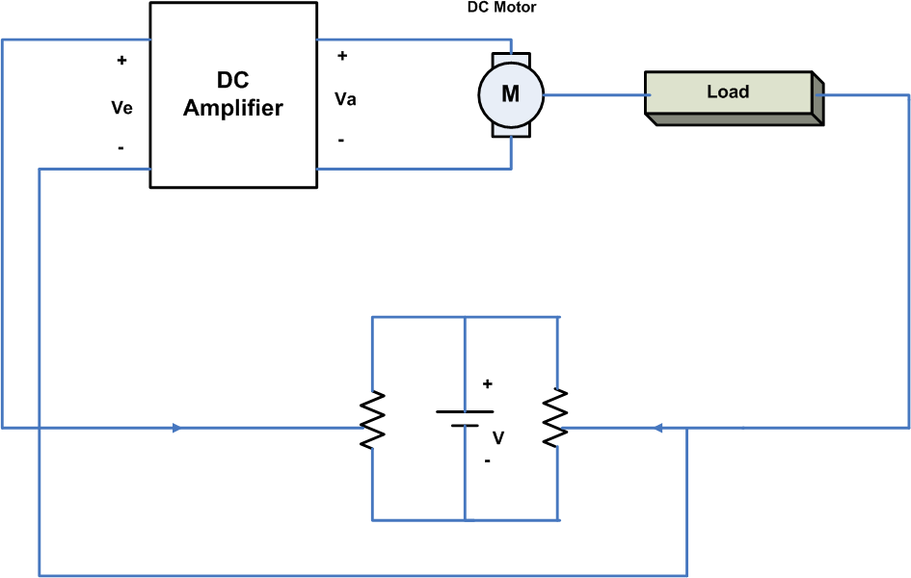
DC Servo System
49

Slide 50
DC Servo System
Working of Servo System
50

Slide 51
Module I – Introduction to Control System
Introduction to Control systems
Control System – Definition and Practical Examples
Classification of Control System : Open Loop and Closed Loop Systems – Definitions, Block diagrams, practical examples, and Comparison, Linear and Non-linear Control System, Time Varying and Time In-varying Systems
Servo System : Definition, Block Diagram, Classification (AC and DC Servo System), Block diagram of DC Servo System.
(4 Marks)
Laplace Transform and Transfer Function
Laplace Transform : Signifiance in Control System
Transfer Function : Definition, Derivation of transfer functions for Closed loop Control System and Open Loop Control System, Differential Equations and transfer functions of RC and RLC Circuit
(4 Marks)
Block Diagram Algebra (8 Marks)
Order of a System : Definition, 0,1,2 order system Standard equation, Practical Examples
Block Diagram Reduction Technique: Need, Reduction Rules, Problems
59

Slide 52
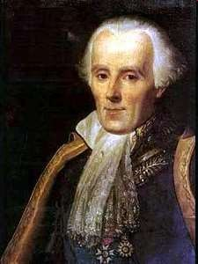
Laplace Transform
The French Newton Pierre-Simon Laplace
Developed mathematics astronomy, physics, and statistics
in
Began work in calculus which led to the Laplace Transform
Focused later on celestial
mechanics
One of | the | first scientists to
suggest | the | existence of black
holes
52

Slide 53
Laplace Transform
To evaluate the performance of an automatic control
system commonly used mathematical tool is “Laplace
Transform”
Laplace transform converts the differential equation into an algebraic equation in ‘s’.
Laplace transform exist for almost all signals of practical interest.
53

Slide 54
Why Laplace Transform?
Laplace Transformation
Time domain
unknown f(t), d/dt, Diff Eqs
Solve Differential Equations
Frequency domain unknown F(s), Alg Eqs
Solve Algebraic Equations
Frequency domain known F(s)
Time domain known f(t)
Inverse Laplace Transform
54

Slide 55
Advantages of Laplace Transform
Solution of intego differential systems can be easily obtained.
equation of time
Initial conditions are automatically incorporated.
Laplace transform provides an easy & effective solution of many problems arising in automatic control systems.
Laplace transform allows the use of graphical techniques, for predicting the system performance.
55

Slide 56
Laplace Transform- Definition
The Laplace transform of a function, f(t), is defined as
[ ]
∫
∞
( )
−st
F (s) = L f (t) =
f t e
dt (1-1)
0
where F(s) is the symbol for the Laplace transform, L is the Laplace transform operator, and f(t) is some function of time, t.
Note: The L operator transforms a time domain function f(t)
into an s domain function, F(s). s is a complex variable:
s = a + bj,
j B −1
56

Slide 57
Standard Laplace Transform
f (t) F(s) = L[ f (t)]
1 or u(t)
1
s
_{e}−α t
1
s + α
ω
s² + ω ²
sinωt
cosωt
s
s² + ω ²
e^{−αt} sin ωt
ω
(s + α )² + ω ²
e^{−αt} cosωt
s + α
(s + α )² + ω ²
t
1
_{s}2
n!
_{s}n+1
_{t} n
_{e}−αt _{t}n
n!
(s + α )^{n+1}
1
δ (t)
*Use when roots are complex.
57

Slide 58
Inverse Laplace Transform
By definition, the inverse Laplace transform operator, L⁻¹, converts an s-domain function back to the corresponding time domain function:
f (t ) = L⁻¹ ⎡⎣F (s)⎤⎦
58

Slide 59
Module I – Introduction to Control System
Introduction to Control systems
Control System – Definition and Practical Examples
Classification of Control System : Open Loop and Closed Loop Systems – Definitions, Block diagrams, practical examples, and Comparison, Linear and Non-linear Control System, Time Varying and Time In-varying Systems
Servo System : Definition, Block Diagram, Classification (AC and DC Servo System), Block diagram of DC Servo System.
(4 Marks)
Laplace Transform and Transfer Function
Laplace Transform : Signifiance in Control System
Transfer Function : Definition, Derivation of transfer functions for Closed loop Control System and Open Loop Control System, Differential Equations and transfer functions of RC and RLC Circuit
(4 Marks)
Block Diagram Algebra (8 Marks)
Order of a System : Definition, 0,1,2 order system Standard equation, Practical Examples
Block Diagram Reduction Technique: Need, Reduction Rules, Problems
67

Slide 60
Transfer Function
The relationship between input & output of a system is
given by the transfer function.
Definition: The ratio of Laplace transform of the output to the Laplace transform of the input under the assumption of zero initial conditions is defined as
“Transfer Function”.
60

Slide 61
Transfer Function
System g(t)
LT
System G(s)
r(t)
c(t)
R(s)
C(s)
For the system shown,
c(t)= output r(t)= input
g(t)= System function
L{c(t)}= C(s)
L{r(t)}= R(s)
L{g(t)}= G(s)
Therefore transfer function G(s) for above system is given by,
Laplace of output ₌
C (s)
R(s)
G(s)=
Laplace of input
61

Slide 62
Transfer Function of closed loop system
Error Signal E(s)
Gain for CL system is given by;
G(s) = ^{C(s)}
E(s)
∴C(s) = G(s).E(s) − − − − − −(3)
R(s)
C(s)
Output
+₋
G(s)
Input
Substitute value of E(s) from eq. 1 to 3
C(s) = G(s).(R(s) − B(s))
∴C(s) = G(s).R(s) − G(s).B(s) − − − − − −(4)
B(s)
H(s)
Feedback Signal
Substitute value of B(s) from eq. 2 to 4
C(s) = G(s) R(s) − G(s).H(s).C(s)
G(s).R(s) = C(s) + G(s).H(s).C(s)
G(s).R(s) = C(s)(1 + G(s).H(s))
Transfer function is given by;
Error signal is given by;
E(s) = R(s) − B(s) − − − − − (1)
∴ R(s) = E(s) + B(s)
Gain of feedback network is given by;
H (s) = ^{B(s)}
C(s) G(s)
C(s)
6/30∴/20B1(6s) = H (s).C(s) − − − − − −(2)
T.F.=
=
R(s) 1 + G(s).H(s) ₇₀

Slide 63
Laplace Transform of Passive Element (R,L & C)
The Laplace transform can be used independently on
different circuit elements, and then the circuit can be solved entirely in the S Domain (Which is much easier).
Let's take a look at some of the circuit elements
63

Slide 64
Laplace Transform of R
Resistors are time and frequency invariant. Therefore, the transform of a resistor is the same as the resistance of the resistor.
L{Resistor}=R(s)
64

Slide 65
Laplace Transform of C
Let us look at the relationship between voltage, current, and capacitance, in the time domain:
i(t) = C ^{dv(t)}
dt
Solving for voltage, we get the following integral:
₁ ∞
v(t) = ∫i(t) dt
C
to
Then, transforming this equation into the Laplace domain, we get the following:
V (s) = ¹ ¹ I (s)
C s
65

Slide 66
Laplace Transform of C
Again, if we solve for the ratio V(s)/I(s), we get the following:
V (s) ₌ 1
I (s) sC
Therefore, the transform capacitance C is given by:
for a capacitor with
1
L{capacitor} =
sC
66

Slide 67
Laplace Transform of L
Let us look at the relationship between voltage, current, and inductance, in the time domain:
v(t) = L ^{di(t)}
dt
putting this into the Laplace domain, we get the formula:
V (s) = sLI(s)
And solving for our ratio
V (s) _{= sL} I(s)
67

Slide 68
Laplace Transform of L
Therefore, the transform of an inductor with inductance L is given by:
L{inductor} = sL
68

Slide 69

Transfer Function of RC and RLC electrical circuits
Example: Find the TF of given RC network
Taking Laplace transform above equation
Vo(s) = ¹ I (s) − − − − − −(2)
C
Vi(t)
i(t)
Vo(t)
sC
∴ I (s) = sC.Vo(s) − − − − − −(3)
From equation 1,
Vi(s) = I (s)(R+ ¹ ) − − − − − −(4)
Apply KVL for input loop,
1
t
vi(t) = Ri(t) + ∫i(t)dt
C
sC
From equation 3 and 4,
0
Taking Laplace transform above equation
Vi(s) = RI(s) + ¹ I (s) − − − − − −(1)
sC
Apply KVL for output loop,
t
1 ₎
Vi(s) = Vo(s).sC.(R+
sC
1
vo(t) = ∫i(t)dt C
69
0

Slide 70
Vo(s) ₌
1
Transfer Function= G(s)=
Vi(s)
sC.(R+ ¹ )
sC
Vo(s) ₌
1
Vi(s)
_{sC.(} sCR + 1
)
sC
Vo(s) ₌ 1
Vi(s)
sCR + 1
1
sCR + 1
Vi(s)
Vo(s)
70

Slide 71

Transfer Function of RC and RLC electrical circuits
Example: Find the TF of given RLC network
L
Apply KVL for input loop,
C
Vi(t)
i(t)
Vo(t)
1
Vi(s) = RI(s) + sLI(s) +
I (s)
sC
Taking Laplace transform above network ₁
∴Vi(s) = [R+ sL+ ]I (s) − − − − − − − (1)
sC
sL
Apply KVL for output loop,
1
sC
Vi(s)
I(s)
Vo(s)
1
Vo(s) =
I (s) − − − − − −(2)
sC
71

Slide 72
From equation 1 and 2,
Transfer Function=
1
Vo(s) ₌
Vi(s)
I (s)
sC
[R+ sL+ ¹ ] I(s)
sC
1
₌ sC
[R+ sL+
1 ]
sC
1
₌ sC sCR + s² LC + 1
sC
1
=
sCR + s² LC + 1
1
=
s² LC + sCR +1
80

Slide 73
Module I – Introduction to Control System
Introduction to Control systems
Control System – Definition and Practical Examples
Classification of Control System : Open Loop and Closed Loop Systems – Definitions, Block diagrams, practical examples, and Comparison, Linear and Non-linear Control System, Time Varying and Time In-varying Systems
Servo System : Definition, Block Diagram, Classification (AC and DC Servo System), Block diagram of DC Servo System.
(4 Marks)
Laplace Transform and Transfer Function
Laplace Transform : Signifiance in Control System
Transfer Function : Definition, Derivation of transfer functions for Closed loop Control System and Open Loop Control System, Differential Equations and transfer functions of RC and RLC Circuit
(4 Marks)
Block Diagram Algebra (8 Marks)
Order of a System : Definition, 0,1,2 order system Standard equation, Practical Examples
Block Diagram Reduction Technique: Need, Reduction Rules, Problems
81

Slide 74
Order of System
The order of control system is defined as the highest power of s present in denominator of closed loop transfer function G(s) of unity feedback system.
74

Slide 75
Example1: Determine order of given system
s(s+ 2)
TF = G(s) =
_{s}4
+ 7s³ +10s² + 5s + 5
75

Slide 76
Example1: Determine order of given system
s(s+ 2)
TF = G(s) =
_{s}4
+ 7s³ +10s² + 5s + 5
Answer: The highest power of equation in denominator of given transfer function is ‘4’.
Hence the order of given system is fourth
76

Slide 77
System Order and Proper System
Highest power of s present in denominator of closed
loop transfer function is called as “Order of System”.
A proper system is a system where the degree of the denominator is larger than or equal to the degree of the numerator polynomial.
77

Slide 78
Example 2 : Determine order of given system
_{G(s) =} (s+ 5)(s+ 2)
s(s+ 3)(s+ 4)
78

Slide 79
Example 2 : Determine order of given system
_{G(s) =} (s+ 5)(s+ 2)
s(s+ 3)(s+ 4)
Solution: To obtain highest power of denominator,
Simplify denominator polynomial.
s(s+ 3)(s+ 4) = 0
s(s² + 7 s+ 12) = 0
s³ + 7s² +12s = 0
The highest power of equation in denominator of given transfer function is ‘3’. Hence given system is “Third Order system”.
The degree of denominator is larger than the numerator hence system is “Proper System”
79

Slide 80
Example 3 : Determine order of given system
K(s+ 5)
G(s) =
s³ (7 s² + 12s + 5)
80

Slide 81
Example 3 : Determine order of given system
K(s+ 5)
G(s) =
s³ (7 s² + 12s + 5)
Solution: To obtain highest power of denominator,
Simplify denominator polynomial.
s³ (7s² +12s + 5) = 0
7s⁵ +12s⁴ + 5s³ = 0
The highest power of equation in denominator of given transfer function is ‘5’. Hence given system is “Fifth Order system”.
The degree of denominator is larger than the numerator hence system is “Proper System”
81

Slide 82
Types of System
(depending on highest power of denominator)
Zero (0) Order System
First Order System
Second Order System
82

Slide 83
Zero (0) Order System
Definition: If highest power of complex variable ‘s’ present in Characteristics equation is zero, then it is called as
“Zero order System”
1
1 + T
R(s)
+
C(s)
-
83

Slide 84
Zero (0) Order System
Consider a unity feedback system with transfer function
1
G(s) =
1 + T
Hence characteristics equation is given by,
1+ T = 0
1+ s⁰T = 0
or
Here the highest power of s is equal to 0,
Hence the system given above is zero order system.
Practical Example: Amplifier type control system
84

Slide 85
First Order System
Definition: If highest power of complex variable ‘s’ present In Characteristics equation is one, then it is called as
“First order System”
1
1 + sCR
+
R(s)
C(s)
-
85

Slide 86
First Order System
Consider a unity feedback system with transfer function
1
G(s) =
1 + sCR
Hence characteristics equation is given by,
1+ sCR = 0
Here the highest power of s is equal to 1,
Hence the system given above is First order system.
Practical Example: RC circuits, thermal type systems
86

Slide 87
Second Order System
Definition: If highest power of complex variable ‘s’ present In Characteristics equation is two, then it is called as “Second order System”
1
s² LC + sCR +1
R(s)
+
C(s)
-
87

Slide 88
Second Order System
Consider a unity feedback system with transfer function
1
G(s) =
s² LC + sCR + 1
Hence characteristics equation is given by,
s² LC + sCR +1 = 0
Here the highest power of s is equal to 2,
Hence the system given above is Second order system.
Practical Example: RLC circuits, Robotic control system.
88

Slide 89
Module I – Introduction to Control System
Introduction to Control systems
Control System – Definition and Practical Examples
Classification of Control System : Open Loop and Closed Loop Systems – Definitions, Block diagrams, practical examples, and Comparison, Linear and Non-linear Control System, Time Varying and Time In-varying Systems
Servo System : Definition, Block Diagram, Classification (AC and DC Servo System), Block diagram of DC Servo System.
(4 Marks)
Laplace Transform and Transfer Function
Laplace Transform : Signifiance in Control System
Transfer Function : Definition, Derivation of transfer functions for Closed loop Control System and Open Loop Control System, Differential Equations and transfer functions of RC and RLC Circuit
(4 Marks)
Block Diagram Algebra (8 Marks)
Order of a System : Definition, 0,1,2 order system Standard equation, Practical Examples
Block Diagram Reduction Technique: Need, Reduction Rules, Problems
97

Slide 90
Need of Block Diagram Algebra
If the system is simple & has limited parameters then it
is easy to analyze such systems using the methods discussed earlier i.e. transfer function, if the system is complicated and also have number of parameters then it is very difficult to analyze it.

Slide 91
Need of Block Diagram Algebra
To overcome this problem representation method is used.
block
diagram
It is a simple way to represent any practically complicated system. In this each component of the system is represented by a separate block known as functional block.
These blocks are interconnected in a proper sequence.

Slide 92
Block Diagram Fundamentals
Block Diagram: It is shorthand, pictorial representation
of the cause and effect relationship between input and output of a physical system.
BLOCK
Input
Output

Slide 93
Block Diagram Fundamentals
Output: The value of the input is multiplied to the value of block gain to get the output.
3s
X(s)
Y(s)
Output
Y(s)= 3s. X(s)

Slide 94
Block Diagram Fundamentals
Summing Point: Two or more signals can be added/ substracted at summing point.
y
+
x
output
+
Output =x+y-z
-
z

Slide 95
Block Diagram Fundamentals
Take off Point: The output signal can be applied to two or more points from a take off point.
Z
Z
Z
Take off point
Z
103

Slide 96
Block Diagram Fundamentals
Forward Path: The direction of flow of signal is from input to output
Forward Path
R(s) +
C(s)
G1
G2
-
H1
Feedback Path
Feedback Path: The direction of flow of signal is from output to input

Slide 97
Block Diagram Reduction Techniques
Rule 1: For blocks in cascade
Gain of blocks connected in cascade gets multiplied with each other.
R(s)
R1(s) _{G2}
C(s)
R(s)
G1G2
C(s)
G1
R1(s)=G1R(s)
C(s)= G1G2R(s)
C(s) =G2R1(s)
=G1G2R(s)

Slide 98
R(s)
G1
G2
G3
C(s)
Find Equivalent
R(s)
G1G2G3
C(s)

Slide 99
R(s)
G1
G2
G3
C(s)
R1(s)
Find Equivalent
R(s)
C(s)
R(s)
G1G2
G3
C(s)
G1G2G3
R1(s)
107

