Slide 1
Topic:
Italy

Slide 2
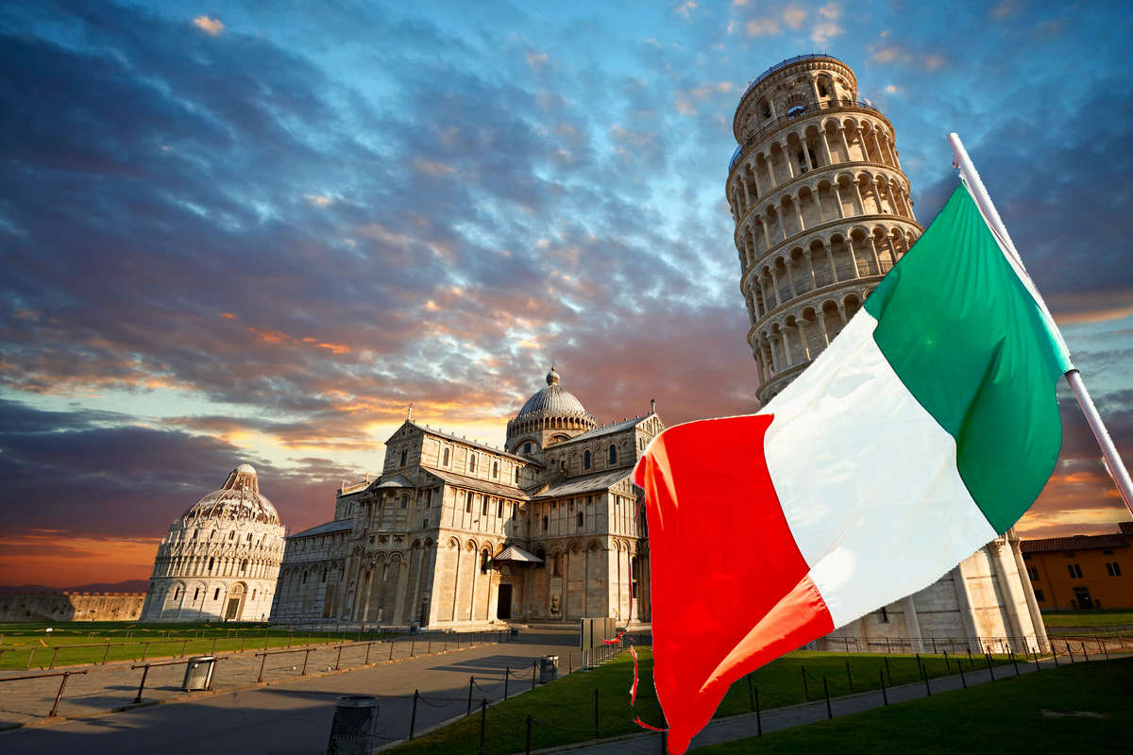
Italy is a country located in the south of Europe, with a rich history and culture. Its capital is Rome, a city that is considered one of the most historical and important in the world.

Slide 3
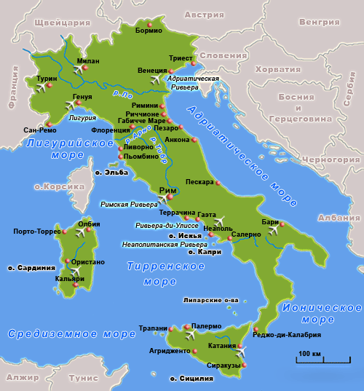
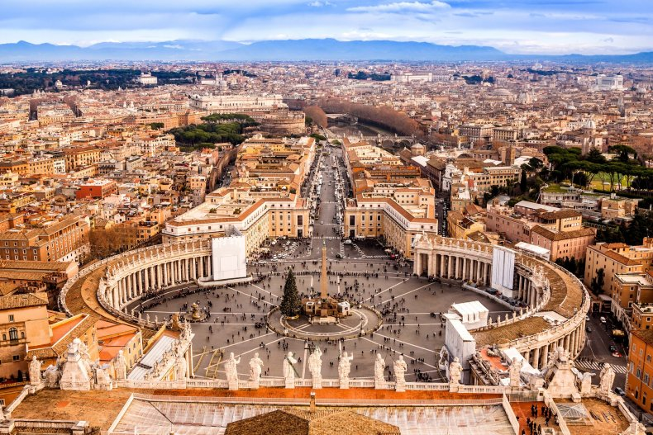
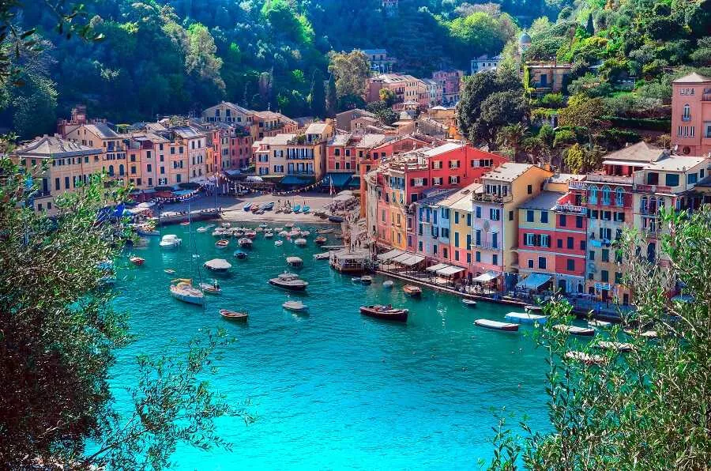
The map of Italy is presented in the form of a "foot". There are many interesting places in Italy.

Slide 4
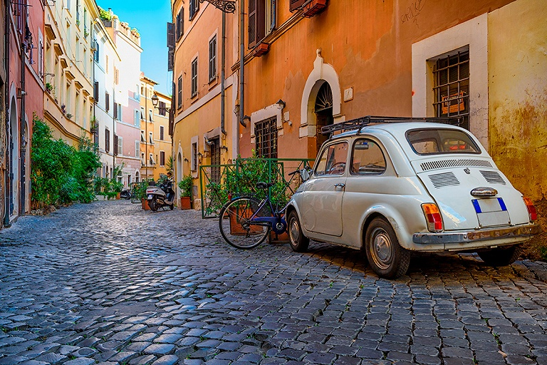
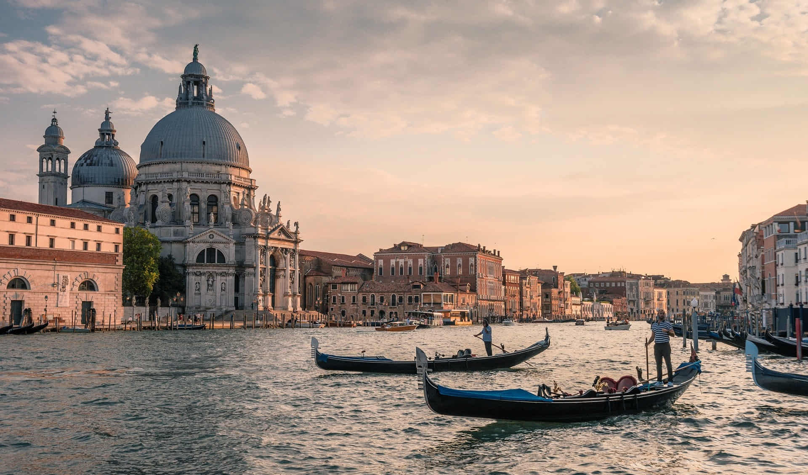
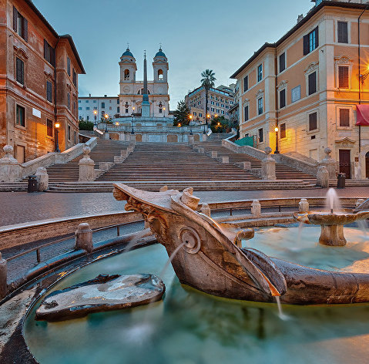
You can admire this beauty all day long You can look at them forever

Slide 5
Italy has one of the most famous cultural heritages in the world. Great artists and writers such as Michelangelo, Leonardo da Vinci and Dante Alighieri were born here. The architecture, art and gastronomy of Italy (pasta, pizza, wine) are known all over the world.

