Slide 1
Axions
Cybersecurity challenge

Slide 2
Who we are
Asen Asenov – DevOps Engineer
Lyubomir Tochev – Senior DevOps Engineer
Vasil Fishev – Cloud Infrastructure Consultant
Ilian Boyadzhiev – Information Security Analyst
Dimitar Dimitrov – Cybersecurity Student
Svetlan Nikolov – DevOps Engineer

Slide 3
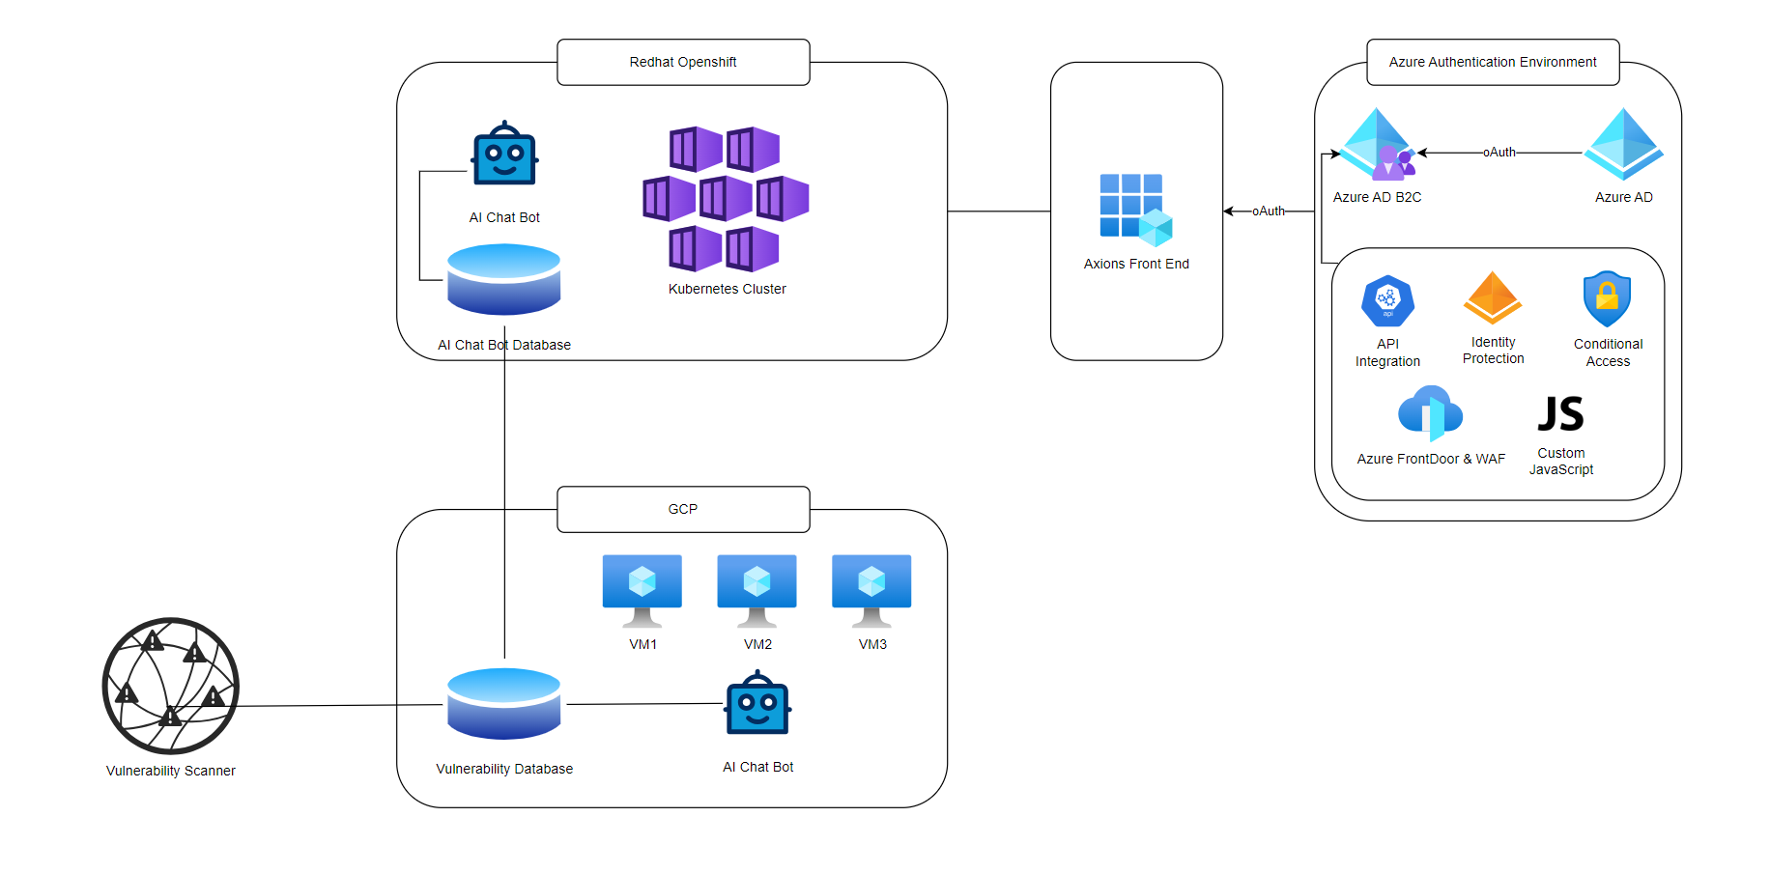

Slide 4
Technology stack
Docker
Google Cloud Platform
Open AI Language Model
Checkov Vulnerability Scanner
Azure AD, Azure B2C, Azure Storage
Red Hat OpenShift container platform

Slide 5


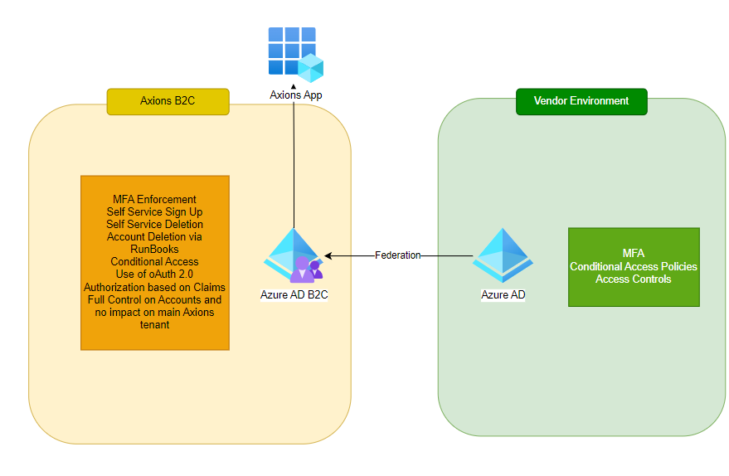

Slide 6
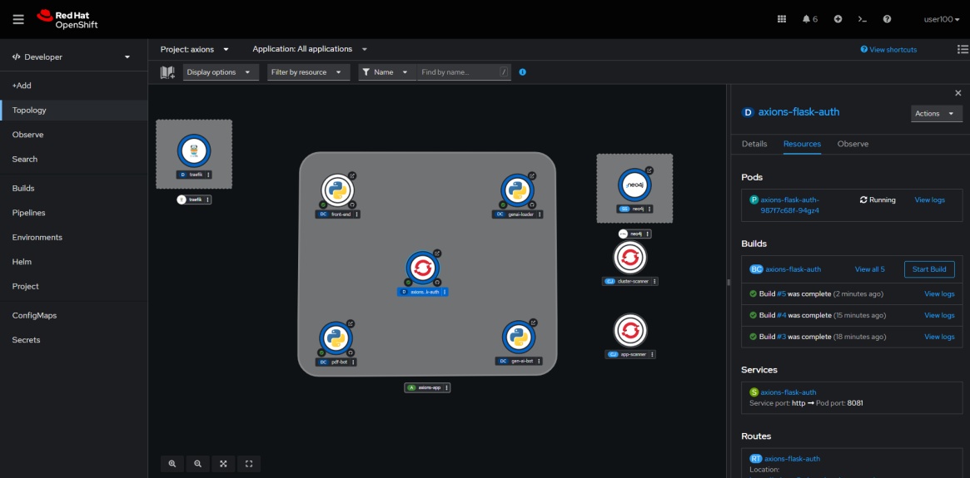
Red hat openshift container platform

Slide 7
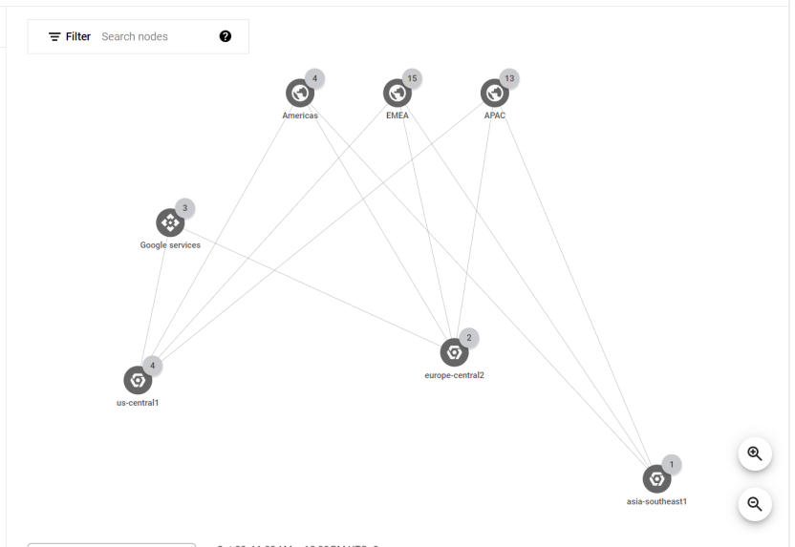
Google cloud

Slide 8
Security risk management
Risk management lifecycle
Third-party risk management for supply chain security
Defense in depth
Security automation

