Slide 1
Axions
Cybersecurity challenge

Slide 2
Who we are
Asen Asenov – DevOps Engineer
Lyubomir Tochev – Senior DevOps Engineer
Vasil Fishev – Cloud Infrastructure Consultant
Ilian Boyadzhiev – Information Security Analyst
Dimitar Dimitrov – Cybersecurity Student
Svetlan Nikolov – DevOps Engineer

Slide 3











Slide 4
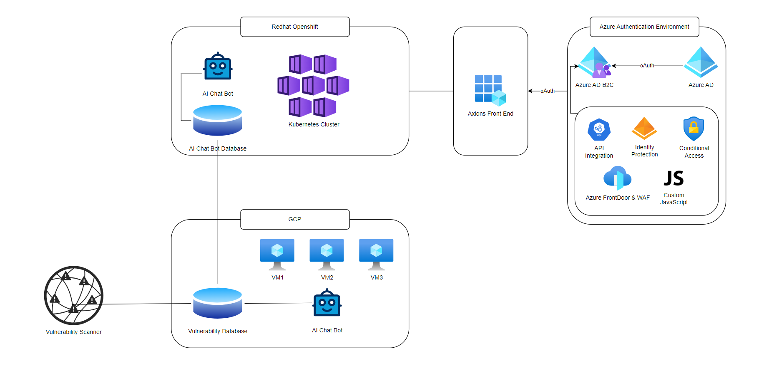

Slide 5
Security risk management
Risk management lifecycle
Third-party risk management for supply chain security
Defense in depth
Security automation

Slide 6


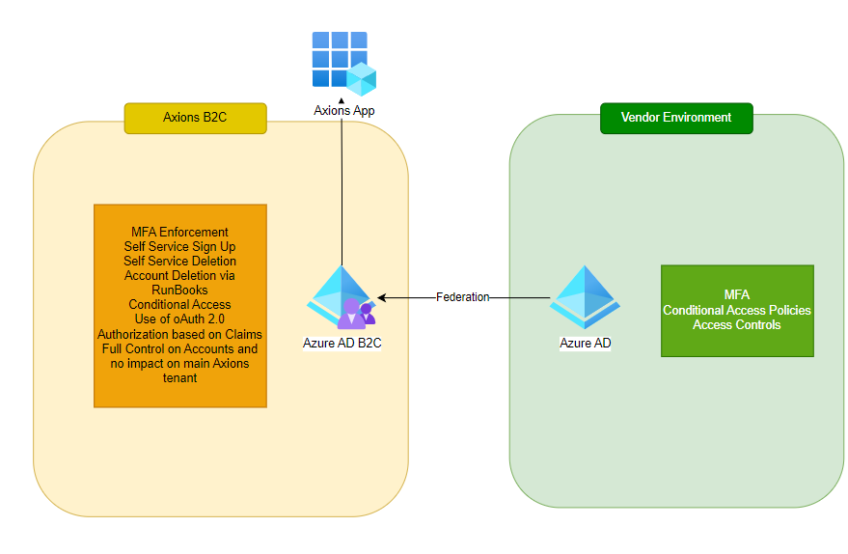

Slide 7
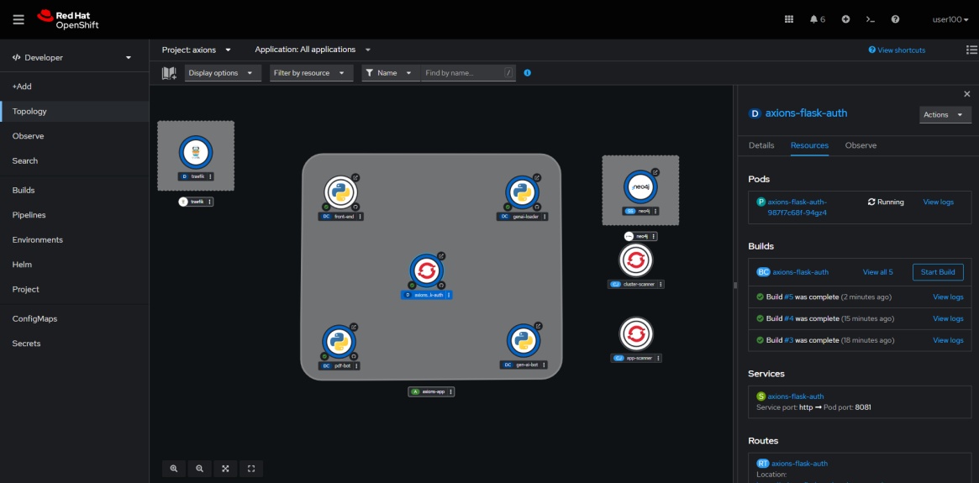
Red hat openshift container platform

Slide 8
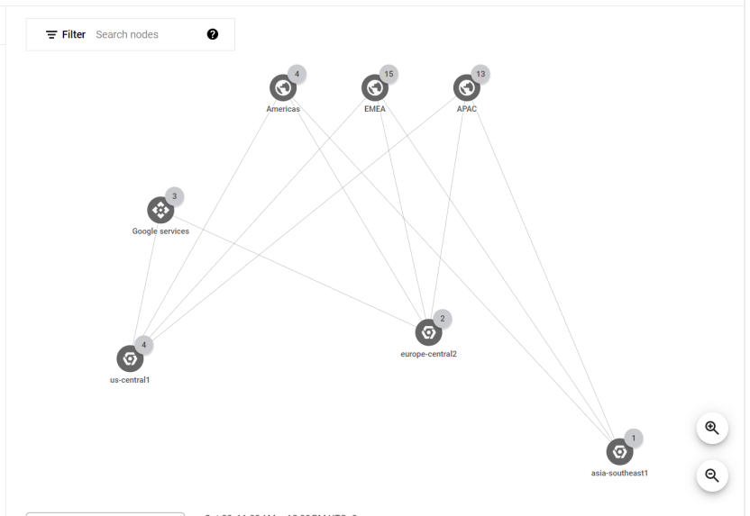
Google cloud

