Slide 1
Stocko
Alex Davis, Andrew Setka, Brendan Lucich, Brady Mack

Slide 2
Audience
Any individual that makes or is seeking to make personal investments to create additional flows of income, generational wealth, or wealth
Great increase in the ‘retail investor’ since the rise of apps like Robinhood, Webull, etc.

Slide 3
Importance
By simply following a process and removing emotional decisions, increasing your portfolios return by a few percentage points after taxes can result in millions of dollars in retirement
There is a great danger in irresponsible investing
Especially among ‘retail investors’

Slide 4
Description
Stocko exists to provide in-depth analytics and evaluations of publicly traded companies
This allows users a truer look at the health and intrinsic value of the company, to make more informed long term investing decisions
By trading on analytics gathered available by a company's public business data
NOT a day-trading application

Slide 5
Potential/Planned Features
Basic Stock Analysis
Graph and Stock Analytics
Stock Evaluation
Intrinsic Value of the Company vs Current Trading Price
Future Stock Price Calculator
Personal Positions Portfolio Tracker
Natural Language Processing (NLP) on Analyst Prediction History
Back Testing Analysis

Slide 6
Technical Details
Angular Front End hosted on GitHub
Flask API Backend hosted on pythonanywhere.com
Python (at this point in time) Backend for all stock processing
Backend sources data via Alpha Vantage Stock API
MongoDB to store user positions/portfolio
Login Authentication
Third Party vs Inhouse System
CI/CD Pipeline
Local Branches -> Dev -> Test -> Prod

Slide 7
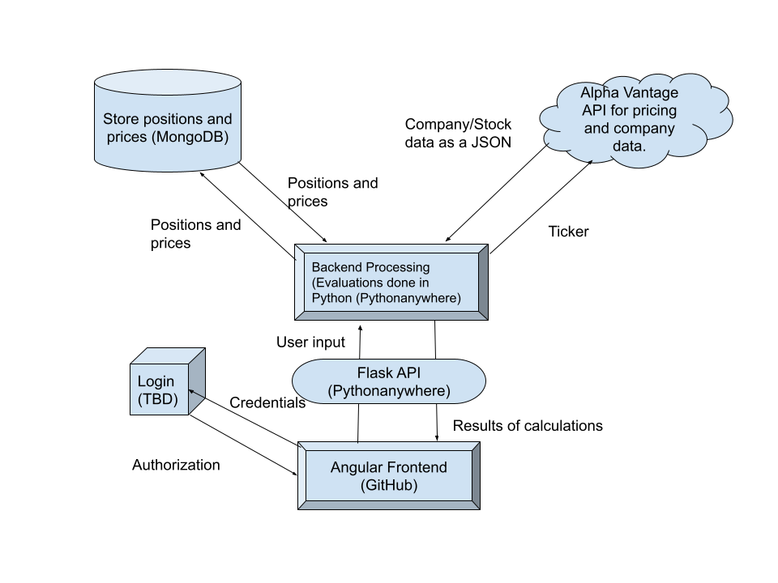
Technical Diagram

Slide 8
Competitors
Websites that simply source the same data that we will be sourcing
CNBC, CNN Money, YahooFinance, Ycharts, Bloomberg, etc.
Our advantage: these sites have a great deal of information and data, but do not allow the users to follow a process
YouTube Channels
Meet Kevin, Graham Stephan, etc.
Our advantage: a developed application to give data based evaluations instead of emotional decisions on a fan based level to our users

Slide 9
Possible Challenges
Free API pull request limitations
Need to effectively store information
Efficiently error check before using a request
Frontend Routing with hosting on Github for free
Communication and Deadline Issues
In regards to branch management and hot fixes that need to be deployed
Limited time frame for 3 sprints to finalize all potential and planned features
Enablers, development, and testing for some more advanced technical features could force features to be backlogged

