Slide 1
Week3:Retro Snake
——Practice of Programming Language 1——
Shen Shuyin
Spring

Slide 2
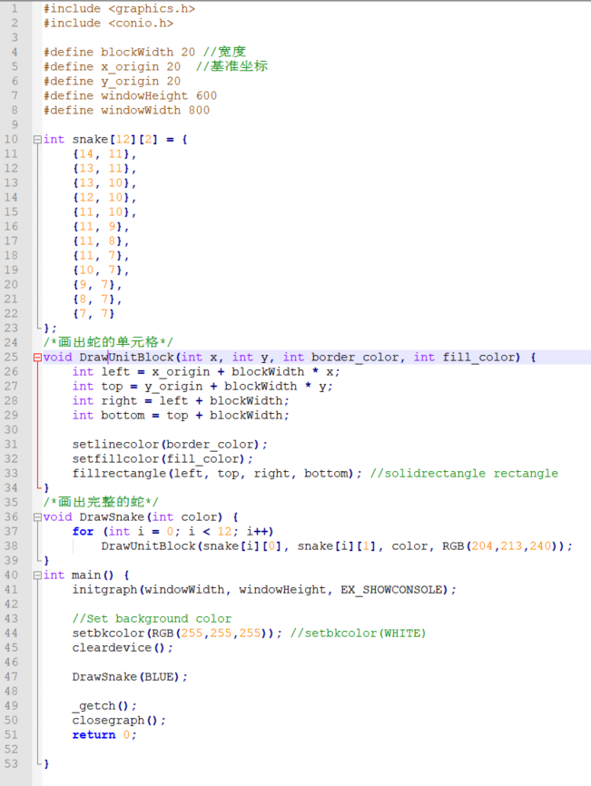
Review

Slide 3
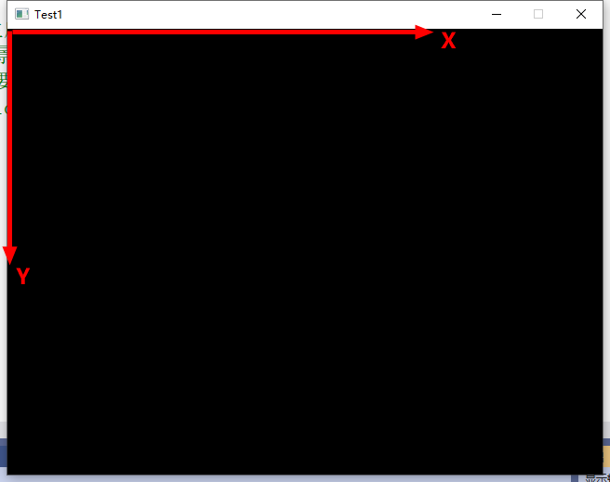
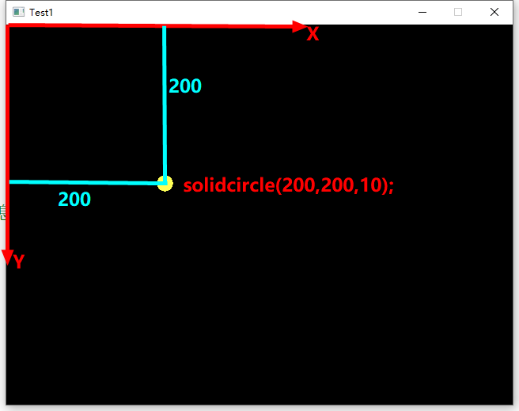
Review

Slide 4
Review
Array Declaration and Initialization
Usage

Slide 5
Review
Which one is correct?
A.int a[2][]={{0,1,2},{3,4,5}};
B.int a[][3]={{0,1,2},{3,4,5}};
C.int a[2][4]={{0,1,2},{3,4},{5}};
D.int a[][3]={{0,2},{},{3,4,5}};

Slide 6
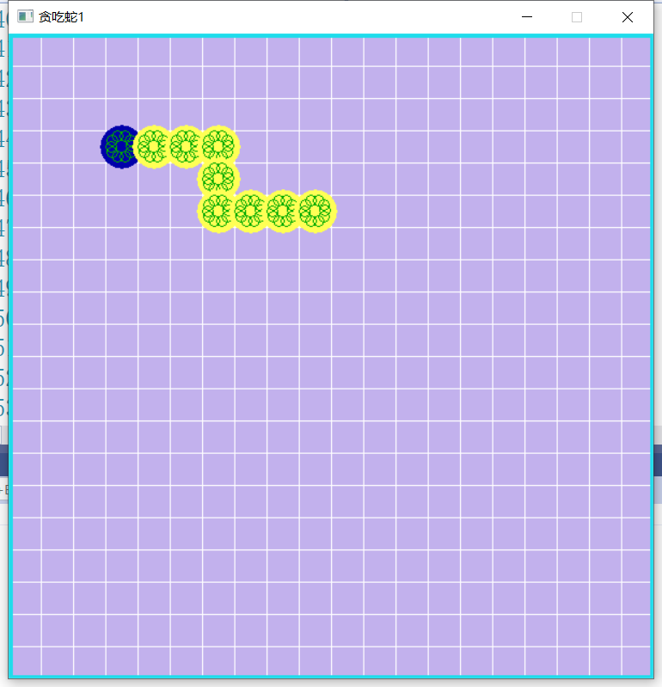
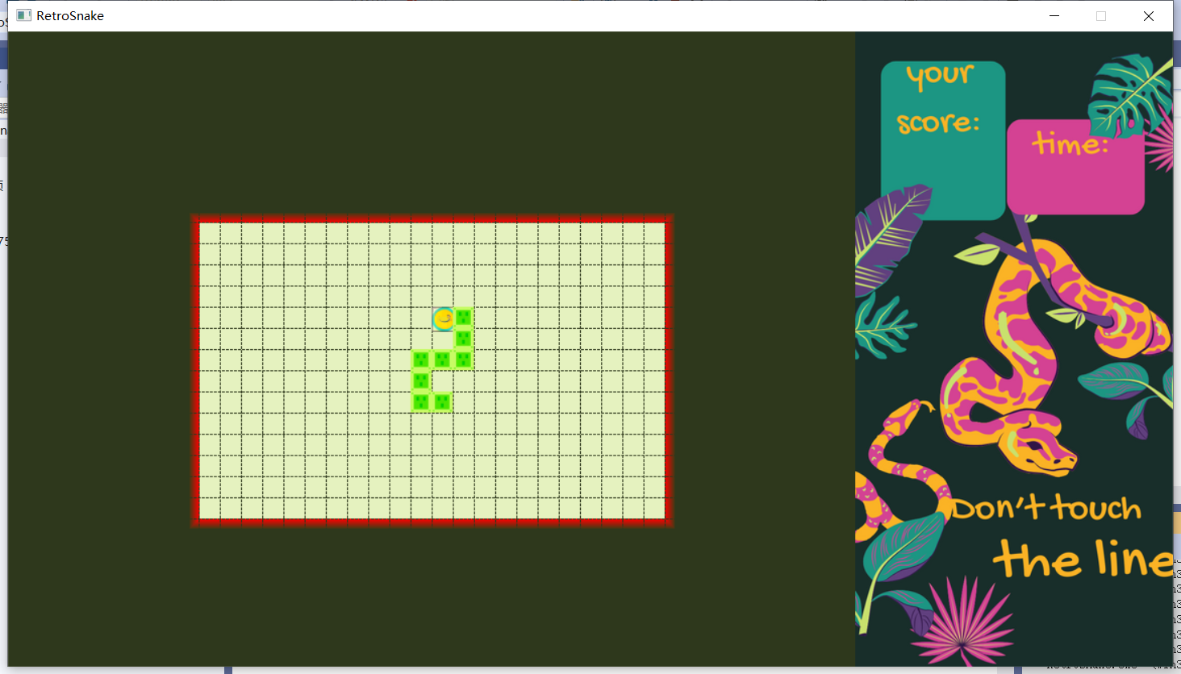
Review

Slide 7
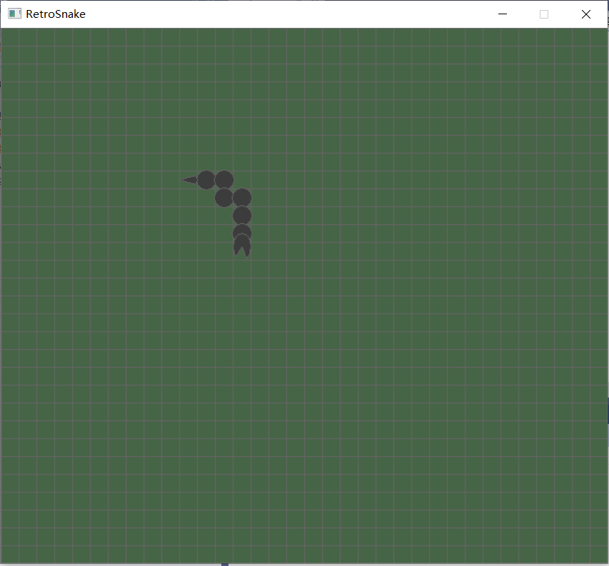
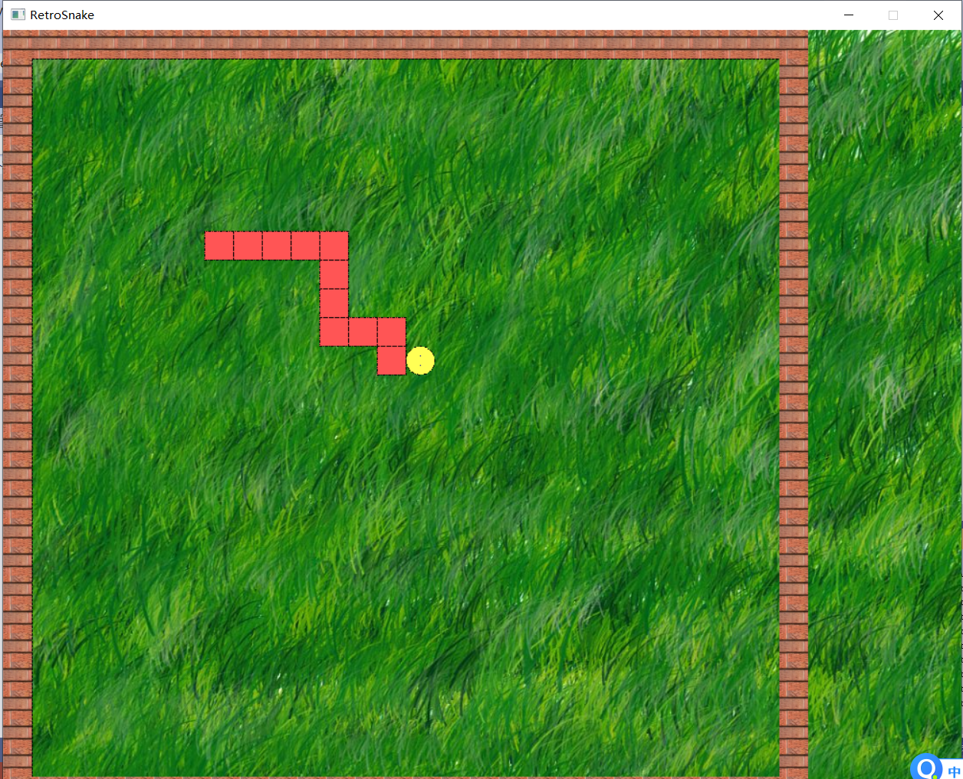
Review

Slide 8
Tips
Use functions
drawUnitBlock()
drawSnake()
drawBackground()
Use setbkcolor or loadimage
RGB(r, g, b);

Slide 9
Review
Model & View
View : Visualization or presentation of the information user required
Model : Storage of the information
Logic (Programmer’s Perspective)
Operations of information, which can handle the information according to the user’s requirement
Separation of the logic and presentation is one of the most important ability of programming.

Slide 10
Play Games
Drawing a snake (2-D Array)
Interacted with users by using the keyboard.
Updating the positions of snake
Snake auto move

Slide 11
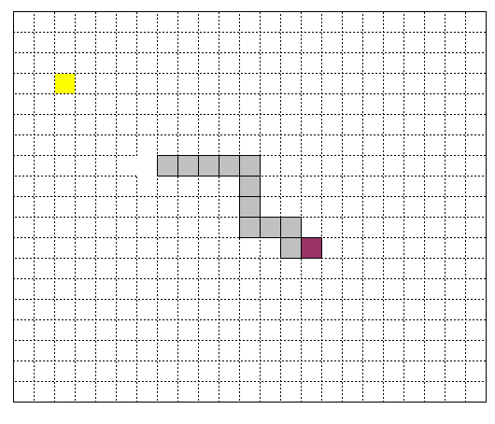
How?
Model: 2-D Array
4 directions
int snake[12][2] = {
{14, 11},
{13, 11},
{13, 10},
{12, 10},
{11, 10},
{11, 9},
{11, 8},
{11, 7},
{10, 7},
{9, 7},
{8, 7},
{7, 7}
}

Slide 12
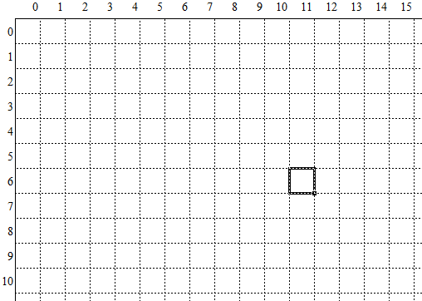
Coordinate
(x, y)
(0,0)
x
y

Slide 13
Keyboard Control
Q: Which keys are most commonly used to control the player’s movement in computer games?
WASD
QWER
ZXCV
1234

Slide 14
KeyBoard Control
Which function to get the input?
int _getch(void);
The function reads one character from the keyboard and returns its ASCII value.
In order to work, the user must click in the graphics window (i.e., the Windows focus must be in the graphics window).
Use _kbhit() to check if there is an input from the keyboard
_getch（）与_kbhit()

Slide 15
Basic Game Loop
while(true)
{
//Get data();
//Control data();
//Draw view();
}
while(1) or while(flag)
char input = _getch(); //Get keyboard input

Slide 16
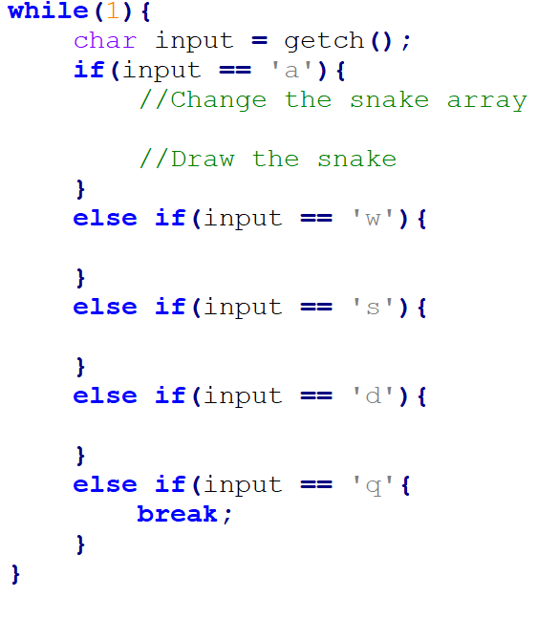
While loops control
while (1)
{
char input = _getch(); //Get data;
if ( input == ‘a’ )
{ // change snake array go "LEFT"
//draw new snake
……
}
else if ( input == ‘s’ )
{ // change snake array go "DOWN"
//draw new snake
……
}
else if ( input == ‘q’ )
{Quit the loop
break;
}
}

Slide 17
Practice1
Complete the code
Make one directions change
Eg. Move Right
Hit key ‘d’, snake move to RIGHT
if(input == ‘d’){
snake[][]=... //How to change snake array?
//How to draw snake?
}

Slide 18
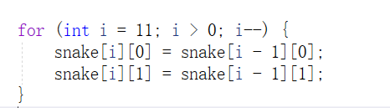

Change Snake Array
Copy the data from the tail to the head
Change the head data

Slide 19
Question
Thinking: How to draw new snake?

Slide 20
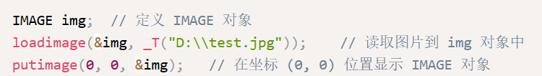

Erase the snake
Draw with the background color or reload the background image.
drawBackground()
Use background image
Implement the loading of the image "D:test.jpg" to the graphics window

Slide 21
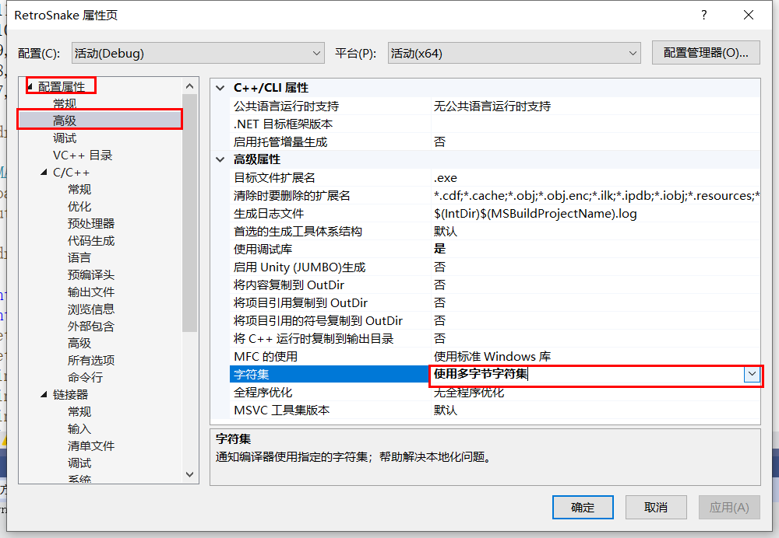
Multi-Byte character set
error C2665: “loadimage”： 2 个重载中没有一个可以转换所有参数类型
项目-〉属性-〉高级-〉字符集-〉使用多字节字符集

Slide 22
Further while loops control
while(1)
{
char input = getch();
if ( input == ‘a’ )
{ // change snake data go "LEFT"
drawBackground(); // Erase
drawSnake(color); // Update
}
else if ( input == ‘s’ )
{ // change snake data go "DOWN"
drawBackground(); // Erase
drawSnake(color); // Update
}
else if.....
}
while(1)
{
if (_kbhit())
{
char input = getch();
if ( input == ‘a’ )
{ // change snake data go "LEFT"｝
else if ( input == ‘s’ )
{ // change snake data go "DOWN"｝
else if.....
....
drawBackground();
drawSnake();
}
}

Slide 23
Function
Use function to encapsulate the code.
void moveSnake();
//Control data;

Slide 24
Array to store snake’s positions
Separate logic and view
The key of moving snake is the positions of snake body.
A two dimensional array is used to record the positions of snake body

Slide 25
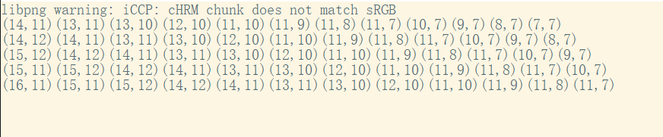
Update array of snake body
Complete function “void moveSnake()”, and make main function outputs like follows to check move correction.
Sequence of dir: ↓→↑→↓

Slide 26
Auto Move
The snake auto moves to the current direction.
Need a variable to store the direction
if(toDirction == ‘LEFT’)
{......
}

Slide 27
Fuction
void autoMove(int toDirection);
// 1,2,3,4 to represent up,down,left,right

Slide 28
Tips
Review is the necessary step of software development.
Review your experience.
Review your work.
Writing is the best way to review.

Slide 29
Homework
Retro Snake2
Use the keyboard to control the snake
Complete function moveSnake()
Print the arrays on the console for each keyboard movement
Complete function autoMove()
Complete the main function

Slide 30
Question
Create food
View Design
Length increase
Other fucntions?

