Slide 1
Week4:Retro Snake
——Practice of Programming Language 1——
Shen Shuyin
Spring

Slide 2
Review
drawUnitBlock()
drawSnake()
drawBackground()
moveSnake()
autoMove()

Slide 3
Review your process
Draw a rectangle with game coordinate space
Mapping game coordinates to screen coordinates
Just use game position after encapsulating the coordinate mapping logic.
Moving Control of one rectangle with a while-loop.
Draw the whole snake by calling drawUnitBlock and using a for-loop.
drawUnitBlock by reading the array (and the color) only.
Encapsulate the for-loop with “drawSnake() ”

Slide 4
Review your process
Make your snake moving
Determine which key is input ( a:left, s:down, d:right, w:up, q:quit)
Erase the snake by using drawSnake() with background color or by drawBackground().
Modifying the positions of snake by updating the array.
Draw the snake at new positions by calling drawSnake().
autoMove() to move the snake toward its current direction

Slide 5
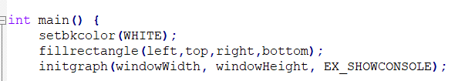
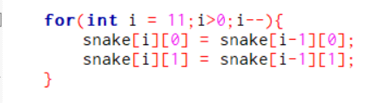
Homework Question
Order of the code
Copy the snake array from the tail to the head

Slide 6
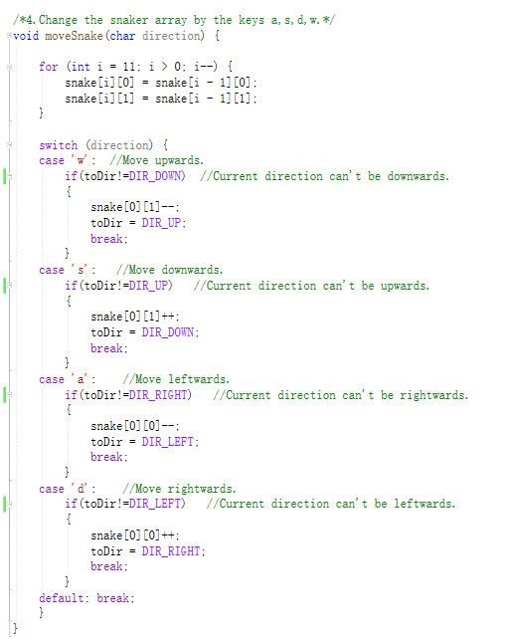
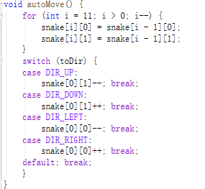
Review

Slide 7
print
Why print array?
Check if your code is correct.
Open console while running the project.
initgraph(800,600,EX_SHOWCONSOLE);

Slide 8
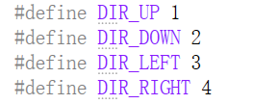
enum
#define
const
enum
In default, UP = 0, DOWN = 1,LEFT = 2, RIGHT =3

Slide 9
Question
Which are correct in C++?
enum direction{1,2,3,4};
enum direction{‘w’,’s’,’a’,’d’};
enum{UP=1,DOWN=2,LEFT=3,RIGHT=4};
enum direction{UP,DOWN,LEFT,RIGHT=4};
enum direction {U,D,L,R};

Slide 10
Any other functions?
Make your snake game more realistic
Check the collision to the border and body.
Generating the food and eating the food
Length Increasing

Slide 11
Collision
Border
Current Direction (Get new position of snake head)
using char or int to store the head toward direction (int toDir;)
Head Coordinate (snake[0][0],snake[0][1])
Use two variables (int newHead_x,newHead_y;) to store new head location.
Compare the two variables with the x_border and y_border.
Body
Current Direction(Get new position of snake head)
Loop to check whether the snake go across itself

Slide 12
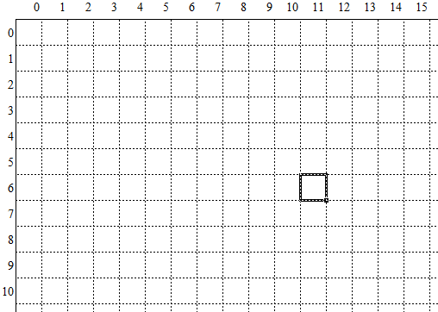
Collision
new head
(?, ?)
head
(x, y)
(0,0)
x
y
(x_border, y_border)

Slide 13
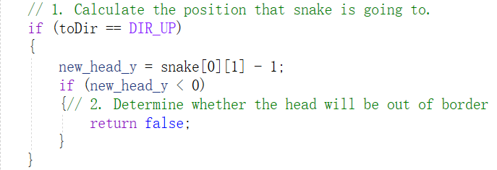
Practice
bool checkCollision();
/*Prepare two new variables for storing the new position of snake head*/
int new_head_x,new_head_y;

Slide 14
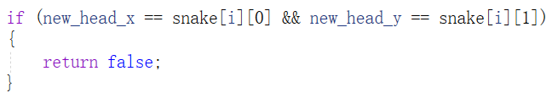
Check Collision
Check the other 3 directions.
/*Determine whether the snake go across itself*/
A for loop the check the whole snake
//if the new head location is one of the snake blocks return false.

Slide 15
Food
Generate Food
Random Coordinate (food_x,food_y)
Food should be inside the border (border check)
Food could not generate on the snake(body check)
drawUnitBlock() with (food_x,food_y) and food color
Eat Food
Check the condition?(food_x,food_y) and snake head
Regenerate the food (Call genFood())
Record the score

Slide 16
Increase Length
Increase Length
How？
2-D Array?
Pointer?

Slide 17
Length
increaseLength()
length++; // global variable length
How does snake array change？
The current position of the tail is equal to the previous position of the tail.”
snake[length-1][0] = tailX;
snake[length-1][1] = tailY;
//when calling autoMove() or moveSnake() update tailX and tailY

Slide 18
Main Function
Initialize
Model:food coordinate,snake array,direction....
View:initgraph, drawBackground,genFood and drawSnake
Loop
while(checkCollision()){
while (!_kbhit()&&checkCollision()) //Auto move or keyboard control
{
autoMove();
eatFood();
speedControl();
,..... }
if(_kbhit())
input = _getch() //get keyboard
moveSnake()
...}

Slide 19
Design your procedure by flowchart
N
WPS
飞书
Visio
Y
Start
Press ‘D’?
N
1. Draw a border
Press ‘A’?
Y
3.1 Erase cursor
at old position
2. Draw a cursor
3.2 Draw cursor at new position
Press ‘Q’?
N
Y
End

Slide 20
Homework
The completely project files.
- Creativity and Functionality: 30%
- Game Mechanics Implementation: 25%
- Graphics and User Interface Design: 20%
- Code Quality and Efficiency: 15%
A small video to show how it works.

Slide 21
Some useful web
https://www.luogu.com.cn/problem/list
https://www.apowersoft.cn/free-online-screen-recorder

